Slide 1
Forecasting Precious Metal Pricings
By: Joel Elliott
Texas Tech University
April 29, 2025

Slide 2
Objectives
Analyze and Correlate long term pricing trends of precious metals
Create multiple fits:
1) Linear Regressive
2) Auto Regressive (AR)
3) Auto Regressive with Moving Average (ARMA)
4) Optimized with AIC & BIC (ARMA)
Forecast future prices while maintaining timescale

Slide 3
Data Source
In this project I used the yahoo finance python library (yfinance) to access the API to gather the prices for each metal.
Metals:
Gold (GC=F)
Silver (SI=F)
Platinum (PL=F)
Palladium (PA=F)
The time frame used: January 2010 – present
The frequency used was the daily close prices

Slide 4
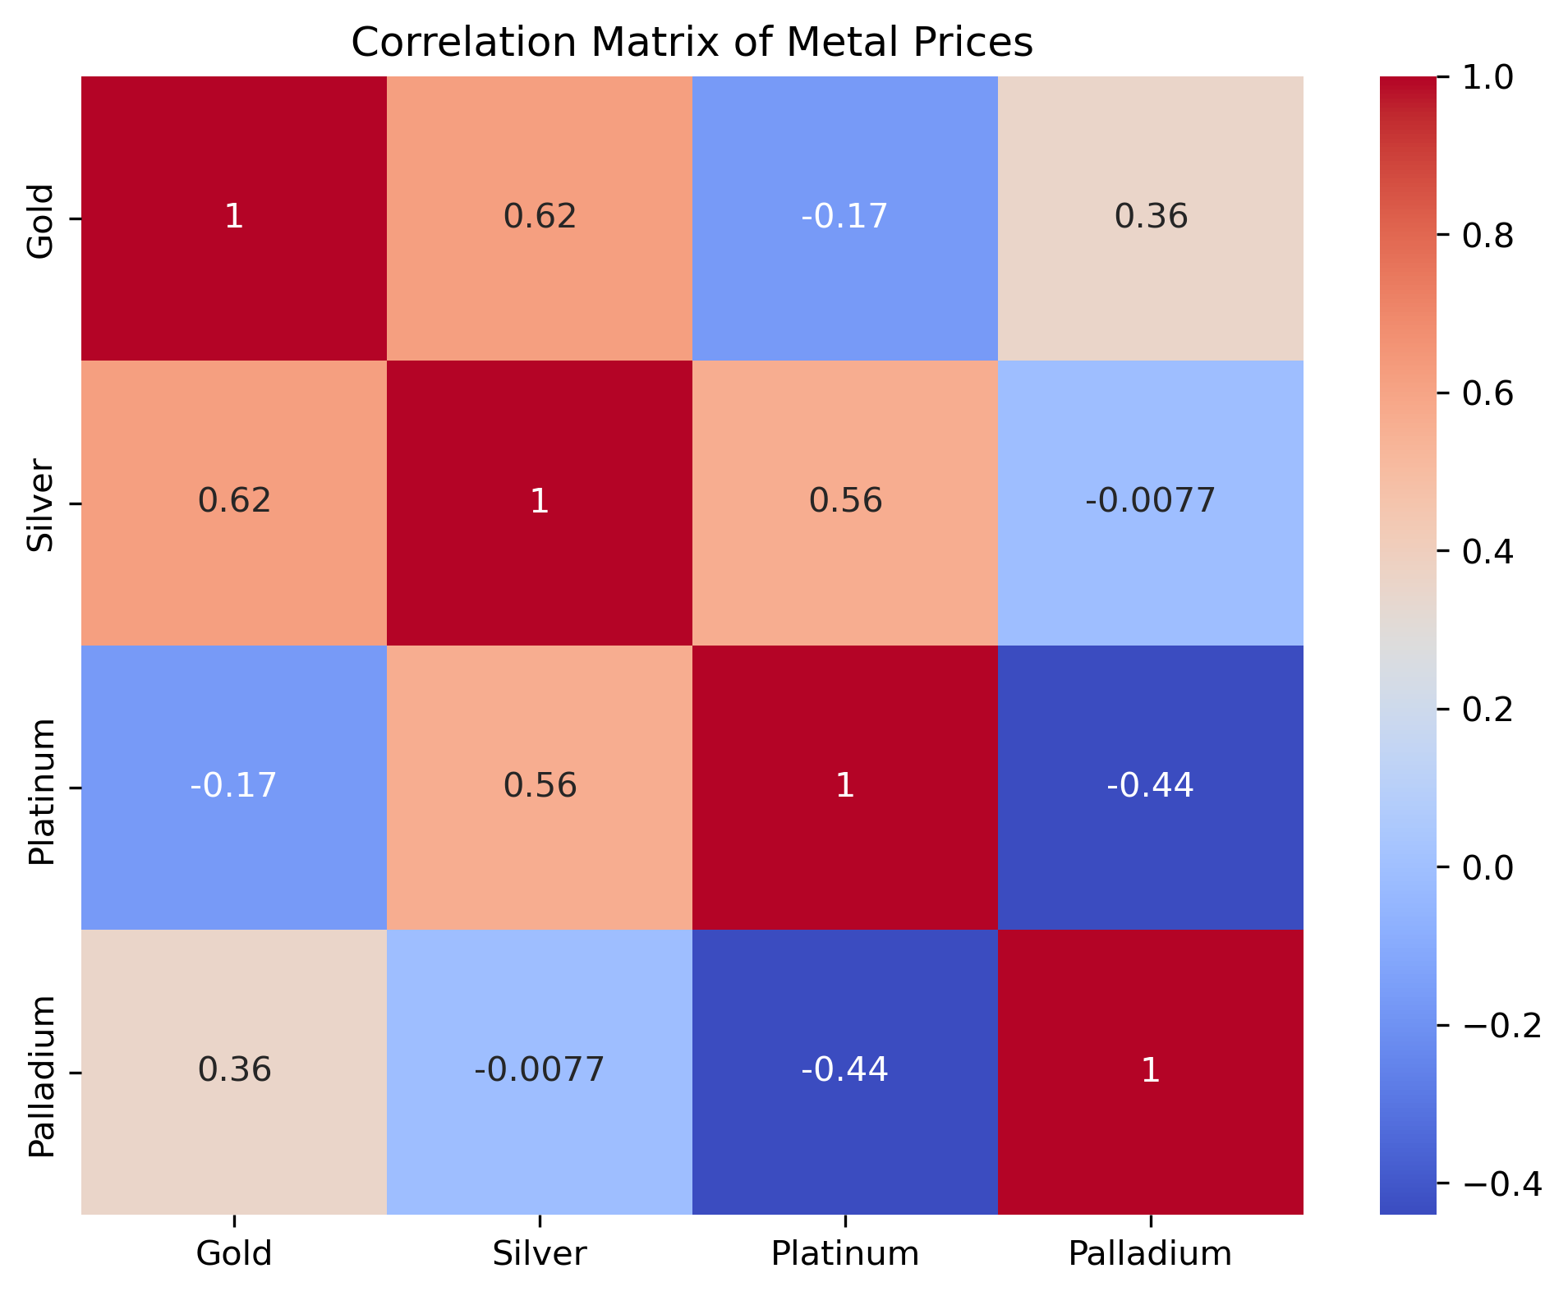
Correlation Analysis
From the heatmap we can observe that:
Gold and Silver have the highest positive correlation
Silver and Platinum have a high positive correlation
Platinum and Palladium have a negative correlation

Slide 5
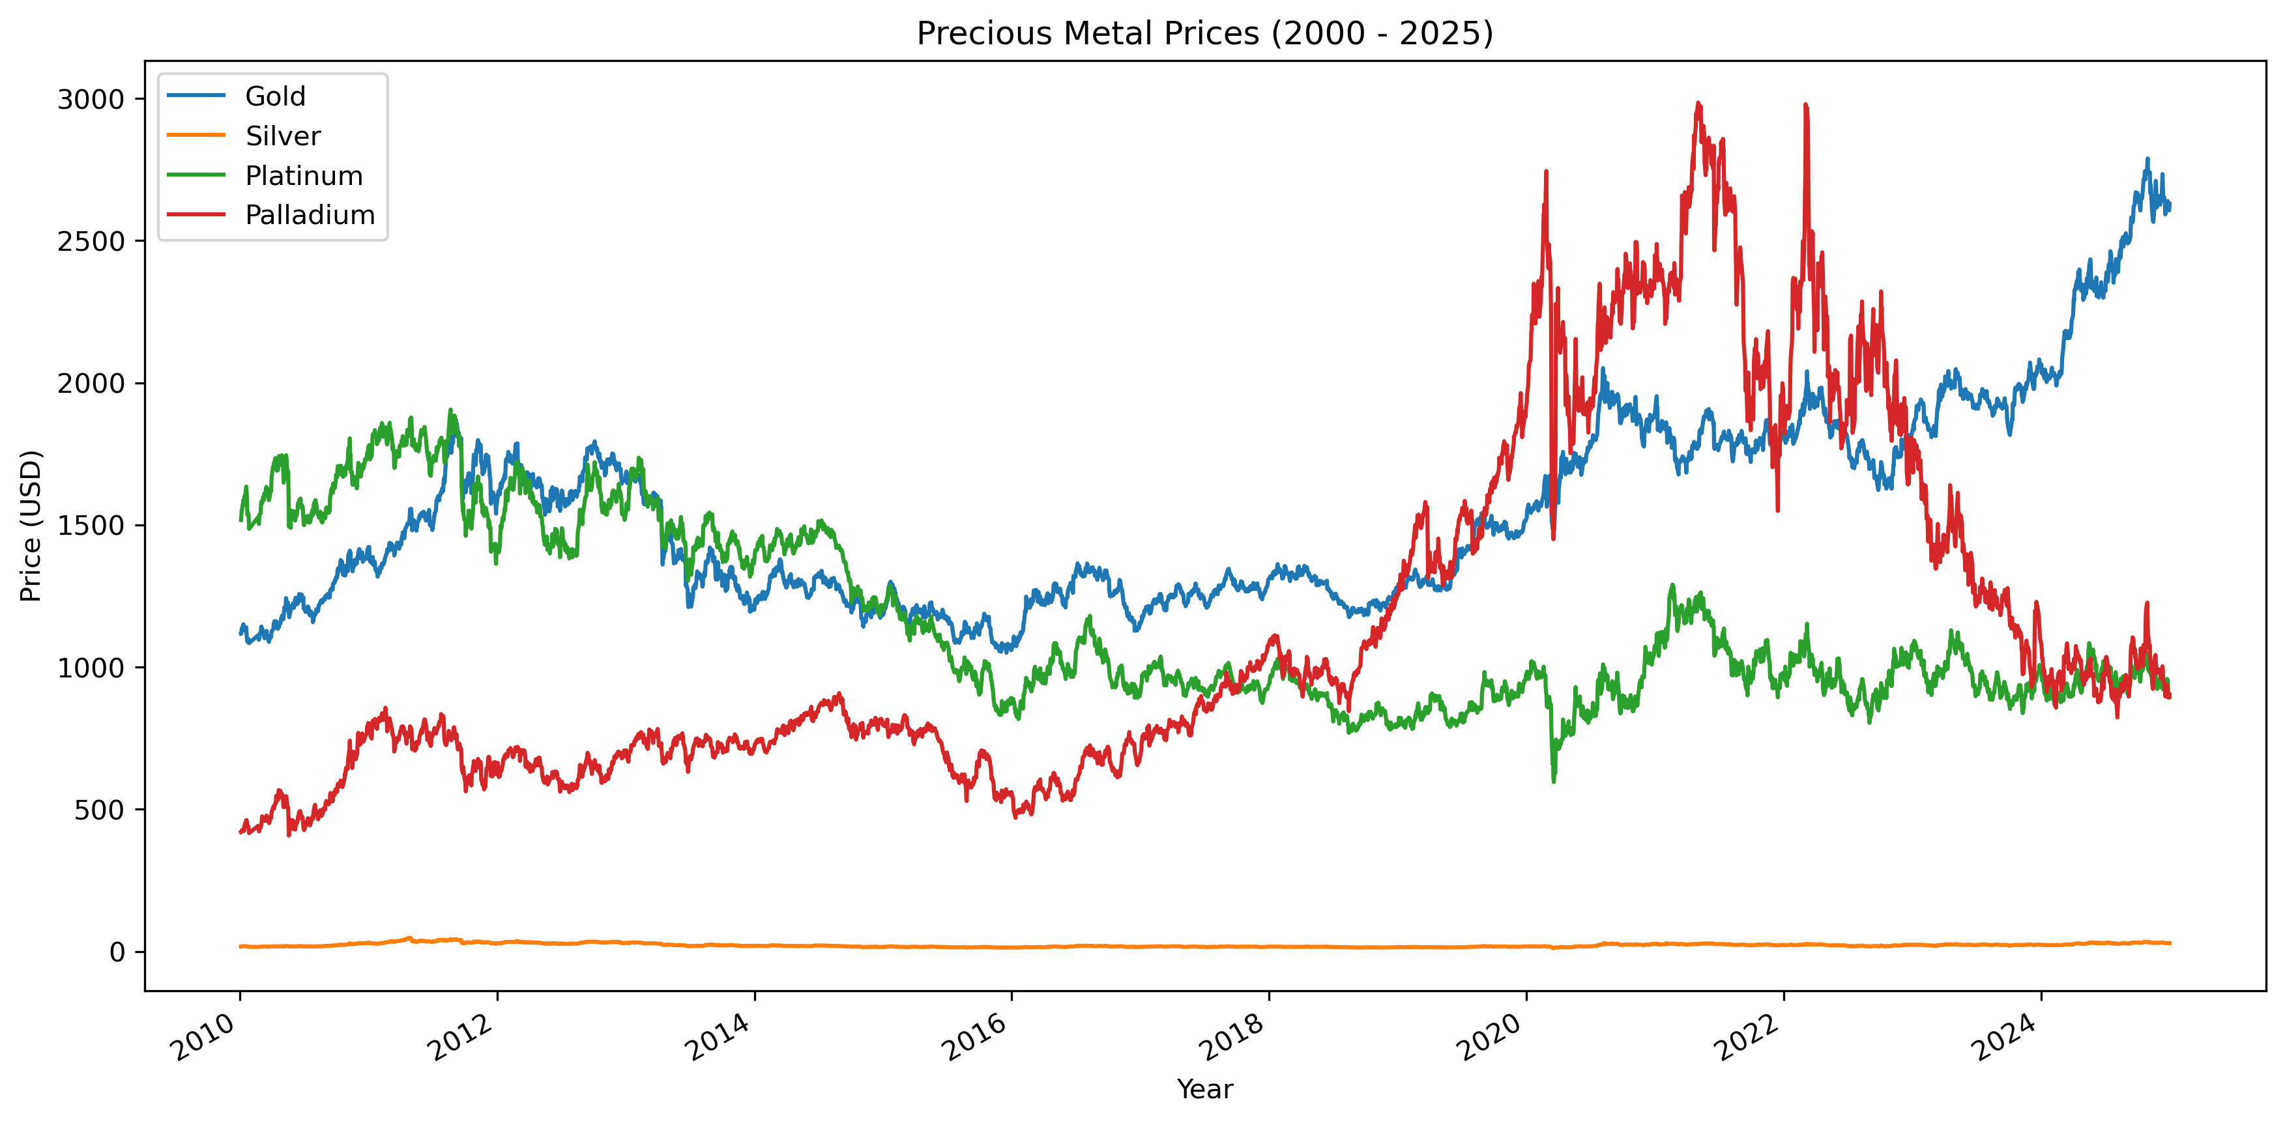
Pricing For relative Time Frame
Silver’s price looks so low because compared to the others it price it only in the 10-50 USD range.

Slide 6
Forecasting Models
For this project I decided to use several models for forecasting the future prices as I listed earlier.
The next slide will contain the Linear Regression model
The slide next four slides will contain the AR model, ARMA model, and the ARMA model optimize with the AIC and BIC for each respective metal.
I used the statsmodels python library to calculate these.

Slide 7
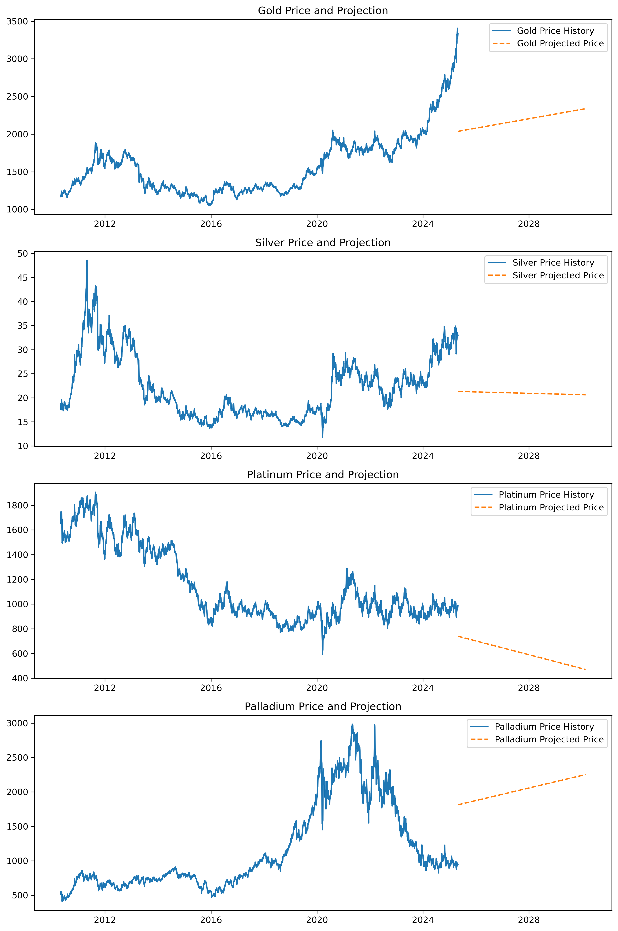
Linear Regressive Model
As seen in the graphs the linear regression model gives unrealistic values compared to the next three models

Slide 8
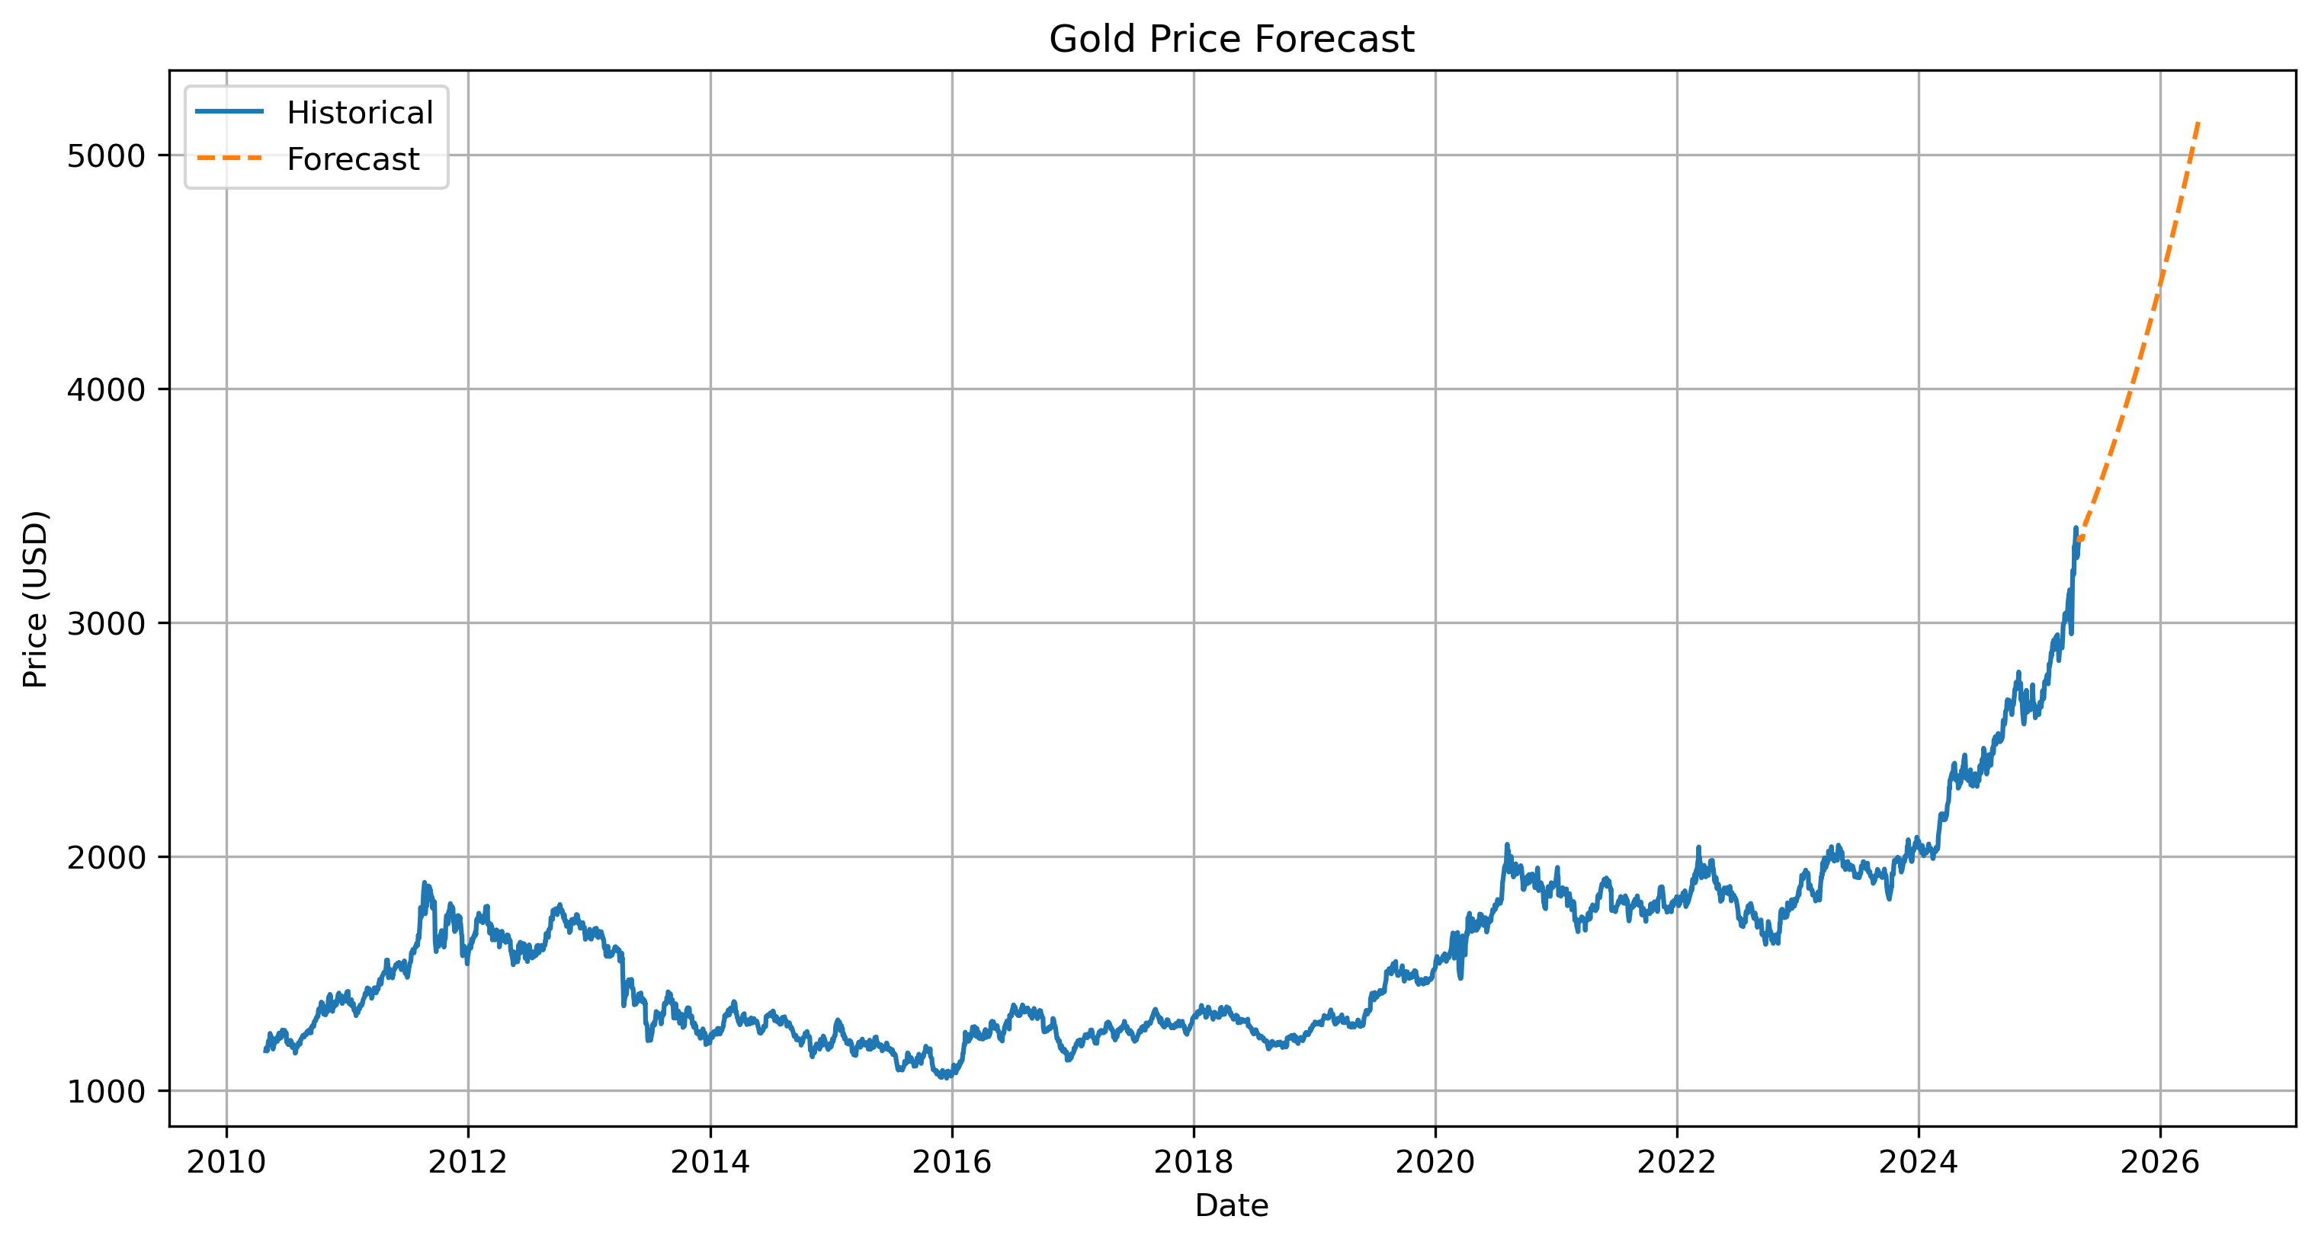
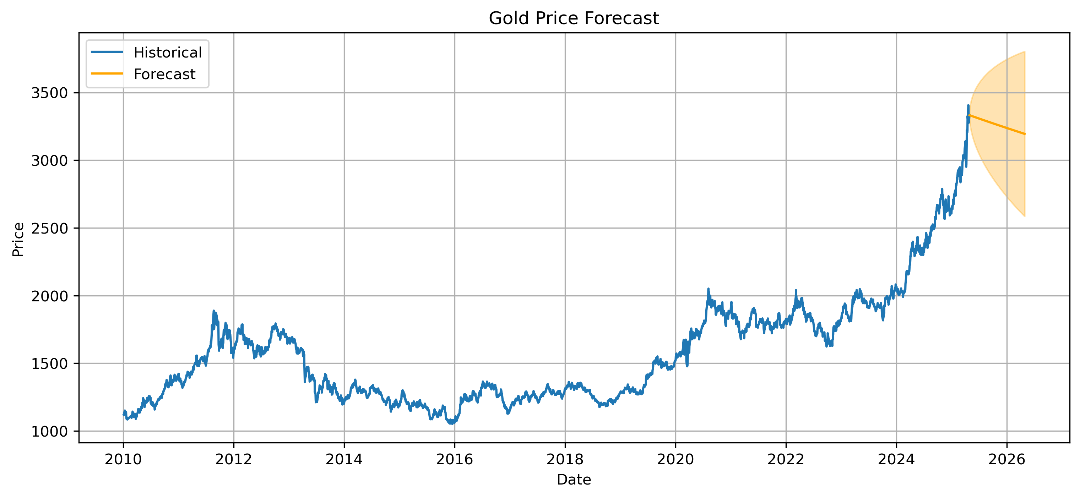
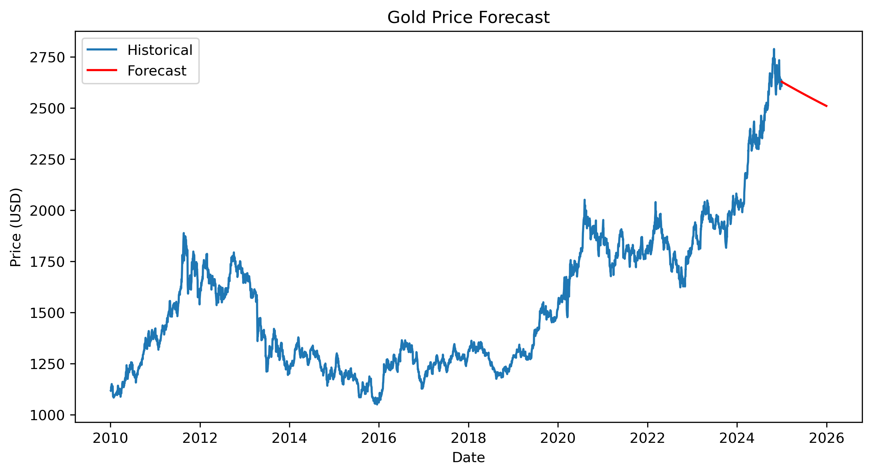
Gold Forecasting
Top Left is the AR Model
Bottom Left is the ARMA model
Bottom Right is the ARMA optimized model

Slide 9
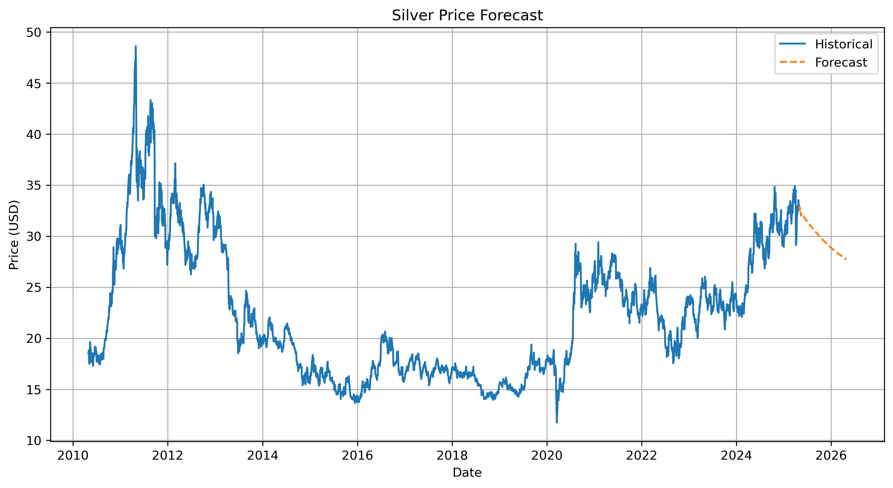
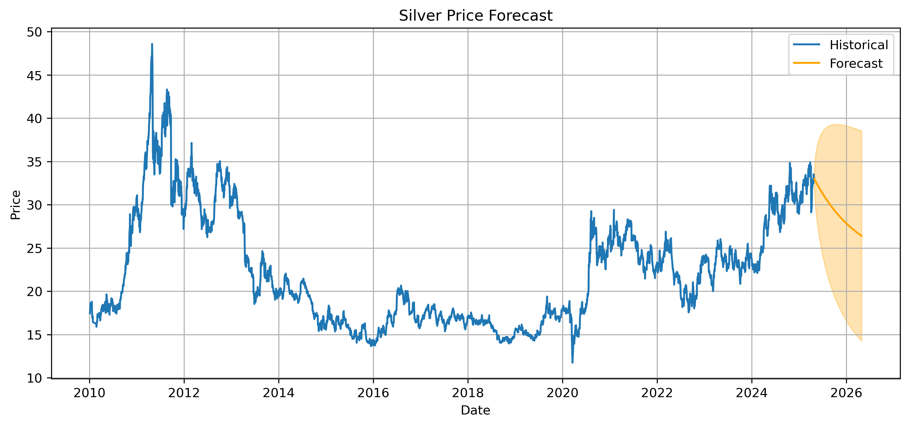
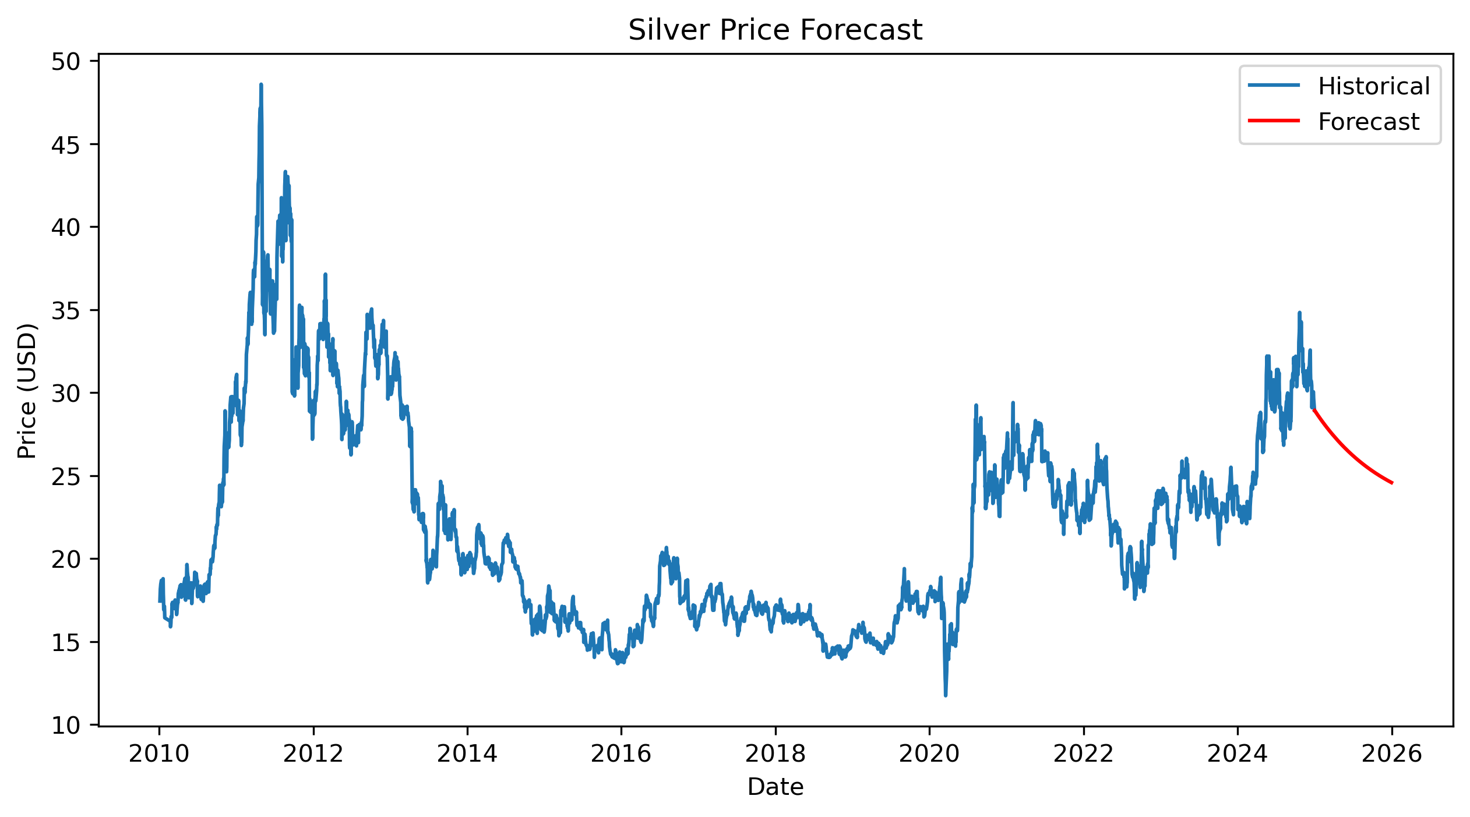
Silver Forecasting
Top Left is the AR Model
Bottom Left is the ARMA model
Bottom Right is the ARMA optimized model

Slide 10
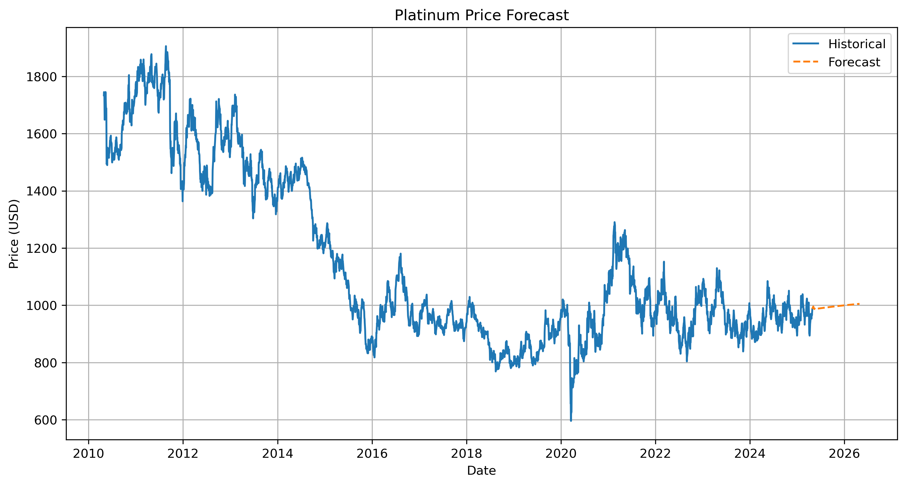
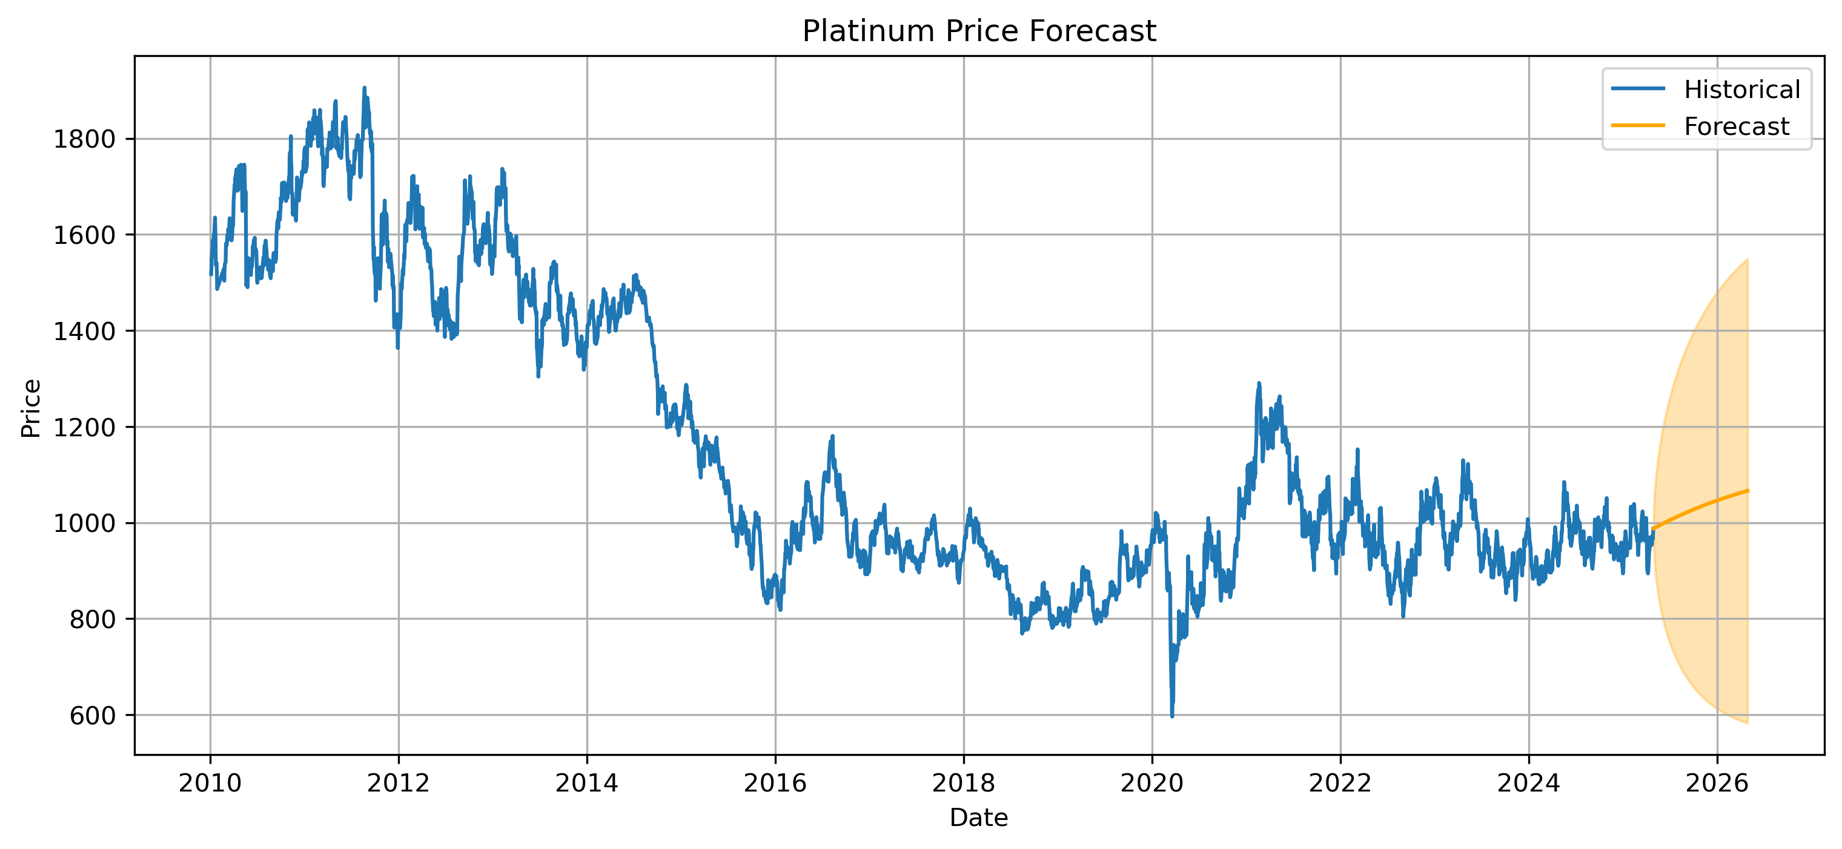
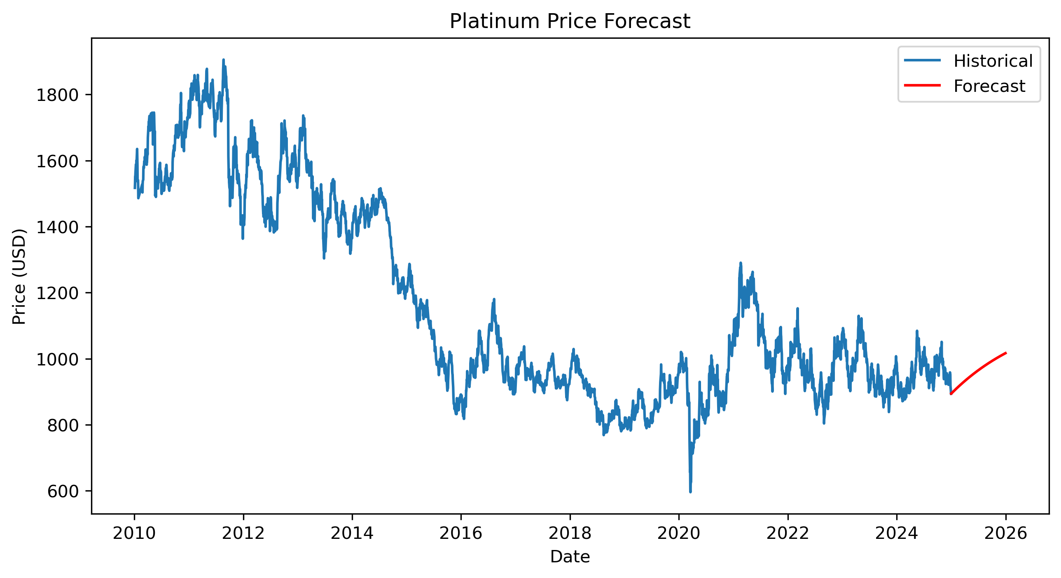
Platinum Forecasting
Top Left is the AR Model
Bottom Left is the ARMA model
Bottom Right is the ARMA optimized model

Slide 11
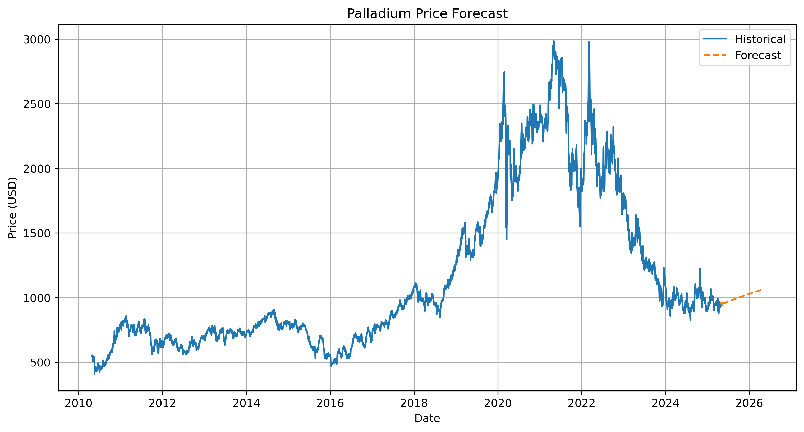
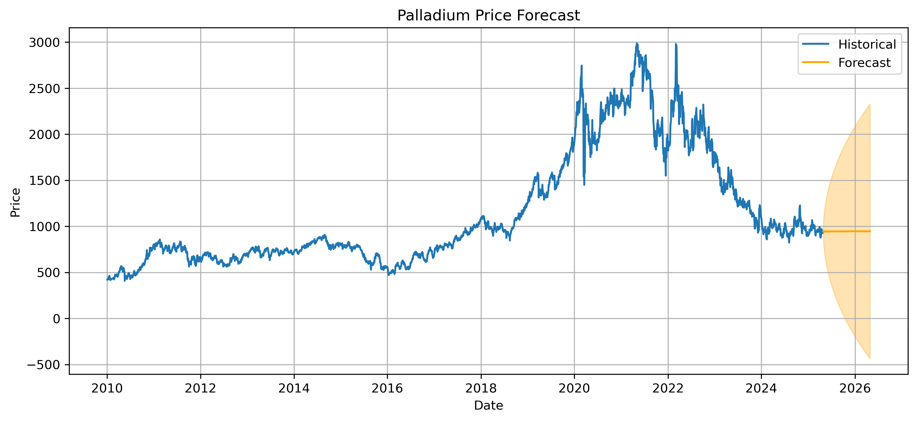
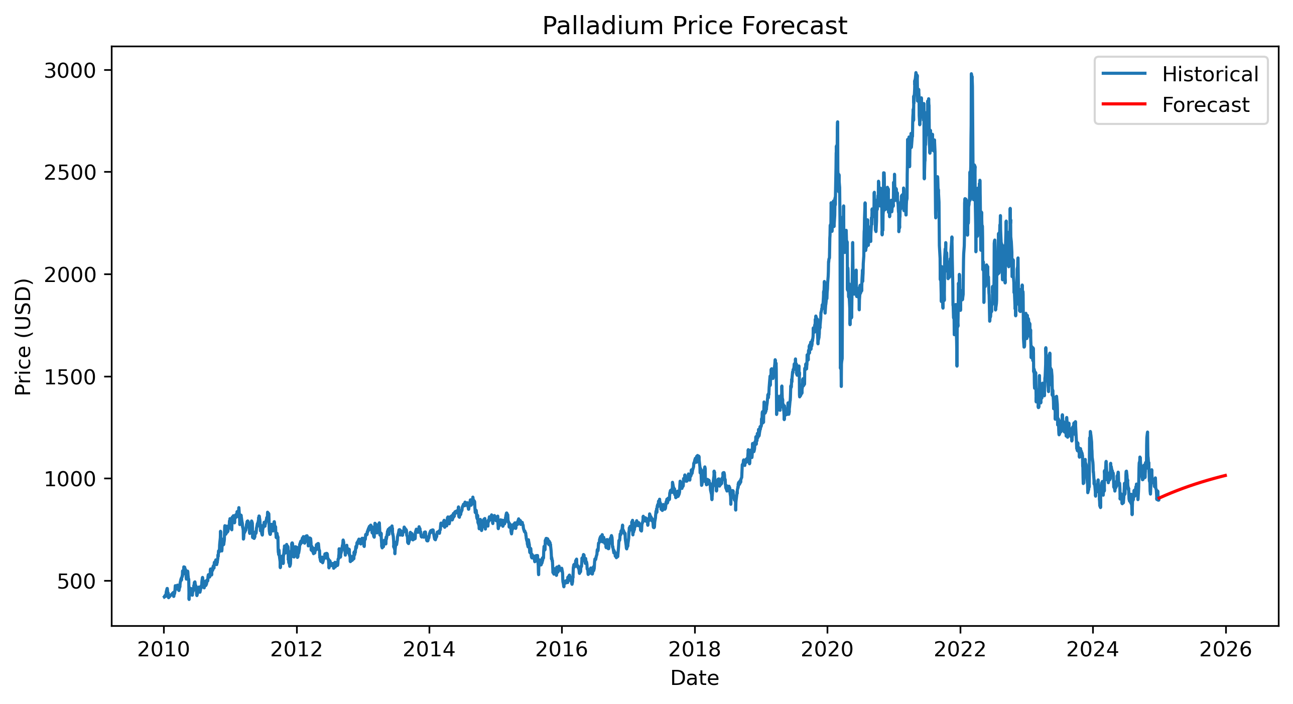
Palladium Forecasting
Top Left is the AR Model
Bottom Left is the ARMA model
Bottom Right is the ARMA optimized model

Slide 12
Conclusions
The strong correlation of Gold and Silver confirm a linkage in their market
The ARMA model is the most effective for short term modeling
The optimized AIC and BIC correct the basic ARMA model
This is scalable to other fields such as crypto or other stocks

Slide 13
Future Work
Possible look into other models like ARIMA or SARIMA to observe the trends better
Include other variables like inflation and rates
Test with a higher frequency using intraday modeling

Slide 14
Questions?
Email: joel.e.Elliott@ttu.edu
Github: https://github.com/Jo3K33p

