Slide 1
Kickstarter Success EDA Outline
Jonathan Henin

Slide 2
Statistical question
How many days should you list a Kickstarter campaign for the highest chance of success.

Slide 3
Background Information
Kickstarter recommends listing for slightly less than 30 days.
A campaign can be listed between 1 and 60 days.

Slide 4
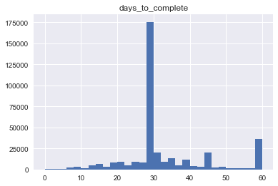
Analysis
Histograms

Slide 5
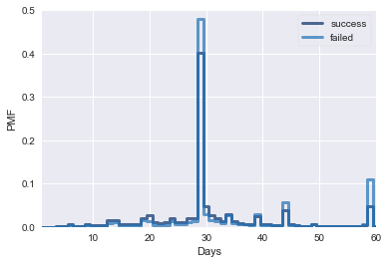
Analysis
PMF

Slide 6
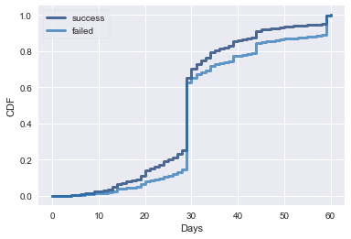
Analysis
CDF

Slide 7
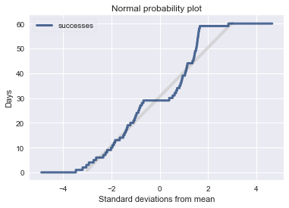
Analysis
Probability Distribution Plot

Slide 8
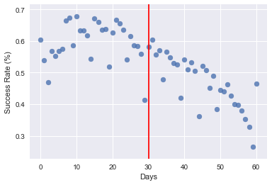
Analysis
Scatterplot

Slide 9
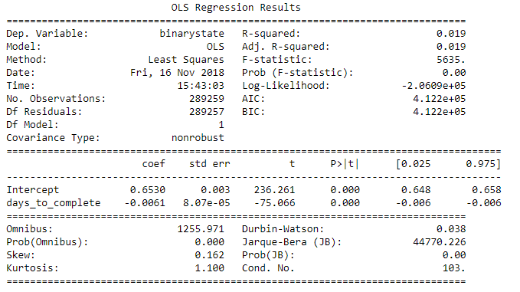
Analysis
Regression Analysis

Slide 10
Final Result
Kickstarter’s recommendation to list less than 30 days is accurate, however so many people have taken this advice that listing for 29 days performs worse than many of the other days.
The days which seem to have the highest chance of success is between 7 and 21 days.

