Slide 1
Foxify
Team HERBY

Slide 2
Outline
1. Our Goal
2. Return on Investment
3. Design
4. Demo
5. Future Enhancements

Slide 3
1. Our Goal
Why did we create Foxify?

Slide 4
To create an application that makes it easy for students to see how the classes they already completed or plan to complete will transfer over to Marist.
Notes:
Our goal: To create an application that makes it easy for students looking to transfer from Dutchess Community College to Marist to see how the classes they already completed or plan to complete will transfer over to Marist. In doing so, the application will also relieve Admissions staff of doing this task, allowing them to focus on other Admissions work.

Slide 5
2. Return on Investment
What can we do for you?

Slide 6
250 hours spent on 500 look-ups
2275 look-ups
1137.5 hours
That’s a lot of time.
That’s a lot more look-ups.
Wow!

Slide 7
89.58%
ROI(%) =(Gain-Investment)*100 / Investment
(1137.5 saved hours – 600 hours) x 100 / 600 =
Overall, a great investment.

Slide 8
3. Design
What does Foxify look like?

Slide 9
Key Features
Scalability
Foxify can scale to fix any device while maintaining the original look and feel of the desktop layout.
Final Report
Students will receive a comprehensive report detailing exactly which classes transfer and how close they are to completing a degree at Marist.
Save Session
Students using Foxify have the ability to save the classes they have inputted and restore them to continue using the application at a later date.

Slide 10
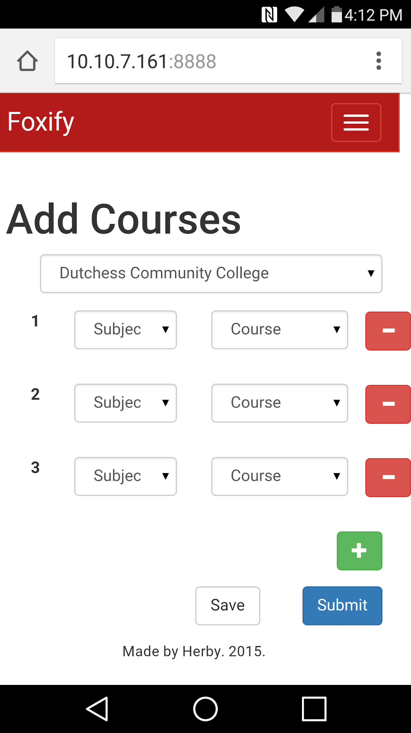
Mobile
Place your screenshot here
Place your screenshot here

Slide 11
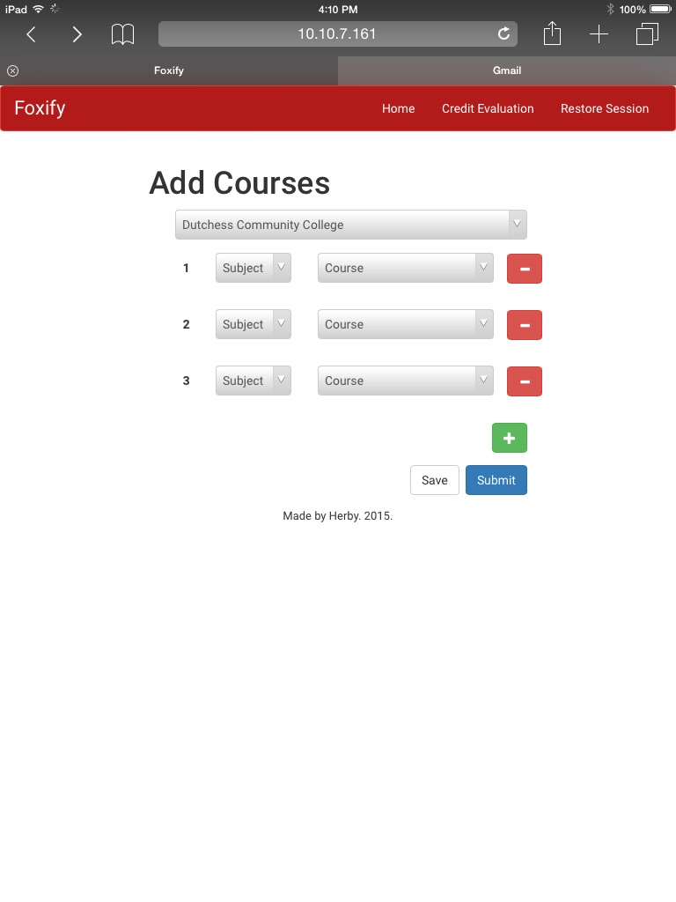
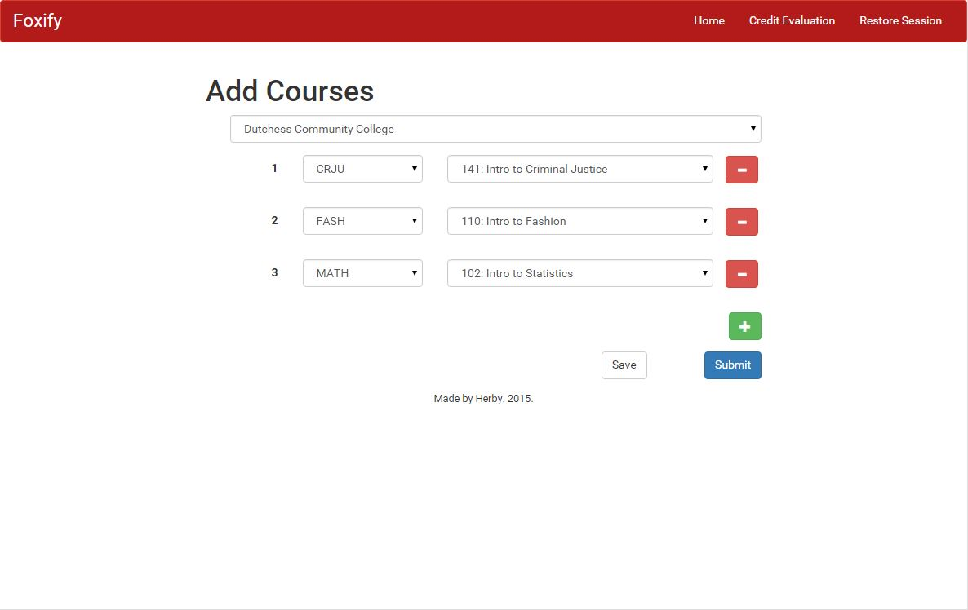
Tablet & Desktop
Place your screenshot here
Place your screenshot here

Slide 12
Key Features
Scalability
Foxify can scale to fix any device while maintaining the original look and feel of the desktop layout.
Final Report
Students will receive a comprehensive report detailing exactly which classes transfer and how close they are to completing a degree at Marist.
Save Session
Students using Foxify have the ability to save the classes they have inputted and restore them to continue using the application at a later date.

Slide 13
4. Demo
How does Foxify work?

Slide 14
5. Future Enhancements
What does the future of Foxify look like?

Slide 15
Future Enhancements
Minor/Pathway
In the future we would like to add the ability to do Minor and Pathway look-ups.
Marketing
Direct marketing to more prospective students. Auto- filling many of the items in the form to make look-ups easier.
Admin Dashboard
This gives the Admins easy access to statistics about the usage and interests of prospective students.

Slide 16
Thank You!
Any questions?
?

Slide 17
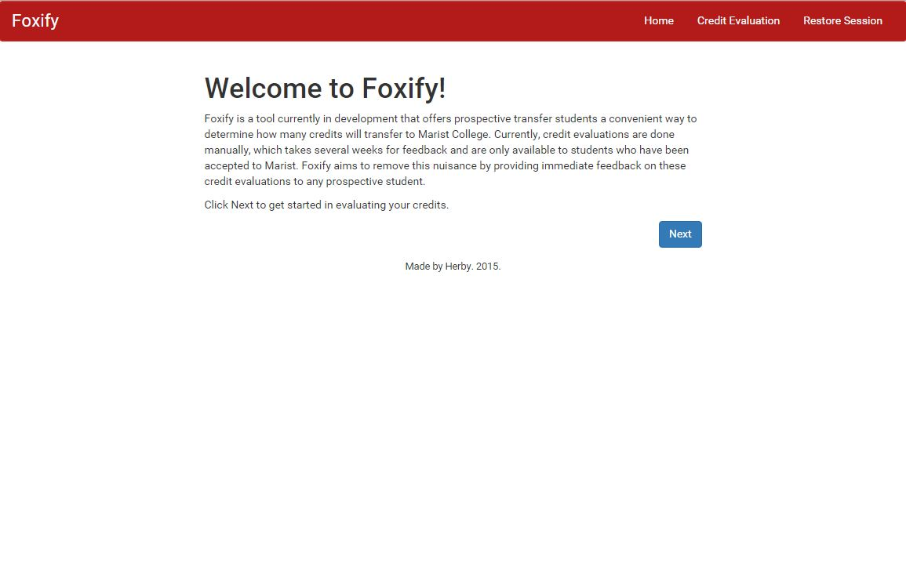
Homepage

Slide 18
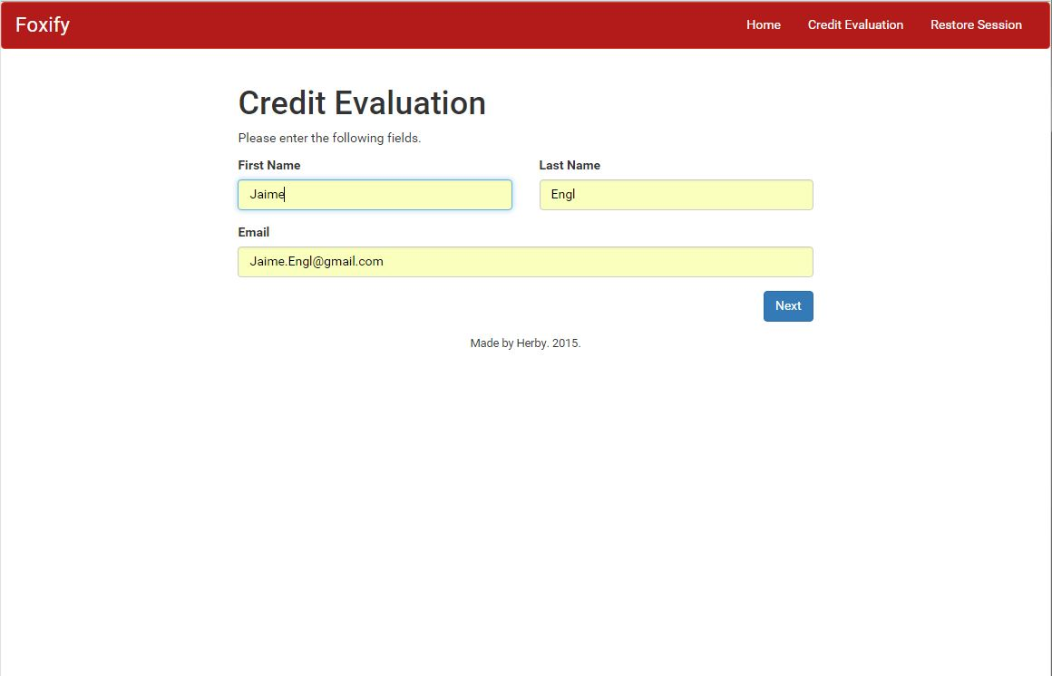
Enter Name

Slide 19
Add Courses

Slide 20
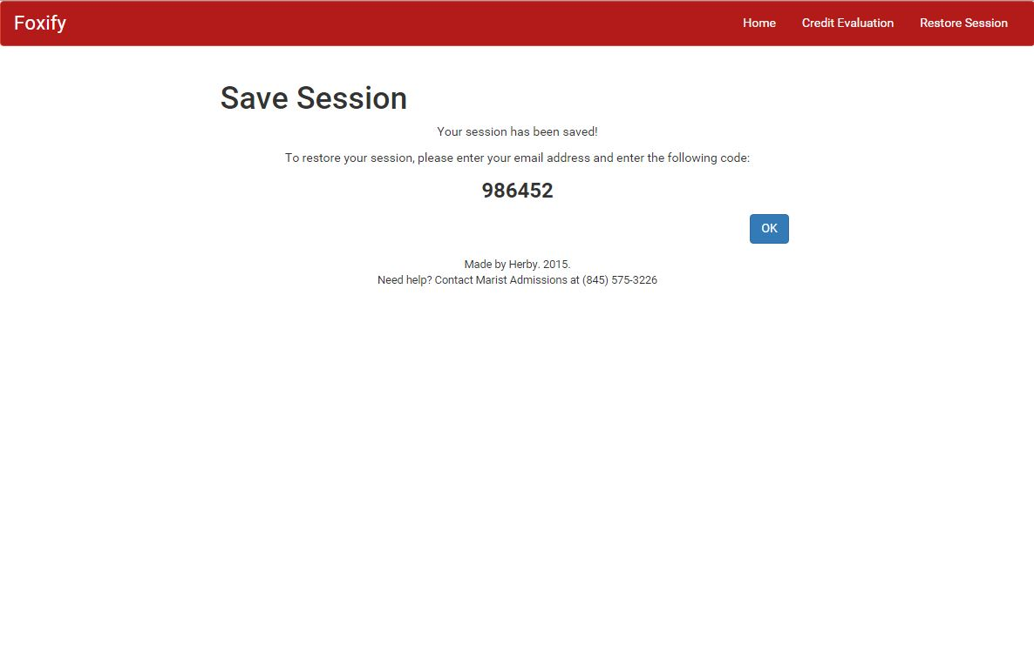
Save Session

Slide 21
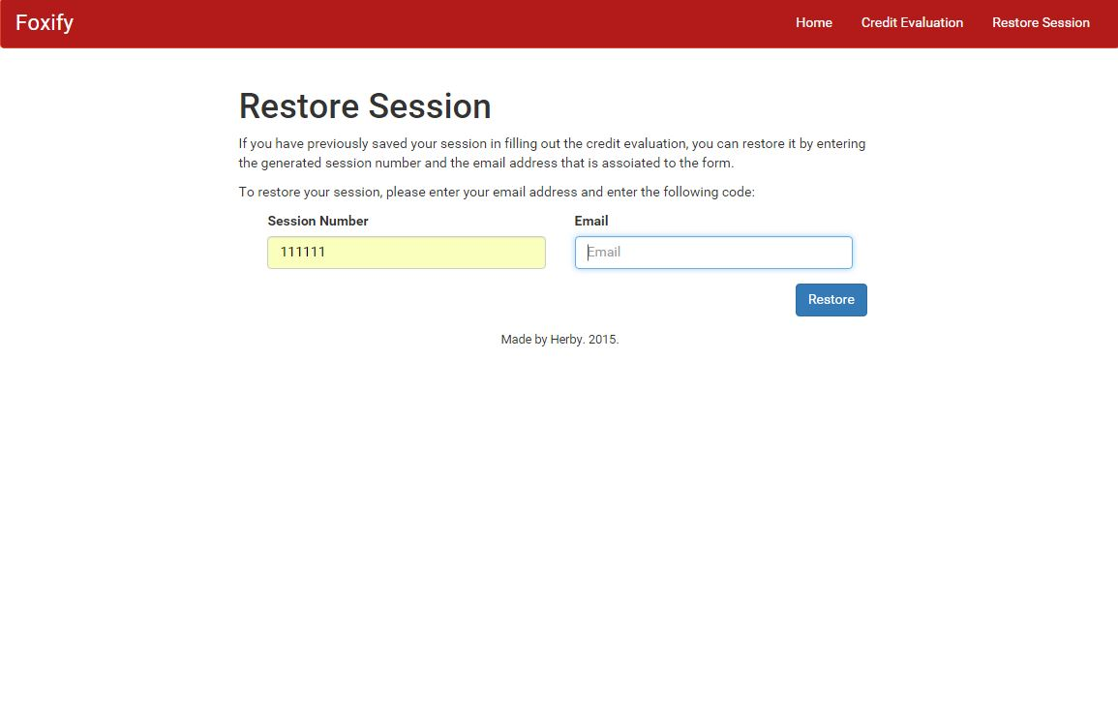
Restore Session

Slide 22
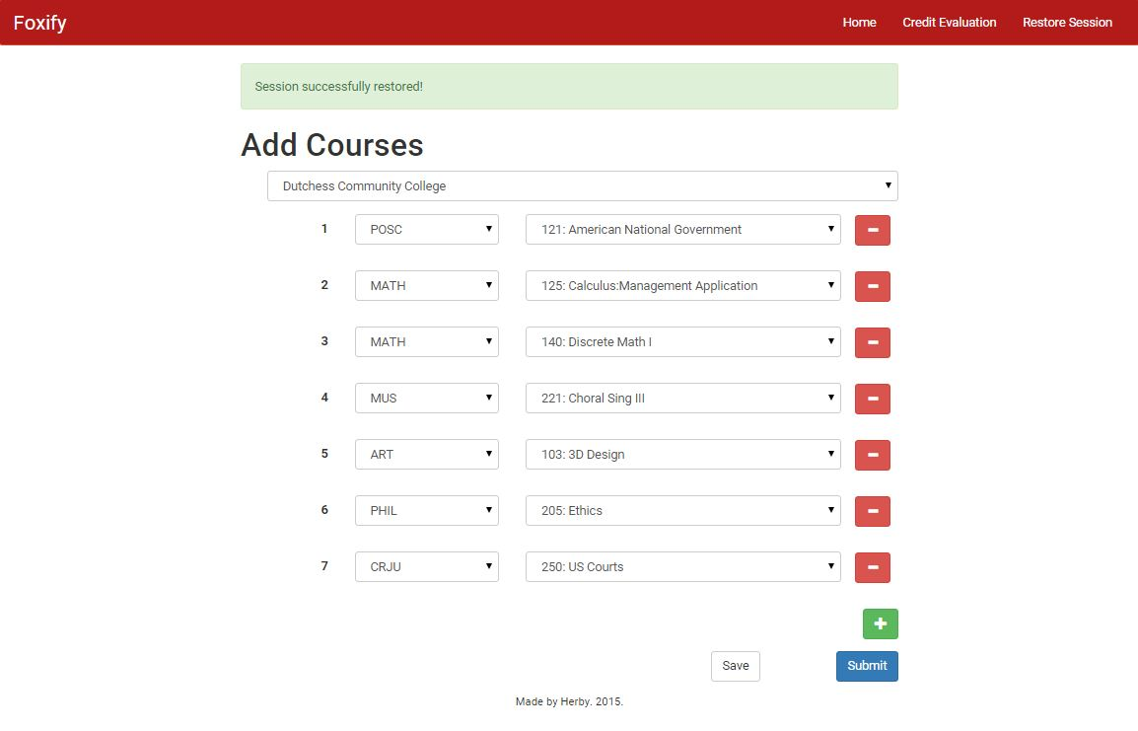
Restored Data

Slide 23
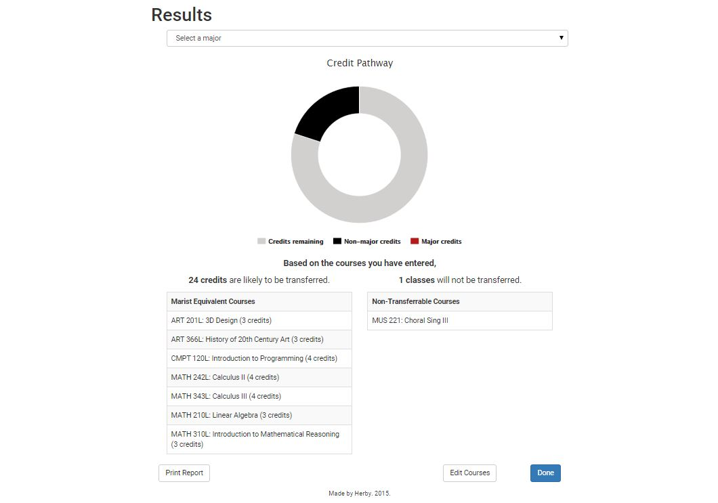
Initial Report

Slide 24
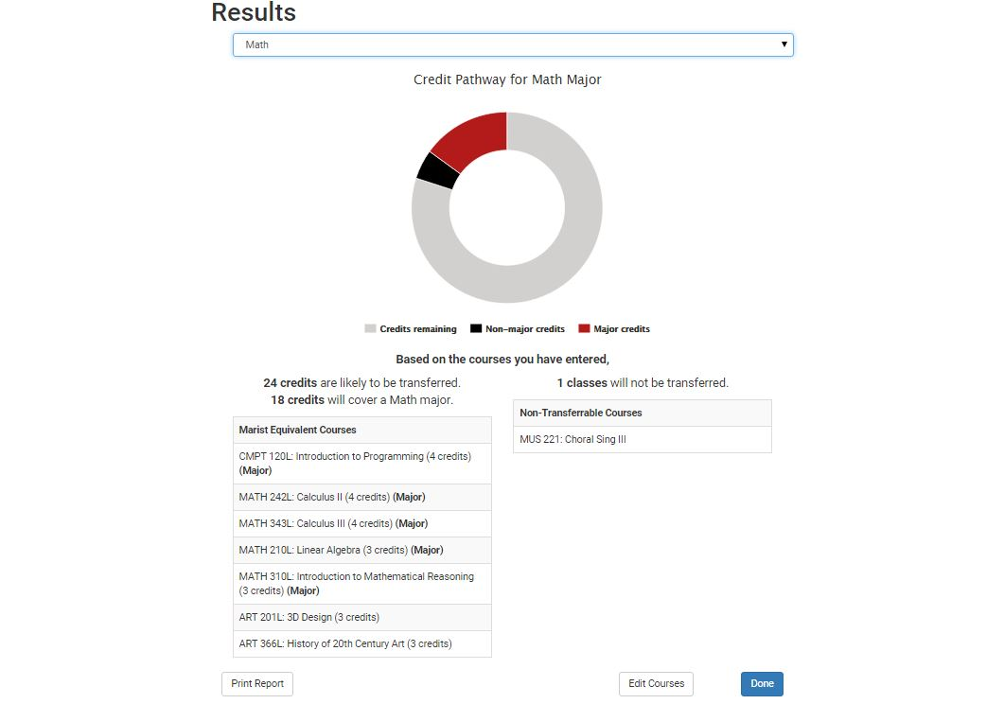
Major Report

Slide 25
5. Future Enhancements
What does the future of Foxify look like?

Slide 26
Future Enhancements
Minor/Pathway
In the future we would like to add the ability to do Minor and Pathway look-ups.
Marketing
Direct marketing to more prospective students. Auto- filling many of the items in the form to make look-ups easier.
Admin Dashboard
This gives the Admins easy access to statistics about the usage and interests of prospective students.

Slide 27
Thank You!
Any questions?
?

Slide 28
SlidesCarnival icons are editable shapes.
This means that you can:
Resize them without losing quality.
Change line color, width and style.
Isn’t that nice? :)
Examples:

