Slide 1
Object Oriented Programming
encapsulation
information hiding
abstraction
separation of concerns
parameterize from above
liskov substitution principle
single responsibility principle
patterns

Slide 2
En(capsule)ation
Data and functions can be bundled together
An access restriction mechanism
struct FILE
{ ...
};
int getc(FILE*);
int ungetc(int, FILE*);
class FILE
{ ...
int getc();
int ungetc(int);
};
class FILE
{
public:
int getc();
int ungetc(int);
private:
...
};

Slide 3
Information Hiding
We hide information partly so we can change what's hidden and limit the change's impact
  public - private
    change requires recompilation
  header file - source file
    change of implementation requires relinking
  opaque types
    change of representation requires relinking
  inheritance hierarchies
    change of type does not require relinking!

Slide 4
Liskov Subtitution Principle
If for each object o1 of type S there is an
object o2 of type T such that for all programs
P defined in terms of T, the behaviour of P is
unchanged when o1 is substituted for o2,
then S is a subtype of T.
Barbara Liskov
P1
T
b()
P2
S1
b()
S2
b()
S3
b()

Slide 5
Liskov Subtitution Principle
For example...
WHAT I WANT TO DO
use
ostream
operator<<
HOW IT
GETS DONE
ostringstream
ofstream
string
FILE

Slide 6
Parameterize From Above
Example of user going to bottom of hierarchy
  refactored
Make parameterization an explicit visible part of the public api of a class/method
Contrasting examples...
a = f() * g() + h();
a = f() * (g() + h());

Slide 7
Single Responsibility Principle
A class should do one thing and one thing only
It's incoming and outgoing dependencies should be part of its parameterization
Example...
a = f() * g() + h();
a = f() * (g() + h());

Slide 8

Separation of Concerns
Understandability
Separability
Protection from Change
a = f() * g() + h();
a = f() * (g() + h());

Slide 9
Patterns
A class is not a useful unit of design!
Design classes in small collaborating clusters
There are some well-known repeating patterns of collaboration
a = f() * g() + h();
a = f() * (g() + h());

Slide 10
Patterns
Do File move to trash
Do Folder move to trash
Create abstraction
Refactor aggregation
Top one harder to name
Recursive whole-part
Tension that exists... resolution of forces...
Composite

Slide 11

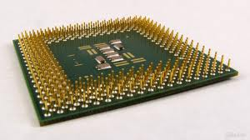
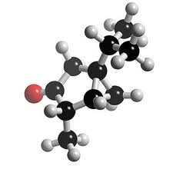
Abstraction
We also hide information when creating
crisp new semantic levels
Edsger Dijkstra
Being abstract is something profoundly
different from being vague... The purpose
of an abstraction is not to be vague, but
to create a new semantic level in which
one can be absolutely precise.

Slide 12
Abstraction
How different are the semantic levels?
use
implementation
abstraction
Some abstractions are weak and abstract away little little
implementation
use
use
abstraction
Some abstractions are strong and abstract away a lot more
implementation

