Slide 1

C++ Foundation
flickr/Paul Goyette
Introduction to C++

Slide 2
Introduction to C++
history and use
sequence points
evaluation order
undefined behaviour
where and why to use C++
spirit of C++
hello C++

Slide 3
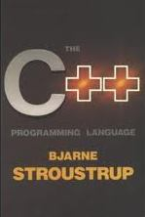
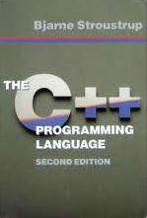
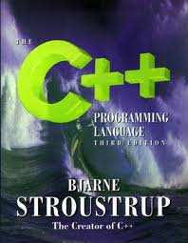
History
The 3 ages of C++ correspond to editions of The C++ Programming Language book
1st age, 1985
2nd age, 1991
3rd age, 1997
4th age, ????
  C++0x (sic)
  promises many new
  language features and libraries
331 pages
720 pages
1040 pages

Slide 4
C/C++ Use
C and C++ continue to be popular languages
Tiobe index, language ranking
  http://www.tiobe.com
 | 1986 | 1996 | 2006 | 2011
C++ | 8 | 3 | 3 | 3
C | 1 | 1 | 2 | 2

Slide 5
Undefined Behaviour
Conformance
  If a “shall” or “shall not” requirement... is violated the behavior is undefined. (4)
Undefined behavior
  Behavior, upon use of a nonportable or erroneous program construct or of erroneous data, for which this International Standard imposes no requirement. (3.4.3)

Slide 6
Evaluation Order
Evaluation order is not always determined by the layout order of the code
  statements, initialisers, operands of the short-circuiting and comma operators are evaluated in strict sequence... and that's pretty much it
  can affect expression certainty and correctness
a = f() * g() + h();
a = f() * (g() + h());
there is no required difference in evaluation order between these two assignments

Slide 7
Sequence Points
At certain specified points in the execution sequence called sequence points, all side effects of previous evaluations shall be complete and no side effects of subsequent evaluations shall have taken place (5.1.2.3)

Slide 8
Sequence Points
sequence points occur...
  at the end of a full expression
  after the first operand of these operators
    && logical and
    || logical or
    ?: ternary
    , comma
  after evaluation of all arguments and function expressions in a function call
  at the end of an intializer
  at the end of a full declarator
  that's it!

Slide 9
Sequence Point Rules
Rule 1
  Between the previous and next sequence point an object shall have its stored value modified at most once by the evaluation of an expression (6.5)
Rule 2
  Between the previous and next sequence point... the prior value shall be read only to determine the value to be stored (6.5)
n = n++
Violates rule 1 - undefined
n + n++
Violates rule 2 - undefined

Slide 10
Multi Paradigm?
C++ supports many many different programming styles
  traditional C style
  data abstraction
  operator overloading
  object oriented
  generic programming (templates)
  multiple inheritance
  exceptional control flow
Very very easy to make a big bad mess
  keep it simple, focus on a few styles only

Slide 11
Comparing Languages
Where to use C++?
  only C and C++ compiler is available
Why use C++?
  you need a higher level of abstraction than C
What to compare C++ with?
  Compare with Java, C#, etc
  Don't compare C++ with C

Slide 12

Spirit of C++
trust the programmer
speed trumps portability
stay close to the hardware
be as close as possible to C, but no closer
don't pay for what you don't use
catch errors at compile time
avoid the preprocessor
you can write the library
in the language

Slide 13
Hello C++
traditional first program
preprocessor #include
(note no .h)
<< streaming operator
“string literal”
#include <iostream>
int main()
{
std::cout << “Hello, world\n”;
}
std namespace
:: scope resolution operator

Slide 14
Key
✓
compiles
?
compiles but questionable
tests fail
✗
doesn't compile
a bug
tests pass
a note

