Slide 1
English for Survival
Jony

Slide 2
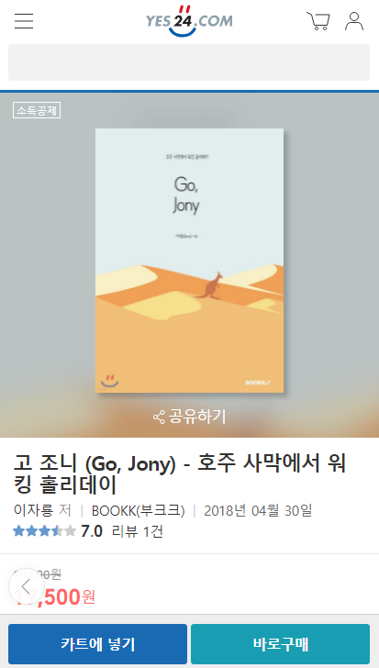
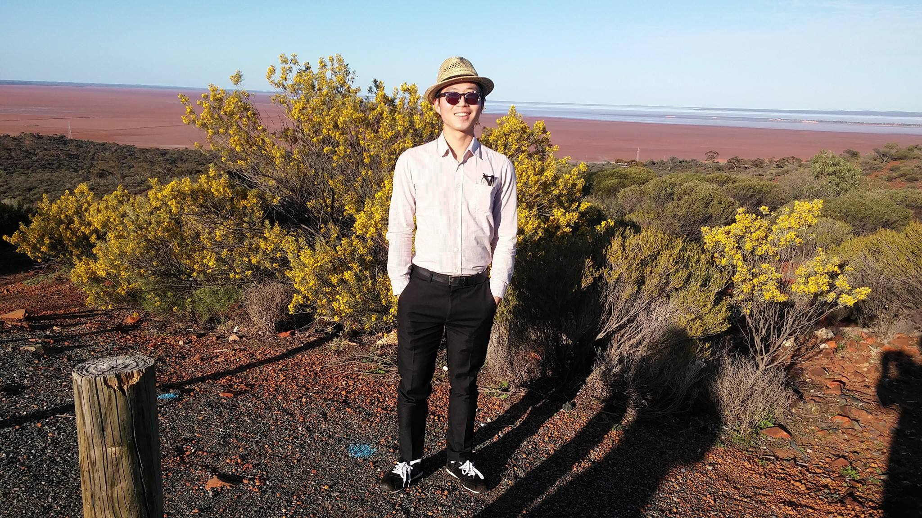
Who am I?
Blue Monkey Restaurant
Cook
2015.4 – 2015.10
Western Australia Kalgoorlie
Go, Jony
Author
2018.4
Personal essay
DuoGreen
Intern
2018.1 – 2018.3
New Jersey, US

Slide 3
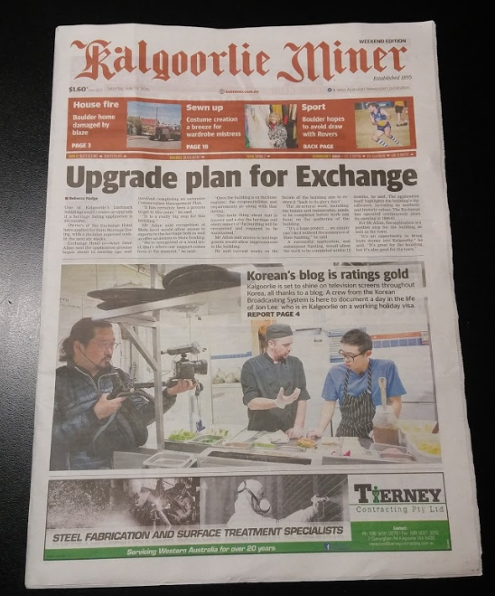

Slide 4
What is this class?
English for survival
Study less, learn more.
Do not be perfect.

Slide 5
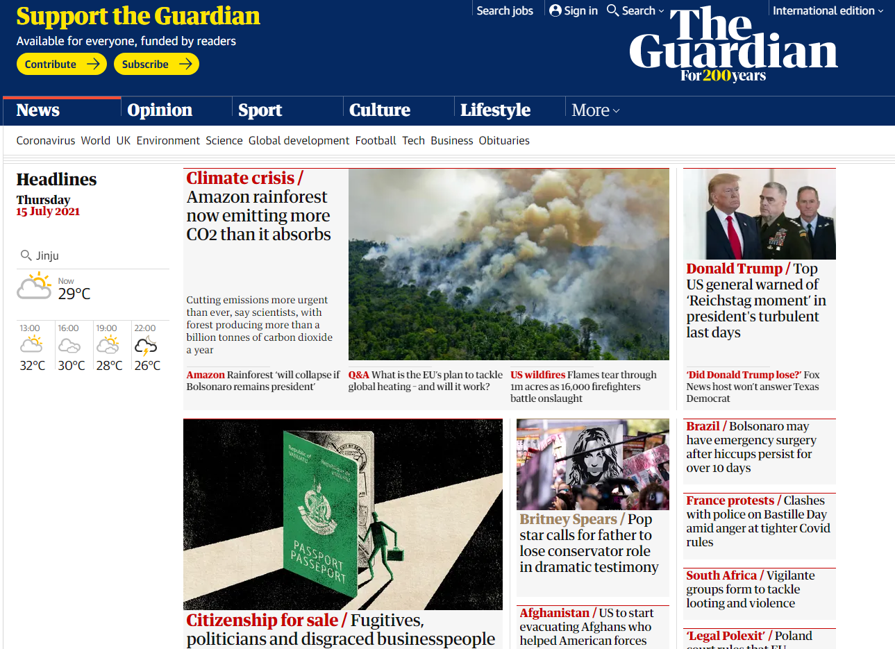
Are you really interested?

Slide 6
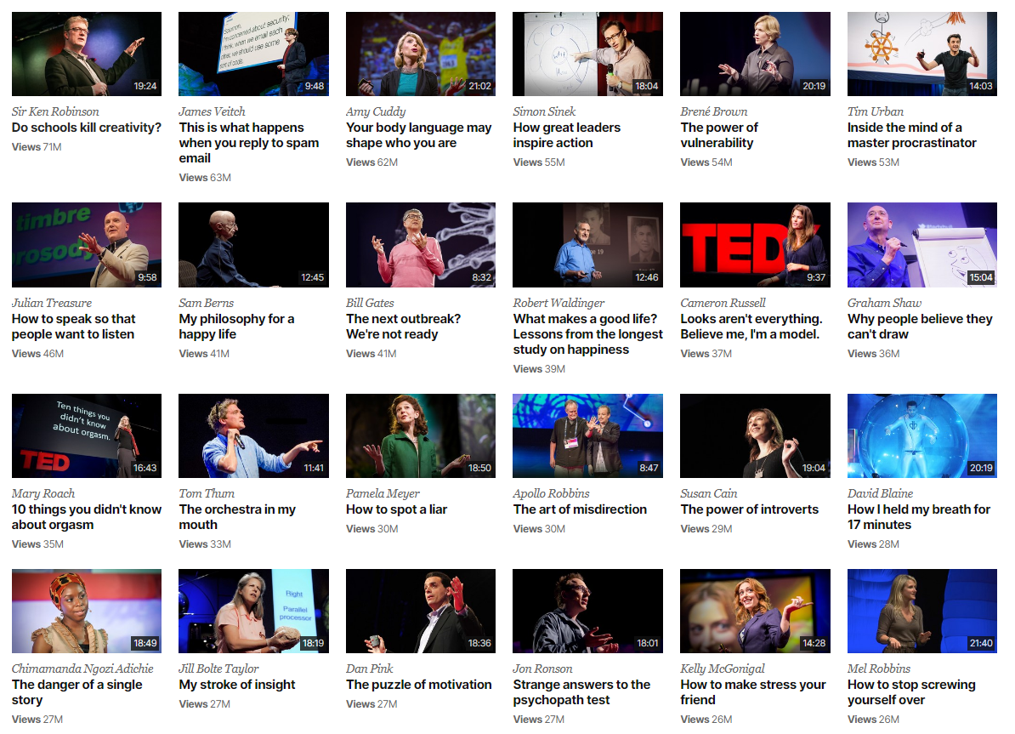

Slide 7
Start simple
Imagine your situation. When do you talk?
with friends
with family
with colleagues
with neighbors

Slide 8
Until next time,
prepare your two minutes of Korean conversation
in your real life

