Slide 1
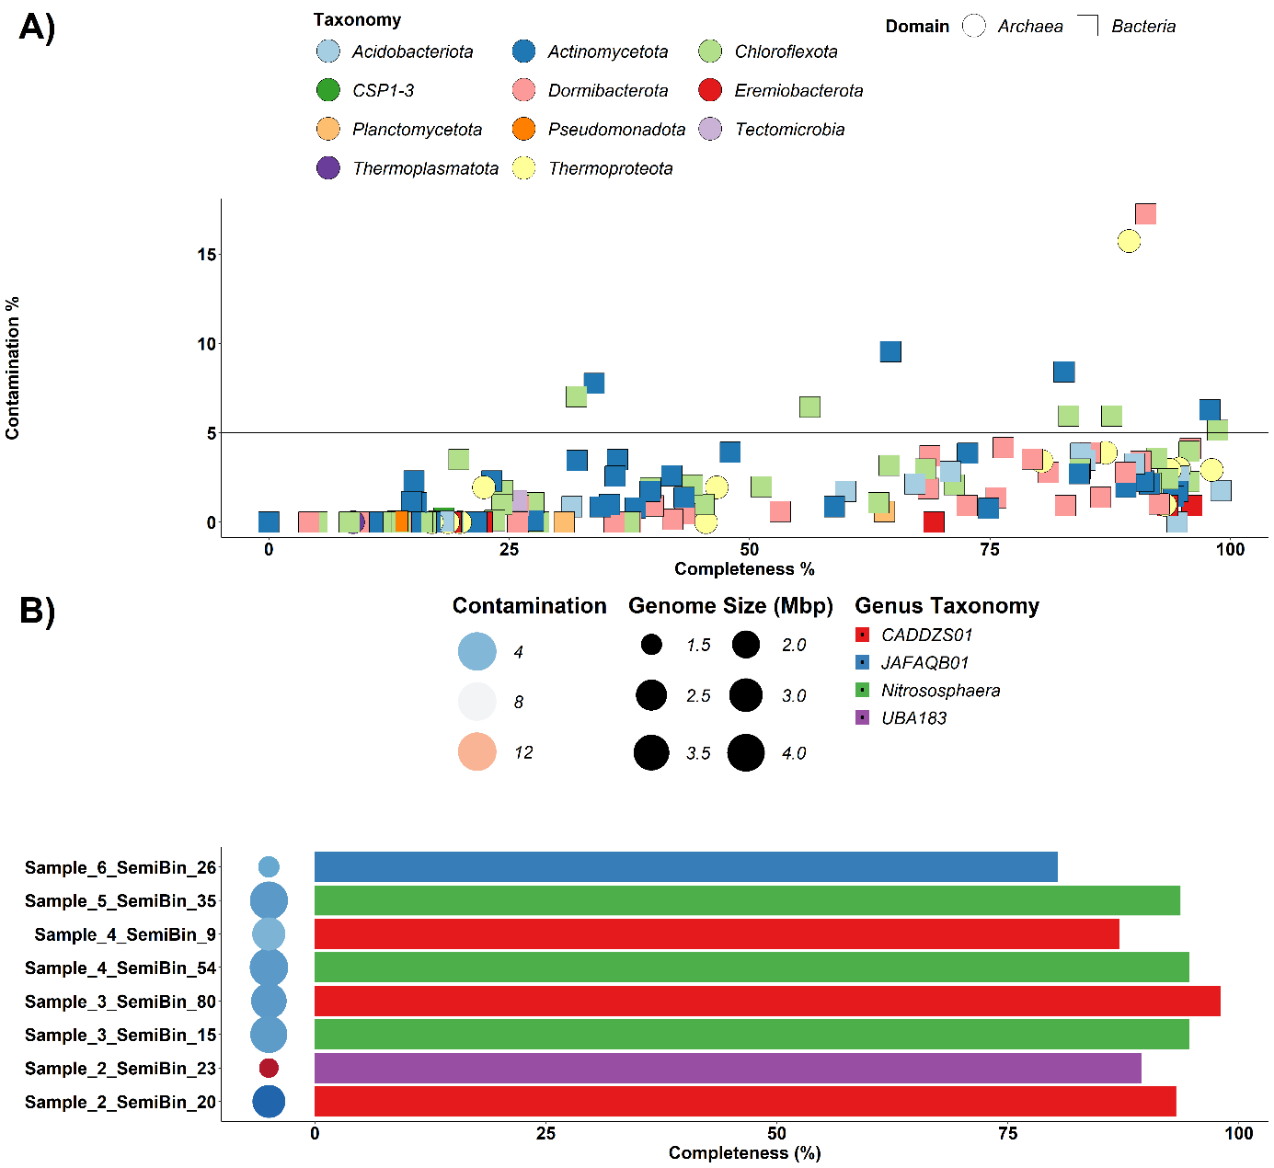
MAGs classified
Nitrosphaera Genomes

