Slide 1
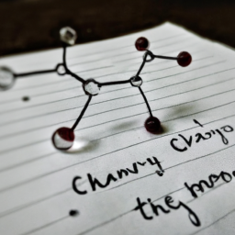
Chemistry: An Introduction
Chemistry is the study of matter and the changes it undergoes.
It is a branch of physical science that studies the composition, structure, properties, and behavior of matter.
Chemistry is a very important part of our everyday lives, from the food we eat to the air we breathe.

Slide 2
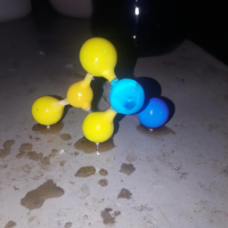
Chemical Reactions
Chemical reactions are processes in which one or more substances are changed into one or more new substances.
Chemical reactions involve the breaking and forming of chemical bonds.
Chemical reactions are essential for life, as they are responsible for the production of energy and the formation of new molecules.

Slide 3
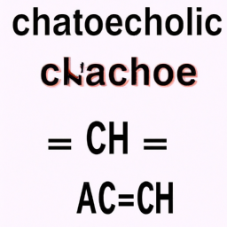
Chemical Equations
Chemical equations are used to represent chemical reactions.
They are written using symbols and formulas to represent the reactants and products of a reaction.
Chemical equations are used to calculate the amount of reactants and products needed for a reaction to occur.

Slide 4
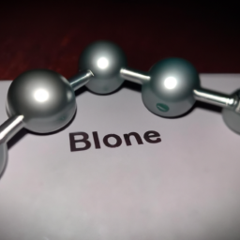
Chemical Bonds
Chemical bonds are the forces that hold atoms together.
There are three main types of chemical bonds: covalent, ionic, and metallic.
Chemical bonds are essential for the formation of molecules and compounds.

Slide 5
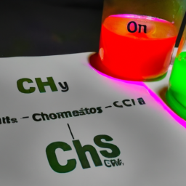
Chemical Properties
Chemical properties are characteristics of a substance that can be observed during a chemical reaction.
Examples of chemical properties include flammability, reactivity, and solubility.
Chemical properties are used to identify and classify different substances.

