Slide 1

What is a Hackathon?
A hackathon is an event where people come together to collaborate on a project
Participants work together to create something new, often a software or hardware project
Hackathons can last anywhere from a few hours to a few days
Participants often work in teams, but can also work individually

Slide 2

Benefits of Attending a Hackathon
Gain experience in working with a team
Learn new skills
Network with people in the tech industry
Get feedback on your project
Have fun and be creative

Slide 3
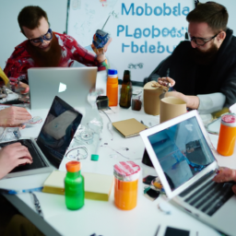
Preparing for a Hackathon
Research the event and the project you want to work on
Make sure you have the necessary tools and materials
Bring snacks and drinks to keep yourself energized
Have a plan for the project and a timeline for completion
Make sure you get enough rest the night before

Slide 4
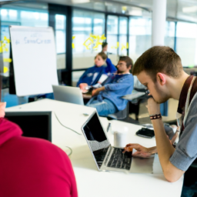
During the Hackathon
Stay focused and work on the project
Take breaks when needed
Ask questions and get help when needed
Have fun and be creative
Celebrate your successes

Slide 5
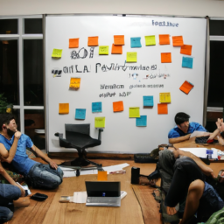
After the Hackathon
Reflect on the experience
Follow up with the contacts you made
Share your project with the world
Celebrate your accomplishments
Keep learning and growing

