Slide 1
Developing an Automated Testing Strategy
Jon Kruger
(@JonKruger)

Slide 2
Forget everything you know
Notes:
I want you to forget everything that you think you already know about how to test software so that we can take an objective look at how we should test software. We all have preconceptions about how testing should be done, maybe from a book you read, or how you do it at work or how you’ve seen it done in the past.

Slide 3
Why do we build software?
Notes:
Make money
Meet some need
Make users happy

Slide 4
Why do we test software?
The real purpose of testing is to make sure that our software is achieving the goals that caused us to build it in the first place.
Notes:
We don’t want it to break, we want to make sure it’s meeting the needs of the business, we don’t want bugs, etc.
The goal of testing is the same as the goal of writing the code
WHICH REALLY MEANS… we don’t want to lose money, we want users to stay happy, etc.

Slide 5
Acceptance Criteria
Notes:
What do we expect this feature to do?
What is acceptable behavior for this feature?
How do we know when we are done?

Slide 6

Acceptance Criteria - Mythbusters

Slide 7
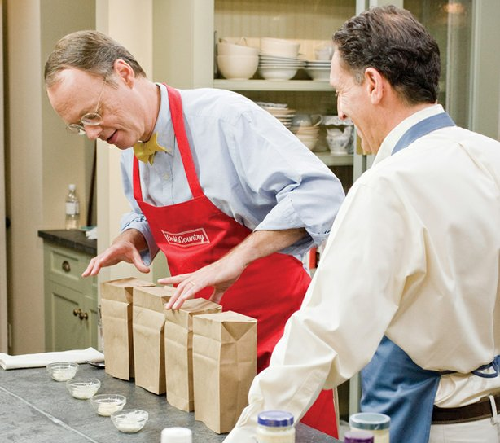
Acceptance Criteria – America’s Test Kitchen
Notes:
What things are important when testing the taste of food?

Slide 8
Types of tests

Slide 9
Unit Tests
Good:
Bad:
Run fast
Test code in isolation
Less brittle
Don’t test the interaction between components
Notes:
Example: test calculation of tax based on the state a product is being shipped to

Slide 10
Integration Tests
Good:
Bad:
Test the components of the system working together
May test interaction with external systems
Slower
More brittle
Might only test part of the system working together
Test data setup might be difficult
Notes:
Example: save a record to the database, then load it back out and see that the data is as you would expect

Slide 11
Acceptance Tests
Good:
Bad:
Test the entire application end to end
Often written in plain English (“gherkin” syntax)
Test the actions that real users will do
Slower
Not good for testing every combination of possibilities
Notes:
Example: user logs in, adds a product to the cart, and then checks out

Slide 12
Manual Tests
Good:
Bad:
Testing subjective things (look and feel, overall user experience)
Exploratory testing – try and break the app
Very time consuming
Not easily repeatable
Doesn’t scale well as the application grows

Slide 13
Security Tests
Make sure the application is not vulnerable to hacking or unauthorized access

Slide 14
Load Tests/Performance Tests
Test how the application behaves under a certain amount of stress

Slide 15
User Acceptance Testing
Do the users agree that what you have built will meet their needs?

Slide 16
A/B Testing
Which of these layouts/colors/approaches get better results?

Slide 17
Choosing a test strategy
… is a TEAM thing!
Notes:
This is a TEAM THING, not just QA’s job
Developers have a certain set of skills, and QA testers have different sets of skills. We want to make the best use of everyone’s skills to test the application effectively and efficiently.

Slide 18
Test Strategy – Micro Level
How are we (the team) going to test this feature?

Slide 19
The Three Amigos
Notes:
Get BAs, QAs, and developers together and decide on acceptance criteria for the feature as well as how you will test it
Example: http://www.youtube.com/watch?v=zrzMhU_4m-g&list=FLY4Oz73XkH0qNK1trlSxPNQ&index=1

Slide 20
Example – Monty Python
http://www.youtube.com/watch?v=zrzMhU_4m-g&list=FLY4Oz73XkH0qNK1trlSxPNQ&index=1

Slide 21
The “Gherkin” Syntax
Given I am a logged in user
When I go to the final checkout page
Then I should see the total cost of the order broken down by product cost, tax, and shipping charges
And I should see the total cost of the order
Notes:
Regardless of how you get there, make sure you have acceptance criteria before you start coding! Otherwise you don’t really know what it is that you’re building. If your BA or QA don’t give you acceptance criteria, write them out yourself.

Slide 22
Feature: Process an order
Given I am a logged in user
When I go to the final checkout page
Then I should see the total cost of the order broken down
by product cost, tax, and shipping charges
And I should see the total cost of the order
Order total = total cost of products on the order + tax + shipping charges
Tax:
Ohio = 7%
Michigan = 6.5%
Other states = 0%
Shipping:
If total cost of products (before tax >= $25), shipping is free, otherwise $5

Slide 23
Feature: Process an order
Given I am a logged in user
When I go to the final checkout page
Then I should see the total cost of the order broken down
by product cost, tax, and shipping charges
And I should see the total cost of the order
Order total = total cost of products on the order + tax + shipping charges
Tax:
Based on the shipping address, not the billing address
Tax charged on the sum of the cost of the products
Ohio = 7%
Michigan = 6.5%
Other states (including DC) = 0%
No shipping internationally
Shipping:
If total cost of products (before tax) >= $25, shipping is free, otherwise $5

Slide 24
Feature: Process an order – Testing Notes
We’ll test the following scenarios:
Order with multiple products
Ship to OH, MI, DC
Unit tests to verify tax calculation for all 51 states
Shipping < $25, = $25, > $25
Verify order totals
Notes:
This is as far as we go in our initial 3 amigos meeting. At this point we’ll break and someone will write out the gherkin for the acceptance tests and then we’ll review the gherkin once it’s written (no need for us all to sit in a room and watch someone type out gherkin).

Slide 25
Feature: Process an order – Testing Notes
Products | Tax | Shipping
Order with one product | Ship to Ohio (7% tax) | Cost of product = $24.99 (shipping is $5)
Order with one product | Ship to Michigan (6.5% tax) | Cost of product = $25 (shipping is free)
Order with multiple products | Ship to DC, billing address is Ohio (0% tax) | Cost of products = $25.01 (shipping is free)
Verifications
Total cost = sum of cost of products + tax + shipping
Notes:
Combine all of the scenarios so that we can have fewer automated tests to write.

Slide 26
Feature: Process an order – Acceptance Criteria
Scenario: Order with one product, ship to OH, total product cost < $25
Given I am a logged in user
And the shopping cart is empty
And I add a product costing $24.99 to the cart
And my shipping state is OH
And my billing state is OH
When I go to the final checkout page
Then the tax amount should be $1.75
And the shipping amount should be $5.00
And the order total should be $31.74
Notes:
- This gherkin essentially becomes our requirements, our test plan, our method of verifying that our feature will meet the needs of the business, and potentially an automated acceptance test.
- The gherkin can be written by anyone on the team. The 3 amigos must all agree on the final gherkin.
- Bonus points if you can get people in the business to write requirements for you in this format!

Slide 27
Risk vs. Cost Mapping
High
High risk,
easy to test
High risk, hard to test
Risk
Low risk, easy to test
Low risk, hard to test
Low
Low
High
Cost
Notes:
Is this test worth automating?
Is it worth it to test this at all?

Slide 28
Questions to ask
What will happen if this feature doesn’t work as designed?
What is the cost of NOT automating this test?
What will it cost to test this in the way that we want to test it? Is it worth it?

Slide 29
Test Strategy – Macro Level
How are we (the team) going to test this application?
What is the best use of our time and resources given the constraints that we have (type of application, people, skills, time, etc.)?

Slide 30
Testing Myth #1
It’s QA’s job to come up with the testing plan.

Slide 31
Testing Myth #2
We should have X% test coverage.
Notes:
Picking an arbitrary number as a threshold for test coverage doesn’t lead to you making the smartest choices. We should look at each piece of functionality and decide how it should be tested (or not tested).

Slide 32
Testing Myth #3
We don’t have time for automated testing.
Notes:
That’s why we’re here – we going to take an objective look at how to make the best use of our time.

Slide 33
Testing Myth #4
We can only have one testing strategy for our application.
Notes:
You might decide to do lots of automated testing against your service layer and only manual testing and some happy flow automated web tests for the front end.

Slide 34
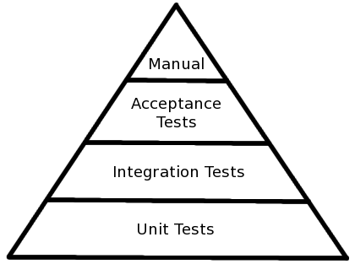
The Automated Testing Triangle
Notes:
The textbook definition of how testing should be done. But does this make sense for you? There’s a good chance that it does, but we should think about this a bit.

Slide 35
Questions to ask
What are the areas of the application that are most likely to fail?
What are the areas or the application that will cause the most damage if they fail?
What is the smartest way we can test the application given our people, skills, tools, and time?
If we had no constraints, what would be the best way to test the application?
Notes:
#4 – realistically, we all have constraints. But maybe we can change the constraints. If we don’t have the right people, maybe we need to add team members with different skill sets (or just more people). If we don’t have a tool we need, maybe we should get it. If we don’t have skills, maybe we should get training.

Slide 36
SpecFlow

Slide 37
Slides and contact info
Slides:
http://jonkruger.com,
click on Presentations
Code:
http://github.com/JonKruger/specflow-selenium-calculator
Email: jon@jonkruger.com
Twitter: @JonKruger
Blog: http://jonkruger.com

Slide 38
Types of Tests
Unit tests
Integration tests
Acceptance Tests
Manual tests
Security tests
Load/performance tests
User acceptance testing
A/B testing
Notes:
You might decide to do lots of automated testing against your service layer and only manual testing and some happy flow automated web tests for the front end.

Slide 39
How would you test…
An internal line-of-business application with 20 users (not mission-critical)
Notes:
How long do we expect this application to be around? (Or, is this a short-term throwaway solution or something we expect to use for a long time?)
How often is it going to change?

Slide 40
How would you test…
Your bank’s website for accessing your checking account
View balance and recent activity
Pay bills
Perform customer service functions

Slide 41
How would you test…
A back-end transaction processing system
Processes 100000 transactions per day
No user interface

Slide 42
How would you test…
A startup competitor to Instagram

Slide 43
How would you test…
The computer in a car

Slide 44
How would you test…
The space shuttle

Slide 45
How would you test…
An e-commerce site for a clothing store

