Slide 1
OOP, SOLID, and More!
by Jon Kruger

Slide 2
Why you should spend the next 4 hours in here
The principles that we will discuss today will help you write better code in ANY language that you use
Because you can never completely master object-oriented programming
Practice makes perfect, so we’re going to practice

Slide 3
CHANGE
Notes:
We spend all day changing our code
Every time you change code, you risk adding a bug to the system
The more code we have to write, the more bugs we risk introducing into the system
All of this costs money!
Therefore, we should do whatever we can to make our code as easy to change as possible.

Slide 4
TESTING
Notes:
This is not a talk about testing. But writing unit tests is the best way that you can keep your code maintainable, well-designed, and easy to change.

Slide 5
What is Test Driven Development?
A software development technique where you write automated unit tests before you write your implementation code
A technique for ensuring good quality and good design
Awesome!

Slide 6
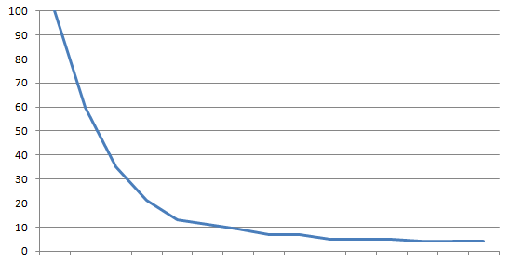
The total cost of owning a mess
Productivity
Time

Slide 7
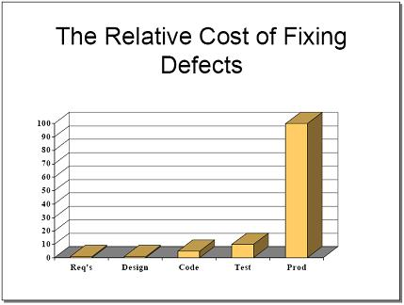

Slide 8
Goal: Better Quality
Fewer bugs – it costs money to find bugs, fix bugs, and clean up the mess created by bugs.
More flexibility – since code will need to change, it should be easy to change

Slide 9
Goal: Get Things Done Faster
It costs money to develop software
It costs money to fix bugs
It costs money to make changes to software

Slide 10
Programming For Others
Notes:
Your code should be easy for someone other than you to understand – someday someone other than you will probably be maintaining your code
Keep a long term view of things – most apps are supposed to last for many years
Remove technical debt, don’t create more of it
Please care.
http://www.codinghorror.com/blog/archives/000801.html

Slide 11
Object-Oriented Programming
Definition: “A method of programming based on a hierarchy of classes, and well-defined and cooperating objects.”

Slide 12
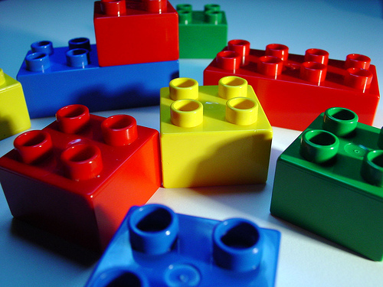
From this…
Notes:
Each of these Legos have a very specific purpose and a way to interact with each other. Using these simple blocks, you can create amazing Lego structures.

Slide 13

… to this
Notes:
-Imagine if some of our Lego blocks were missing the pins on the top, some were very weird shapes, some couldn’t attach anything to the bottom, some were glued together, etc. – if would be really hard to build different things with them or change what we were building

Slide 14
OOP vs. Procedural Programming
Object-oriented programming
Procedural programming
Collaboration between objects that send and receive messages with each other
Functionality is grouped by object
Objects and their behavior can be reused
.NET, Java, Ruby, C++
A series of functions, subroutines, or tasks
Functionality is grouped by task
Functions/subroutines/tasks can be reused
SQL, VB6

Slide 15
Why object-oriented programming?
Objects are a natural way of representing behavior and properties in code
Objects are more reusable
Objects are more maintainable
Objects are more extensible

Slide 16
Gotchas
Just because you are using an OO language does not mean that you are doing object-oriented programming
Reuse is good (avoid NIH syndrome)
The purely object-oriented solution is not always the best solution
Don’t be a code hoarder
Notes:
Some of the most un-object-oriented code I have ever seen has been in object-oriented languages
Ruby Gems – good example of reuse. Open source projects – good example of reuse. But sometimes it’s better to just write something yourself.
Use your brain – sometimes non-OO code is good enough (as long as it’s well encapsulated inside a method)
- Write your code so that it’s easier for others to reuse it

Slide 17
Classes
Defines the characteristics of something (object)
I am: fields and properties
I do: methods
Contains the blueprint for how objects are created
I am a Dog.
I have a name.
I have a gender.
I can Bark.
I can Eat.

Slide 18
Objects
An instance of a class
Exists at runtime
Class: Dog
Rover
Max
Fido

Slide 19
3 Tenants of OOP
Encapsulation
Inheritance
Polymorphism

Slide 20
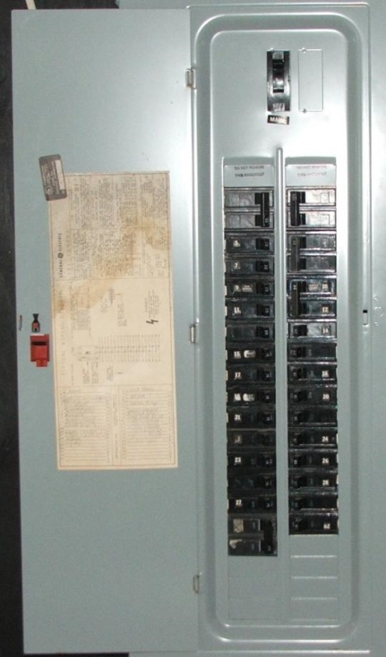

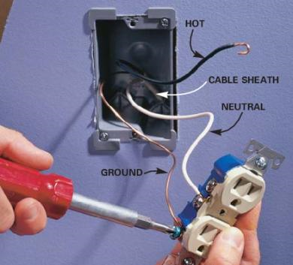

Encapsulation
Hide implementation details from the outside world
Example: home electrical wiring

Slide 21
Encapsulation
public class BankAccount
{
public decimal Balance { get; set; }
}
It’s true that a BankAccount has a Balance, but this class does not contain information about the behaviors of a BankAccount.

Slide 22
Encapsulation
public class BankAccount
{
public decimal Balance { get; set; }
public void Deposit(decimal amount)
{
Balance += amount;
}
public void Withdraw(decimal amount)
{
Balance -= amount;
}
}
Sure, we could do it this way, but we are violating encapsulation by exposing the inner workings of this class (the Balance property).

Slide 23
Encapsulation
public class BankAccount
{
private decimal _balance;
public decimal Balance
{
get { return _balance; }
}
public void Deposit(decimal amount)
{
_balance += amount;
}
public void Withdraw(decimal amount)
{
_balance -= amount;
}
}
Much better – the inner workings of the class are hidden from consumers of the class.

Slide 24
Encapsulation
public class BankAccount
{
private decimal _balance;
public decimal Balance
{
get { return _balance; }
}
public void Deposit(decimal amount)
{
_balance += amount;
}
public void Withdraw(decimal amount)
{
if (_balance - amount < 0)
throw new InsufficientFundsException();
_balance -= amount;
}
}
Change! Throw an exception if there are insufficient funds during a withdrawal.
Notes:
We can make this change easily without breaking any code that uses this class.

Slide 25
Encapsulation
public bool Withdraw(BankAccount bankAccount, decimal amount)
{
bool couldWithdrawMoney;
// check to see if there is enough money for the withdrawal
if (bankAccount.Balance >= amount)
{
bankAccount.Withdraw(amount);
couldWithdrawMoney = true;
}
else
couldWithdrawMoney = false;
return couldWithdrawMoney;
}
Change! You cannot withdraw money if the account is closed.
Notes:
The comment in this code is a code smell – if you need a comment to describe what you’re code is doing, your code should be more descriptive!

Slide 26
Encapsulation
public bool Withdraw(BankAccount bankAccount, decimal amount)
{
bool couldWithdrawMoney;
// check to see if there is enough money for the withdrawal
// and if the account is open
if (bankAccount.Balance >= amount &&
bankAccount.Status == BankAccountStatus.Open)
{
bankAccount.Withdraw(amount);
couldWithdrawMoney = true;
}
else
couldWithdrawMoney = false;
return couldWithdrawMoney;
}
Change! You cannot withdraw money if the account is closed.
The code in the if statement is a leaky abstraction – the details about whether you can withdraw money is spread out among the consumers of the BankAccount instead of being encapsulated inside the BankAccount object.

Slide 27
Encapsulation
public class BankAccount
{
public bool CanWithdraw(decimal amount)
{
return Balance >= amount && Status == BankAccountStatus.Open;
}
}
public bool Withdraw(BankAccount bankAccount, decimal amount)
{
bool couldWithdrawMoney;
// no need for a comment anymore, this code says what it does!
if (bankAccount.CanWithdraw(amount))
{
bankAccount.Withdraw(amount);
couldWithdrawMoney = true;
}
else
couldWithdrawMoney = false;
return couldWithdrawMoney;
}
The details about whether an amount of money can be withdrawn from a bank account is now encapsulated inside the BankAccount class.

Slide 28
Law of Demeter
public class AtmMachine
{
public void DoSomething(BankAccount bankAccount)
{
if (bankAccount.PrimaryAccountHolder.State == “OH”)
{
DoSomethingElse(bankAccount);
}
}
}
A method of an object may only call methods of:
1) The object itself.
2) An argument of the method.
3) Any object created within the method.
4) Any direct properties/fields of the object.

Slide 29
Law of Demeter
public class AtmMachine
{
public void DoSomething(BankAccount bankAccount)
{
if (bankAccount.StateWhereAccountIsHeld == “OH”)
{
DoSomethingElse(bankAccount);
}
}
}
public class BankAccount
{
public string StateWhereAccountIsHeld
{
get { return PrimaryAccountHolder.State; }
}
}

Slide 30
?

Slide 31
Inheritance
“Is-a” vs. “Has-a”
What is the relationship between these objects?
Customer
string FirstName
string LastName
string Address
PreferredCustomer
string FirstName
string LastName
string Address
CustomerContact
string FirstName
string LastName
string Address

Slide 32
Inheritance
“Is-a” vs. “Has-a”
What is the relationship between these objects?
PreferredCustomer
: Customer
IList<CustomerContact> Contacts
CustomerContact
string FirstName
string LastName
string Address
Has-a
Is-a
Customer
string FirstName
string LastName
string Address

Slide 33
We could do this…
PreferredCustomer
: Customer
IList<CustomerContact> Contacts
CustomerContact : Person
Has-a
Is-a
Customer : Person
Is-a
Person
string FirstName
string LastName
string Address
string FormatName()
FormatName() will format name as Last Name, First Name.

Slide 34
We could do this…
PreferredCustomer
: Customer
IList<CustomerContact> Contacts
CustomerContact : Person
Has-a
Is-a
Change! We want to format the name for CustomerContact objects as “First Name Last Name” instead of “Last Name, First Name”.
Customer : Person
We could change FormatName() to FormatName(bool lastNameFirst)
We could change FormatName() to FormatName(INameFormatter formatter)
Is-a
Person
string FirstName
string LastName
string Address
string FormatName()
Either way will force us to change any code that calls FormatName() on any class deriving from Person!

Slide 35
Rethinking inheritance
What’s good about inheritance
What’s bad about inheritance
Enables code reuse
Polymorphism (“one with many forms”)
Tight coupling – changes to the base class can cause all derived classes to have to changes
Deep inheritance hierarchies are sometimes hard to figure out

Slide 36
Rethinking inheritance
PreferredCustomer
: Customer
IList<CustomerContact> Contacts
CustomerContact : Person
Has-a
Is-a
Question:
Will we ever have code that requires us to use the methods and properties that we put in the Person class? Person person = GetImportantPerson(); return person.FormatName();
Customer : Person
Is-a
Person
string FirstName
string LastName
string Address
string FormatName()

Slide 37
Rethinking inheritance
PreferredCustomer
: Customer
IList<CustomerContact> Contacts
CustomerContact
string FirstName
string LastName
string Address
string FormatName()
Has-a
Is-a
Customer
string FirstName
string LastName
string Address
string FormatName()
Employee
string FirstName
string LastName
string FormatName()
What do we have now:
Our classes are no longer tightly coupled by inheritance, so we can change FormatName() on one class without affecting another
But we still want to reuse the name formatting code!

Slide 38
Rethinking inheritance
Create classes that format names – an object-oriented solution!
public class FirstNameLastNameNameFormatter
{
public string FormatName(string firstName, string lastName)
{
return firstName + “ “ + lastName;
}
}
public class LastNameFirstNameNameFormatter
{
public string FormatName(string firstName, string lastName)
{
return lastName + “, “ + firstName;
}
}

Slide 39
Rethinking inheritance
Any class that needs to format names can use the name formatter objects.
public class Customer
{
public string FormatName()
{
return new FirstNameLastNameNameFormatter()
.FormatName(FirstName, LastName);
}
}
This technique is called composition – classes can add functionality by using functionality in other objects.

Slide 40
Ruby mixins
module FirstNameLastNameNameFormatter
def format_name
return first_name + " " + last_name;
end
end
class Customer
include FirstNameLastNameNameFormatter
attr :first_name, true
attr :last_name, true
end
customer = Customer.new
customer.first_name = ‘Jon’
customer.last_name = ‘Kruger’
puts customer.format_name # this line will output: Jon Kruger

Slide 41
Composition vs. inheritance
Composition allows you to reuse code without being tightly coupled to a base class
Many loosely coupled, small, testable classes that provide bits of functionality that can be used by anyone who wants to use them
Example: going shopping at a grocery store vs. growing your own food on a farm – at the grocery store, it’s much easier to change what you get!

Slide 42
More Composition
public class Fruit
{
// Return number of pieces of peel that
// resulted from the peeling activity.
public int Peel()
{
return 1;
}
}
public class Apple : Fruit
{
}
public class Example1
{
public static void Main(String[] args)
{
Apple apple = new Apple();
int pieces = apple.Peel();
}
}

Slide 43
More Composition
public class Fruit
{
// Return number of pieces of peel that
// resulted from the peeling activity.
public PeelResult Peel()
{
return new PeelResult { NumberOfPeels = 1, Success = true };
}
}
public class Apple : Fruit
{
}
public class Example1
{
public static void Main(String[] args)
{
Apple apple = new Apple();
int pieces = apple.Peel(); // Compile error!
}
}
Notes:
Because we used inheritance, changes to the Fruit class are affecting the Example1 class. Example1 is tightly coupled to Fruit in this case.

Slide 44
More Composition
public class Fruit
{
// Return number of pieces of peel that
// resulted from the peeling activity.
public int Peel()
{
return 1;
}
}
public class Apple
{
private Fruit fruit = new Fruit(); // Composition instead of inheritance
public int Peel()
{
return fruit.Peel();
}
}
public class Example2
{
public static void Main(String[] args)
{
Apple apple = new Apple();
int pieces = apple.Peel();
}
}
Notes:
Instead of having Apple inherit from Fruit, it will compose itself by having an internal Fruit object.

Slide 45
More Composition
public class Fruit
{
// Return number of pieces of peel that
// resulted from the peeling activity.
public PeelResult Peel()
{
return new PeelResult { NumberOfPeels = 1, Success = true };
}
}
public class Apple
{
private Fruit fruit = new Fruit(); // Composition instead of inheritance
public int Peel()
{
return fruit.Peel().NumberOfPeels; // Changes stop here!
}
}
public class Example2
{
public static void Main(String[] args)
{
Apple apple = new Apple();
int pieces = apple.Peel();
}
}
Notes:
Changes to Fruit affect the Apple class, but nothing that uses the Apple class. We have better encapsulation and less coupling between our objects.

Slide 46
?

Slide 47
(break time!)

Slide 48
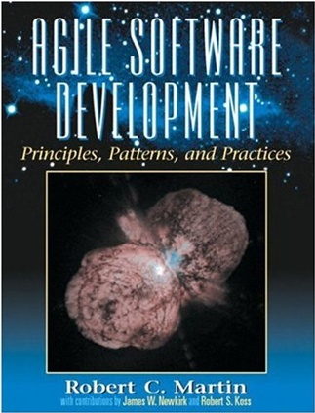
SOLID Principles
Agile Software Development Principles, Patterns, and Practices, by Robert C. Martin (aka “Uncle Bob” Martin)

Slide 49
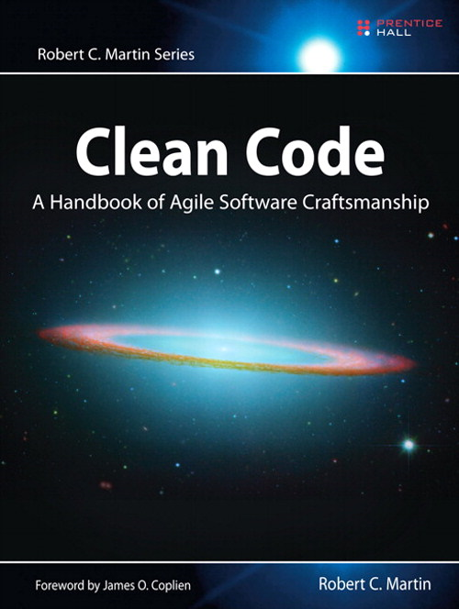
More from Uncle Bob
Clean Code: A Handbook of Agile Software Craftsmanship, by Robert C. Martin (aka “Uncle Bob” Martin)

Slide 50
Ground Rules
These are guidelines, not hard and fast rules
Use your brain – do what makes sense
Ask why
Notes:
I will try to explain situations where (I think) you can not follow these principles
The goal is to make software development easier. This DOES NOT mean that you shouldn’t follow these principles just because you don’t understand it or don’t know how to do it.
Try to understand why you are doing things the way you are doing it.
Do what makes sense to you – but make sure you do your homework and make sure you are doing the right thing
Don’t just do something because someone says you should – learn why you should do it that way (they could be wrong)
You should be able to explain why you made a decision – not “Microsoft told me to do it” or “someone says this is the right way to do it” or “this is how we’ve always done it in the past”
Have seen projects that took these principles to extremes, or added unnecessary complexity without knowing why they were doing it, and the project suffered or failed because of it

Slide 51
This should make things easier!
Software should be:
Easy to test
Easy to change
Easy to add features to
Easy != not learning a new way of doing things

Slide 52
Complexity
Have only as much complexity as you need – have a reason for complexity
“I don’t want to learn this new way” != too complex
Notes:
If you’re not willing to use a technology because you’re not willing to learn something new, that is a big problem
not saying that you need to spend all of your time outside of work learning new stuff
be open to change and new ideas

Slide 53
Single Responsibility Principle
A class should have one, and only one, reason to change.

Slide 54
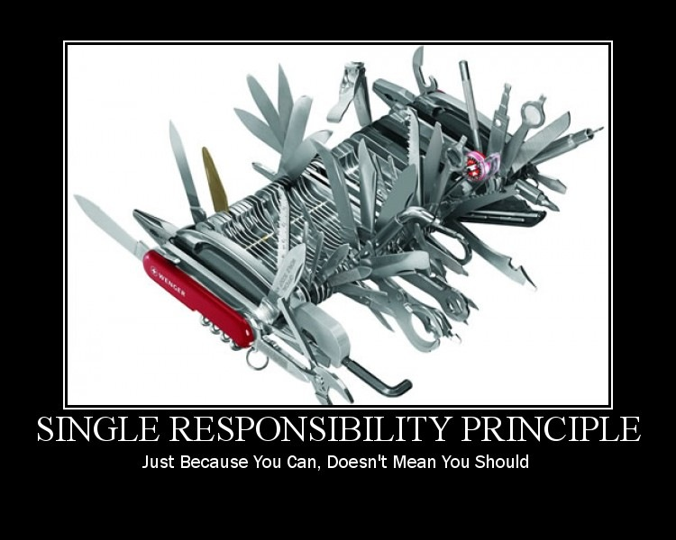
Notes:
- Imagine trying to use this thing! It can do everything you want, but doing what you want will be difficult.

Slide 55
SRP Violation – Multiple Responsibilities
public class Person
{
private const decimal _minimumRequiredBalance = 10m;
public string Name { get; set; }
public decimal Balance { get; set; }
public decimal AvailableFunds
{
get { return Balance - _minimumRequiredBalance; }
}
public void DeductFromBalanceBy(decimal amountToDeduct)
{
if (amountToDeduct > Balance)
throw new InvalidOperationException(“Insufficient funds.”);
Balance -= amountToDeduct;
}
}
Notes:
- What happens if the requirements change and now you can have a joint account that is held by two people?

Slide 56
SRP Fix – Split big classes
public class Account
{
private const decimal _minimumRequiredBalance = 10m;
public decimal Balance { get; set; }
public decimal AvailableFunds
{
get { return Balance - _minimumRequiredBalance; }
}
public void DeductFromBalanceBy(decimal amountToDeduct)
{
if (amountToDeduct > Balance)
throw new InvalidOperationException(“Insufficient funds.”);
Balance -= amountToDeduct;
}
}
Notes:
- Account doesn’t know anything about who holds the account

Slide 57
SRP Fix – Split big classes
public class Person
{
public string Name { get; set; }
public Account Account { get; set; }
public decimal AvailableFunds
{
get { return Account.AvailableFunds; }
}
public decimal AccountBalance
{
get { return Account.Balance; }
}
public void DeductFromBalanceBy(decimal amountToDeduct)
{
Account.DeductFromBalanceBy(amountToDeduct);
}
}
Notes:
- Person still has methods and properties dealing with accounts, but now all of the account logic is correctly encapsulated in the Account class

Slide 58
public class OrderProcessingModule {
public void Process(OrderStatusMessage orderStatusMessage) {
// Get the connection string from configuration
string connectionString = ConfigurationManager.ConnectionStrings["Main"].ConnectionString;
Order order = null;
using (SqlConnection connection = new SqlConnection(connectionString)) {
// go get some data from the database
order = fetchData(orderStatusMessage, connection);
}
// Apply the changes to the Order from the OrderStatusMessage
updateTheOrder(order);
// International orders have a unique set of business rules
if (order.IsInternational)
processInternationalOrder(order);
// We need to treat larger orders in a special manner
else if (order.LineItems.Count > 10)
processLargeDomesticOrder(order);
// Smaller domestic orders
else
processRegularDomesticOrder(order);
// Ship the order if it's ready
if (order.IsReadyToShip()) {
ShippingGateway gateway = new ShippingGateway();
// Transform the Order object into a Shipment
ShipmentMessage message = createShipmentMessageForOrder(order);
gateway.SendShipment(message);
}
}
SRP Violation -Spaghetti Code

Slide 59
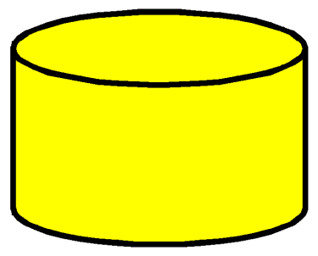
Tips for not violating SRP - Layers
UI
Business Logic (Domain Model)
Data Access
Database
Notes:
- small, useful Lego blocks instead of oddly-shaped ones

Slide 60
SRP Violation – “god” classes
public class OrderService
{
public Order Get(int orderId) { ... }
public Order Save(Order order) { ... }
public Order SubmitOrder(Order order) { ... }
public Order GetOrderByName(string name) { ... }
public void CancelOrder(int orderId) { ... }
public void ProcessOrderReturn(int orderId) { ... }
public IList<Order> GetAllOrders { ... }
public IList<Order> GetShippedOrders { ... }
public void ShipOrder { ... }
}
Notes:
Explain what a domain service is – not a web service

Slide 61
Tips for not violating SRP – XML Comments
Fill out the XML doc comments for the class – be wary of words like if, and, but, except, when, etc.
/// <summary>
/// Gets, saves, and submits orders.
/// </summary>
public class OrderService
{
public Order Get(int orderId) { ... }
public Order Save(Order order) { ... }
public Order SubmitOrder(Order order) { ... }
}

Slide 62
Tips for not violating SRP - Verbs
Domain services should have a verb in the class name
public class GetOrderService
{
public Order Get(int orderId) { ... }
}
public class SaveOrderService
{
public Order Save(Order order) { ... }
}
public class SubmitOrderService
{
public Order SubmitOrder(Order order) { ... }
}
Notes:
- This is not added complexity – I’m not writing any more code than I did when it was all one class

Slide 63
Why SRP matters
We want it to be easy to reuse code
Big classes are more difficult to change
Big classes are harder to read
Smaller classes and smaller methods will give you more flexibility, and you don’t have to write much extra code (if any) to do it!
Notes:
Big classes are harder to read, write, change, or test
Big classes often mean tight coupling, so it’s difficult to change one part of the class without affecting the other parts of it

Slide 64
When violating SRP might be OK
The violating class is not going to be reused and other classes don’t depend on it
The violating class does not have private fields that store values that the class uses
Your common sense says so
Example: MVC controller classes, web services
Notes:
- Common sense – go with your gut – don’t sit there for half an hour trying to figure out if a class violates SRP. If you can’t make a decision, just leave it how it is, you can come back and refactor later if you need to.

Slide 65
Don’t overcomplicate!
Don’t code for situations that you won’t ever need
Don’t create unneeded complexity
However, more class files != more complicated
Remember, this is supposed to make your lives easier! (but not easier to be lazy)
You can always refactor later (if you write tests)

Slide 66
?

Slide 67
Offshoot of SRP - Small Methods
A method should have one purpose (reason to change)
Easier to read and write, which means you are less likely to write bugs
Write out the steps of a method using plain English method names

Slide 68
Small Methods - Before
public void SubmitOrder(Order order)
{
// make sure that the order has products
if (order.Products.Count == 0)
{
throw new InvalidOperationException(
"Select a product.");
}
// calculate tax
order.Tax = order.Subtotal * 1.0675;
// calculate shipping
if (order.Subtotal < 25)
order.ShippingCharges = 5;
else
order.ShippingCharges = 10;
// submit the order
_orderSubmissionService.SubmitOrder(order);
}
Notes:
- What is this method doing? You can figure it out, but you have to read it carefully and figure out what’s going on, even for this simple example.

Slide 69
Small Methods - After
public void SubmitOrder(Order order)
{
ValidateOrderHasProducts(order);
CalculateTax(order);
CalculateShipping(order);
SendOrderToOrderSubmissionService(order);
}
Notes:
- What is this method doing? Even a non-programmer could tell you!

Slide 70
public void SubmitOrder(Order order)
{
ValidateOrderHasProducts(order);
CalculateTax(order);
CalculateShipping(order);
SendOrderToOrderSubmissionService(order);
}
public void ValidateOrderHasProducts(Order order)
{
if (order.Products.Count == 0)
throw new InvalidOperationException("Select a product.");
}
public void CalculateTax(Order order)
{
order.Tax = order.Subtotal * 1.0675;
}
public void CalculateShipping(Order order)
{
if (order.Subtotal < 25)
order.ShippingCharges = 5;
else
order.ShippingCharges = 10;
}
public void SendOrderToOrderSubmissionService(Order order)
{
_orderSubmissionService.SubmitOrder(order);
}
Small Methods - After
Notes:
- When you’re writing a one line method, it’s a lot easier because you can concentrate on what that one line is supposed to do… you don’t have to think about the overall flow and logic of what you’re trying to do overall

Slide 71
?

Slide 72
Open Closed Principle
Software entities (classes, modules, methods) should be open for extension but closed for modification.

Slide 73
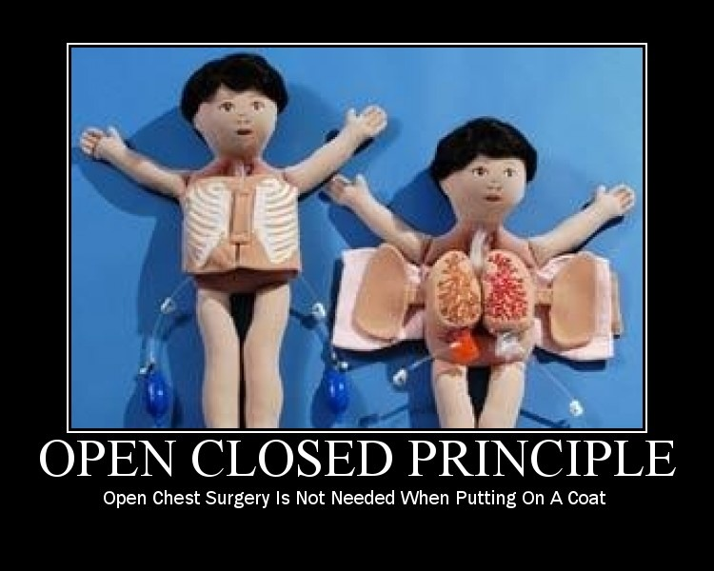

Slide 74
OCP Violation
public class GetUserService
{
public IList<UserSummary> FindUsers(UserSearchType type)
{
IList<User> users;
switch (type)
{
case UserSearchType.AllUsers:
// load the “users” variable here
break;
case UserSearchType.AllActiveUsers:
// load the “users” variable here
break;
case UserSearchType.ActiveUsersThatCanEditQuotes:
// load the “users” variable here
break;
}
return ConvertToUserSummaries(users);
}
}
Notes:
- We are trying to do 2 things here – find subsets of users, and return user summaries

Slide 75
OCP Fix – Strategy Pattern
public interface IUserQuery
{
IList<User> FilterUsers(IList<User> allUsers);
}
public class GetUserService
{
public IList<UserSummary> FindUsers(IUserQuery query)
{
IList<User> users = query.FilterUsers(GetAllUsers());
return ConvertToUserSummaries(users);
}
}
Notes:
Now the IUserQuery is responsible for filtering the users, and the FindUsers() method is only responsible for return user summaries for a list of users
We can reuse the IUserQuery in other places, and now we don’t have to modify GetUserService.FindUsers() in order to create a new type of query.

Slide 76
Why OCP matters
Anytime you change code, you have the potential to break it
Sometimes you can’t change libraries (e.g. code that isn’t yours)
May have to change code in many different places to add support for a certain type of situation
Notes:
- Comments that say “if you want to add another X, you have to add code in these 5 places”

Slide 77
When violating OCP is OK
When the number of options in the if or switch statement is unlikely to change (e.g. switch on enum)
public void UpdateFontStyle (Paragraph paragraph)
{
switch (IsBoldCheckBox.CheckState)
{
case CheckState.Checked:
paragraph.IsBold = true;
break;
case CheckState.Unchecked:
paragraph.IsBold = false;
break;
case CheckState.Indeterminate:
break;
}
}

Slide 78
OCP Rules of Thumb
Use if/switch if the number of cases is unlikely to change
Use strategy pattern when the number of cases are likely to change
Always use common sense!

Slide 79
Don’t overcomplicate!
Don’t code for situations that you won’t ever need
Don’t create unneeded complexity
However, more class files != more complicated
Remember, this is supposed to make your lives easier!
You can always refactor later (if you write tests)

Slide 80
?

Slide 81
Liskov Substitution Principle
Functions that use references to base classes must be able to use objects of derived classes without knowing it.

Slide 82
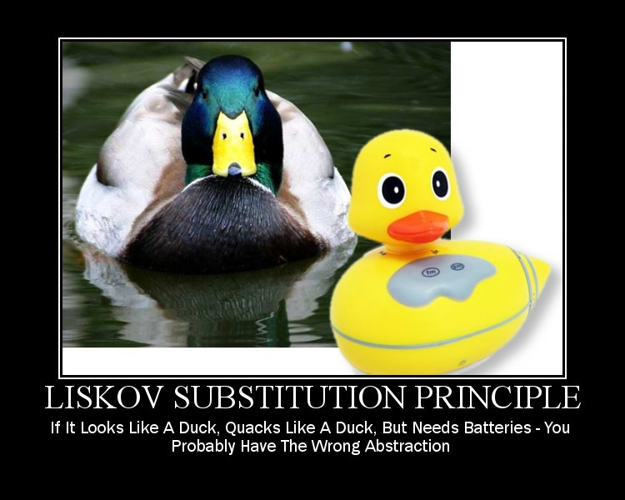

Slide 83
LSP Violation – Bad Abstraction
public class Product
{
public string Name { get; set; }
public string Author { get; set; }
}
public class Book : Product {}
public class Movie : Product {}
If someone had a Product object (which was actually a Movie) and asked for the Author, what should it do (a Movie doesn’t have an Author)?

Slide 84
LSP in other words…
People using derived classes should not encounter unexpected results when using your derived class.

Slide 85
LSP Violation – Unexpected Results
public class MyList<T> : IList<T>
{
private readonly List<T> _innerList = new List<T>();
public void Add(T item)
{
if (_innerList.Contains(item))
return;
_innerList.Add(item);
}
public int Count
{
get { return _innerList.Count; }
}
}

Slide 86
If you violate LSP…
Throw exceptions for cases that you can’t support (still not recommended)
public class Rectangle : Shape
{
public double Width { get; set; }
public double Height { get; set; }
public override double Area
{
get { return Width * Height; }
}
}
public class Cube : Shape
{
public override double Area
{
get { throw new NotSupportedException(); }
}
}
Notes:
- Probably need a 2DShape and 3DShape base class

Slide 87
?

Slide 88
Interface Segregation Principle
Clients should not be forced to depend on interfaces that they do not use.

Slide 89
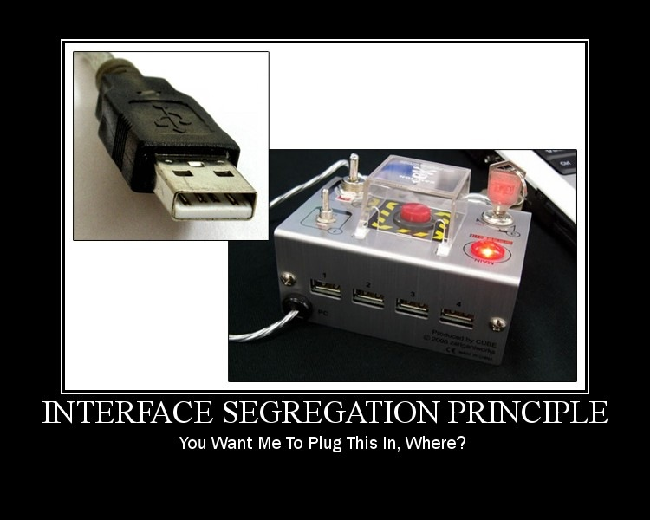
Notes:
- Example – going to a friend’s house and they have the complicated home theater system and you want to watch TV

Slide 90
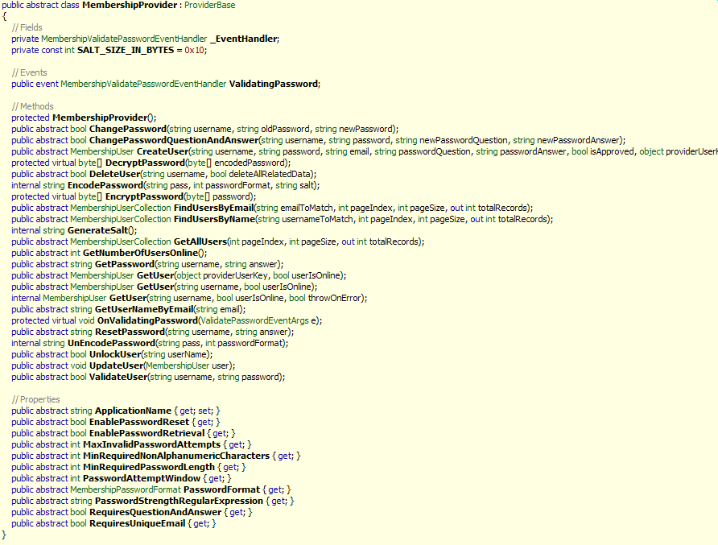
ASP.NET MembershipProvider class – a very “fat” interface!

Slide 91
ISP Smells
If you implement an interface or derive from a base class and you have to throw an exception in a method because you don’t support it, the interface is probably too big.

Slide 92
Why ISP matters
Single Responsibility Principle for interfaces/base classes
If your interface has members that are not used by some inheritors, those inheritors may be affected by changes in the interface, even though the methods that they use did not change.

Slide 93
When violating ISP is OK
Why would you want to?
Use common sense

Slide 94
?

Slide 95
Dependency Inversion Principle
High level modules should not depend on low level modules. Both should depend on abstractions.
Abstractions should not depend on details. Details should depend on abstractions.

Slide 96
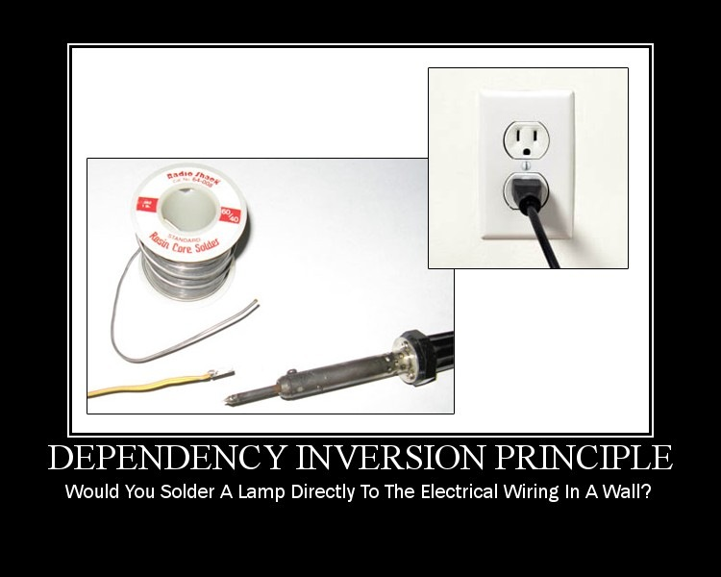

Slide 97
Tight Coupling
Two classes are tightly coupled if they are linked together and are dependent on each other
Tightly coupled classes can not work independent of each other
Makes changing one class difficult because it could launch a wave of changes through tightly coupled classes

Slide 98
Tips for not violating DIP - Layers
UI
Business Logic (Domain Model)
Data Access
Database

Slide 99
Tips for not violating DIP - Layers
UI
Interfaces
Business Logic (Domain Model)
Interfaces
Data Access
Database

Slide 100
Tips for not violating DIP - Layers
Each layer should not know anything about the details of how the other layers work.
Example: your domain model should not know how data access is done – it shouldn’t know if you’re using stored procedures, an ORM, etc.

Slide 101
Layers – What’s the big deal?
Tight coupling is bad – if your business layer contains code related to data access, changes to how data access is done will affect business logic
Harder to test because you have to deal with implementation details of something you’re not trying to test

Slide 102
DIP Enables Testability
Stubs, mocks, and fakes in unit tests are only possible when we have an interface to implement
Notes:
- example: I want to test my validation code. I just want to test the validation logic, so why should I have to actually save something to the database to do this?

Slide 103
Unit Tests vs. Integration Tests
Unit tests:
Tests a small unit of functionality
Mock or “fake out” external dependencies (e.g. databases)
Run fast
Integration tests:
Test the whole system working together
Can run slow
Can be brittle

Slide 104
DIP Violations
Use of “new”
public class GetProductService
{
public IList<Product> GetProductById(int id)
{
var productRepository = new ProductRepository();
return productRepository.Get(id);
}
}

Slide 105
DIP Violations
Use of “static”
public class SecurityService
{
public static User CurrentUser { get; set; }
}

Slide 106
DIP Violations
Use of singletons using “static”
public class ProductCache
{
private static readonly _instance = new ProductCache();
public static ProductCache Instance
{
get { return _instance; }
}
}

Slide 107
Enabling DIP – create interfaces
public class ProductRepository : IProductRepository
{
public Product Get(int id) { ... }
}
public interface IProductRepository
{
Product Get(int id);
}

Slide 108
Enabling DIP – Constructor Injection
public class GetProductService : IGetProductService
{
private IProductRepository _productRepository;
public GetProductService(
IProductRepository productRepository)
{
_productRepository = productRepository;
}
public IList<Product> GetProductById(int id)
{
return _productRepository.Get(id);
}
}

Slide 109
What is a DI (IoC) Container?
Creates objects that are ready for you to use
Knows how to create objects and their dependencies
Knows how to initialize objects when they are created (if necessary)

Slide 110
DI Containers
Popular .NET choices:
StructureMap, Ninject
Other .NET choices:
Unity, Castle Windsor, Autofac, Spring .NET
Java
Spring
Ruby
We don’t need no stinkin’ DI containers!
Notes:
Java: Spring
Ruby: we don’t need no stinkin’ DI containers!

Slide 111
Enabling DIP – Constructor Injection
public class GetProductService : IGetProductService
{
private IProductRepository _productRepository;
public GetProductService(
IProductRepository productRepository)
{
_productRepository = productRepository;
}
public IList<Product> GetProductById(int id)
{
return _productRepository.Get(id);
}
}

Slide 112
Setting up StructureMap
ObjectFactory.Initialize(x =>
{
x.ForRequestedType<IGetProductService>()
.TheDefaultIsConcreteType<GetProductService>();
});

Slide 113
StructureMap - Conventions
ObjectFactory.Initialize(x =>
{
x.Scan(scan =>
{
scan.WithDefaultConventions();
scan.AssemblyContainingType<IProductRepository>();
});
});
Automatically map “ISomething” interface to “Something” class

Slide 114
StructureMap - Initialization
ObjectFactory.Initialize(x =>
{
x.ForRequestedType<IProductRepository>()
.TheDefaultIsConcreteType<ProductRepository>()
.OnCreation(repository =>
repository.ConnectionString =
ConfigurationManager.AppSettings["MainDB"]);
});
We just reduced duplication and complexity by setting this up here!

Slide 115
StructureMap - Singletons
ObjectFactory.Initialize(x =>
{
x.ForRequestedType<IProductCache>()
.TheDefaultIsConcreteType<ProductCache>()
.AsSingletons();
});
There will only ever be one IProductCache
We don’t violate DIP by having static variables

Slide 116
StructureMap – Object Lifetimes
ObjectFactory.Initialize(x =>
{
x.ForRequestedType<ICurrentUser>()
.CacheBy(InstanceScope.Hybrid)
.TheDefault.Is.ConstructedBy(
c => new CurrentUser(Thread.CurrentPrincipal));
});
InstanceScope.Hybrid means that we will only have one of these objects per request (web) or thread (in our tests)
Testing will be easier because we won’t reference Thread.CurrentPrincipal

Slide 117
DI Container Rules
Don’t “new” up anything that is a dependency
Don’t new up classes that you want to create a fake for in a test
Do new up entity objects
Do new up value types (e.g. string, DateTime, etc.)
Do new up .NET Framework types (e.g. SqlConnection)
Entity objects should not have dependencies
If you have to have static variables, isolate them behind the DI container (e.g. example in previous slide)
Use ObjectFactory.GetInstance() to create objects when you can’t take them in as constructor parameters
Don’t use the DI container when writing unit tests (usually)

Slide 118
?

Slide 119
Recap
USE YOUR BRAIN!!!!

Slide 120
Resources / Contact Info
Uncle Bob’s SOLID articles
http://bit.ly/solid1
Uncle Bob talking about SOLID on Hanselminutes
http://bit.ly/solid2
ALT.NET mailing list
http://bit.ly/solid4
This list of links (including these slides)
http://jonkruger.com/blog/oopsolid
My Info:
email: jon@jonkruger.com
twitter: @jonkruger / blog: http://jonkruger.com/blog

Slide 121
"Draw Five"
Draw Five is a card game where you draw five cards and get points based on the cards that you draw. You can also view the high scores and save high scores to a database.
When drawing cards - 5 cards are drawn from a standard 52-card deck (keep in mind that the same card cannot be drawn twice) - should show the user what cards they drew
When scoring the draw - face cards = 10 - aces = 15 - numbers = number value
in addition to base score: - each pair +50 - three of a kind +150 - four of a kind +300 - each spade +1
When showing the high scores - should show the top 5 scores (name and score)
When saving a high score - should save the name (entered by the user) and the score
===========================================================================
"Blackjack"
In this simple version of blackjack, you just draw two cards and calculate the score for the two cards (no drawing of extra cards). High scores are not saved in Blackjack.
When drawing cards - 5 cards are drawn from a standard 52-card deck (keep in mind that the same card cannot be drawn twice) - should show the user what cards they drew
When scoring the draw - face cards = 10 - aces = 11 - numbers = number value

Slide 122
change #1
- Draw Five has 2 Jokers in the deck
- jokers = 20 pts each
- two jokers = 200 pt bonus (in addition to the 20 pts for each Joker)
change #2
- in Draw Five:
- a "run" of 3 sequential cards is worth 50 pts
- a "run" of 4 sequential cards is worth 100 pts
- a "run" of 5 sequential cards is worth 150 pts
- the order of cards for "runs" is: A,2,3,4,5,6,7,8,9,10,J,Q,K,A (notice the Ace can be used at either end)
extra credit change
- create an interface that will allow people to write their own scoring system as a plugin

