Slide 1
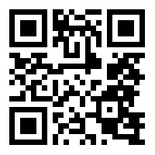
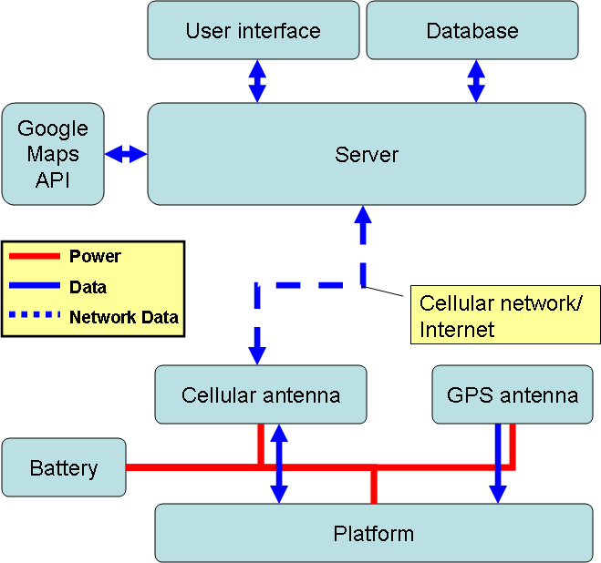
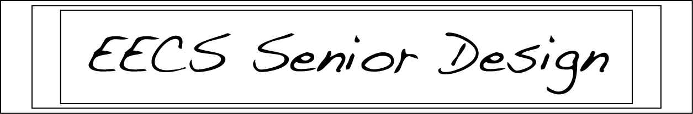

BackTrack: Vehicle Tracking Device
Team 7: Jonathan Lamont (Lead), Cody Mitchell,
David Combs, Michael Honey, Garland Shull
Customer: Asanga Bandara
http://goo.gl/forms/qQSSNTCOrl
Introduction
Our customer, Asanga, approached us to create a low cost vehicle tracking device which provided real time feedback in regard to position, speed, and route. Our product was also required to keep a month-long record of the locations where the device has been.
In addition to these primary goals, the product was to be portable and concealable, shock and weather resistant, and compatible with all major mobile and home operating systems.
Backtrack is unique from other similar products because it can be used by people with no technological experience, and without the need for professional installation
Results
We created a design for a functional, cost-effective and simplistic vehicle tracking device that anyone would be able to use. Our design fulfills the requirements established with our customer while maintaining emphasis on user security and privacy. The potential end users for this product can be anything from parents with young drivers to small businesses developing a fleet tracking system.
We made a few amendments to our design during the process. For one, we moved from “real-time” being a continuous influx of information to having the GPS transmit location data every 3 seconds. This helps maintain the longevity of the battery while providing accurate measurements to our customer. We also decided to store the data remotely in a database,
rather than locally
on the device. This
was an attempt to
keep the travel
information of our
users secure.
Our team decided
to use a fiberglass
casing as a cost-
effective way to
make our device
shock-proof. This
will protect the
device, particularly
the lithium ion
battery pad used to
power it which can
be dangerous if
punctured.
Materials and Methods
GPS receiver
Cellular transceiver
Database server
Position/route user interface
Fiberglass casing for shock resistance
Red/Blue LED lights for indicating battery level
Lithium-Ion thin battery (pad)
The tracking device will be a black box to the user. It will determine its position using a GPS receiver and upload position and time data to a server over a cellular network. The data will then be recorded in a database associated with the device’s key. The database will have a 1 to 1 trackers to accounts connection and 1 to many accounts to trackers connection to protect user security and privacy. Users will be able to log in and view their device’s history and latest position.
Conclusions
Although we ran into a few obstacles in our design phase, we ultimately came through with a design that successfully meets our customer’s specifications. While we eventually amended the original design choices, we were able to implement a design that is not only cost-effective, but both digitally and physically secure. Even though we are not able to conduct physical testing of our product, we firmly believe that it would perform optimally in a real-world environment.
Literature Cited
“Fiberglass Information.” Fiberglass Warehouse. n.d. Web. 13 Apr. 2015. <https://www.fiberglasswarehouse.com/MainPage.php?Nav=Fiberglass%20Products&Category=Fiberglass%20Cloth>.
"Google Maps API." Google Developers. Google, n.d. Web. 10 Apr. 2015. <https://developers.google.com/maps/>.
"InnovationNews." Red Light-Emitting Diode Sets New Efficiency Record. N.p., n.d. Web. 13 Apr. 2015. <http://www.siemens.com/innovation/en/news/2010/red-light-emitting-diode-sets-new-efficiency-record.htm>.
“Lithium-Ion Battery Specifications.” Battery Space. Web. 13 Apr. 2015.
<http://www.batteryspace.com/prod-specs/icr18650nh-2200.pdf>.
Acknowledgments
We would like to acknowledge Dr. Birdwell for the direction in the project. We would also like to acknowledge Asanga Bandara for the project idea and feedback on the various stages of the project. Finally, we would like to thank the University of Tennessee and the EECS Department for the facility that allowed our team to meet together and work.

