Slide 1
Quick Guide to loading data and packages
Getting going with R
And R Studio
If you are not already
familiar with R

Slide 2
Install R and R Studio
Open R Studio
It will look a bit like this

Slide 3
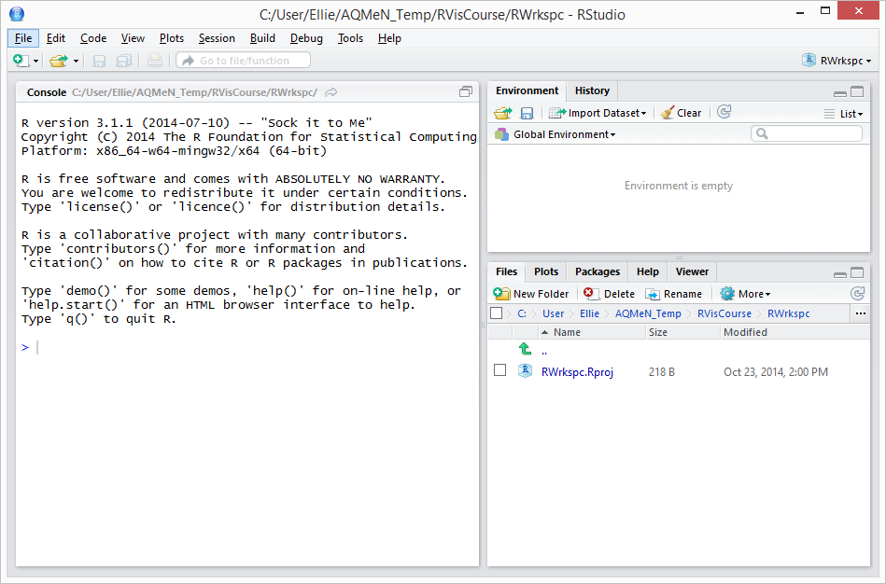

Slide 4
Set the working directory

Slide 5
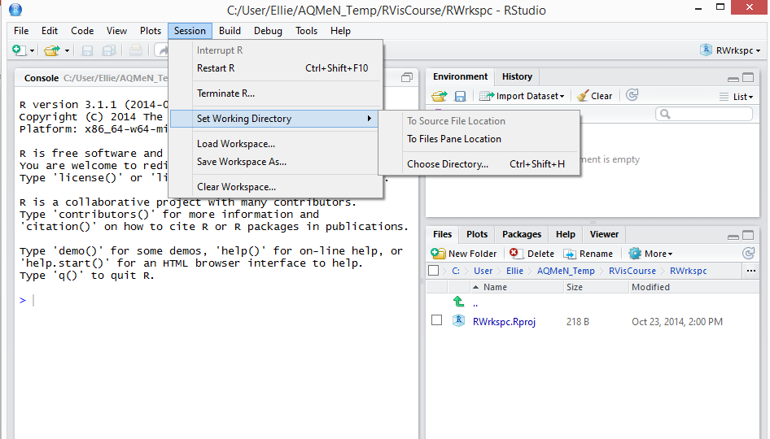

Slide 6
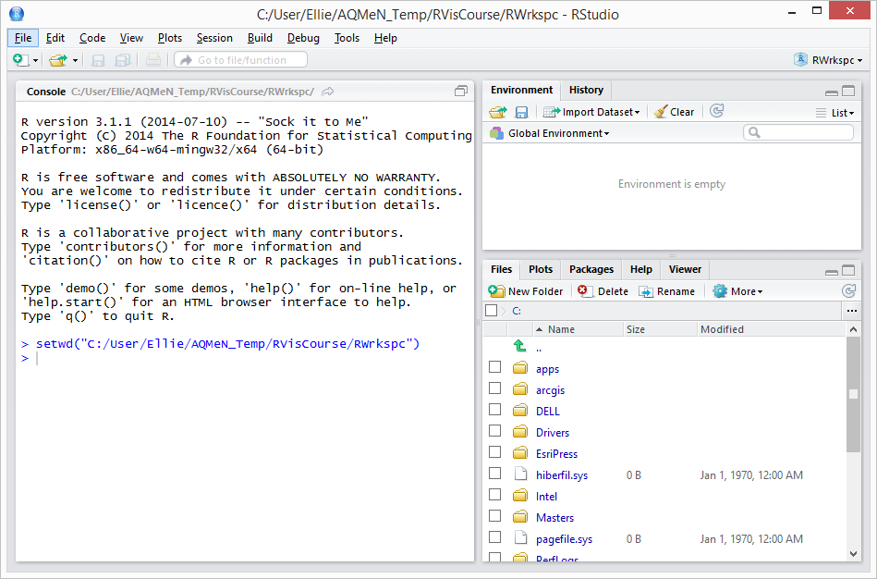

Slide 7
Load some data

Slide 8
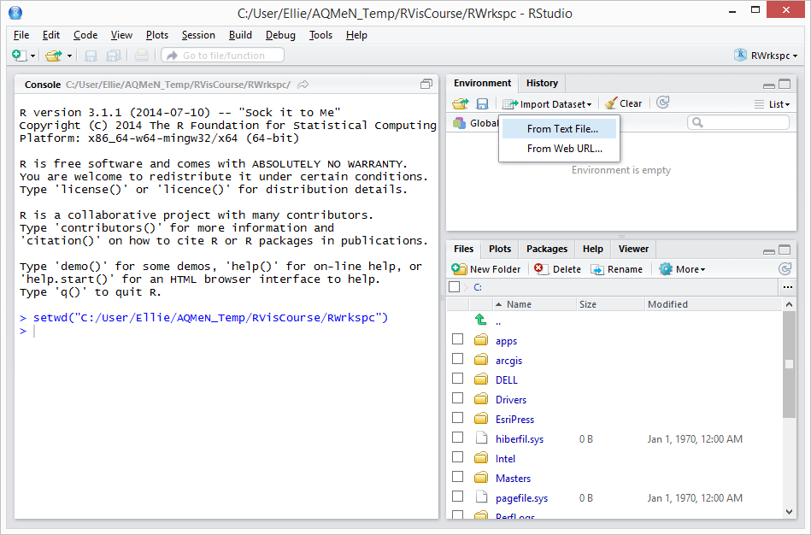

Slide 9
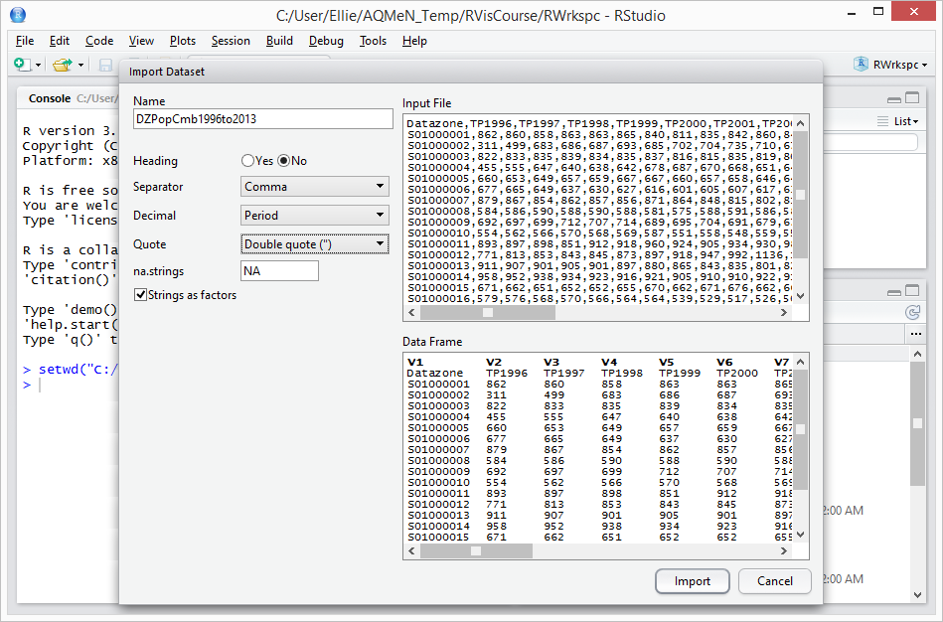
If you want you can change the name of the object you are reading the data into here in the Name box

Slide 10
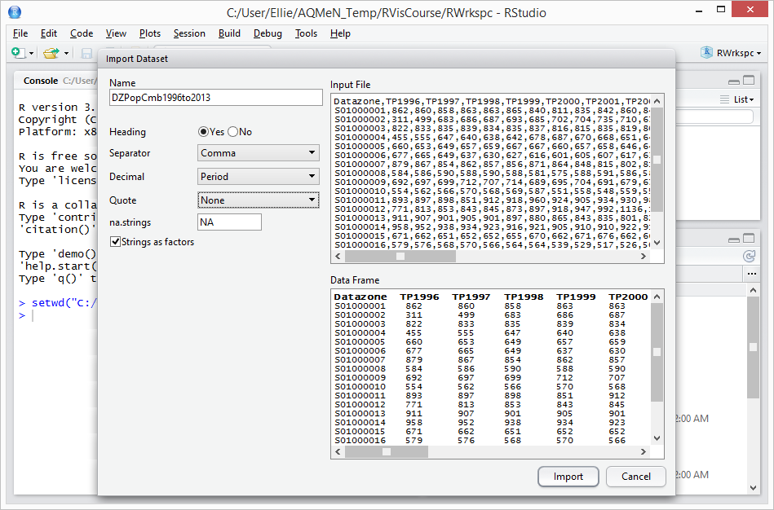

Slide 11
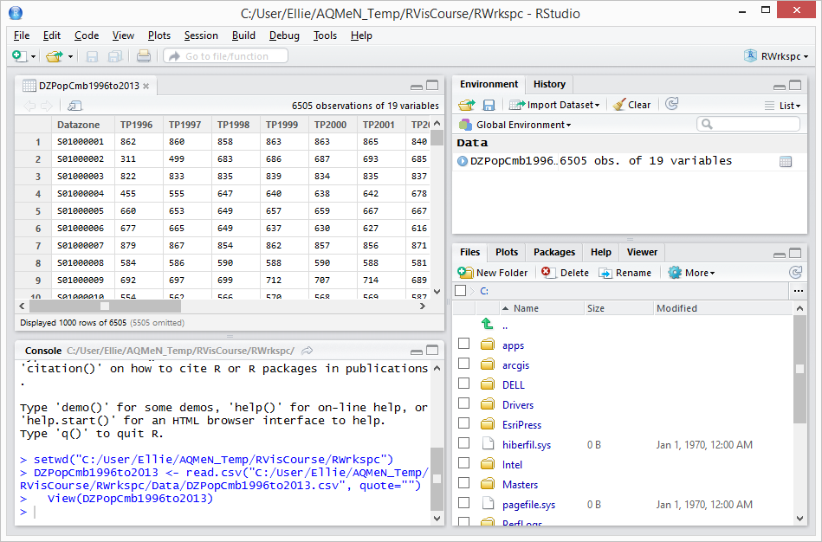

Slide 12
Open a new blank
script file

Slide 13
Click the little green plus button

Slide 14
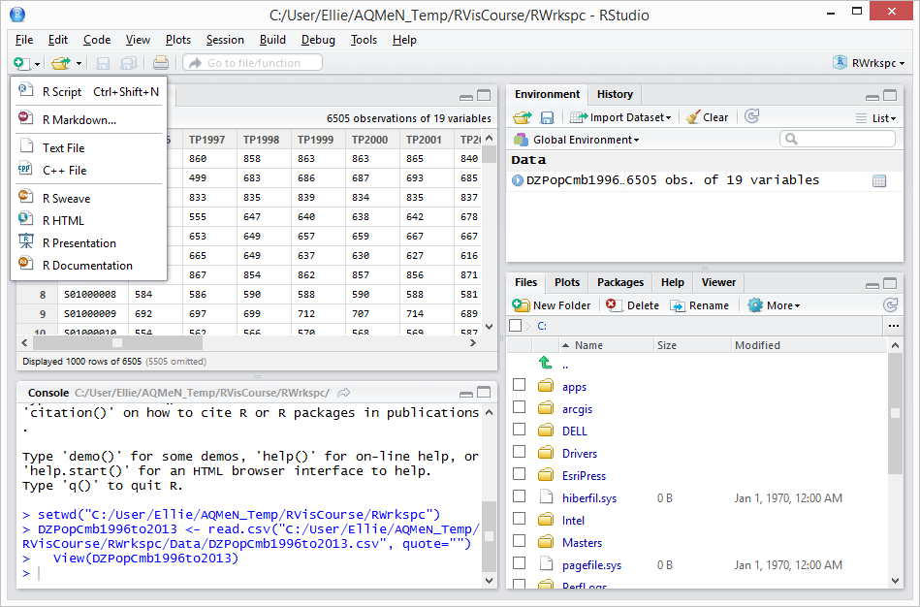

Slide 15
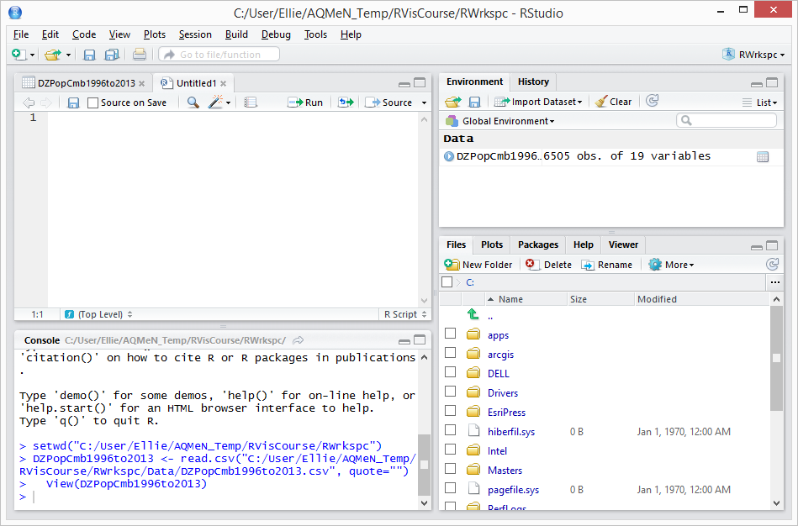

Slide 16
Copying existing code to
Script window to keep for
later

Slide 17
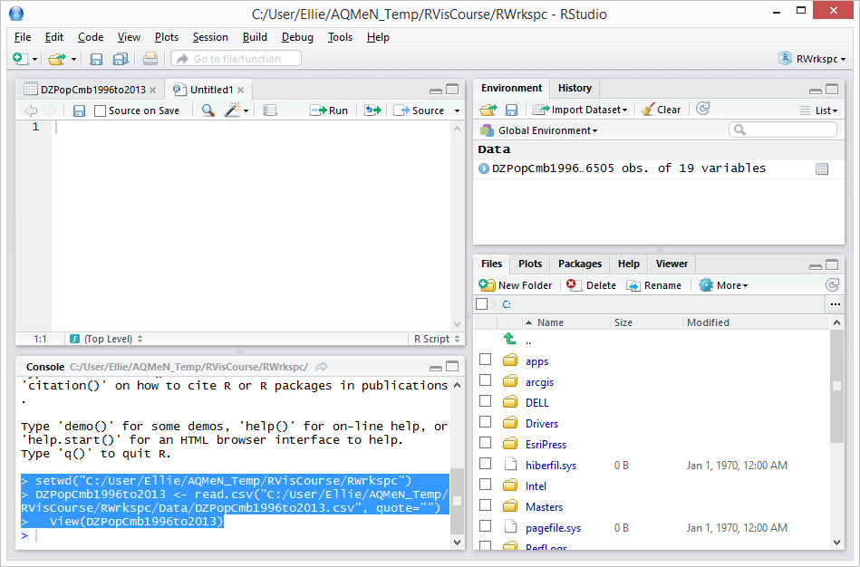

Slide 18
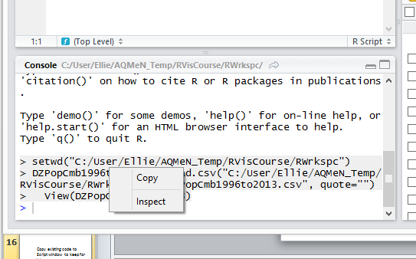

Slide 19
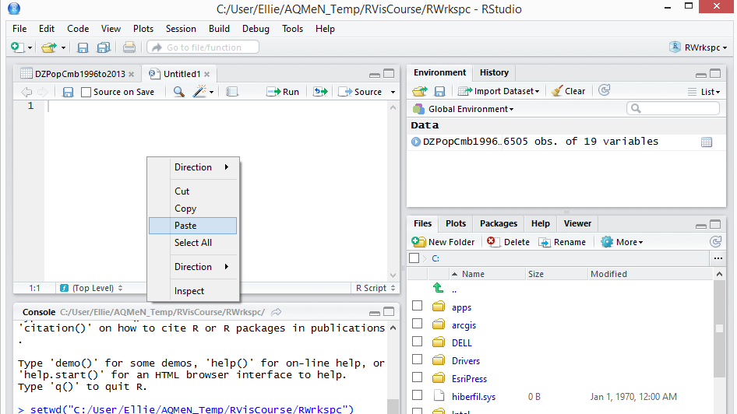

Slide 20
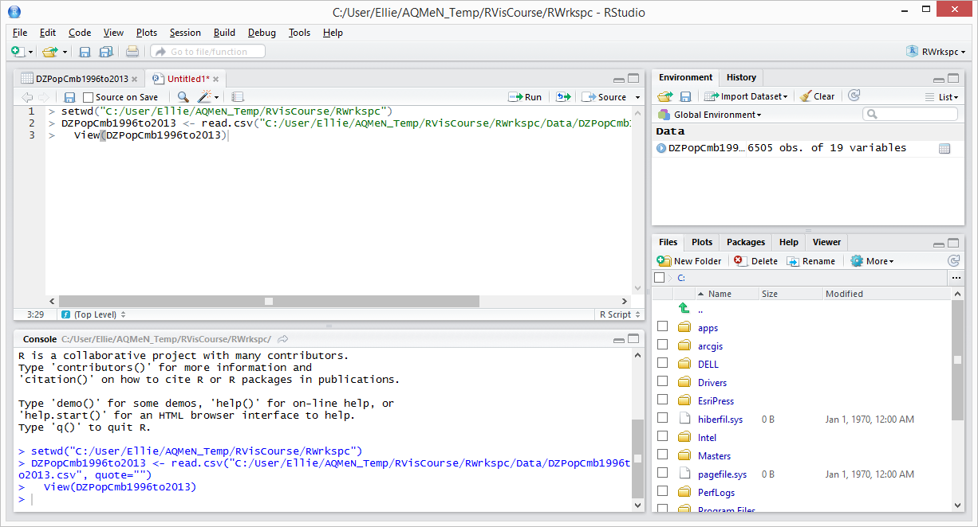
You need to delete the > at the start of the code
before you use it / save it
You can expand windows

Slide 21
Comment code

Slide 22
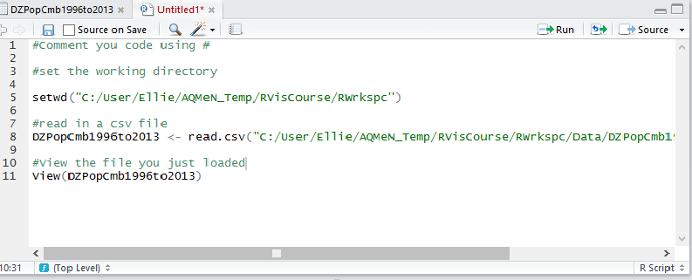
Comment your code with # at the start

Slide 23
Save script for loading your
data

Slide 24
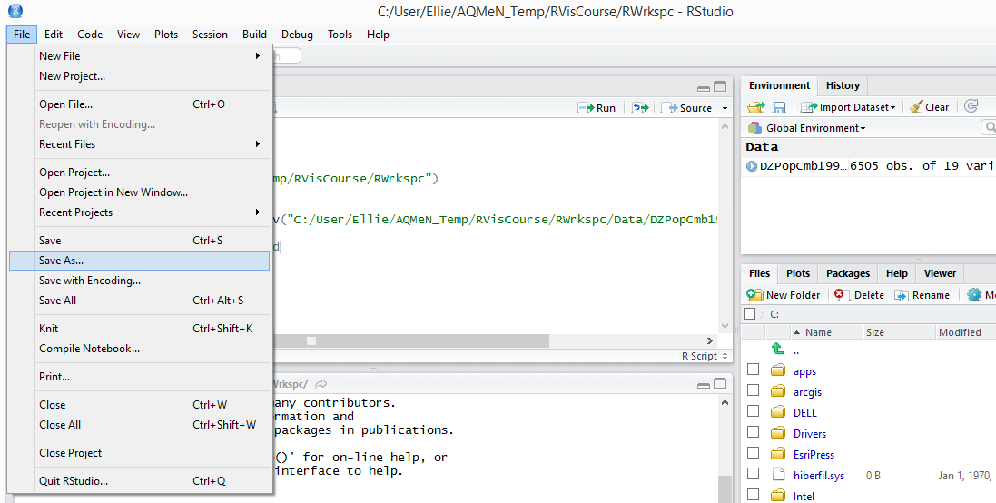

Slide 25
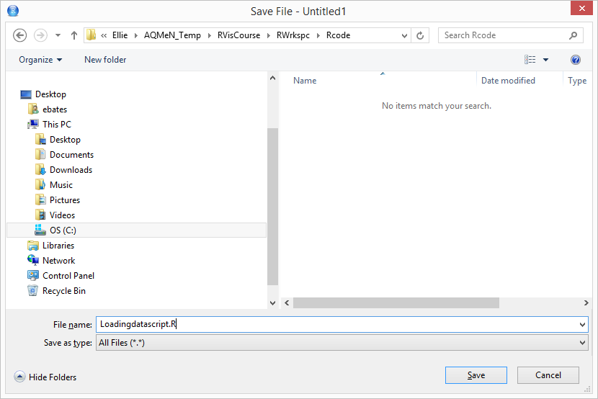
Give you R script the file extension .R

Slide 26
Installing your package

Slide 27
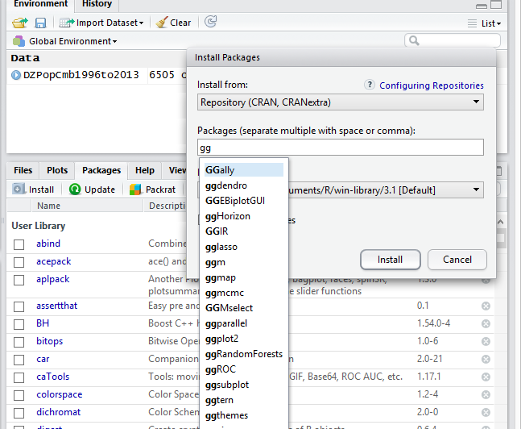
Click on the Packages tab and click the
install button – the Install Packages window appears

Slide 28
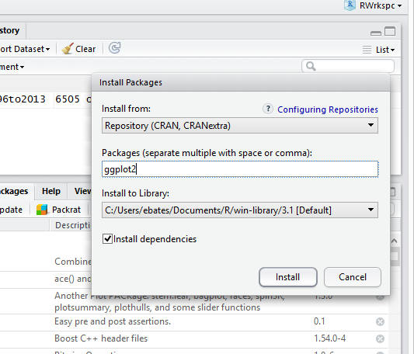
Make sure Install
dependencies is ticked and click install

Slide 29
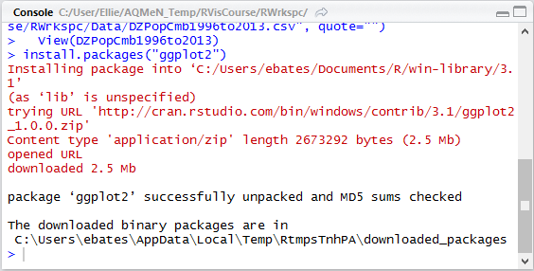
The code to install packages
Messages from R as it is downloading the package
(in red)
Messages saying package is downloaded (in black)

Slide 30
Load your package
You can use
require()
Or
library()
Or R Studio GUI

Slide 31
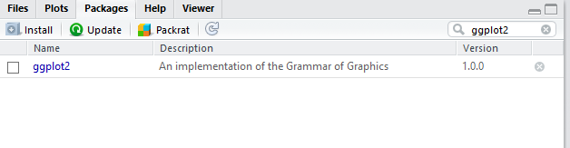
In the packages tab type the name of library you want.
Tick the package

Slide 32
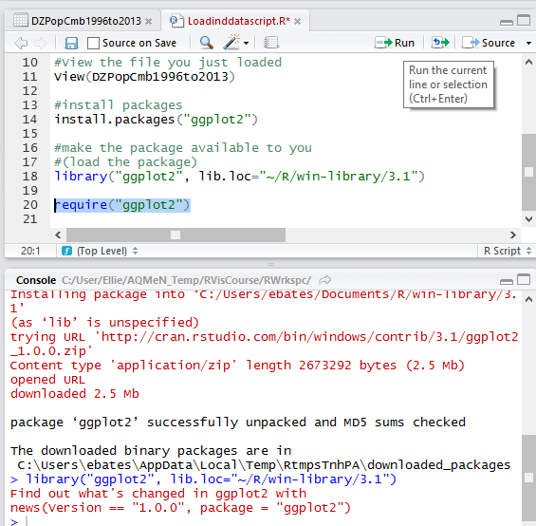

Slide 33
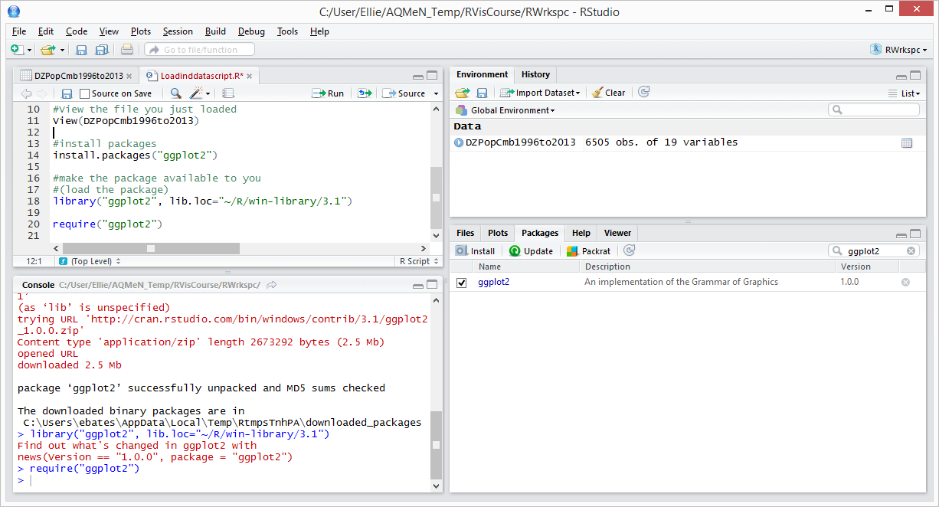

Slide 34
Troubleshooting and finding
out more about packages

Slide 35
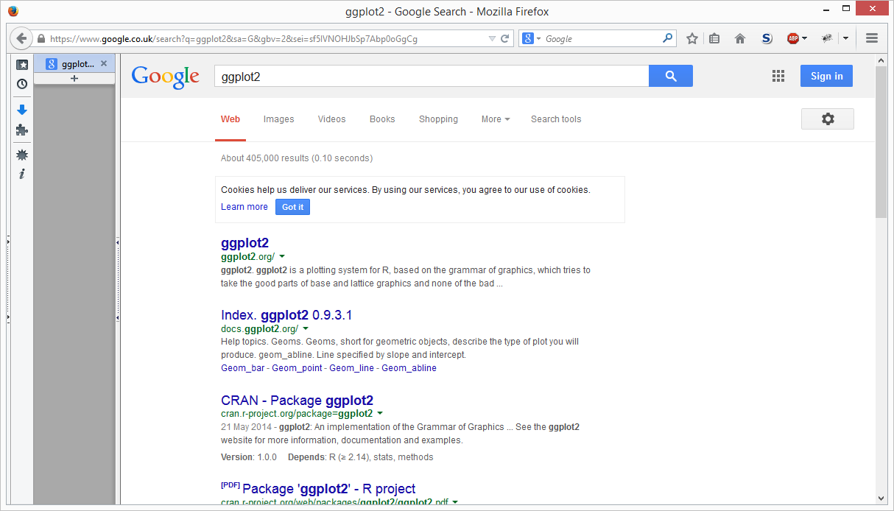

Slide 36
