Slide 1
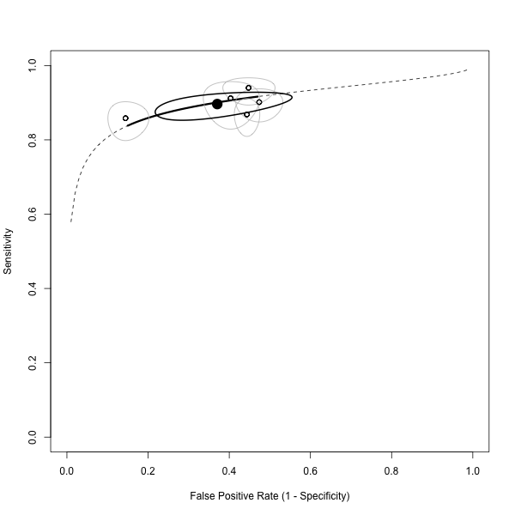

Slide 2
HOLLOW CIRCLE:
Point estimate from
an individual study

Slide 3
LIGHT GREY OVAL
95% confidence region
for an individual study
HOLLOW CIRCLE:
Point estimate from
an individual study

Slide 4
SOLID BLACK CIRCLE:
Point estimate from
the pooled model

Slide 5
BLACK OVAL
95% confidence region
from the pooled model
SOLID BLACK CIRCLE:
Point estimate from
the pooled model

Slide 6
SOLID BLACK LINE:
Interpolated part of
the SROC curve
(more data based)

Slide 7
SOLID BLACK LINE:
Interpolated part of
the SROC curve
(more data based)
DASHED LINE
Extrapolated part of
the SROC curve
(more model based)

