Slide 1
The Demographic Visualisation of Conviction Rates: What can we learn from shaded contour maps? Dr Jon Minton, University of Glasgow

Slide 2
Acknowledgements
Susan McVie for the opportunity
Ben Matthews & The Scottish Government for the data

Slide 3
Structure
Shaded contour maps and Lexis surfaces
The data
The visualisations
The visualisations
The visualisations

Slide 4
Shaded contour maps
Something I (accidentally) re-invented
Minton, Vanderbloemen, Dorling (2013), Visualising Europe’s demographic scars with coplots and contour plots, International Journal of Epidemiology. 42 (4):1164-1176
Vaupel, Gambill, Yashin (1987), Thousands of Data at a Glance: Shaded Contour Maps of Demographic Surfaces. IIASA Research Reports
A high information density method of visualisng data arranged into Lexis surfaces

Slide 5
Lexis Surfaces
‘Time is space’
Relative time: age
Absolute time: year
Age | Year | Value
0 | 2000 | A
1 | 2000 | B
0 | 2001 | C
1 | 2001 | D
 | 2000 | 2001
0 | A | C
1 | B | D

Slide 6
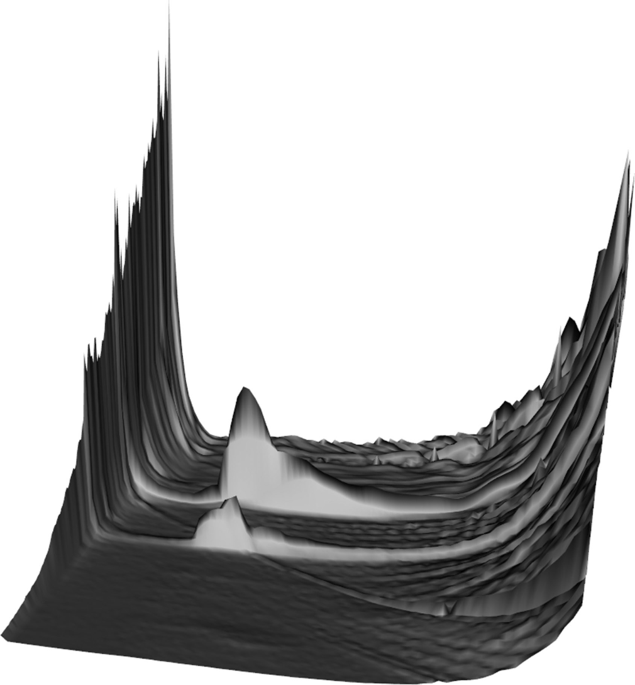
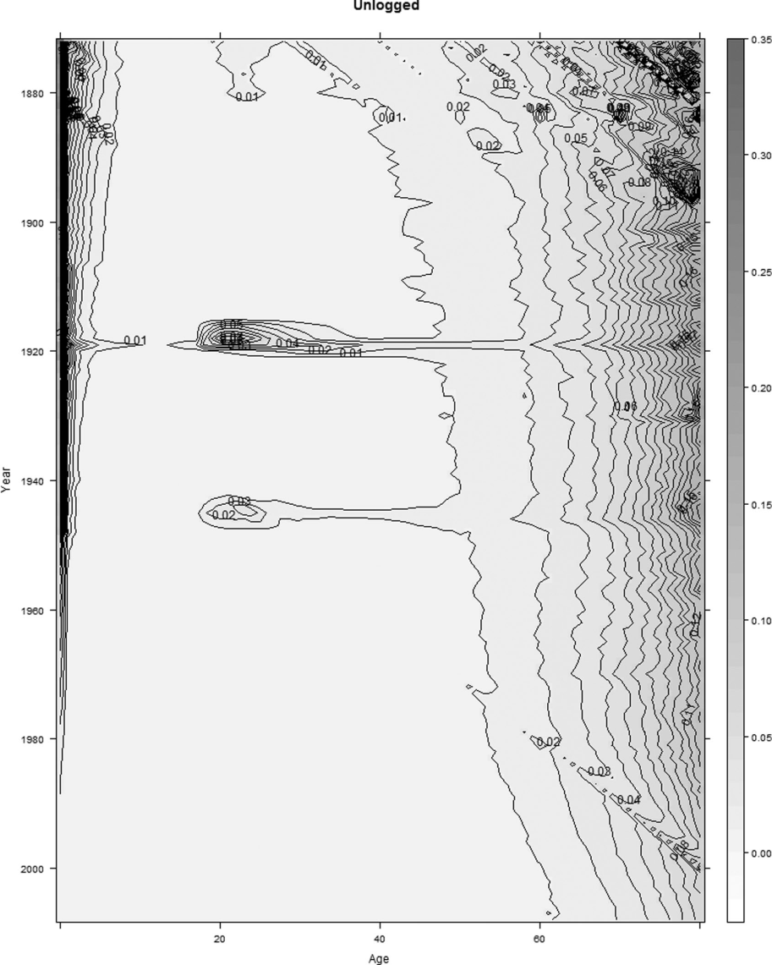
Contour maps Heights on landscapes

Slide 7
Types of effects that can be identified
Group Effects:
How does group A compare with group B?
Age Effects:
What is explained by knowing age only?
Period Effects:
What is explained by knowing the year in which observations took place?
Cohort Effects:
Is anything explained by the cohort membership?
Shaded contour maps can help distinguish between each of these effects… if we know how to read them.

Slide 8
Our data
Conviction rates
By gender
Age (16 to 60 presented)
Year
Scotland
From 1989 to 2012

Slide 9
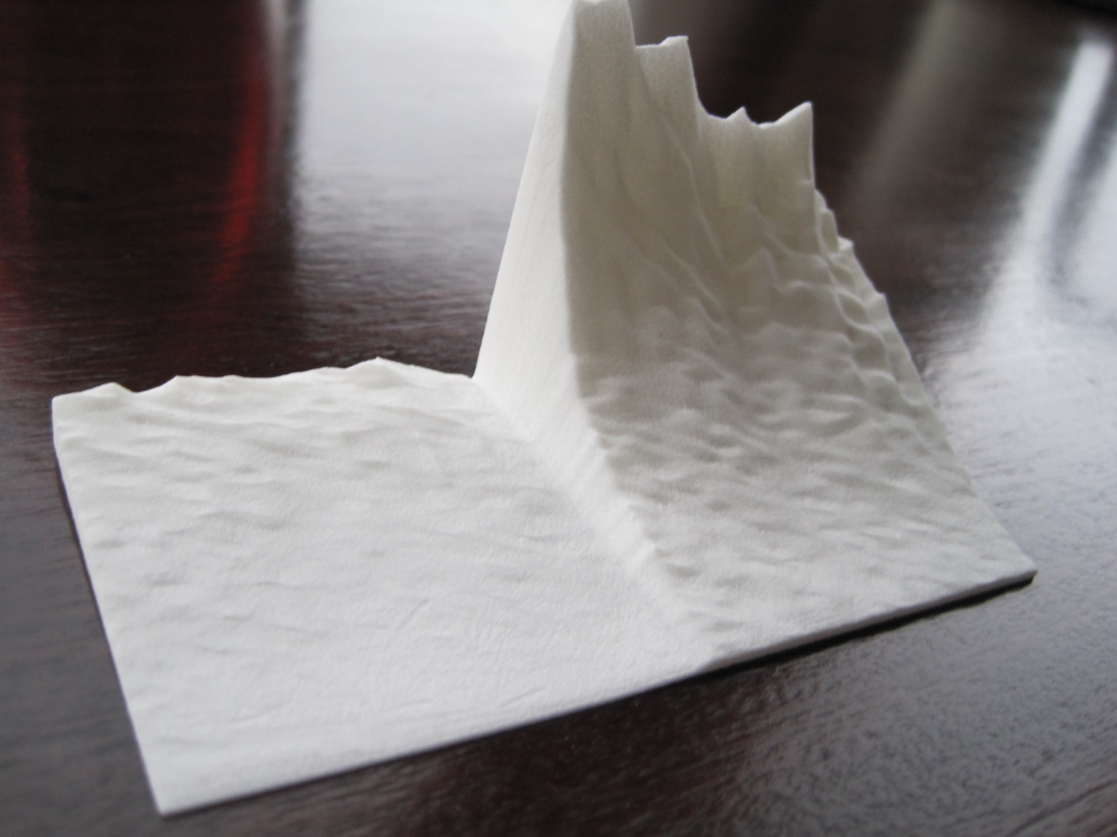
As a data sculpture

Slide 10
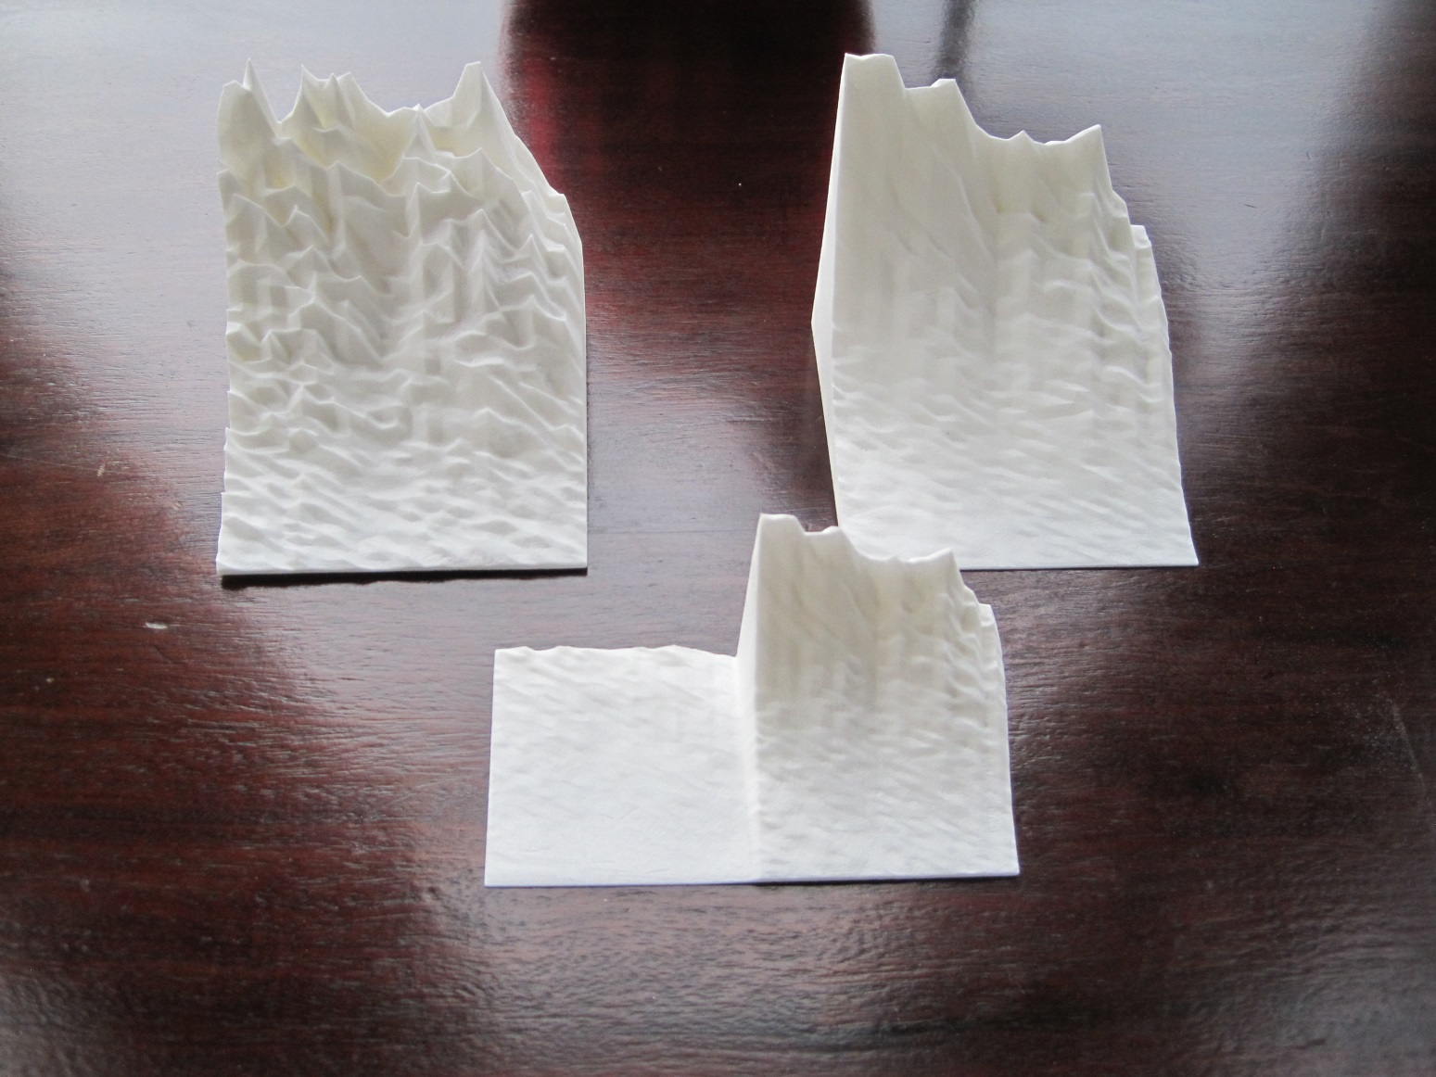
As a data sculpture

Slide 11
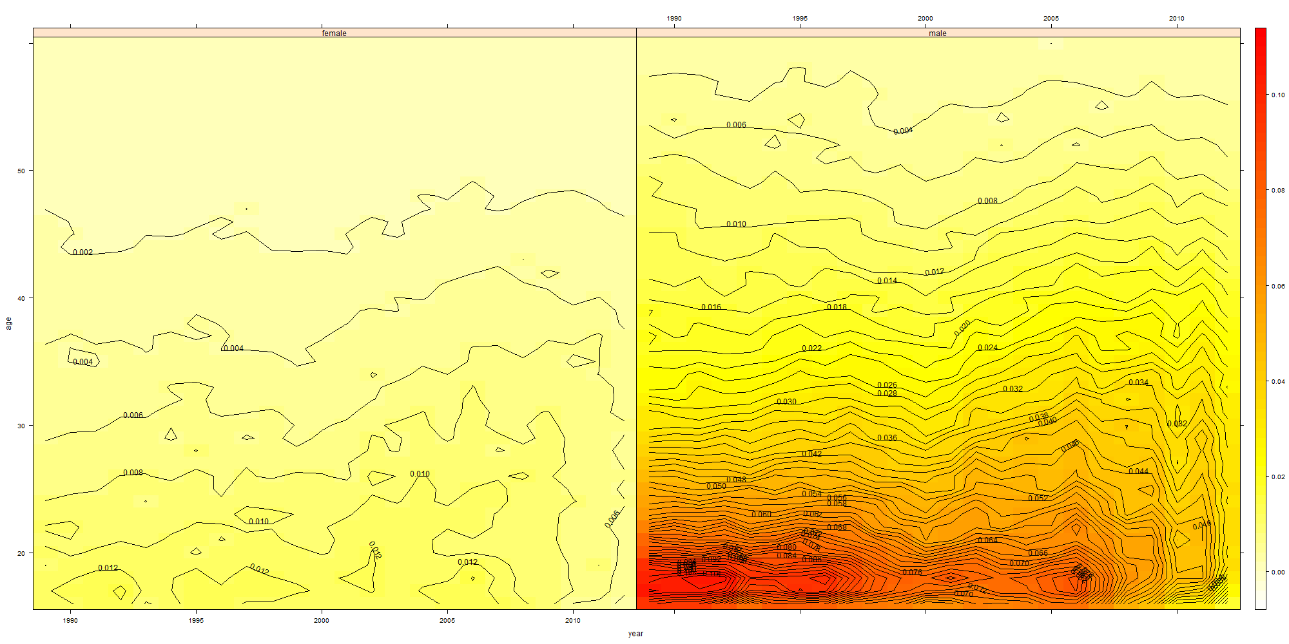
Lexis Surface

Slide 13


Slide 14
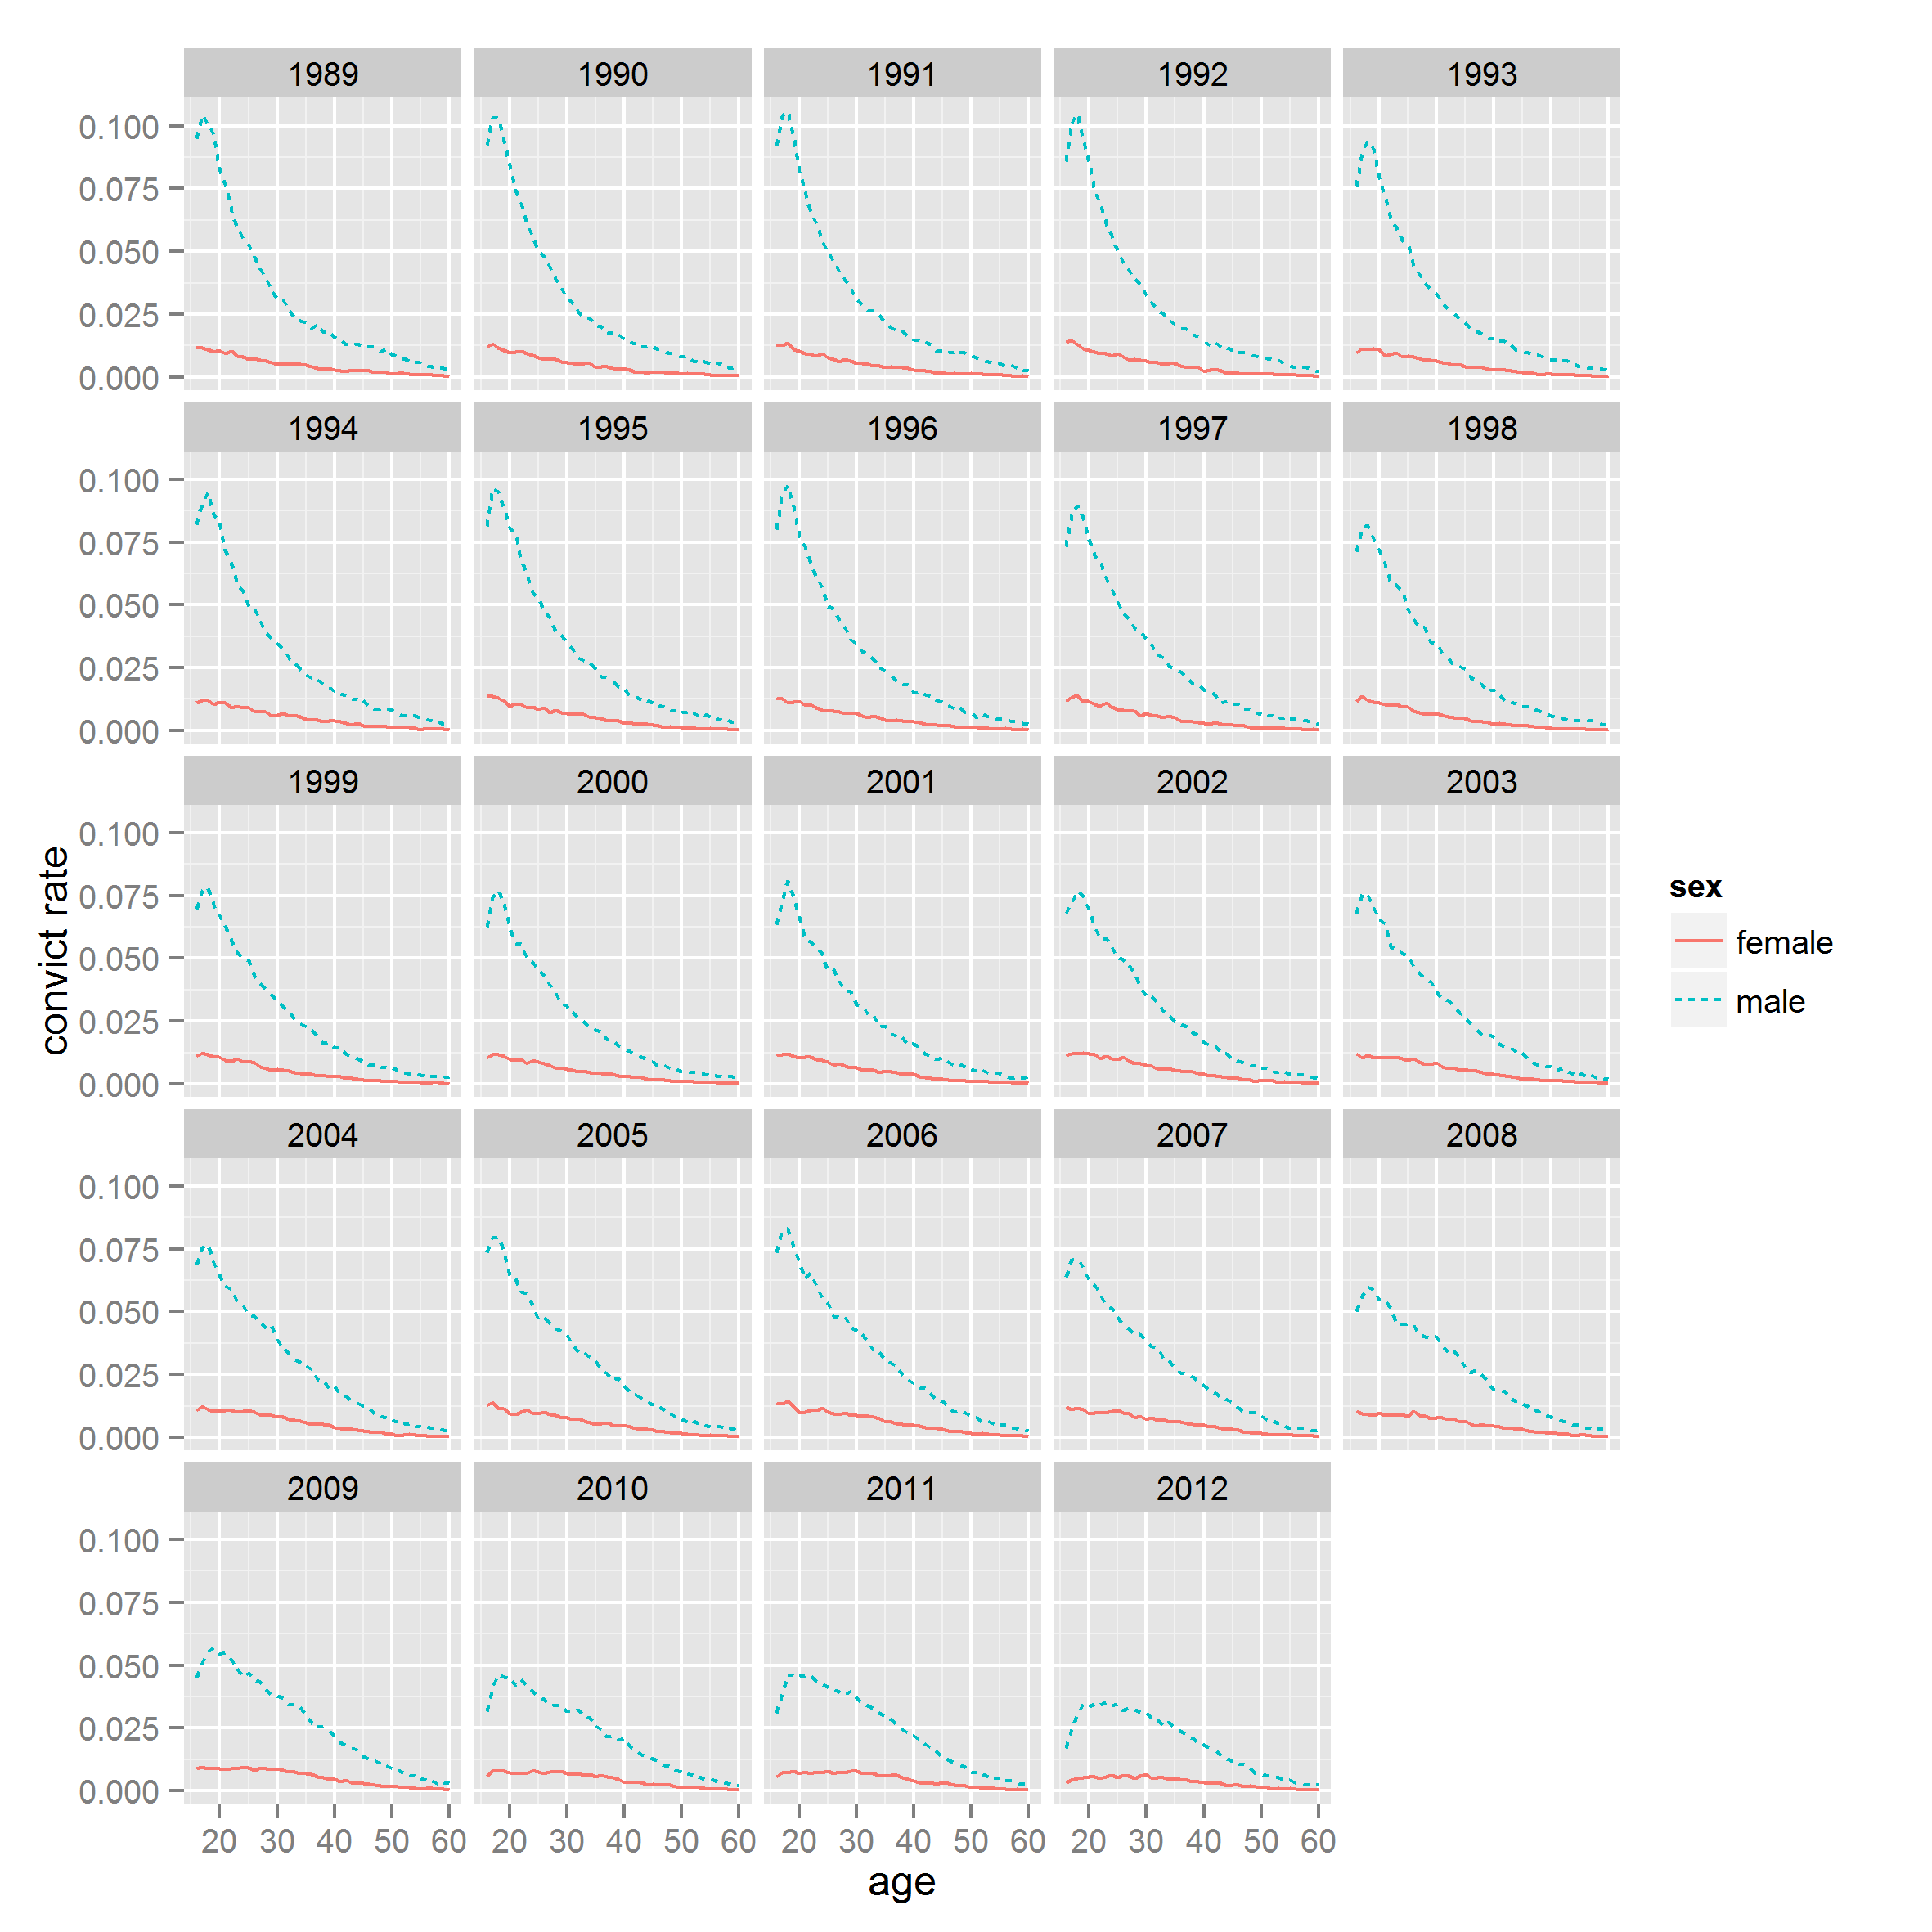

Slide 15
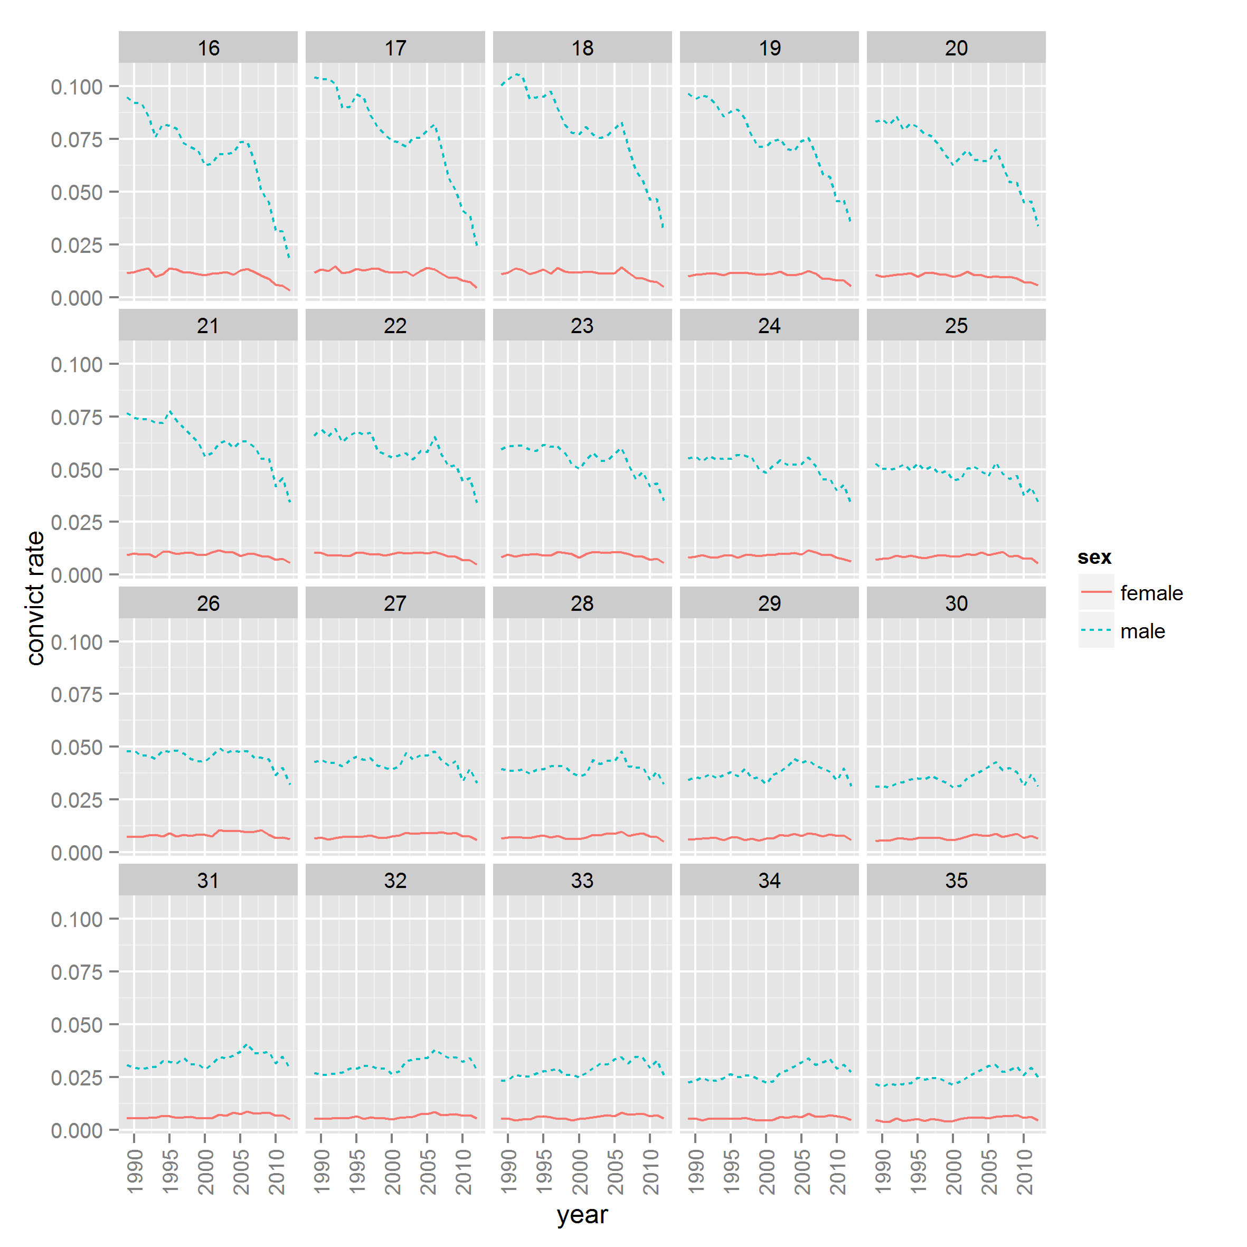

Slide 16
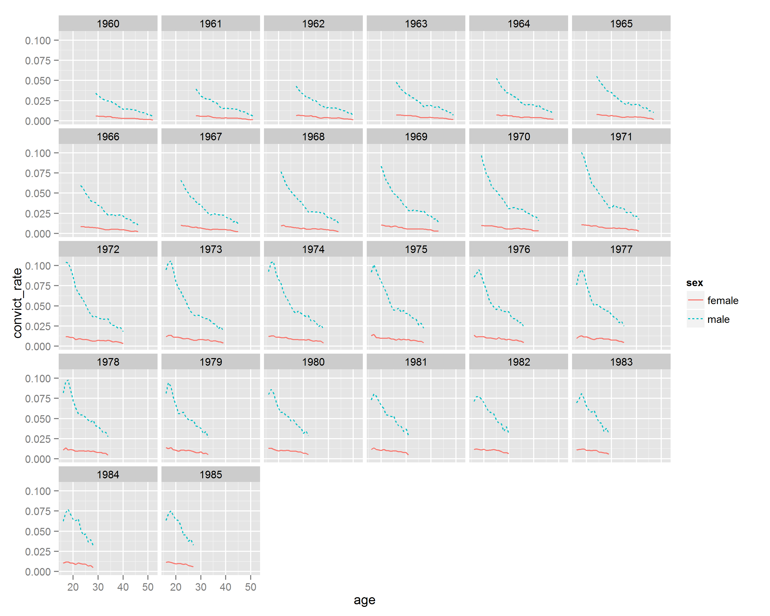

Slide 17
Conclusions
A hierarchy of factors
Most important: Gender
Peak female conviction rate equivalent to male rate in middle age
Then Age effects
Then Period effects
Least Important (but still significant): Cohort effects

Slide 18
More about our research
aqmen.ac.uk@AQMeNNetwork
Any further questions?
Jonathan.Minton@glasgow.ac.uk

