Slide 1
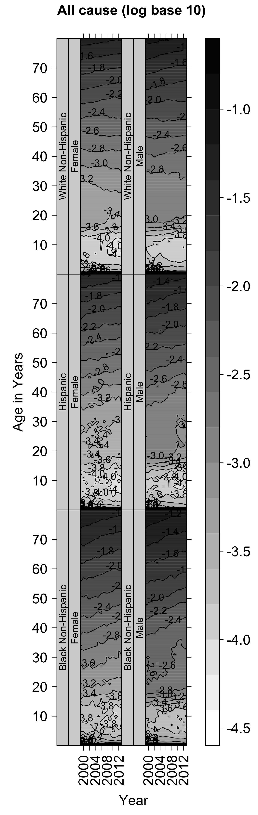
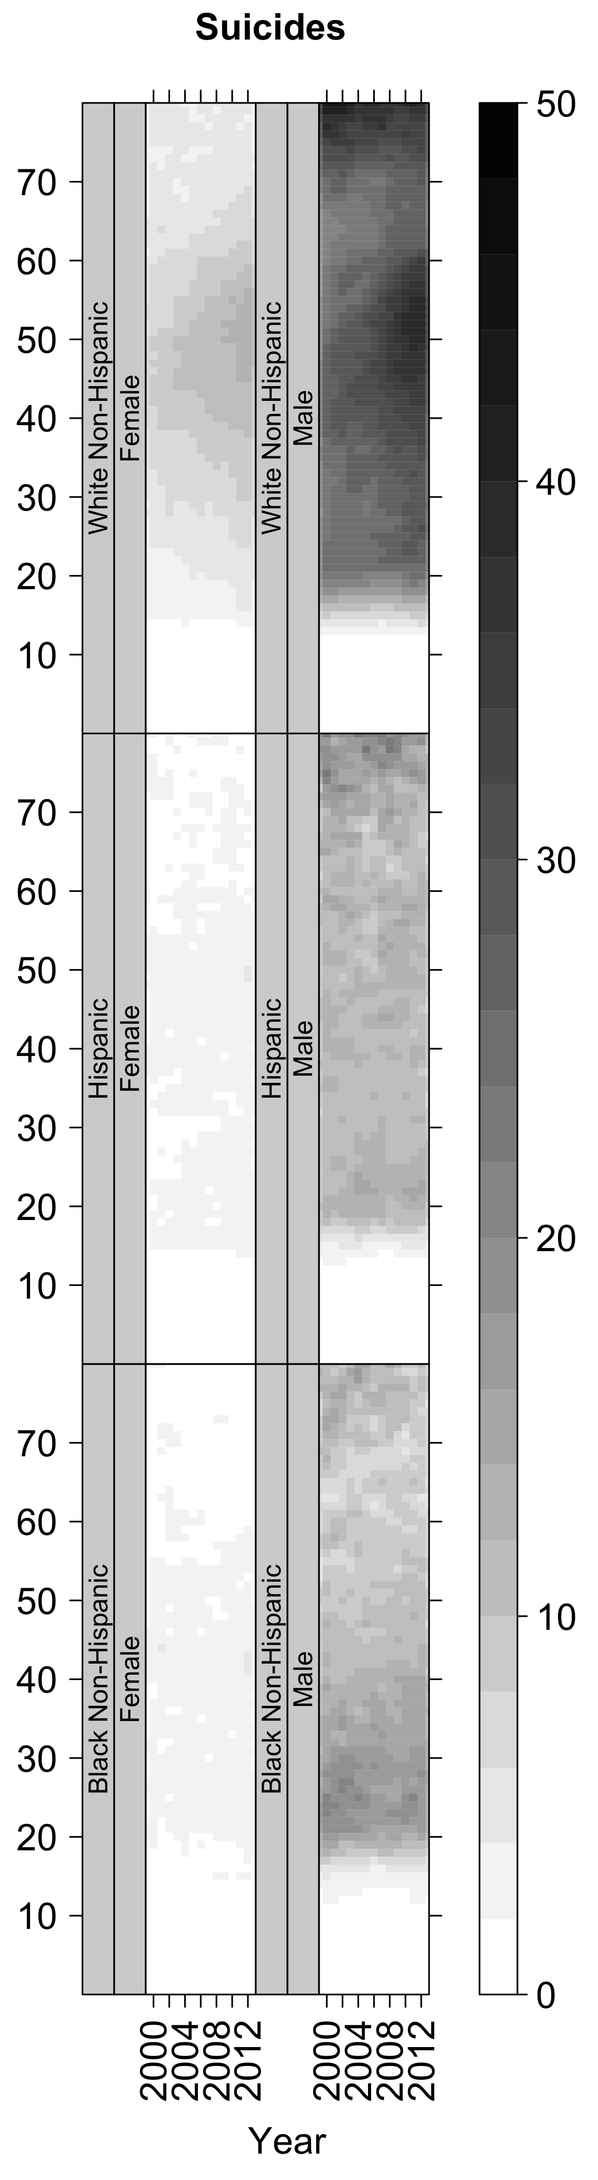
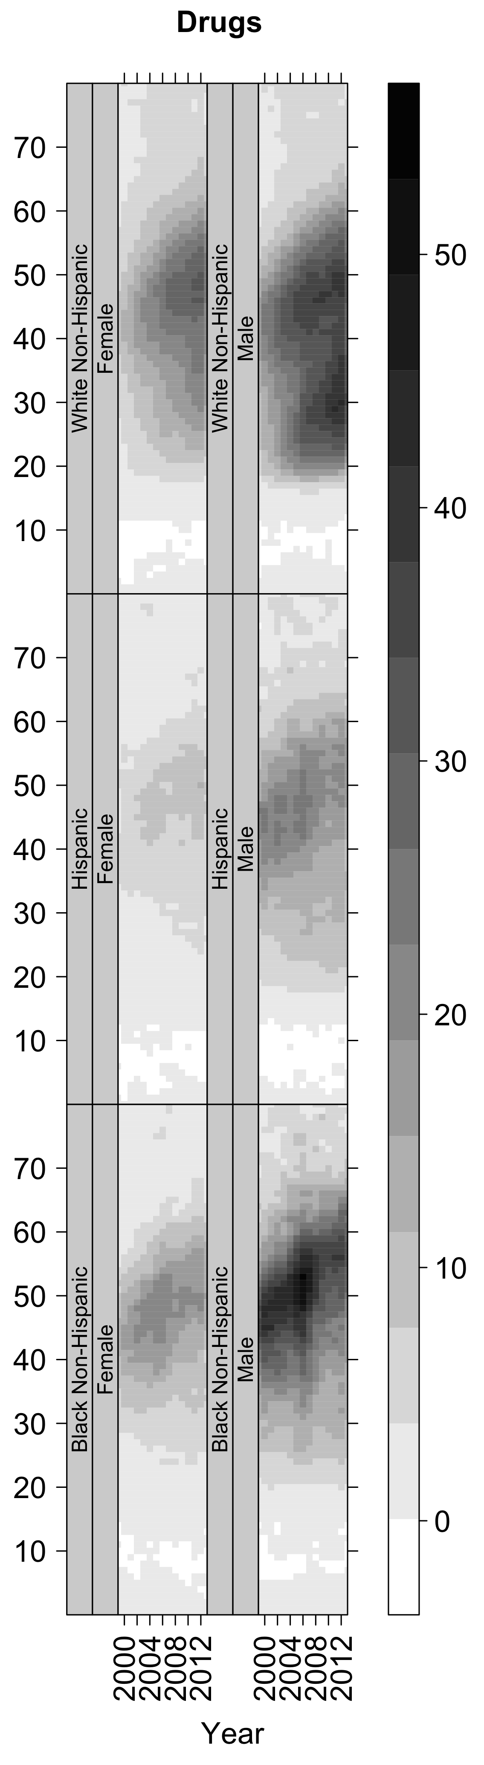
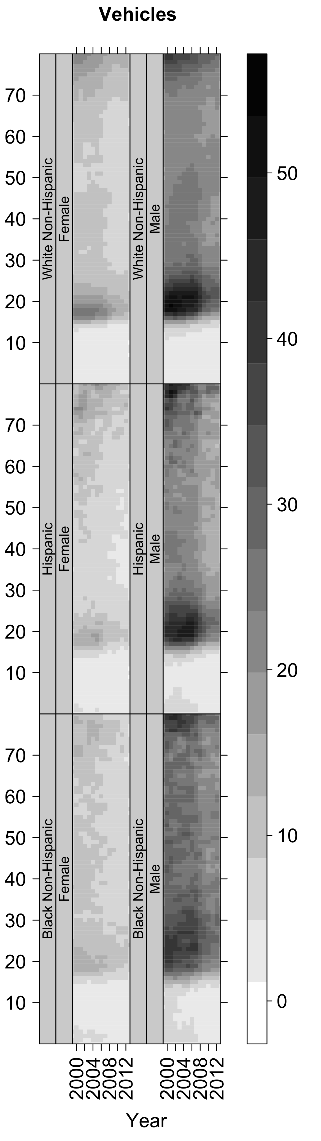
(a)
(b)
(c)
(d)

Slide 2
White Non-Hispanic Female
White Non-Hispanic Male
Hispanic Male
Hispanic Female
Black Non-Hispanic Female
Black Non-Hispanic Male

