Slide 1


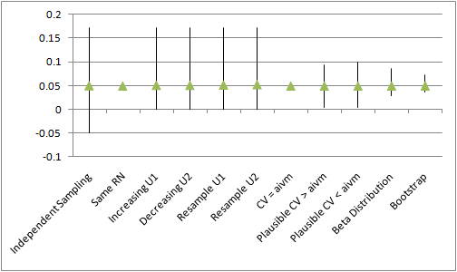
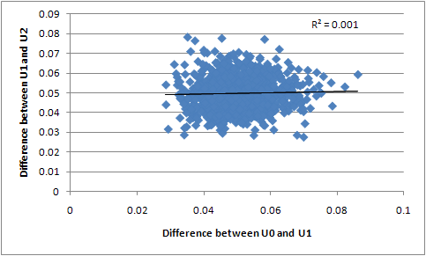
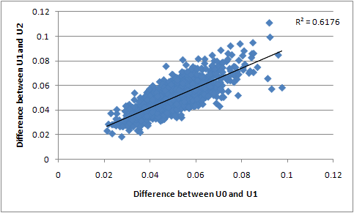
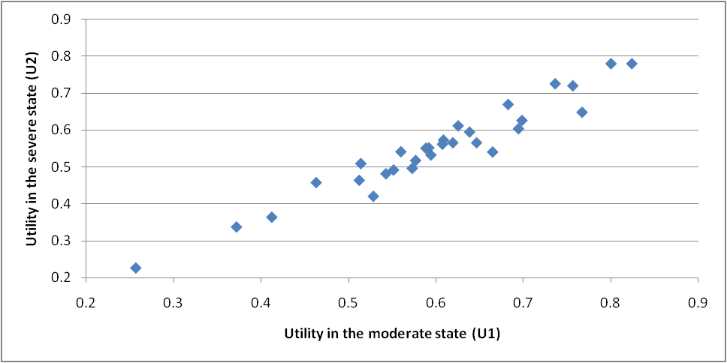
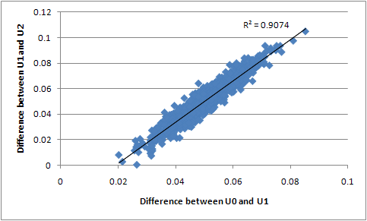
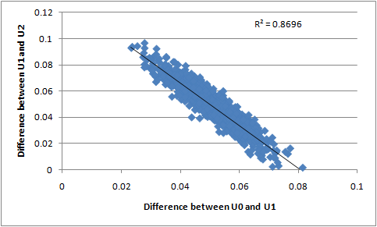
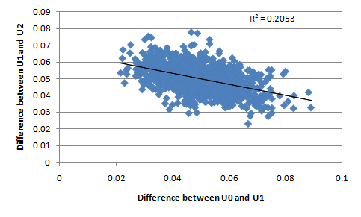
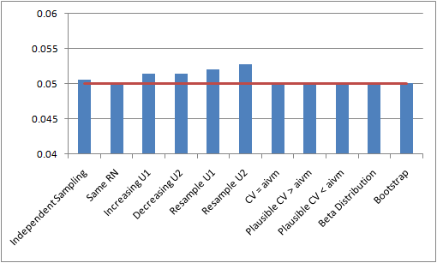



THE MOST APPROPRIATE METHODOLOGY FOR DEALING WITH MONOTONICITY IN THE CONTEXT OF SUMMARY DATA
M Stevenson *, N Latimer ª School of Health and Related Research, University of Sheffield, UK. * Corresponding author: (m.d.stevenson@shef.ac.uk)
Motivation
Methodologies Evaluated (Stage 1)
Results (Stage 1) continued
Methodologies Evaluated (Stage 2)
Discussion
The authors have observed a number of models submitted for peer-review or part of the NICE Single Technology Appraisal process where, in the context of summary data, the methodologies used for handling of monotonicity has been erroneous.
A selection of methods were explored to determine whether broad guidance regarding the most appropriate way to ensure monotonicity could be provided when only summary data is available.
The methodologies were:
Independently sampling from the distributions,
Using the same random number when sampling U1 and U2,
Increasing U1 so that it equalled U2, where monotonicity was violated
Decreasing U2 so that it equalled U1, where monotonicity was violated
Resampling U1 until U1>U2
Resampling U2 until U2<U1
Assuming that the covariance between U1 and U2 (CV) was equal to the average of the individual variances of the means (aivm).
Assuming a value for CV that produced ‘plausible confidence intervals’, where CV > aivm, and monotonicity was upheld
Methodology 8 but with CV< aivm
Assuming a plausible Beta distribution to represent the difference between U1 and U2.
For methodologies 8 and 9 it was assumed that a plausible confidence interval could be defined by setting a CV that led to the minimum difference being marginally greater than 0. These were 0.0004 and 0.00084 respectively.
For methodology 10, it was assumed that the maximum difference would be set following a discussion with a clinician. For illustrative purposes a Beta (1,19) was used which was assumed to provide a reasonable estimation of the difference.
Figure 3: The mean maximum and minimum differences between U1 and U2.
It is seen that independently sampling U1 and U2 violates the assumption of monotonicity.
Using the same random number or setting a CV value equal to aivm does not allow the uncertainty to be captured in the Monte Carlo sampling. Methods 3-6, which were shown to produce a bias mean estimate of the difference, also provided a greatly inflated estimate of the uncertainty.
1) Using independent Beta distributions to describe the difference between U0 and U1 and U1 and U2. Both Beta distributions were assumed to be (1,19).
2) Using a Beta distribution to describe the difference between U0 and U2, (assumed to be 16,144) and a second Beta distribution (assumed to be 70,70) to indicate where the value of U1 was estimated to lie within this range.
3) Selecting co-variance parameters (U0-U1; U0-U2; and U0-U3). Three different sets of parameters were chosen to provide a positive correlation between U0-U1 and U1 to U2, a negative correlation and a small correlation.
The values chosen to populate these models are illustrative only and assumed to be reasonable representations of the differences between U0, U1 and U2.
It is seen that a number of methods that have been used in economic evaluations are not appropriate when monotonicity must be upheld.
Those methodologies that provide a bias expectation in the difference will also provide a biased estimation of the incremental cost-effectiveness ratio and should thus be avoided.
Those methods which are known to under (or over) estimate the uncertainty will produce answers from value of information analyses that are incorrect, in addition to providing the decision maker with inappropriate certainty in the adoption decision.
Two broad methodologies were not rejected. The parameters for the co-variances and the parameters for the Beta distribution were selected through a trial and error process (prior to the results of the bootstrapped analysis being known). Ideally a Bayesian approach should be undertaken where a clinical expert would provide certain characteristics that a distribution would demonstrate, with the analyst attempting to replicate this.
Where only two variables were considered there was little difference between the recommended methods. However, where there were three variables and a prior belief that there would be correlation between these the co-variance method was observed to have an advantage in replicating clinical reality.
Methods (Stage 1)
A hypothetical disease was investigated where the patients could have either moderate or severe disease. A dummy data set was constructed simulating the responses from 30 patients who provided utility values for both states. Patients were assumed always to rate the utility in the moderate health state (U1) higher than that in the severe state (U2). The assumed data are shown in Figure 1.
Figure 1: A plot of the assumed data set.
It is assumed that these data are reported as shown in the Table 1.
Table 1: The assumed available summary data
Ten methodologies for estimating values for U1 and U2 were evaluated. The mean, standard deviation, maximum and minimum values of U1 – U2 were recorded for each, having performed 1000 Monte Carlo simulations.
As this was a simulation study these results were compared against 1000 sets of 30 bootstrap samples (with replacement) from the paired data, which had a mean difference of 0.05, a maximum difference of 0.073 and a minimum difference of 0.036. It is acknowledged that these ‘true’ values would not be known where only summary data were provided.
Results (Stage 2)
The correlation between parameters are shown in Figures 4 to 6. The variance co-variance matrix used for Method 3 are also provided in Figure 6.
Figure 4: Methodology 1 Figure 5: Methodology 2
Figure 6: Methodology 3
It is seen that there is minimal correlation between the two independent Beta distributions. Method 2 is associated with a positive correlation. This is expected as the difference between U0 and U2 and the point at which U1 divides this range are independently sampled. As such, where the difference between U0 and U2 is larger than average, the difference between U0 and U1 andU1 and U2 are also likely to be larger than average.
The third method of using a variance-covariance matrix allows control over the correlation between the differences in U0 and U1 and U1 and U2. As such this represents a more flexible methodology than using Beta distributions.
Results (Stage 1)
Conclusion(Stage 1)
The mean differences between U1 and U2 in each methodology are shown in Figure 2, the distribution of differences are shown in Figure 3.
Figure 2: The mean difference between U1 and U2
Although all methods are subject to sampling error, it is seen that the methodologies which artificially adjust either U1 or U2 (methodologies 3-6) introduce bias and inflate the expected difference.
Those methods that were not rejected involved judiciously selecting a co-variance parameter or expressing a belief in the difference in the utilities via a statistical distribution (in this case a Beta distribution). Both of these approaches would need the input of a clinical expert in order to produce a confidence interval around the difference that would be seen as plausible.
.
 | U1 | U2
Mean Value | 0.60 | 0.55
95% Confidence Interval of Mean | 0.555 – 0.644 | 0.506-0.594
Methods (Stage 2)
The differences in the non-rejected methods were further explored with the addition of a third health state (mild disease – U0) to the dummy data set. The value for U0 was greater than for U1. The summary data for U0 was a mean of 0.65 and a 95% confidence interval of 0.603 – 0.697. Three methods, all of which upheld monotonicity were evaluated.
Particular attention was paid to the potential for correlations between the values in each methodology. The suitability of each method for incorporating clinical belief, such as that if the difference between U0 and U1 were larger than average, the difference between U1 and U2 was also likely to be larger (or would be smaller) than average, was assessed.
Recommendations
When presented with summary data and with a belief that monotonicity must apply, a judicious selection of the covariance parameters or of the distributions for the differences appears appropriate. The former strategy is likely to be preferential if there are more than two parameters and there is some belief of correlation between the variables.

