Slide 1
Fertility (and futures?) of 45 countries: Lexis surface data visualisations
Dr Jonathan Minton
University of Glasgow
Jonathan.Minton@Glasgow.ac.uk

Slide 2
Acknowledgements
Serena Pattaro, University of Glasgow
Laura Vanderbloemen, Imperial College London
Nick Bailey, University of Glasgow
Gwilym Pryce, University of Sheffield

Slide 3
Introduction: Fertility in Europe
Fertility has been declining
There are differences between European regions
… And between Europe and other parts of the world

Slide 4
Introduction: Lexis Surfaces
Share the challenge and techniques of map-makers
How to visually represent three dimensional relationships on a two dimensional surface
Treating time like space
Spatial maps have latitude and longitude
Temporal maps (Lexis surfaces) have absolute time and relative time
Absolute time: year
Relative time: time since birth, time since first child, time since leaving education, etc

Slide 5
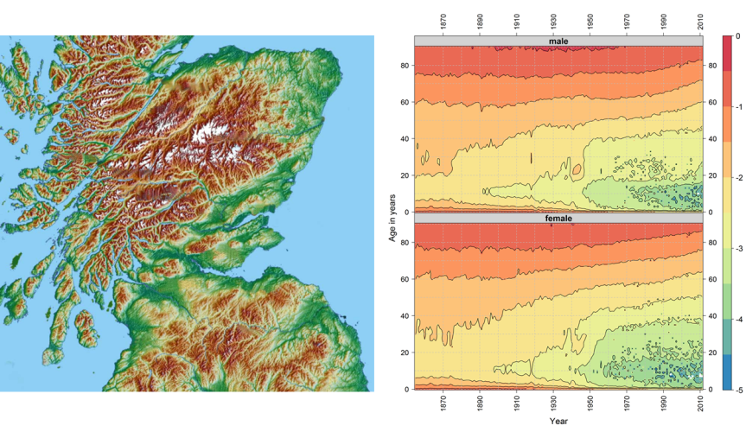
https://ije-blog.com/2016/06/27/lexis-cubes-1-from-maps-of-space-to-maps-of-time/

Slide 6
Demographic definitions of fertility
Not about biological potential, but about ‘realisation of outcome’
Age-specific fertility rates
Number of live births/woman of age x in period (year/birth year) y
(Various technical complications about defining age and period: squares, triangles or parallelograms)
Schedule of fertility rate with age
Total fertility rates as a period-based measure

Slide 7
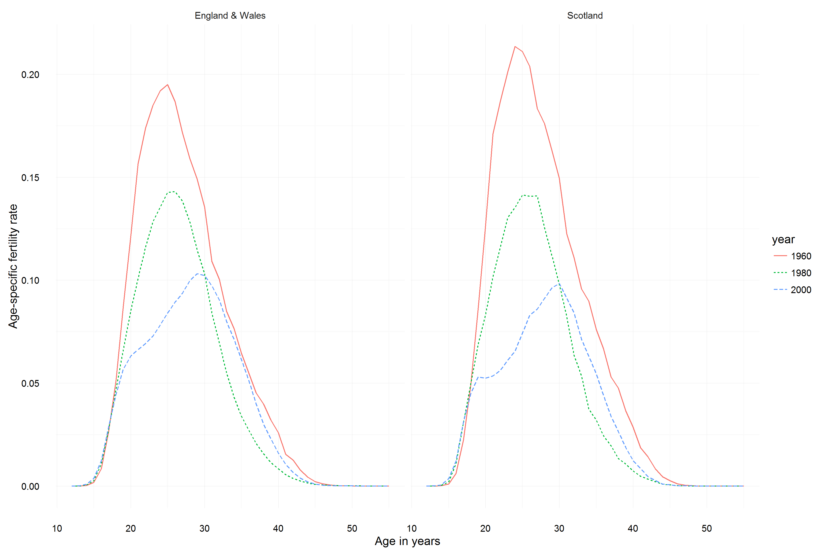

Slide 8
Period measures and cohort measures
Total fertility rates as a period-based measure:
Observations of schedule of age and fertility rate observed in a period
Effectively produces a ‘synthetic cohort’
(n.b. biological and demographic uses of the term ‘period’ are distinct)

Slide 9
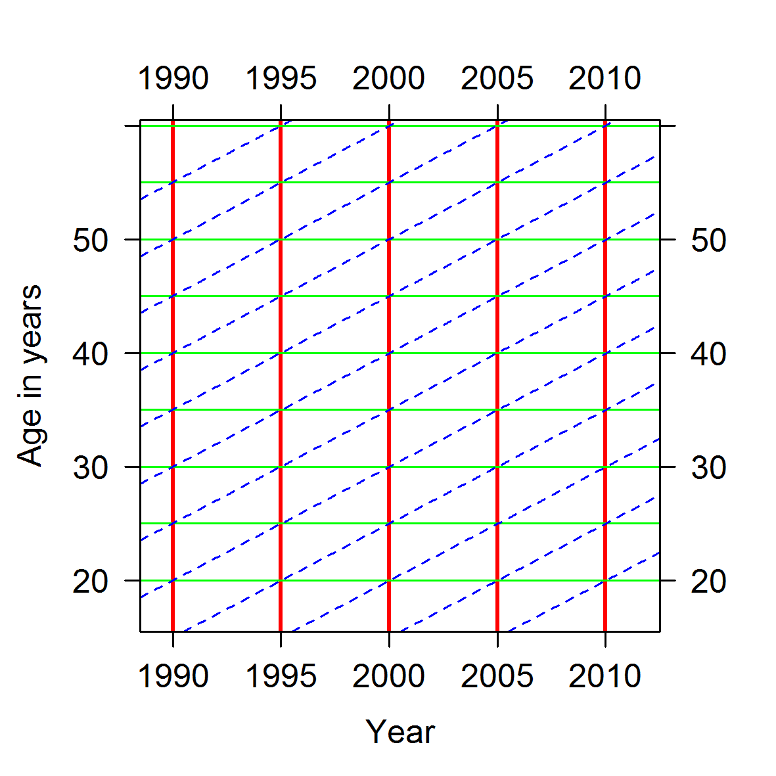

Slide 10
Period measures and cohort measures
Real cohorts are birth cohorts
Total fertility of 1920s cohorts: known
Total fertility of 1980s cohorts: unknown
Important unknowns
Time to first birth
Interval between births (Tempo changes)

Slide 11
Methods: data
Human Fertility Database: http://www.humanfertility.org/
Human Fertility Collection: http://www.fertilitydata.org/
Preferential ‘munging’ of the two:
1) HFD;
2) HFC:
i) STAT: Official statistical data : Data that come from statistical publications and official websites of national statistical offices
ii) ODE: European Demographic Observatory (L'Observatoire Démographique Européen)
Reference: http://www.fertilitydata.org/cgi-bin/collections.php
Additional ‘munging’ to impute ASMRs in more recent missing years

Slide 12
Methods: Software
R with Github
R packages:
Lattice/LatticeExtra: main maps
R2stl: 3D printable STL files (HFD only)
Wickhamese packages – readr, tidyr, stringr, dplyr, purrr – for general data management and automation
Github
https://github.com/JonMinton/comparative_fertility/
https://github.com/JonMinton/Statistical_Sculpture/

Slide 13
Methods: Producing cumulative cohort fertility rates
Given ASFRs, at what age do different birth cohorts ‘achieve’ a given number of children?
CCFRs of 1.30, 1.50, 1.80, and 2.05 are highlighted as contours
2.05 = ‘replacement fertility levels’
The 1.30 line always below 1.50 line, 1.50 below 1.80, 1.80 below 2.05
If a contour line is not visible for a particular birth cohort, that birth cohort did not achieve that cumulative fertility rate
If 2.05 line not visible: long term ageing and declining population
For the final latticeplot – country tiles are coloured by region, and arranged by fertility rate in last year

Slide 14
Methods: Graphs produced
Heatmaps/level plots of ASMRs given age and year
Contour maps of ASMRs given age and year
Heatmaps/level plots of ASMRs given age and birth year
Cumulative cohort fertility maps
Contours giving CCFRs, colour/shade giving ASMRs
CCFR latticeplot for all countries

Slide 15
Results

Slide 16
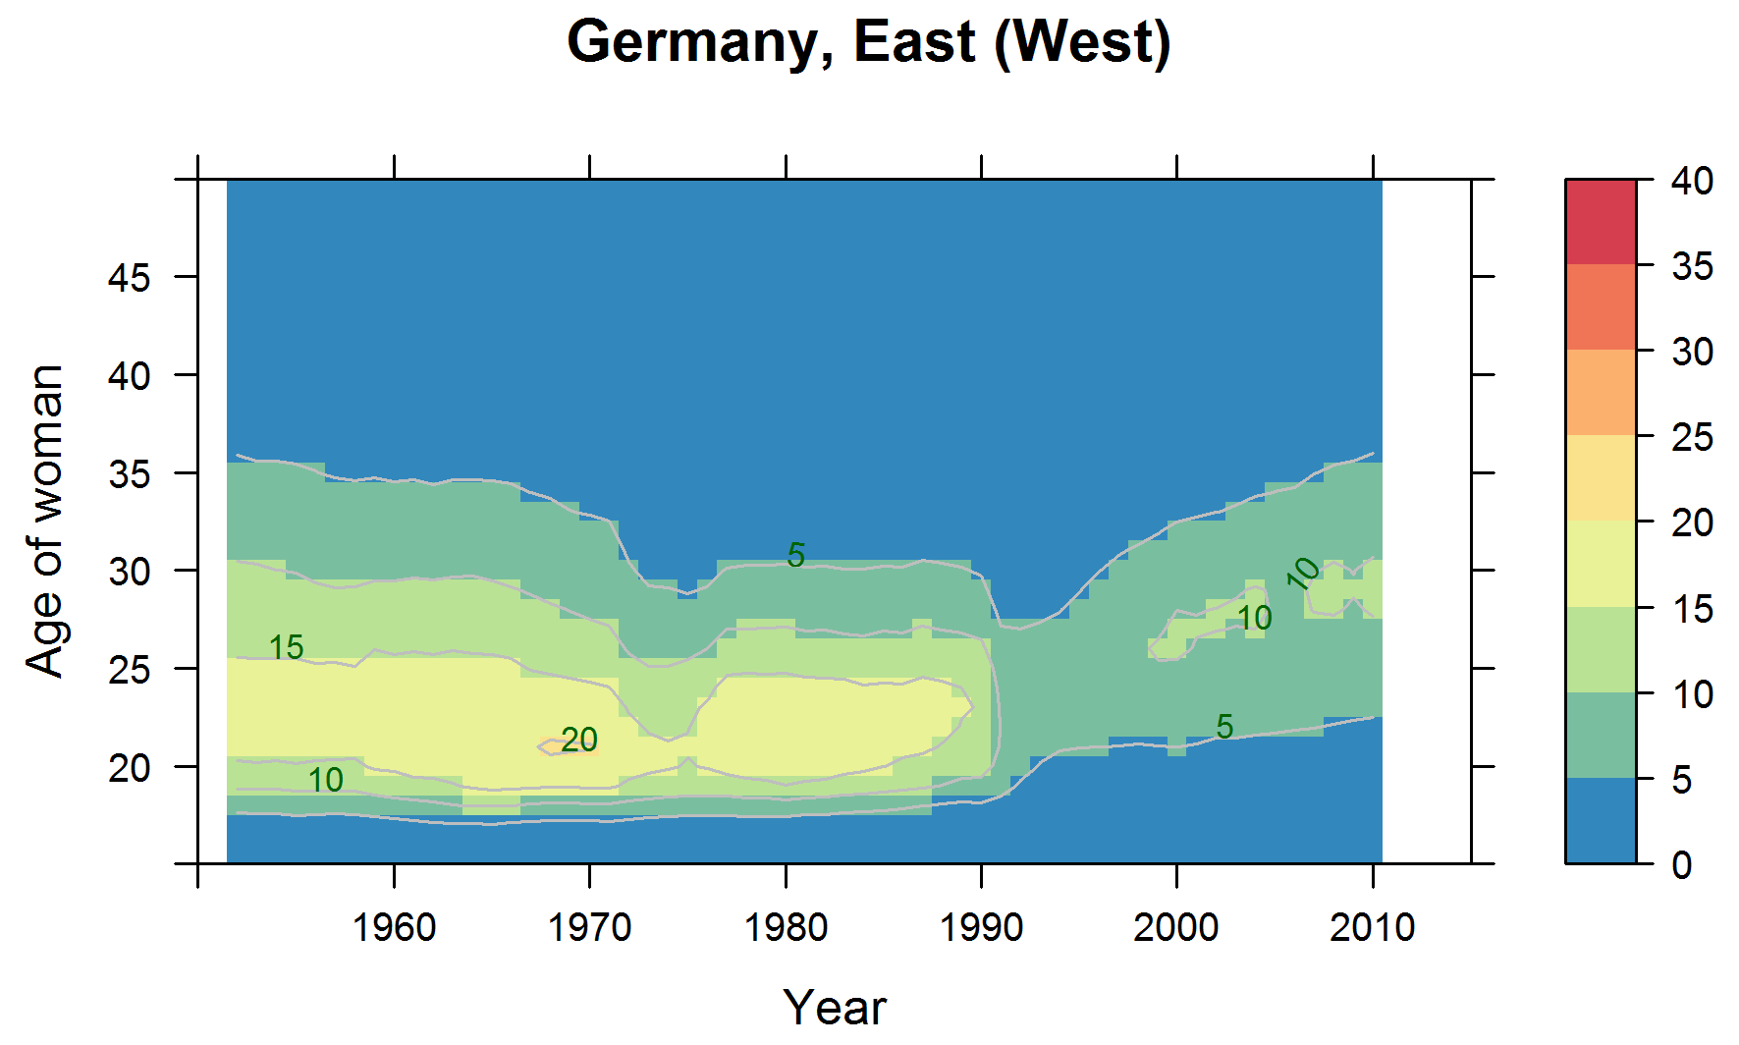
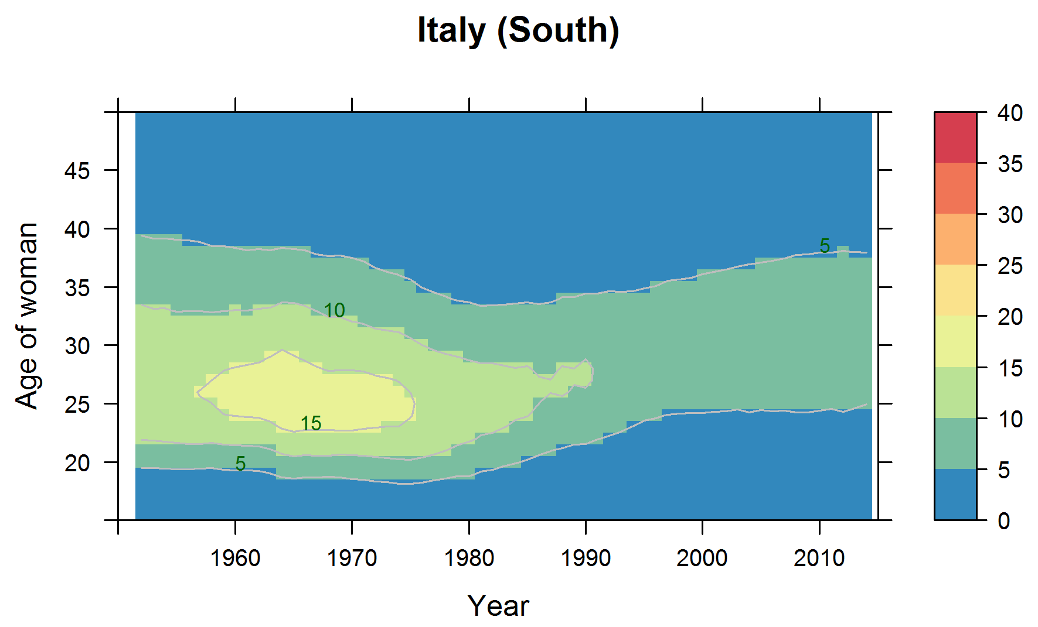
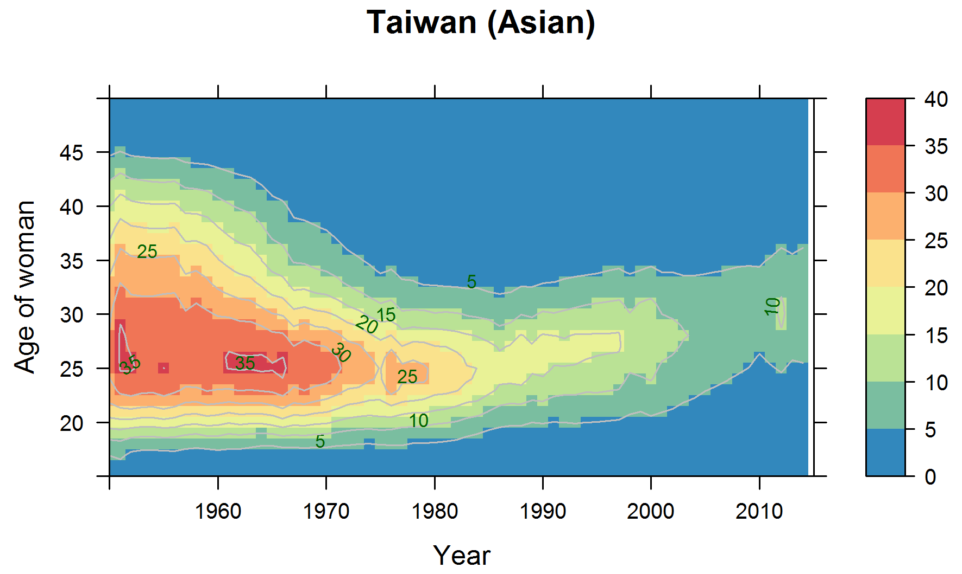
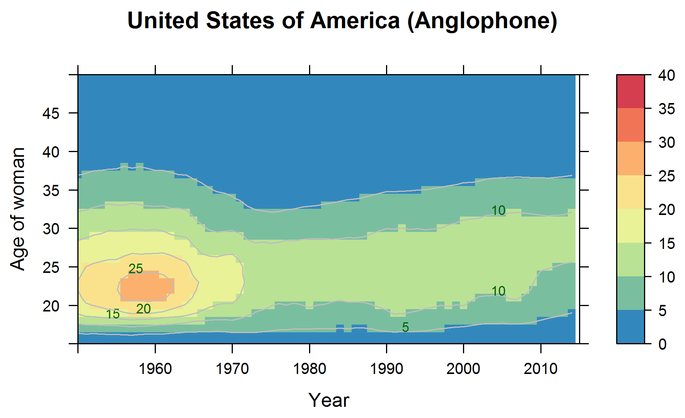

Slide 17
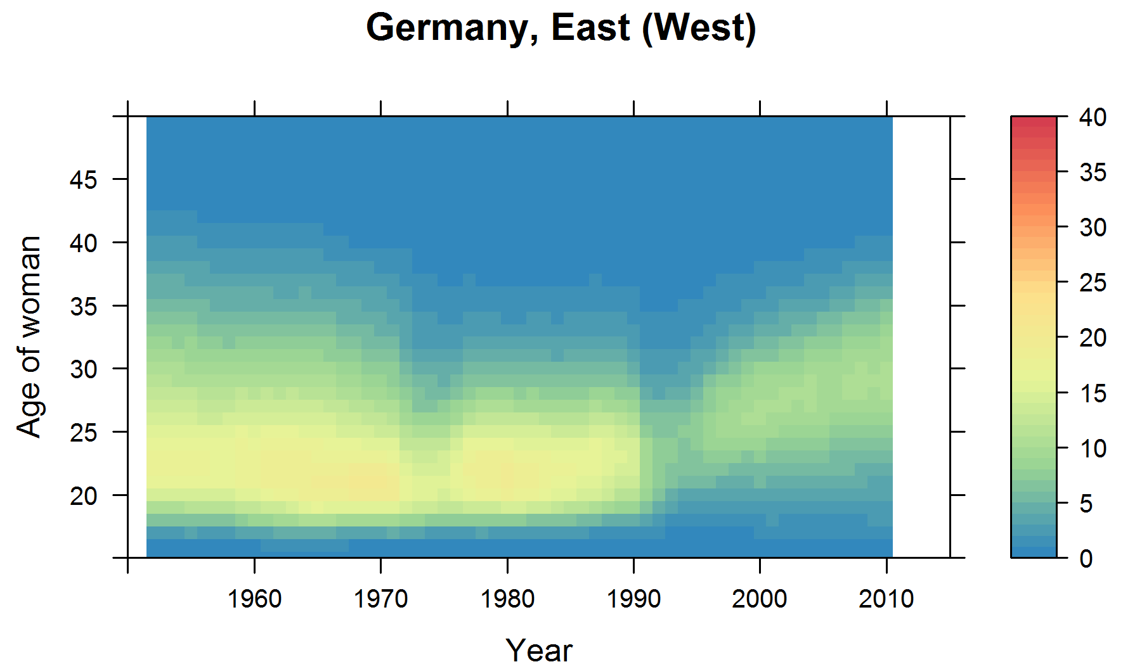
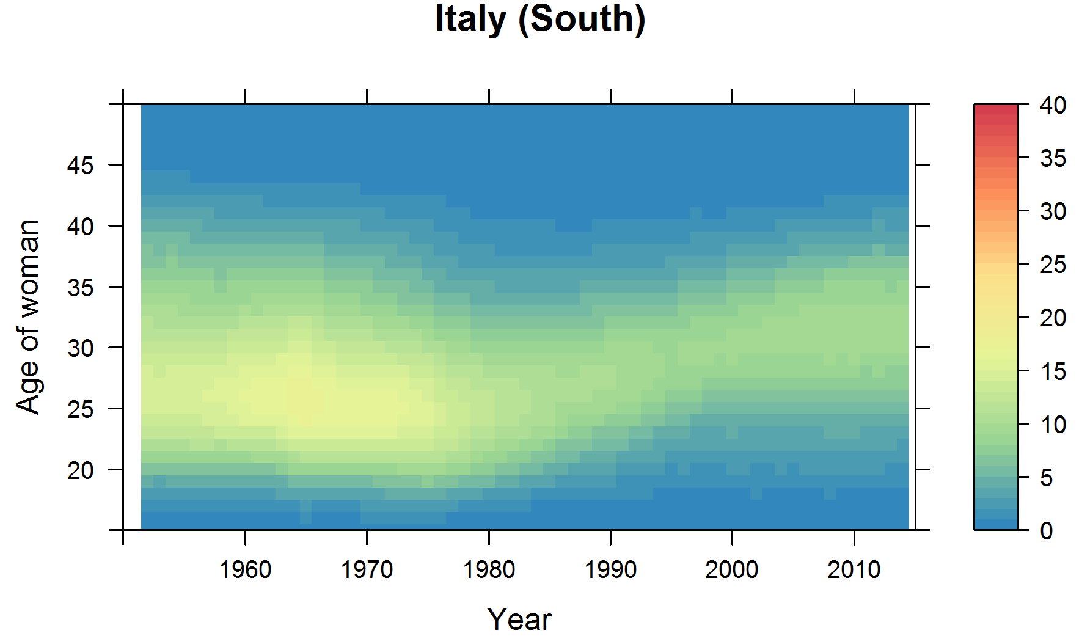
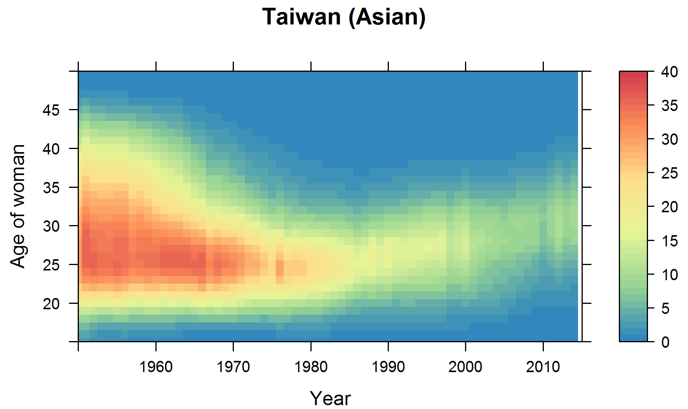
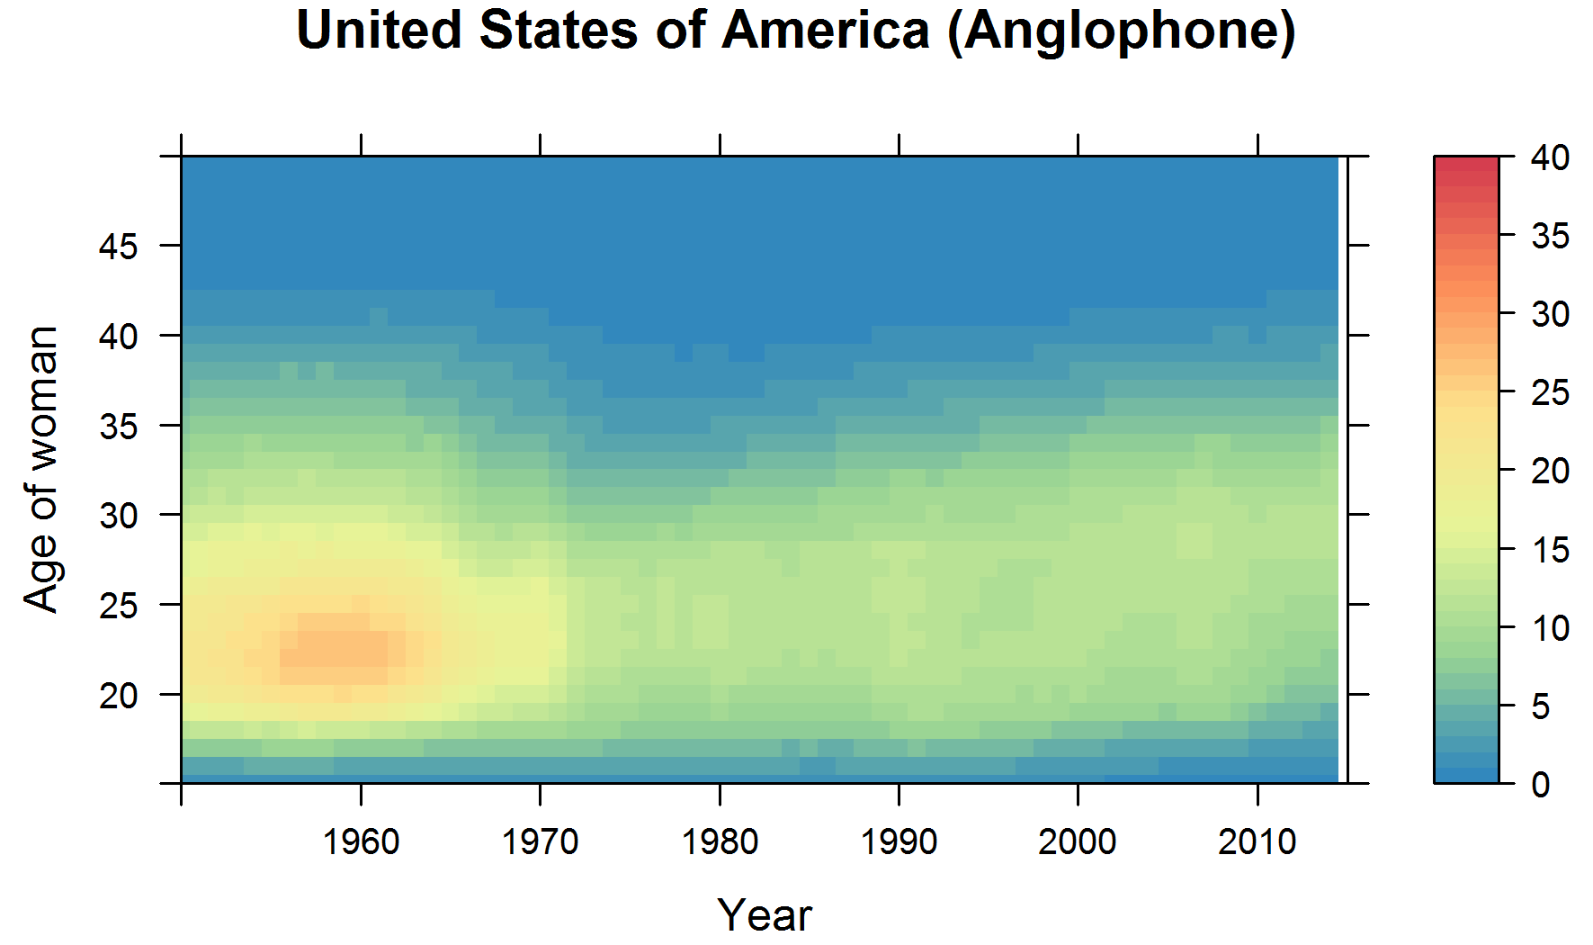

Slide 18
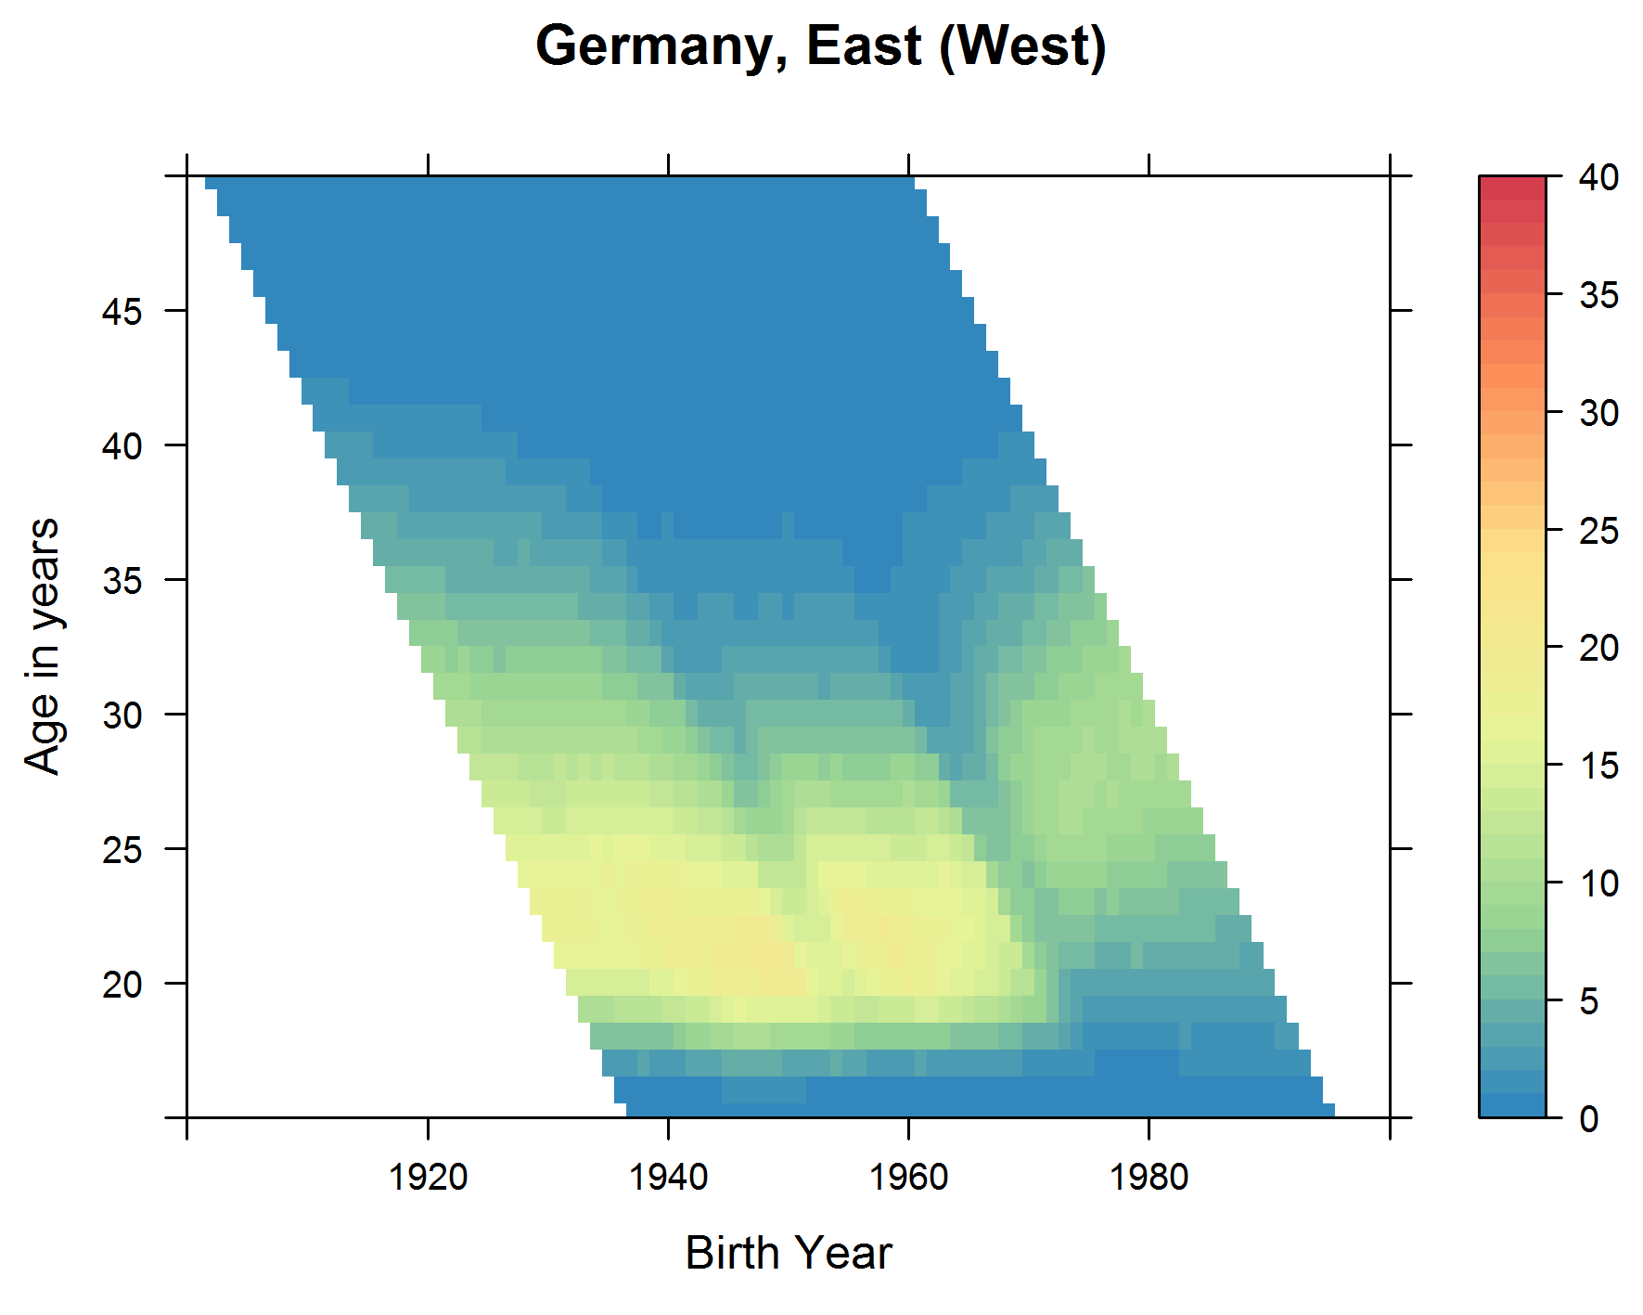
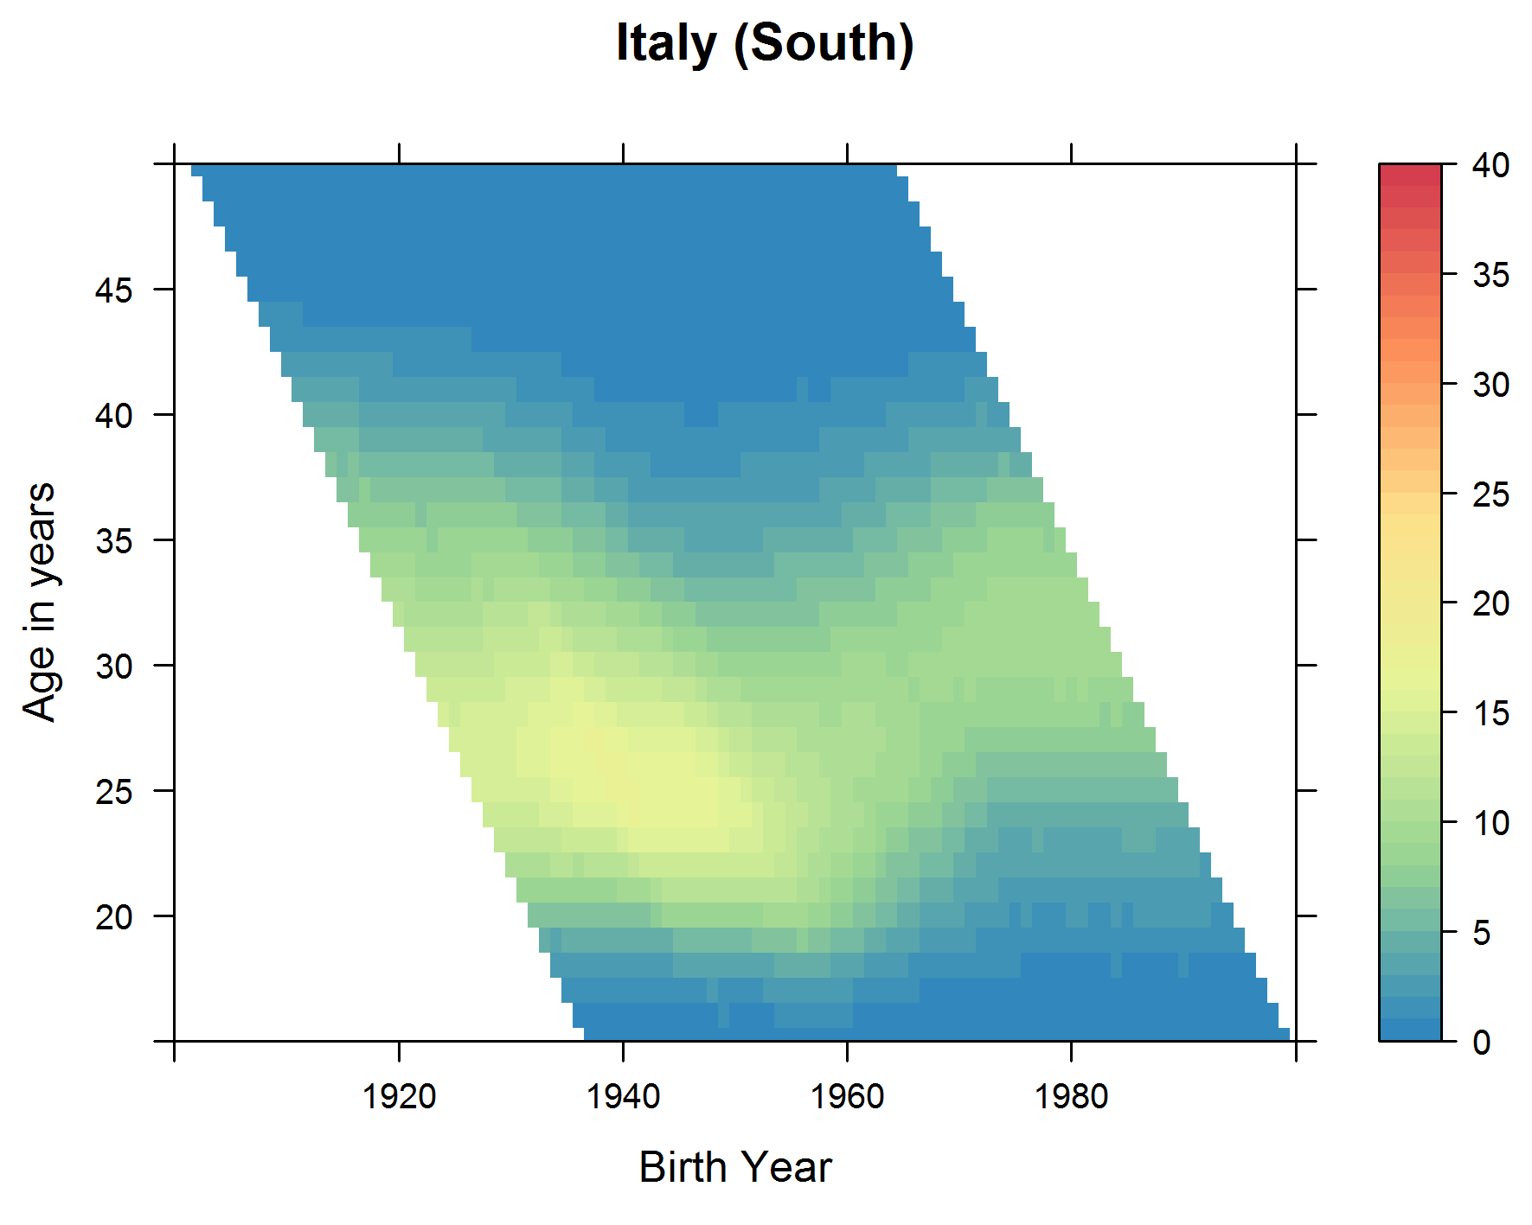
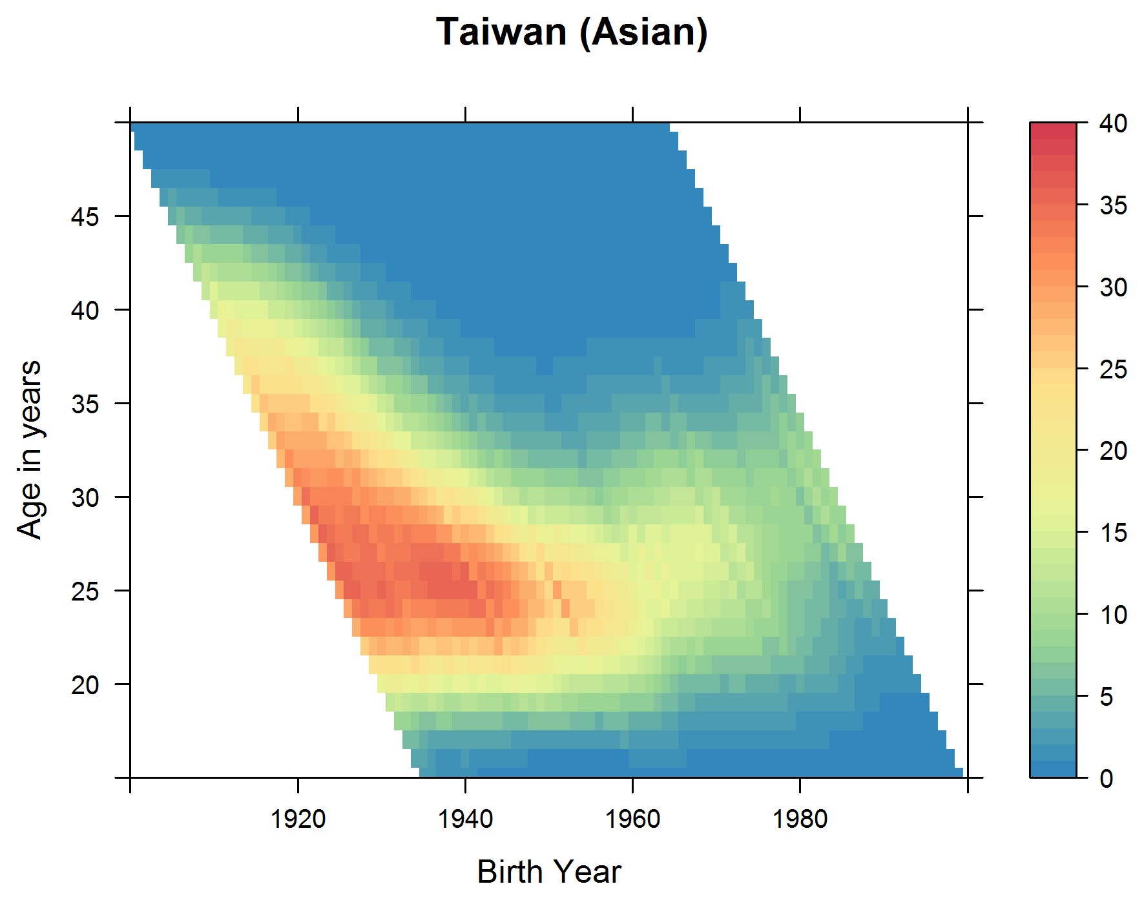
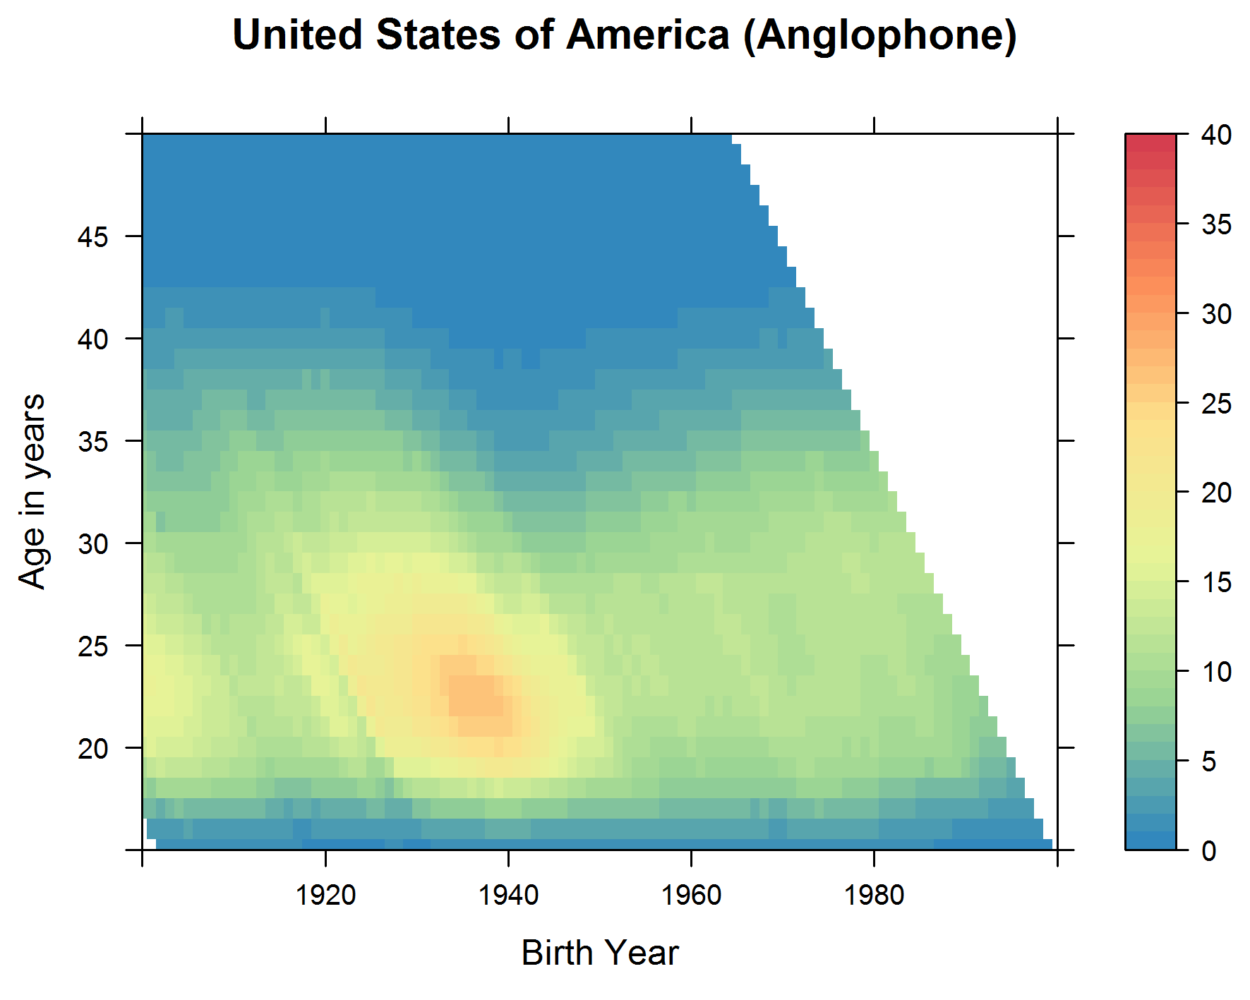

Slide 19
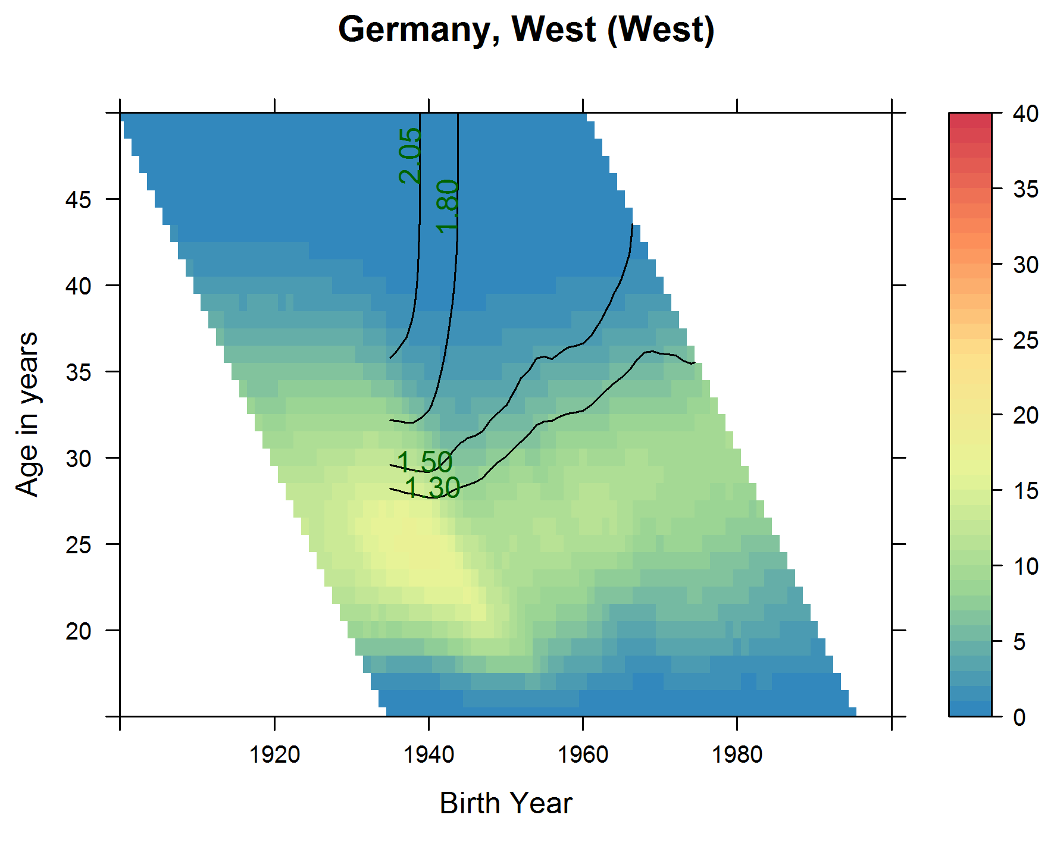

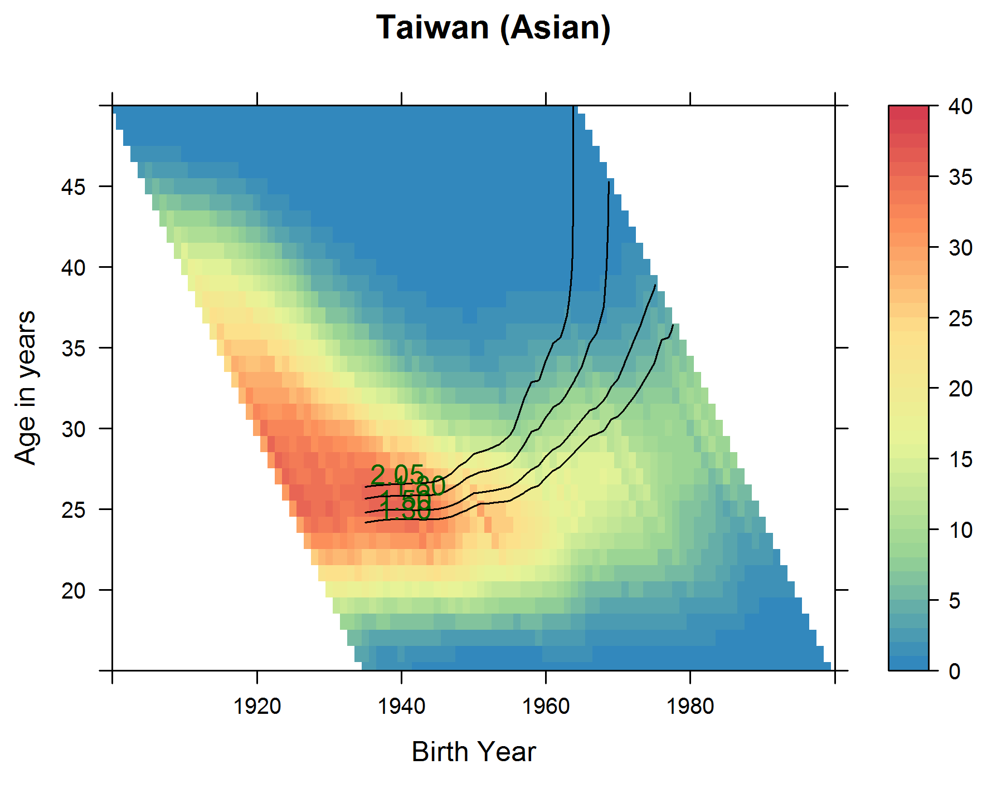
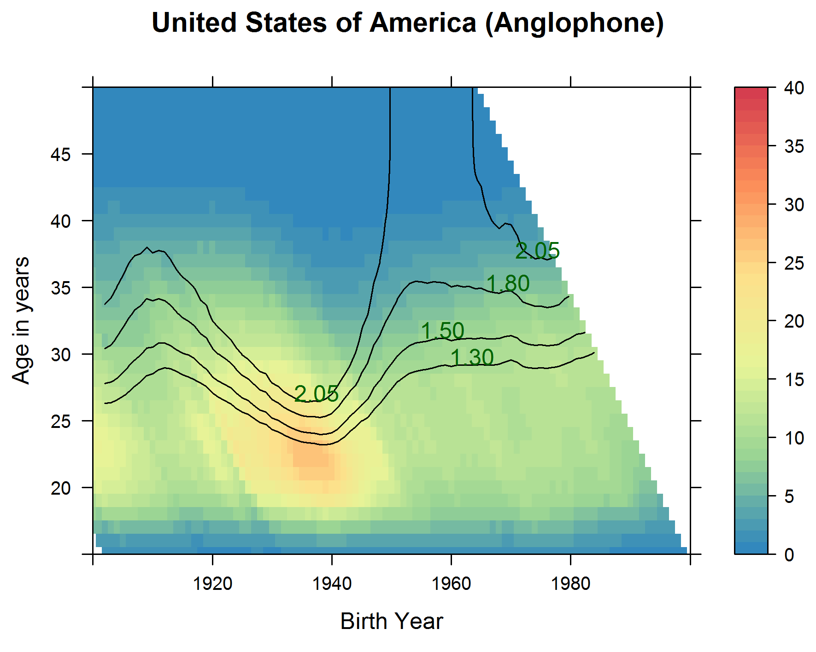

Slide 20
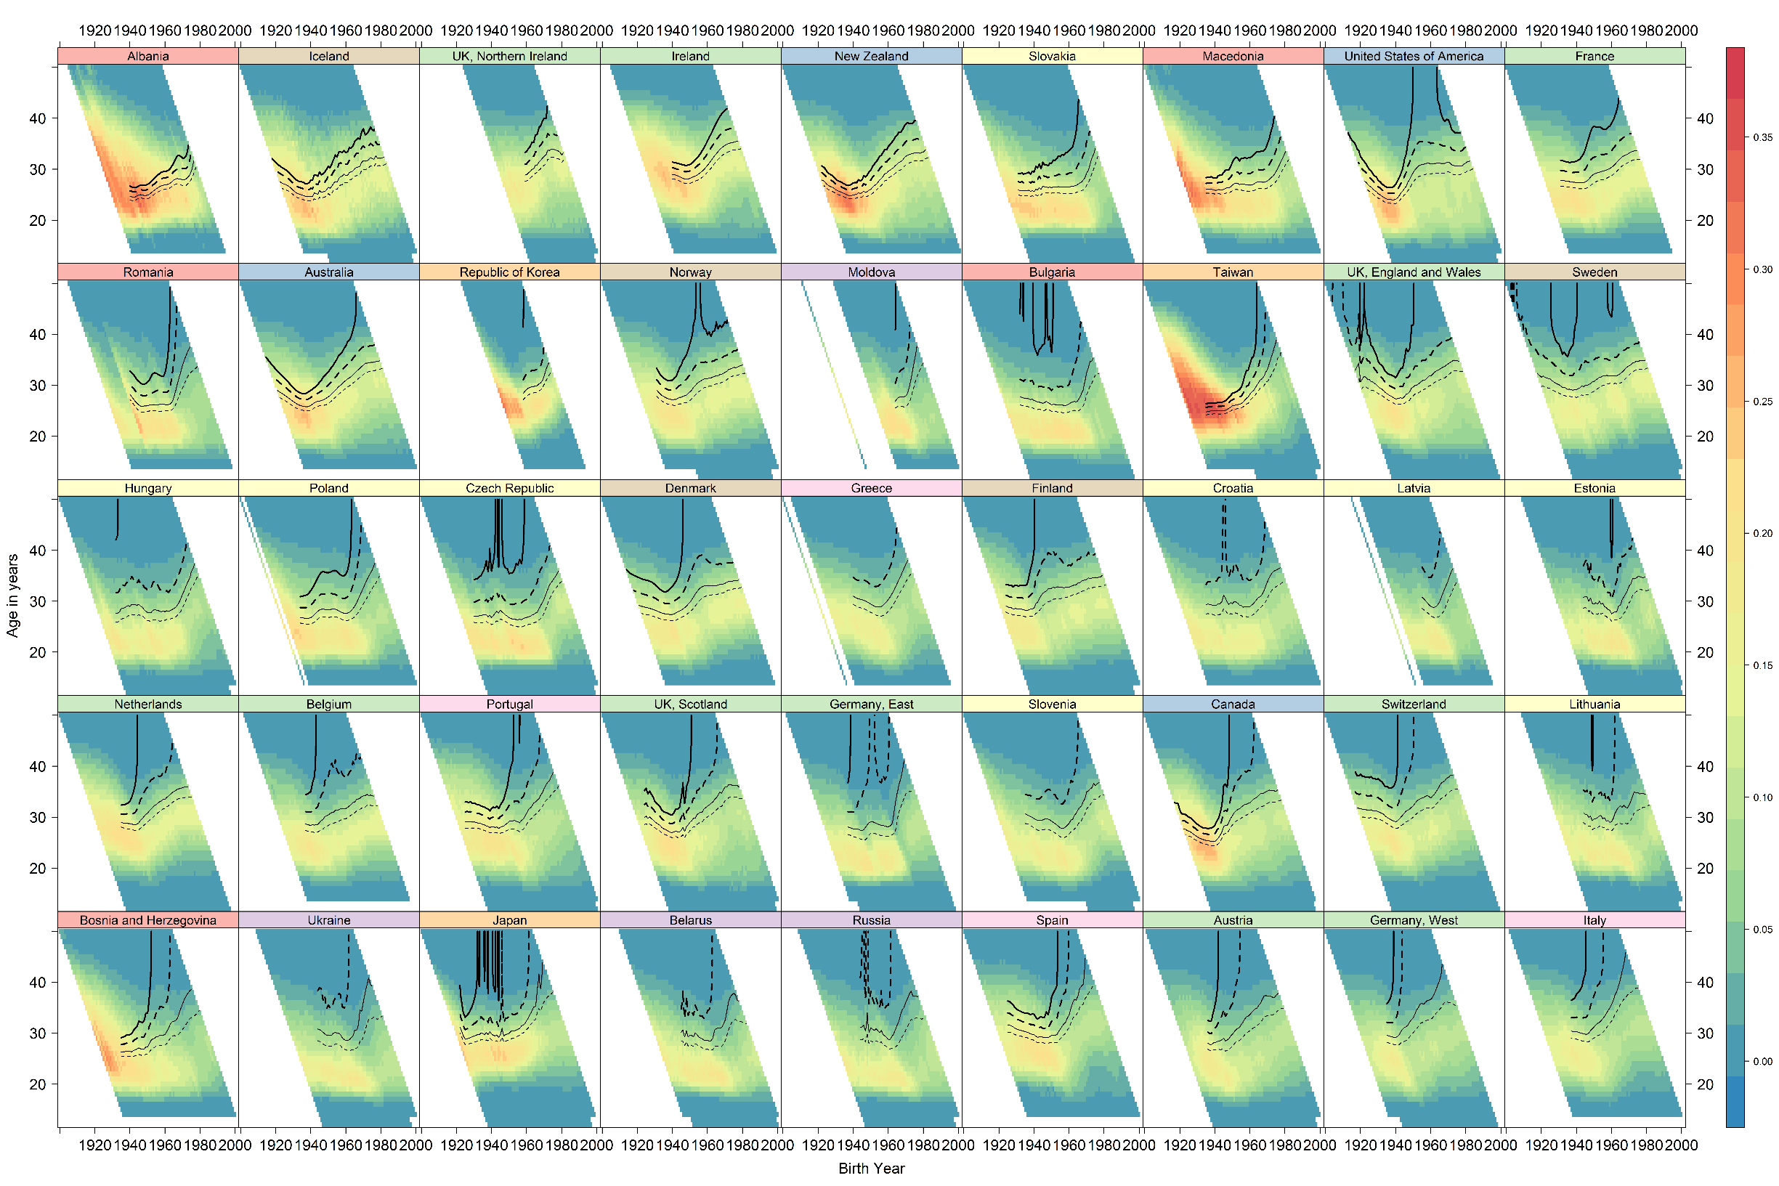

Slide 21
Discussion: Methodological Contributions
Much data can be shown and made sense of at a time
Nearly 100 000 values represented in the latticeplot
Complex data vis: A need to slow… down
Guiding through steps
Intuitive sense of where different countries are heading
Plotting of contours gives an approximate sense of trajectories:
Extrapolate iff age < 42? Vertical if age >= 42?
Ordering in latticeplot is for last year but implied trendlines suggest which are stabilising and which are changing

Slide 22
Discussion: Substantive Contributions
Most (‘developed’) countries do not achieve replacement fertility levels
Countries that have include: Albania, Iceland, Ireland, New Zealand, USA, Norway?
No strong overall relationship between countries’ CCFRs and regions
Southern and Central European countries tend have low fertility
Small countries with relatively high fertility
Ordering in latticeplot is by fertility in last year, but lines show different trajectories

Slide 23
Discussions: Speculations
Primary and secondary effects of migration
USA fertility recovery and Mexican immigration?
Germany, Austria and openness to migration
Differences between Scotland and England/Wales (‘Wangland’)
Regional differences within countries
London and the rest

Slide 25
Discussion: Refugee Crises and European Demographic Trajectories
Almost all European countries need migration to stabilise dependency ratios
Primary effects: More 25 year olds now
Secondary effects (perhaps): higher fertility rates so more 25 year olds in the next generation
Within EU, countries with lower fertility appear more accepting of refugees
Austria, Germany, Italy?

Slide 26
Discussion: Brexit
Brexit: Mass migration is the solution to long-term decline in Europe, not the problem
As long as
short-term costs
regional variations in service demand
- can be mitigated appropriately
Conservatives: Austerity
Labour (or a bit of it): Migration Relief Fund
Scarcity: “Charity begins at home”

Slide 27
For further information
NCRM podcast:
http://www.ncrm.ac.uk/resources/podcasts/view.php/Visualising-social-trends-in-3D
Blogs:
https://ije-blog.com/2016/06/27/lexis-cubes-1-from-maps-of-space-to-maps-of-time/
https://ije-blog.com/2016/06/27/lexis-cubes-2-case-study-log-mortality-for-males-in-finland-1878-to-2012/
Papers:
http://www.ncbi.nlm.nih.gov/pubmed/24062300
http://jech.bmj.com/content/early/2016/03/01/jech-2014-205226.abstract
http://www.sciencedirect.com/science/article/pii/S1877584514000173
Github repos (as before)
Or… email Jonathan.Minton@Glasgow.ac.uk
Thanks for listening!

