Slide 1
Driving Licence Uptake & Emerging Inequalities
Driving Segregation
Julie Clark & Jon Minton
University of Glasgow

Slide 2
Overview
Research background
Understanding Society
Demographic drivers
Raising questions

Slide 3


Technological change
‘Urban renaissance’
Lifestyle/ consumer preference issues
Choice?
Choice?
Declining mobility
Applying an ‘equalities’ lens
Precarity in employment
Increased entry and maintenance costs
Car miles per person stabilising
Fall in young adults holding a driving licence
Constraint?
Constraint?

Slide 4
Choice?
Declining mobility
Applying an ‘equalities’ lens
Car miles per person stabilising
Fall in young adults holding a driving licence
Constraint?

Slide 5
Aim
Are these trends temporary or do they signal longer term change?
What might the equity implications of such changes be?
To gain greater understanding of overall trends driving licence holding and car use
Gender
Urbanisation
Social Class
Notes:
Proxy, educational qualifications (parental income/ earning potential)

Slide 6

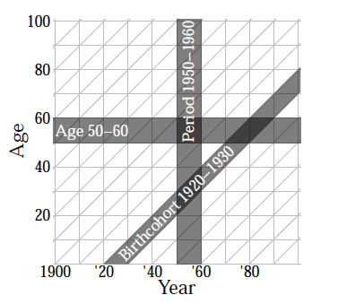
BHPS established 1991
10,000 people in 5,050 hhds
Merged with Understanding Society in 2010/11
Panel data, rather than
cross-sectional snapshots
Combines questions on car access with extensive socio-economic data
Approach
Licence holding & car access:
Examination of age, period & cohort effects by gender, social class and urbanisation.
Figure from Schöley & Willekens (2015: 3)
Notes:
We are using 1993-2009
Understanding population processes
The term Lexis surface has been introduced by Arthur and Vaupel (1984) to describe a collection
of demographic rates given by discrete time and age.
Heatmaps express the value of a variable for every point on the time-age plane by the use of colour
https://www.iser.essex.ac.uk/bhps/documentation/volb/wave1/aindresp15.html

Slide 7
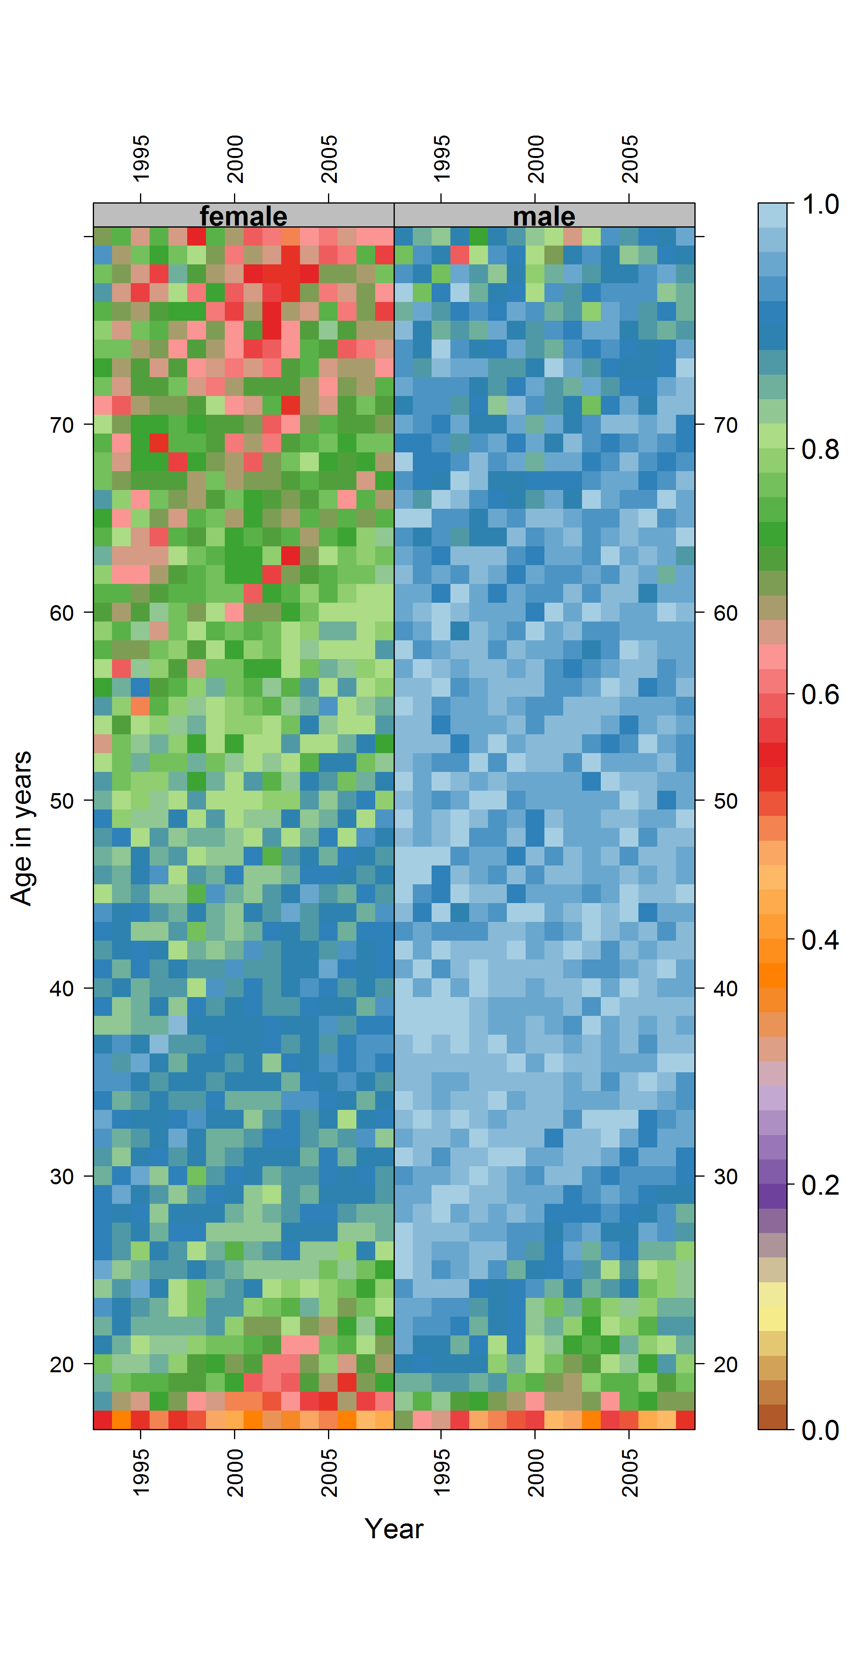
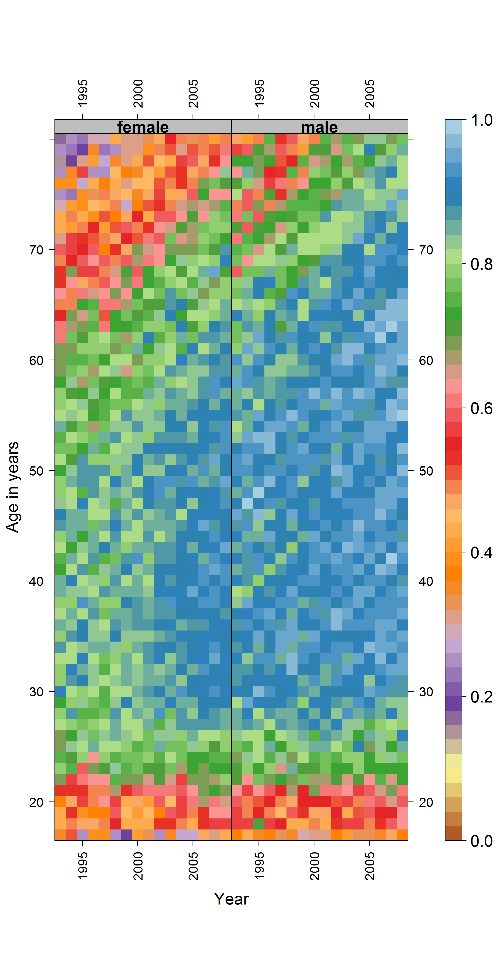
Licenced Drivers driving
Gender
Baby boomers
(Born 1946-1964 – male!)
Pronounced historic cohort effects in licence uptake for women

Slide 8
Licenced Drivers driving
Gender
Baby boomers
(Born 1946-1964 – male!)
Pronounced historic cohort effects in licence uptake for women
Notes:
GENDER
70 yrs born 1925; 60 years born 1935 etc
License
Access
Baby boomers (male!) Born 1946-64 high car ownership
Millenials – Born 1980s entering adutlhood early 2000
Evidence of historic cohort effects for females
Around 70% of women born up to around 1940 (55 in 1995) had driving licences. This rose to around 80% for women born around 5 years later (1945 cohort, 50 in 1995), and to around 90% for women born 10 years later still (1955 cohort, 40 in 1995). The rates stabilised at this 90% level for cohorts born between 1955 and around 1970/1975 (25 in 1995), both for newer cohorts seem to have fallen to around 80%.
For males driving licence ownership rates have long been over 90%, and seem to be in the 95%+ range for most cohorts born between around 1945 and 1970. For males born after this period there is evidence of a steady decline in driving licence ownership, to around 90% for cohorts born around 1975, to around 80% or lower for cohorts born around 1985 and later.
10– proportion of drivers driving, by age, year and sex
For both males and females there is evidence of a historic cohort effect of successive cohorts with driving licences choosing to drive. For women this increased from around 20% for cohorts born around 1915, to 40% for those born around 1920, then around 57% for those born around 1925, and 75%-80% for those born after around 1935. Up until the early 2000s, rates for most female cohorts stabilised at around 80%, then increased to around 90% thereafter from around the age of 26 years onwards. A similar kind of historic cohort effect is evident for males, but without any period-based change in the 2000s, and with rates typically in the low 90%s.
At younger ages, between around the ages of 17 and 30, there has been great consistency over time in the proportion of people with driving licences who drive, with rates typically around 40% for teenagers, moving to slightly over 50% in the early 20s, then up to the high 80%s/low 90%s by the age of 30.

Slide 9
Licenced Drivers driving
Gender
Change for men far less marked

Slide 10
Licenced Drivers driving
Gender: 50s/60s cohorts
Female ‘catch up’ towards parity in licence holding for women born in 1950s
Convergence for cohorts born in 1960s (nearer 90%+ driving licence ownership for both genders in these cohorts)
Lower
Mobility
Transition
Higher
Mobility

Slide 11
Licenced Drivers driving
Gender & the Millennials
For cohorts born after around 1970, licence levels fell around 10% for both genders
They fell further for those born after around 1980s (Early Millennials?), and faster for men
Licence gap closing
Lower
Mobility
Lower
Mobility

Slide 12
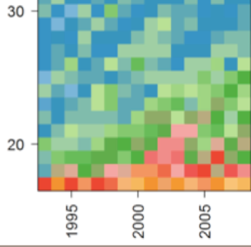
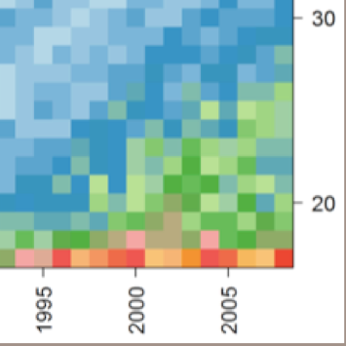
males
Licenced Drivers driving
The Millenials
Female
The Millenials
Period effect for young males?
Females
Males

Slide 13
Licenced Drivers driving
Gender
Historic cohort effects for both genders
More consistency (age effect) at younger ages (approx 17-30) years
Born 1915
Born 1928
Born 1935
Born 1955

Slide 14
Licenced Drivers driving
Gender gap
in converting licence to opportunity
BUT
more consistent age effect between genders for drivers driving
Notes:
GENDER
GETTING A LICENCE IS A BARRIER, PARTICULARLY FOR WOMEN
ONCE YOU HAVE A LICENCE, AGE (££ that comes with age) IS MORE OF AN ISSUE FOR TRANSITIONING TO ACCESS FOR THOSE BORN LATE 60s onwards?
What is the differentiating factor in that cohort effect for licence?
Evidence of historic cohort effects for females
Around 70% of women born up to around 1940 (55 in 1995) had driving licences. This rose to around 80% for women born around 5 years later (1945 cohort, 50 in 1995), and to around 90% for women born 10 years later still (1955 cohort, 40 in 1995). The rates stabilised at this 90% level for cohorts born between 1955 and around 1970/1975 (25 in 1995), both for newer cohorts seem to have fallen to around 80%.
For males driving licence ownership rates have long been over 90%, and seem to be in the 95%+ range for most cohorts born between around 1945 and 1970. For males born after this period there is evidence of a steady decline in driving licence ownership, to around 90% for cohorts born around 1975, to around 80% or lower for cohorts born around 1985 and later.
10– proportion of drivers driving, by age, year and sex
For both males and females there is evidence of a historic cohort effect of successive cohorts with driving licences choosing to drive. For women this increased from around 20% for cohorts born around 1915, to 40% for those born around 1920, then around 57% for those born around 1925, and 75%-80% for those born after around 1935. Up until the early 2000s, rates for most female cohorts stabilised at around 80%, then increased to around 90% thereafter from around the age of 26 years onwards. A similar kind of historic cohort effect is evident for males, but without any period-based change in the 2000s, and with rates typically in the low 90%s.
At younger ages, between around the ages of 17 and 30, there has been great consistency over time in the proportion of people with driving licences who drive, with rates typically around 40% for teenagers, moving to slightly over 50% in the early 20s, then up to the high 80%s/low 90%s by the age of 30.

Slide 15
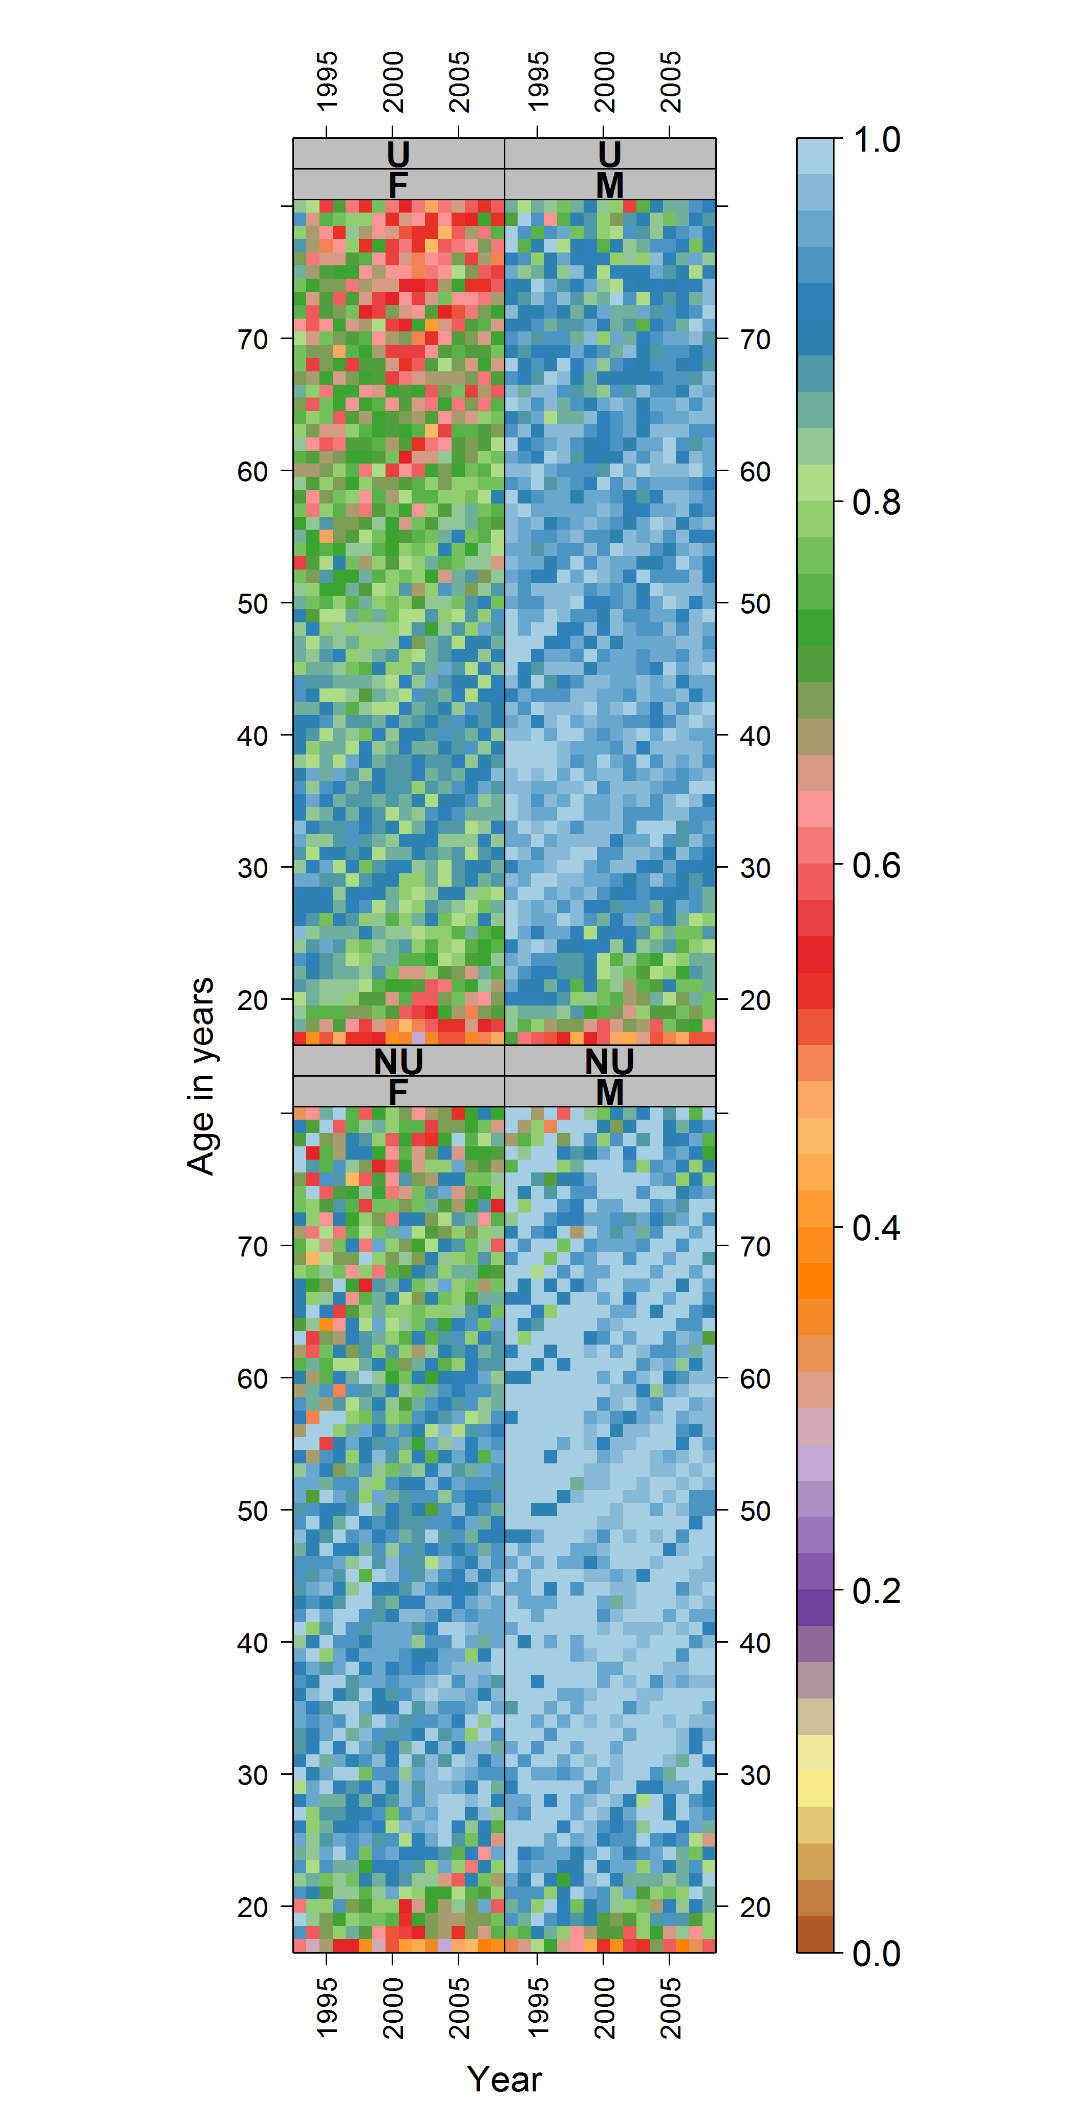
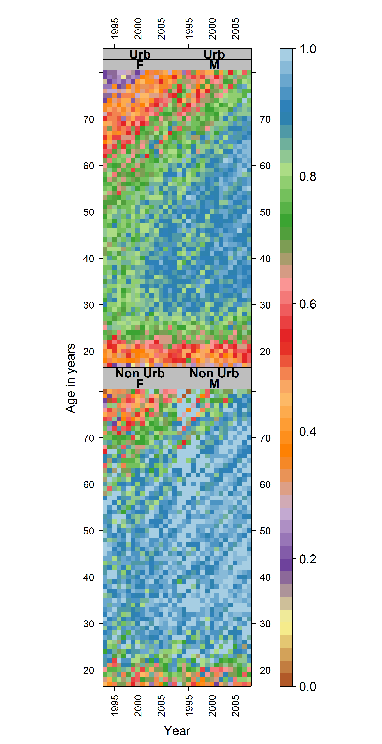
Urban/ Non-urban
Gender differences more marked in urban areas
Choice: more alternative modes available in highly urbanised areas?
Constraint: risk of forced car ownership in less urban environments?
Urban
Licenced
Drivers driving
Maybe women just don’t like driving??
Non-
Urban
Notes:
URBAN Theory: maybe women just don’t like driving?

Slide 16
Non-Urban
Close to 100% for rural males
Earlier female-male cohort ‘catch up’ than for more urban counterparts
A decline for the millennial cohort (less pronounced than for urban males)
Urban
Licenced
Drivers driving
Non-
Urban

Slide 17
Urban
Older urban women, 10-20% lower licence-holding than men of the same age
Some catch up for the 1970s - 80s cohorts (<40yrs in 1995)
Declining for both from mid-1970s onwards
Urban
Licenced
Drivers driving
More consistency
between genders at younger ages
(approx 17-30) years
Non-
Urban
Notes:
URBAN
Suggest choice to drive in women rather than dislike!

Slide 18
Urban/Non-Urban
Historic cohort effect (more drivers driving) most clearly evident in urban areas.
Urban
Licenced
Drivers driving
Non-
Urban

Slide 19
Urban/Non-Urban
Historic cohort effect (more drivers driving) most clearly evident in urban areas.
Slower conversion from licence to driving for young adults in urban areas BUT gender parity in the age effect
Urban
Licenced
Drivers driving
Non-
Urban

Slide 20
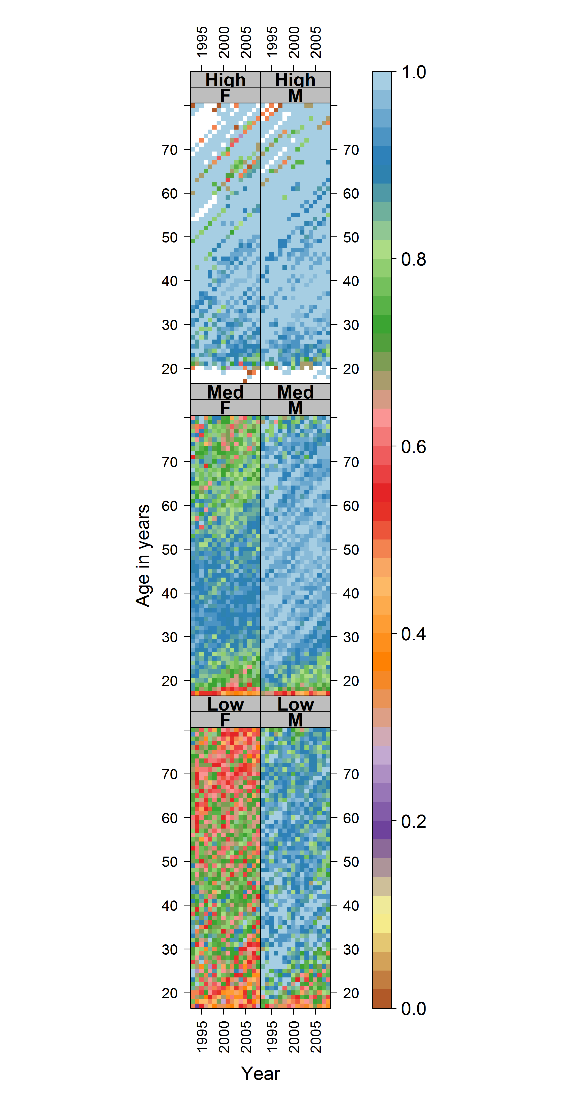
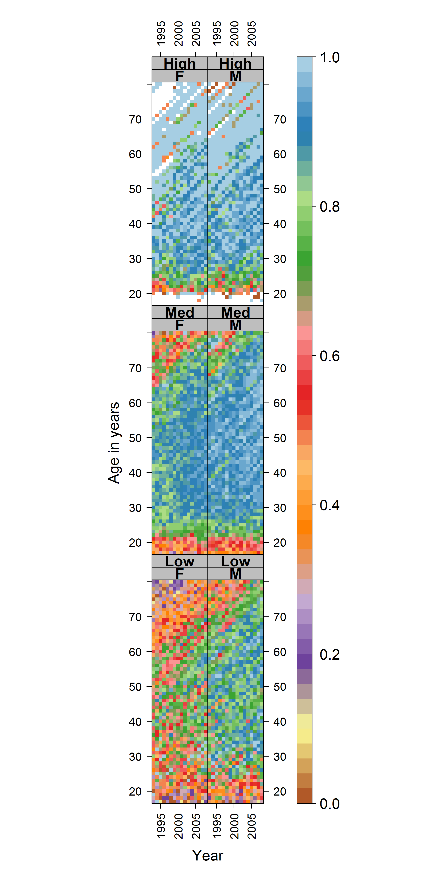
Social Class
Highest educational qualification strongly mediates female licence holding
Effect most pronounced in older cohorts
High
Licenced
Medium
Drivers driving
Low

Slide 21
Social Class
Some ‘catch up’ for women with intermediate qualifications for the 1945-1970 cohorts (much weaker evidence for women in the lowest category)
Recent declining licence holding for men most apparent in low-intermediate groups
High
Licenced
Medium
Drivers driving
Low

Slide 22
Social Class
The historic trend towards successive cohorts with driving licences driving (around 1940) is most clearly evident in those with low qualifications, especially women
Evident to a lesser extent with the intermediate but not the high group
High
Licenced
Medium
Drivers driving
Low

Slide 23
Social Class
For those in intermediate and high groups, the main change is an age effect, between 17 & 30 yrs
High
Licenced
Medium
Drivers driving
Low
Notes:
09 – proportion of dlos, by age, year, sex, highest qual
The highest educational qualification strongly mediates the rates of female driving licence ownership, whereas for males rates of driving licence ownership had long been similar regardless of highest qualification, though somewhat (perhaps around 5%) lower with lower qualification levels.
For older female cohorts, and compared with those with higher qualifications (who had close to 100% driving licence rates), those with intermediate qualifications had around a 15% lower driving licence rate (around 80%), and for those with no further qualifications were around 15-20% lower still (around 55-60%). There was evidence of ‘catch up’ to high qualification levels for females with intermediate qualifications amongst cohorts born between around 1945 and 1970, with driving licence levels reaching around 95%, then a decline to around 80%, falling perhaps to the low 70%s, for later cohorts. Much weaker evidence of ‘catch up’ for women with no further education was reported, and for cohorts born after around 1970 levels have declined steadily to under 50%.
For males there has also been evidence of declining driving licence rates for cohorts born after around 1970-1975, most clearly evident for those with intermediate qualifications (a fall from around 97% to 90% then around 80%), then for those with no further qualifications (which seem to be to a lower level, but ‘noisier’ due to fewer observations), and to a lesser extent for those with higher educational qualifications.
12– proportion of drivers driving, by age, year, sex, and highest educational qualifications
The period-based change, occurring in the early 2000s, towards increased proportions of females born between around 1945 and 1970 who have driving licences driving, is most evident in females with intermediate qualifications levels, though also amongst other educational categories.
The historic trend towards successive cohorts with driving licences, born up to around 1940, driving, is most clearly evident in those with no further education, especially for females; it is evident to a lesser extent for those with intermediate qualifications but not for those with the highest educational qualifications (although the patches of white indicate missing data, as historically far fewer people had degrees than in more recent years).
The greatest difference between genders in drivers driving appears to be in those with no further education. For those with intermediate and higher qualifications the main change is an age effect, between around the age of 17 and 30 years.

Slide 24
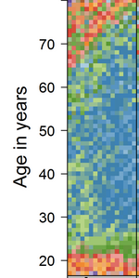
Social Class
The greatest period-based change, (early 2000s) shows increased
High
proportions of women born 1945-1970 driving, is clearest in the intermediate category, although apparent elsewhere.
Licenced
Medium
Drivers driving
Low

Slide 25
High
High
Although gender differences are still striking, social class dominates in the gap between licence and practice
Medium
Medium
Licenced
Drivers driving
Low
Low

Slide 26
Implications
Gender:
increased gender parity in licence and driving; cultural (choice)
period effect with millenials (economic insecurity, mostly male, constraint)
Urbanisation:
Less need to drive in urban areas BUT male/ female differential suggests still very desirable and possibly necessary for many
Social class:
Strong mediation by social class and period effect for intermediate women indicates constraint rather than choice as the key factor in lower mobility
Choice?
Applying an ‘equalities’ lens
Constraint?

Slide 27
Driving segregation: Driving licence uptake & emerging inequalities
Gender
Choice
Thank you!
Social Class
Constraint
Julie Clark & Jon Minton
University of Glasgow
Notes:
With the BHPS/US, can follow individuals over time (though not something we've done here) to better explore mobility over the life course. For example, we could look at whether individual life events, such as getting married, or birth of first child, influence whether people either get a licence or own a car.
Can correlate with many other individual and household level variables such as tenure and health.
Slightly more disagregated data on educational qualifications.
Possibly a more consistent set of questions over time.
(Based on the lookup table): in NTS it looks like whether people own a licence isn't asked directly, but a response to a question "Difficulties with using car for journeys to work", so people who don't have a licence may choose a different option.

