Slide 1
IFoA Life
Conference 2026

Slide 2
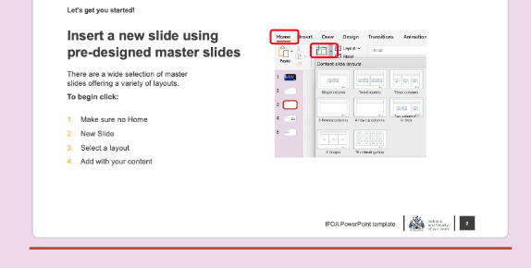

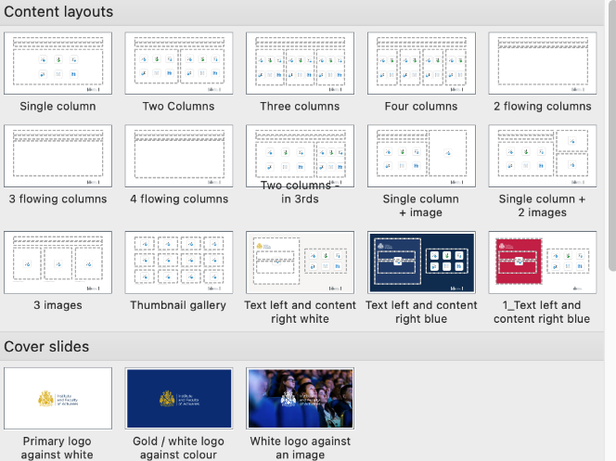
Let’s get you started!
Insert a new slide
1.
First make sure no slides are pre-selected. Your cursor should be a blinking horizontal line underneath the last slide.
This template contains a variety of
pre-defined, customizable layouts.
Follow the steps below to insert a new slide:
Make sure no existing slides are selected
Click 'Home', then 'New slide'
Select your preferred layout
The layout will load into your deck
Add your content and adjust the
slide to suit your needs
2.
3.
Layouts
are organised
into categories
4.

