Slide 1
IFoA Life
Conference 2026

Slide 2
Healthy Workforce:
Trends and metrics for long-term sickness and recovery rates for the UK working-age population
David Beddows FIA C.Act, Dr. Chris Martin, Dr. Jon Minton
IFoA Healthy Workforce Working Party
09:55 – 10:40, Friday 20th November 2026

Slide 3
Today’s agenda
Presented by members of the IFoA Healthy Workforce WP
Item | Time | Description
Welcome | 5 minutes | Background to the Healthy Workforce Working Party and relevance for actuaries
Why a healthy workforce matters | 10 minutes | Recent trends Independent and government-commissioned reviews Reflections from a clinical practitioner and human perspective
Health economics approaches to modelling long-term sickness | 5 minutes | Multi-state models for long-term sickness Health economics compared to actuarial approaches Survey data compared to administrative data
Metrics: methods and estimates | 15 minutes | Healthy Working Life Expectancy and related metrics Estimates of HWLE with CMI rates Applications of these metrics
Q&A | 10 minutes | Discussion of the topics presented Next steps for the WP

Slide 4
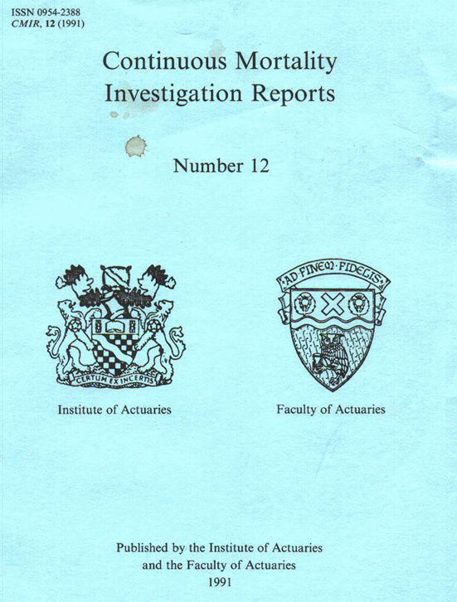
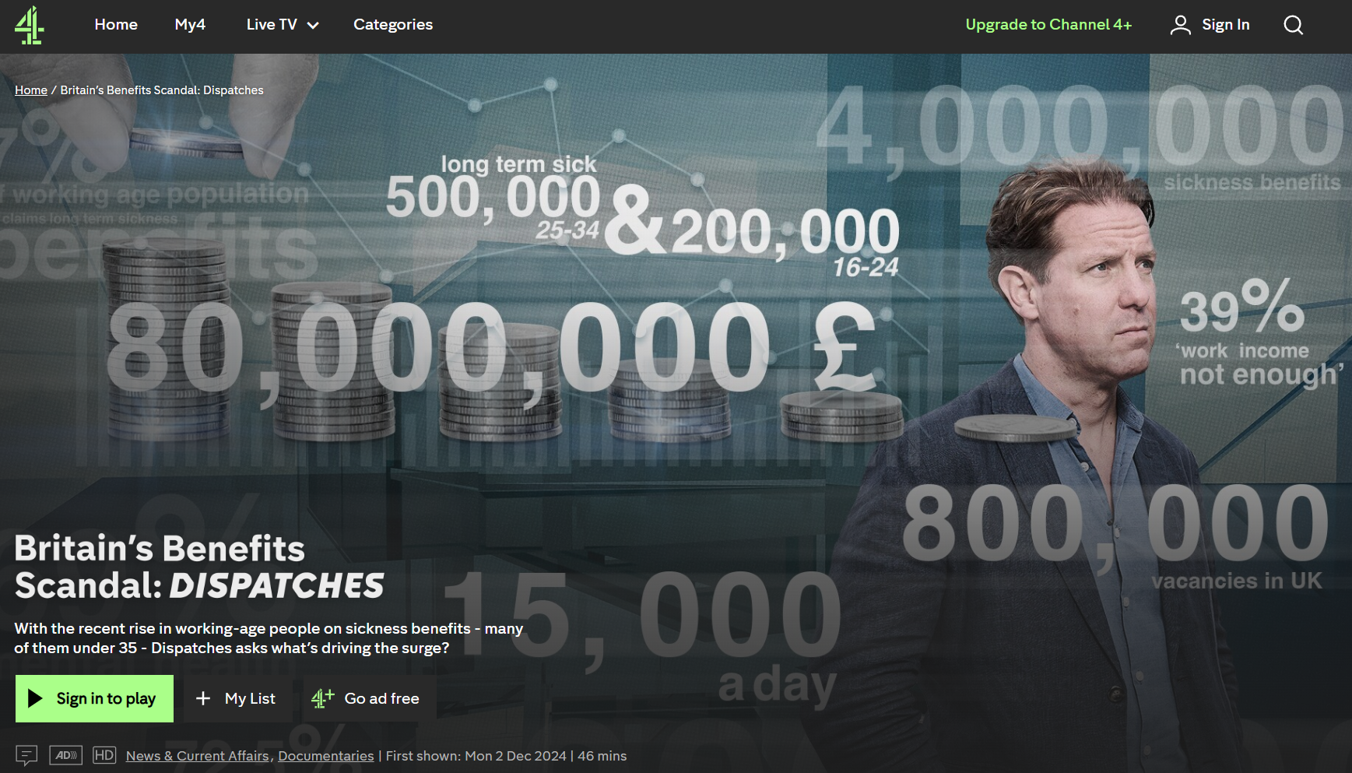

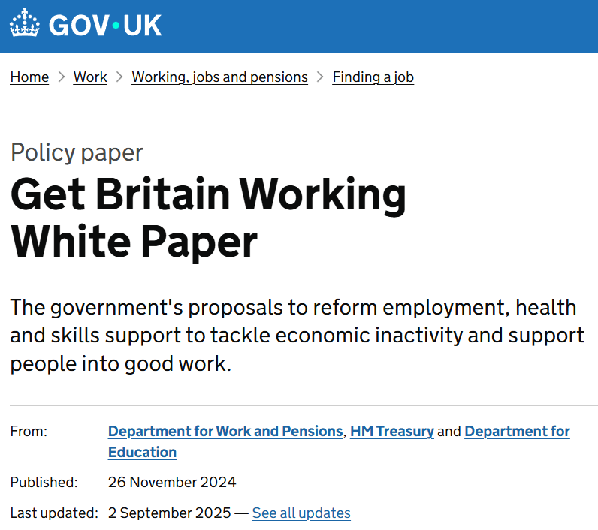
Background to the Healthy Workforce WP
Renewed focus on long-term sickness having high relevance for actuaries
public interest and government focus in 2024
  Lord Darzi NHS review
  Get Britain Working White Paper
high profile media stories, e.g.
  Channel 4 Dispatches documentary
actuarial knowledge and expertise in this area
well established methods with Income Protection modelling
CMI well-established methods and data
WP set up in early-2025
Notes:
Lord Darzi’s 2024 report on England's National Health Service stated that "the number of people [in the UK] who are economically inactive because of long-term sickness has risen to record highs."
It went further: "At the start of this year [2024], long-term sickness was the most common reason why people were out of the workforce, accounting for 30 per cent of the total or some 2.8 million people."
Long term sickness is clearly bad for the individuals affected and also bad for society.
Aside from the obvious undesirable state of poor health for the individuals concerned, it generates unwanted impacts including:
pressure on the nation's health system to support these individuals to recover;
financial insecurity for the individuals and their families of being unable to work.
Income Protection (IP) insurance products were originally developed to provide security for people against the financial consequences of being absent from work due to accident or illness for periods beyond statutory sick pay.
The insurance contracts are typically designed to start paying benefits at the point that statutory sick pay, or sickness benefits provided directly by the employer, reach their expiry date.
In recent years, insurers have begun to offer health and rehabilitation services alongside the pure insurance coverage.
These initiatives could have the double positive effects of reducing sickness incidence rates and also increasing recovery rates.
Within the IFoA, the Continuous Mortality Investigation (CMI) has produced, during several decades, many IP papers and IP claim inception rates and recovery rates tables for insured populations based on data provided by CMI subscribers.
These are immensely useful for many actuarial applications, such as pricing and reserving IP portfolios.
Some of these analyses have reviewed the 'cause of claim' (meaning the type of sickness) which have further potential applications, such as improving reserving methods and informing contract design.
In addition to the 'cause of claim' analyses performed by the CMI, there is potential to build on the profession's understanding of IP rates by researching UK population surveys and datasets.
As such, the IFoA set up a Working Party to explore the potential for external data sources (i.e. data not held by the CMI) to enhance the understanding of long-term sickness and recovery rates within national workforce population.
The aim was to provide insights to the modelling of income protection portfolios and wider public health applications.

Slide 5
The importance of a healthy workforce

Slide 6
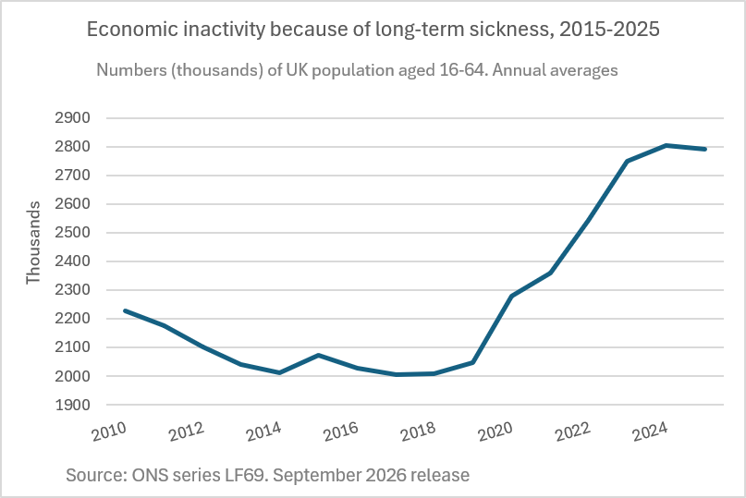
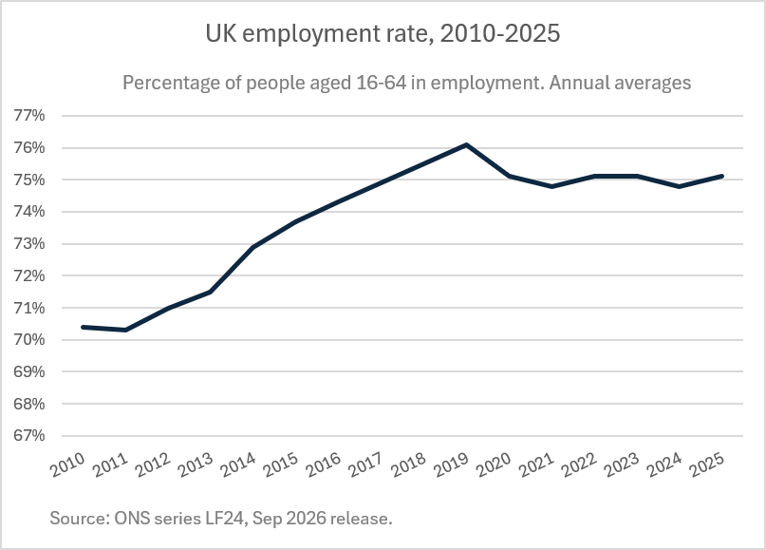
The rise in long-term economic inactivity due to ill health
The pandemic was clearly an important factor.
Whilst many suggest the problem began before the pandemic, the trivial rise in LSA in 2019 is marginal and may reflect population and demographic change.
Pandemic
Pandemic

Slide 7
The rise in sickness-related economic inactivity
UK, ages 16–64. Annual averages, 2019 to 2025
+746,000
More people economically inactive
because of long-term sickness
2.046 million in 2019 to 2.792 million in 2025 [1]
Illustrative allocation of the increase
Population growth
Demographic change
Remaining increase
≈86,000
≈65,000
≈595,000
11.5% of the increase
8.7% of the increase
79.8% of the increase
Larger population, holding the
2019 inactivity rate fixed. [1, 2]
2019–2022 share extrapolated
to 2019–2025.
Assumes separate, additive effects of population size and age composition. The residual does not isolate worsening health.
Sources: [1] ONS LFS, LF69. [2] ONS LFS, LF2O. September 2026 release.
Demographic share: Observed 8.7% of the increase between 2019 and 2022 projected to 2025.
Notes:
SOURCE LINKS AND CALCULATIONS
1. ONS Labour Force Survey series LF69, Long Term Sick, UK ages 16–64, seasonally adjusted, thousands. Release 15 September 2026. Annual 2019: 2,046,000. Annual 2025: 2,792,000. Difference: 746,000.
https://www.ons.gov.uk/employmentandlabourmarket/peoplenotinwork/economicinactivity/timeseries/lf69/lms
2. ONS LFS population aged 16–64 series LF2O, thousands. Same release. Annual 2019: 41,558,000. Annual 2025: 43,299,000. Increase: 1,741,000. Holding the aggregate 2019 sickness-inactivity rate constant gives 1,741,000 × (2,046,000 / 41,558,000) = about 85,714, rounded to 86,000 (11.5% of the increase). This is a counterfactual calculation, not an ONS causal estimate.
https://www.ons.gov.uk/employmentandlabourmarket/peopleinwork/employmentandemployeetypes/timeseries/lf2o/lms
3. User-supplied demographic share 8.7%, described as extrapolated from 2019–2022. Its original source has not been verified. 746,000 × 8.7% = 64,902, rounded to 65,000.
ONS (19 May 2023), Health, demographic and labour market influences on economic inactivity, UK: 2019 to 2022, estimates an age-structure effect for inactivity for ALL reasons. That analysis does not directly substantiate an 8.7% contribution to the increase due to long-term sickness.
https://www.ons.gov.uk/employmentandlabourmarket/peoplenotinwork/economicinactivity/articles/healthdemographicandlabourmarketinfluencesoneconomicinactivityuk2019to2022/2023-05-19
Illustrative chart uses 86,000 + 64,902 + 595,098 = 746,000. The residual is approximately 595,000 or 79.8%. This assumes population size and demographic composition contributions can be treated separately and additively. The demographic source and its compatibility with this outcome need verification before presenting this as an established decomposition. The residual may encompass changes in health, employment conditions, reporting, measurement and other influences. It does not quantify worsening health alone.

Slide 8



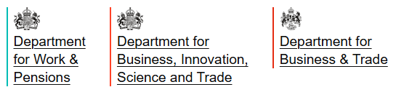
The problem
2024
Lord Darzi’s independent review of the NHS
Identified:
Deteriorating working age health
Deteriorating access to health care
Rise in long-term economic inactivity due to poor health.
2024-2026 reports
A call to action to the government
2024
Get Britain Working
80% employment ambition
Joining up of health, employment and skills support
2025 (Sep 2026 update)
Keep Britain Working
Employer perspective
Plan for action

Slide 9

Factors affecting absence and return
Capacity has to match the job and the wider demands on the person
Socio-economic context
Illness or disability
Workplace and role
Variability
Adaptability
Personality
Vulnerabilities
Work stressors
COPE
Work
Family
Competing roles and responsibilities
Culture
Carer
Functional impairments
Social norms about the sick role
Functional requirements / risks
Financial demands

Slide 10
Illness and disability factors
Same condition, different work impact
Worker | Health issue | Why it stops work
Warehouse worker | Knee arthritis | Unable to do manual work until the knee operation; a desk worker might barely notice it
Lorry driver | Depression, on sedating antidepressants | Drowsiness rules out driving; severe depression can mean a stable period before driving again
Surgeon | Breast cancer, successfully treated | Left with poorer eyesight and less sensation in her fingers, so operating is harder
Firefighter | Asthma triggered by smoke | The trigger is the job's core exposure
Treatment, not only illness, can be the barrier.
Presenter examples (C. Martin, occupational health and GP experience). DVLA fitness-to-drive guidance.

Slide 11
Proposed changes
Promising proposals, with caveats
Proposal | What it could do | Clinical caveat
Workplace health provision | Help employers adapt roles and phase returns | Still relies on NHS services for anything beyond minor episodes
Early contact during absence | Keep people connected to their job | Can feel like harassment when stress is work-related; making it routine may help
Healthy Working Lifecycle | A conceptual basis for building workplace health provision | Its value is at system level, more than for keeping individual cases in work
The measurement gap: sustained return to work is seldom measured consistently. Modelling onset, recovery and recurrence can help fill it.
Mayfield, Keep Britain Working (Nov 2025) and September 2026 update. Caveats: C. Martin.

Slide 12
From survey data to administrative data

Slide 13
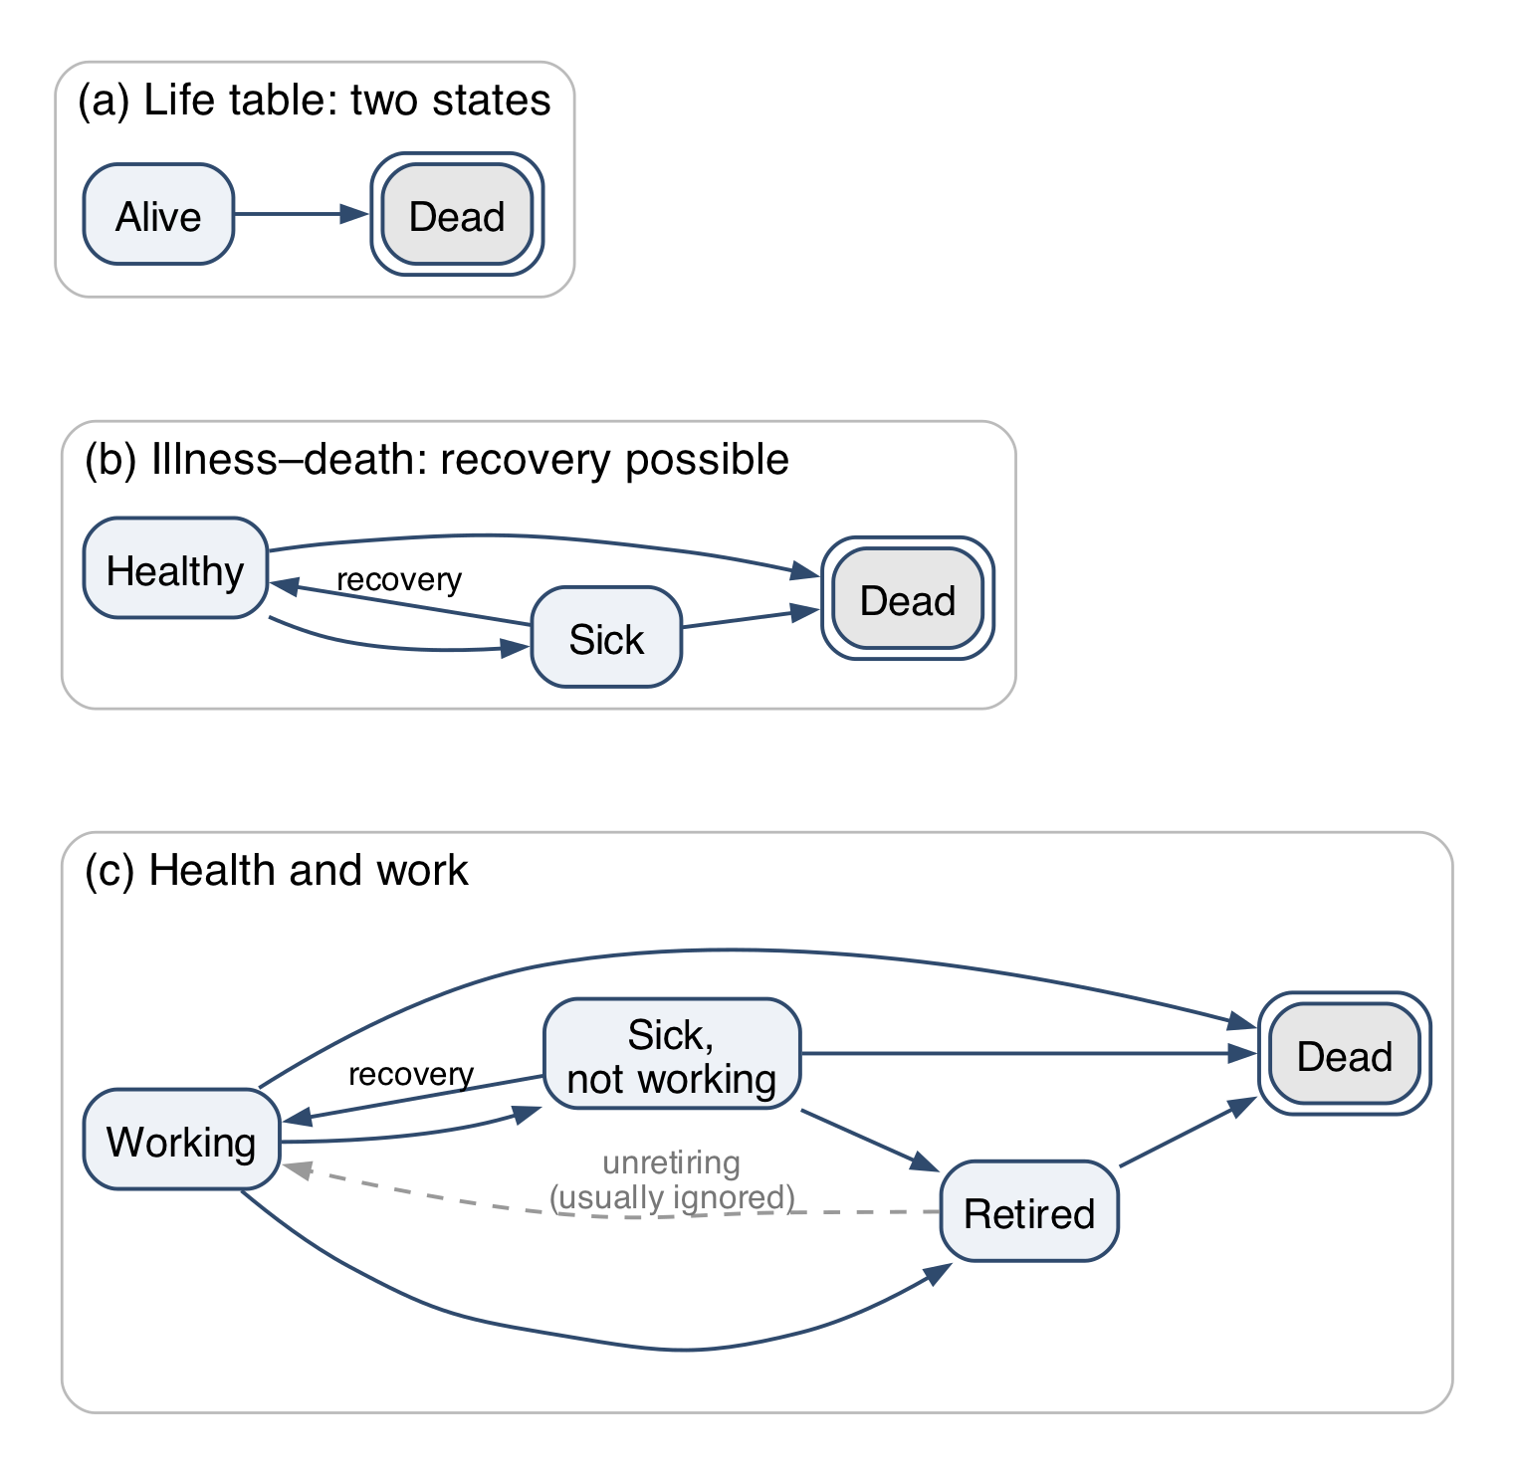
Multi-state models: a reminder
A life table is a two-state model. Add states, and the same machinery gives expected time in each state: HWLE is expected years working.
Absorbing states can’t be left (death, double border). Non-absorbing states can: sickness allows recovery.
Retirement is usually modelled as one-way, but in life it isn’t quite absorbing.
Notes:
Jon Minton, Knowledge Tree and Butterfly: one-line intro on taking over from Chris.
About 1.5 minutes. A reminder, not a lecture: everyone here has seen multi-state life tables. Panel (a) is the life table; (b) adds a state you can leave; (c) is the shape of the health-and-work problem. Double border = absorbing.
Retirement: “Hotel California”: you can check out any time you like, but you can never leave. In the model it is one-way; in life people do unretire, and pension-age policy cares about exactly that.
REMINDER (Jon): unpack HWLE here, briefly, and say David defines it fully in his section. From a modelling perspective there are three ways to bound 'working life'. They are conceptually similar but get thought about slightly differently: (1) treat retirement as an absorbing state, like death, so time stops accruing once someone retires; (2) count only the time accumulated in the feeder states (working, sick) on the way to retirement; (3) only consider paths that start and end within working age (e.g. 50 to 65). David's model starts everyone working and retires everyone at 65, so it sits closest to (1) and (3).

Slide 14
Same machinery, two traditions
Health economics
Markov cohort models with many states, recovery included
Each state carries a cost and a utility (quality of life)
Question: is this intervention worth paying for? (cost per QALY)
Usually parameterised from trials and surveys
Actuarial
Multi-state models from dated events (time-to-event)
Rates can depend on duration in a state
Question: how long, and at what cost, in each state?
Usually parameterised from experience data
→ HWLE sits between them: a public-health question answered with actuarial tools.
Notes:
About 1.5 minutes. The point for this audience: health economists and actuaries build the same kind of model and ask different questions of it. Health economics attaches utilities and costs to states to decide what to fund; actuaries attach durations and money to states to price and reserve. Working-age ill health is a place where both questions matter: the policy question (Keep Britain Working, from Chris) and the insurance question (David’s section).

Slide 15
What survey data give us, and what they force on us
Surveys give us (ELSA, Understanding Society)
The whole population, including people not working or insured
Health and work status, observed together
Accessible, well understood, long-running
Surveys force on us
Roughly annual waves: status at snapshots, not dated events
So: one-year Markov steps; moves between waves are unseen
No duration since onset, so recovery can’t depend on it
Self-reported states; tens of thousands of people at best
→ Administrative data relax these limitations. → Next: HWLE from insurers’ claims data.
Notes:
About 2 minutes, ending on the hand-off. Survey data are the only view of the whole population, which is why every published UK HWLE estimate so far uses them (ELSA: Lynch 2022, Parker 2020; supplement). But annual waves mean the model can only be a one-year Markov chain: what happened between interviews is invisible, and there is no clock on how long someone has been sick. Actuarial time-to-event data give dated claim inceptions and recoveries, with recovery depending on how long the claim has run. Hand over: “David will show what that buys us: healthy working life expectancy from CMI income protection experience.”

Slide 16
Healthy Working Life Expectancy

Slide 17
Healthy Working Life Expectancy as a metric
Concepts similar to HWLE presented in the actuarial journals: tracing the move from working-life tables to multi-state models and healthy working life expectancy
Selected academic and actuarial publications | 1970–2025
1970
1975
1980
1985
1990
1995
2000
2005
2010
2015
2020
2025
Lièvre et al.
Healthy working life at 50 · Europe
Methods & HWLE introduction
Sullivan
Health expectancy method
Mathers et al.
Sullivan method validation
Parker et al.
Review + England estimates
Lynch; Heller; Weber
England / Germany / Europe
HWLE estimates for the UK
Haberman II; Waters
Decrement tables; multi-state models
Dudel
Healthy / unhealthy WLE
Lynch et al.
HWLE determinants at age 50
Haberman & Bloomfield
Work time lost to sickness
Pollard
Morbidity–mortality interaction
Journal of the Institute of Actuaries
Haberman I
Decrement tables / morbidity
Haberman
Long-term sickness & invalidity
CMI WP 109
Proposed IP06 claim inception
CMI IP Tool v1.2
Income protection modelling tool
CMI Income Protection investigations
CMIR 12
Permanent health insurance data
CMI WP 59
Income protection investigation
CMI WP 131 / IP11 Claim inception & termination
Notes:
Similar concepts, including 'expectation of disease-free-life' and 'working life expectancy', were presented in the actuarial literature in earlier decades
Many examples in the Journal of the Institute of Actuaries from the 1970s to the 1990s (Pollard, 1980) and (Haberman and Bloomfield, 1990).
For example, analysis of 'expectation of disease-free life’ , including specific diseases such as 'expectation of breast-cancer-free life' was presented by Pollard (Pollard, 1980).
Derivations of 'average duration of sickness' (Haberman, 1987) and development of methods for calculating 'working life expectancy' (Haberman and Bloomfield, 1990) were also published.
This coincides with the beginning of the Continuous Mortality Investigation (CMI) starting to investigate Income Protection experience.
The CMI has collected data from its contributors (UK life insurers) since the 1970’s (“landmark publication” : IFoA CMI Report 12, 1991) on the sickness and claims incidence of individual income protection (IP) portfolios.
This was the forerunner to the IP investigations.
So it has long been recognized that HWLE and similar metrics are of interest to actuaries and life and health insurers.
E.g. HWLE could be a useful benchmark for life and health insurers when developing new life insurance products such as disability income protection and pensions savings contracts.

Slide 18
Healthy Working Life Expectancy as a metric
Healthy working-life expectancy first appears as a term in the public health literature in 2007
Selected academic publications | 1970–2025
1970
1975
1980
1985
1990
1995
2000
2005
2010
2015
2020
2025
Lièvre et al.
Healthy working life at 50 · Europe
Methods & HWLE introduction
Sullivan
Health expectancy method
Mathers et al.
Sullivan method validation
Parker et al.
Review + England estimates
Lynch; Heller; Weber
England / Germany / Europe
HWLE estimates for the UK
Dudel
Healthy / unhealthy WLE
Lynch et al.
HWLE determinants at age 50
…. but similar concepts had been presented in actuarial journals decades earlier
Notes:
Methods for Healthy Life Expectancy described in the 1960s and 1970s.
Sullivan developed a method for combining disease prevalence data with life tables to derive Healthy Life Expectancy (not considering work capacity).
The term ‘Healthy Working Life Expectancy’ (HWLE) first appears in the literature in 2007 (Lièvre et al. 2007).
It has been the focus of many public health / health economics papers since then and is becoming more common as a metric for indicating the health and potential productivity of a population.
Many papers not shown on the slide here as we have picked out just some of the recent ones focusing on the UK.
But some examples during the years in between for other countries.
It is a useful indicator for a number of public health and policy areas.
In recent years it has been presented as a measure for assessing the appropriateness of increasing retirement ages and for the adequacy of national social security policy-making (Parker et al. 2020b).
It could also be a useful metric for public health planning and developing and measuring the success of strategic plans for national health services.
Similar concepts had been presented in actuarial journals and other literature decades earlier.

Slide 19
Healthy Working Life Expectancy as a metric
A statistic which incorporates sickness rates, recovery rates and mortality rates across the future lifetime
Usefulness and applicability to the life and health insurance domain
comparing existing pricing and reserving bases
benchmarking pricing and reserving bases against wider population
product development for new population segments
Usefulness and applicability to health economics and public policy-making
social security benefits demand projections;
health service demand projections;
economic analyses incorporating projections of the future UK workforce;
setting retirement ages and state pensions policy.
Notes:
Insurance applications
It allows population survey-based estimates of HWLE, WLE, HWPLE or WPLE to act as benchmarks for the HWPLE derived from life insurance portfolios which can help to refine income protection insurance modelling assumptions, pensions savings scheme projections, or develop modelling assumptions for new life insurance customer segments.
For example, insurers aiming to develop income protection contracts for new population segments can use estimates of HWPLE for segments with distinct health characteristics or distinct occupations to inform their pricing assumptions.
Insurers with existing portfolios of IP contracts can update their assumptions for claim inception rates and recovery rates by calculating HWPLE for their existing assumptions and comparing these with population trends of HWPLE.
HWPLE can act as a useful and easily understood descriptive statistic for describing morbidity bases.
From one time period to another or from one population segment to another, the HWPLE offers a meaningful statistic that can be used to compare bases.
It can be understood intuitively.
For example, the mortality rates in the basis can be set the same for different segments and then segment-specific sickness inception and recovery rates applied.
The HWPLE then offers an indication of the relative difference of the sickness and recovery rates.
Health Economics applications
clearly a number of uses
For pensions provision, it provides a view on how many years people will be actively working and therefore able to make regular contributions to a pension savings scheme. Current pension scheme projections of retirement benefits are typically based on the expectation that people will work uninterrupted from now until the State Pension Age. In reality, this is not true for many people. HWPLE offers a method to adjust pension projections to a more realistic level, allowing for the expectation that there will be periods of sickness during a working lifetime which may be mean periods of reduced income, and therefore allow people to make more informed decisions about their retirement provisions.

Slide 20
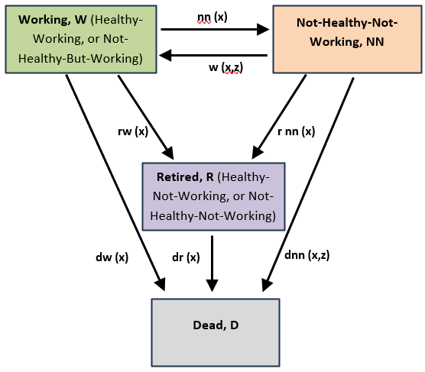
Multi-state model method with administrative data
to take advantage of CMI IP11 rates
leading to an increment-decrement life table
Rate | Basis
nn(x) | CMI IP11 claim inception, DP4
w(x,z) | CMI IP11 recovery rates
dw(x), dr(x) | ONS UK 2022–24
dnn(x,z) | CMI IP11 claimant mortality
rw(x), rnn(x) | 1 at age 65; 0 otherwise
4 states with 7 transition routes
transition rates derived from administrative data
Advantages
transitions out of NN state are duration-dependent
explicit allowance for expected retirement age
Disadvantages
currently limited data availability in the UK beyond insured populations
CMI claim inception rates used as a proxy for sickness inception rates
Notes:
So here is the multi-state model we settled on in the Healthy Workforce WP for our first version, and the initial parameterisation.
4 states and 7 transitions between them.
Model
Despite there being well-established notation conventions for such models, we introduced new notation in order to distinguish from the CMI multi-state model.
Parameterising the model with transition rates:
We are using CMI claim inception rates as a proxy for sickness inception rates.
Recovery rates back to the Working state are CMI rates for recoveries from claim state.
Mortality rates for deaths from the Working and Retired states based on UK population data.
Retirement rates set to be 1 at age 65 and 0 at all other ages. This can be varied in future iterations: e.g. to allow for early retirements, late retirements and extending the normal retirement age.
As the CMI rates are derived from income protection portfolios, the initial state is people who are working.
Their health status is unknown except to the extent that they are sufficiently healthy to work.
However, for the purpose of the demonstration, we refer to them as Healthy and Working.
The Not-Healthy-Not-Working state is people who have paused working due to health reasons.
Advantages of this 4-state model
duration-dependent recovery rates
explicit allowance for retirement age
Disadvantages of this 4-state model
currently limited data in the UK beyond insured populations
CMI claim inception rates used as a proxy for sickness rates
However, if we are interested only in long-term sickness and happy to ignore sickness where the recovery was within 4 weeks then this is not such a bad approximation,

Slide 21
Healthy Working Life Table
Derived from administrative data (CMI and ONS)
Example for females occupation class 1 who are healthy and working at age 50
time in years | exact age | Healthy Working lives | Retirees | Not-Healthy Not-Working lives | Deaths
0 | 50 | 100’000 | 0 | 0 | 0
1 | 51 | 98’265 | 0 | 1’501 | 235
2 | 52 | 97’368 | 0 | 2’109 | 524
3 | 53 | 96’478 | 0 | 2’676 | 846
4 | 54 | 95’524 | 0 | 3’272 | 1’204
5 | 55 | 94’480 | 0 | 3’916 | 1’604
6 | 56 | 93’341 | 0 | 4’615 | 2’044
… | … | … | … | … | …
14 | 64 | 80’910 | 0 | 11’727 | 7’363
15 | 65 | 78’341 | 10’364 | 3’213 | 8’082
16 | 66 | 0 | 91’525 | 0 | 8’475
17 | 67 | 0 | 90’706 | 0 | 9’294
Estimates: female 50 OC1
HWPLE = Healthy Working Partial Life Expectancy
NNPLE = Not-Healthy Not-Working Partial Life Expectancy
13.5 years
0.9 years
Notes:
So here are some preliminary results. (using the CMI IP11 rates for Deferred Period 4 weeks and Occupation Class 1)
The multi-state model in this example is initiated with all lives in the Working State, 100’000 lives, and aged exactly 50 at time zero.
It generates a life table as shown.
which can be visualised like this… [move to next slide showing the chart]

Slide 22
Healthy Working Life Table
Derived from administrative data (CMI and ONS)
Example for females occupation class 1 who are healthy and working at age 50
Estimates: female 50 OC1
HWPLE = Healthy Working Partial Life Expectancy
NNPLE = Not-Healthy Not-Working Partial Life Expectancy
13.5 years
0.9 years
Notes:
which can be visualised like this… [move to next slide showing the chart]
The 100’000 lives transition in and out of the not-healthy-not-working state from age 50 up to age 65.
At age 65, all working and all not-healthy-not-working lives start transition to the Retired state during that year.
(In raw results, there might be some spillage of retirements into age 66 due to multiple-decrement approximations)
(using the CMI IP11 rates for Deferred Period 4 weeks and Occupation Class 1)
Explain HWPLE and NNPLE
P = Partial
NN is shorthand for NHNW
From the generated life table, it is then straightforward to calculate the expected time spent in each state.
Given that the model is parameterised for everyone to retire at age 65 then the maximum possible HWLE would be 15 years.
Our preliminary results (as a reminder based on CMI IP11 transition rates and UK population mortality) indicates:
HWLE = 13.5 years
NNLE = 0.91 years
The gap to 15 years relates to the deaths.

Slide 23
HWLE estimates with CMI IP rates: males and females
Examples for a sample of starting ages to age 65 for occupation class 1
Females
Males
retire 65
retire 65
NNPLE = Not-Healthy Not-Working Partial Life Expectancy
HWPLE = Healthy Working Partial Life Expectancy
Notes:
Here are examples of our initial results, which aim to demonstrate the proof-of-concept of using administrative data to make estimates of HWLE.
Observations applying to both females and males: (align with intuition) (using the CMI IP11 rates for Deferred Period 4 weeks and Occupation Class 1)
HWPLE decreases as starting age increases (obviously);
NNPLE decreases as starting age increases but proportionally less so than HWPLE;
The proportion of the working life to age 65 spent in the NN state is higher at older starting ages.
A 20-year-old woman has 42.4 years HWPLE and 1.3 years NNPLE, meaning they spend 94% of their working lifetime to age 65 in the working state and 3% of their working lifetime in the NN state.
A 50-year-old woman has 13.5 years HWPLE and 0.9 years NNPLE, meaning they spend 90% of their working lifetime to age 65 in the working state and 6% of their working lifetime in the NN state.
A 20-year-old man has 42.2 years HWPLE and 0.9 years NNPLE, meaning they spend 94% of their working lifetime to age 65 in the working state and 2% of their working lifetime in the NN state.
A 50-year-old man has 13.7 years HWPLE and 0.6 years NNPLE, meaning they spend 91% of their working lifetime to age 65 in the working state and 4% of their working lifetime in the NN state.

Slide 24
HWLE estimates with CMI IP rates
Examples for a sample of starting ages to age 65 for occupation class 1
(average of females and males)
Observations (align with intuition)
HWPLE decreases as starting age increases;
NNPLE decreases as starting age increases but proportionally less so than HWPLE;
The proportion of the working life to age 65 spent in the NN state is higher at older starting ages.
HWPLE = Healthy Working Partial Life Expectancy
NNPLE = Not-Healthy Not-Working Partial Life Expectancy
Starting Age | HWPLE to age 65 | NNPLE to age 65
20 | 42.3 | 1.1
30 | 32.5 | 1.0
40 | 23.0 | 1.0
50 | 13.6 | 0.7
60 | 4.7 | 0.2
A 20-year-old has 42.3 years HWPLE and 1.1 years NNPLE meaning:
94.0% of their working life to age 65 in the working state;
2.4% of their working lifetime in the NN state;
3.6% of the 45 years relates to deaths before 65.
A 50-year-old has 13.6 years HWPLE and 0.7 years NNPLE meaning:
90.7% of their working life to age 65 in the working state;
4.9% of their working lifetime in the NN state;
4.4% of the 15 years relates to deaths before 65.
Notes:
Here is a summary showing the average of female and male results at selected ages.
and summary of observations described previously.
Highlight the result for age 50 as that is used for comparison with outputs of other studies

Slide 25
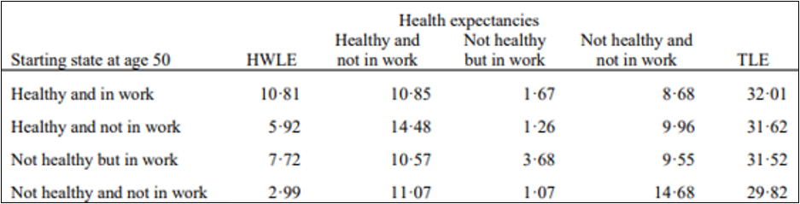
HWLE comparisons with other published results
Parker et al. (2020) developed estimates of HWLE for English lives starting at age 50
derived from survey data (English Longitudinal Study of Ageing, ELSA) for a representative sample of the UK population aged 50 and older.
results given for the average time spent in each of 4 healthy/working states from age 50 onwards.
retirement is not modelled
lives can be in any of the 4 states at age 50, unlike in our modelling in which all lives start in the Working state.
12.48
compare 13.6
Notes:
Much of the literature focusses on a single starting age for calculating HWLE and this is typically chosen to be age 50.
Furthermore, they are based on population survey data and not a specific cohort, such as those people who are currently working.
As such, there are only a small number of comparable results in the literature and, even those are not exactly like-for-like.
The most comparable work identified is that of Parker et al. (Parker et al. 2020b), who developed estimates of HWLE for lives starting at age 50.
That work was based on a representative sample of the UK population aged 50 and older.
Most of their results presented show the average time spent in each of 4 healthy/working states from age 50 onwards.
This means that retirement is not considered and also that lives can be in any of the 4 states at age 50, unlike in our modelling in which all lives start in the Working state.
Parker does present some results for lives starting in the Healthy and Working state at age 50.
"People who were healthy and in work at age 50 years had a healthy working life expectancy of 10·81 years…"
From this, we can infer that the Healthy Working Partial Life Expectancy most comparable to our result is (the sum of HWLE and Not-Healthy but in Work LE)), meaning 10.81 + 1.67 = 12.48 years.
This compares to our results of 13.6 years (OC1), 13.8 years (OC2), 13.5 years (OC3) and 13.3 years (OC4).
The Parker result represents the general UK population whereas the CMI IP11 rates represent insured lives, so are different population segments. Additionally, the CMI IP11 rates are claim inception rates which ignore short durations of sickness and are based on definition of sickness under IP insurance policies rather than self-reported health survey responses.
Due to both the population segment and the definition of sickness/health, it is not unreasonable to expect the Parker result to be lower than the results based on the CMI IP11 rates.
Additionally, Parker's method includes the possibility of people being healthy and working at ages above 65, whereas our modelling intentionally truncates the working life at age 65.
This modelling assumption causes our HWPLE to be lower than Parker's HWLE, all else being equal.
Although both Parker and our model generate results for not-healthy-not-working, Parker‘s NHNW results include time periods post-retirement whereas our results are limited by retirement.
E.g. In the HWP Tool, for a 50-year-old, the sum of HWPLE and NNPLE is less than 15 years since it assumes 100% retirement at age 65.
Parker‘s method does not consider a retirement age.
E.g. Some of the 8.68 years in Parker's NHNW result would be years post-retirement age.

Slide 26
Closing discussion

Slide 27
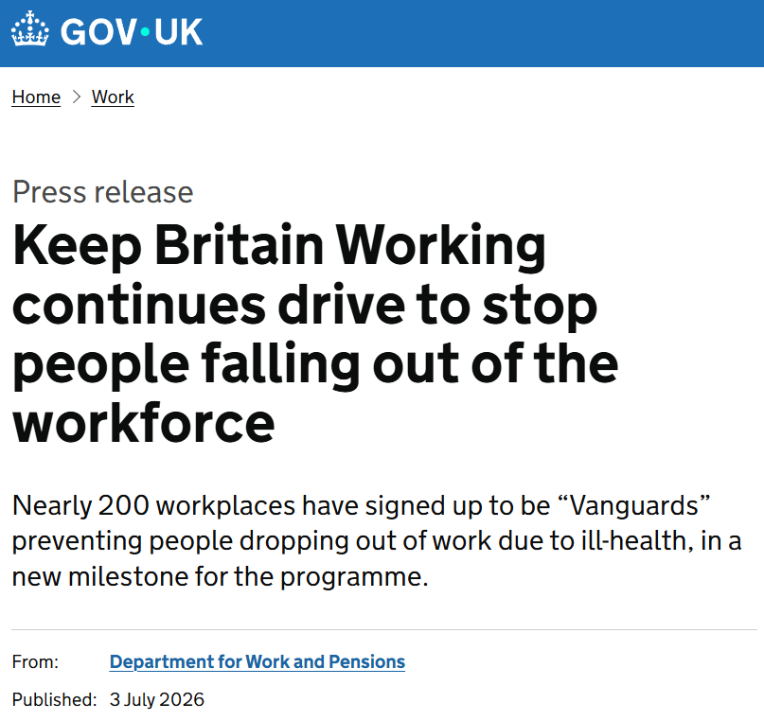
Coming soon
Policy initiatives and IFoA planned research
UK government
IFoA Healthy Workforce WP
modelling a range of retirement ages;
alternative definitions of 'healthy' and 'working';
CMI data over time periods to give indications of trends over time;
rates derived from population surveys to provide further benchmarks;
transition rates that are derived from administrative data held by UK public authorities such as the DWP;
international comparisons
Notes:
Keep Britain Working
Over 250 employers, 10 mayoral authorities and all 3 devolved administrations work with Sir Charlie Mayfield, reshaping how disability and ill-health are supported at work.
Latest Keep Britain Working report shows shared responsibility and better data, supported by personalised plans will be key to helping people remain in work.
A new Workplace Health Intelligence Unit will track sickness absence, return-to-work outcomes and disability participation making workplace health performance visible for the first time.
IFoA Healthy Workforce WP
additional scenarios to reflect the planned evolution of UK State Pension Age and also incorporating estimates of rates of early retirements;
alternative definitions of 'healthy' and 'working';
rates derived from CMI data over time periods to give indications of trends over time;
rates derived from population surveys to provide further benchmarks against the whole UK working-age population and comparisons against the literature;
transition rates that are derived from administrative data held by UK public authorities that administer sickness and incapacity benefits;
transition rates that are derived from administrative data from other countries to enable international comparisons.

Slide 28
Conclusions
HWLE is an important metric for many purposes
Administrative data can complement or replace survey data for HWLE (methods)
development of public datasets
recognise value of insurance industry data
HWLE is a useful descriptive statistic for morbidity bases (insurance)
assessing pricing and reserving bases
product design and expanding IP products to wider segments
HWLE has policy relevance to state benefits, State Pension Age and pensions adequacy (policy)
Keep Britain Working
social care policy
pension planning
health service planning
→ Opportunity for actuaries to deploy core expertise for the public interest
Notes:
HWLE is an important metric for many purposes.
Administrative data can complement or replace survey data for HWLE (methods):
development of public datasets;
opportunity for actuaries to deploy core knowledge.
HWLE is a useful descriptive statistic for morbidity bases (insurance):
assessing pricing and reserving bases;
product design and expanding IP products to wider segments.
HWLE has policy relevance to state benefits, State Pension Age and pensions adequacy (policy):
Keep Britain Working;
social care policy;
pension planning;
health service planning.

Slide 29
Questions
Comments
Expressions of individual views by members of the Institute and Faculty of Actuaries and its staff are encouraged.
The views expressed in this presentation are those of the presenter.

Slide 30
Appendices

Slide 31
Healthy Workforce
Trends and metrics for long-term sickness and recovery rates for the UK working-age population
Abstract Summary:
As Sir Charlie Mayfield notes in the 2025 Keep Britain Working report, "ill-health has now become one of the biggest drivers of economic inactivity in the UK". The well-established methods that actuaries employ for understanding and explaining the dynamics of Income Protection business can have useful applications for understanding the health of the workforce.
A specific population health metric that is gaining more attention is Healthy Working Life Expectancy ('HWLE'). This is an estimate of the length of time that a person will be both healthy and working and can be an indicator of the health and potential productivity of a population. It has been presented as a measure for assessing the appropriateness of increasing retirement ages and for the adequacy of national social security policy-making. It could be a useful benchmark for life and health insurers when developing new life insurance products such as disability income protection and pensions savings contracts.
Furthermore, estimating HWLE from datasets across historic time periods is a useful statistic for measuring the trends in long-term sickness and economic inactivity within the UK national workforce population. Using life insurance data to calculate HWLE represents the first attempt to estimate HWLE for a UK population segment with administrative data, rather than survey results, and therefore is a novel approach.
Key takeaways will include methods and results of calculating HWLE for the UK population and discussion of the advantages and disadvantages of these methods.
Practical details
Presenters: David, Chris and Jon
Date: Friday 20th November
Time: 09.55-10.40 (Please note that the day/time of your session may be subject to change)
Location: The ICC, 8 Centenary Square, Birmingham, B1 2EA

Slide 32
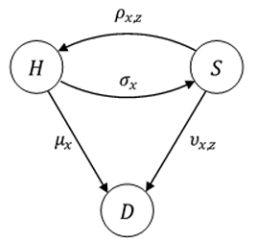
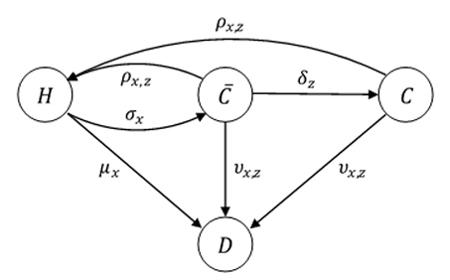
CMI income protection analysis
sickness inception rates v claim inception rates
For many years, the CMI used the multiple-state model shown top right, originally introduced in CMIR 12, as a basis for the modelling of Income Protection business, where H, S and D denote the Healthy, Sick, and Dead states, respectively. However, one limitation was:
“… the model focuses on sicknesses whereas the data supplied to the CMI instead relates to claims, and not all sicknesses result in claims. Indeed, an IP claim inception can only arise from a sickness inception if the insured life remains sick throughout the deferred period of the policy and then claims. The CMI dataset therefore does not allow observation of transitions during the deferred period between states S and H, in either direction, or from state S to state D."
To address this limitation, the CMI introduced a 4-state model, as shown bottom right. In this expanded version of the multiple-state model, the Sick state, S, is split into a 'Sick-but-not-Claiming' state, 𝐶 ̅, and the 'Sick-and-Claiming' state, C. This model may be regarded as a multiple-state model for IP claim inceptions.

Slide 33
Definitions of ‘healthy’ and ‘working’ states
Survey data versus administrative life insurance data
Study | Definition of Healthy or Not-Healthy | Definition of Working or Not-Working
Survey data examples: Lynch et al., 2024 And Parker et al., 2020b (England) | Self-reported responses to these 2 questions: "Do you have any long-standing illness, disability or infirmity?" "Do these illnesses or disabilities limit your activities in any way?" | Work status self-reported in the ELSA survey as participation in paid work or self-employment within the month preceding the ELSA interview, or not.
Administrative data examples: CMI IP11 (UK) | A person insured within an income protection scheme and actively working (i.e. not claiming benefits under the scheme) or not. People who are receiving benefits are 'Not-Healthy' and 'Not-Working' as per the claim trigger definitions within their insurance policy. People who are not receiving benefits are 'Working' but details of their health status are not complete so cannot for sure be described as 'Healthy'.
Notes:
Survey-based analyses use definitions that are based on answers provided by survey respondents.
Answers to specific questions are used to classify the respondents into the states of interest, such as with the analyses that use results from the English Longitudinal Study of Ageing (ELSA) (Banks et al. 2021).
CMI IP portfolio data is based on administrative data of Income Protection portfolios and reflects actual transitions between working and not working due to ill-health (limited by the effect of IP deferred periods).
However, the IP data does not collect data on health status whilst working, or during the IP policy deferred period. Insurers may have collected some data at the policy application underwriting stage but this is not routinely collected by the CMI.

Slide 34
CMI occupation classes
Definitions used in the CMI Income Protection investigations
Occupation Class | Description
OC1 | Professional, managerial, executive, administrative and clerical classes not engaged in manual labour
OC2 | Master craftsmen and tradesmen engaged in management and supervision; skilled operatives engaged in light manual work in non-hazardous occupations
OC3 | Skilled operatives engaged in manual work in non-hazardous occupations
OC4 | Skilled and semi-skilled operatives engaged in heavy manual work or subject to special hazard
Source: CMI IP Occupation Class Descriptions (IFoA CMI Working Paper 59, 2012)
Notes:
Survey-based analyses use definitions that are based on answers provided by survey respondents.
Answers to specific questions are used to classify the respondents into the states of interest, such as with the analyses that use results from the English Longitudinal Study of Ageing (ELSA) (Banks et al. 2021).
CMI IP portfolio data is based on administrative data of Income Protection portfolios and reflects actual transitions between working and not working due to ill-health (limited by the effect of IP deferred periods).
However, the IP data does not collect data on health status whilst working, or during the IP policy deferred period. Insurers may have collected some data at the policy application underwriting stage but this is not routinely collected by the CMI.

Slide 35
HWLE estimates: CMI occupation classes
Examples to age 65 for the CMI Occupation Classes for starting age 50
Healthy Working Partial Life Expectancy, HWPLE
Not-Healthy Not-Working Partial Life Expectancy, NNPLE
Occupation Class | Females | Males | Overall
CMI IP11 OC1 | 13.5 | 13.7 | 13.6
CMI IP11 OC2 | 13.7 | 13.8 | 13.8
CMI IP11 OC3 | 13.3 | 13.6 | 13.5
CMI IP11 OC4 | 13.1 | 13.4 | 13.3
Occupation Class | Females | Males | Overall
CMI IP11 OC1 | 0.9 | 0.6 | 0.7
CMI IP11 OC2 | 0.7 | 0.4 | 0.6
CMI IP11 OC3 | 1.0 | 0.6 | 0.8
CMI IP11 OC4 | 1.2 | 0.8 | 1.0
Observations on HWPLE
HWPLE is higher for men than for women, across all 4 occupation classes;
HWPLE is highest for occupation class 2, closely followed by class 1, then class 3 and class 4 has the lowest HWPLE;
Across all 4 occupation classes, HWLE is higher for females than males at younger ages but switches to being higher for males than females at older ages.
Observations on NNPLE
NNPLE is lower for men than for women, across all 4 occupation classes;
NNPLE is lowest for occupation class 2, closely followed by class 1, then class 3 and class 4 has the highest NNPLE, i.e. the reverse order compared to HWPLE;
Notes:
HWPLE ranges from 13.8 years for males in occupation class 2 to 13.1 years for females in occupation class 4;
NNPLE ranges from 0.4 years for males in occupation class 2 to 1.2 years for females in occupation class 4

