Slide 1
Healthy Working Life Expectancy
From survey data to insurer administrative data
IFoA Healthy Workforce Working Party
Presented by David Beddows, Chris Martin and Jon Minton
on behalf of Z. Woodroffe, D. Bates, S. Batrakova, R. Pal and C. Zhang

Slide 2
❓ Presentation-wide questions (REMOVE THIS SECTION BEFORE FINALISING)

Slide 3
❓ Format and logistics
☒ Slot length?
  45 minutes including Q&A: 35 min presenting + 10 min Q&A. 2–3 min/slide → 10–18 slides.
  Call: David’s last talk here had 15 slides and was rushed; realistic target ~12 content slides. Draft is at 15 — cut/merge candidates flagged below.
☒ Presenter(s)?
  Three presenters with hand-over: David → Chris → Jon → David → all for Q&A.
☒ Session type?
  Workshop stream (?) — room of perhaps 50; ~95% actuaries, rest life-insurance industry delegates; mix of technical and commercially minded. Abstract promised a not-very-technical talk.
☒ Branding / template
  IFoA template mandatory. Supplied 28 Aug; stored as ifoa_life_template.pptx; pandoc-compatible copy ifoa_life_reference.pptx is wired into the YAML. See NOTES.md.
☒ Submission deadline
  18 October 2026.
☐ Disclaimer slide — standard IFoA Working Party disclaimer wording.
  ☐ David to supply wording to Jon.
☐ CMI data permissions — which numbers/diagrams can be shown publicly.
  Diagrams believed OK as they pre-date subscriber restrictions.
  ☐ David to confirm no retrospective change in permissions.
☒ Recording / slides shared afterwards?
  Not recorded. Might be shared on restricted virtual learning environment for actuaries.

Slide 4
❓ Audience and pitch
☒ Assumed audience
  Mostly life and health actuaries.
☐ Core message — choose ONE to lead with (or a (d) of our own):
  “Admin data can complement/replace survey data for HWLE” (methods)
  “HWPLE is a useful descriptive statistic for morbidity bases” (insurance)
  “HWLE has policy relevance to SPA / pensions adequacy / Keep Britain Working” (policy)
  Call leaned towards: which data sources are best for these models — survey or CMI? — and the value of triangulating independent approaches. Deferred to next call.
☐ Avoid double-counting multi-state methods between Jon’s and David’s sections — decide who explains the model once.
☒ How much literature review?
  ≈ 5 min, folded into Jon’s “survey data” section.
☒ How much maths?
  Diagrams sufficient; no additional equations.
☒ Show the Excel HWP Tool?
  No.
☒ Link to UKHLS / economic inactivity work?
  Yes, briefly — Jon’s section.

Slide 5
❓ Content decisions affecting several slides
☐ Which headline numbers? Draft uses age 50, retire at 65: HWPLE 13.1–13.8 yrs, NNPLE 0.44–1.21 yrs. Also age-20 (42.3 / 1.08 yrs)?
☐ OC1 vs OC2 “counter-intuitive” ordering — talking point or downplay?
☐ Female OC3/OC4 credibility caveat — footnote or one caveat line?
☐ Terminology: HWPLE / NNPLE throughout, or HWLE in titles with “partial” defined once?
☐ Figures needed:
  ☒ HWPLE / NNPLE by starting age × OC (line chart — generated in this file)
  ☐ Stacked bar: % of working life to 65 in W / NN / Dead, ages 20 vs 50
  ☐ Redrawn 4-state HWP Tool diagram (Figure 5 is missing from the docx)
☒ Exact title of the Mayfield review
  Keep Britain Working is the current name (renamed from Get Britain Working; name change discussed at the 28 Aug call).
☐ Darzi review (2024, NHS-focused) — mention in Chris’s policy backdrop? Agreed worth a mention, but it is NHS- rather than workforce-focused; decide on prominence.
☒ Personal intros
  Each presenter gives a slightly longer personal intro when taking over their section; David does a brief one at the start.
☒ Presenter names — Chris Martin; three presenters on behalf of the wider WP, whose names appear on title slide and WP slide.
☒ Meeting transcript (Pocket AI, 28 Aug call) — reviewed; points folded into NOTES.md and these checklists.
☐ Chris’s content — Chris will draft as a text document for Jon to fold in here.

Slide 6
MAIN DECK

Slide 7
Agenda [DAVID · 2–5 min]
Background to the Healthy Workforce Working Party — David
Why this matters: Keep Britain Working, and a clinician’s view — Chris
Public health approaches using survey data — Jon
Healthy working life expectancy from CMI income protection rates — David
Q&A and next steps — all
David: brief personal intro here; Chris and Jon introduce themselves on taking over.
Notes:
Standard IFoA disclaimer to be added as slide 2 once David supplies wording.

Slide 8
The Healthy Workforce Working Party [DAVID · 5 min]
TODO (David): remit, membership, history, outputs to date.
Members: D. R. Beddows, Z. Woodroffe, J. Minton, D. Bates, S. Batrakova, C. Martin, R. Pal, C. Zhang
Mix of actuarial, clinical and public-health backgrounds
First output: Healthy working life expectancy methods paper (v1, Aug 2026) + public Healthy Workforce Projection Tool
Support from the CMI and IFoA Professional Communities team

Slide 9
❓ Questions — Agenda & Working Party
☐ David: one slide or two for WP background?
☐ Do we name the paper and say where it will be available (IFoA website? journal?)
☐ Should the disclaimer be its own slide (costs one of the 18) or in the footer?

Slide 10
Why this matters [CHRIS · 10 min]

Slide 11
The policy backdrop
TODO (Chris): review of the reports — Darzi (2024; NHS-focused but discussed the health of the working population; cited when the WP was set up), Mayfield Keep Britain Working (2025; formerly Get Britain Working), and 2026 outputs from the Health Foundation and think tanks (TODO: confirm which). Aim: reflect what is actually in them and bring them to life.
Economic inactivity due to ill-health: c. 2.8 m people (TODO: latest figure)
Employers’ role in preventing health-related job loss; “the cost of doing nothing”
Government target of 80% employment rate
State Pension Age rising 66 → 67 (2026–28) → 68 (2044–46): can people work that long in health?

Slide 12
A clinician’s perspective
TODO (Chris): reflections as a former occupational physician and GP — the coal-face, human side of leaving work through ill-health.
What “long-term sick” looks like in a consulting room
Recovery and return to work: why duration matters
Mental health vs. physical health; own-occupation vs. any-occupation

Slide 13
❓ Questions — Why this matters
☐ Chris: how much weight on Darzi (NHS) vs. Mayfield (workforce)? One bullet or its own slide?
☐ Which Health Foundation / think-tank 2026 outputs to cite?
☐ Any 2026 news items to cite (new legislation, statistics releases)?
☐ Is 3 slides right for 10 minutes, or does the clinical section want a case-study slide?
☒ The “what we can measure” slide overlaps with Jon’s opener — moved to Supplement.

Slide 14
Public health approaches with survey data [JON · 5–10 min]

Slide 15
How HWLE has been estimated so far
All published UK HWLE estimates use survey data, mainly ELSA (age 50+)
Sullivan method: life table × cross-sectional prevalence of health states
Multi-state (Markov) models: transition rates between states, estimated from repeated waves
  Lynch et al. 2022 — 3 states, ELSA waves 2–6, n ≈ 11,500
  Parker et al. 2020 — 5 states, ELSA waves 1–6, n ≈ 15,300; HWLE at 50 ≈ 10.8 years for those healthy and working at 50

Slide 16
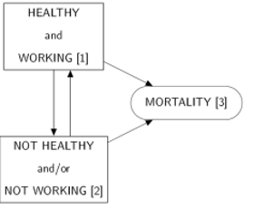
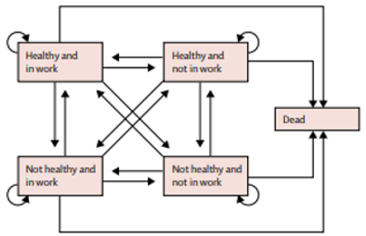
Lynch 3-state model
Parker 5-state model

Slide 17
Modelling transitions in UKHLS (Understanding Society)
Household panel, waves 1–13 (2009–2022), all working ages — not just 50+
Economic status: employed / unemployed / long-term sick / student / carer / retired / other
Multinomial model of next-wave status given this-wave status, age, sex — a Markov chain from survey data
Add health (SF-12 mental & physical scores, limiting illness) and ask counterfactual questions: what if health were better?
  e.g. improving mental and physical health by 1 SD → ~30% fewer long-term sick
TODO: one figure — transition matrix or PAF-style bar chart from reports/ifoa/ work.

Slide 18
What survey data can and cannot do
Strengths
Exists, well understood, accessible
Representative of the whole population
Covers people not currently working
Observes health while working
Weaknesses
Self-reported health and work status
Prevalence at annual snapshots, not dated events
Transitions within a year unobserved
Tens of thousands of respondents at best

Slide 19
→ Hand-over: can administrative data do better?

Slide 20
❓ Questions — Survey approaches
☐ 5 or 10 minutes? Three slides fits 5–7 min; add a UKHLS results slide if 10.
☐ Are the Lynch/Parker figures OK to reproduce, or redraw schematically?
☐ Which UKHLS figure to show — transition table (03_feedback_response) or a counterfactual bar chart?
☐ Keep the “strengths/weaknesses” as the bridge into David’s section, or let David make the admin-data case himself?
☐ Where does the triangulation message go — here (survey ≈ 12.5 yrs vs CMI ≈ 13.5 yrs, same direction) or in David’s comparison slide?
☐ Multi-state modelling explained here (UKHLS Markov model) or in David’s section — not both.

Slide 21
HWLE estimates with CMI rates [DAVID · 10 min]

Slide 22
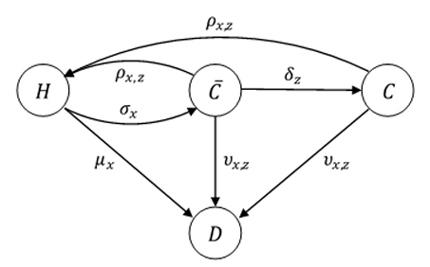
The CMI income protection data
IP11 rates (WP 131): 2007–2016, c. 4.8 m policy-years, c. 106k claims
By sex × deferred period × 4 occupation classes, ages 17–64
Claim inceptions, recoveries, claimant deaths
Recovery and death rates depend on duration of claim
Claims, not sicknesses: sickness inside the deferred period is unobserved
CMI 4-state claim inception model (WP 109)

Slide 23
The Healthy Workforce Projection Tool
TODO: redraw 4-state diagram (W, NN, R, D) — Figure 5 missing from the paper.
Rate | Basis
Working → Not-healthy-not-working | IP11 claim inception, 4-week deferred period
NN → Working (recovery), NN → Dead | IP11 rates, by duration in NN
Working / Retired → Dead | ONS UK 2022–24
Retirement | 100% at age 65

Slide 24
Everyone starts working; one transition per year; run separately for OC1–OC4
Output: partial expectancies to 65 — HWPLE and NNPLE

Slide 25
Results: a working 50-year-old, retiring at 65
Occupation class | HWPLE F | HWPLE M | All | NNPLE F | NNPLE M | All
OC1 professional / clerical | 13.5 | 13.7 | 13.6 | 0.91 | 0.56 | 0.73
OC2 light manual / supervisory | 13.7 | 13.8 | 13.8 | 0.71 | 0.44 | 0.57
OC3 manual, non-hazardous | 13.3 | 13.6 | 13.5 | 1.03 | 0.64 | 0.83
OC4 heavy manual / hazardous | 13.1 | 13.4 | 13.3 | 1.21 | 0.76 | 0.98

Slide 26
Of 15 years: 13.1–13.8 yrs working, 0.4–1.2 yrs not-healthy-not-working, remainder deaths. Men > women; OC2 > OC1 > OC3 > OC4. Data centred on 2011; female OC3/OC4 thin.

Slide 27
How does it compare, and what are the caveats?
Parker (ELSA, survey): ≈ 12.5 yrs working from 50 (10.8 healthy + 1.7 not-healthy-but-working) vs. our 13.3–13.8 — direction expected: insured lives, ≥4-week claims, capped at 65
Strengths: objective dated events; incidence not prevalence; duration-dependent recovery; explicit retirement age; large exposure
Caveats: insured segment, not the population; claims as proxy for sickness; excluded conditions; everyone starts working; yearly steps; rates restricted to CMI subscribers
Uses: HWPLE as an intuitive summary of a morbidity basis; benchmarking IP assumptions; pensions projections allowing for sickness; policy on SPA and benefits

Slide 28
❓ Questions — CMI section
☒ By-age chart moved to Supplement; section now 4 slides. Fold back if David wants it for 10 min.
☐ Who redraws the HWP Tool 4-state diagram, and in what tool?
☐ OC1 < OC2: offer hypotheses on the slide (selection, own-occupation definitions, mental-health claims in OC1) or “further work”?
☐ Is the Parker “10.81 + 1.67 = 12.5” comparison fair enough to put on a slide? Sanity-check with lead author.
☐ Combine comparison + caveats + uses on one slide (as drafted) or split into two?
☐ Confirm CMI is happy with the data-volume figures being shown.

Slide 29
Next steps for the Working Party [ALL · Q&A 10 min]
Monthly time steps; SPA evolution and early-retirement scenarios
Trends over successive CMI investigation periods; more granular cohorts
Survey-based benchmarks (ELSA, UKHLS) for the whole working-age population
Starting states other than “working”
Public-authority sickness/incapacity benefit data; international comparisons
Questions?

Slide 30
Thank you
IFoA Healthy Workforce Working Party
Correspondence: David Beddows, c/o professional.communities@actuaries.org.uk
Paper: Healthy working life expectancy methods (IFoA HWWP, 2026) · Public HWP Tool

Slide 31
❓ Questions — Close
☐ Prioritise three “next steps” or keep all?
☐ Name a next deliverable and date (v2 tool? journal submission?)
☐ Contact details: David only, or all presenters? QR code to the paper?
☐ Merge “next steps” into the “thank you” slide to save one?

Slide 32
SUPPLEMENT — material held back from the main deck

Slide 33
❓ Supplement — fold-back review
☐ Go through each supplement slide and mark: promote / appendix / delete
☐ Anything promoted must displace something — main target is ~12 content slides
☐ Anything in main that is really supplementary detail → move down here

Slide 34
Supplement · Why this matters

Slide 35
What we can — and cannot — measure
Life expectancy: two states, well measured
Healthy life expectancy: needs a definition of “healthy”
Working life expectancy: needs a definition of “working”
Healthy working life expectancy: both — and the data to observe the transitions
Systematic review (Parker et al. 2020a): “no current and reliable estimates” for the UK

Slide 36
UK State Pension Age timetable
Legislation | Period | Men | Women
Pre-2010 |  | 65 | 60
Pensions Act 1995 | 2010–2016 | 65 | 60→63
Pensions Act 2011 | 2016–2020 | 65→66 | 63→66
 | 2021–2025 | 66 | 66
Pensions Act 2014 | 2026–2028 | 66→67 | 66→67
 | 2029–2043 | 67 | 67
Pensions Act 2007 | 2044–2046 | 67→68 | 67→68
 | 2047 onwards | 68 | 68

Slide 37
Supplement · Survey approaches

Slide 38
Administrative vs. survey data — full trade-offs
Administrative — for
Objective events, not self-report
Incidence, not prevalence
Exact dates → accurate exposure by age and duration
Sub-annual transitions observable
Hundreds of thousands of lives/yr
Survey — for
Exists, well understood, accessible
More representative of the population
Covers people not currently working
Captures health while working

Slide 39
Definitions of health and work states
Study | Healthy / not-healthy | Working / not-working
Lynch 2022; Parker 2020 (ELSA) | Self-reported long-standing illness that limits activities | Paid work or self-employment in the month before interview
CMI IP11 | Not claiming = “working” (health unknown); claiming = not-healthy-not-working per policy trigger | As left

Slide 40
Supplement · CMI rates

Slide 41
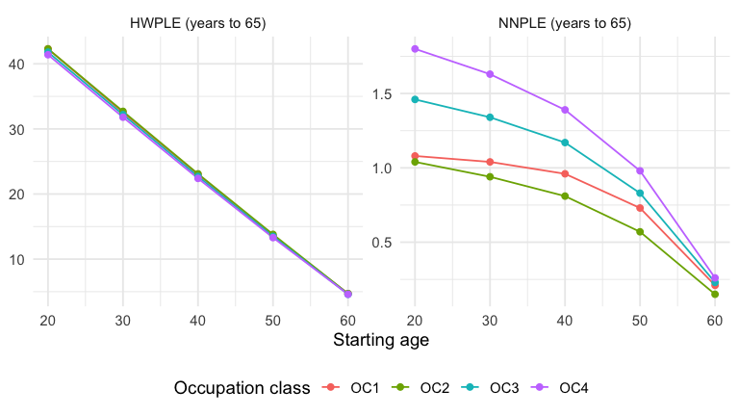
Results by starting age
Figure 1: HWPLE and NNPLE to age 65 by starting age and CMI occupation class (sexes combined). Source: HWP Tool, Tables 9a–9d.
Notes:
Age 20: 94% of working life to 65 spent working, 2.4% NN, 3.6% lost to death. Age 50: 90.7% / 4.9% / 4.4%.

Slide 42
CMI occupation classes
Class | Description
OC1 | Professional, managerial, executive, administrative and clerical; not engaged in manual labour
OC2 | Master craftsmen and tradesmen in management/supervision; skilled operatives in light manual, non-hazardous work
OC3 | Skilled operatives in manual, non-hazardous work
OC4 | Skilled and semi-skilled operatives in heavy manual work or subject to special hazard

Slide 43
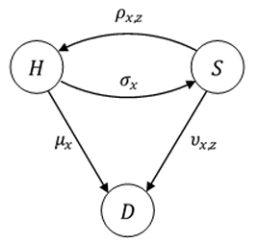
CMI 3-state sickness model (CMIR 12, 1991)

Slide 44
Transition rates in the HWP Tool
Rate | Description | Basis
nn(x) | W → NN | CMI IP11 claim inception, DP4
w(x,z) | NN → W (recovery) | CMI IP11 recovery rates
dw(x), dr(x) | mortality, W and R | ONS UK 2022–24
dnn(x,z) | mortality in NN | CMI IP11 claimant mortality
rw(x), rnn(x) | retirement | 1 at age 65; 0 otherwise

Slide 45
x = age, z = duration in NN. Monthly IP11 rates in claim years 1–2 collapsed to yearly.

Slide 46
Data volumes behind the rates
 | In force (start yr) | Claims (inceptions) | Claims (recoveries)
Total IP11 | 4.76 m | 105,957 | 98,659
DP4 | 522 k (11%) | 17,745 (17%) | 16,894 (17%)
Ages 50–64 | 1.43 m (30%) | 50,019 (47%) | 47,366 (48%)

Slide 47
Rates used rest on c. 140k–430k records vs. c. 12–15k ELSA respondents.

Slide 48
Life expectancy from the HWP Tool
Starting age | Females | Males | Overall
20 | 62.3 | 58.8 | 60.4
30 | 52.6 | 49.1 | 50.8
40 | 42.9 | 39.8 | 41.3
50 | 33.5 | 30.7 | 32.1
60 | 24.9 | 22.4 | 23.5

Slide 49
ONS 2022–24 basis; near-identical across OCs because mortality in W is not OC-specific.

Slide 50
Supplement · Close

Slide 51
Key references
Lièvre A. et al. (2007) J Nutr Health Aging 11:508–514
Parker M. et al. (2020a) Soc Indic Res 150:337–350; (2020b) Lancet Public Health 5:e395–e403
Lynch M. et al. (2022) Sci Rep 12:2408
Dudel C. (2021) Lancet Healthy Longev 2:e629
IFoA CMI Working Papers 109 (2018), 131 (2020), 136 (2021); IP11 Briefing Note (2020)
IFoA Healthy Workforce Working Party (2026) Healthy Workforce Projection Tool (public version)
Mayfield, C. (2025) Keep Britain Working — independent review (formerly Get Britain Working)
Darzi, A. (2024) Independent investigation of the NHS in England

