Slide 1
IFoA Life
Conference 2026

Slide 2
Healthy Workforce:
Trends and metrics for long-term term sickness and recovery rates for the UK working-age population
David Beddows, Dr. Chris Martin, Jon Minton
IFoA Healthy Workforce Working Party
09:55 – 10:40, Friday 20th November 2024

Slide 3
Today’s agenda
45 minutes slot: e.g 35 mins presentation + 10 mins Q&A
David 5 mins
Presented by members of the IFoA Healthy Workforce WP
Item | Time | Description
Welcome and Intros [David] | 09:55 – 10:00 | Introduction Background to the Healthy Workforce Working Party Why it is a relevant topic for actuaries
Why a healthy workforce matters [Chris] | 10:00 – 10:10 | E.g. Lord Darzi Review, Get Britain Working and Keep Britan Working Reviews, recent outputs from Health Foundation etc. Reflections from a clinical practitioner, human perspective Include trends
Public health / Health economics approaches [Jon] | 10:10 – 10:15 | Multi-state models: start with 2-state model and extend to 3-states Health economics looks too at benefits, not only costs Survey data (some limitations, but can be extended)
HWLE methods and estimates[David] | 10:15 – 10:30 | Admin data v survey data (pros and cons) Administrative data: CMI IP11 rates HWLE and related metrics Actuaries have well-established approaches Initial results Uses of these metrics (for actuaries and for wider audiences)
Q&A [all] | 10:30 – 10:40 | Discussion of the topics presented Next steps for the WP

Slide 4
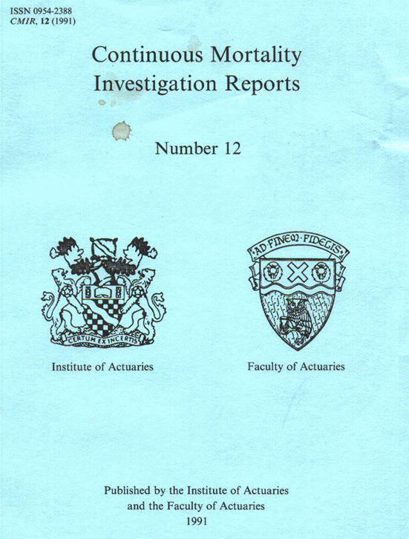
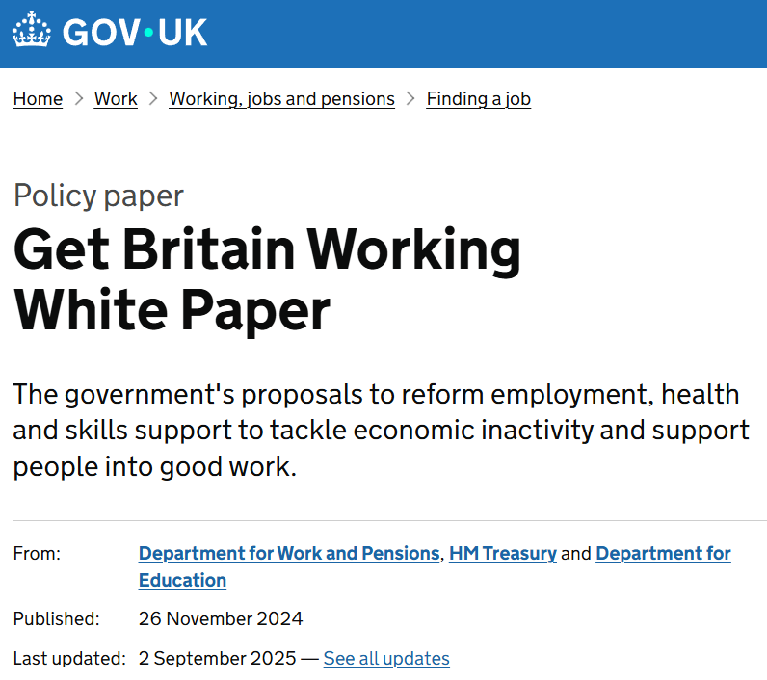
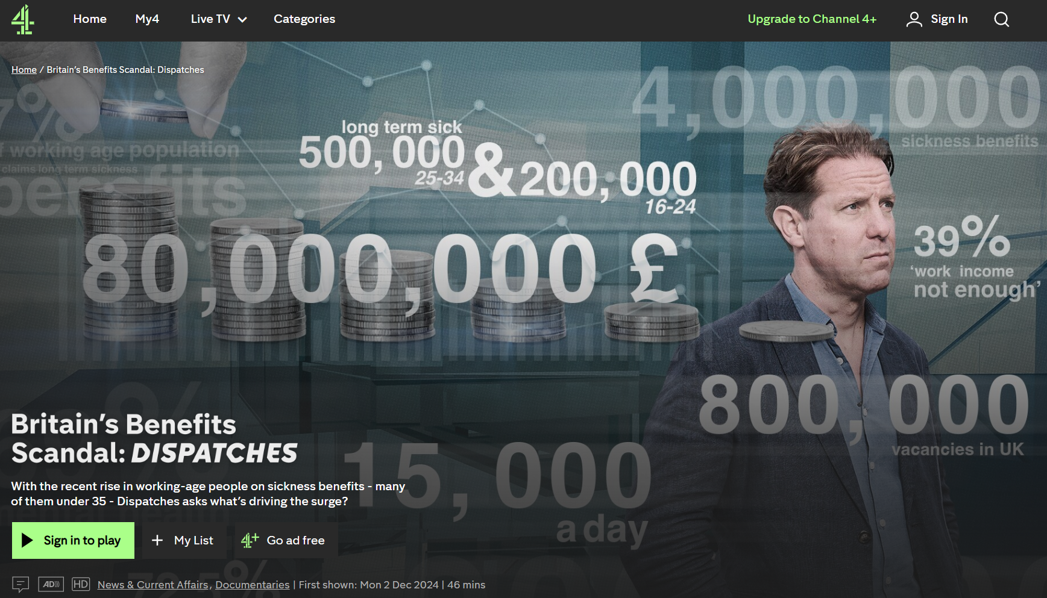

Background to the Healthy Workforce WP
David 2 mins
Chris 5-10 mins
Renewed focus on long-term sickness having high relevance for actuaries
public interest and government focus in 2024
  Lord Darzi NHS review
  Get Britain Working White Paper
high profile media stories including Channel 4 Dispatches documentary
actuarial knowledge and expertise in this area
well established methods with Income Protection modelling
CMI well-established methods and data
WP set up in early-2025

Slide 5
The importance of a healthy workforce
Chris 5-10 mins

Slide 6
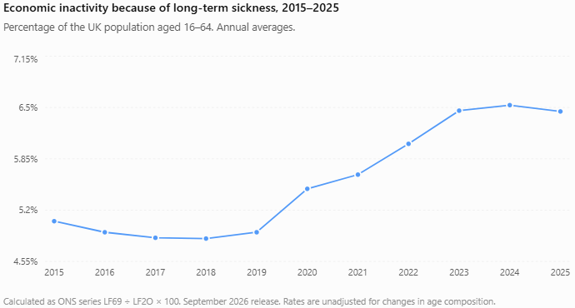
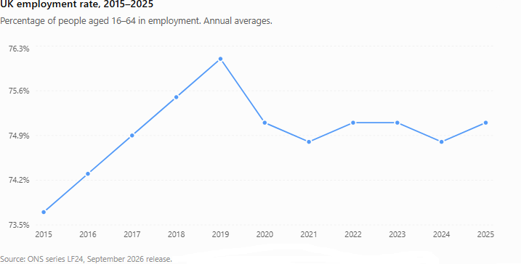
The rise in long-term economic inactivity due to ill health
The pandemic was clearly an important factor.
Whilst many suggest the problem began before the pandemic, the trivial rise in LSA in 2019 is marginal and may reflect population and demographic change.

Slide 7
The rise in sickness-related economic inactivity
UK, ages 16–64. Annual averages, 2019 to 2025
+746,000
More people economically inactive
because of long-term sickness
2.046 million in 2019 to 2.792 million in 2025 [1]
Illustrative allocation of the increase
Population growth
Demographic change
Remaining increase
≈86,000
≈65,000
≈595,000
11.5% of the increase
8.7% of the increase
79.8% of the increase
Larger population, holding the
2019 inactivity rate fixed. [1, 2]
2019–2022 share extrapolated
to 2019–2025.
Assumes separate, additive effects of population size and age composition. The residual does not isolate worsening health.
Sources: [1] ONS LFS, LF69. [2] ONS LFS, LF2O. September 2026 release.
Demographic share: Observed 8.7% of the increase between 2019 and 2022 projected to 2025.
Notes:
SOURCE LINKS AND CALCULATIONS
1. ONS Labour Force Survey series LF69, Long Term Sick, UK ages 16–64, seasonally adjusted, thousands. Release 15 September 2026. Annual 2019: 2,046,000. Annual 2025: 2,792,000. Difference: 746,000.
https://www.ons.gov.uk/employmentandlabourmarket/peoplenotinwork/economicinactivity/timeseries/lf69/lms
2. ONS LFS population aged 16–64 series LF2O, thousands. Same release. Annual 2019: 41,558,000. Annual 2025: 43,299,000. Increase: 1,741,000. Holding the aggregate 2019 sickness-inactivity rate constant gives 1,741,000 × (2,046,000 / 41,558,000) = about 85,714, rounded to 86,000 (11.5% of the increase). This is a counterfactual calculation, not an ONS causal estimate.
https://www.ons.gov.uk/employmentandlabourmarket/peopleinwork/employmentandemployeetypes/timeseries/lf2o/lms
3. User-supplied demographic share 8.7%, described as extrapolated from 2019–2022. Its original source has not been verified. 746,000 × 8.7% = 64,902, rounded to 65,000.
ONS (19 May 2023), Health, demographic and labour market influences on economic inactivity, UK: 2019 to 2022, estimates an age-structure effect for inactivity for ALL reasons. That analysis does not directly substantiate an 8.7% contribution to the increase due to long-term sickness.
https://www.ons.gov.uk/employmentandlabourmarket/peoplenotinwork/economicinactivity/articles/healthdemographicandlabourmarketinfluencesoneconomicinactivityuk2019to2022/2023-05-19
Illustrative chart uses 86,000 + 64,902 + 595,098 = 746,000. The residual is approximately 595,000 or 79.8%. This assumes population size and demographic composition contributions can be treated separately and additively. The demographic source and its compatibility with this outcome need verification before presenting this as an established decomposition. The residual may encompass changes in health, employment conditions, reporting, measurement and other influences. It does not quantify worsening health alone.

Slide 8



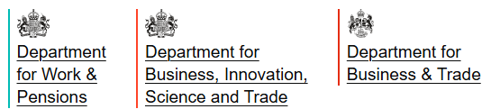
The problem
Chris 5-10 mins
2024
Lord Darzi’s independent review of the NHS
Identified:
Deteriorating working age health
Deteriorating access to health care
Rise in long-term economic inactivity due to poor health.
2024-2026 reports
A call to action to the government
2024
Get Britain Working
80% employment ambition
Joining up of health, employment and skills support
2025 (Sep 2026 update)
Keep Britain Working
Employer perspective
Plan for action

Slide 9
Factors affecting absence and return
Capacity has to match the job and the wider demands on the person
Factor | What can start an absence? | What can obstruct a return?
Illness or disability | Symptoms or impairment limit safe work | Persistent impairment, fluctuation or treatment effects
Workplace and role | Tasks, exposures or relationships become difficult | Feasible adjustments or alternative work are unavailable
Social and economic context | Domestic pressures or reduced support add strain | Delayed care and competing demands continue
These factors interact. They can change during an absence.
Clinical framework informed by your notes and qualitative return-to-work research.

Slide 10
Illness and disability factors
Same condition, different work impact
Worker | Health issue | Why it stops work
Warehouse worker | Knee arthritis | Unable to do manual work until the knee operation; a desk worker might barely notice it
Lorry driver | Depression, on sedating antidepressants | Drowsiness rules out driving; severe depression can mean a stable period before driving again
Surgeon | Breast cancer, successfully treated | Left with poorer eyesight and less sensation in her fingers, so operating is harder
Firefighter | Asthma triggered by smoke | The trigger is the job's core exposure
Treatment, not only illness, can be the barrier.
Presenter examples (C. Martin, occupational health and GP experience). DVLA fitness-to-drive guidance.
Notes:
NEW DRAFT (Jon, from Chris's notes). Proposed replacement for the previous slide, about 2:30.
Work capacity depends on the condition and the job together, not on the diagnosis alone. A minor disability can be very disabling for manual work and insignificant for sedentary work. Treatment can itself be the barrier: the lorry driver is off because of the antidepressant's side effects as well as the depression.
Check before use: Chris's notes say the driver would need to be well for about 6 months before returning; his literature review flagged that this applies to specified severe-depression criteria (DVLA), not to antidepressant use generally.

Slide 11
Workplace and societal factors
Return depends on more than health
The workplace
Can the job adapt? Small firms may have no alternative role
Doing only part of a job is often impractical
Alternative roles must be in the right place
Sometimes work is the problem: bullying, intimidation or abuse, real or perceived
A culture that resists adaptation
Wider society
A finite capacity to cope: domestic and caring demands can make a manageable condition incompatible with work
Mental ill-health more widely accepted as a disability
Possibly less presenteeism since the pandemic; the evidence is mixed
Plausible mechanisms; their share of the rise since 2019 is not quantified
Presenter observations (C. Martin). CIPD 2025. Fonagy review, 2026. Sources in notes.
Notes:
NEW DRAFT. Proposed single replacement for the separate Workplace and Societal factors slides, about 2:15.
Whether someone stays in or returns to work depends on the employer's ability to adapt and on pressures outside work, not only on clinical severity.
Finite capacity to cope: someone may manage a chronic condition while work and home demands are manageable, then struggle when caring, financial or other demands rise.
Presenteeism: Chris's literature review found a general decline is not established; CIPD 2025 reports more employers seeing increased presenteeism with homeworking (35%) than a decrease (14%). Check before use.
Mental health: the Fonagy review (Oct 2026) says the evidence cannot establish overdiagnosis at scale.

Slide 12
Proposed changes
Promising proposals, with caveats
Proposal | What it could do | Clinical caveat
Workplace health provision | Help employers adapt roles and phase returns | Still relies on NHS services for anything beyond minor episodes
Early contact during absence | Keep people connected to their job | Can feel like harassment when stress is work-related; making it routine may help
Healthy Working Lifecycle | A conceptual basis for building workplace health provision | Its value is at system level, more than for keeping individual cases in work
The measurement gap: sustained return to work is seldom measured consistently. Modelling onset, recovery and recurrence can help fill it.
Mayfield, Keep Britain Working (Nov 2025) and September 2026 update. Caveats: C. Martin.
Notes:
NEW DRAFT. Closes Chris's section, about 1:45.
All three proposals come from Mayfield's Keep Britain Working review; the caveats are Chris's clinical reading. The Healthy Working Lifecycle has five phases: recruitment and onboarding, healthy in work, unwell in work, absence and return to work, exit and re-employment. 'Unwell in work' is the clinically important phase, while the person is still connected to their job.
Bridge to Jon: the September 2026 update proposes measuring whether someone is still in work six months after returning, and says sustained-return outcomes are seldom measured consistently. That is the gap multi-state models of onset, recovery and recurrence address.

Slide 13
From survey data to administrative data
Jon 5 - 10 mins

Slide 14
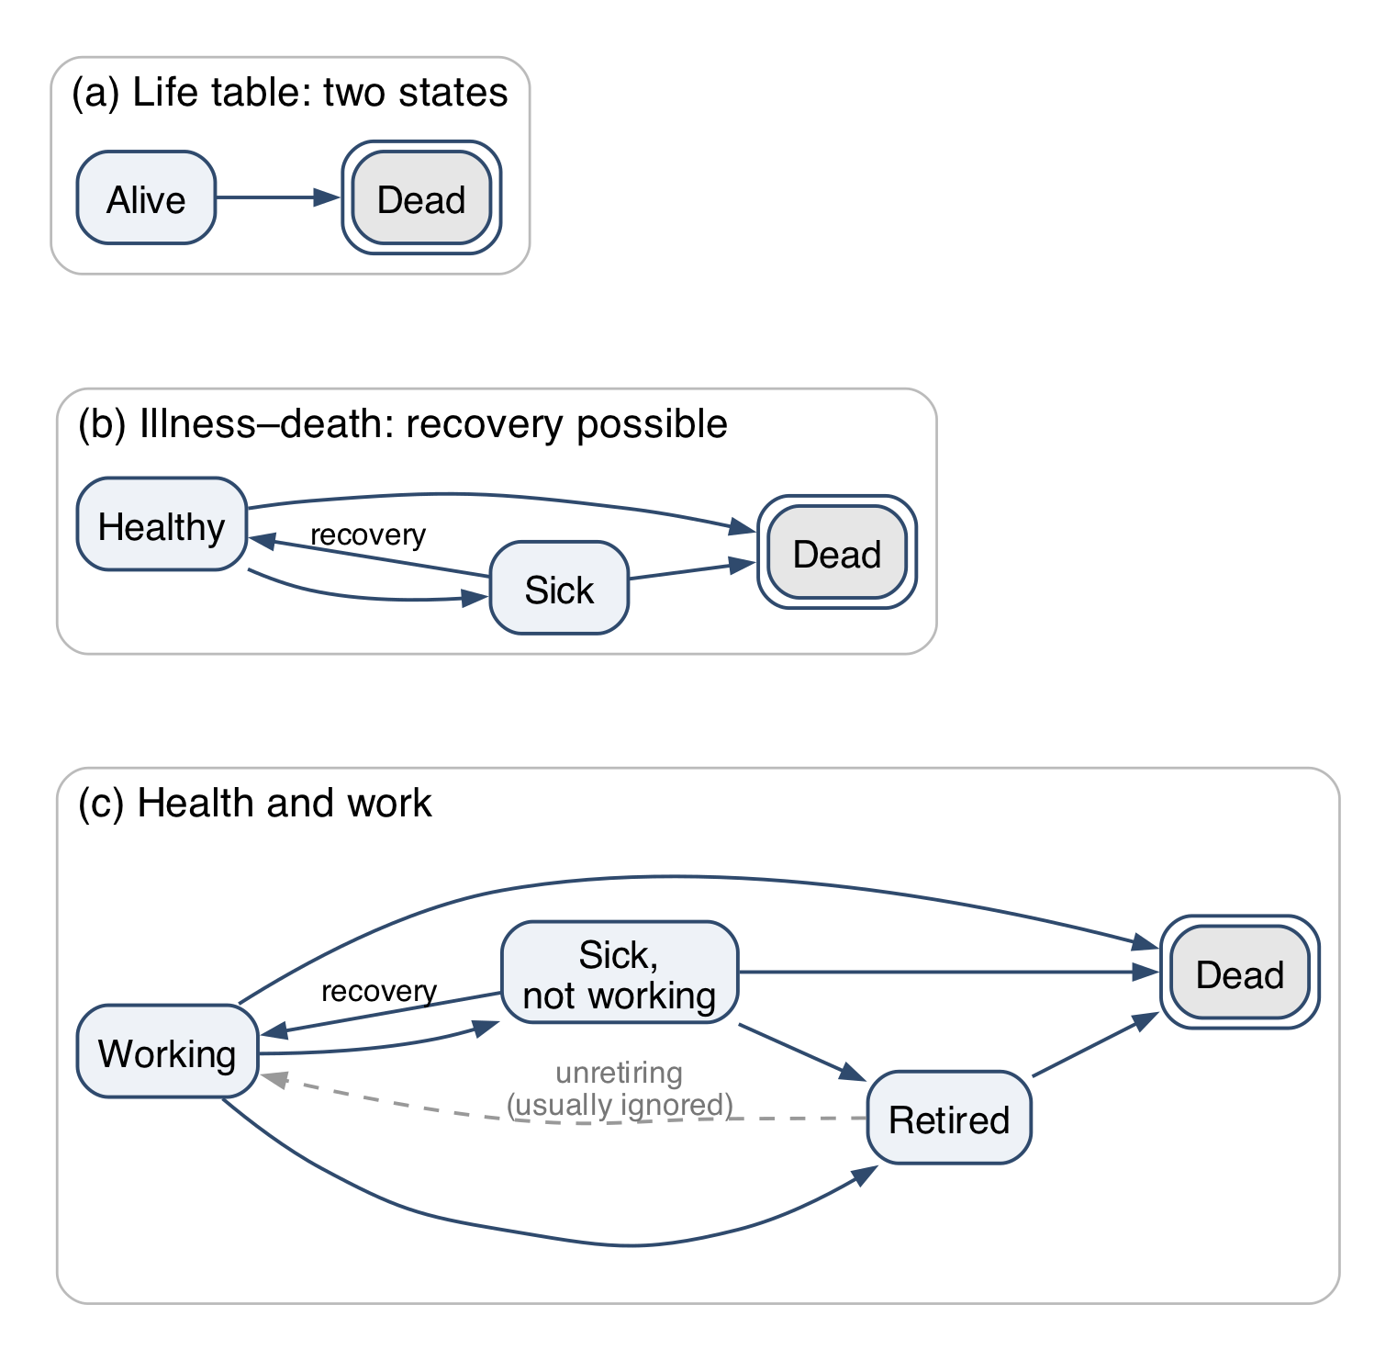
Multi-state models: a reminder
Jon 2 - 3 mins
A life table is a two-state model. Add states, and the same machinery gives expected time in each state: HWLE is expected years working.
Absorbing states can’t be left (death, double border). Non-absorbing states can: sickness allows recovery.
Retirement is usually modelled as one-way, but in life it isn’t quite absorbing.
Notes:
Jon Minton, Knowledge Tree and Butterfly: one-line intro on taking over from Chris.
About 1.5 minutes. A reminder, not a lecture: everyone here has seen multi-state life tables. Panel (a) is the life table; (b) adds a state you can leave; (c) is the shape of the health-and-work problem. Double border = absorbing.
Retirement: “Hotel California”: you can check out any time you like, but you can never leave. In the model it is one-way; in life people do unretire, and pension-age policy cares about exactly that.

Slide 15
Same machinery, two traditions
Jon 2 - 3 mins
Health economics
Markov cohort models with many states, recovery included
Each state carries a cost and a utility (quality of life)
Question: is this intervention worth paying for? (cost per QALY)
Usually parameterised from trials and surveys
Actuarial
Multi-state models from dated events (time-to-event)
Rates can depend on duration in a state
Question: how long, and at what cost, in each state?
Usually parameterised from experience data
HWLE sits between them: a public-health question answered with actuarial tools.
Notes:
About 1.5 minutes. The point for this audience: health economists and actuaries build the same kind of model and ask different questions of it. Health economics attaches utilities and costs to states to decide what to fund; actuaries attach durations and money to states to price and reserve. Working-age ill health is a place where both questions matter: the policy question (Keep Britain Working, from Chris) and the insurance question (David’s section).

Slide 16
What survey data give us, and what they force on us
Jon 2 - 3 mins
Surveys give us (ELSA, Understanding Society)
The whole population, including people not working or insured
Health and work status, observed together
Accessible, well understood, long-running
Surveys force on us
Roughly annual waves: status at snapshots, not dated events
So: one-year Markov steps; moves between waves are unseen
No duration since onset, so recovery can’t depend on it
Self-reported states; tens of thousands of people at best
→ Administrative data relax these. Over to David: HWLE from insurers’ claims.
Notes:
About 2 minutes, ending on the hand-off. Survey data are the only view of the whole population, which is why every published UK HWLE estimate so far uses them (ELSA: Lynch 2022, Parker 2020; supplement). But annual waves mean the model can only be a one-year Markov chain: what happened between interviews is invisible, and there is no clock on how long someone has been sick. Actuarial time-to-event data give dated claim inceptions and recoveries, with recovery depending on how long the claim has run. Hand over: “David will show what that buys us: healthy working life expectancy from CMI income protection experience.”

Slide 17
HWLE estimates
David 15 mins for this section

Slide 18
Healthy Working Life Expectancy as a metric
David 2 mins
Healthy working-life expectancy first appears as a term in the public health literature in 2007
Selected peer-reviewed milestones (not exhaustive). Sources: Lièvre 2007; Parker 2020; Lynch 2022, 2024.
2007 Lièvre et al.
2020 Parker et al.
EUROPE · 12 COUNTRIES
ENGLAND
Introduces HWLE as a combined health + employment indicator.
Population estimates at age 50; large socioeconomic and regional gaps.
J Nutr Health Aging
Lancet Public Health
2007
2010
2015
2020
2025
2020 Parker et al.
SYSTEMATIC REVIEW
Synthesizes early HWLE evidence and highlights limited use of the measure.
add/remove other papers? E.g. other countries
Social Indicators Research
2022 Lynch et al.
ENGLAND · PROJECTIONS
Projects HWLE to 2035; gains lag life expectancy and policy ambitions.
Nature Aging
…. but similar concepts had been presented in actuarial journals and other literature decades earlier
Notes:
Healthy Working Life Expectancy (HWLE) is becoming more common as a metric for indicating the health and potential productivity of a population: the term first appears in the literature in 2007 (Lievre et al. 2007) and has been the focus of many public health / health economics papers since then.
Many papers not shown on the slide here as we have pcked out just some of the recent ones focusing on the UK.
But many in the years in between for other countries.
It is a useful indicator for a number of public health and policy areas.
A good description of the advantages of estimating HWLE as opposed to WLE or HLE is given by Heller et al. 2022 (Heller et al. 2022). From the perspective of considering whether to increase retirement ages, the extension of HLE offers an indication of the capacity for populations to achieve that without health being a limiting factor but does not take into account the willingness of individuals to work longer. WLE, on the other hand, is directly assessing the capacity to work longer but ignores the reality that health impacts people's ability and willingness to work at all and, additionally, affects the quality of the work of which they are capable.
In recent years it has been presented as a measure for assessing the appropriateness of increasing retirement ages and for the adequacy of national social security policy-making (Parker et al. 2020b).
It could also be a useful metric for public health planning and developing and measuring the success of strategic plans for national health services.
…. but similar concepts had been presented in actuarial journals and other literature decades earlier

Slide 19
Healthy Working Life Expectancy as a metric
David 2 mins
Concepts similar to HWLE presented in the actuarial journals: tracing the move from working-life tables to multi-state models and healthy working life expectancy
1949
2020
The Length of Working Life
Population-based estimates of healthy working life expectancy…
S. L. Wolfbein
Population Studies
add/remove other papers? E.g. Haberman, CMI
M. Parker, M. Bucknall, C. Jagger & R. Wilkie
The Lancet Public Health
Life-table measurement of work-life span.
Establishes HWLE at age 50 using ELSA multi-state modelling.
1950
1960
1970
1980
1990
2000
2010
2020
1977
1990
JIA
2021
A Markov chain model of working life tables
Work time lost to sickness, unemployment and stoppages
Changes in healthy and unhealthy working-life expectancy…
J. M. Hoem
Scandinavian Actuarial Journal
S. Haberman & D. S. F. Bloomfield
Journal of the Institute of Actuaries 117(3)
Multi-country study
The Lancet Healthy Longevity
Continuous-time Markov approach to labour-force entry and exit.
Multiple-state working-life table; sickness and other work-time losses.
Tracks healthy/unhealthy WLE across 14 OECD countries.
‘expectation of disease-free life’
‘average duration of sickness’’
‘working life expectancy’’
Notes:
Similar concepts, including 'expectation of disease-free-life' and 'working life expectancy', were presented in the actuarial literature in earlier decades
Many examples in the Journal of the Institute of Actuaries from the 1970s to the 1990s (Pollard, 1980) and (Haberman and Bloomfield, 1990).
For example, analysis of 'expectation of disease-free life’ , including specific diseases such as 'expectation of breast-cancer-free life' was presented by Pollard (Pollard, 1980).
Derivations of 'average duration of sickness' (Haberman, 1987) and development of methods for calculating 'working life expectancy' (Haberman and Bloomfield, 1990) were also published.
This coincides with the beginning of the Continuous Mortality Investigation (CMI) starting to investigate Income Protection experience.
The CMI has collected data from its contributors (UK life insurers) since the 1970’s (“landmark publication” : IFoA CMI Report 12, 1991) on the sickness and claims incidence of individual income protection (IP) portfolios.
This was the forerunner to the IP investigations.
So it has long being recognized that HWLE and similar metrics are of interest to actuaries and life and health insurers.
E.g. HWLE could be a useful benchmark for life and health insurers when developing new life insurance products such as disability income protection and pensions savings contracts.

Slide 20
Healthy Working Life Expectancy as a metric
David 2 mins
along with Not-Healthy-Not-Working Life Expectancy
Usefulness and applicability to the life and health insurance domain
comparing existing pricing and reserving bases
benchmarking pricing and reserving bases against wider population
product development for new population segments
Usefulness and applicability to health economics and public policy-making
social security benefits demand projections;
health service demand projections;
economic analyses incorporating projections of the future UK workforce;
setting retirement ages and state pensions policy.
Notes:
Insurance applications
It allows population survey-based estimates of HWLE, WLE, HWPLE or WPLE to act as benchmarks for the HWPLE derived from life insurance portfolios which can help to refine income protection insurance modelling assumptions, pensions savings scheme projections, or develop modelling assumptions for new life insurance customer segments.
For example, insurers aiming to develop income protection contracts for new population segments can use estimates of HWPLE for segments with distinct health characteristics or distinct occupations to inform their pricing assumptions.
Insurers with existing portfolios of IP contracts can update their assumptions for claim inception rates and recovery rates by calculating HWPLE for their existing assumptions and comparing these with population trends of HWPLE.
HWPLE can act as a useful and easily understood descriptive statistic for describing morbidity bases.
From one time period to another or from one population segment to another, the HWPLE offers a meaningful statistic that can be used to compare bases.
It can be understood intuitively.
For example, the mortality rates in the basis can be set the same for different segments and then segment-specific sickness inception and recovery rates applied.
The HWPLE then offers an indication of the relative difference of the sickness and recovery rates.
Health Economics applications
clearly a number of uses
For pensions provision, it provides a view on how many years people will be actively working and therefore able to make regular contributions to a pension savings scheme. Current pension scheme projections of retirement benefits are typically based on the expectation that people will work uninterrupted from now until the State Pension Age. In reality, this is not true for many people. HWPLE offers a method to adjust pension projections to a more realistic level, allowing for the expectation that there will be periods of sickness during a working lifetime which may be mean periods of reduced income, and therefore allow people to make more informed decisions about their retirement provisions.

Slide 21
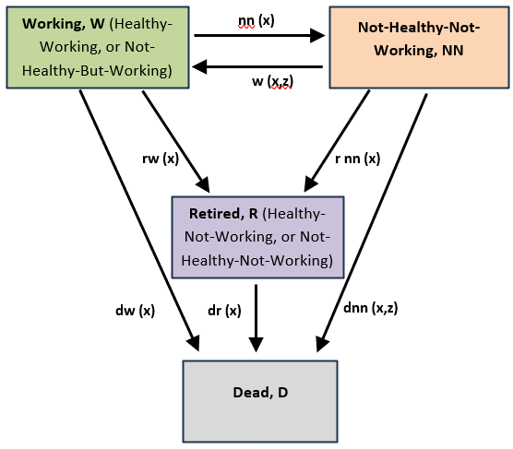
Multi-state model method
David 4 mins
leading to an increment-decrement life table
Rate | Basis
nn(x) | CMI IP11 claim inception, DP4
w(x,z) | CMI IP11 recovery rates
dw(x), dr(x) | ONS UK 2022–24
dnn(x,z) | CMI IP11 claimant mortality
rw(x), rnn(x) | 1 at age 65; 0 otherwise
4 states with 7 transition routes
Advantages
transitions out of NN state are duration-dependent
explicit allowance for expected retirement age
Disadvantages
currently limited data availability in the UK beyond insured populations
CMI claim inception rates used as a proxy for sickness inception rates
Notes:
So here is the multi-state model we settled on in the Healthy Workforce WP for our first version, and the initial paramerisation.
Model
Despite there being well-established notation conventions for such models, note we introduced new notation in order to distinguish from the CMI multi-state model.
Parameterising the model with transition rates:
Make clear that we are using CMI claim inception rates as a proxy for sickness inception rates.
Recovery rates back to the Working state are CMI rates for recoveries from claim state.
Mortality rates for deaths from the Working and Retired states based on UK population data.
Retirement rates set to be 1 at age 65 and 0 at all other ages. This can be varied in future iterations: e.g. to allow for early retirements or later.

Slide 22
Healthy Working Life Table
David 3 mins
Example for females occupation class 1 who are healthy and working at age 50
time in years | exact age | Healthy Working lives | Retired lives | Not-Healthy Not-Working lives | D deaths
0 | 50 | 100’000 | 0 | 0 | 0
1 | 51 | 98’265 | 0 | 1’501 | 235
2 | 52 | 97’368 | 0 | 2’109 | 524
3 | 53 | 96’478 | 0 | 2’676 | 846
4 | 54 | 95’524 | 0 | 3’272 | 1’204
5 | 55 | 94’480 | 0 | 3’916 | 1’604
6 | 56 | 93’341 | 0 | 4’615 | 2’044
… | … | … | … | … | …
14 | 64 | 80’910 | 0 | 11’727 | 7’363
15 | 65 | 78’341 | 10’364 | 3’213 | 8’082
16 | 66 | 0 | 91’525 | 0 | 8’475
17 | 67 | 0 | 90’706 | 0 | 9’294
Estimations
HWLE = 13.5 years
NNLE = 0.9 years
Replace table with a chart…?
Or show the table quickly and then move to the chart
Notes:
So here are some preliminary results.
The multi-state model in this example is initiated with all lives in the Working State, 100’000 lives, and aged exactly 50 at time zero.
It generates a life table as shown.
The 100’000 lives transition in and out of the not-healthy-not-working state from age 50 up to age 65.
At age 65, all working and all not-healthy-not-working lives start transition to the Retired state during the next year and a bit.
(Some spillage of retirements into age 66 due to multiple-decrement approximations)
From the generated life table, it is then straightforward to calculate the expected time spent in each state.
Given that the model is parameterised for everyone to retire at age 65 then the maximum possible HWLE would be 15 years.
Our preliminary results (as a reminder based on CMI IP11 transition rates and UK population mortality) indicates:
HWLE = 13.5 years
NNLE = 0.91 years
The gap to 15 years relates to the deaths.

Slide 23
Healthy Working Life Table
David 3 mins
Example for females occupation class 1 who are healthy and working at age 50
Estimations
HWLE = 13.5 years
NNLE = 0.9 years
Notes:
So here are some preliminary results.
The multi-state model in this example is initiated with all lives in the Working State, 100’000 lives, and aged exactly 50 at time zero.
It generates a life table as shown.
The 100’000 lives transition in and out of the not-healthy-not-working state from age 50 up to age 65.
At age 65, all working and all not-healthy-not-working lives start transition to the Retired state during the next year and a bit.
(Some spillage of retirements into age 66 due to multiple-decrement approximations)
From the generated life table, it is then straightforward to calculate the expected time spent in each state.
Given that the model is parameterised for everyone to retire at age 65 then the maximum possible HWLE would be 15 years.
Our preliminary results (as a reminder based on CMI IP11 transition rates and UK population mortality) indicates:
HWLE = 13.5 years
NNLE = 0.91 years
The gap to 15 years relates to the deaths.

Slide 24
HWLE estimates
David 3 mins
Examples for a sample of starting ages to age 65 for occupation class 1
Healthy Working Partial Life Expectancy, HWPLE, to age 65
Not-Healthy Not-Working Partial Life Expectancy, NNPLE, to age 65
Starting Age | Females | Males | Overall
20 | 42.4 | 42.2 | 42.3
30 | 32.6 | 32.5 | 32.5
40 | 22.9 | 23.0 | 23.0
50 | 13.5 | 13.7 | 13.6
60 | 4.6 | 4.7 | 4.7
Starting Age | Females | Males | Overall
20 | 1.3 | 0.9 | 1.1
30 | 1.3 | 0.8 | 1.0
40 | 1.2 | 0.8 | 1.0
50 | 0.9 | 0.6 | 0.7
60 | 0.3 | 0.2 | 0.2
Replace table with a chart…?
Observations (align with intuition)
HWPLE decreases as starting age increases;
NNPLE decreases as starting age increases but proportionally less so than HWPLE;
The proportion of the working life to age 65 spent in the NN state is higher at older starting ages.
A 20-year-old has 42.3 years HWPLE and 1.1 years NNPLE meaning:
94.0% of their working life to age 65 in the working state;
2.4% of their working lifetime in the NN state;
3.6% of the 45 years relates to deaths before 65.
A 50-year-old has 13.6 years HWPLE and 0.7 years NNPLE meaning:
90.7% of their working life to age 65 in the working state;
4.9% of their working lifetime in the NN state;
4.4% of the 15 years relates to deaths before 65.

Slide 25
HWLE estimates
David 3 mins
Examples for a sample of starting ages to age 65 for occupation class 1
Females
Males
retire 65
retire 65
Notes:
Observations (align with intuition)
HWPLE decreases as starting age increases;
NNPLE decreases as starting age increases but proportionally less so than HWPLE;
The proportion of the working life to age 65 spent in the NN state is higher at older starting ages.
A 20-year-old man has 42.2 years HWPLE and 0.9 years NNPLE.
A 50-year-old woman has 13.5 years HWPLE and 0.9 years NNPLE.

Slide 26
HWLE estimates
David 3 mins
Examples to age 65 for the CMI Occupation Classes for starting age 50
Healthy Working Partial Life Expectancy, HWPLE
Not-Healthy Not-Working Partial Life Expectancy, NNPLE
Occupation Class | Females | Males | Overall
CMI IP11 OC1 | 13.5 | 13.7 | 13.6
CMI IP11 OC2 | 13.7 | 13.8 | 13.8
CMI IP11 OC3 | 13.3 | 13.6 | 13.5
CMI IP11 OC4 | 13.1 | 13.4 | 13.3
Occupation Class | Females | Males | Overall
CMI IP11 OC1 | 0.9 | 0.6 | 0.7
CMI IP11 OC2 | 0.7 | 0.4 | 0.6
CMI IP11 OC3 | 1.0 | 0.6 | 0.8
CMI IP11 OC4 | 1.2 | 0.8 | 1.0
Replace tables with a chart…?
Observations on HWPLE
HWPLE is higher for men than for women, across all 4 occupation classes;
HWPLE is highest for occupation class 2, closely followed by class 1, then class 3 and class 4 has the lowest HWPLE;
Across all 4 occupation classes, HWLE is higher for females than males at younger ages but switches to being higher for males than females at older ages.
Observations on NNPLE
NNPLE is lower for men than for women, across all 4 occupation classes;
NNPLE is lowest for occupation class 2, closely followed by class 1, then class 3 and class 4 has the highest NNPLE, i.e. the reverse order compared to HWPLE;
Notes:
HWPLE ranges from 13.8 years for males in occupation class 2 to 13.1 years for females in occupation class 4;
NNPLE ranges from 0.4 years for males in occupation class 2 to 1.2 years for females in occupation class 4

Slide 27
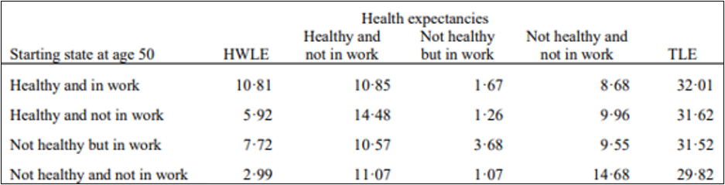
HWLE comparisons with other published results
David 2 mins
Parker et al. (2020) developed estimates of HWLE for UK lives starting at age 50
derived from survey data (English Longitudinal Study of Aging, ELSA) for a representative sample of the UK population aged 50 and older.
results given for the average time spent in each of 4 healthy/working states from age 50 onwards.
retirement is not modelled
lives can be in any of the 4 states at age 50, unlike in our modelling in which all lives start in the Working state.
12.48
compare 13.6
Notes:
Much of the literature focusses on a single starting age for calculating HWLE and this is typically chosen to be age 50.
Furthermore, they are based on population survey data and not a specific cohort, such as those people who are currently working.
As such, there are only a small number of comparable results in the literature and, even those are not exactly like-for-like.
The most comparable work identified is that of Parker et al. (Parker et al. 2020b), who developed estimates of HWLE for lives starting at age 50.
That work was based on a representative sample of the UK population aged 50 and older.
Most of their results presented show the average time spent in each of 4 healthy/working states from age 50 onwards.
This means that retirement is not considered and also that lives can be in any of the 4 states at age 50, unlike in our modelling in which all lives start in the Working state.
Parker does present some results for lives starting in the Healthy and Working state at age 50.
"People who were healthy and in work at age 50 years had a healthy working life expectancy of 10·81 years…"
From this, we can infer that the Healthy Working Partial Life Expectancy most comparable to our result is (the sum of HWLE and Not-Healthy but in Work LE)), meaning 10.81 + 1.67 = 12.48 years.
This compares to our results of 13.6 years (OC1), 13.8 years (OC2), 13.5 years (OC3) and 13.3 years (OC4).
The Parker result represents the general UK population whereas the CMI IP11 rates represent insured lives, so are different population segments. Additionally, the CMI IP11 rates are claim inception rates which ignore short durations of sickness and are based on definition of sickness under IP insurance policies rather than self-reported health survey responses.
Due to both the population segment and the definition of sickness/health, it is not unreasonable to expect the Parker result to be lower than the results based on the CMI IP11 rates.
Additionally, Parker's method includes the possibility of people being healthy and working at ages above 65, whereas our modelling intentionally truncates the working life at age 65.
This modelling assumption causes our HWPLE to be lower than Parker's HWLE, all else being equal.
Although both Parker and our model generate results for not-healthy-not-working, Parker‘s NHNW results include time periods post-retirement whereas our results are limited by retirement.
E.g. In the HWP Tool, for a 50-year-old, the sum of HWPLE and NNPLE is less than 15 years since it assumes 100% retirement at age 65.
Parker‘s method does not consider a retirement age.
E.g. Some of the 8.68 years in Parker's NHNW result would be years post-retirement age.

Slide 28
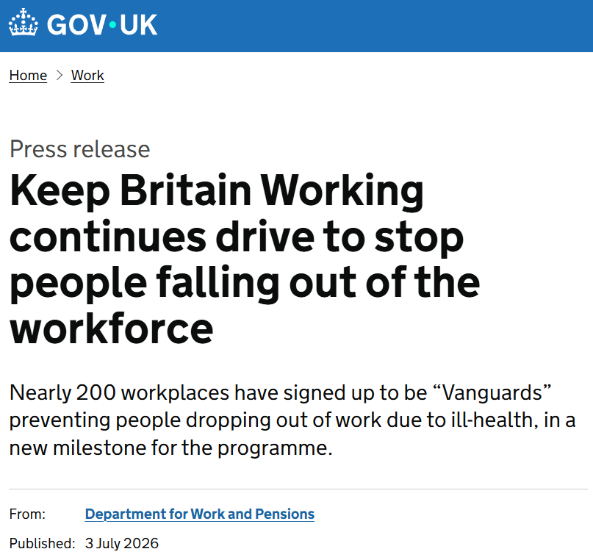
Coming soon
Policy initiatives and planned research
UK government
Health Thinktanks
The Health Foundation
The Kings Fund
Nuffield Trust
IFoA Healthy Workforce WP
modelling a range of retirements ages;
alternative definitions of 'healthy' and 'working';
CMI data over time periods to give indications of trends over time;
rates derived from population surveys to provide further benchmarks;
transition rates that are derived from administrative data held by UK public authorities such as the DWP;
international comparisons
Discuss what best to show here.
Maybe this is talked about already at the start.
Notes:
Keep Britain Working
Over 250 employers, 10 mayoral authorities and all 3 devolved administrations work with Sir Charlie Mayfield, reshaping how disability and ill-health are supported at work.
Latest Keep Britain Working report shows shared responsibility and better data, supported by personalised plans will be key to helping people remain in work.
A new Workplace Health Intelligence Unit will track sickness absence, return-to-work outcomes and disability participation making workplace health performance visible for the first time.
Health Thinktanks
IFoA Healthy Workforce WP
additional scenarios to reflect the planned evolution of UK State Pension Age and also incorporating estimates of rates of early retirements;
alternative definitions of 'healthy' and 'working';
rates derived from CMI data over time periods to give indications of trends over time;
rates derived from population surveys to provide further benchmarks against the whole UK working-age population and comparisons against the literature;
transition rates that are derived from administrative data held by UK public authorities that administer sickness and incapacity benefits;
transition rates that are derived from administrative data from other countries to enable international comparisons.

Slide 29
Conclusions
David 10 mins for this section

Slide 30
Conclusions
David 3 mins
Discuss the 3 key takeaways we want to show
HWLE is an important metric for many purposes
Administrative data can complement or replace survey data for HWLE (methods)
development of public datasets
opportunity for actuaries to deploy core knowledge
HWLE is a useful descriptive statistic for morbidity bases (insurance)
assessing pricing and reserving bases
product design and expanding IP products to wider segments
HWLE has policy relevance to state benefits, State Pension Age and pensions adequacy (policy)
Keep Britain Working
social care policy
pension planning
health service planning

Slide 31
Questions
Comments
Expressions of individual views by members of the Institute and Faculty of Actuaries and its staff are encouraged.
The views expressed in this presentation are those of the presenter.

Slide 32
Appendices / unused materials
David 10 mins for this section

Slide 33
Healthy Workforce
Trends and metrics for long-term term sickness and recovery rates for the UK working-age population
Abstract Summary:
As Sir Mayfield notes in the 2025 Keep Britain Working report, "ill-health has now become one of the biggest drivers of economic inactivity in the UK". The well-established methods that actuaries employ for understanding and explaining the dynamics of Income Protection business can have useful applications for understanding the health of the workforce.
A specific population health metric that is gaining more attention is Healthy Working Life Expectancy ('HWLE'). This is an estimate of the length of time that a person will be both healthy and working and can be an indicator of the health and potential productivity of a population. It has been presented as a measure for assessing the appropriateness of increasing retirement ages and for the adequacy of national social security policy-making. It could be a useful benchmark for life and health insurers when developing new life insurance products such as disability income protection and pensions savings contracts.
Furthermore, estimating HWLE from datasets across historic time periods is a useful statistic for measuring the trends in long-term sickness and economic inactivity within the UK national workforce population. Using life insurance data to calculate HWLE represents the first attempt to estimate HWLE for a UK population segment with administrative data, rather than survey results, and therefore is a novel approach.
Key takeaways will include methods and results of calculating HWLE for the UK population and discussion of the advantages and disadvantages of these methods.
Practical details
Presenters: David, Chris and Jon
Date: Friday 20th November
Time: 09.55-10.40 (Please note that the day/time of your session may be subject to change)
Location: The ICC, 8 Centenary Square, Birmingham, B1 2EA
Preparation:
WP meetings: 16 September; 21 October
Submit slides to Conference organisers: 18 October

Slide 34
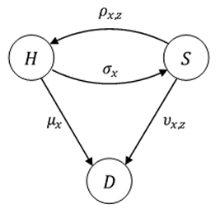
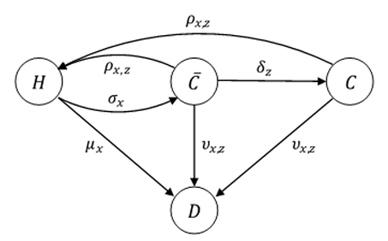
CMI income protection analysis
David to use only if question arises
sickness inception rates v claim inception rates
For many years, the CMI used the multiple-state model shown top right, originally introduced in CMIR 12, as a basis for the modelling of Income Protection business, where H, S and D denote the Healthy, Sick, and Dead states, respectively. However, one limitations was:
“… the model focuses on sicknesses whereas the data supplied to the CMI instead relates to claims, and not all sicknesses result in claims. Indeed, an IP claim inception can only arise from a sickness inception if the insured life remains sick throughout the deferred period of the policy and then claims. The CMI dataset therefore does not allow observation of transitions during the deferred period between states S and H, in either direction, or from state S to state D."
To address this limitation, the CMI introduced a 4-state model, as shown bottom right. In this expanded version of the multiple-state model, the Sick state, S, is split into a 'Sick-but-not-Claiming' state, 𝐶 ̅, and the 'Sick-and-Claiming' state, C. This model may be regarded as a multiple-state model for IP claim inceptions.

Slide 35
Healthy Working Life Expectancy
David 2 mins
and similar metrics
health economics literature
survey data
general working population
starting state includes all work and health states
actuarial literature
administrative data
insured lives
starting state limited to working and healthy

Slide 36
Definitions of ‘healthy’ and ‘working’ states
David 2 mins
Survey data versus administrative life insurance data
Study | Definition of Healthy or Not-Healthy | Definition of Working or Not-Working
Survey data examples: Lynch et al., 2024 And Parker et al., 2020b (England) | Self-reported responses to these 2 questions: "Do you have any long-standing illness, disability or infirmity?" "Do these illnesses or disabilities limit your activities in any way?" | Work status self-reported in the ELSA survey as participation in paid work or self-employment within the month preceding the ELSA interview, or not.
Administrative data examples: CMI IP11 (UK) | A person insured within an income protection scheme and actively working (i.e. not claiming benefits under the scheme) or not. People who are receiving benefits are 'Not-Healthy' and 'Not-Working' as per the claim trigger definitions within their insurance policy. People who are not receiving benefits are 'Working' but details of their health status are not complete so cannot for sure be described as 'Healthy'.
Notes:
Survey-based analyses use definitions that are based on answers provided by survey respondents.
Answers to specific questions are used to classify the respondents into the states of interest, such as with the analyses that use results from the English Longitudinal Survey of Aging (ELSA) (Banks et al. 2021).
CMI IP portfolio data is based on administrative data of Income Protection portfolios and reflects actual transitions between working and not working due to ill-health (limited by the effect of IP deferred periods).
However, the IP data does not collect data on health status whilst working, or during the IP policy deferred period. Insurers may have collected some data at the policy application underwriting stage but this is not routinely collected by the CMI.

