Slide 1
The Shape of the Troubles? Visualising and modelling an ‘anomaly’ in Northern Irish morality data
Dr Jonathan Minton
University of Glasgow, Scotland
Jonathan.Minton@glasgow.ac.uk

Slide 2
Two Models of Academic Research
Model 1
Model 2
Grand Theory
Upper middle
Bundle of bundle
Operationalisation
Middle middle
Bundle of ideas
Refine theory?
Hypotheses
Source Data
Lower middle
Idea
Analysis
Analysis
Analysis
Analysis
Analysis
Format Data
Raw Data
Tidy Data
Analysis
Analysis
Analysis
Findings
Analysis
Analysis
Analysis
Analysis

Slide 3
Exploring the HMD
Online Shiny App created by Jonas Schoeley
https://jschoeley.shinyapps.io/hmdexp/
Let’s explore for 5 minutes
Github repo: https://github.com/jschoeley/hmdexp

Slide 4
My route to this research
Rest of WE
Rest of UK
Scotland
Scotland
England & Wales
Northern Ireland
Republic of Ireland

Slide 5
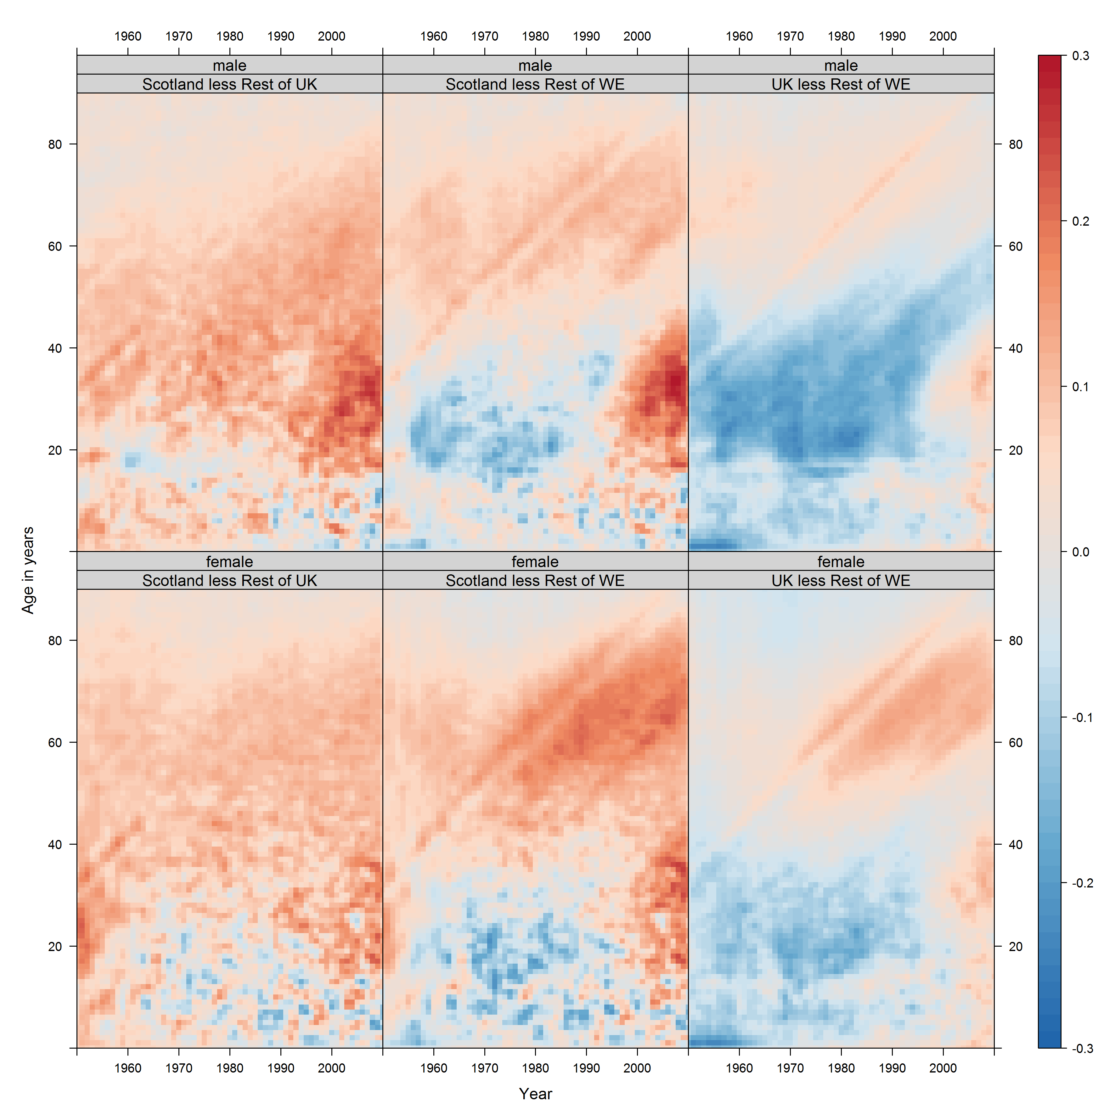
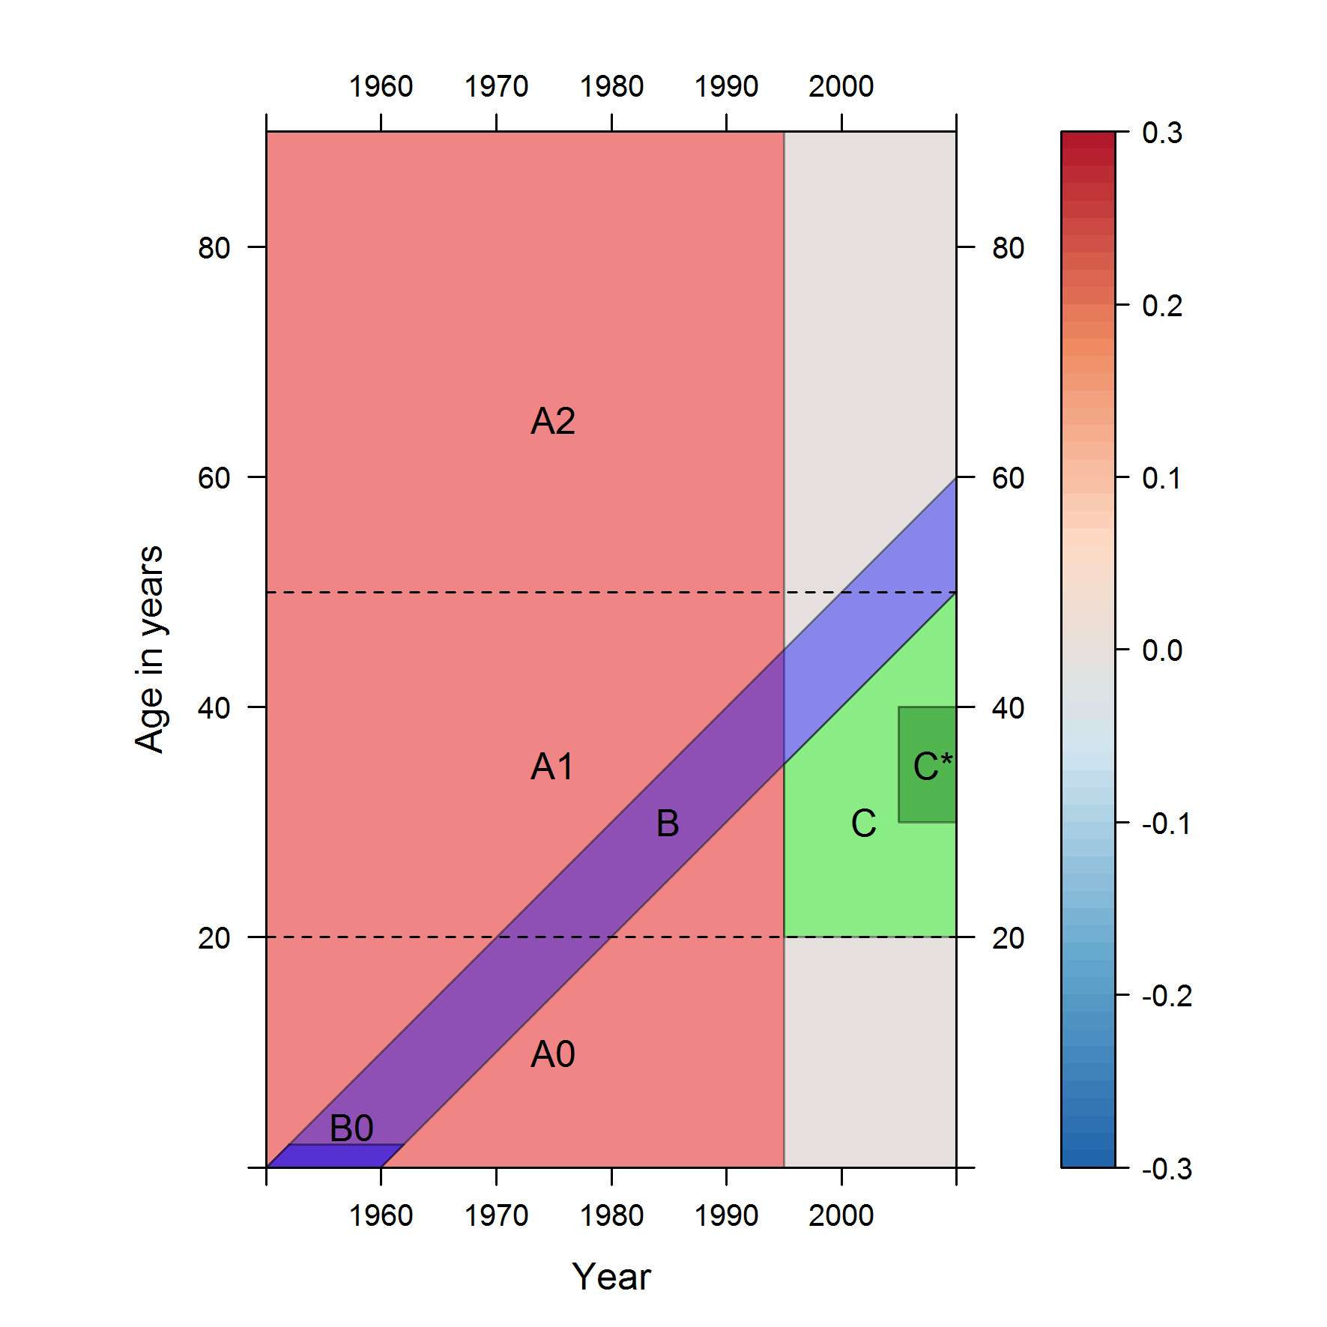

Slide 6
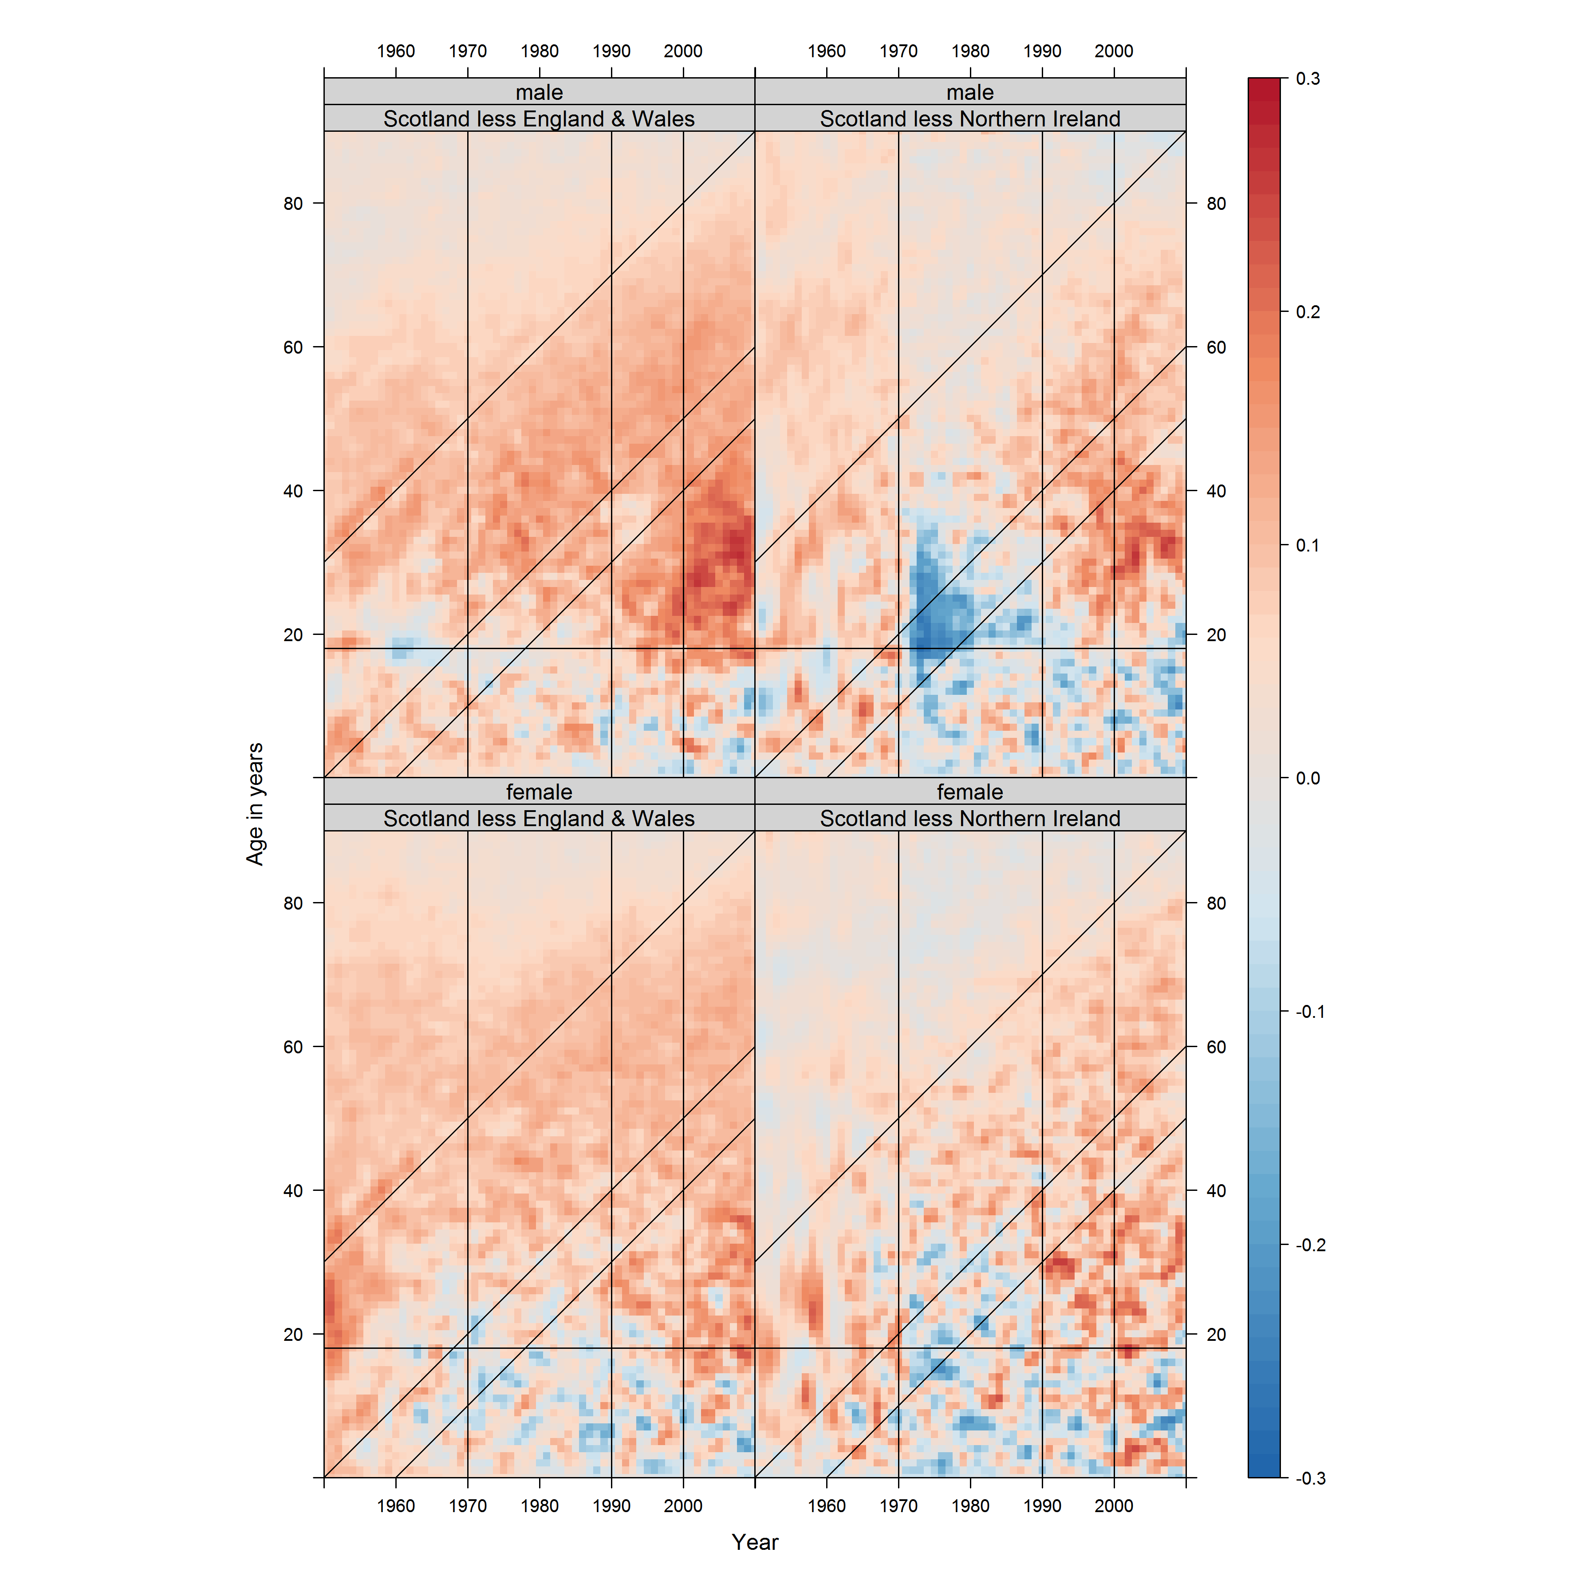

Slide 7
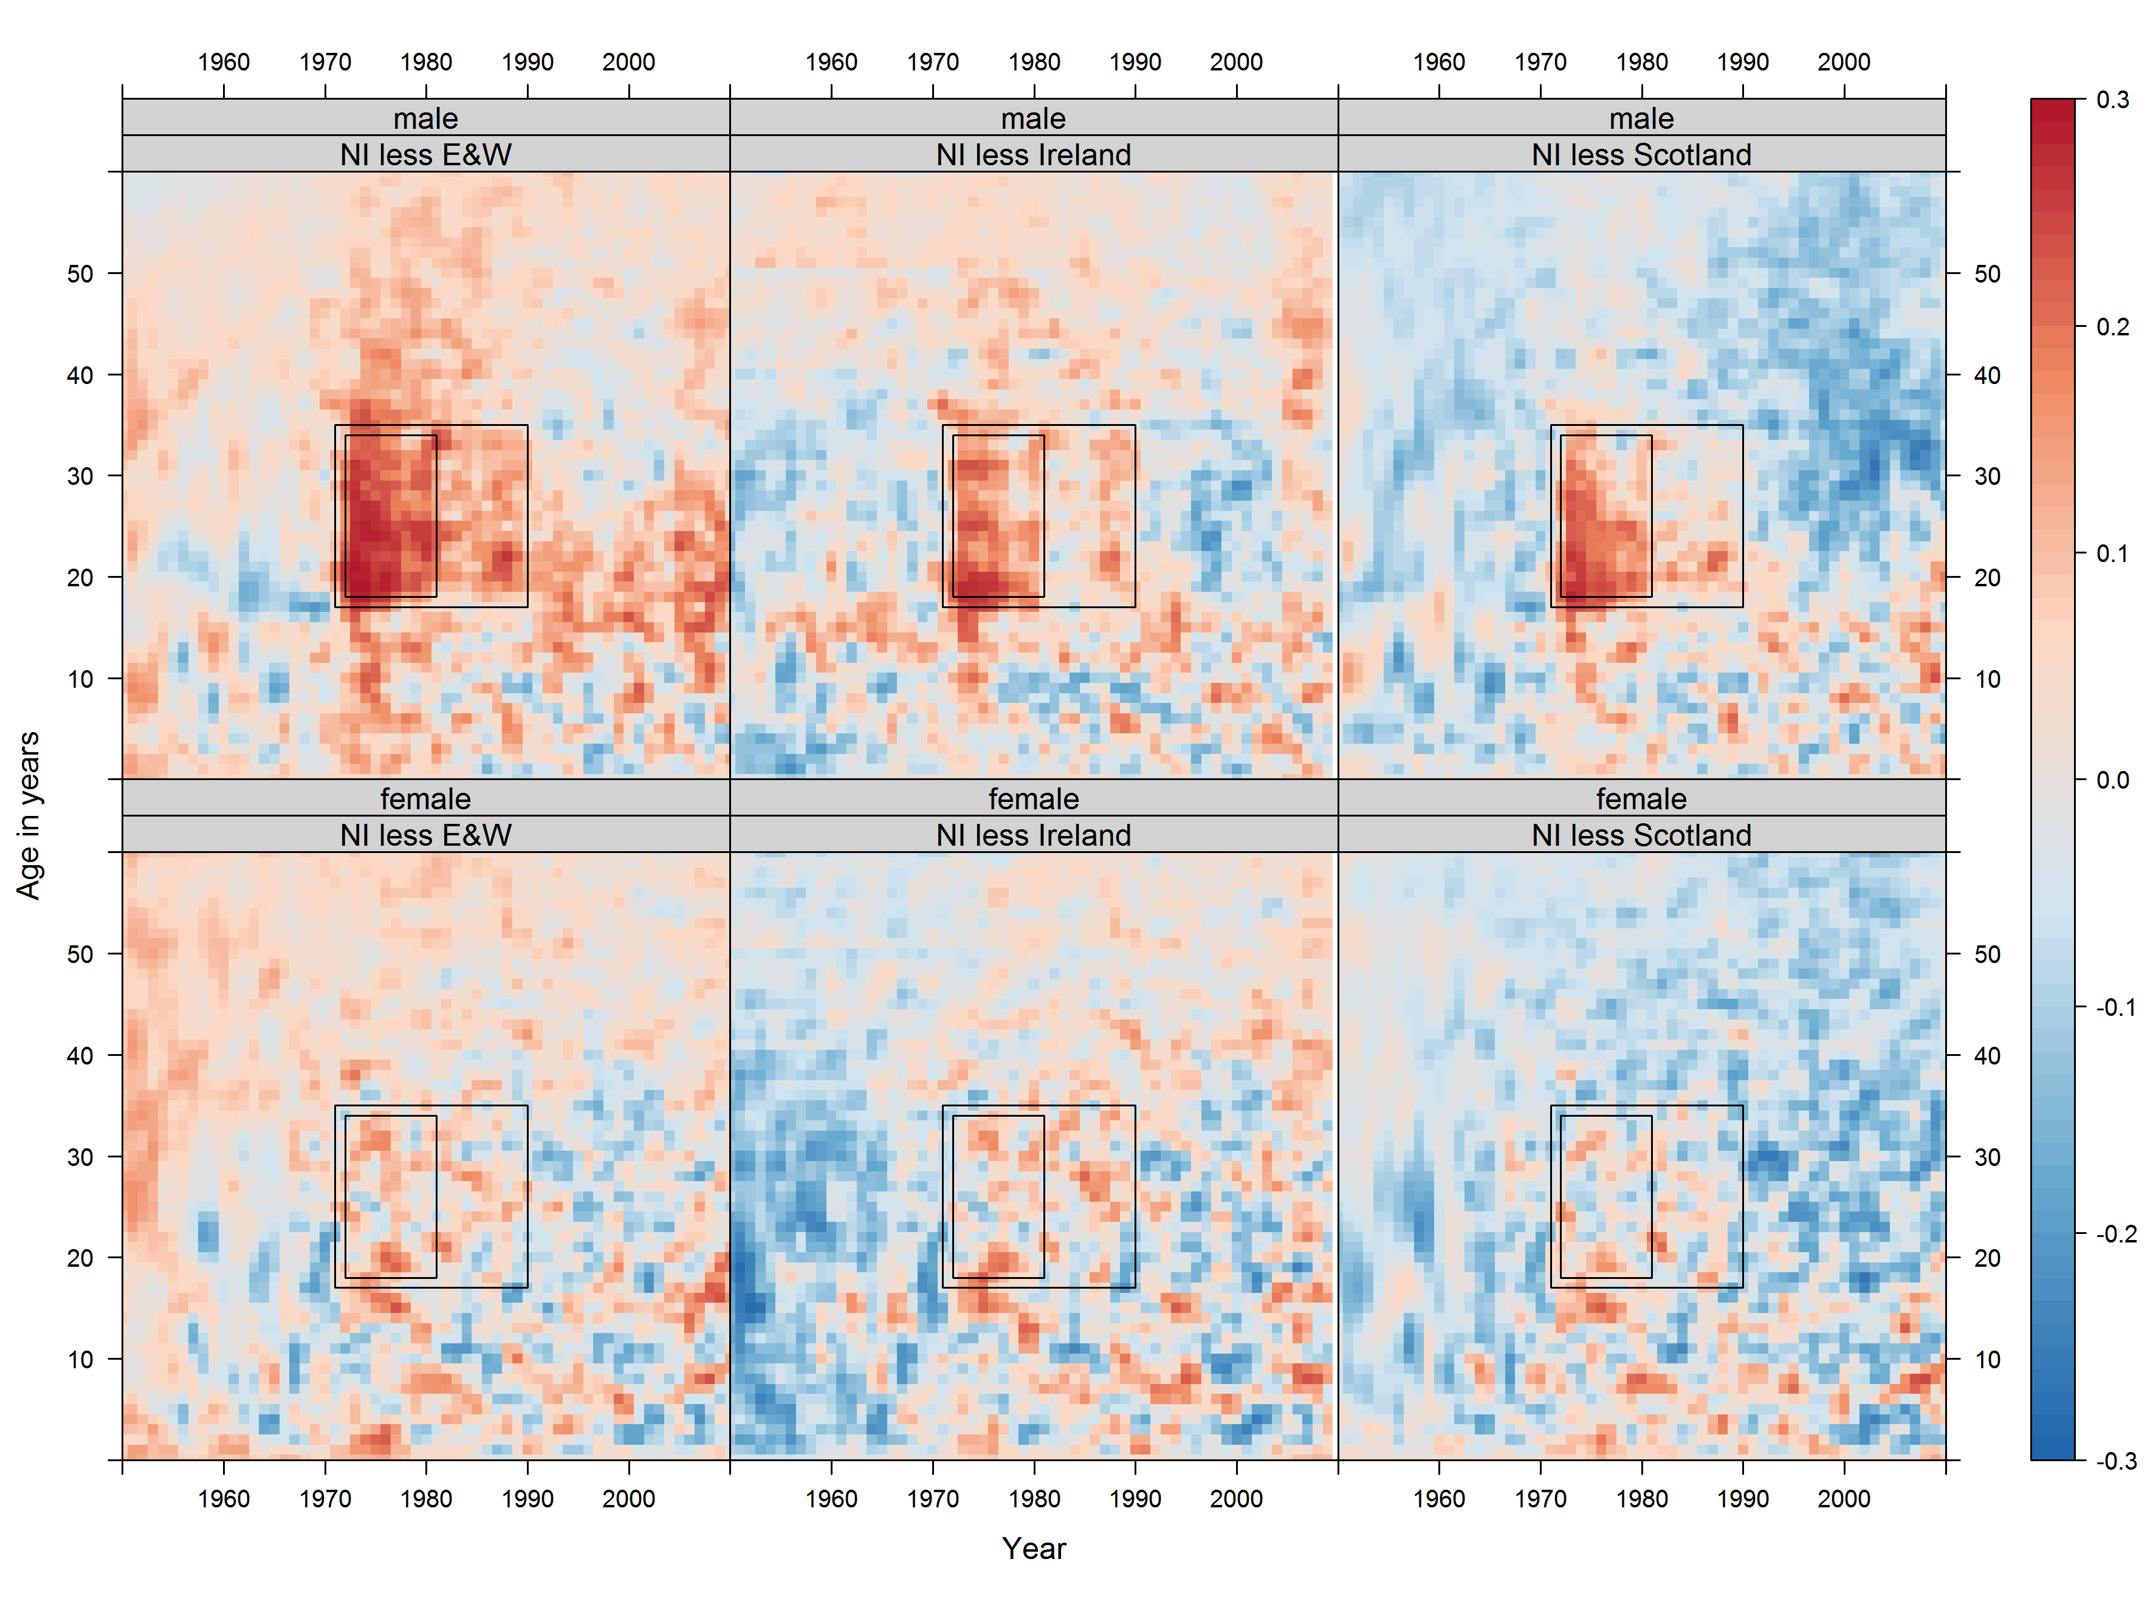

Slide 8
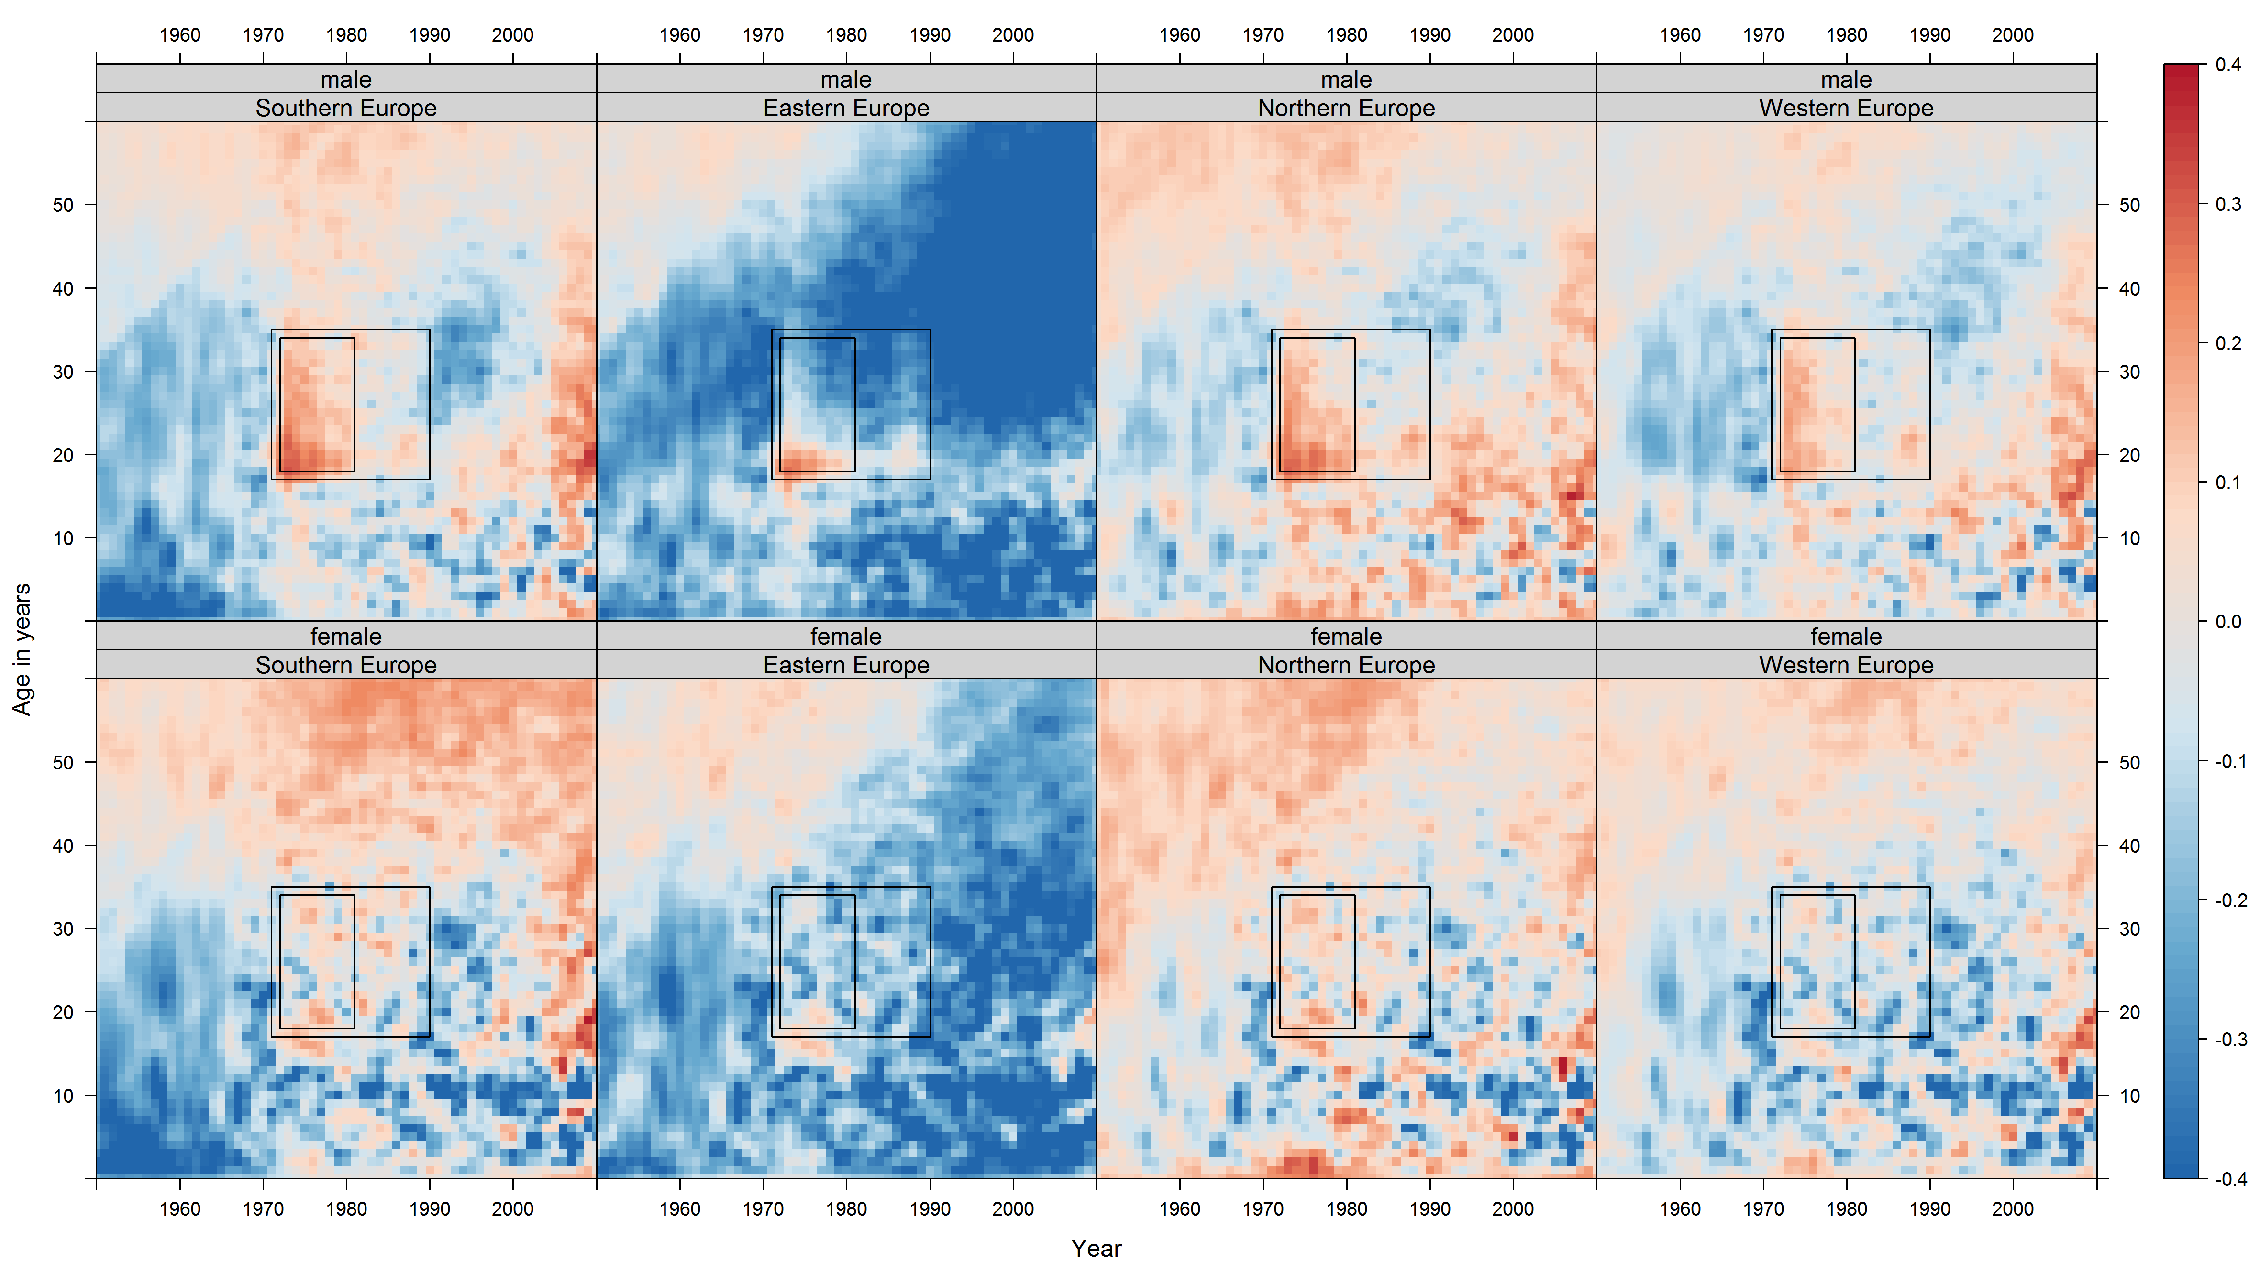

Slide 9
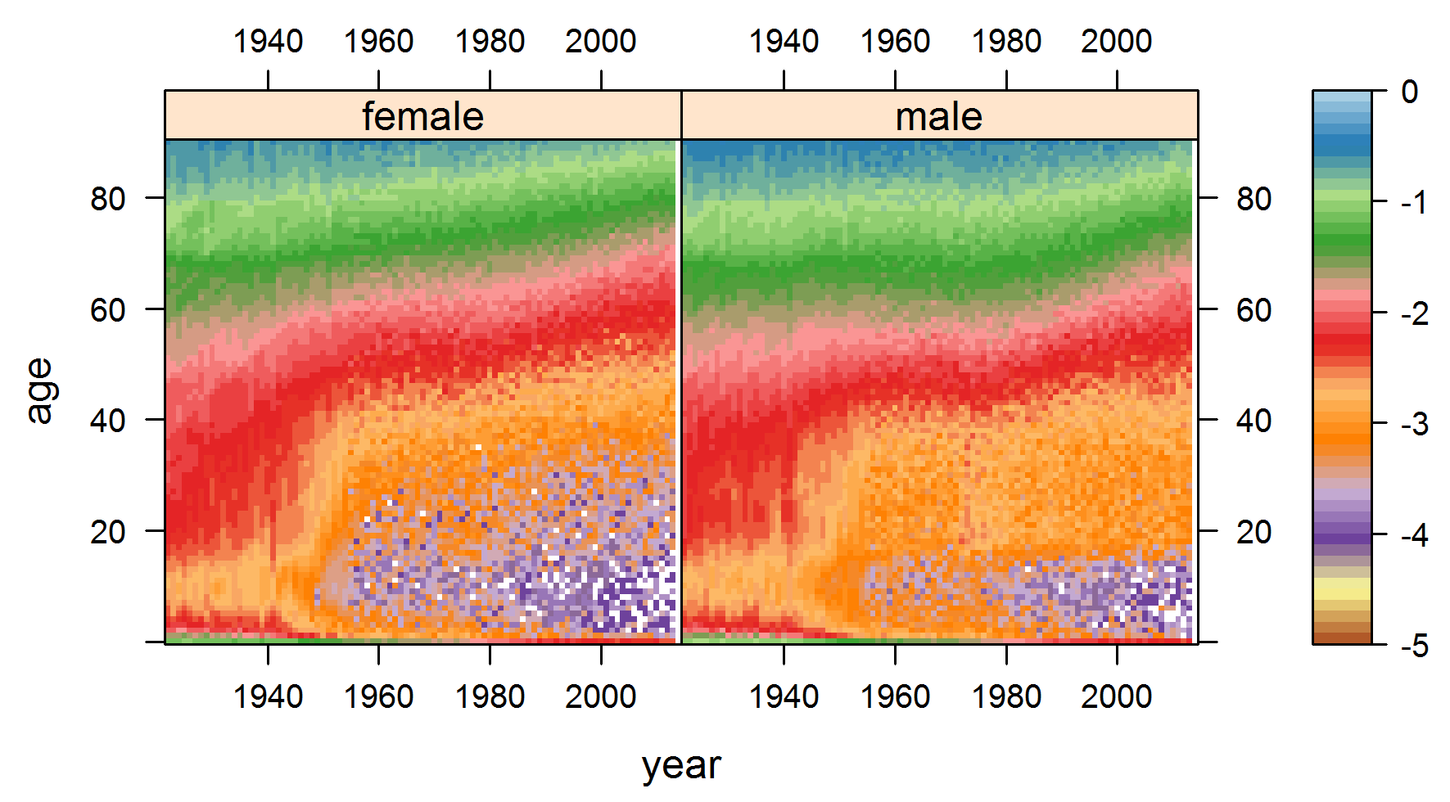

Slide 10
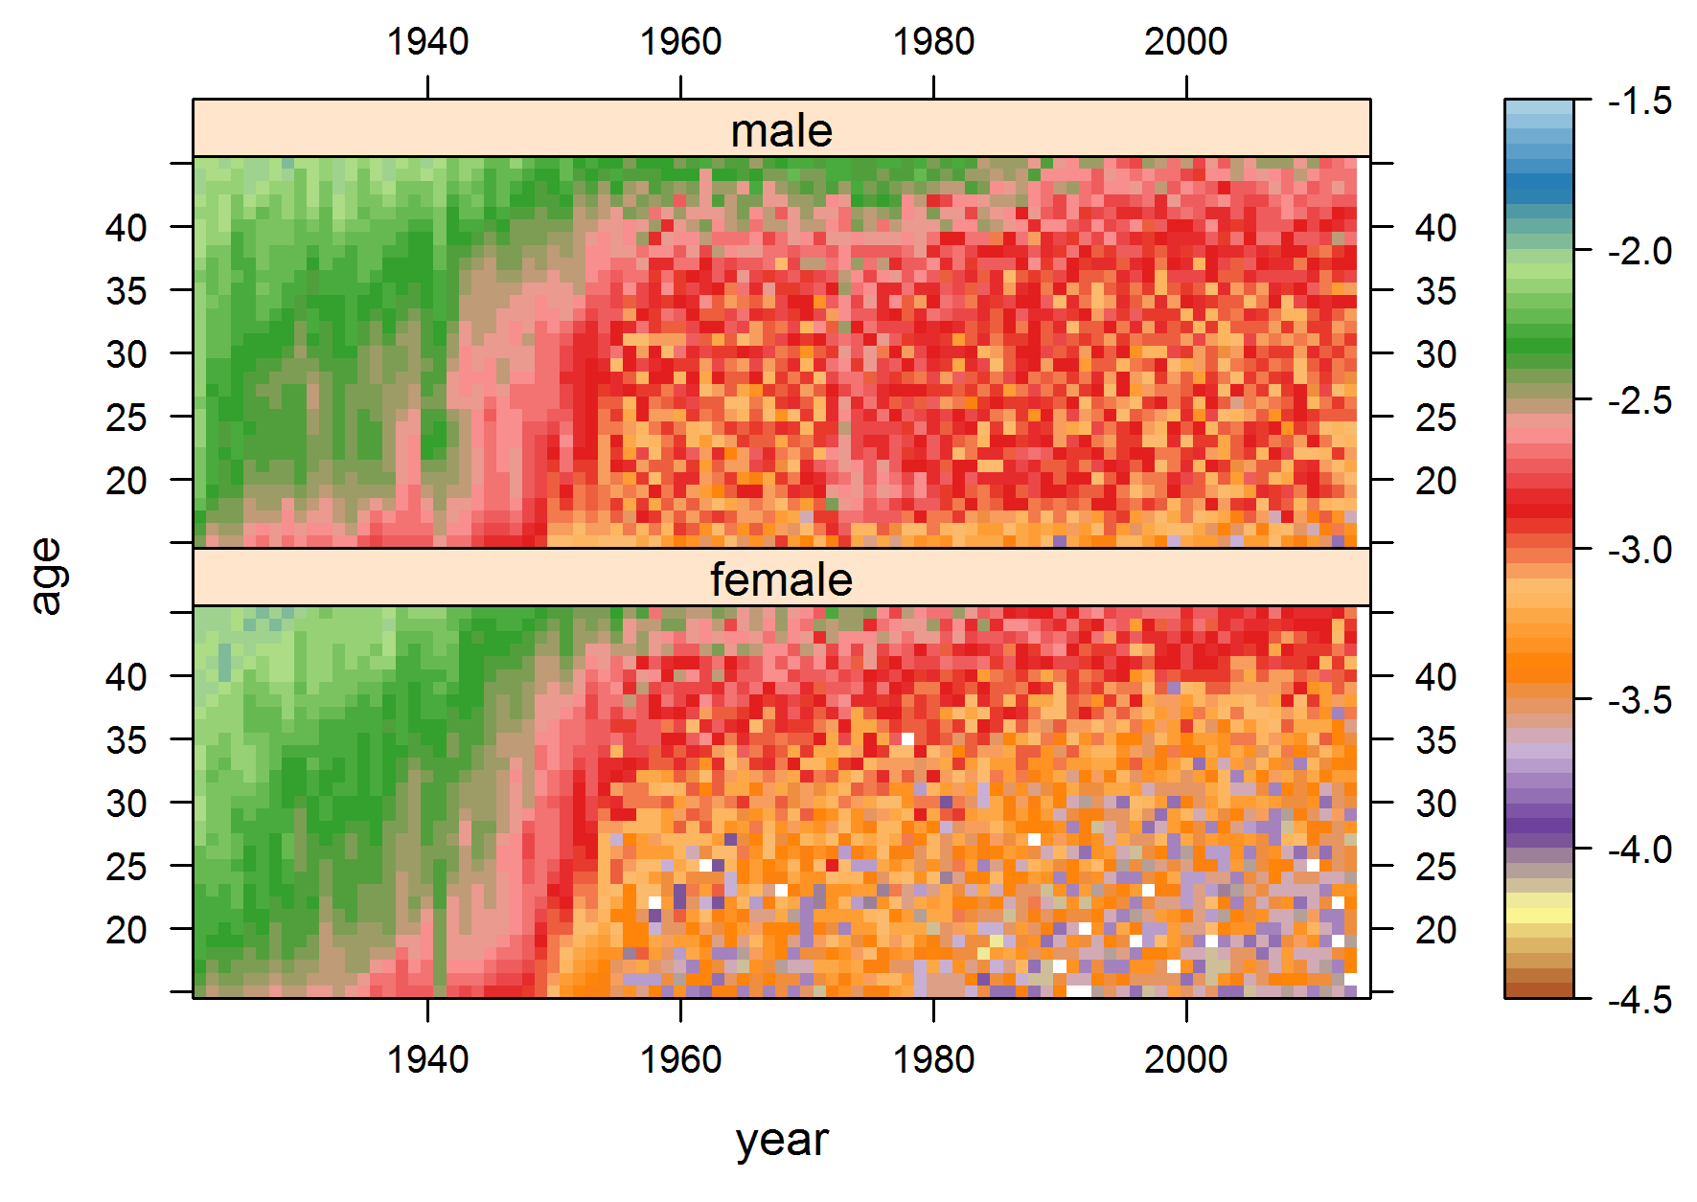

Slide 11
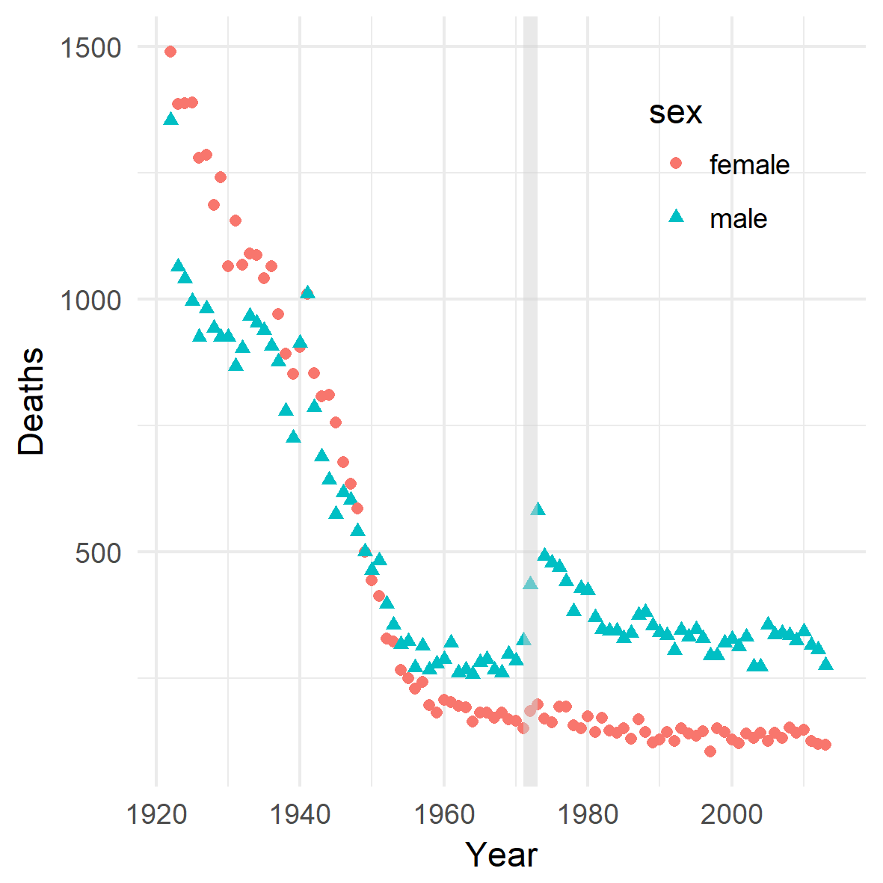

Slide 12

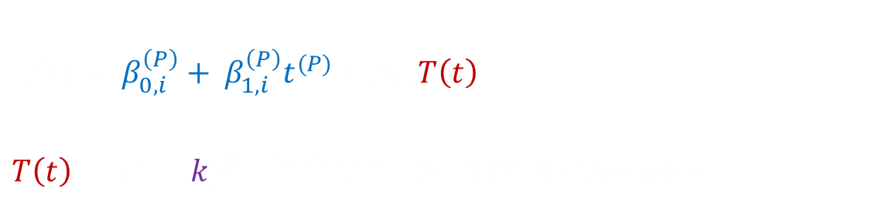
The Shape
Phase 1: 1922 to 1938
Phase 2: 1939 to 1955
Phase 3: 1956 onwards
Impulse
Conflict
Intensity
$$l_{i}\left(t\right)= β_{0, i}^{\left(P\right)}+ β_{1, i}^{\left(P\right)}t^{(P)}+β_{2,i}T\left(t\right)$$
$$T\left(t\right)= {(1−k)}^{(t−1972)} IFF t≥1972;0 otherwise$$
Decay
Time
$λ_{1/2}= \frac{log⁡(\frac{1}{2})}{\log{(1−k)}}$.
Half-life of (log) intensity
Time

Slide 13
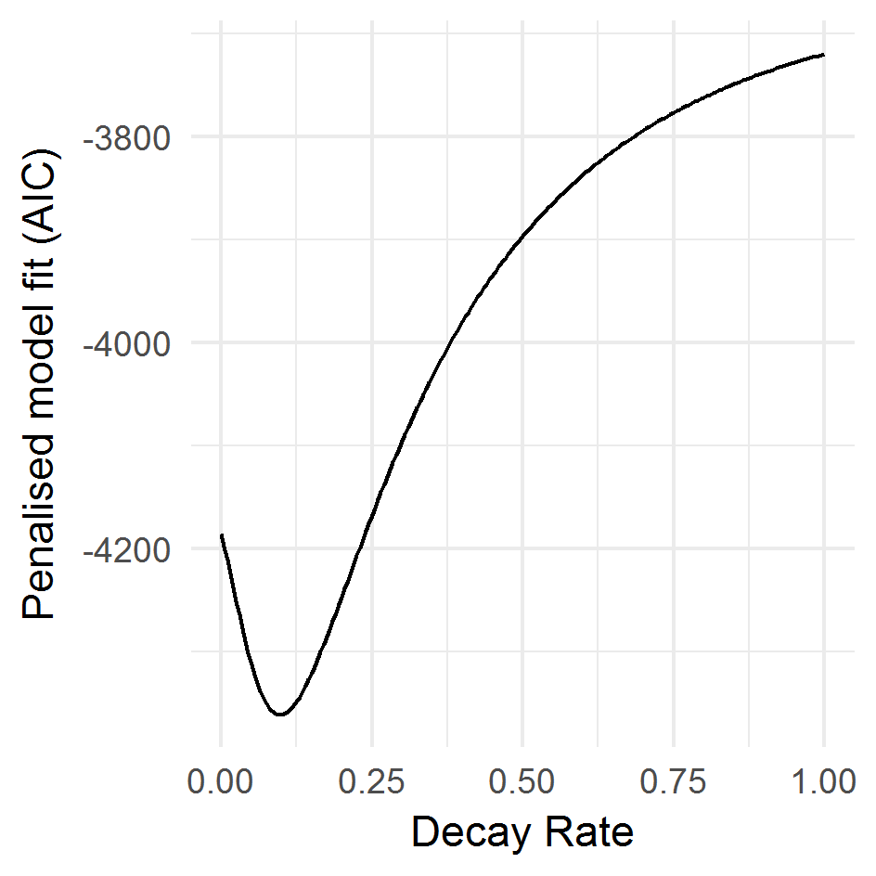
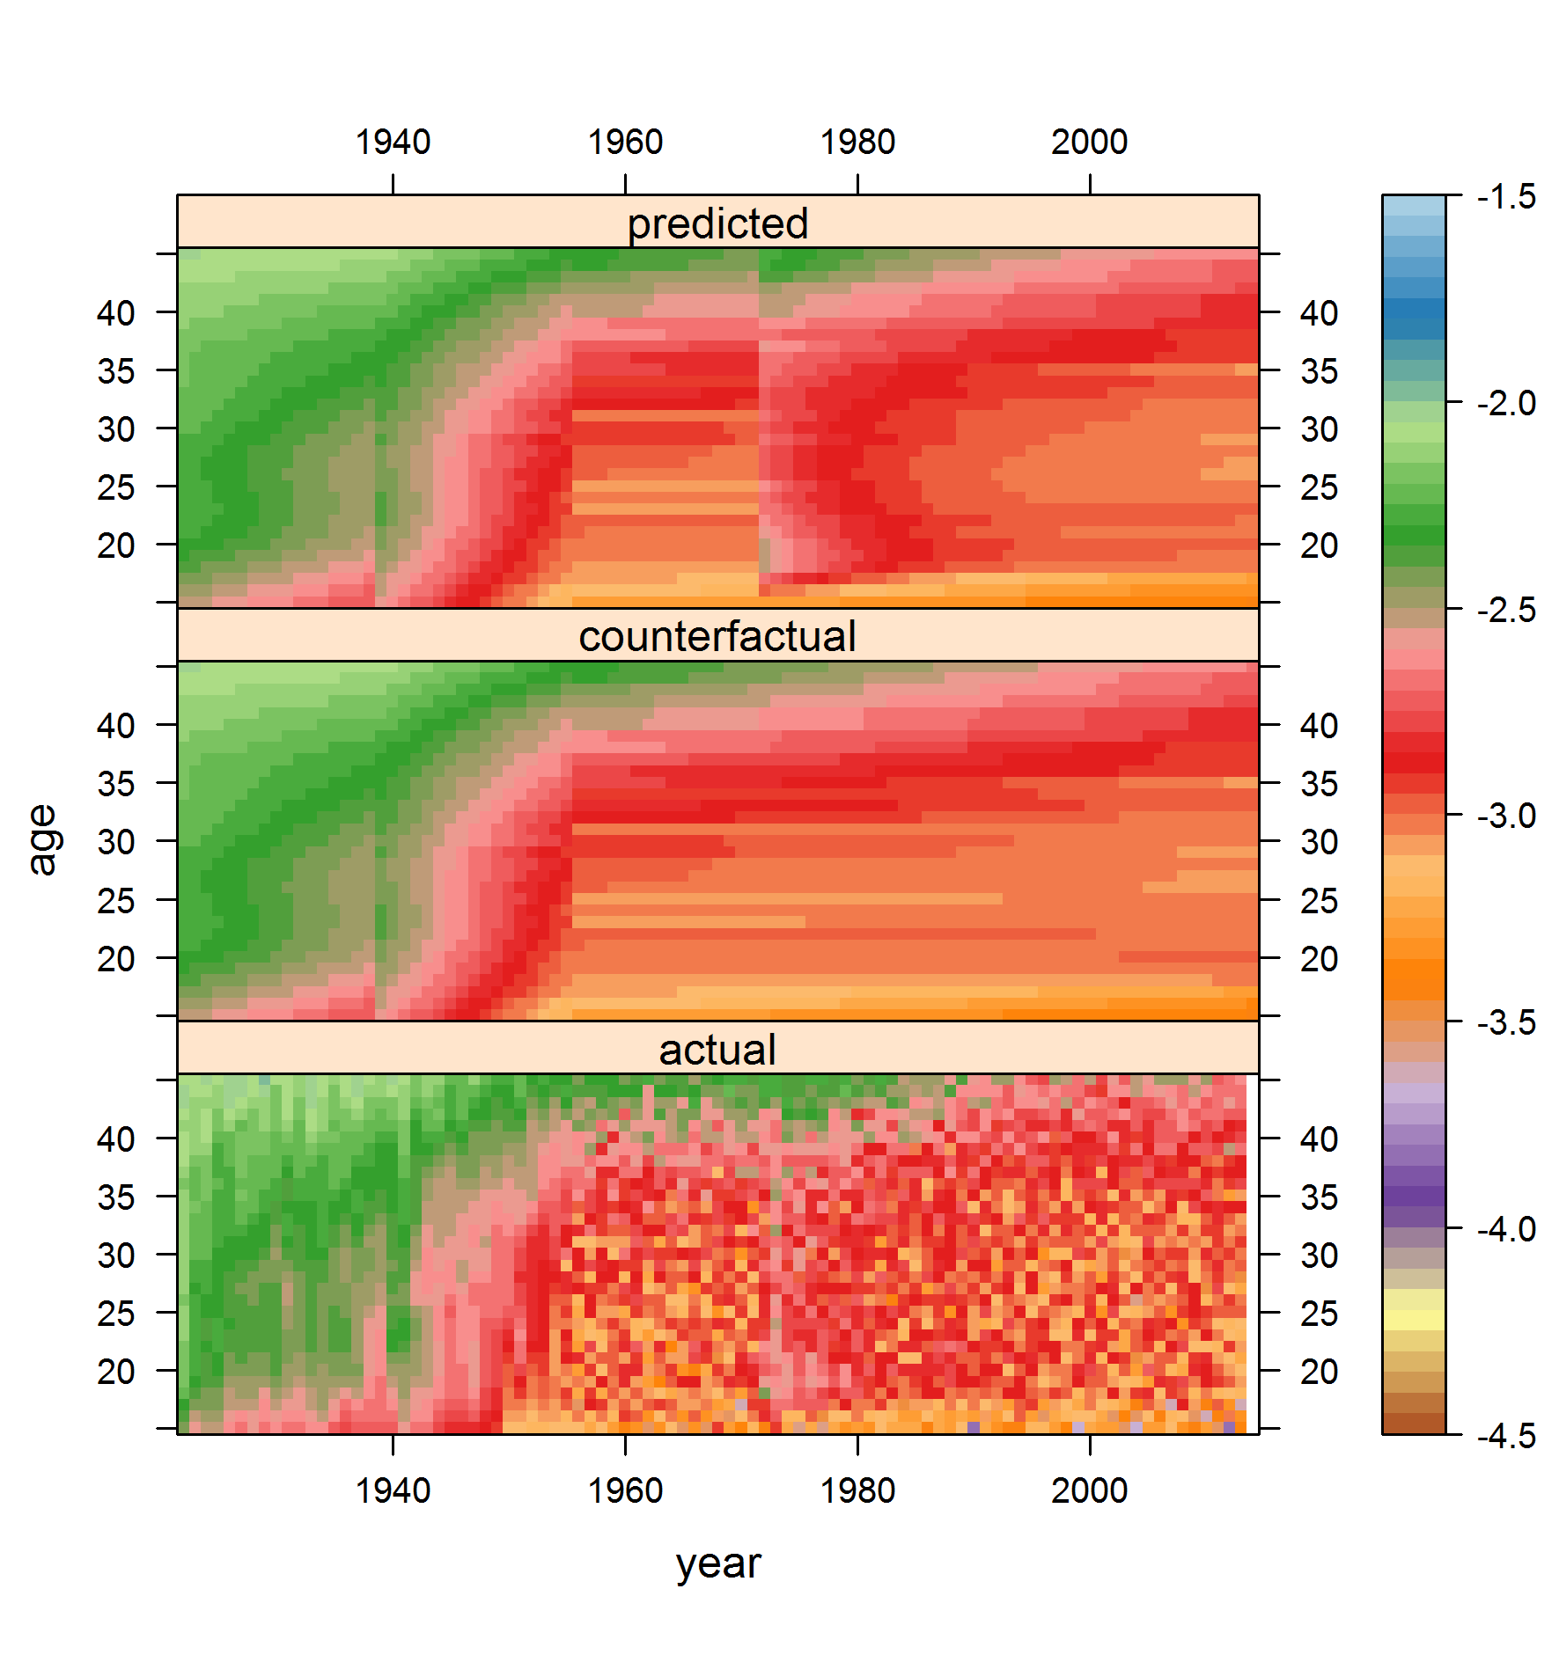
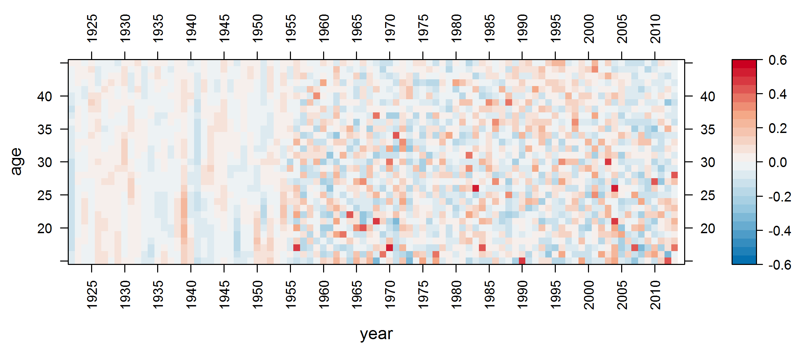
Visual Model Diagnostics

Slide 14
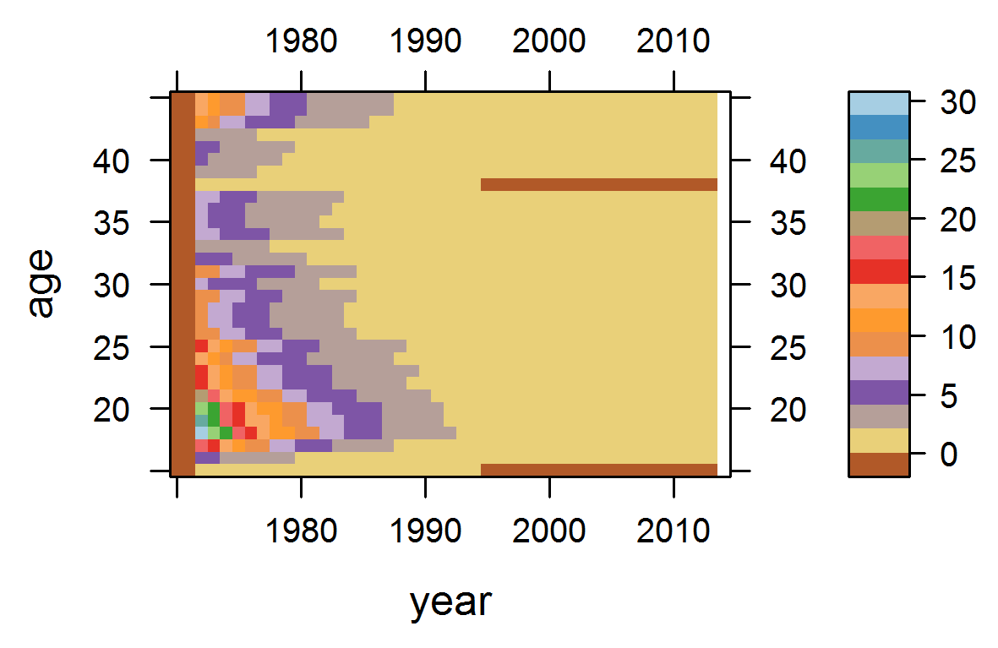
The excess, visually

Slide 15
Excess as table
 | Age Group
Year | [15,20] | (20,25] | (25,30] | (30,35] | (35,40] | (40,45] | Total | Cumulative
1990 | 10 | 9 | 6 | 5 | 3 | 6 | 39 | 2466
1991 | 9 | 8 | 5 | 4 | 3 | 5 | 35 | 2501
1992 | 8 | 7 | 5 | 4 | 3 | 5 | 31 | 2532
1993 | 7 | 7 | 4 | 4 | 2 | 4 | 28 | 2560
1994 | 6 | 6 | 4 | 3 | 2 | 4 | 25 | 2585
1995 | 5 | 5 | 4 | 3 | 2 | 3 | 22 | 2607
1996 | 5 | 5 | 3 | 3 | 2 | 3 | 20 | 2627
1997 | 4 | 4 | 3 | 3 | 2 | 3 | 18 | 2645
1998 | 4 | 3 | 3 | 2 | 2 | 3 | 16 | 2661
1999 | 3 | 3 | 2 | 2 | 1 | 2 | 14 | 2675
2000 | 3 | 3 | 2 | 2 | 1 | 2 | 13 | 2688
2001 | 3 | 2 | 2 | 2 | 1 | 2 | 11 | 2700
2002 | 3 | 2 | 1 | 1 | 1 | 2 | 10 | 2710
2003 | 2 | 2 | 1 | 1 | 1 | 2 | 9 | 2719
2004 | 2 | 2 | 1 | 1 | 1 | 1 | 9 | 2728
2005 | 2 | 2 | 1 | 1 | 1 | 1 | 8 | 2736
2006 | 2 | 2 | 1 | 1 | 1 | 1 | 7 | 2743
2007 | 2 | 1 | 1 | 1 | 1 | 1 | 6 | 2749
2008 | 1 | 1 | 1 | 1 | 1 | 1 | 6 | 2755
2009 | 1 | 1 | 1 | 1 | 0 | 1 | 5 | 2760
2010 | 1 | 1 | 1 | 1 | 0 | 1 | 5 | 2765
2011 | 1 | 1 | 1 | 1 | 0 | 1 | 4 | 2769
2012 | 1 | 1 | 1 | 0 | 0 | 1 | 4 | 2773
2013 | 1 | 1 | 0 | 0 | 0 | 1 | 3 | 2776
Total | 816 | 654 | 388 | 313 | 208 | 395 | 2776
 | Age Group
Year | [15,20] | (20,25] | (25,30] | (30,35] | (35,40] | (40,45] | Total | Cumulative
1972 | 101 | 78 | 43 | 32 | 22 | 46 | 322 | 322
1973 | 86 | 67 | 39 | 29 | 19 | 39 | 279 | 601
1974 | 73 | 58 | 34 | 26 | 17 | 34 | 243 | 844
1975 | 64 | 50 | 30 | 23 | 15 | 30 | 212 | 1056
1976 | 56 | 43 | 26 | 21 | 13 | 26 | 186 | 1242
1977 | 49 | 38 | 23 | 19 | 12 | 23 | 164 | 1407
1978 | 44 | 34 | 20 | 17 | 11 | 20 | 146 | 1552
1979 | 39 | 30 | 18 | 15 | 10 | 18 | 130 | 1682
1980 | 35 | 27 | 16 | 13 | 9 | 16 | 116 | 1798
1981 | 32 | 24 | 14 | 12 | 8 | 14 | 104 | 1902
1982 | 28 | 22 | 12 | 11 | 7 | 13 | 93 | 1995
1983 | 25 | 20 | 11 | 9 | 7 | 11 | 84 | 2079
1984 | 22 | 18 | 10 | 8 | 6 | 10 | 75 | 2154
1985 | 20 | 16 | 9 | 7 | 5 | 9 | 67 | 2221
1986 | 17 | 15 | 8 | 7 | 5 | 9 | 61 | 2282
1987 | 15 | 13 | 8 | 6 | 4 | 8 | 54 | 2336
1988 | 13 | 12 | 7 | 6 | 4 | 7 | 49 | 2385
1989 | 11 | 10 | 6 | 5 | 3 | 6 | 43 | 2428

Slide 16
Geometry & Aetiology
Informal
Geometry
Formal
Geometry
Informal Aetiology
Formal Aetiology

Slide 17


Aetiology of The Shape
t = 1
t = 2
t = 3
t = 4
t = 5
$$τ$$
k
Input
t
$$K ≫k$$
K
switch
Output
t

Slide 18
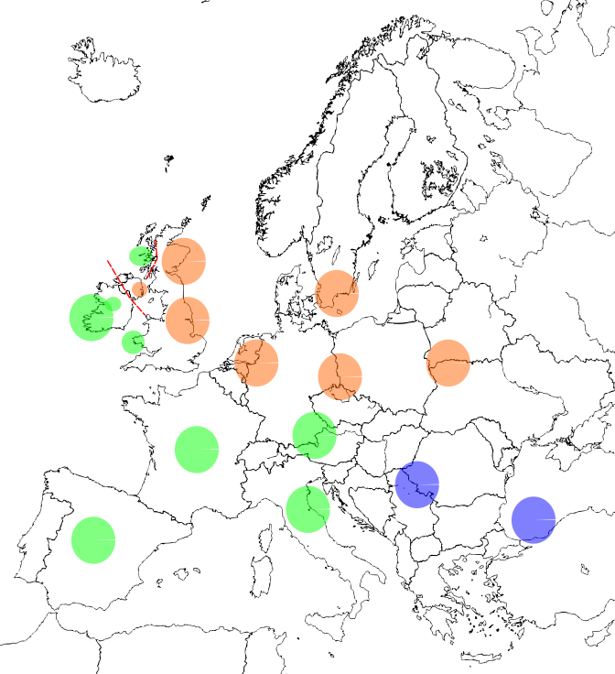
Meta-Ethnic Frontiers
Peter Turchin
Ethnic -> Meta-ethnic
Polytheistic -> Monotheistic
Judaistic -> Christian
Catholic -> Protestant
Charles Tilly
Durable Inequality
Paired & Unequal Binary social groups

Slide 19
Exacerbations
Bloody Sunday
Protests
Internment
Paras
Intensity
Republican Paramilitaries
British Army as ‘Peacekeepers’
OIRA/PIRA Split
Protestant Backlash: Loyalist Paramilitaries
Catholic Civil Rights Movement (Emulation from US Civil Rights Movement)
time

Slide 20
The Concern
???
???
???
Brexit Phase 1 stall: NI Border
Intensity
Economic Stagnation, collapse of £
Tory-DUP Alliance
UK 2017 Election
Brexit
EU Referendum
time

Slide 21
Discussion
Unchanged Fundamentals?
Persistence of meta-ethnic voting patterns
Good Friday Agreement & Consociationalism
Parallel Lives
Further Exacerbation
EU Border Assistance: Phase 1 (1995): €500m; Phase 2 (2000s): €531m, Phase 3 (up to 2013): … etc
UK Govt indifference to Border Issues in Phase 1 Brexit Negotiations
Neo-colonialist thinking: ‘Ireland isn’t EU’…
Signals of Persistence
Secondary Transfer Effect: Gay Marriage in RoI, Abortion laws in NI, etc

Slide 22
Broader Applications & Final Thoughts
International Conflict Studies
Data requirements: All cause only
Comparative Analyses: Intensity and Persistence
Case study of Algeria
Quasi-Geometric Thinking
APC Interactions as norm not exception
Quasi-spatial models of demographic processes
Material available from:
https://osf.io/3pj2f/ - OSF project
https://osf.io/hqd95/ - OSF preprint
To contact me:
jonathan.minton@glasgow.ac.uk
@jonminton
Thanks for listening!

