Slide 1

CodeHero
Contester Database
Group 14

Slide 2
OUTLINE
This project involves designing a contester database, which is an application oriented to programming competitions and coding exercises.
The name of our application is “CodeHero”.
The database of CodeHero should hold information related to the registered users, exercises, statistics etc.
The users will sign in into the contester with their username and password. They will have access to exercises, together with their category and status.
Notes:
Jon

Slide 3
OUTLINE (cont.)
During competitions, the entrants of the competition will have the privilege of accessing a special section with exclusive exercises according to the respective contest.
Each exercise, will be accompanied with a brief description, simulation and a section for code submission.
The compilers provided on the contester will include support for around 15 programming languages such as JAVA, C, C++, JavaScript etc.
Users will have the opportunity to create threads, discuss and comment for topics around the question.
Notes:
Jon

Slide 4
PLANNING
Research and Idea Consolidation : Kevin and Enest
Database Requirements : Jon and Fabio
ERD : Kevin, Enest, Kristi and Eugen
Rationales for ERD design : Kevin
Relational Schema : Kristi and Eugen
Functional Dependencies and Normalization: Jon
Creating tables : Kevin
Populating tables : Fabio
Views for derived attributes : Jon
Managerial queries : All members
Notes:
Jon

Slide 5
RESEARCH AND IDEA
Normalization
Normalization is the process of structuring a relational database from one normal form up to another, with the purpose of reducing data redundancy and integrity.
The advantage of a normalized database is that, the operations for insertions, deletion and modification will cause no anomaly behavior.
It makes our database ACID(Atomicity Consistency Isolation Durability) compliant.
Normalization guarantees validation of data no matter the scenarios, but puts a bigger pressure on the correct creation of queries using JOINS.
Notes:
Kevin

Slide 6
RESEARCH AND IDEA (cont.)
Indexing
Indices are used to find rows of a column quickly, without reading through the entire table.
Since, MySQL supports B+ Trees, that is what our team took advantage of for the implementation of our database.
B Trees, is a generalized form of a binary tree, which differs from the fact that instead of a single entry, its node will point to an array of entries and have a reference to the child node of each entry.
B+ Tree takes this even further by storing the data only on its leaf nodes, meaning that all values in non-leaf nodes is duplicated onto the leaves.
Notes:
Enest

Slide 7

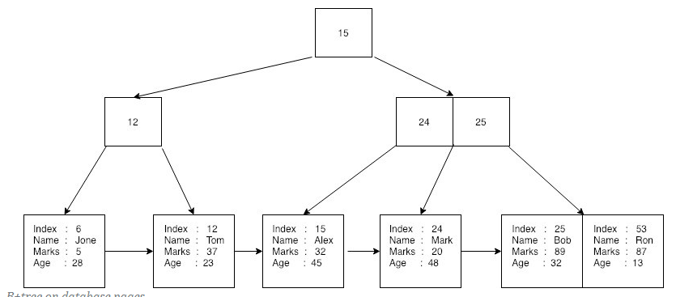
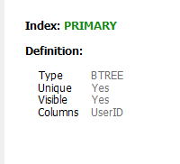
INDEXING
The way this data structure is designed gives the advantage of having a logarithmic time complexity for searching, insertions and deletions.
This property of the B+ tree means that they can be implemented directly for indexing on a database albeit with a little modification.
The entry or payload will consist of a key and a value associated with that key, the value itself being a pointer or reference to the record of interest on our database.
Implementation by MySQL
Visual representation of BTREE indexing
Notes:
Enest

Slide 8
DATABASE REQUIREMENTS
CodeHero is a contester webpage where students, coders and other professionals have the opportunity to practice their coding skills, compete for contests and prepare for interviews.
The ER diagram of the database for CodeHero is based on the following requirements:
The CodeHero Database will keep track of people, backgrounds, locations, users, memberships, contacts, questions, contests, categories, discussions, submissions, playgrounds, editors and environments.
For each person, CodeHero will keep track of a unique person identifier, full name, date of birth and gender.
For each contact, CodeHero will keep track of optional phone number, and optional social addresses.
Notes:
Fabio : mention only some requirements including a definition for entity.

Slide 9
DATABASE REQUIREMENTS
A user does not need to comment in a discussion, but may comment in many discussions many times. A discussion does not need to be commented by a user, but may be commented by many users.
A discussion is discussed by exactly one question (identifying relationship). A question may be discussed by many discussions or by no discussion at all.
A question does not need to be solved by a submission, but may be solved by many submissions. A submission can solve exactly one question.
A category may include many or no question at all. A question must be included by at least one category.
A user exists for exactly one person. A person exists for exactly one user.
Notes:
Fabio : don’t forget to mention the requirement about the relationships

Slide 10
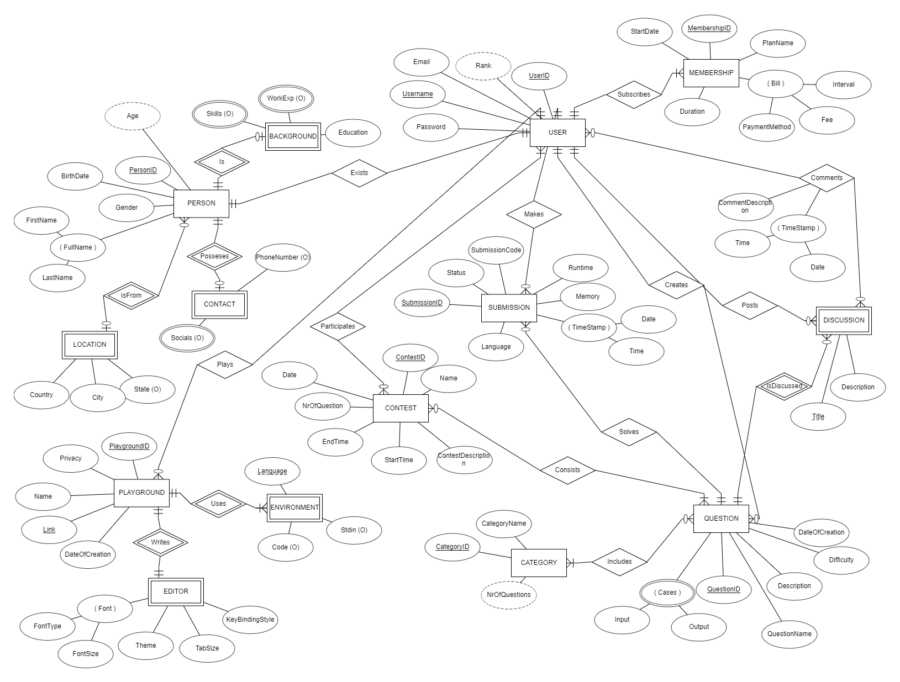
CodeHero ERD
Notes:
Eugen : mention all the entities and relationships by going over them on the image

Slide 11
DESIGN RATIONALES
Usage of weak entities
We decided to make Discussion and Environment weak entities, since they cannot be uniquely identified by only their attributes.
They are identifiable in combination with the question for which the discussion is made at the first place or the playground for which the environment is being used.
Therefore, via an identifying relationship ‘isDiscussed’ and ‘uses’, Discussion is related to Question while Environment is related to Playground.
Notes:
Kevin : reference the image of ERD

Slide 12
DESIGN RATIONALES
Weak entities without keys
The entity Editor includes no fully or partially unique key as its attribute.
While typically a weak entity has a composite key consisting of the key of its parent entity plus one or more additional attributes, it doesn't have to be so always.
In our case, the Playground entity can have at most only one editor, meaning that PlaygroundID can serve on its own as an identifying key for the Editor.
The same applies for Location, Contact and Background.
Notes:
Kevin : reference the image of ERD

Slide 13
DESIGN RATIONALES
Optional attributes and min. cardinality usage
The attributes Code and Stdin of entity Environment are left as optional, since there could be scenarios where the users leave the environment empty or where no input is supposed to be taken from the keyboard.
The relationship of person with entities such as Location, Contact and Background was made as optional, since we took into consideration the fact that some individuals prefer to be discrete and not provide too much personal information.
Notes:
Kevin : reference the image of ERD

Slide 14
DESIGN RATIONALES
Comments relation and language attribute
The relation Comments has attributes for description and timestamp of the comment, since users can comment many times on the same discussion thread.
The entity Submission has attributes related to memory consumed, runtime and language of script, since memory and runtime depend on the different solutions that exists for the same question.
CodeHero supports many programming languages, so the language attribute is included to make a distinction between different submissions of the same question.
Notes:
Kevin : reference the image of ERD

Slide 15
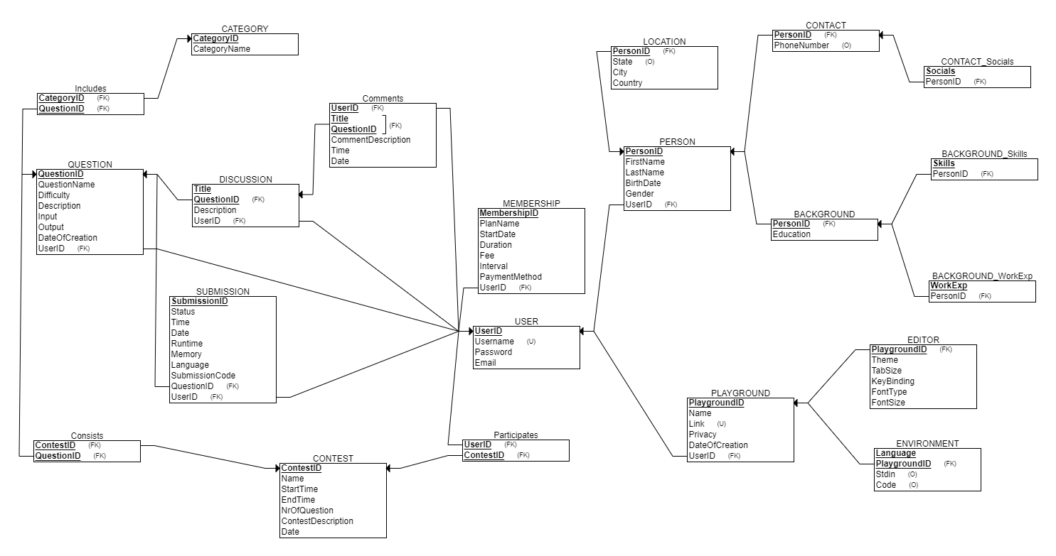
CodeHero RS
Notes:
Kristi : show the new relations that were created during the convertion. Fo example : Contact_Socials, BACKGROUN_Skills because of multi-valued attributes, Comments because of many to many relationships.

Slide 16
FUNCTIONAL DEPENDENCIES
Table: Question
Primary Key: QuestionID
Partial Key: None, since the relation has a single column primary key.
Full Key: QuestionID => QuestionName, Difficulty, Description, Input, Output, DateOfCreation
Transitive: None, since no non-key column defines another column.
Normalization:
The table Question is already in 1NF, since no multi-values are present.
The table Question is already in 2NF, since no partial key dependency exists.
The table Question is already in 3NF, since no transitive dependency exists.
Notes:
Jon

Slide 17
FUNCTIONAL DEPENDENCIES (cont.)
Table: Discussion
PK: Composite (Title + QuestionID (FK))
Partial Key: None, even though the relation has a composite primary key.
Full Key: QuestionID, Title => Description
Transitive: None, since no non-key column defines another column.
Normalization:
The table Discussion is already in 1NF, since no multi-values are present.
The table Discussion is already in 2NF, since no partial key dependency exists.
The table Discussion is already in 3NF, since no transitive dependency exists.
Notes:
Jon

Slide 18
DATABASE DUMP
Creating tables
Based on the Relational Schema, I wrote the CREATE statements in SQL for our database.
The order of the CREATE statements is in conformity with the Referential Integrity Constraint, meaning that relations with foreign keys are created after relations being referenced by foreign keys.
The tool I used mostly to create the tables of our database was MySQL Workbench.
For each primary key of our relations, I included the keyword AUTO_INCREMENT on the CREATE TABLE statement.
Notes:
Kevin : Auto-Increment means that there is no need to insert the id for the records, since MySQL will autogenerate them and increment for a new one each time.

Slide 19
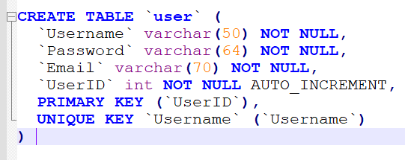
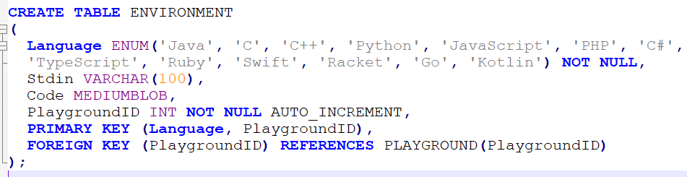
Create statements examples
Notes:
Kevin : Show the keyword Auto_Increment and why you chose data types such as ENUM and MEDIUMBLOB. ENUM for a list of options and MEDIUMBLOD, because codes will be stores as Binary Large Objects

Slide 20
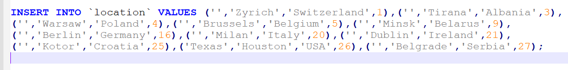
DATABASE DUMP
Populating tables
For our database to have a meaning and for the managerial queries to be tested properly and basically give a result, the tables need to be populated with data.
This operation was done by executing queries using INSERT INTO statement. I decided that 10 to 15 records for each table was enough to serve as a sample of the database.
Notes:
Fabio : Describe the process of inserting data to the tables using the import wizard of MySQL Workbench

Slide 21
MANAGERIAL QUERIES -PLAN
DATABASE DUMP
Derived Attributes : Jon
Contest, categories and questions : Kevin
Discussions : Fabio
Playground and User : Eugen
Person : Kristi
Questions, Submissions : Enest
Notes:
Jon

Slide 22
DATABASE DUMP
Derived Attributes
Since derived attributes are not shown in the Relational Schema, they are not present in the CREATE statements.
However, they are part of our database and we should present them by using queries.
The queries will call functions, for which parameters are passed and a calculated output is returned.
The queries are stored on Views, that will show the tables together with their derived attributes each time they are selected
Notes:
Jon

Slide 23
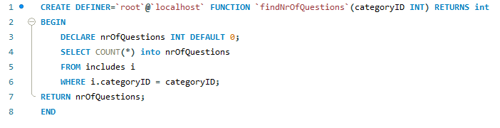
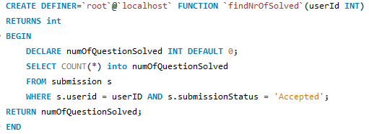
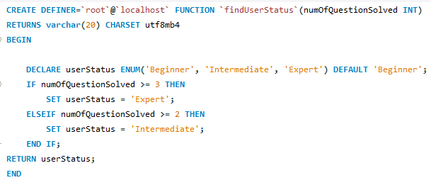
Functions
Notes:
Jon

Slide 24
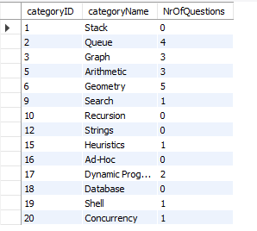
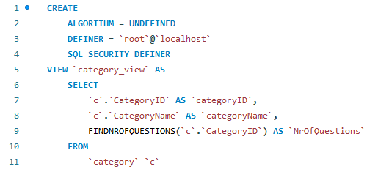
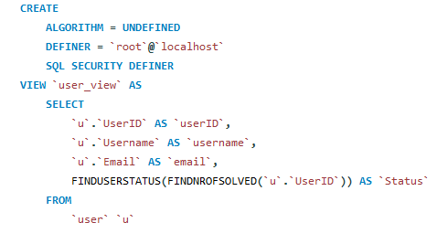
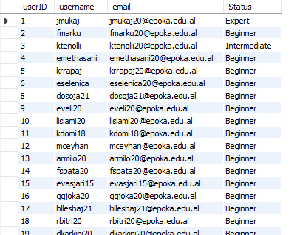
Views for derived attributes
Notes:
Jon

Slide 25
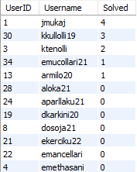
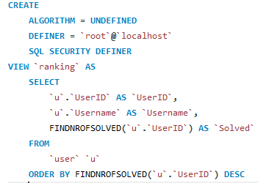
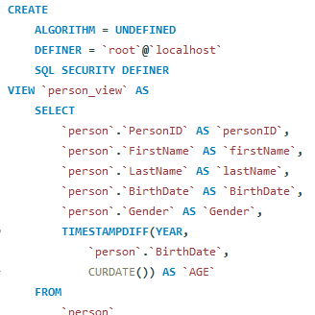
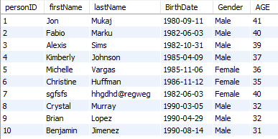
Views for ranking and age
Notes:
Jon

Slide 26
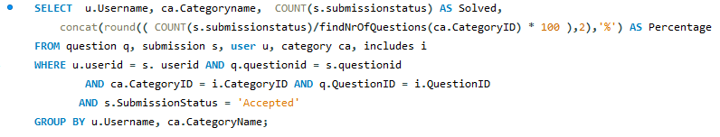
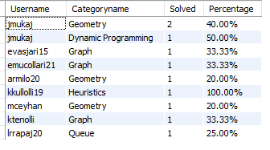
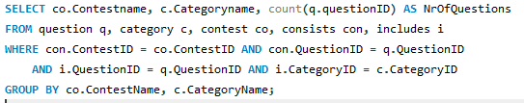
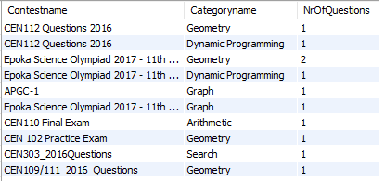
Managerial Queries- Kevin
Description: Shows nr of solved questions in a category from each user
Description: Shows the number of questions from each category included in each contest
Notes:
Kevin

Slide 27
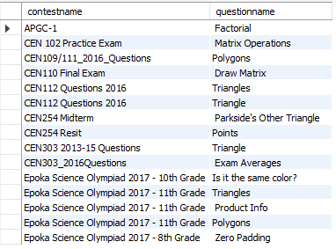

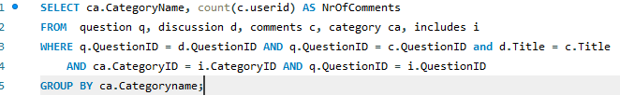

Managerial Queries- Kevin (cont.)
Description: Shows each contest and its question
Description: Shows number of comments for each category
Notes:
Kevin

Slide 28
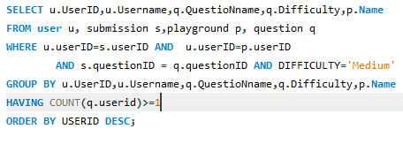

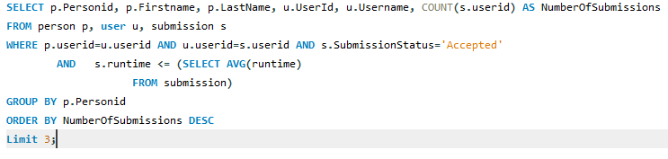

Managerial Queries- Eugen
Description: Select the id , username, playground-name and the name of the question of all the
users that have attempted to solve at least 1 medium question.
Description: Select the real name username id, for the top 3 users with the most questions submitted and whose runtime is faster than the average
Notes:
Egi

Slide 29
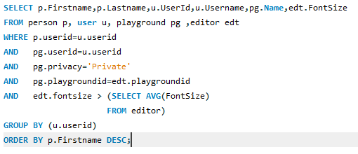

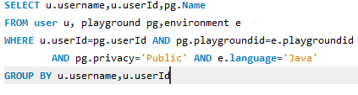

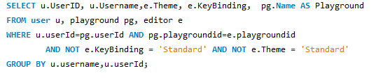

Managerial Queries- Eugen (cont.)
Description: Select the firstname, lastname ,userid,username,playgroundname for all users that use private playgounds where the fontsize is greater than the average
Description: Select the username, userid, playground name for all users that use java in public playgrounds
Description: Select the username, userid, password, theme, keybinding and playground name for all the users whose editor keybinding and theme is different from standard
Notes:
Egi

Slide 30




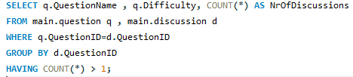

Managerial Queries- Fabio
Description: Select all the users from THE CEN (Computer Enginnering) question that have made a disscusion about a question. Display them by id, username and title.
Description: Display UserID , membership plan the user has paid , and the Title of the discussion this user has made . Order them by userid.
Description: Diplay the QuestionName, its difficulty and number of discussions for questions which were discussed more than once.
Notes:
Fabio

Slide 31
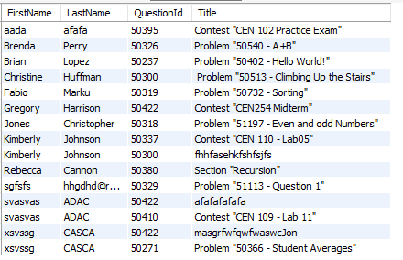



Managerial Queries- Fabio (cont.)
Description: For all the persons who have made discussion about an exercise, display ther FirstName , LastName, the QuestionID and title. Sort them by first name .
Description: Display the firstname, lastname, id, country and city of all the users that have made discussion in the contester
Notes:
Fabio

Slide 32

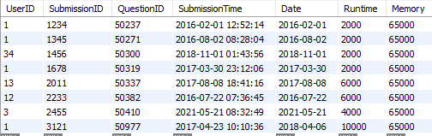




Managerial Queries- Enest
Description: Show all the submissions on the C language whose status is accepted.
Description: Retrieve the Username, Email, UserID and status for each user whose status is different than beginner.
Description: Retrieve QuestionID, QuestionName, Difficulty and DateOfCreation for each question in the Easy' questions category that have been created in '2019' sorted by date of creation.
Notes:
Enest

Slide 33
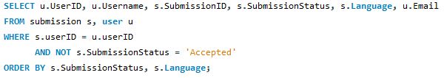
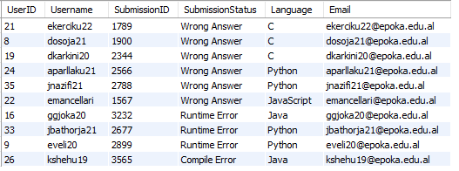
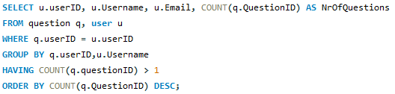
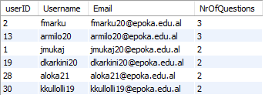
Managerial Queries- Enest (cont.)
Description: Show the userId, username, SubmissionID, SubmissionStatus, Language and email of the student for each submission whose status is not 'Accepted'. Order by status and language.
Description: Show the userID, email and the number of created questions for every user that has created more than one question.
Notes:
Enest

Slide 34
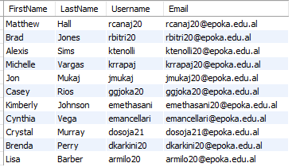
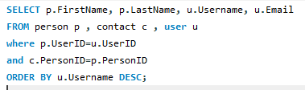


Managerial Queries- Kristi
Description: Select the first name, last name, username and email and order them by username in descending order.
Description: Select person id , person name, phone number and skills where person id is between 1 and 5.
Notes:
Kristi

Slide 35
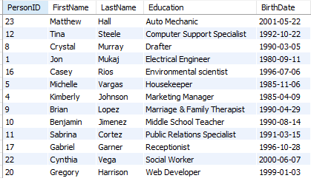

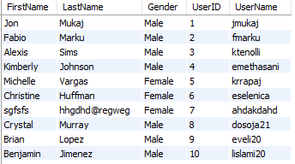

Managerial Queries- Kristi (cont.)
Description: Select name, education, person id, and birthdate and order them by education.
Description: Select the first name, last name, gender, user id and user name and order them by their userid.
Notes:
Kristi

Slide 36
THANK YOU !

