Slide 1
Distributed Training Operator
Declarative, auto-tuned distributed ML training on Kubernetes
Jon Mukaj
Praktikum 2
Supervisor: Dr. Enes Bajrovic

Slide 2
The Problem: Distributed Training by Hand
Praktikum 1: fine-tuning LLM with distributed PyTorch on GKE — every run required 5 manual commands
1
2
3
4
5
provision pool
save YAML
apply job
wait + collect
delete pool
gcloud container node-pools create …
vim baseline-pytorchjob.yaml
kubectl apply -f …
kubectl cp master-pod:/… results/
gcloud container node-pools delete …
Can we automate all of this?
Pain points
Manual overhead per run: provision the node pool, wait for training to finish, collect results, delete the pool — all by hand
No memory between runs and no strategy for deciding node count — N is guessed, not computed from time or cost objectives
1 / 6

Slide 3
The Solution: distributed-training-operator
Pending
Provisioning
Ready
Running
Collecting
Succeeded
OPERATOR
deployed once by admin
USER CR
spec — applied per training run
STATUS
operator writes back
apiVersion: apps/v1
kind: Deployment
metadata:
name: controller-manager
namespace: distributed-training-system
spec:
template:
spec:
containers:
- image: jmukaj/distributed-training-operator:latest
command: [/manager]
args:
- --leader-elect
- --health-probe-bind-address=:8081
- --cloud-provider=gke
- --gcp-project=praktikum2-494215
- --gcp-location=us-east1-d
- --cluster-name=praktikum2
- --default-cpu-machine-type=
e2-standard-4
- --machine-costs-configmap=
machine-costs
- --node-service-account=
gke-cluster-sa@...
apiVersion: training.distributedjob.io/v1
kind: DistributedTraining
metadata:
name: distributedjob-obj-a3
namespace: default
spec:
backend: pytorch
hardware:
type: cpu
machineType: c4-highcpu-8
topology:
nodes: 3
processesPerNode: 1
model:
name: BEE-spoke-data/smol_llama-101M-GQA
training:
epochs: 1
batchSize: 4
learningRate: "2e-5"
ddpBackend: gloo
outputPVCName: distributed-training-output-pvc
spec:
……
status:
phase: Succeeded
startTime: "2026-06-01T17:41:26Z"
trainingStartTime: "2026-06-01T17:43:29Z"
finishTime: "2026-06-01T17:53:12Z"
resolvedTopology:
nodes: 7
masterReplicas: 1
workerReplicas: 6
estimatedTime: 9m13s
estimatedCost: "0.4327"
results:
trainingTime: 9m9s
provisioningTime: 1m22s
estimatedCostUSD: "0.4294"
collectionTime: 4s
metrics:
loss: "1.5835"
perplexity: "4.8720"
samplesPerSecond: "63.80"
2 / 6

Slide 4

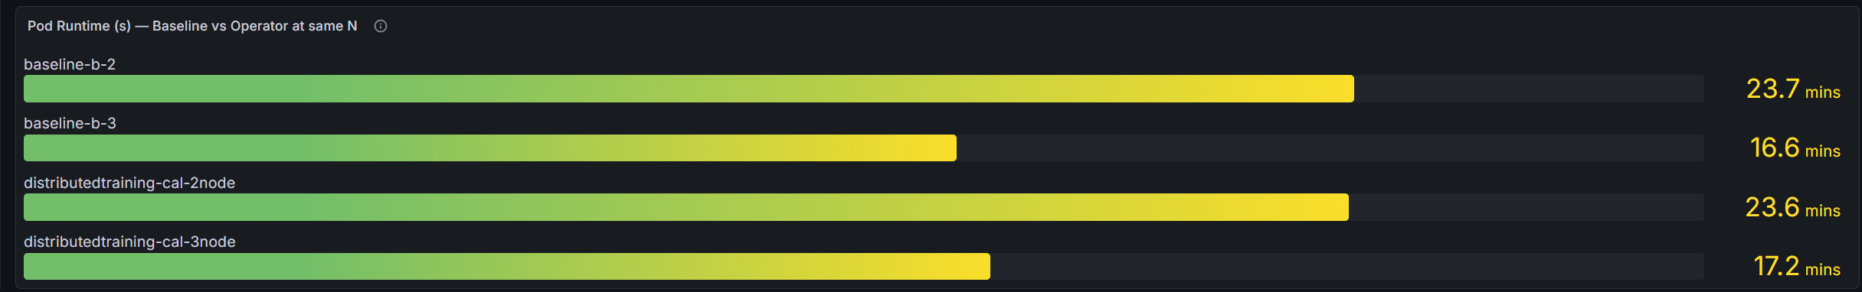
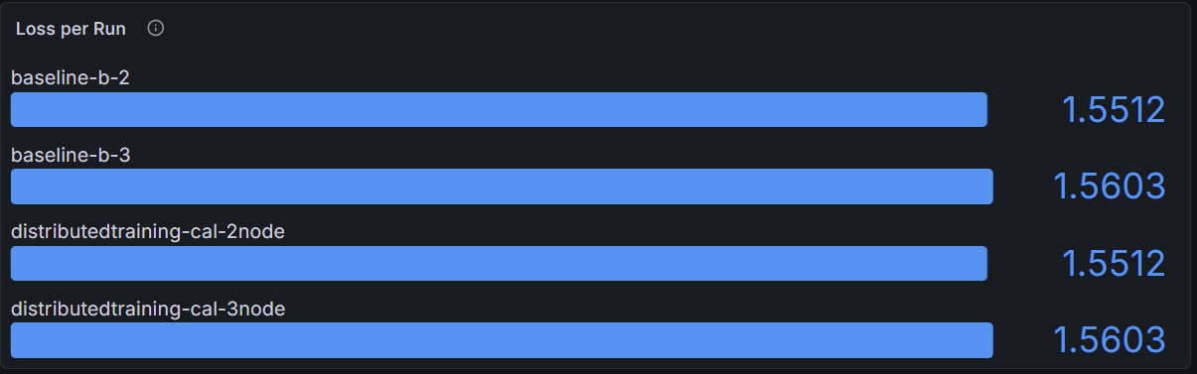
Workflow Comparison: Baseline vs Operator
Google Cloud GKE
smol_llama-101M-GQA model
medalpaca / medical flashcards dataset
c4-highcpu-8 · $0.42 / hr / node
B-2: 2 nodes / B-3: 3 nodes
Key results vs baseline:
5 commands per run → 1 kubectl apply (5× fewer human steps, same GKE infrastructure)
Training time nearly identical between manual baseline and operator runs
Training quality identical — same eval loss and perplexity at matched node count
Cost and provisioning time comparable; collection fully automated via operator
3 / 6

Slide 5
Topology Tuner: Auto-Selecting Node Count from History
The Core Shift: from static node count to declaring an objective
Before — Static Node Count
After — Declare an Objective
spec:
topology
nodes: 3
backend: pytorch
# no memory between runs
spec:
objective:
targetTime: "10m"
maxCost: “1"
maxNodes: 10
...
User manually picks N; operator runs with that exact count.
Operator infers optimal N from history; satisfies objective automatically.
Tuner Steps
1
Load History
DistributedTrainingHistory CR — written by operator after each run
Query DistributedJobHistory entries matching config hash; group by node count, find average throughput P per node count.
apiVersion: training.distributedtraining.io/v1
kind: DistributedTrainingHistory
metadata:
labels:
config-hash: 57c363d8...997d
name: djh-disttraining-cal-3node-kpbfz
spec:
backend: pytorch
configHash: 57c363d8...997d
machineType: c4-highcpu-8
nodes: 3
provisioningSeconds: '82'
throughput: 26270793037n
totalWork: '27164'
trainingSeconds: '1034'
2
Derive Base Rate
Compute single node throughput P0 = P_min / n_min. Extract total work W and mean provisioning time t_prov for the prediction.
3
Fit α (Scaling Overhead)
Efficiency model decay η(n)=1/(1+α(n-1)). Closed-form for 2 history entries; golden-section search for 3+ history entries.
4
Select Optimal Number of Nodes
Evaluate T(n) and Cost(n) per candidate; pick smallest n meeting targetTime, the largest n within maxCost, or when both given, satisfy time first then reduce n until cost fits.
4 / 6
Notes:
1. Load history Query all DistributedTrainingHistory CRs matching this config hash. Group entries by node count and average throughput at each — if no history exists, fall back to a default calibration topology to collect the first data point.
2. Derive base rate From the smallest observed node count n_min, compute single-node throughput P₀ = P_min / n_min. Also extract total work volume W and average provisioning time t_prov — both feed directly into the time and cost predictions.
3. Fit α (scaling overhead) Model throughput as P(n) = P₀ · n · η(n), where η(n) = 1 / (1 + α(n−1)) captures efficiency loss from coordination overhead.
1 distinct node count → α = 0, linear scaling assumed
2 distinct node counts → closed-form solution: α = (1 − η_obs) / (η_obs · (n − 1))
3+ distinct node counts → golden-section search minimising sum of squared residuals across all observations
4. Select optimal node count Predict T(n) = W / P(n) and Cost(n) = n · rate · (T(n) + t_prov) for each candidate n. Then:
Time objective only → binary search for the smallest n where T(n) ≤ targetTime
Cost objective only → binary search for the largest n where Cost(n) ≤ maxCost
Both → find n satisfying time first, then verify cost; back off toward fewer nodes until both constraints are met

Slide 6
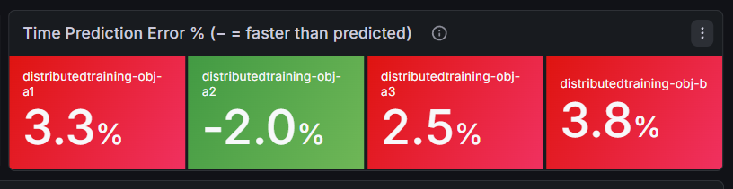
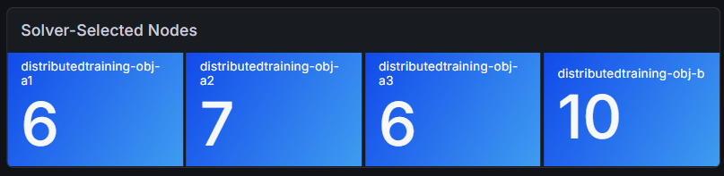
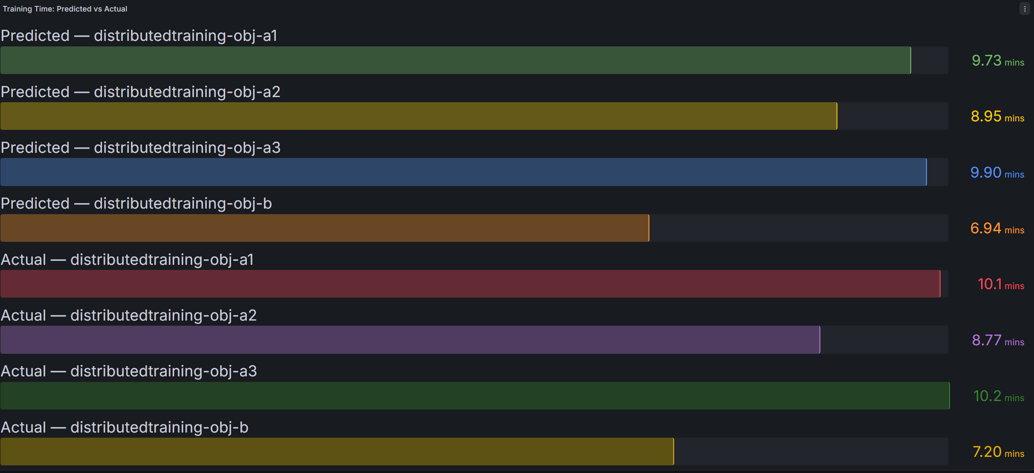
Tuner Accuracy: Prediction Converges
Run A1: 3.3% — tuner fitted from only 2 calibration points
Run A2: 2% — alpha refitted with 3rd history entry. Faster than predicted time
Run A3: 2.5% — error increase; but lower number of nodes
Run B: 3.8% — different objective, similar prediction error
Objectives used:
# Objective A
objective:
targetTime: "10m"
maxCost: “10"
maxNodes: 10
# Objective B (tighter)
objective:
targetTime: "7m"
maxCost: "10"
maxNodes: 15
5 / 6

Slide 7
Conclusion & Limitations
01
Automation with zero quality cost
Operator reproduces baseline training exactly (loss, perplexity, throughput) while reducing the per-run workflow from 5 commands to 1.
02
Scaling model improves with use
Two calibrations give sub-7% time prediction. Alpha stabilizes as history grows.
03
Objective-driven scaling
User declares a time/cost objective; tuner computes number of nodes from historical data.
Limitations
Constant-α model assumption
Evaluation time absorbed into α
Single cloud provider and backend validated
A single serial fraction does not capture non-linear scaling at high node counts. A piecewise or per-N model would extend the accurate range.
Post-training HuggingFace evaluation is fixed overhead folded into the scaling fit; modeling a separate T_eval term would sharpen predictions.
Only GKE (CPU/gloo) is measured end-to-end. EKS/AKS interfaces and other backends are designed but not implemented.
6 / 6

Slide 8
Thank You
Questions?
Source code: github.com/JonMukaj/distributed-training-operator
Jon Mukaj · Praktikum 2 · Supervisor: Prof. Enes Bajrovic

Slide 9
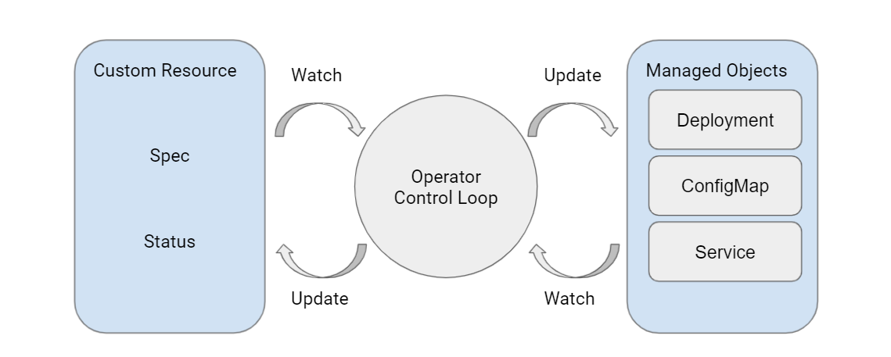
What Is a Kubernetes Operator?
Kubernetes manages built-in resources (Pods, Services, Deployments). Operators extend it with custom types and operational logic.
Operators extend the Kubernetes API by introducing new resource types (CRDs) the cluster understands natively.
A CRD defines the schema for a custom resource, the desired state (spec) and observed state (status).
A Controller (e.g Deployment object) watches those resources and runs a reconcile loop, observe actual state, compare to desired, act to close the gap.
CRD + Controller = Operator Pattern
2 / 10

Slide 10
How the Solver Works
1
Read history
Load DistributedJobHistory entries for this workload (same config hash). Group by node count N, average throughput P_k per group.
2
Compute base parameters from history
W = avg(T_k × P_k) total work (samples), constant per workload
p0 = avg(P_k) / n_min per-node baseline throughput
T_prov = avg(provisioning_s) average provisioning time
At the smallest observed N (n_min):
3
Fit alpha — scaling overhead
1 distinct N → alpha = 0 (linear scaling assumed)
2 distinct N → observed_eta = (P2/n2)/(P1/n1) // actual parallel efficiency
→ alpha = (1 - observed_eta ) / (observed_eta * (n2-n1))
3+ distinct N → argmin_alpha sum[ (P(n) - p0*n*eta(n,alpha))^2 ]
How fast efficiency decays as more nodes are added (gloo backend communication cost):
4
Predict T(n) and Cost(n), then select N
eta(n) = 1/(1+alpha*(n-1)) predicted parallel efficiency
P(n) = p0*n*eta(n) predicted throughput
T(n) = W/P(n) predicted training time
Cost(n) = C_h*n*(T(n)+T_prov)/3600
Select: smallest n where T(n)<=targetTime AND Cost(n)<=maxCost
For each candidate n compute predicted time and cost, then pick the smallest n that meets the Objective:
7 / 10

