Slide 1
Title… Something

Slide 2
Question 1.
The intensity of a photon beam decreases as it travels through a medium. This can be described by the linear attenuation coefficient, µ. What is the physical interpretation of µ? There are three main processes involved in these interactions name these and at which energies do each of them dominate? (Low, medium and high energy). Hint: draw a rough sketch.

Slide 3

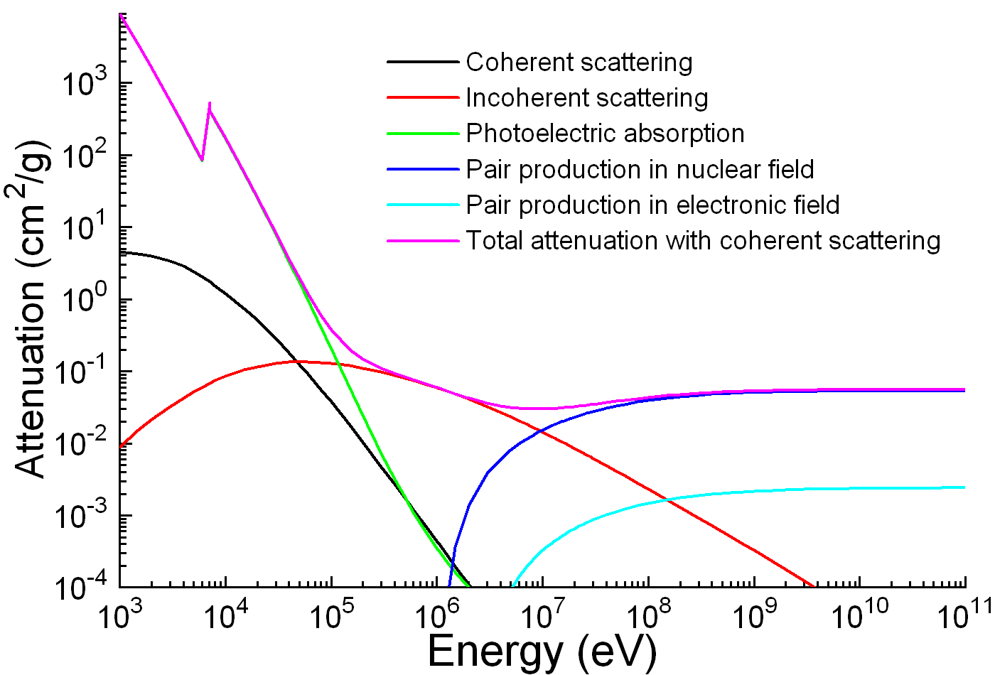
Solution 1.
µ represents the probability for a photon interaction per length unit for a photon traveling through a medium in the form of pair production, Compton and photoelectric effect. Pair production – High, Compton scattering – Medium and Photoelectric effect. In the figure you are only supposed to draw the red, green and blue.

Slide 4
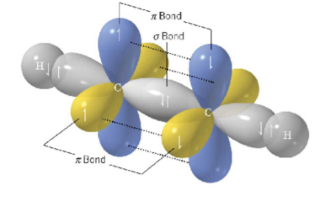

Question 2.
What is the physical motivation for the formation of hybrid orbitals sp, sp2 and sp3, instead of the standard 1s, 2s and 2p orbitals?
Name the different orbital(s) for carbon $C_{6}$, define hybrid orbitals and give an example?
What’s the difference between pi and sigma bonds?
Knowing the chemical formula for ethyn $C_{2}H_{2}$ and the given the illustration, place the corresponding bonds and explain why.

Slide 5
Solution 2.
Solution: To minimize the energy of a molecule in the form of minimizing the coulomb repulsion.
1S^2, 2S^2, 2P^2. Hybrid orbitals is a orbital that is a linear combinations of two different natural(s, p, d, f etc) orbitals f.esk sp orbitals which is a combination of the s and p orbitals.
Sigma bonds are symmetric with respect to the molecular axis while pi bonds are asymmetric with respect to the nodal plane.
We have sigma bonds between the hydrogens and carbons (symmetric overlap) and the middle overlap between the carbons (symmetric overlap). There are one pi bond between the blue blubs and one between the yellow blub. This is because they are asymmetric with respect to the nodal plane.

