Slide 1
The Benchmarking Process
From Initiation to Implementation

Slide 2
Start with Purpose
Building a Purpose: Key Concepts
Effective benchmarking begins with clear questions—not just answers. Because institutional data can be large and complex, simple, focused visuals are often more powerful for guiding inquiry than overly complex analyses.
A strong purpose should center on understanding your position within a peer group. This requires identifying the performance metrics most valued by leadership and institutional stakeholders.

Slide 3
Start with Purpose
Benchmarking should:
Compare performance across peer institutions
Highlight strengths, gaps, and trends
Incorporate meaningful aggregates, such as peer averages, top performers, and distance-to-benchmark measures
Finally, metrics must align with institutional strategy. Selecting the right indicators ensures that benchmarking efforts directly support progress toward strategic goals.

Slide 4
Start with Purpose
Defining Benchmarking Metrics
Metrics should be driven by the report’s purpose and the needs of its users. Department leaders and institutional stakeholders often provide valuable input on which IPEDS variables are most relevant.
Once a draft set of metrics is identified, IPEDS data dictionaries can be used to map those metrics to the appropriate variables. Integrated Postsecondary Education Data System provides comprehensive datasets and documentation to support this process.

Slide 5
Start with Purpose
Our Approach
Our benchmarking framework was designed to support multiple institutional priorities:
Meeting accreditor requirements Ensuring compliance with required standards and validating institutional performance using accreditor defined metrics.
Creating a centralized tool for tracking progress Leveraging standardized, publicly available data to enable consistent use across departments and safe external sharing.

Slide 6
Start with Purpose
Staying aligned with national best practices Identifying high-performing peer institutions to understand successful strategies.
Building peer-to-peer collaboration Using benchmarking insights to foster communication and share actionable practices with peer institutions.
Supporting continuous improvement Establishing an ongoing process to monitor performance and refine institutional strategy over time.

Slide 7
Create a Benchmarking Data Store
Survey A 2024
Final Storage:
Survey A
Concatenated
Years
IPEDS
Survey A 2023
Survey A 2022
Each desired survey from IPEDS can be combined into one table for all collection years

Slide 8
Create a Benchmarking Data Store
Pull in Data
We used python to make requests for each dataset. Code for this can be found in the Github repository.
Define the year and dataset you want
Make the request to pull in the dataset
Store it in your preferred location
The end result for this step will be a table for each survey and year
Ex. EF2024A, EF2024B, EF2024C etc.

Slide 9
Create a Benchmarking Data Store
Structure the Data
This step will add the trending element to your report. For each survey table, you will:
Union the same survey across the different years that you pulled in.
Some surveys add new variables/columns from year to year, so you will have to add these variables to previous years as blank values.
We used python again to handle this structuring, but it can be as simple as starting with the most recent year and copy pasting the previous year to the dataset.
Ex. EF2024A union EF2023A union EF2022A union EF2021A etc.s

Slide 10
Create a Benchmarking Data Store
Structure the Data
UNITID | COLLECTION | EFALEVEL | LINE | SECTION | EFTOTLM
156107 | 2024 | 1 | 29 | 3 | 3136
156107 | 2023 | 1 | 29 | 3 | 2923
156107 | 2022_rv | 1 | 29 | 3 | 2745
156107 | 2021_rv | 1 | 29 | 3 | 2573

Slide 11
Create a Benchmarking Data Store
Structure the Data
Lastly, we put together our defined metrics using all needed surveys and collections.
If needed, different surveys can now be joined on UNITID (institution id) and collection year (self-defined).
Calculate the metric with the necessary IPEDS variables.
Some surveys may need to be prefiltered to certain codes. We made sure each join was only between tables that had one row per school per collection year.

Slide 12



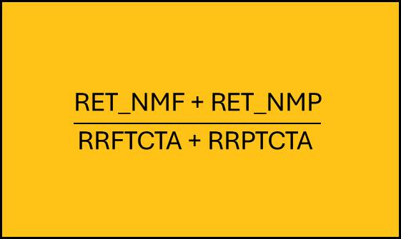
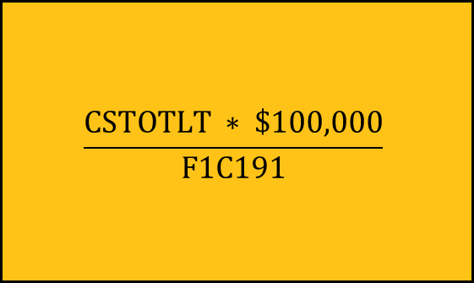
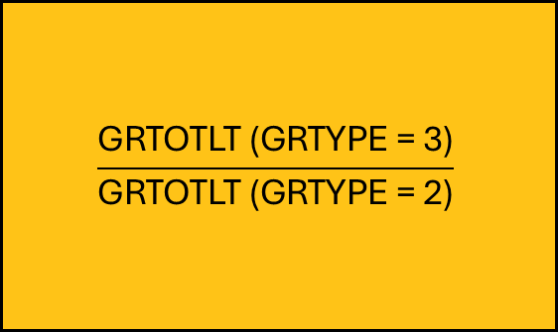
Create a Benchmarking Data Store
Example Calculations
Source: C20##_B joined F2#2#_F1A
Source: EF20##D
Source: GR20##

Slide 13
Create a Benchmarking Data Store
End Result
Institution ID | Year | First-Year Retention Rate | Outcome Efficiency Index | 150% Graduation Rate
156107 | 2024 | 0.5641025641 | 2.96561973795 | 0.43
156107 | 2023 | 0.5576619273 | 3.28290891027 | 0.36
156107 | 2022 | 0.5082352941 | 3.28651778775 | 0.3
156107 | 2021 | 0.4727592267 | 3.22737016641 | 0.38

Slide 14
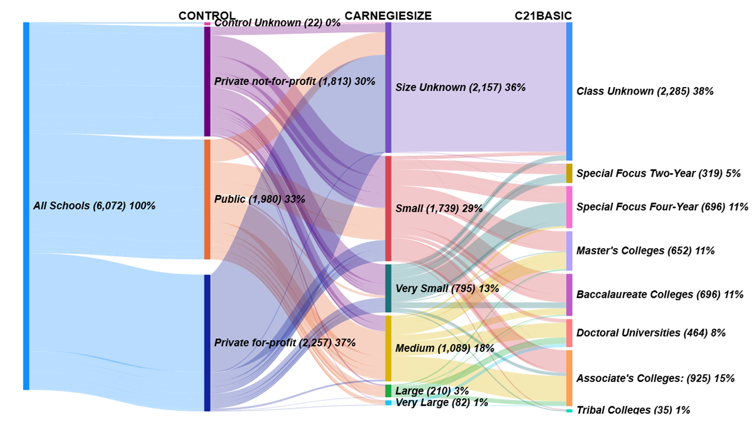
Grouping Peers

Slide 15
Grouping Peers
Filter down to similar institutions
Before we choose peers, it is helpful to establish a baseline pool of institution to choose your peers from.
Carnegie classifications help determine what schools have high level characteristics with your own school.
We used:
Public vs Private (Control)
Institution Size (CARNEGIESIZE)
College Type (C21BASIC)
Institutional characteristics can be found in the directory survey from IPEDS (HD2024)

Slide 16
Grouping Peers
Example
We are:
Public
Medium to Very Large
Associate’s Colleges
Resulting pool of colleges had 444 to choose from.

Slide 17
Grouping Peers (cont)
Augment the selection process (optional)
Using the baseline pool filtered down, we can also include clusters to help us understand potential peers.
K Means Clustering and a selection of metrics will create clusters to further group institutions with similar performance.
The code used for this will be in the Github Repository for this project. We used the Inertia and the Silhouette Method to find the optimal K number of clusters, which in our case was eight.

Slide 18
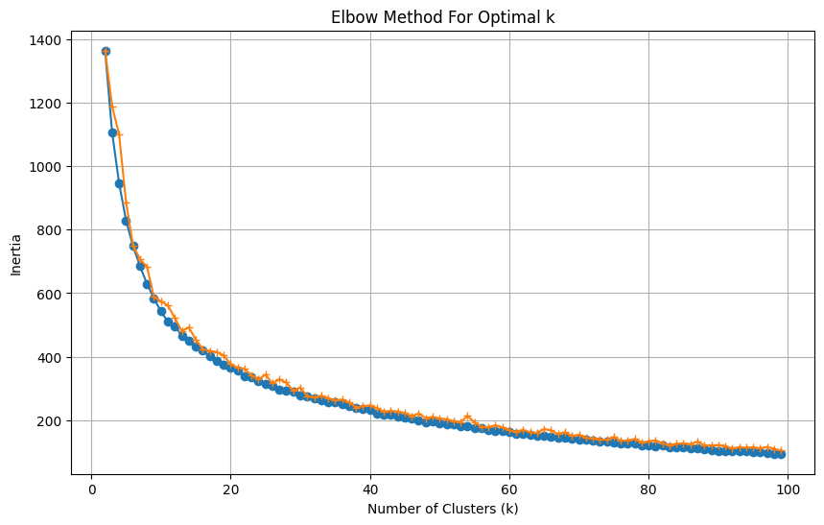
Grouping Peers (cont)
Augment the selection process (optional)

Slide 19
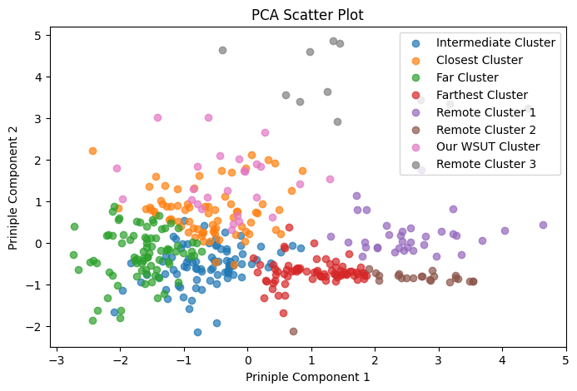
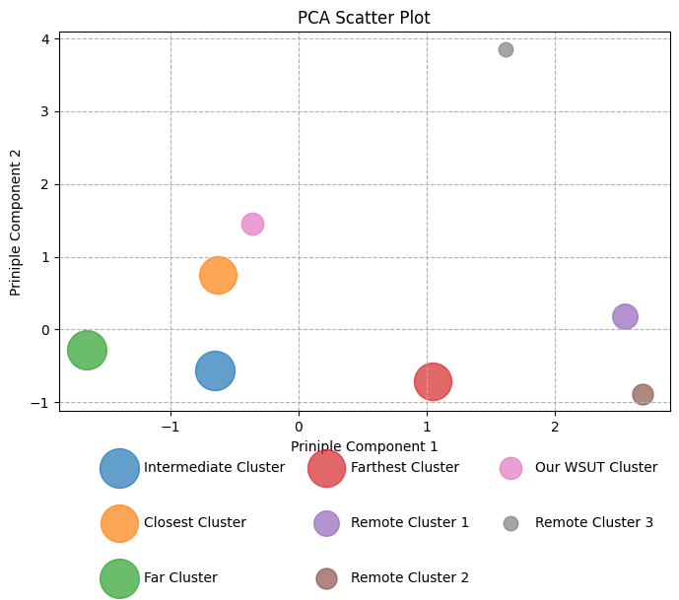
Grouping Peers (cont)
Augment the selection process (optional)
Next, we found the Principal Components of the same dataset (same selected metrics) to reduce the dimensions of our dataset. This is a preferred way to visualize the data to a 2-dimensional plane.
The first scatter plot are all schools graphed on the first two PCs, color coded to their corresponding cluster. The second is the average value for each cluster.
The Clusters were labeled after visually confirming their relationship with our own cluster.

Slide 20
Selecting Peers
Criteria
We used five metrics to base our selection criteria from.
First-Year Retention Rate
Graduation Rate
Completion & Transfer Rate
Outcome Efficiency Index
Fall Enrollment
Using theses five, we then defined the performance needed to be placed in our peer groups.

Slide 21
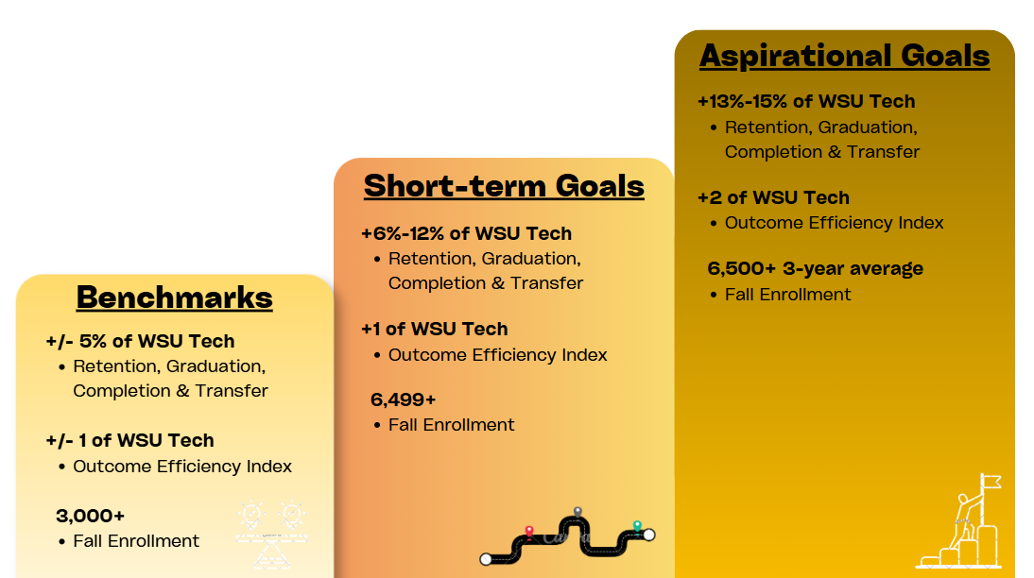
Selecting Peers
Criteria

Slide 22
Selecting Peers
Cosine Similarity (optional)
Cosine Similarity also helps us understand schools with similar or non-similar performance, but on a school-by-school basis. In this way, each school will have a distance score related to your own institution.
Using the same metrics again and baseline institution pool, create a new column that holds the cosine similarity (code used can be found in the github repo).
Order the new column in descending order. Cosine similarity is between 1 and -1, from most similar, to having opposite similarity, respectively. This can also be ordered by the different clusters created.
This extra information comes in handy when selecting multiple peers that meet your criteria. Using similarity helps narrow down your selection.

Slide 23
Developing a Report
What you should have so far
A clear purpose to guide report structure and content.
Defined metrics sourced from IPEDS definitions. This may also include metric groupings if created.
A validated peer list for comparison. This also could contain the peer groups that align with your institutional strategy.
Supporting institutional reference data (e.g., labels, categories). This is found in the directory survey in IPEDS (HD2024)

Slide 24
Developing a Report
Displaying multiple dimensions
This is a common problem for data professionals to handle. How do you display as many factors or dimensions of data as possible in one visual? Here we have:
Time (Year over Year collections)
Peers (Multiple institutions)
The Metric itself
Benchmarking/Ranking/Comparison element
And not to mention any other breakdown you may need. One of many solutions we implemented was to have two dedicated pages that broke these dimensions apart:
Single Year Comparison
Yearly Trend Comparison

Slide 25
Developing a Report
Single Year Comparison
Here we visualize:
Metrics in columns
Peers in rows
Added aggregate rows are:
Ranking for each metric that our school falls into
Change in rank from prior year

Slide 26
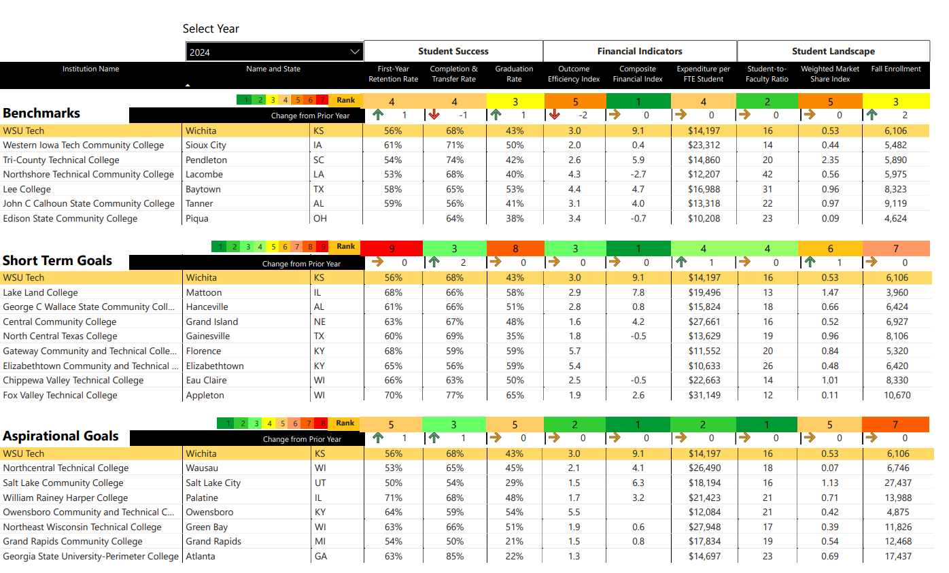
Developing a Report
Single Year Comparison

Slide 27
Developing a Report
Yearly Trend Comparison
Here we visualize:
Metrics typically on the y axis
Peers as color codes or represented as an aggregate group
Time of course lays on the x axis for each visual
You will also notice not all visuals are related to trend. These are not meant to be hard rules, but as helpful thought exercises to get a report that displays your benchmarking data in a meaningful way.

Slide 28
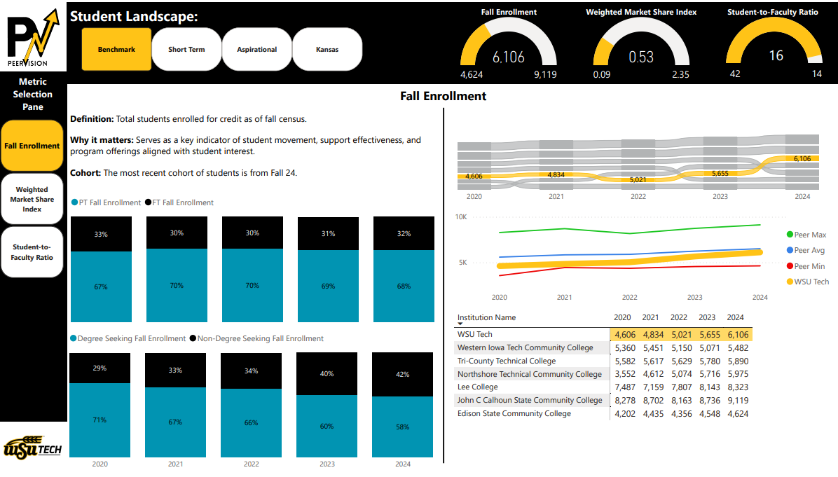
Developing a Report
Yearly Trend Comparison

Slide 29
Appendices
WSU Tech Metric Definitions
Notes on IPEDS Variables and Codes

Slide 30

Metric Definitions
First-Year Retention Rate
$$\frac{\text{RET}\text{_}\text{NMF}\text{ + }\text{RET}\text{_}\text{NMP}}{\text{RRFTCTA}\text{ + }\text{RRPTCTA} }$$
IPEDS Surveys: EF20##D

Slide 31
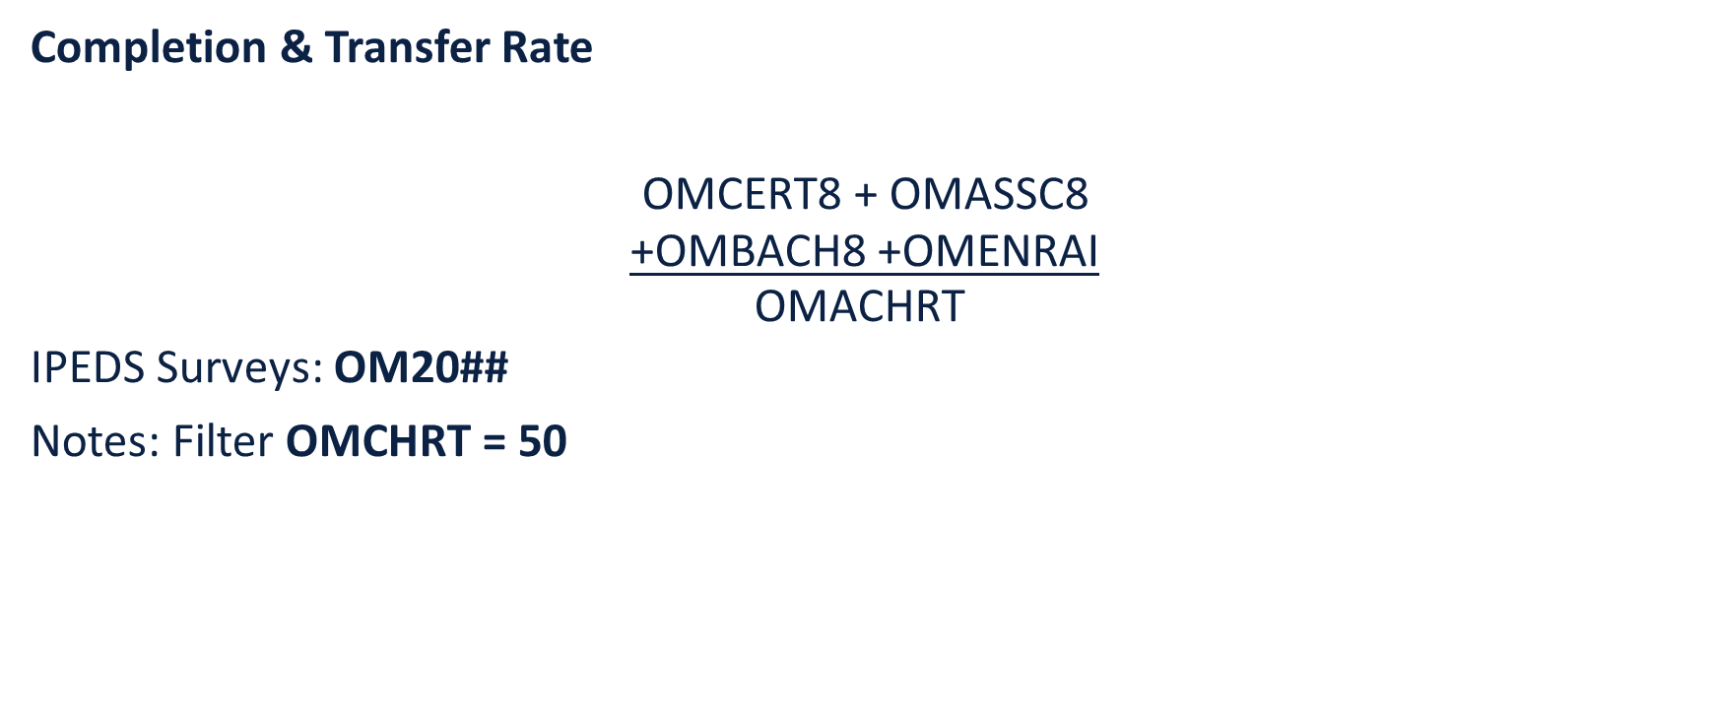
Metric Definitions
Completion & Transfer Rate
$$\frac{\begin{aligned} \\ \\ \text{OMCERT}\text{8 + }\text{OMASSC}\text{8} \\ \text{+}\text{OMBACH}\text{8 +}\text{OMENRAI}\end{aligned}}{\text{OMACHRT} }$$
IPEDS Surveys: OM20##
Notes: Filter OMCHRT = 50

Slide 32
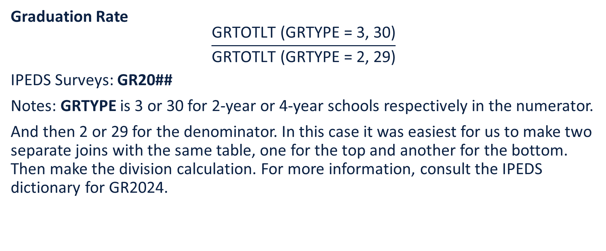
Metric Definitions
Graduation Rate
$$\frac{\text{GRTOTLT}\text{ (}\text{GRTYPE}\text{ = 3, 30)}}{\text{GRTOTLT}\text{ (}\text{GRTYPE}\text{ = 2, 29)}}$$
IPEDS Surveys: GR20##
Notes: GRTYPE is 3 or 30 for 2-year or 4-year schools respectively in the numerator.
And then 2 or 29 for the denominator. In this case it was easiest for us to make two separate joins with the same table, one for the top and another for the bottom. Then make the division calculation. For more information, consult the IPEDS dictionary for GR2024.

Slide 33
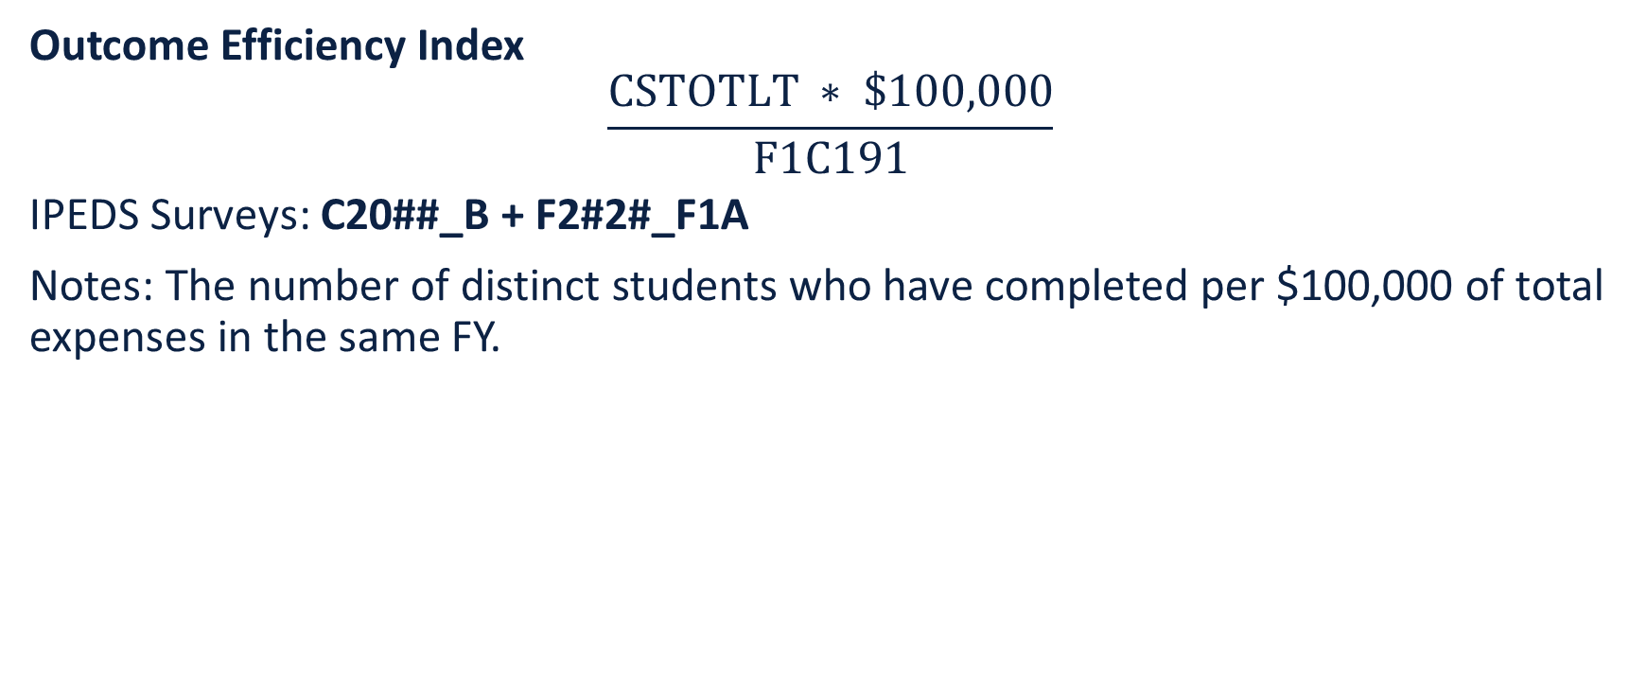
Metric Definitions
Outcome Efficiency Index
$$\frac{CSTOTLT ∗ \$100,000}{F1C191}$$
IPEDS Surveys: C20##_B + F2#2#_F1A
Notes: The number of distinct students who have completed per $100,000 of total expenses in the same FY.

Slide 34
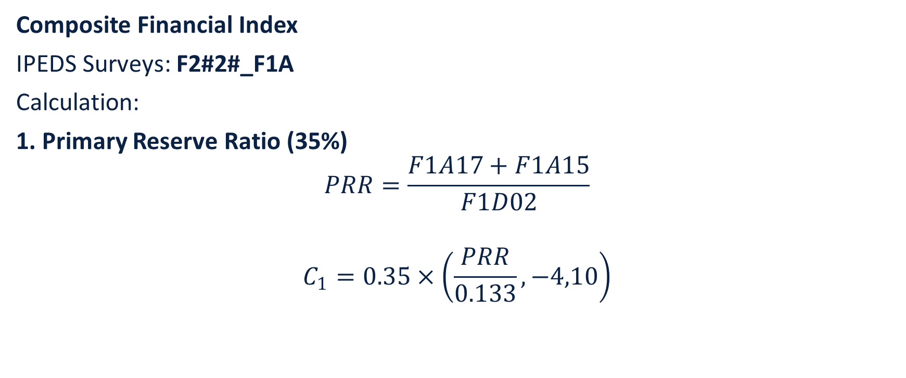
Metric Definitions
Composite Financial Index
IPEDS Surveys: F2#2#_F1A
Calculation:
1. Primary Reserve Ratio (35%)
$$PRR=\frac{F1A17+F1A15}{F1D02}$$
$$C_{1}=0.35×\left(\frac{PRR}{0.133},−4,10\right)$$

Slide 35
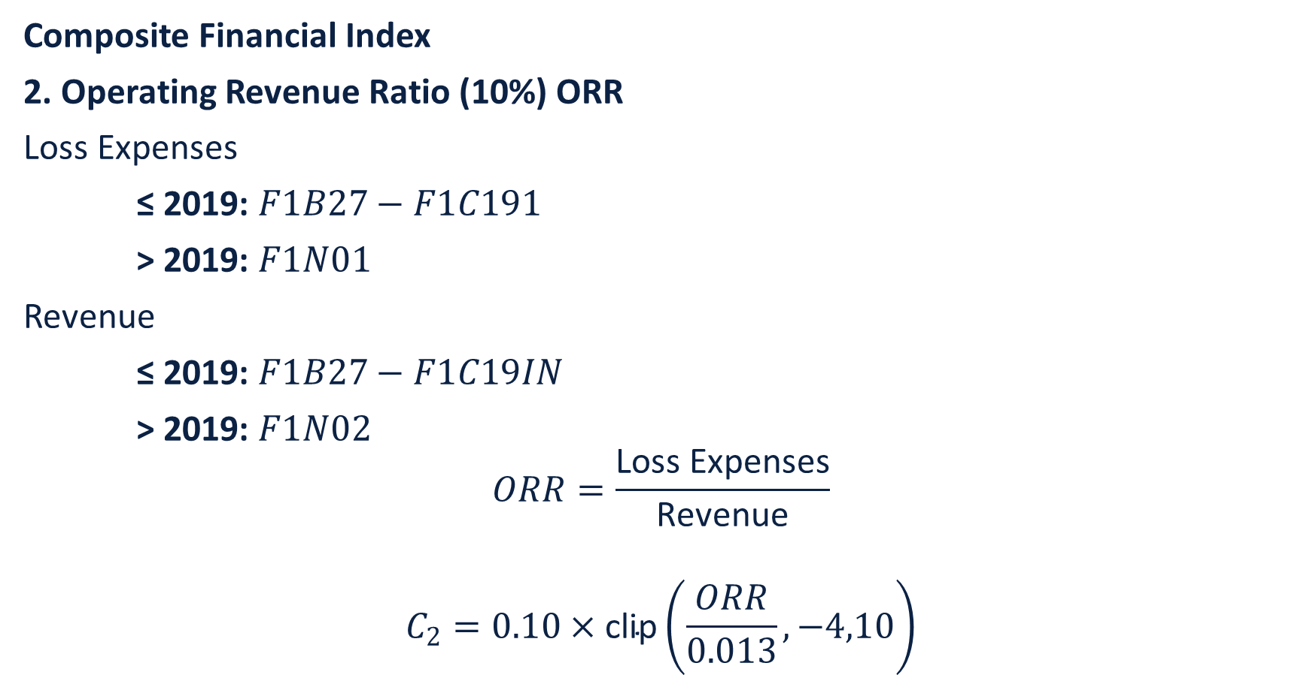
Metric Definitions
Composite Financial Index
2. Operating Revenue Ratio (10%) ORR
Loss Expenses
≤ 2019: $F1B27−F1C191$
> 2019: $F1N01$
Revenue
≤ 2019: $F1B27−F1C19IN$
> 2019: $F1N02$
$$ORR=\frac{\text{Loss} \text{Expenses}}{\text{Revenue}}$$
$$C_{2}=0.10×\text{clip}\left(\frac{ORR}{0.013},−4,10\right)$$

Slide 36

Metric Definitions
Composite Financial Index
3. Return on Net Assets (20%)
$$RONA=\frac{F1D03}{F1D04} \\ C_{3}=0.20×\text{clip}\left(\frac{RONA}{0.02},−4,10\right)$$

Slide 37
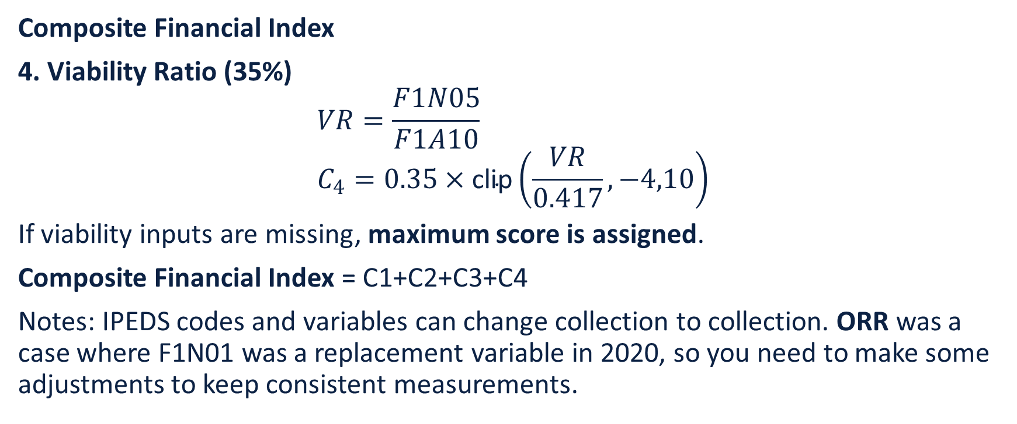
Metric Definitions
Composite Financial Index
4. Viability Ratio (35%)
$$VR=\frac{F1N05}{F1A10} \\ C_{4}=0.35×\text{clip}\left(\frac{VR}{0.417},−4,10\right)$$
If viability inputs are missing, maximum score is assigned.
Composite Financial Index = C1​+C2​+C3​+C4​
Notes: IPEDS codes and variables can change collection to collection. ORR was a case where F1N01 was a replacement variable in 2020, so you need to make some adjustments to keep consistent measurements.

Slide 38
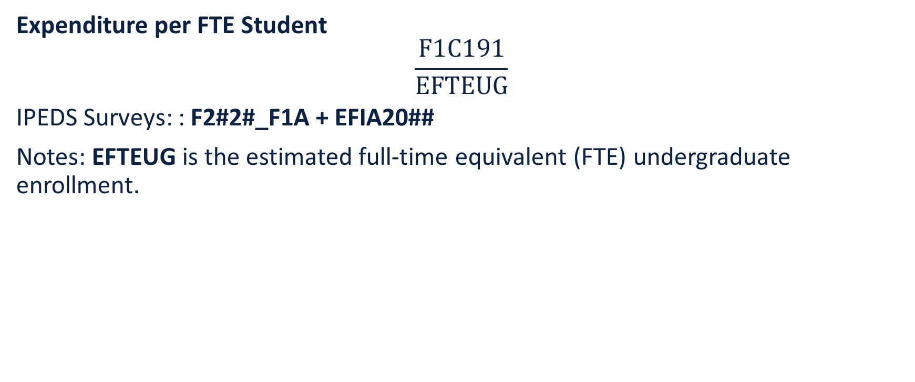
Metric Definitions
Expenditure per FTE Student
$$\frac{F1C191}{EFTEUG}$$
IPEDS Surveys: : F2#2#_F1A + EFIA20##
Notes: EFTEUG is the estimated full-time equivalent (FTE) undergraduate enrollment.

Slide 39
Metric Definitions
Student-to-Faculty Ratio
STUFACR
IPEDS Surveys: EF20##D
Notes: IPEDS uses their own definition for FTE students and faculty so make sure to consult the EF2024D or relevant collection definition.

Slide 40
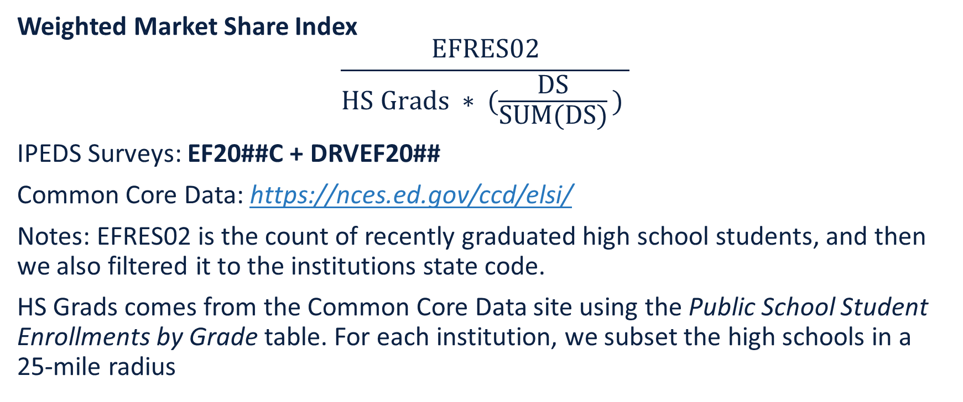
Metric Definitions
Weighted Market Share Index
$$\frac{EFRES02}{HS Grads ∗ (\frac{DS}{SUM(DS)}\text{)} }$$
IPEDS Surveys: EF20##C + DRVEF20##
Common Core Data: https://nces.ed.gov/ccd/elsi/
Notes: EFRES02 is the count of recently graduated high school students, and then we also filtered it to the institutions state code.
HS Grads comes from the Common Core Data site using the Public School Student Enrollments by Grade table. For each institution, we subset the high schools in a 25-mile radius

Slide 41
Metric Definitions
Weighted Market Share Index (cont)
Notes: HS Grads comes from the Common Core Data site using the Public School Student Enrollments by Grade table. For each institution, we subset the high schools in a 25 mile radius from the institution, and then added the HS membership for each AY to get the 12th grade counts. We then multiplied this by the state average HS graduation rate to proxy the number of available graduates in for the following Fall after their 12th grade year.

Slide 42
Metric Definitions
Weighted Market Share Index (cont)
Notes: Lastly, DS is EFUG1ST + EFUGTRN + EFUGCNT from the DRVEF20## survey in IPEDS. It is the total number of degree seeking students, which we filtered to only the institutions within a 25-mile radius of the target institution. The numerator is the target institutions DS and the denominator is the total local DS enrollment. The product of this ratio and HS Grads ensures that a school is indexed weighted on their local enrollment size. If there is only one college in the area, they will have a higher recent HS graduate enrollment than a college that has multiple local competitors.

Slide 43
Metric Definitions
Fall Enrollment
ENRTOT
IPEDS Surveys: DRVEF20##

Slide 44
Notes on IPEDS Variables and Codes
Inconsistencies
Some surveys like the finance F2020_F1A will update and add/delete variables. Another change could be the codes being used year to year. In a few of our metrics, we use the codes to filter to total students or some subset, but these codes are liable to change to mean something different. However, this may not be immediately evident, especially for unfamiliar institutions. So it is beneficial to go through each collection definition being used for your own created metric to make sure you are staying consistent throughout your collection years.

