Slide 1

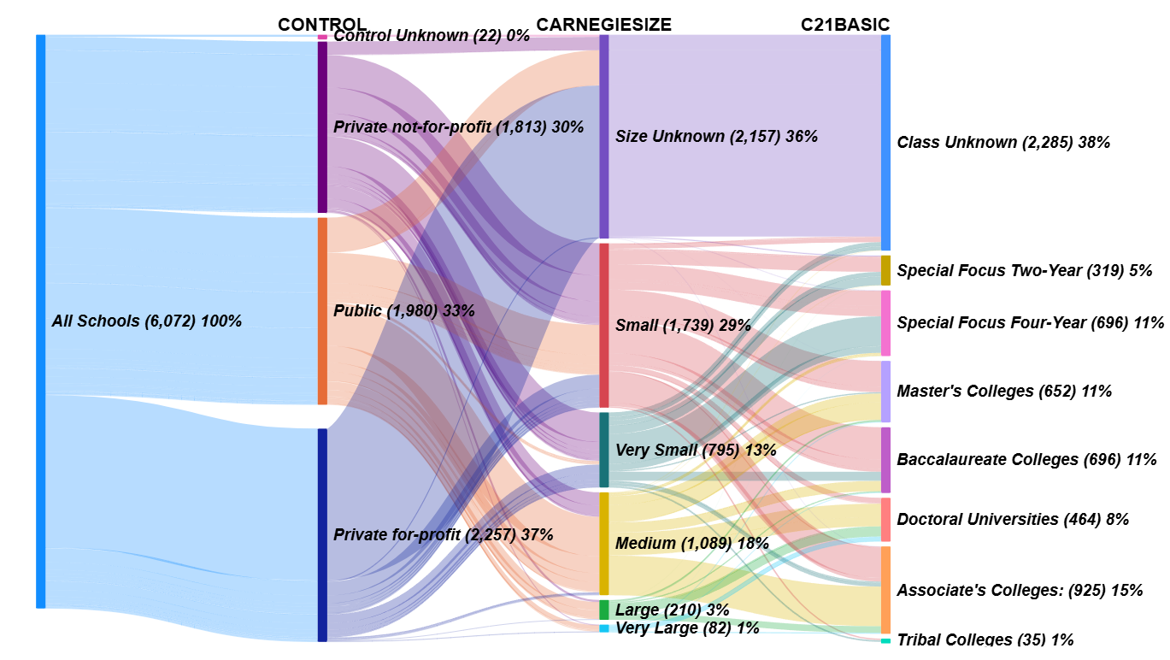
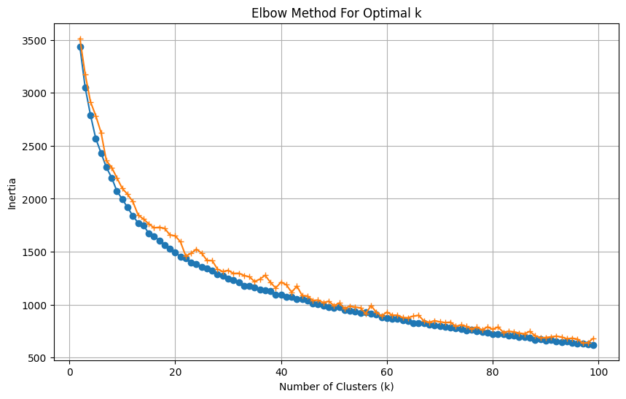
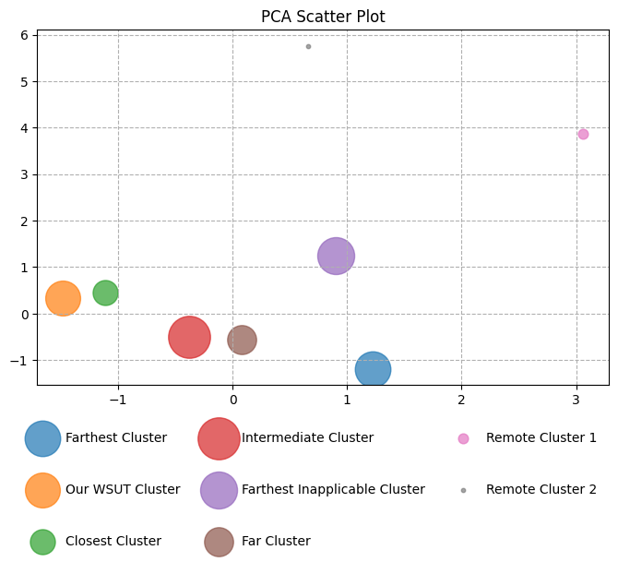
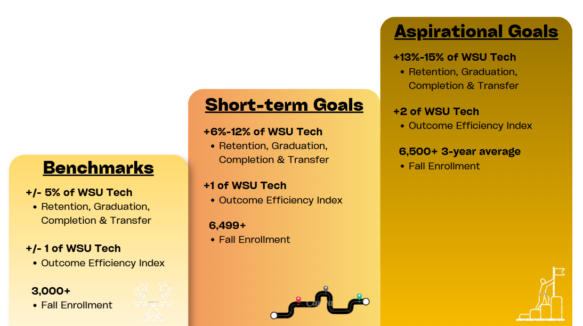
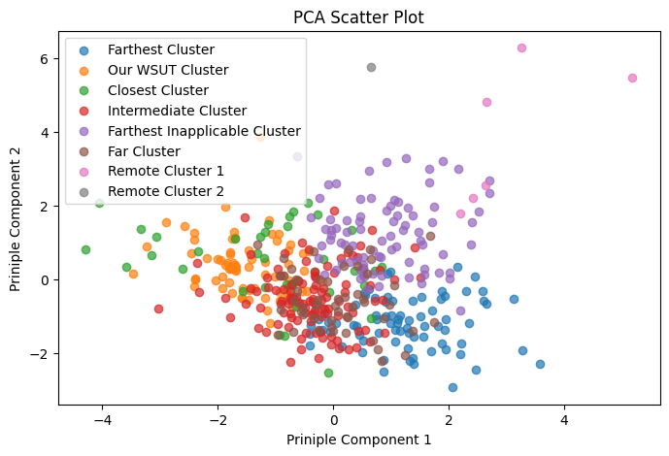
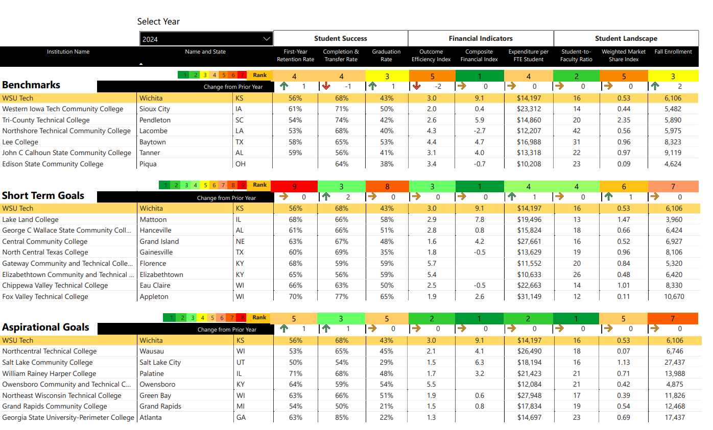
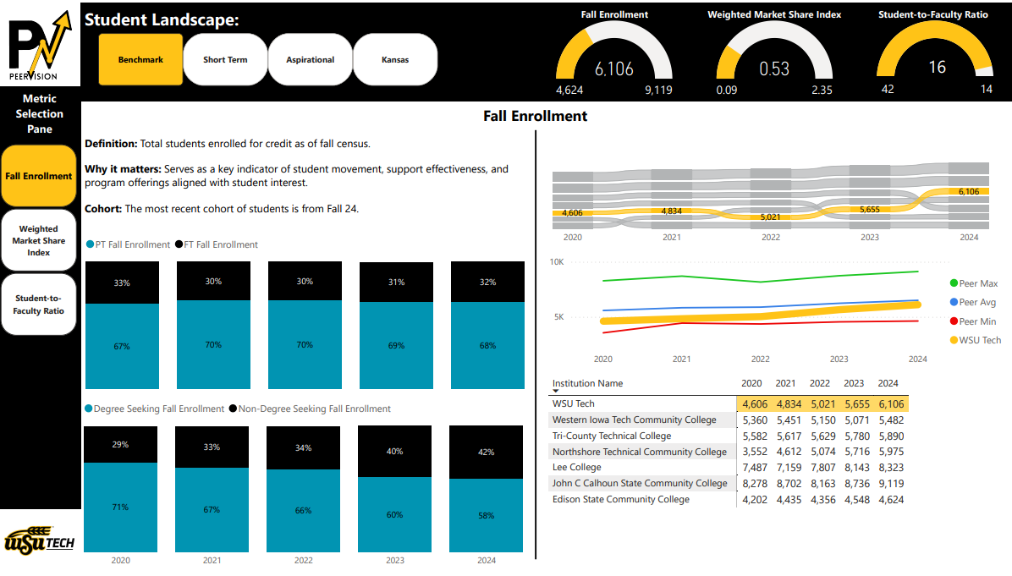








The Benchmarking Process
From Initiation to Implementation
Compare yourself to other institutions
Utilize IPEDS data efficiently
Translate goals into actionable networking
Start with Purpose
Create a Benchmarking Data Store
Grouping Peers
Building a Purpose: Key Concepts
Focus on guiding questions, not just answers
Compare performance across peer institutions
Highlight strengths, gaps, and trends
Align metrics with institutional strategy
Incorporate national best practices
Support decision-making and continuous improvement
Our Approach
Meet HLC requirements for evaluating student success outcomes
Create a centralized tool to track progress toward goals
Stay current with nationwide best practices
Build a peer-to-peer networking pipeline
Support ongoing continuous improvement
Survey A 2024
Final Storage:
Survey A
Concatenated
Years
Using Carnegie Filters
What
we chose
IPEDS
Survey A 2023
Public (CONTROL)
Medium to Very Large (CARNEGIESIZE)
Associate’s Colleges (C21BASIC)
Survey A 2022
Each desired survey from IPEDS can be combined into one table for all collection years
Granularity: One row per School per Year
Institution Name | Year | First-Year Retention Rate | 150% Graduation Rate | Completion & Transfer Rate | Composite Financial Index | Weighted Market Share Index
WSU Tech | 2024 | 56.41% | 43% | 67.56% | 9.11 | 0.528
WSU Tech | 2023 | 55.77% | 36% | 68.5% | 8.9 | 0.501
WSU Tech | 2022 | 50.82% | 30% | 65.54% | 8.73 | 0.536
Grouping Peers (cont.)
Selecting Peers
Developing a Report
Using your Carnegie filter, you can further group by using K Means Clustering
We used a subset of defined metrics to create the clusters (try not to pick too many)
the Elbow Method with Inertia to pick K along with the Silhouette Method
You can use Cosine Similarity to help show the absolute similarity between schools
We use the same metric space as K Means Clustering
Then order schools in descending order by similarity
This helps organize some schools who fall into some
of the Criteria but not all
What You Need
A clear purpose to guide report structure and content
Defined metrics sourced from IPEDS definitions
Organized metric groups to structure the report
A validated peer group list for comparison
Supporting institutional reference data (e.g., labels, categories)
How It Supports Development
Translates purpose into report structure and flow
Ensures metrics are consistent, reliable, and actionable
Improves readability through logical grouping of content
Enables meaningful peer benchmarking and comparisons
Adds context through standardized institutional attributes
Using PCA then helps you understand the spatial relationship of your clusters
Single Year Comparison
Yearly Trend Comparison
Final Result
$$\frac{\text{RET}\text{_}\text{NMF}\text{ + }\text{RET}\text{_}\text{NMP}}{\text{RRFTCTA}\text{ + }\text{RRPTCTA} }$$
$$\frac{\text{GRTOTLT}\text{ (}\text{GRTYPE}\text{ = 3)}}{\text{GRTOTLT}\text{ (}\text{GRTYPE}\text{ = 2)}}$$
See Reference Material
$$\frac{F1C191}{EFTEUG}$$
STUFACR
First-Year Retention Rate
Completion & Transfer Rate
Graduation Rate
$$\frac{CSTOTLT ∗ \$100,000}{F1C191}$$
Composite Financial Index
Expenditure per FTE Student
Student-to-Faculty Ratio
ENRTOT
$$\frac{\begin{aligned} \\ \\ \text{OMCERT}\text{8 + }\text{OMASSC}\text{8} \\ \text{+}\text{OMBACH}\text{8 +}\text{OMENRAI}\end{aligned}}{\text{OMACHRT} }$$
OMCHRT = 50
Outcome Efficiency Index
Weighted Market Share Index
Fall Enrollment
$$\frac{EFRES02}{HS Grads ∗ (\frac{DS}{SUM(DS)}\text{)} }$$
DS = EFUG(1ST + TRN + CNT)

