Slide 1
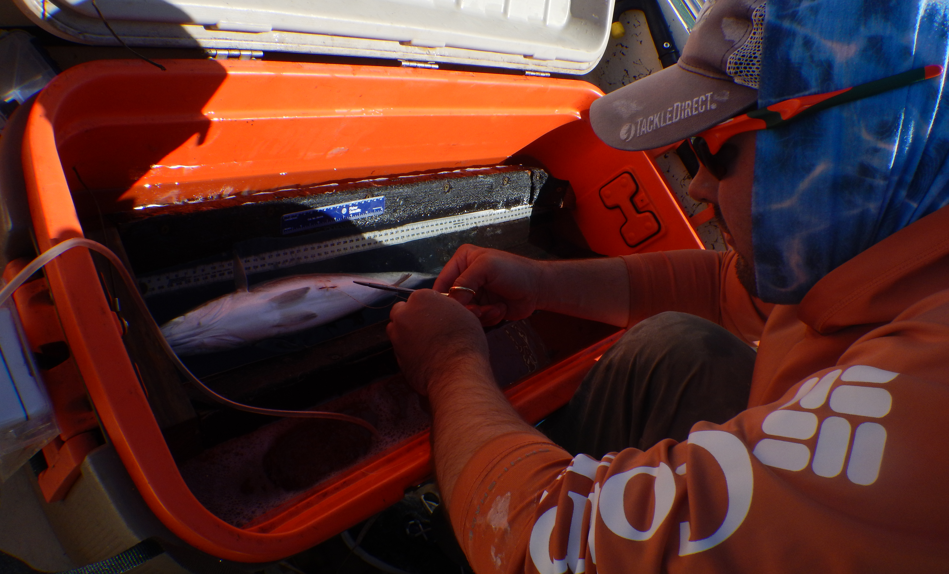
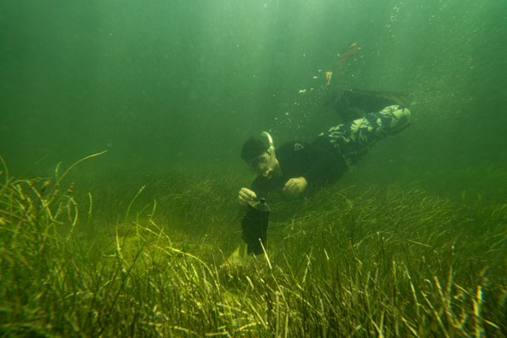
From downloads to discussions: Leveraging Yet Another Positioning Solver (YAPS) and modern movement analysis to transform raw telemetry data into interpretable results
Jonathan Rodemann¹, Sophia Costa², Cameron Atkinson², Camille Demaire², Jennifer Rehage²
¹National Center for Ecological Analysis and Synthesis, University of California Santa Barbara, Santa Barbara, CA, US
²Department of Earth and Environment, Florida International University, Miami, FL, US

Slide 2
Outline for today
Scales of Habitat Selection
Modeling Habitat Selection – acoustic telemetry
Fine-scale habitat selection
Considerations and Decision Breakpoints
Hands-on example with code using Spotted Seatrout data

Slide 3
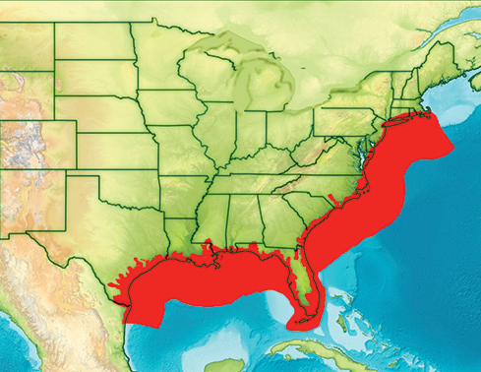
Habitat selection occurs on multiple scales
First-order: Ecological Range

Slide 4
Habitat selection occurs on multiple scales
Second-order: Home Range
First-order: Ecological Range

Slide 5
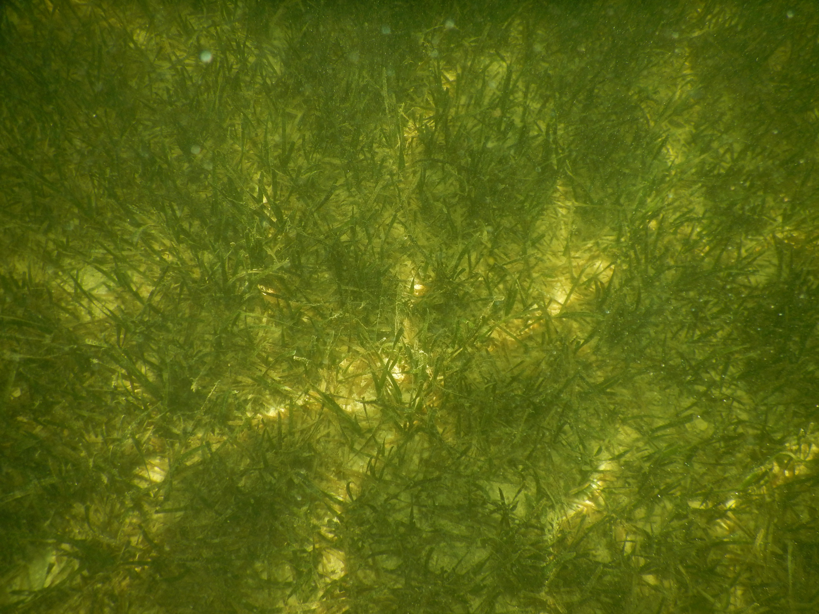
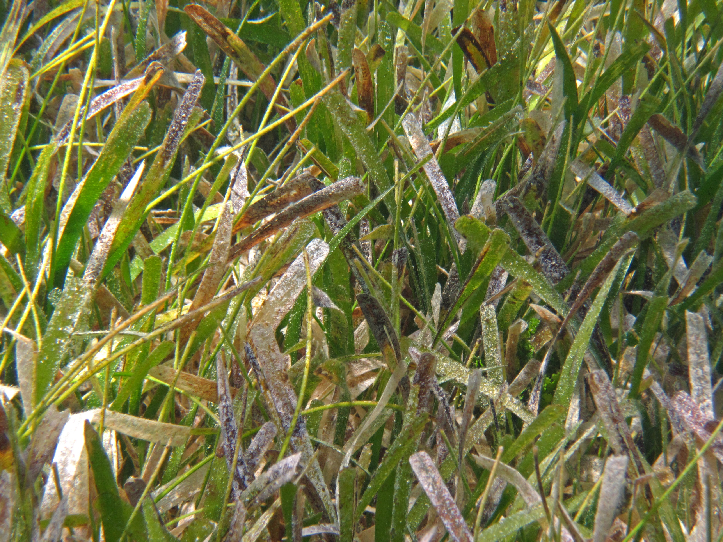
Habitat selection occurs on multiple scales
Third-order: Habitat Patches
Second-order: Home Range
First-order: Ecological Range

Slide 6
Habitat selection occurs on multiple scales
Third-order: Habitat Patches
Second-order: Home Range
First-order: Ecological Range

Slide 7
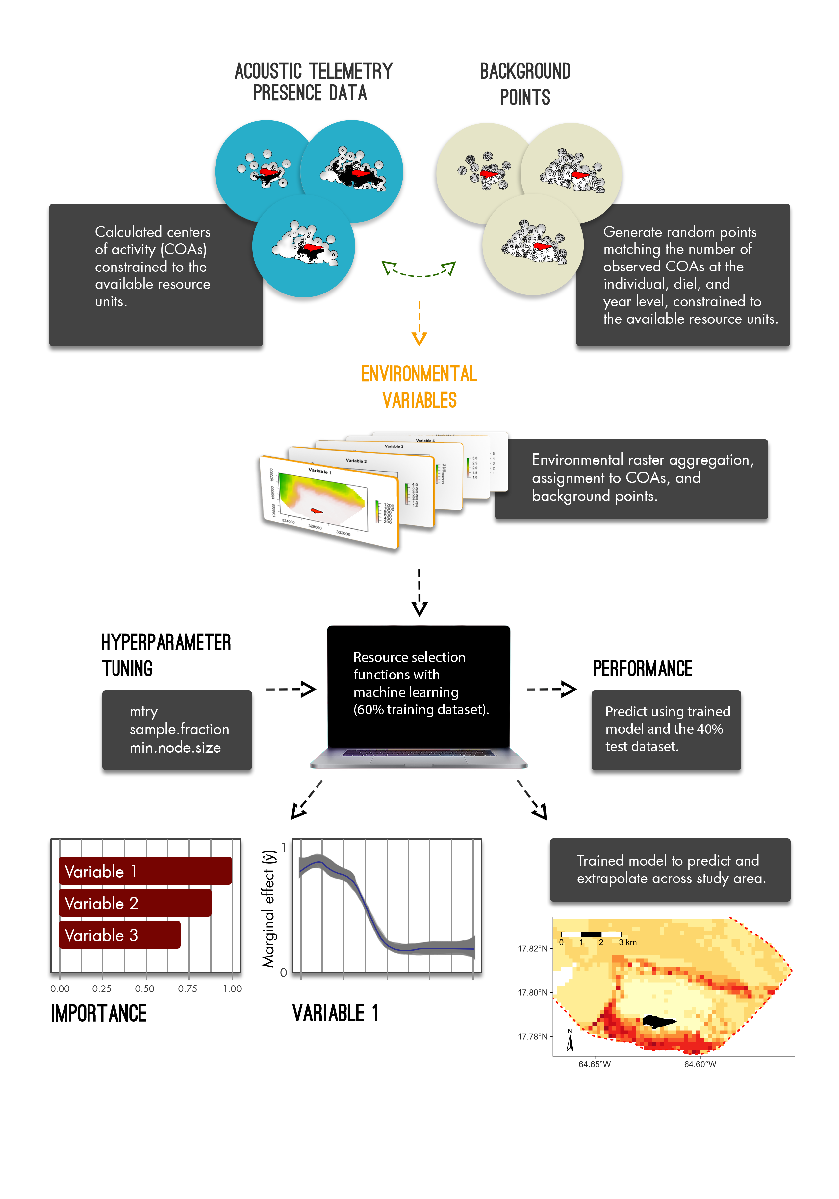
Second-order Selection: Resource Selection Functions

Slide 8
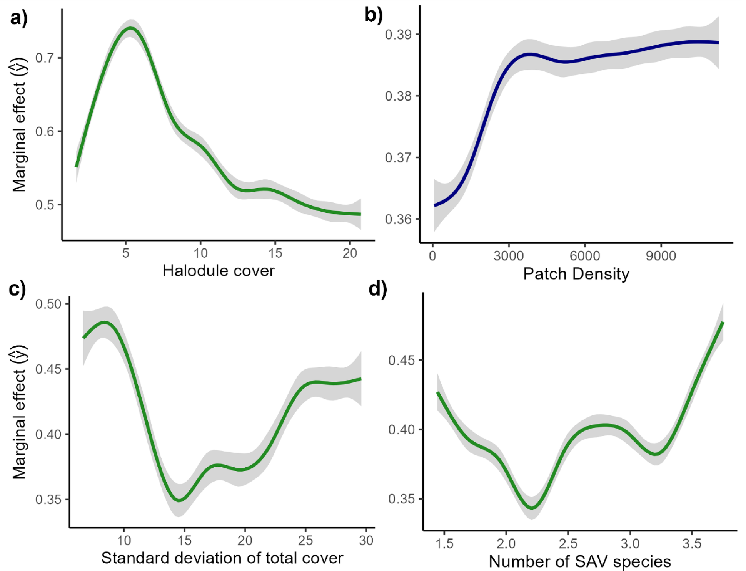
Second-order Selection: Resource Selection Functions
Relative Habitat Selection and Resource Selection Functions in Aquatic Acoustic Telemetry: Theory, Application, and Process
Hierarchical habitat selection by a predatory fish in a patchy seascape

Slide 9
Habitat selection occurs on multiple scales
Third-order: Habitat Patches
Second-order: Home Range
First-order: Ecological Range

Slide 10
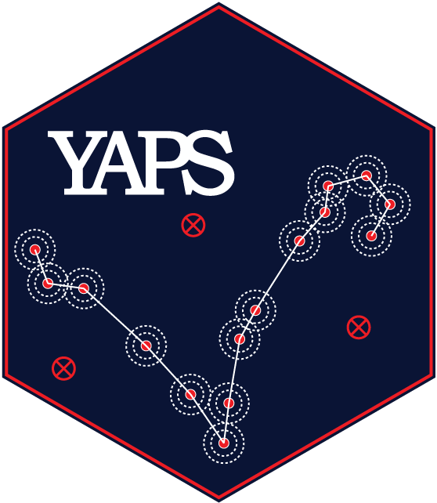
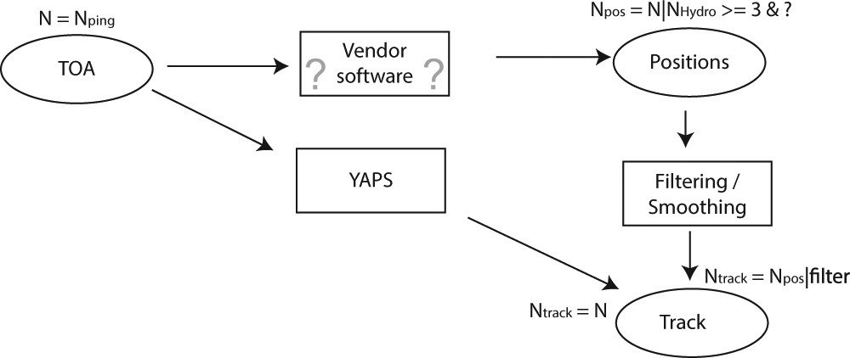
Third-order Selection: Yet Another Positioning Solver (YAPS)

Slide 11
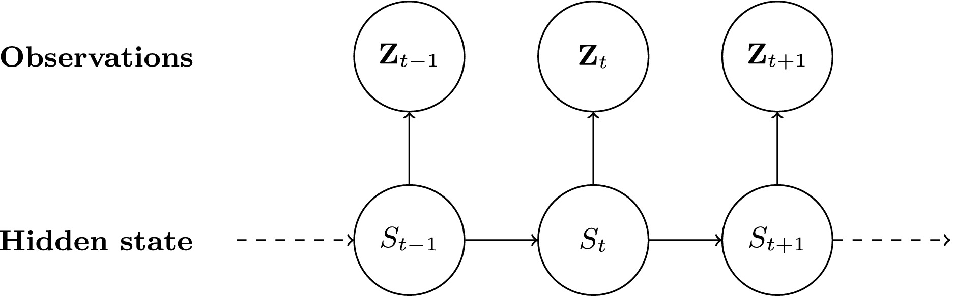
Third-order Selection: Hidden Markov Models (HMMs)

Slide 12
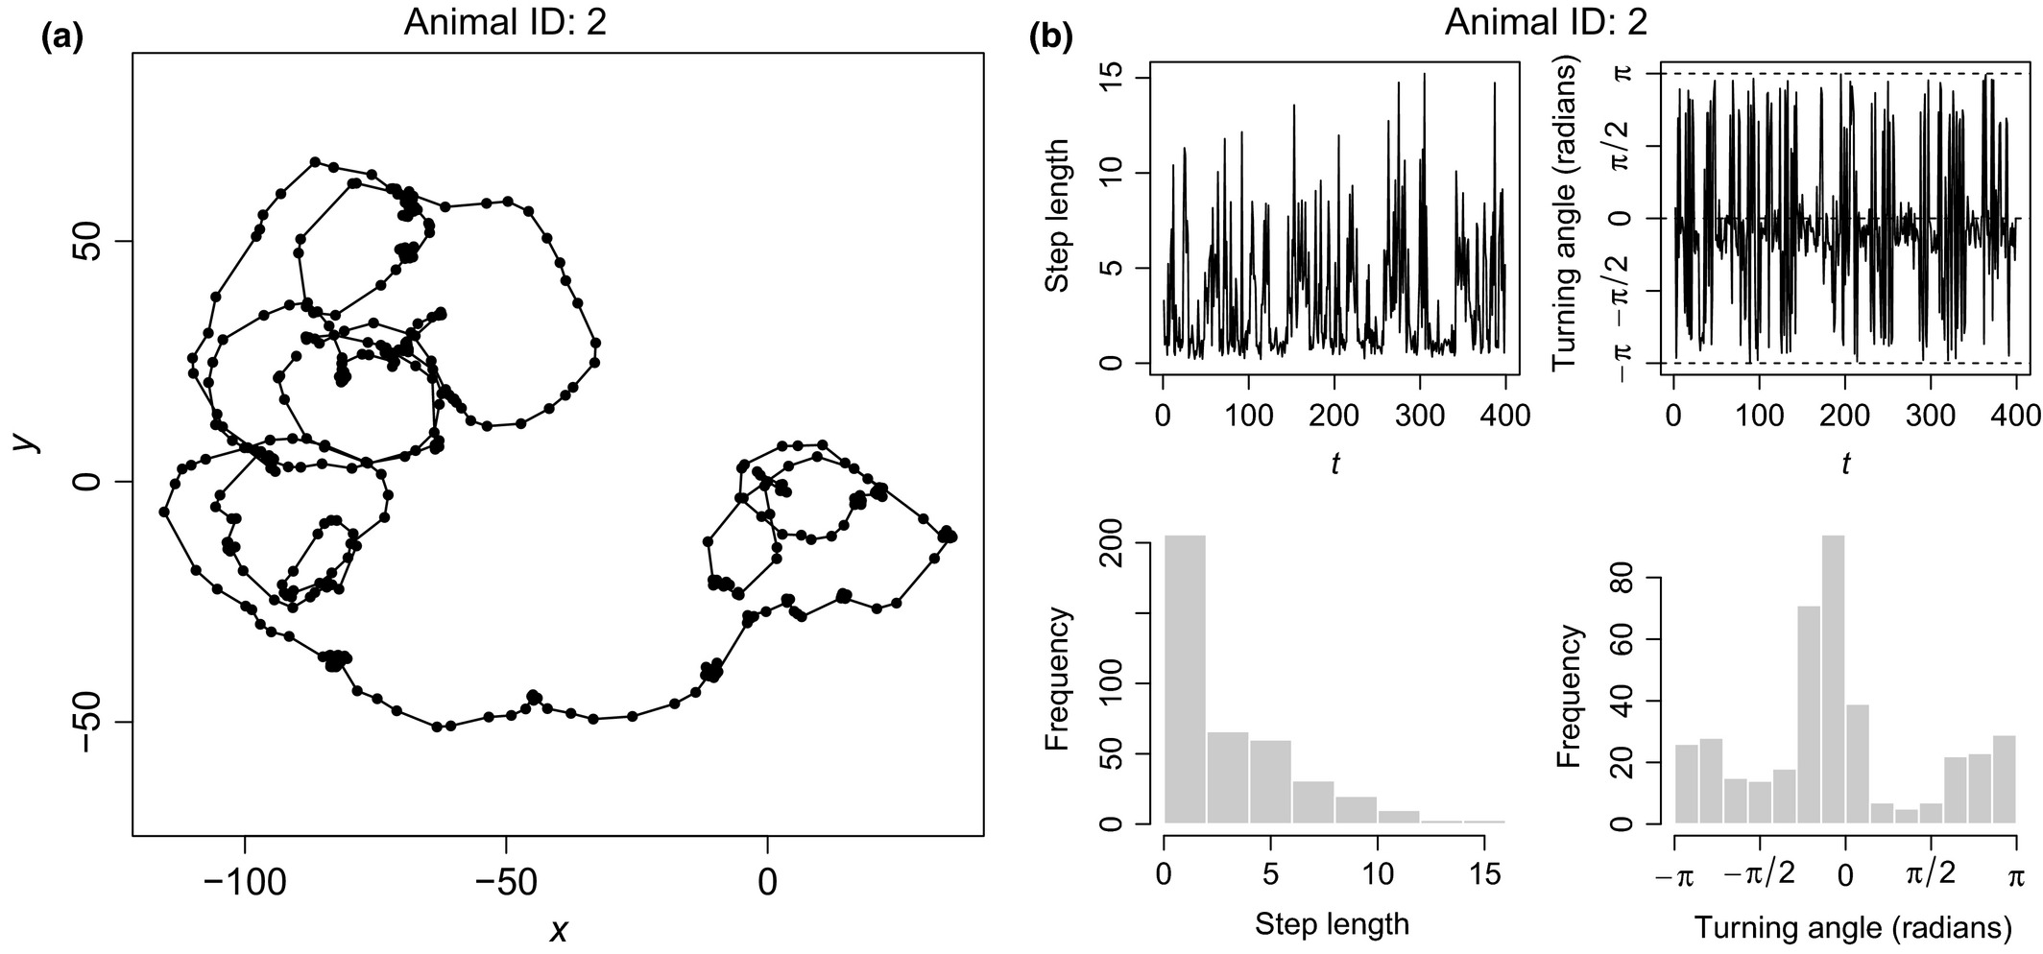
Third-order Selection: Hidden Markov Models (HMMs)

Slide 13
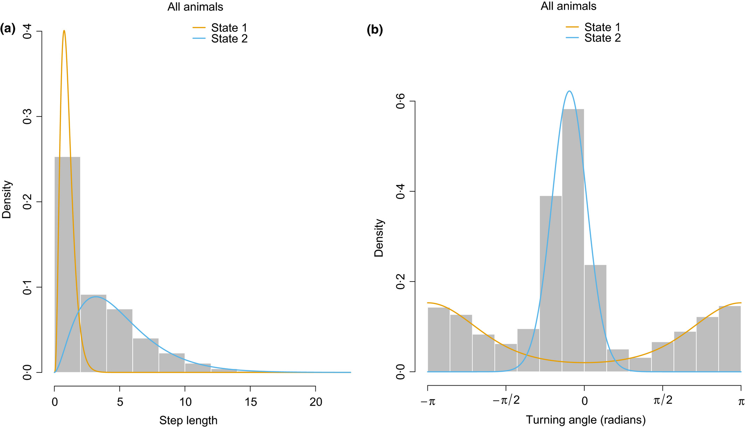
Third-order Selection: Hidden Markov Models (HMMs)

Slide 14
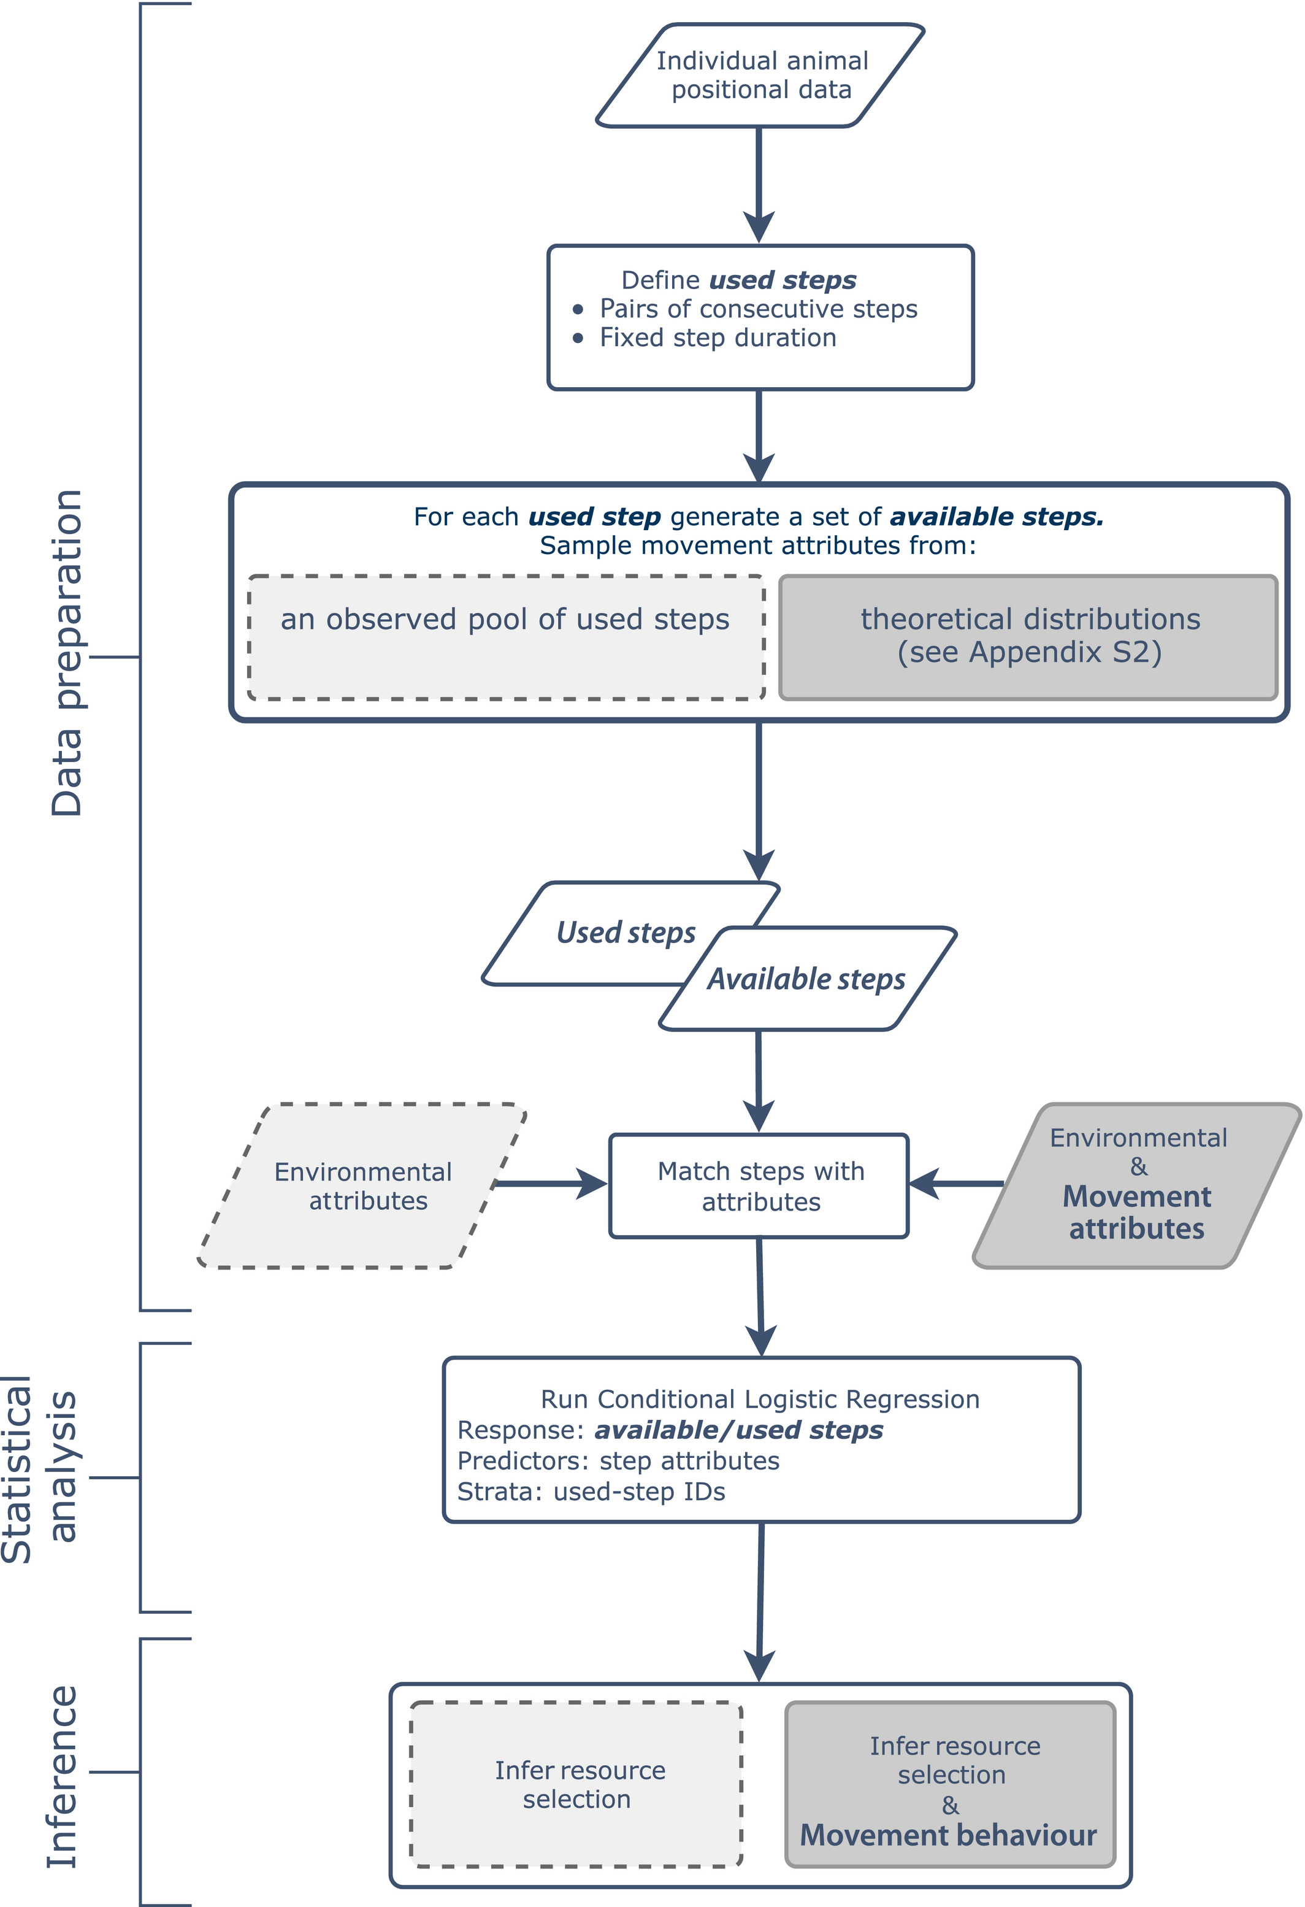
Third-order Selection: integrated Step Selection Functions (iSSFs)

Slide 15
Third-order Selection: integrated Step Selection Functions (iSSFs)

Slide 16
Third-order Selection: integrated Step Selection Functions (iSSFs)

Slide 17
Third-order Selection: integrated Step Selection Functions (iSSFs)

Slide 18
Third-order Selection: integrated Step Selection Functions (iSSFs)

Slide 19
Third-order Selection: integrated Step Selection Functions (iSSFs)

Slide 20
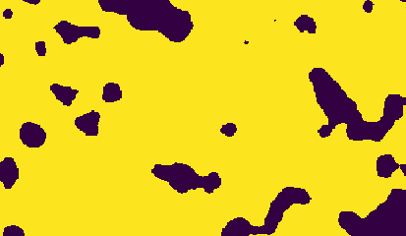
Third-order Selection: integrated Step Selection Functions (iSSFs)

Slide 21
Considerations and Decisions in YAPS, HMMs and iSSFs
Array design
Is it an array designed for fine-scale positioning?
Does it cover enough habitat variation?
Tag specifications
What is the time delay of your tags? This will impact the timing of your steps
Accuracy of calculated positions
What is the allowable accuracy of your calculated positions? This will impact the resolution of your environmental variables
Track specifications
How long do you wait between positions before you start a new track? What constitutes a fish leaving the array?
What tracks are worth keeping? How long do they need to be?
Environmental variables
Keep in mind the resolution of your variables! Also are they static or dynamic?

Slide 22
Seatrout Example

Slide 23
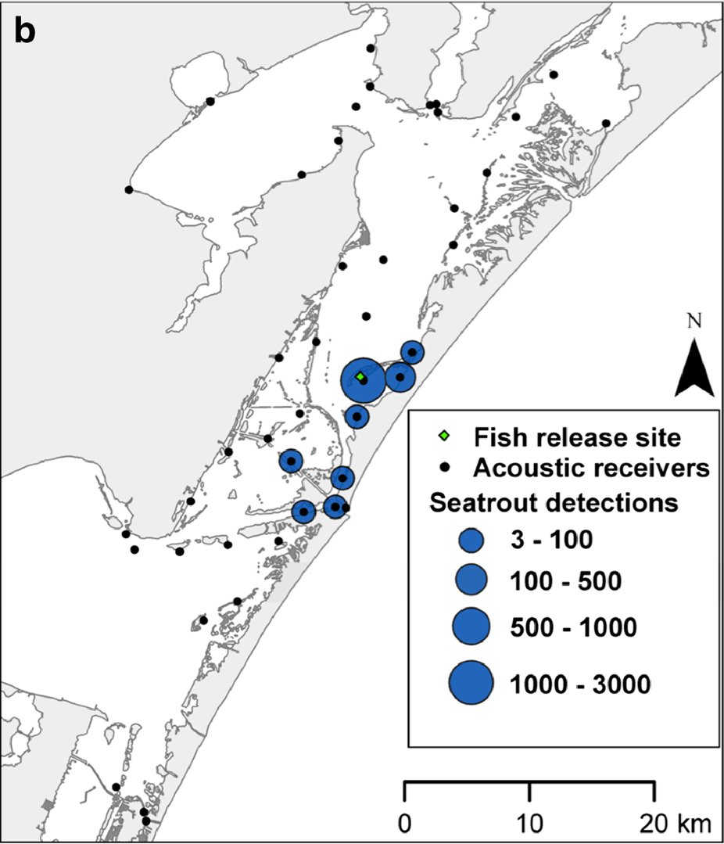
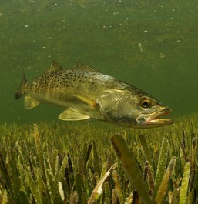

Spotted Seatrout (Cynoscion nebulosus)
Moulton et al., 2017 Estuar Coasts
Notes:
So now I get to introduce you to one of the best fish species in the world (no citations for that, its just a fact), the Spotted Seatrout! This beautiful species has a geographic range from Cape Cod, Massachusetts down around Florida all the way to Mexico. It is the most caught marine recreational species in the United States, with 60 million caught each year!
In Florida, an estimated 13.8 million Seatrout are caught recreationally each year, with catches highest along the Gulf of Mexico coast.
Spotted Seatrout are estuary-dependent species and exhibit high residency within their home estuary. Acoustic tagging studies found that for the most part they do not move further than 10 km away from where they were tagged. An example of this is Moulton et al 2017. You can see by the map that they are relatively residential. Furthermore, genetics studies have shown that each estuary in Florida harbors its own sub-population of Seatrout! They also have a wide range of physical tolerances due to being an estuarine species.
Furthermore, Seatrout have been shown to be associated with seagrass throughout their life cycle! Larvae settle into seagrass beds and juveniles have also been caught more over seagrass. Adult seatrout forage in seagrass seascapes, feeding on seagrass-associated fish and crustaceans.

Slide 24
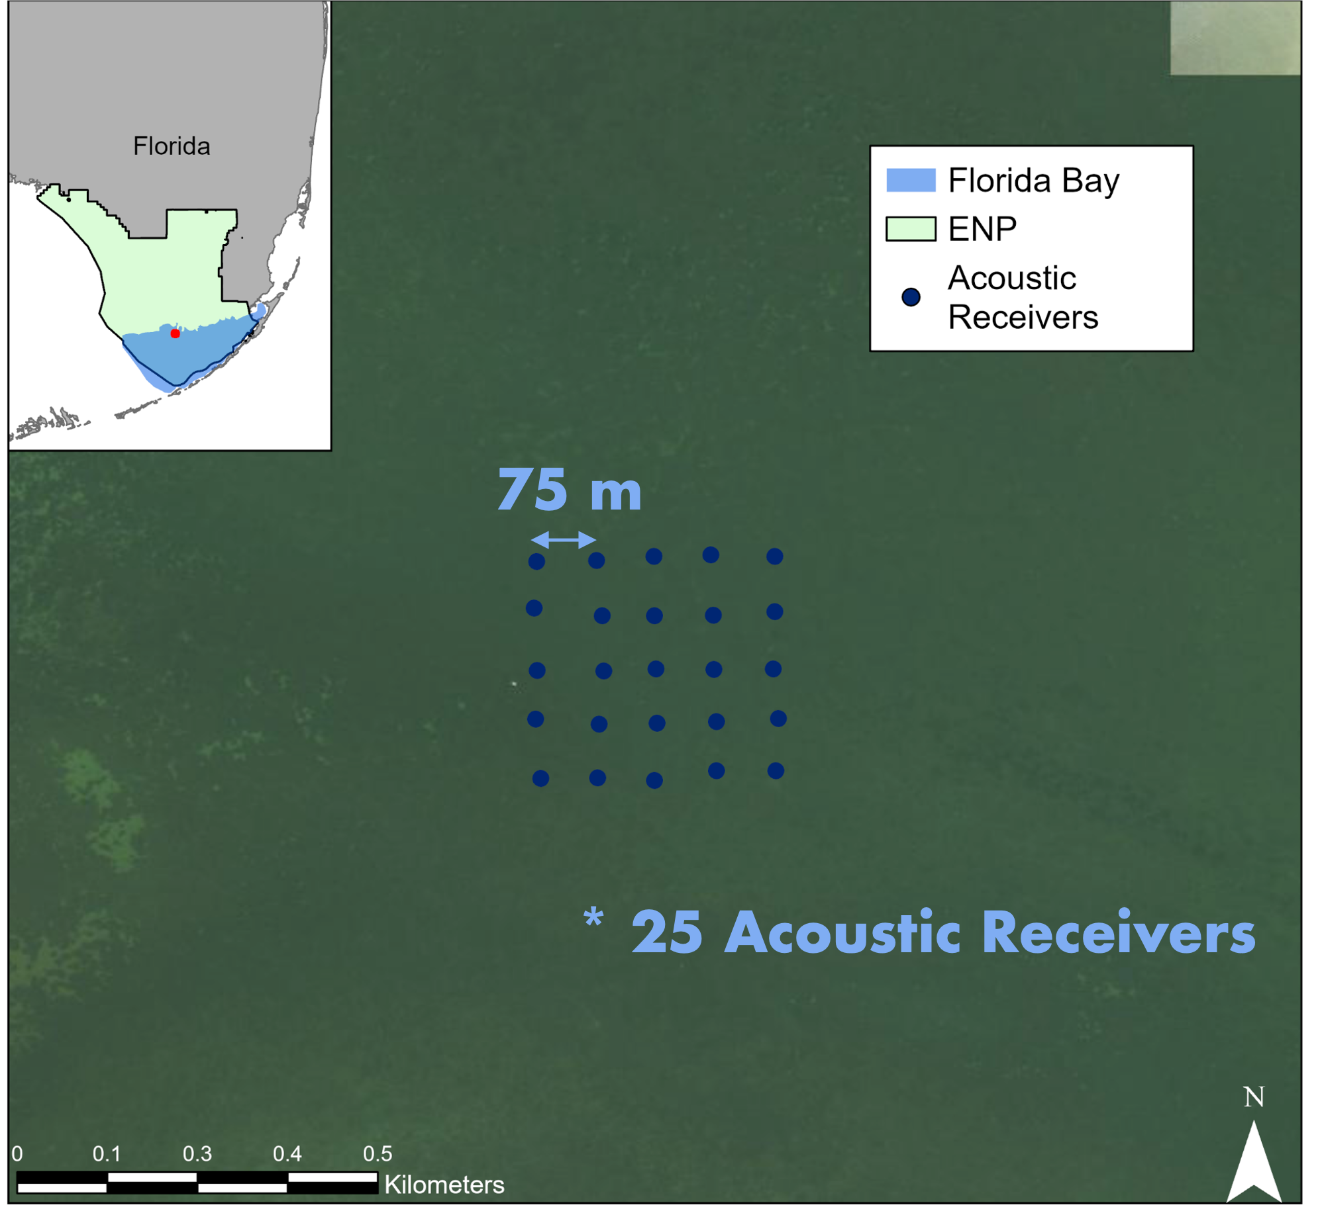
Methods
25 receivers
151 tagged seatrout
  Using a subset of 3 individuals
Notes:
To investigate spotted seatrout habitat use, I established an array of 29 Innovasea acoustic receivers within Rankin Basin. These acoustic receivers were placed in a grid pattern to facilitate the study of habitat use and home range estimation. Each of these receivers had a detection range of approximately 75m. A total of 151 spotted seatrout were tagged with V9 acoustic tags with either a 60-90s signal delay or 20-40s signal delay.

Slide 25
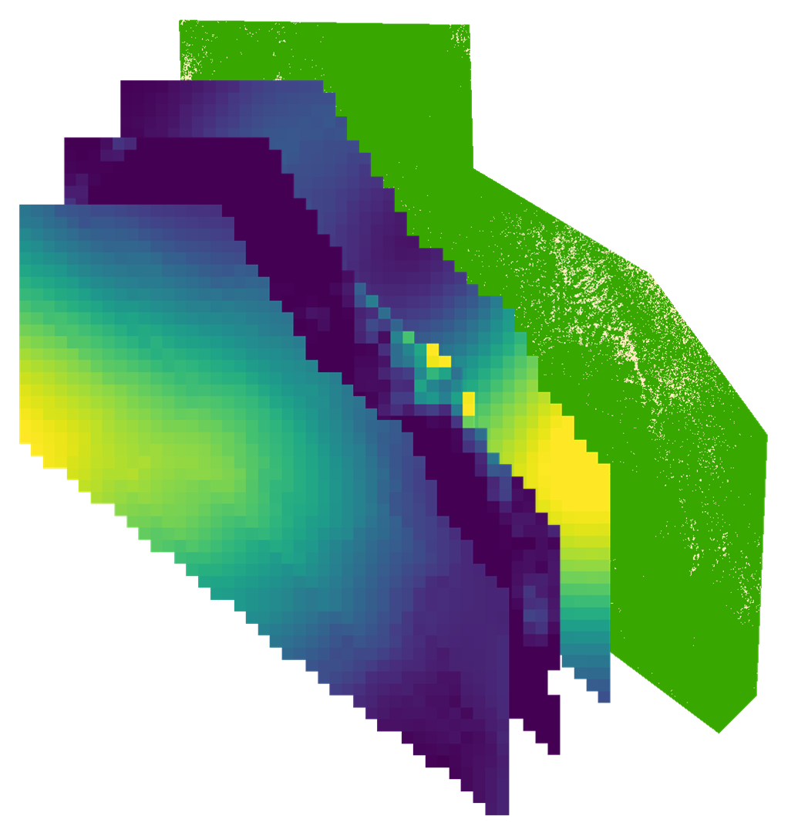
Methods
SAV surveys
Aerial imagery
Spatial Pattern Metrics
Notes:
Habitat variables were mapped at the 2 scales. A 2-class random forest classifier following the methodology in the SAV die-off chapter was on run on aerial imagery for the seascape scale. Ordinary kriging interpolation was used to map habitat variables for the within-patch scale. Seascape level variables were then calculated using spatial pattern metrics across the 2-class random forest classifier on the dense SAV class similar to the SAV die-off chapter. Data from the Fish Habitat Assessment Program, or FHAP, was also used to map species cover of Thalassia and Halodule. For this example we are only looking at within-patch variables

Slide 26
Let’s move on over to the script!

