Slide 1
FolkRAG
A Retrieval-Augmented Generation System for Cultural Heritage Materials
Jonathan Schild, Paul Kelly
GWU MS DS Capstone, Winter 2024

Slide 2
Archival Data
Collections described across multiple systems:
Catalog records (bibliographic)
Finding aids (hierarchical)
Digital objects (file-level)
Current limitations:
Multiple disconnected systems
Complex navigation
Requires expert knowledge

Slide 3
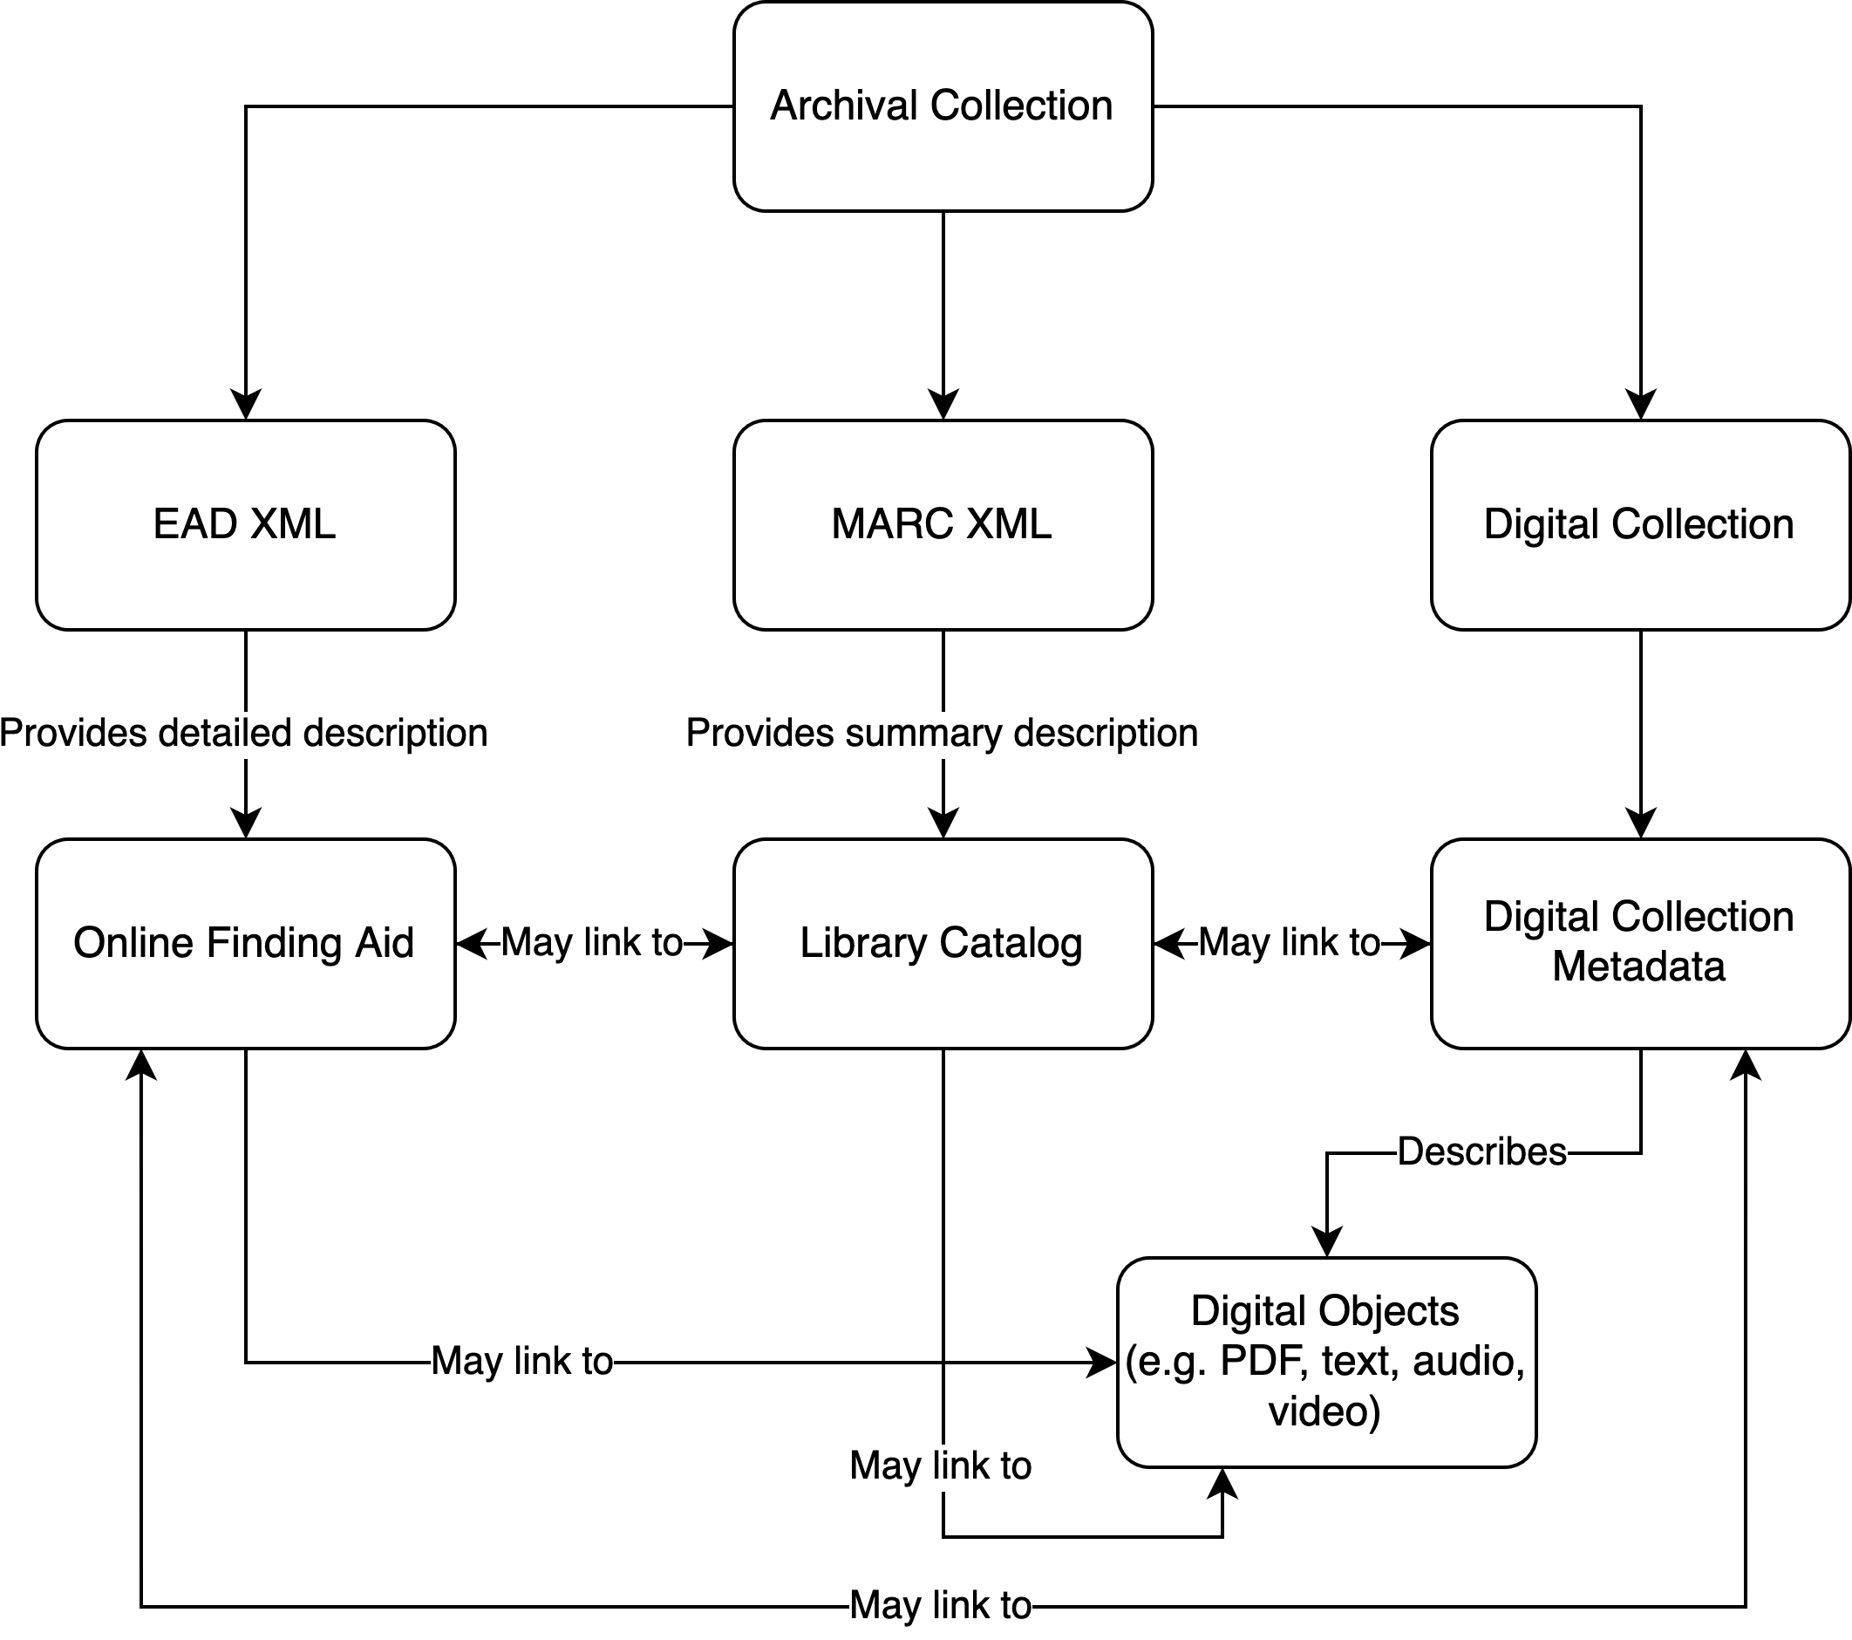

Slide 4
American Folklife Center
Division at Library of Congress
Founded 1976 by American Folklife Preservation Act
Houses Archive of Folk Culture (est. 1928)
Materials: Folk songs, oral histories, field notes, manuscripts, photographs, audio/video recordings

Slide 5
FolkRAG
Simple UI that enables researchers and librarians to more efficiently identify their research materials and reference documents.
Proof of Concept
Combines LLMs with information retrieval
Enables natural language queries
Maintains archival context, provides citations
94% retrieval accuracy

Slide 6
Data Acquisition and Processing
Web scraping pipeline:
EAD XML from LoC finding aids
MARC XML from catalog records
JSON metadata via LoC API
Document processing:
10,980 Whisper audio transcriptions
4,292 Tesseract OCR outputs
29,778 library-created text files
Metadata integration:
Pattern matching for identifiers
Hierarchical field mapping

Slide 7
Initial Steps
Started with FAISS:
Fast similarity search
GPU optimization
Metadata limitations
Switched to DeepLake:
Individual tensor per field
Preserved metadata hierarchy
Efficient filtering capability

Slide 8
Technical Overview
DeepLake vector store w/metadata
Instructor-XL embeddings
HyDE generator (Claude/Bedrock)
TF-IDF re-ranking

Slide 9
RAG Architectures: Naïve
Primary Components
Vector database
LLM

Slide 10
LLM Prompts: Response Generator
Human: Please answer the following query based on the provided context and metadata.
Query: [User Query]
Context: [Relevant text from top-ranked documents]
Metadata: [Relevant metadata from top-ranked document]
Instructions:
1. Answer the question using ONLY the information provided in the Context and Metadata above.
2. Do NOT include any information that is not explicitly stated in the Context or Metadata.
3. Begin your answer with a direct response to the question asked.
4. Include relevant details from the Context and Metadata to support your answer.
5. Pay special attention to the recording date, contributors, and locations provided in the metadata.
6. Inform the user of what document filename they can find the information in.

Slide 11
RAG Architectures: HyDE
Naïve + HyDE
Primary Components
HyDE Generator
Vector database
LLM

Slide 12
LLM Prompts: HyDE Generator
Derivative query generation prompt:
Rewrite this query to be slightly different but similar in meaning: {query}
Hypothetical response generation prompt:
You are a document that answers this question {query}.
Write a short, natural paragraph that directly answers this question.
Include additional relevant information if possible.

Slide 13
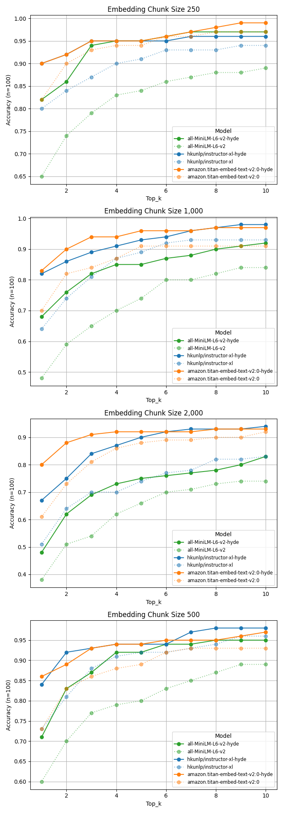
Evaluation: Sample Data
Criteria
Accuracy on 100 test questions (Correct document filename among top_k documents)
RAG System (Naïve, HyDE)
Observations
Drop MiniLM as an embedding option
Retain 250, 1,000 sized chunking strategies

Slide 14
RAG Architectures: HyDER
Naïve + HyDE + Re-ranking
Primary Components
Enhanced HyDE Generator
Vector database
Custom Re-ranker
LLM

Slide 15
Re-Ranking Calculations
Total Score = (TF-IDF Score x 0.5) + (Freshness Score x 0.3) + (Keyword Coverage x 0.2)
TF-IDF Score = Cosine Similarity* (TF-IDF of Query, TF-IDF of Document)
Freshness Score = (0, 1 - Time Different in Days/365)
Keyword Coverage = Number of Matching Query Keywords in Document/Total Unique Keywords in Query.
* As calculated using the Sklearn Python package

Slide 16
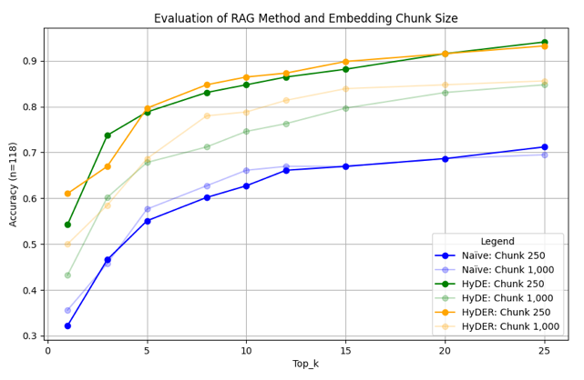
Evaluation: All Data
Criteria
Accuracy on 18 test questions (Correct document filename among top_k documents)
RAG System (Naïve, HyDE, HyDER)
Best Model Config
Instructor-xl
Smaller chunking strategy (250)
HyDER (slight preference)

Slide 17
Evaluation: Generation
Query: What is Captain Pearl R. Nye's favorite ballad?
HyDER (250 Chunked Vector DB)
Captain Pearl R. Nye's favorite ballad is Barbara Allen. This information can be found in the context, where Captain Nye states, "I guess Barbara Allen is my favorite of them all." The recording was made on June 27, 1937 in Akron, Ohio, as part of a field interview conducted by John A. Lomax. This information is part of a sound recording titled "Two Sailors: Sea Shanties and Canal Boat Ballads," which is one of 10 radio programs in "The Ballad Hunter" radio series. The original filename for this information is sr28a_en.txt.
HyDER (1,000 Chunked Vector DB)
Captain Pearl R. Nye's favorite ballad is Barbara Allen. This information can be found in the file "afc1933001_ms403_002.txt". The context explicitly states: "I guess Barbara Allen is my favorite of them all." This quote is attributed to Captain Nye in the passage. Additionally, the context mentions that the Library of Congress has eighty-three versions of Barbara Allen, further emphasizing the popularity and significance of this ballad.
The metadata indicates that this information comes from the John A. Lomax and Alan Lomax papers, specifically from a manuscript titled "Adventures of a Ballad Hunter." The document was created between 1907 and 1969 in the United States, though Captain Nye's exact recording date is not specified in the given information.

Slide 18
Results
Naive RAG baseline: ~45% accuracy
Basic HyDE: ~75% accuracy
HyDER: ~90% accuracy at top-k=15
Chunk size comparison:
250 chars: 94% max accuracy
1000 chars: 87% max accuracy
2000 chars: 82% max accuracy

Slide 19
Conclusions and Future Work
Future Work:
Multimodal Integration:
Image understanding
Cross-modal relationships
Visual context preservation
Conversational Interface:
Memory of past interactions
Context accumulation
Thread-based exploration

