Slide 1
Priority Assignment Saucy Tracker App
PASTA
Olivia Hillman | Nimisha Patal | Karen Kauffman| Devin Nicholson | Jon Scott | Cole Grigbsby
Notes:
Olivia - Project Manager
Nimisha - Front end engineer
Karen - Product Manager
Devin - UI/UX Engineer
Jon - Full Stack engineer
Cole - Backend and Test Engineer but my group called me the bug squasher

Slide 2
Agenda
Introduction
Problem
Aim
Methodology
User Stories
Requirements
Results and Discussion
AHP Analysis
Diagrams
Implementation
Demo
Conclusion and Future Work
Notes:
Olivia

Slide 3
Problem
College courses give students a lot to keep track of. Between the nightly 11pm deadline to submit your CPE 357 project and the NGA that needs to get done to avoid receiving a malus, it's essential to stay on top of assignment deadlines.
With the pressure of deadlines, and forgetting assignments until the night before, students may resort to skipping class or sacrificing sleep to get things done on time. We see this as a problem.
Hence, the creation of PASTA: the ultimate web application to streamline student tasks.
Introduction | Methodology | Results and Discussion | Conclusion and Future Work
Notes:
Olivia

Slide 4
Aim
We want to help students -- and hopefully we can do that with PASTA. Through this project, our goal is to ease:
Time management
Forgetfulness
Note organization
Sleep-deprivation
Procrastination
...and more!
by providing students with a single application to store and track all assignments, activities, notes, and important reminders!
Introduction | Methodology | Results and Discussion | Conclusion and Future Work
Notes:
Olivia
We know students get busy. Tasks are often forgotten, time management is a widespread struggle -- sometimes sleep is sacrificed, etc.

Slide 5
User Stories
During the initial stages of PASTA, we wanted some stakeholders’ perspectives in order to further understand what to include in the application:
As a student, I want to view a calendar populated with assignments, so that I can plan ahead.
As a student, I want to store notes separate from my assignments, so that I can organize information how I want.
As a student, I want to modify an existing assignment, so that I can adapt to changing deadlines and requirements.
Introduction | Methodology | Results and Discussion | Conclusion and Future Work
Notes:
Olivia
Wanted -- at least to simulate -- perspective

Slide 6
Requirements
With the constraints of this project, we could not implement the functionality for all of our requirements, but full-scale PASTA would require that:
The system shall display a calendar with the list of to-do assignments.
The system shall notify the user of all assignments due by midnight each night.
The system shall record the amount of time worked on an assignment.
The system shall allow the user to decompose an assignment into smaller ones.
The system shall allow the user to filter assignments into user-specified categories.
The system shall display the cumulative total time worked on assignments in a day.
Introduction | Methodology | Results and Discussion | Conclusion and Future Work
Notes:
Olivia (?)
Smaller tasks to seem less stressful, etc.
Now Nimisha will introduce our AHP

Slide 7
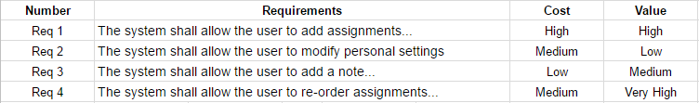
AHP Analysis
Introduction | Methodology | Results and Discussion | Conclusion and Future Work

Slide 8
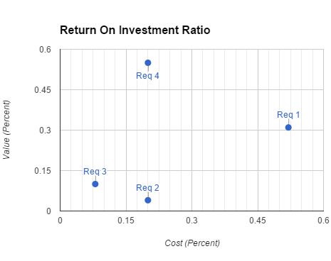
AHP Analysis
We chose the requirements we felt were the main goals of our project -- were it to be released in reality -- and compared their relative costs (to us in time) and values (to our stakeholders).
Introduction | Methodology | Results and Discussion | Conclusion and Future Work
Notes:
Nimisha

Slide 9
Storyboard
When we dreamed up PASTA, we thought about what would be most useful to students, most easy to use, and most aesthetically pleasing.
We hoped to create an online application that students could access quickly, as to not lose track of a new assignment or waste valuable homework time.
Our storyboard adaption of PASTA focuses on the most important functionality, and serves as a goal for the ultimate end of the project.
This is how we imagined PASTA could look.
Introduction | Methodology | Results and Discussion | Conclusion and Future Work
Notes:
Nimisha

Slide 10
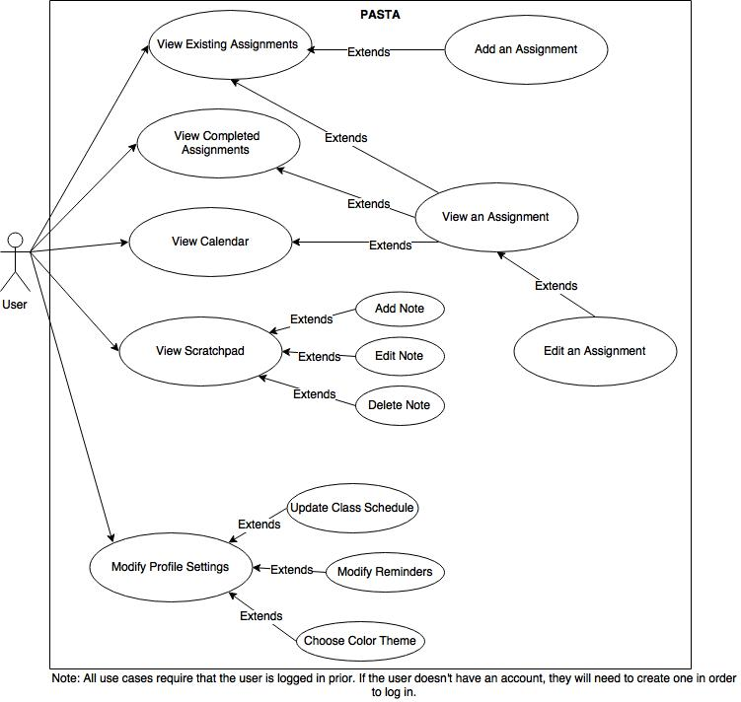
Use Case Overview Diagram
The main activities of our program are viewing and editing assignments, the calendar, scratchpad, and settings.
The user must log in or create an account before accessing the other features of the application.
For ease of use, the user can add or view an assignment from multiple screens in the application.
Introduction | Methodology | Results and Discussion | Conclusion and Future Work

Slide 11
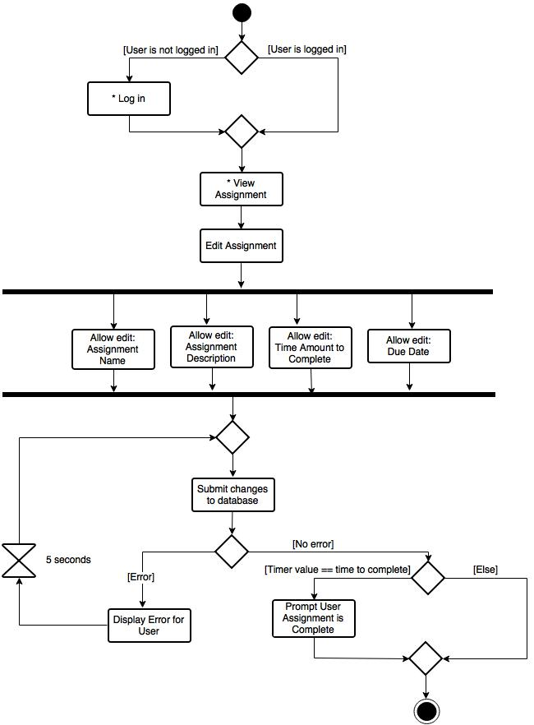
Activity Diagram
Name: Edit an assignment
The student requests to view an assignment.
The system displays the assignment details.
The student requests to edit the assignment.
The system prepares an assignment details form.
For each field the student edits, the system verifies that each field is complete.
When the student indicates the assignment details are correct, the system saves or updates the assignment.
The system checks the timer and prompts to complete assignment if the timer value equals the amount of time to complete.
Extensions:
6a. System fails to save changes in database: System prompts the user to retry.
Introduction | Methodology | Results and Discussion | Conclusion and Future Work

Slide 12
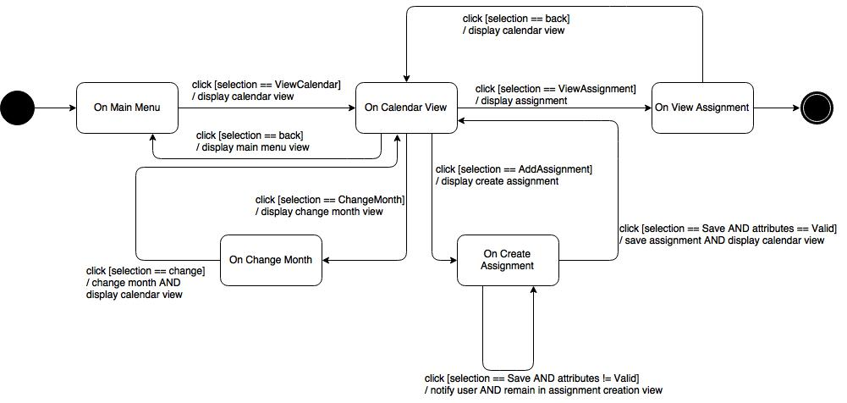
State Diagram - View Calendar
Introduction | Methodology | Results and Discussion | Conclusion and Future Work
Notes:
Karen

Slide 13
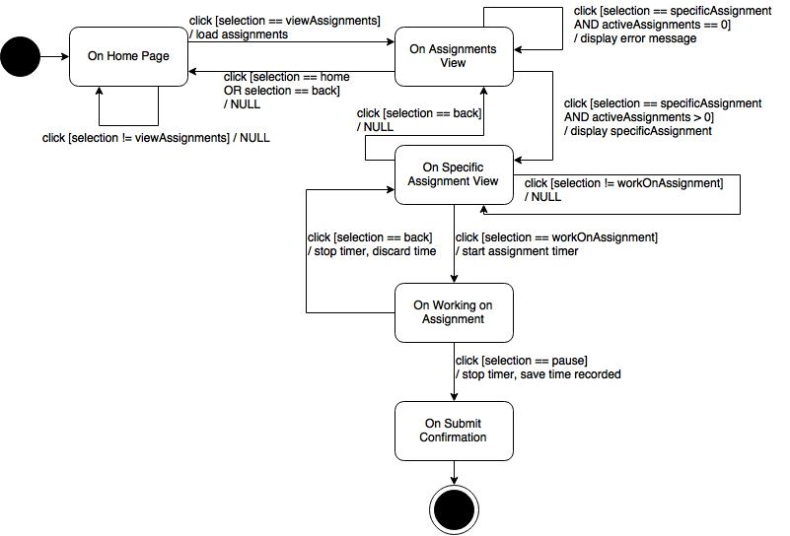
State Diagram - Work on Assignment
Introduction | Methodology | Results and Discussion | Conclusion and Future Work
Notes:
Karen

Slide 14
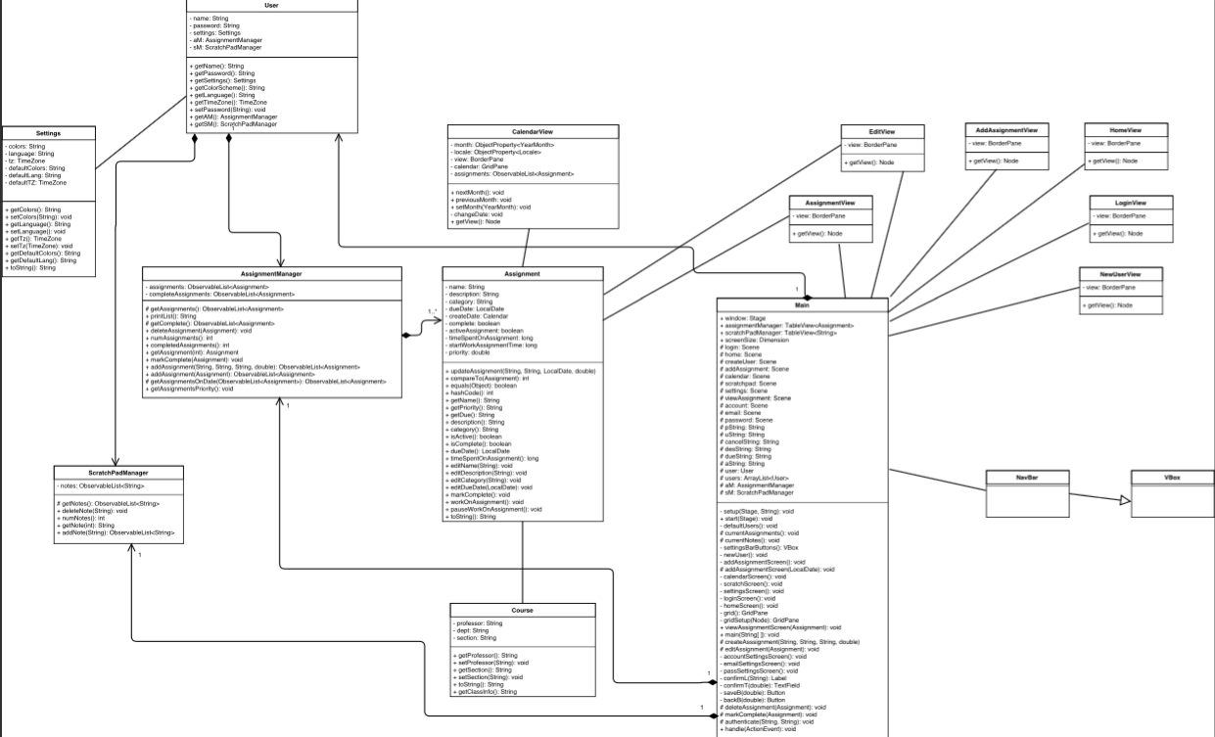
Class Diagram
Introduction | Methodology | Results and Discussion | Conclusion and Future Work
Notes:
Karen

Slide 15
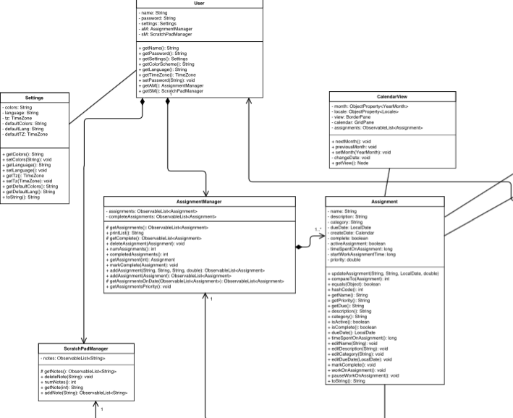
Class Diagram
Introduction | Methodology | Results and Discussion | Conclusion and Future Work
Notes:
Karen

Slide 16
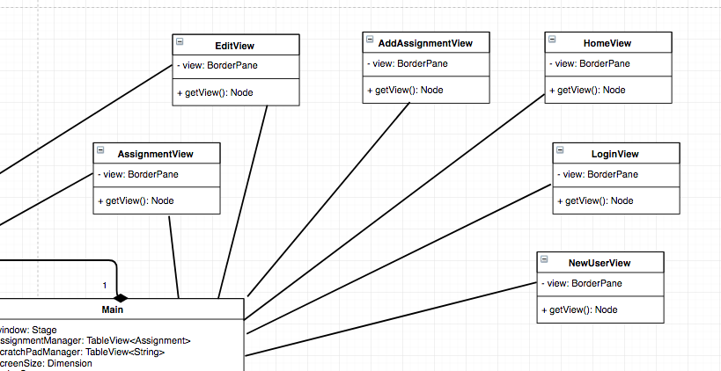
Class Diagram
Introduction | Methodology | Results and Discussion | Conclusion and Future Work
Notes:
Karen

Slide 17
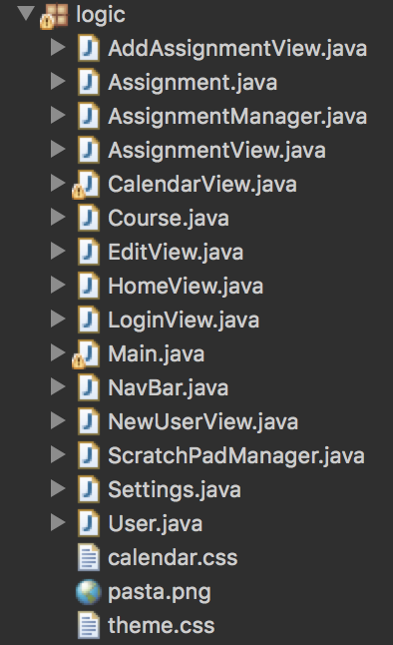
Implementation
Focused on UI
Visibility, control and freedom
Top-Down Implementation
Collaborative technique
Wireframing and prototypes
MVC Style
Logic separate from UI
Introduction | Methodology | Results and Discussion | Conclusion and Future Work
Notes:
Devin
"You have to start with the customer experience and work backwards to the technology"

Slide 18
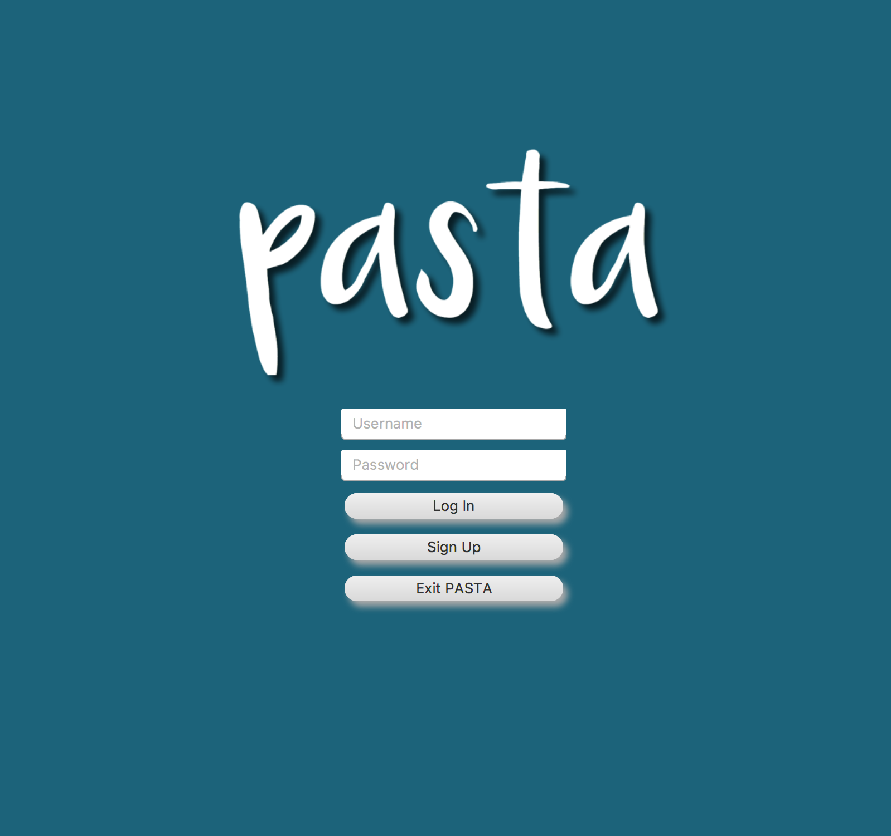
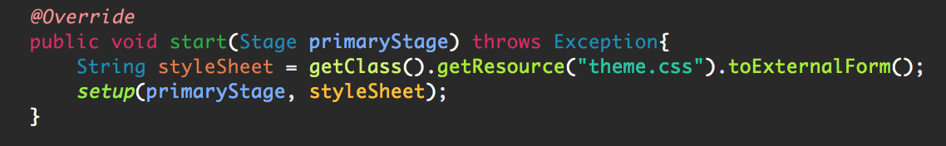
Implementation (UI)
JavaFX
Minimalist design
Why JavaFX vs JavaSwing?
Productivity, capability
Portability
Can easily create an Android app’s design
CSS rather than FXML
Roadblocks / problems encountered
None of the members had experience with FX
Introduction | Methodology | Results and Discussion | Conclusion and Future Work
Notes:
Devin
Notes:
Productivity - Easy to use as a beginner, testing, Java only
Capability - Controls, Eventing, CSS usage

Slide 19
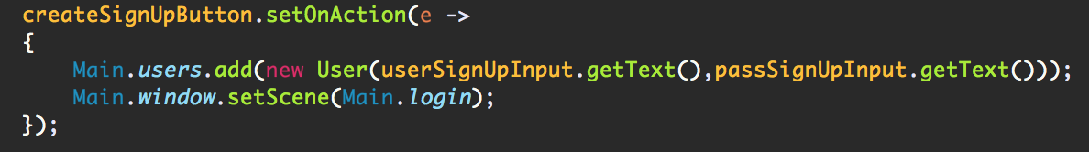
Implementation (Backend)
Classes such as User, Assignment, Assignment Manager, Settings, etc.
Nothing to do with the view
Keeps information for the actual user
Ideal mobile application
Challenges:
SVN
Sonarqube
Redmine
Introduction | Methodology | Results and Discussion | Conclusion and Future Work
Notes:
Devin -

Slide 20
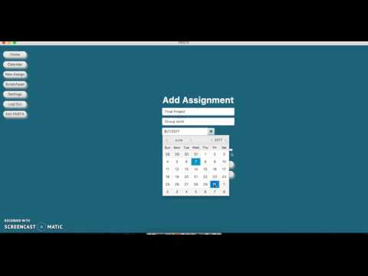
Demonstration
Introduction | Methodology | Results and Discussion | Conclusion and Future Work
Notes:
Jon

Slide 21
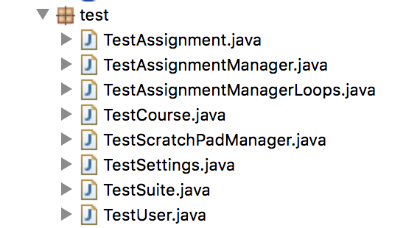
Testing
Six test classes to test our model and controller classes
GUI testing done manually
JavaFX is not easily testable with JUnit
Loop testing
Get assignments on date
Search assignments by name
Other loops do not run a variable number of times
Introduction | Methodology | Results and Discussion | Conclusion and Future Work
Notes:
Cole
Thanks jon,
So for testing, we had 6 test classes to test our different model and controller /Manager style classes. While not all of these classes were fully implemented, we created backbones and core methods for each to guide future work. One interesting test we have is for our assignment model class, which implements comparable. Because of this, We actually had a code smell that appeared when we were not testing the overridden equals method, so we had to implement tests for this.
As for testing our view classes, many of them are not as easily tested with JUnit testing, so we did a lot of manual testing to find bugs, so at this point it’s not likely bug free, but rather works for what we needed to demo.
Loop testing was a bit more challenging, we don’t use many loops as our backend is fairly simple at the moment. Most of our loops are of set iterations in the javaFX set up. We had two fairly simple loops that we did test though. One finds assignments that are due a certain date. This is used for the calendar to display assignments by their date.
The second loop is a search function for searching through assignments by the name. While this has not yet been implemented in the User Interface, it was still written for the backbone of the assignment manager class.
Sonarqube was also a useful tool in preventing errors in our code by requiring our code to be held to a standard. I was in charge of running sonarqube every time we had a new commit and making sure that we kept our code smells minimized throughout the entire development process, which led to my nickname: The stink master.
Overall, testing was straightforward and keeping on top of sonarqube was very helpful.

Slide 22
Future Work
Make it into a cloud based application - allows for access on any device
More advanced prioritization algorithm implementation - take into account percentage toward grade, time to complete assignment, etc.
Implement notification settings - give the user the ability to set alerts for a certain amount of time prior to assignment deadline
Separation of completed and to-do assignments - with prompts to mark as complete based on timer and length of assignment
Specify different categories of events for calendar - to allow for expanding beyond class assignments
Introduction | Methodology | Results and Discussion | Conclusion and Future Work
Notes:
Cole - true database in the backend
So where do we go from here? We have quite a few options to add functionality as well as greatly improve our current prototype.
As mentioned before, we would ideally like our application to work across all platforms. This would require us to implement a cloud based database with real authentication for users. Scaling to the cloud would also allow the program to focus more on graphics and less on calculations if we implement algorithms to predict the time required to complete assignments based on similar past assignments.
In order to do this, we would also have to implement our planned time tracker for assignments, as well as an expected difficulty for the assignment.
With these implemented, we also want to allow for notifications to remind the user that they should start working on an assignment, or remind them when near future assignments are due. Planbooks are great to write assignments down, but they don’t offer notifications, so we think this would be a key future.
There is also plenty of room to improve in the interface. While it was not our main focus, Devin did explain how we wanted it to at least look pretty for presentation. We could explore other graphics packages to allow more flexibility in creating our interface. We also have ideas that were not implemented such as a view to see completed assignments and categorizing assignments to sort them.
We can also include more advanced views of assignments with more fields, more sorting and search options, and even implementing the Course model in the view.
We essentially want to expand our current system to be more universal and implement more features that would increase productivity and organization of users.

Slide 23
Conclusion
Our current version of PASTA is extremely promising for the potential of an extended application like this for students.
We hope you see the value in PASTA for your own scholastic career, and perhaps beyond. Keep an eye out -- maybe we’ll make it happen someday.
Introduction | Methodology | Results and Discussion | Conclusion and Future Work
Notes:
Cole
And that leads us into our conclusion!
Clearly, PASTA is an ambitious project, but we have made headway into creating a viable application to help manage time when school gets too hectic. We definitely have big ideas for the project if we were to continue. While we may not be the next evernote or Planner pro, we enjoyed trying to make our own tailored version of an assignment tracker.
Thank you all for listening, it’s been a pleasure to present to you all.
Sonarqube + loop test
Stink master

Slide 24
Questions?
Notes:
Cole -
Does anyone have any questions?

