Slide 1
Data analysis on Harmful Particulate in the air (Particulate Matter PM 2.5)
Jon Sham (P2317342)

Slide 2
Links To Dataset
https://beta.data.gov.sg/datasets/d_397fe8de643aea9927bdee32e49307ff/view
https://beta.data.gov.sg/collections/505/view
https://github.com/AndreaPi/Open-industrial-datasets
https://zenodo.org/records/3754964
https://www.bts.gov/topics/national-transportation-statistics

Slide 3

Background
Mr Tan, an environmental service agent under the Ministry Of Sustainability and the Environment Agency, wants to find out if the amount of Particulate Matter specifically Particular Matter PM 2.5 in the air is posing as a safety hazard to the public. After finding out if it is a safety hazard, he wants to find the main causes of the discharge of this particulate matter. By doing so, he hopes to establish more measures to be put in place to reduce the production of this harmful particulate matter.

Slide 4
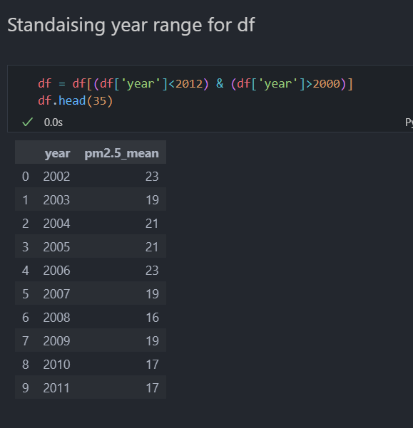
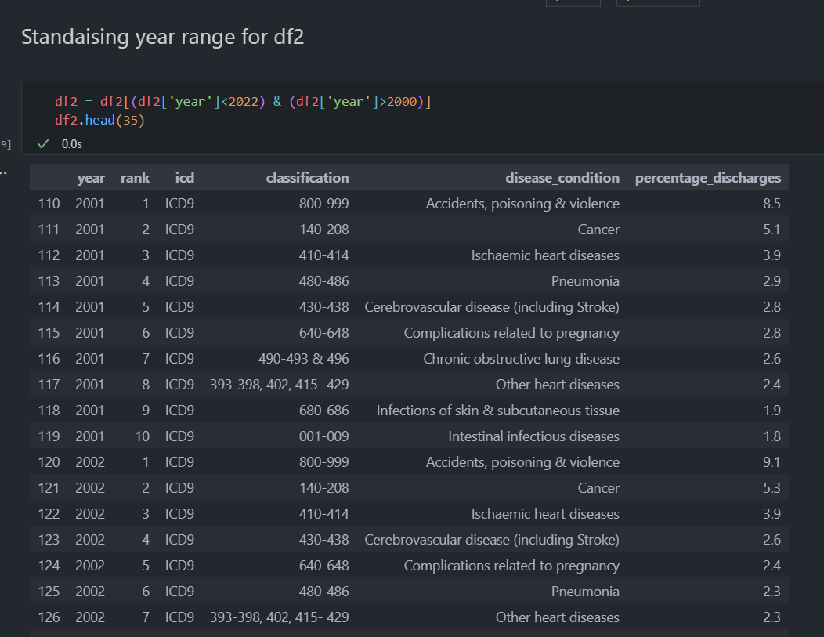
Part 1 (Data Wrangling)
finding out if there is a correlation between amount of particular matter pm 2.5 in the air and medical records of patients with chronic obstructive lung disease
Make years range from 2001 to 2011

Slide 5
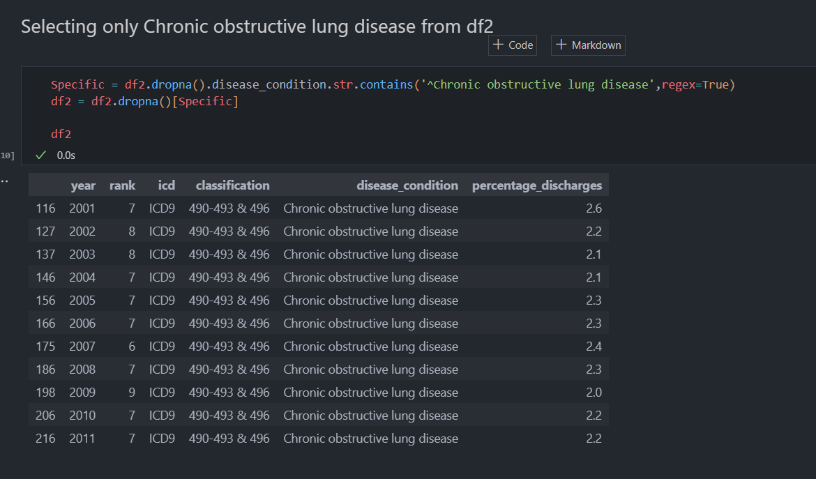
Part 1 (Data Wrangling)
First use .str.contains to see if contains the specific illness I am looking for the rest of the values will be false then will be dropped. After that will be left with a df only containing chronic obstructive lung disease under disease_condition column

Slide 6
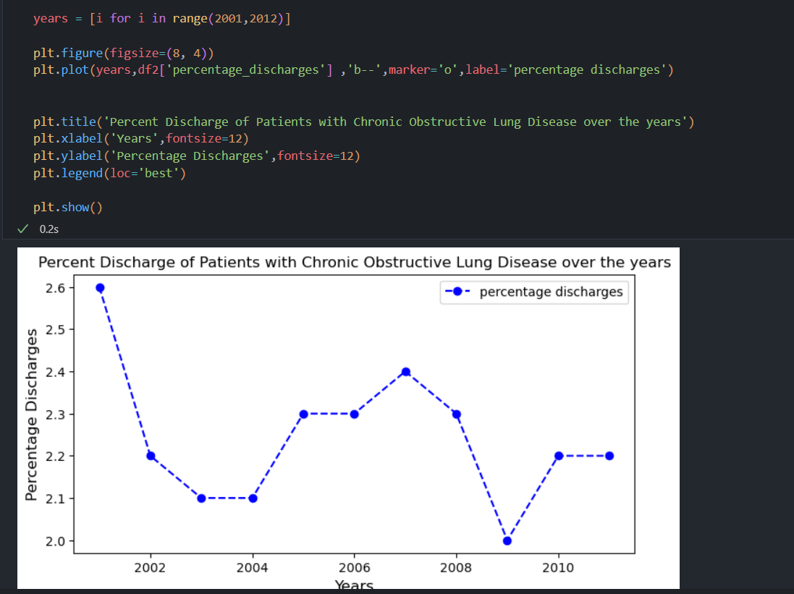
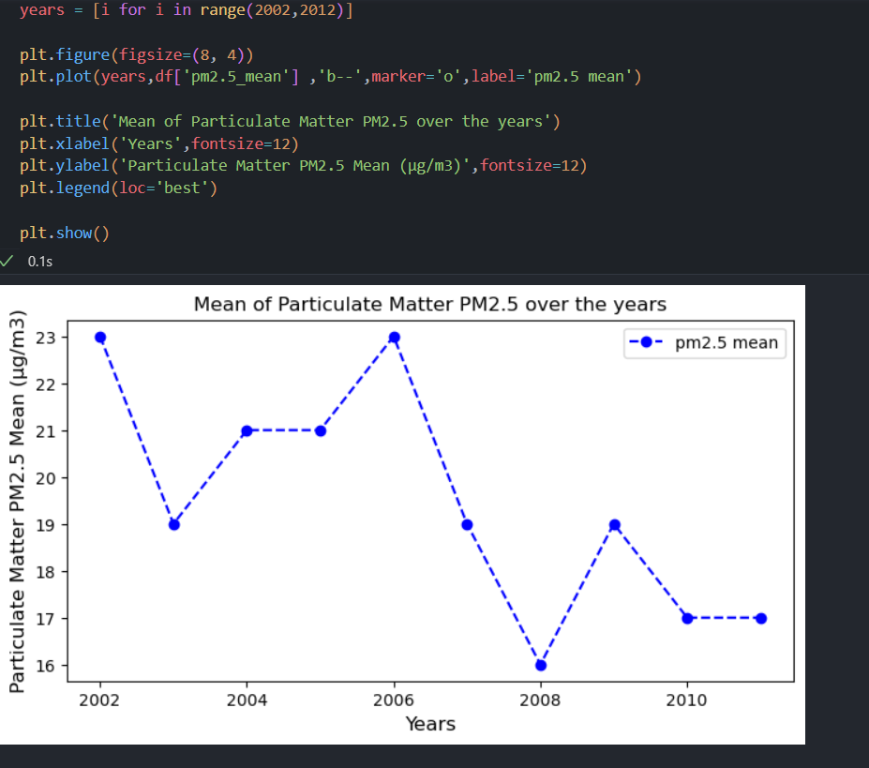
Part 1 (Exploratory Data analysis)
Use line graphs to find similar trend
Conclusion: Based on the eda, Mr Tan confirms a correlation between the amount of particular matter pm 2.5 in the air and medical records of patients with chronic obstructive lung disease. This can be seen as, the first graph shows from 2001 to 2003, there was a decrease in patient discharges and graph 2 from 2001 to 2003, there was a decrease in mean of particular matter pm 2.5, 2004 to 2006, in graph 1 there was an increase in patient discharges and graph 2 from 2001 to 2006, there was an increase in mean of particular matter pm 2.5. Lastly from 2007 to 2008 there was a decrease in patient discharges and graph 2 from 2007 to 2008, there was a decrease in mean of particular matter pm 2.5. Another thing noted is this was for patients discharged not patients admitted hence explains why there was a slight delay in change for about half to a year in both graphs trends.

Slide 7
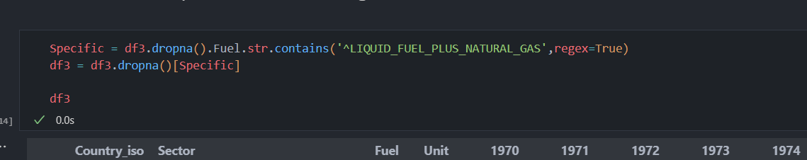
Part 2 (Data Wrangling)
Now that Mr Tan has confirmed a clear correlation, he wants to move on to his next action, to discover to main produces of this harmful particulate matter. He does extensive research and finds out that liquid fuel and natural gas combustion releases pm 2.5 when incompletly combusted. He narrows his research to sectors that use most liquid fuel and natural gas combustion.
str.contains to see if contains the specific fuel type I am looking for the rest of the values will be false then will be dropped. After that will be left with a df only containing Liquid fuel and natural gas under Fuel column

Slide 8
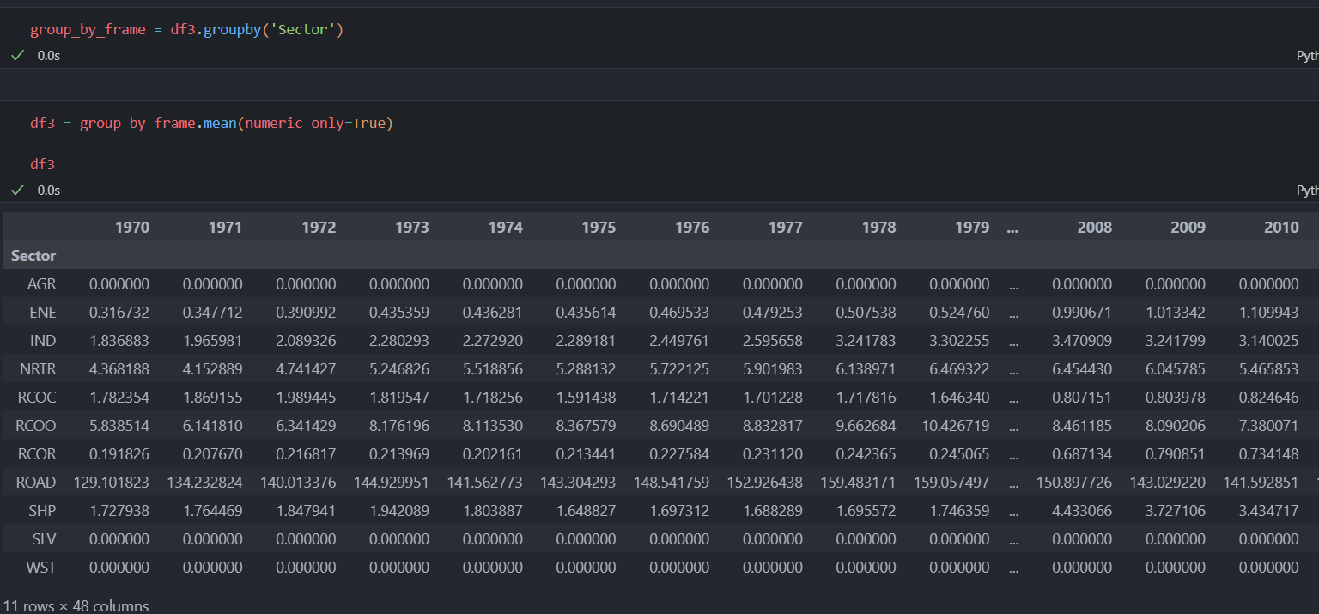
Part 2 (Data Wrangling)
Next I groupby Sector to index sector as we would be focusing on which sector used the most liquid fuel and natural gas. Then I used an aggregated function .mean() and parameter numeric_only to True to ignore non numeric

Slide 9
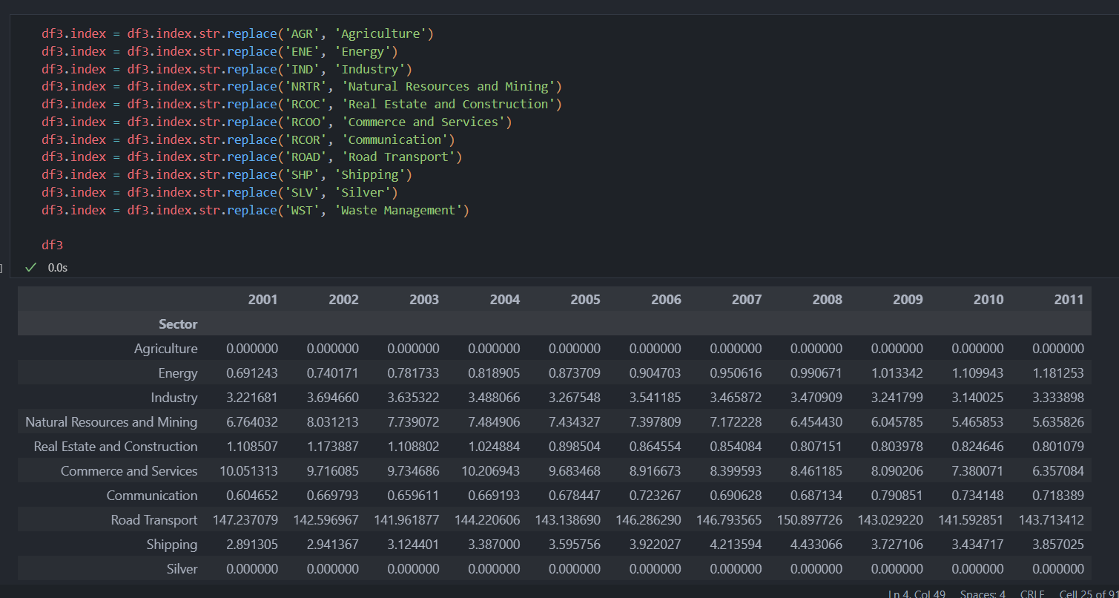
Part 2 (Data Wrangling)
I used .replace to replace the short form of the sector to their full names to I am better able to know which sector is which

Slide 10
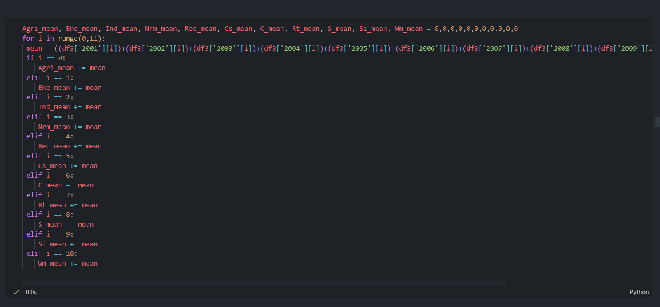
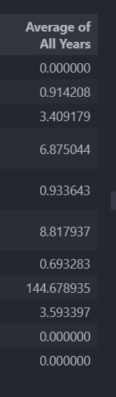
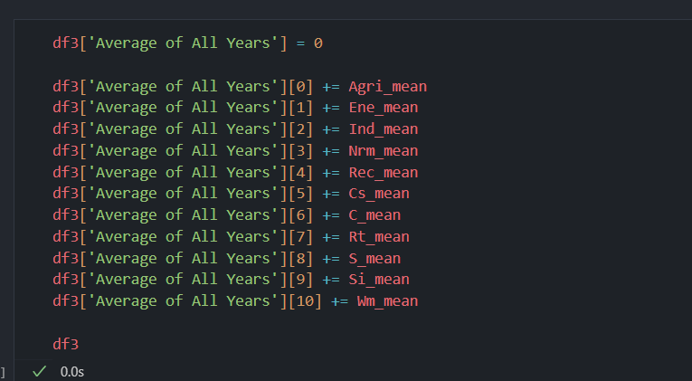
Part 2 (Data Wrangling)
I then created a loop to calculate the average fuel usage then created a column Average of all years to store the data

Slide 11
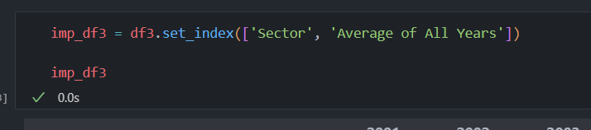
Part 2 (Data Wrangling)
I used multi indexing to index sector and the new column I made Average of all years

Slide 12
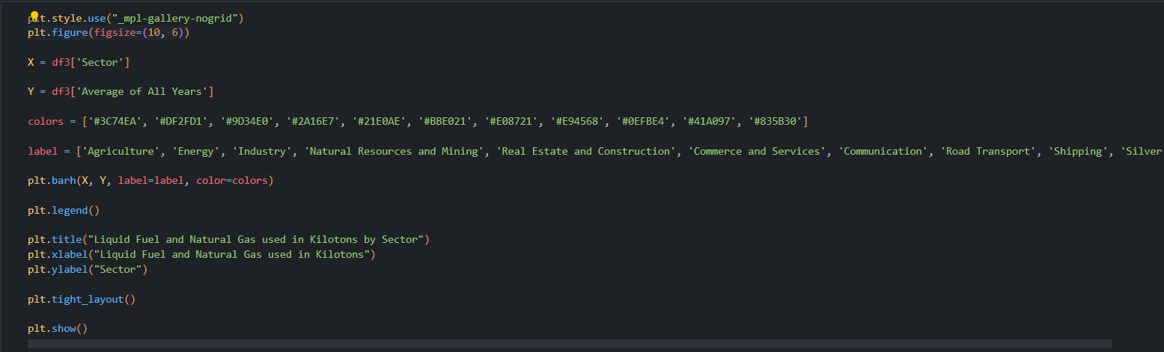
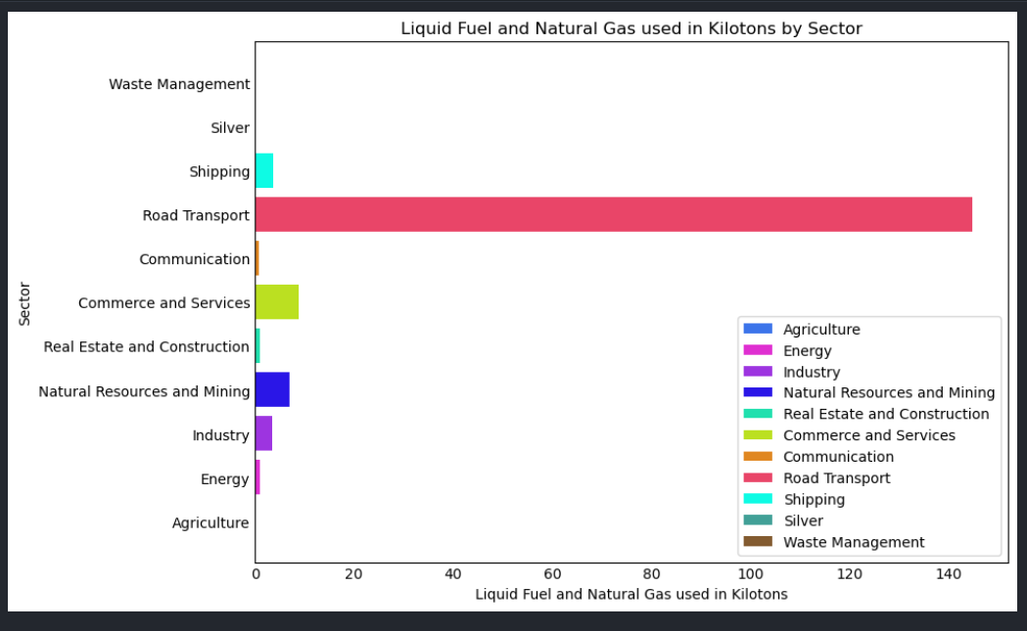
Part 2 (Exploratory Data analysis)
I plotted a horizontal bar graph to compare which sector used the most liquid fuel and natural gas
Conclusion : After the eda, Mr Tan is able to determine the highest producer of pm 2.5 while using a horizontal bar chart to compare the usage of Liquid Fuel and Natural Gas used in Kilotons by Sector. The highest producer was the Road Transport Sector.

Slide 13
Part 3 (Data Wrangling)
Mr Tan realised that the road transport sector is a vast sector consisting of many modes of transport. He wanted to go a step furthur to figure out which mode of transport was using the most liquid fuel. That way it would be more efficient to take establish measures.

Slide 14
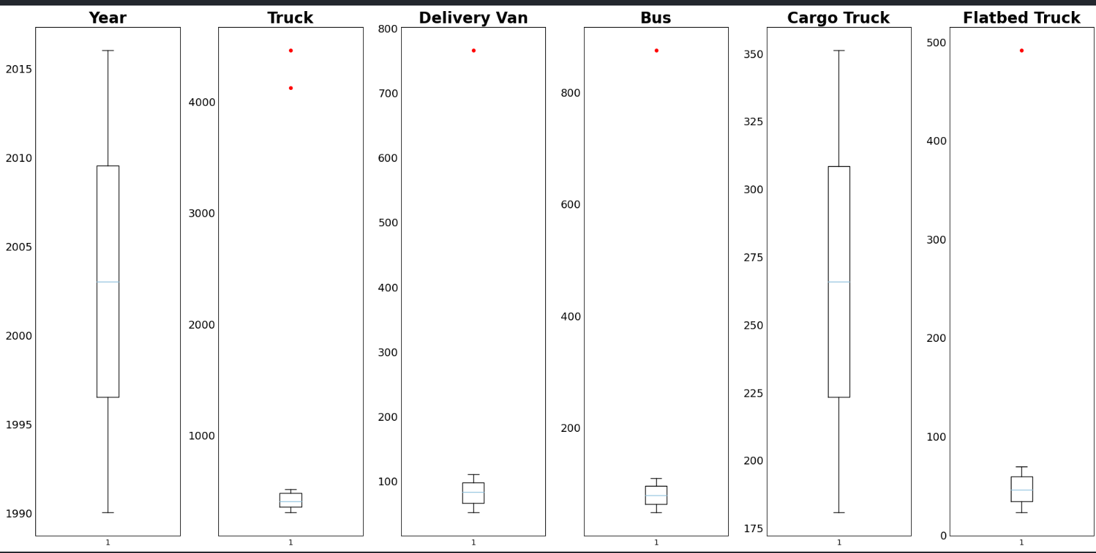
Part 3 (Data Wrangling)
Spotted some outlier in the data so plotted box plot to visualise the red dots show the outliers.

Slide 15
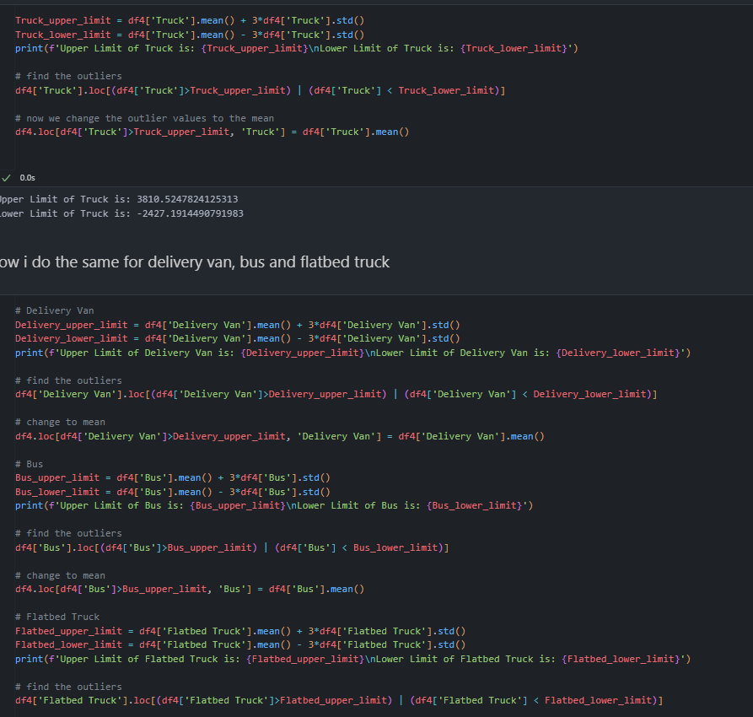
Part 3 (Data Wrangling)
Used z score to find upper limit and lower limit then if data falls above or below the limits selects them and converts them to mean of the column

Slide 16
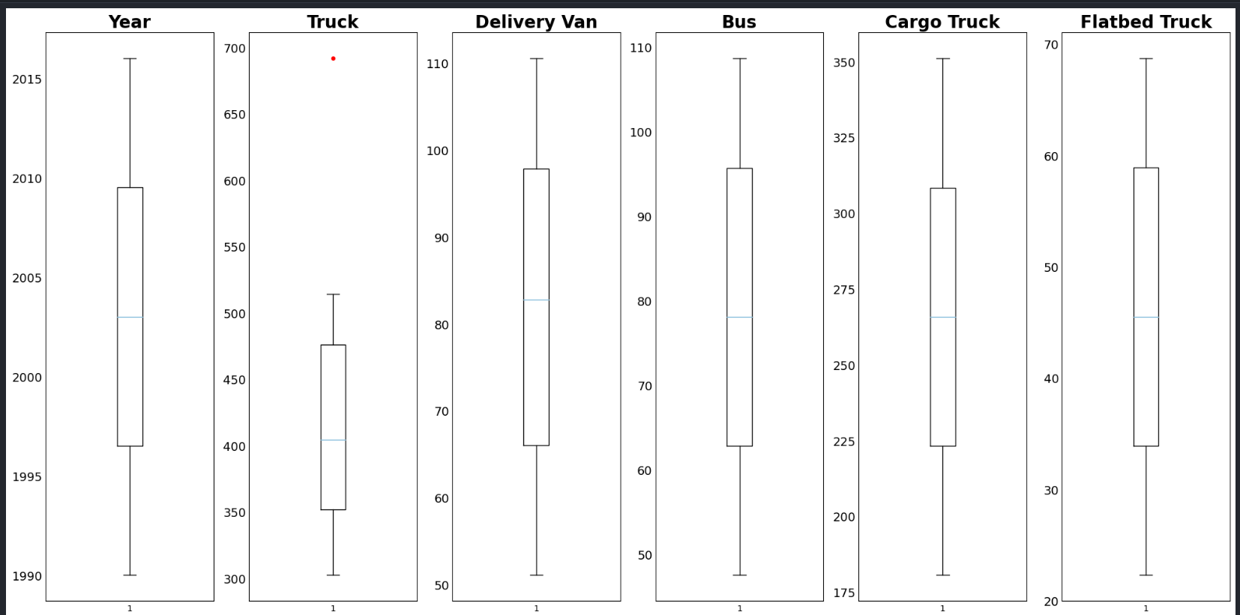
Part 3 (Data Wrangling)
Replot box plot can see improved data as almost all outliers were reduced

Slide 17
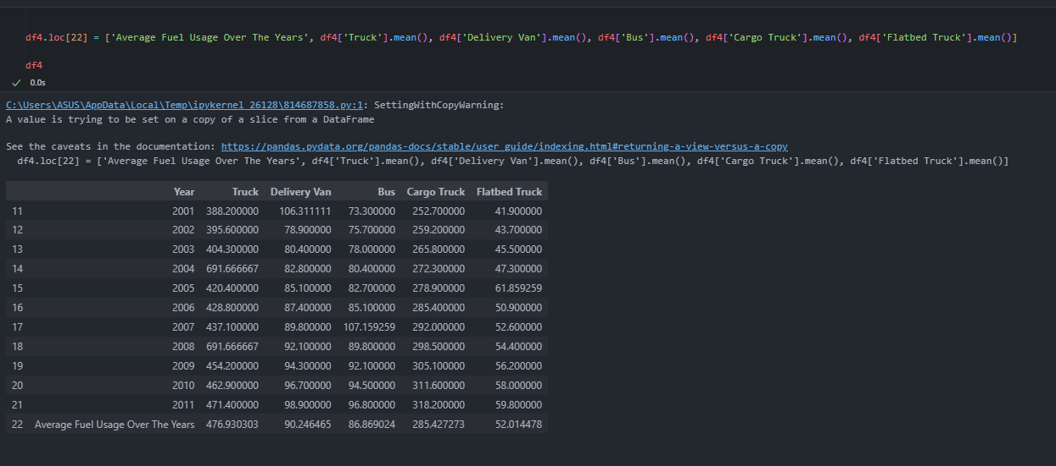
Part 3 (Data Wrangling)
Created new row for average fuel use over the years

Slide 18
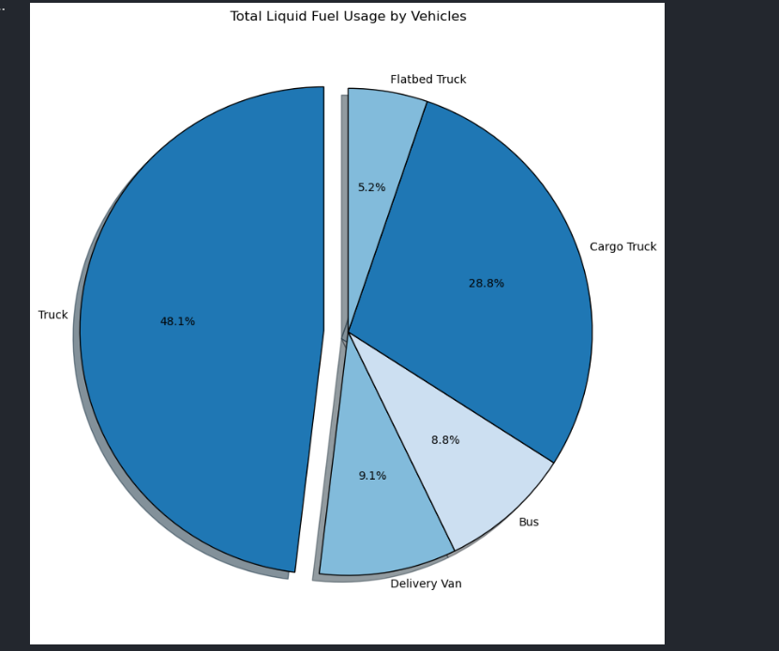
Part 3 (Exploratory Data analysis)
Created pie chart and exploded region of the highest percentage if liquid fuel usage
Conclusion: Mr Tan concludes from the pie chart that the mode of transport that uses the most liquid fuel is the truck

Slide 19
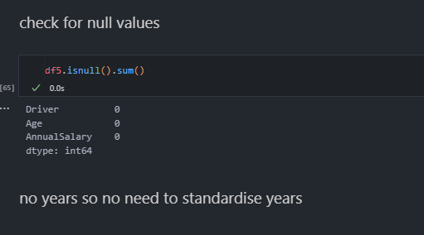
Part 4 (Data wrangling)
Mr Tan wants to tax truck drivers as a way to discourage trucks as a mode of transport but he wants to find a reasonable tax rate
Used.isnull().sum() to check if there are any missing data

Slide 20
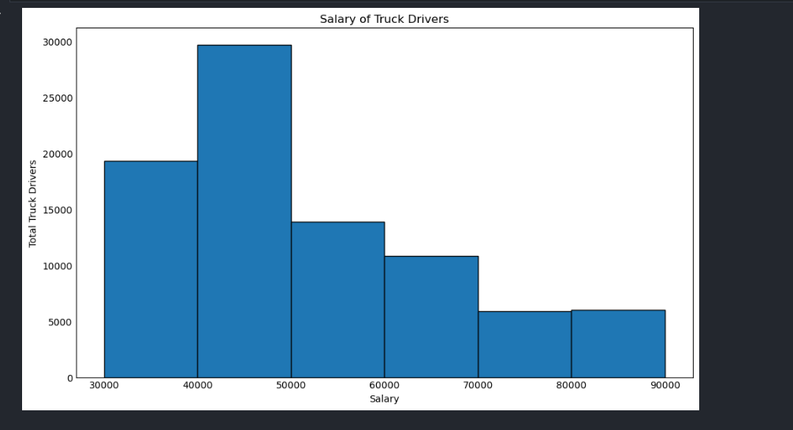
Part 4 (exploratory data analysis)
Used a histogram to see which range of salary has the highest disdribution
Conclusion: Mr Tan concluded from the histogram that around $45000 is the highest distribution of annual salary hence it would be appropriate to charge 10% of $45000 as the addition tax truck drivers will have to pay. This would discourage the transport mode of trucks, hence reduce the amount of fuel used by trucks, therefore reducing the amount of particulate matter 2.5 released into the air by incomplete combustion of liquid fuel. Overall This would in the long run reduce the amount of pm 2.5 in the air.

