Slide 1
PHASE 1 · PROJECT PROPOSAL & DATA PREPARATION
Machine Learning-Based Stock Market Trend Analysis
and Momentum Breakout Prediction
Using S&P 500 Historical Data (2016–2026)
Saurabh Madhesia
24BDS1082
Guided by : Dr. Vijayalakshmi A
School of Computer Science and Engineering, VIT Chennai
Notes:
Good [morning/afternoon]. This is Phase 1 of my project on Machine Learning-Based Stock Market Trend Analysis and Momentum Breakout Prediction, using ten years of S&P 500 historical data.

Slide 2
Problem Statement
Stock prices alternate between quiet consolidation and sharp momentum breakouts — moves above a resistance level, confirmed by a surge in trading volume. Detecting these early is highly valuable, but today it relies almost entirely on manual technical analysis.
1
2
3
4
Subjective
Not Scalable
False Signals
Inconsistent
Two analysts reading the same chart reach different conclusions.
A human can realistically track only a handful of the S&P 500's 500 stocks.
Rule-based screeners fire on brief crosses that quickly reverse.
Fatigue and bias affect judgment quality over time.
This project builds the foundational data pipeline for an ML system that replaces manual chart-reading with a quantitative, auditable breakout-detection framework.
ML-Based Stock Trend & Momentum Breakout Prediction — Phase 1
2
Notes:
Stock prices move between quiet periods and sudden momentum breakouts. Detecting these today relies on manual chart analysis, which is subjective, doesn't scale across hundreds of stocks, and produces inconsistent, error-prone signals. This project builds a data pipeline to replace that with a quantitative approach.

Slide 3
Objectives
PRIMARY OBJECTIVE
Design a machine-learning-ready pipeline that transforms raw S&P 500 price data into engineered features and a quantitative momentum-breakout target label.
1. Historical Data Acquisition — 10 yrs, 50 companies via yfinance
5. Exploratory Data Analysis — trends, sectors, distributions
2. Data Cleaning & Preprocessing — missing values, duplicates, formats
6. ML-Ready Dataset Preparation — encoding + normalization
3. Technical Indicator Generation — SMA, EMA, RSI, Momentum, Volatility
7. Foundation for Predictive Modelling — Phase 2 algorithm comparison
4. Rule-Based Breakout Labelling — 20-day high + volume confirmation
8. Interactive Decision Support Dashboard — Phase 3 visualization
ML-Based Stock Trend & Momentum Breakout Prediction — Phase 1
3
Notes:
The primary objective is a full ML-ready pipeline covering eight steps: acquiring data, cleaning it, engineering technical indicators, defining a rule-based breakout label, exploratory analysis, preparing the dataset, and laying groundwork for Phase 2 modelling and a Phase 3 dashboard.

Slide 4
Dataset Identification
Sources evaluated before selecting a primary data provider
Source | Advantages | Limitations | Decision
Yahoo Finance | Free, extensive history, daily updates, easy Python integration | Minor missing values for some tickers | Selected
Alpha Vantage | High-quality API, technical indicators built in | Free tier has strict request limits | Rejected
Twelve Data | Modern API, multiple asset classes | Limited requests in free version | Rejected
Kaggle Datasets | Ready-to-use CSV files | Static, not continuously updated | Deferred
Polygon.io | Institutional-quality, real-time feeds | Paid subscription required | Rejected
Yahoo Finance (via the yfinance Python API) satisfied every selection criterion — free academic access, daily OHLCV granularity, ten-year depth, and full reproducibility — making it the primary data source for this project.
ML-Based Stock Trend & Momentum Breakout Prediction — Phase 1
4
Notes:
For data, I evaluated five sources. Yahoo Finance, accessed through the yfinance API, was selected — it's free, reliable, updates daily, and integrates directly with Python. Alternatives like Alpha Vantage and Twelve Data had restrictive rate limits, and Polygon required a paid subscription.

Slide 5
Why This Dataset?
Justification for the selected primary data source
A
B
Domain Realism
Sector Diversity
Authentic market data shaped by real earnings, sentiment, and macro events — not synthetic or simulated prices.
50 companies span 10 GICS sectors, reducing bias toward any single industry's volatility regime.
C
D
Temporal Coverage
Accessibility & Scale
10-year window spans pre-pandemic calm, the 2020 crash, 2022 rate-hike correction, and the 2023-26 AI rally.
Free, unrestricted, reproducible via script — the same pipeline scales to the full 500-stock index.
ML-Based Stock Trend & Momentum Breakout Prediction — Phase 1
5
Notes:
The choice is justified on four fronts: the data reflects real market behaviour, not simulation; fifty companies across ten sectors reduce bias toward any one industry; the ten-year window spans multiple market regimes including COVID and the AI rally; and the whole pipeline is free and fully reproducible.

Slide 6
Dataset at a Glance
50
10
10 yrs
~132,500
Companies
(S&P 500 constituents)
GICS Sectors
covered
2016 – 2026
daily history
Total raw
trading records
Raw fields: Date · Ticker · Open · High · Low · Close · Adjusted Close · Volume (8 raw variables per record)
Sectors: Technology · Finance · Healthcare · Energy · Consumer · Industrials · Materials · Utilities · Real Estate · Communication
ML-Based Stock Trend & Momentum Breakout Prediction — Phase 1
6
Notes:
In numbers: fifty companies, ten sectors, ten years, roughly one hundred thirty-two thousand five hundred raw trading records, each with eight core OHLCV fields.

Slide 7
Literature Review
Five recent (2023–2025) studies grounding this project's methodology · Part 1 of 2
Hu, Zhang & Li (2023)
Finding: No single model dominates; feature engineering + technical indicators drive accuracy gains.
Machine Learning Techniques for Stock Market Prediction: A Comprehensive Survey
Gap: Focuses on price/return forecasting — not momentum breakout classification.
Kim, Lee & Park (2024)
Finding: LSTM captures long-term temporal dependencies, outperforming regression baselines.
Deep Learning-Based Financial Time Series Forecasting Using LSTM Networks
Gap: Predicts price, not breakout events; doesn't use volume as confirmation.
Patel, Sharma & Gupta (2023)
Finding: RSI + MACD + Moving Averages markedly improve classifier accuracy; ensembles win.
Technical Indicator-Based ML Framework for Stock Trend Prediction
Gap: Narrow indicator set; no momentum/volatility/volume-confirmation feature stack.
ML-Based Stock Trend & Momentum Breakout Prediction — Phase 1
7
Notes:
I reviewed five recent papers to ground this methodology. Hu et al.'s survey found no single model dominates — feature engineering matters most. Kim et al. showed LSTMs capture long-term dependencies well. Patel et al. confirmed that RSI, MACD and moving averages meaningfully boost classifier accuracy.

Slide 8
Literature Review
Part 2 of 2 · plus synthesis of common threads
Wang, Chen & Zhao (2025)
Finding: Volume, moving averages & momentum are the most influential features (via XAI feature-importance).
Explainable AI for Financial Market Prediction
Gap: Interprets models rather than building a full acquisition-to-prediction pipeline.
Singh, Kumar & Mehta (2024)
Finding: Ensemble methods (RF, Gradient Boosting) consistently beat single classifiers.
Comparative Analysis of ML Algorithms for Financial Market Classification
Gap: Uses predefined datasets — no automated acquisition or breakout-specific labelling.
SYNTHESIS
Across all five studies: technical indicators remain the dominant feature family; ensemble/deep models are the standard comparators; and rule-based event labelling (rather than pure price regression) is a validated way to frame breakout detection — the approach this project adopts.
ML-Based Stock Trend & Momentum Breakout Prediction — Phase 1
8
Notes:
Wang et al. used explainable AI to show volume and momentum are the most influential features — directly shaping my feature choices. Singh et al. confirmed ensemble methods outperform single classifiers. Across all five, the common thread is: technical indicators still dominate, and rule-based event labelling — like a breakout flag — is a validated way to frame this as classification, which is exactly the approach I took.

Slide 9
Dataset Understanding
Raw OHLCV structure — one row per company per trading day
Field | Description | Research Relevance
Date | Trading date | Maintains chronological order for time-series analysis
Ticker | Company stock symbol | Identifies individual companies
Open | Opening market price | Measures daily market sentiment at open
High / Low | Intraday high / low price | Captures buying / selling pressure extremes
Close | Final trading price | Most commonly used variable for trend analysis
Adj Close | Close adjusted for splits/dividends | Provides consistent long-term price history
Volume | Shares traded | Measures participation; confirms breakout strength
ML-Based Stock Trend & Momentum Breakout Prediction — Phase 1
9
Notes:
The raw dataset is a simple OHLCV structure — one row per company per trading day, with Date, Ticker, Open, High, Low, Close, Adjusted Close and Volume.

Slide 10
Engineered Technical Features
Derived from raw OHLCV to capture trend, momentum & volatility
Daily Return
SMA-20 / SMA-50
% change in close, day-over-day
20 & 50-day moving averages — long-term trend
EMA-20
RSI-14
Exponential MA — reacts faster to recent moves
Momentum oscillator — overbought/oversold zones
Rolling Volatility
Momentum
20-day std. dev. of returns — market uncertainty
Price change over trailing N days
Rolling High (20)
Rolling Avg Volume
Dynamic resistance level for breakout detection
Baseline volume to detect abnormal spikes
Volume Ratio
Breakout Label
Today's volume ÷ 20-day average volume
Target: price > 20-day high AND volume > 1.5× avg
ML-Based Stock Trend & Momentum Breakout Prediction — Phase 1
10
Notes:
From those raw fields I engineered ten features: returns, moving averages, RSI, rolling volatility, momentum, a rolling high as dynamic resistance, rolling average volume, a volume ratio, and the breakout label — triggered when price closes above the twenty-day high on volume at least one-point-five times average.

Slide 11
Data Preprocessing Pipeline
Five-stage workflow from raw download to model-ready dataset
1
2
3
4
5
Missing Value Audit
Duplicate Detection
Data Type Conversion
Categorical Encoding
Normalization & Outliers
Column-wise null check; forward/backward-fill within each ticker where needed
Unique-key check on (Date, Ticker); duplicates removed, records sorted chronologically
Date → datetime, Ticker → categorical, price/volume → numeric
Ticker & Sector encoded (one-hot / label) for ML compatibility
Min-Max scaling for price/volume; Z-score for indicators; genuine market extremes retained, not deleted
→
→
→
→
Non-trading days (weekends/holidays) are not treated as missing data — markets are simply closed.
ML-Based Stock Trend & Momentum Breakout Prediction — Phase 1
11
Notes:
Preprocessing was a five-stage pipeline: audit and handle missing values, remove duplicates, convert data types, encode categorical fields like ticker and sector, and finally normalize — Min-Max scaling for price and volume, Z-score for the indicators — while deliberately keeping genuine market extremes rather than deleting them as outliers.

Slide 12
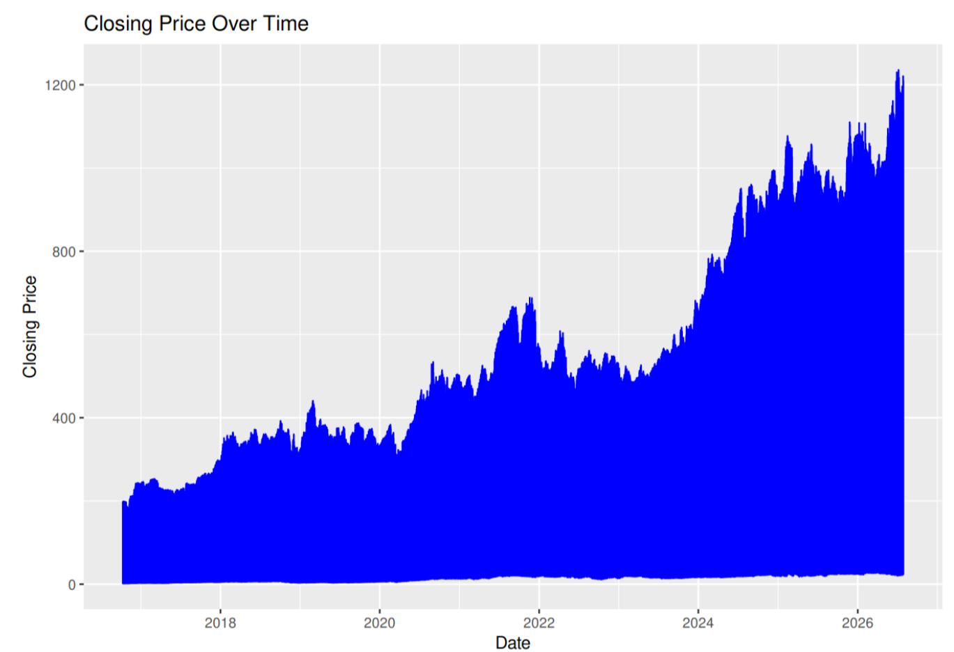
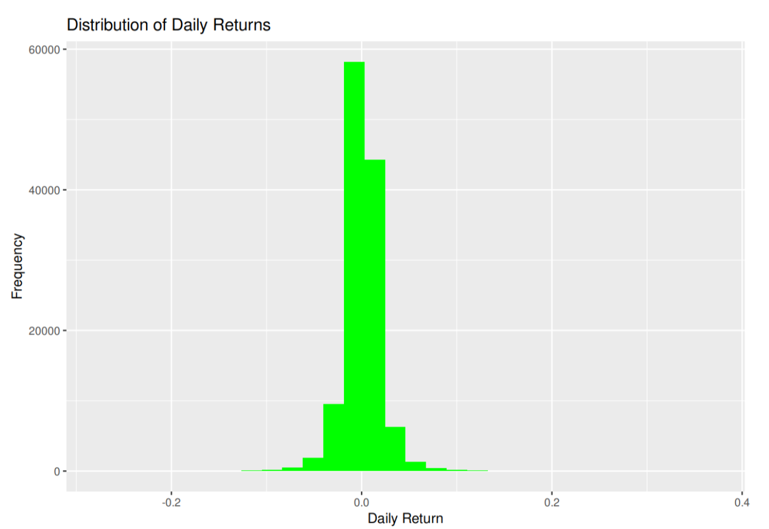
Exploratory Data Analysis
Built in RStudio with ggplot2 & corrplot · Visualizations 1–2
1. Closing Price Over Time
2. Distribution of Daily Returns
📷 Insert screenshot / graph here
📷 Insert screenshot / graph here
Line chart — Closing price trend, full 10-year window
Histogram — Daily_Return frequency distribution
Long-term upward trend with visible corrections and recovery phases.
Returns cluster tightly around zero — small daily moves are far more common than large swings.
ML-Based Stock Trend & Momentum Breakout Prediction — Phase 1
12
Notes:
For exploratory analysis in R, I visualized closing price over time, which shows the long-term upward trend, and the distribution of daily returns, which clusters tightly around zero as expected.

Slide 13
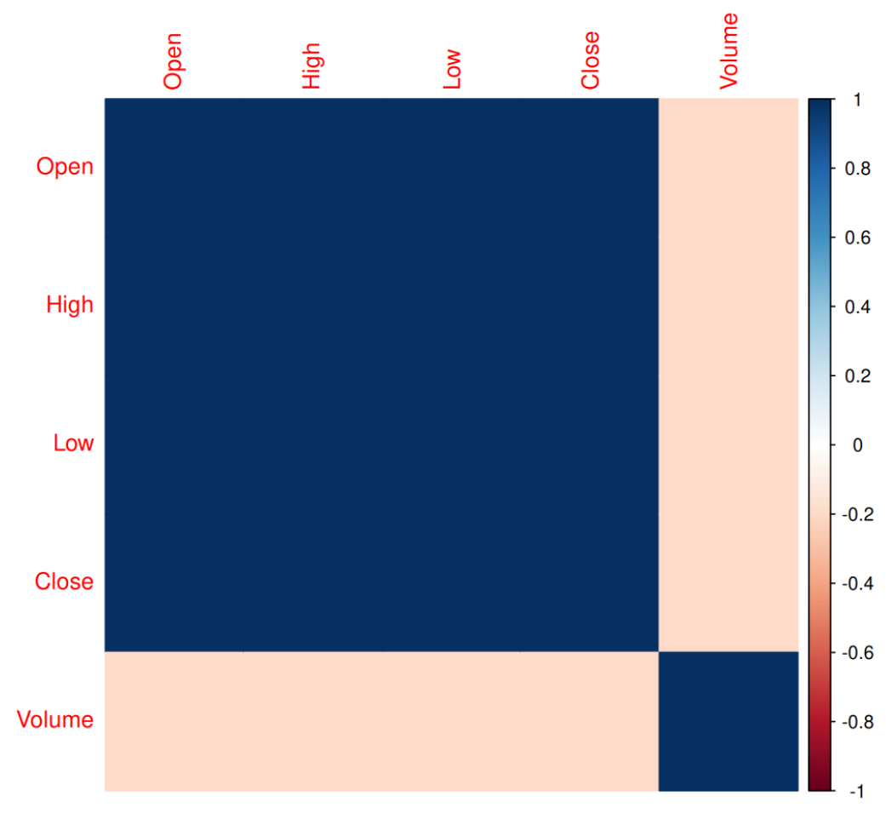
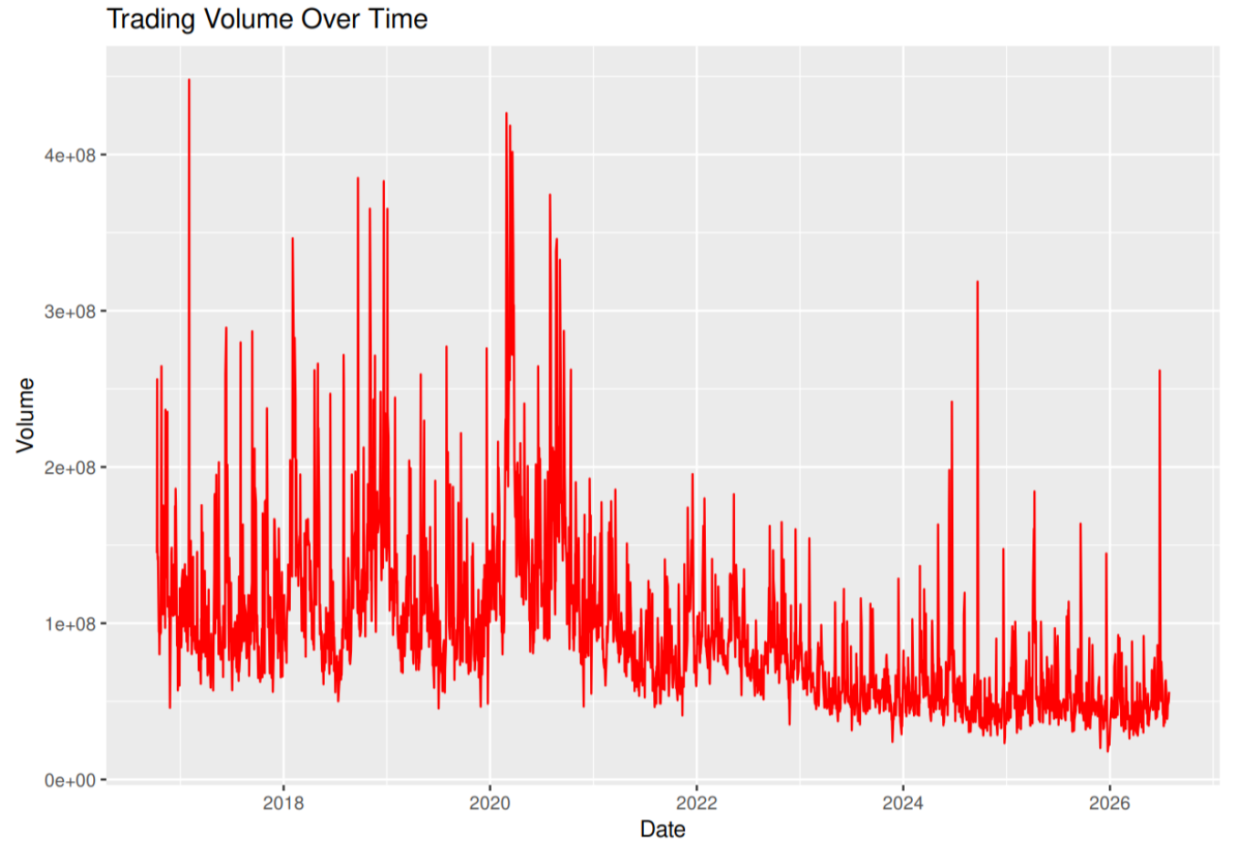
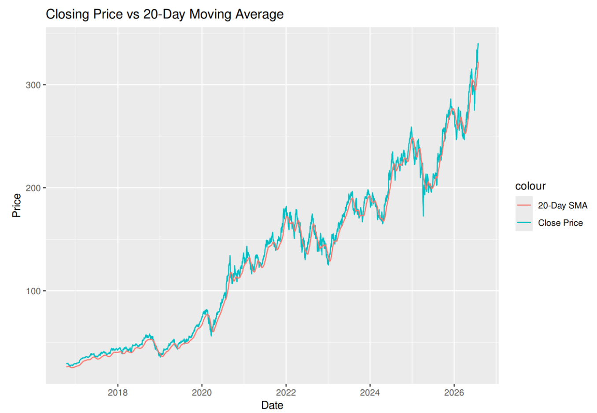
Exploratory Data Analysis
Visualizations 3–5
3. Trading Volume Over Time
4. Correlation Heatmap
5. Close vs 20-Day SMA
📷 Insert screenshot / graph here
📷 Insert screenshot / graph here
📷 Insert screenshot / graph here
Insert R plot output
Insert R plot output
Insert R plot output
Volume spikes align with major market events
Open/High/Low/Close strongly correlated; Volume weaker
SMA smooths noise, confirms underlying trend direction
ML-Based Stock Trend & Momentum Breakout Prediction — Phase 1
13
Notes:
I also examined trading volume over time, which spikes around major market events; a correlation heatmap showing price fields are highly correlated while volume is more independent; and closing price against its twenty-day moving average, confirming the SMA smooths noise while tracking the underlying trend.

Slide 14
Summary & Next Steps
This phase delivered a clean, well-justified, diverse dataset — 50 S&P 500 stocks across 10 sectors, 10 years of daily history — with literature-grounded technical indicators and a quantitative momentum-breakout target label, validated through exploratory analysis.
Final Dataset: 123,150 rows × 45 columns — normalized, encoded, model-ready
PHASE 2 · MODEL BUILDING
Random Forest
XGBoost
SVM
LSTM
Predicting the Breakout and Trend_Binary target labels defined in this phase.
ML-Based Stock Trend & Momentum Breakout Prediction — Phase 1
14
Notes:
To summarize: this phase produced a clean, diverse, literature-grounded dataset of one hundred twenty-three thousand one hundred fifty rows across forty-five columns, fully normalized and encoded. Phase 2 will train and compare Random Forest, XGBoost, SVM and LSTM models to predict the breakout and trend labels defined here. Thank you.

Slide 15


