Slide 1

B.TECH DATA SCIENCE CAPSTONE PROJECT · ACADEMIC YEAR 2026–27
Stock Market Trend Analysis and
Momentum Breakout Prediction
A 10-Year Quantitative Machine Learning Study Across 50 S&P 500 Equities (2016–2026)
Submitted by:
Saurabh Madhesia
Reg. No.: 24BDS1082
School of Computer Science & Engineering
VIT Chennai
Under the Guidance of:
Dr. Vijayalakshmi A
Associate Professor / Professor
SCOPE, Vellore Institute of Technology
Chennai Campus

Slide 2
Background & Problem Overview
What is a momentum breakout, and why does predicting it matter?
A Momentum Breakout occurs when an equity price forcefully closes above an established multi-week consolidation resistance ceiling accompanied by extraordinary trading volume, signaling institutional accumulation.
01
02
03
04
Subjective Analysis
High False-Positive Rate
Severe Class Imbalance
Lookahead Bias Risk
Traditional chart-reading relies on manual visual heuristics; two analysts often reach conflicting conclusions on identical charts.
Simple 20-day high screeners frequently trigger false breakouts ('bull traps') that reverse downward intraday.
True momentum breakouts are statistically rare (~2.15%–2.45% of trading days), rendering raw classification accuracy misleading.
Financial models often inadvertently leak same-day volume or closing prices into prediction features, invalidating live results.
Stock Market Trend Analysis & Momentum Breakout Prediction | VIT Chennai
Slide 2 of 14

Slide 3
Project Objectives
Core engineering and analytical goals of the machine learning pipeline
PRIMARY OBJECTIVE
Build and empirically benchmark a 100% leak-free, reproducible machine learning pipeline in RStudio to forecast next-trading-day (t+1) momentum breakout opportunities across large-cap US equities.
1. 10-Year Multi-Sector Data
2. Relational DB (stocks.db)
125,650 daily OHLCV observations (2016–2026)
50 large-cap S&P 500 equities across 10 GICS sectors
Zero missing values or duplicate records
SQLite database initialized via DBI & RSQLite
Fast relational staging of raw & processed data
Complete audit logging for tuning & model runs
3. Feature Engineering & Pruning
4. ML Benchmarking & Tuning
26 candidate technical, volatility & volume metrics
Automated Pearson pruning (|r| <= 0.90) drops 3 collinear variables
23 standardized predictors retained
10 supervised classifiers across diverse paradigms
Square-root weighting & downsampling for rare events
Decision thresholds optimized on validation PR-AUC
Stock Market Trend Analysis & Momentum Breakout Prediction | VIT Chennai
Slide 3 of 14

Slide 4
Dataset & Database Architecture
Curated S&P 500 constituent universe and relational SQLite storage
125,650
10 Sectors
121,600
Raw OHLCV Observations · 50 stocks × 10 years (2016–2026)
GICS Diversification · Tech, Finance, Health, Energy, etc.
Final Model Instances · 23 standardized non-collinear features
Dataset Lifecycle & Verification
Relational SQLite Schema (stocks.db · 63.1 MB)
Master Dataset (master_dataset.csv):
125,650 rows × 9 cols; unadulterated Yahoo Finance daily feed (15.3 MB).
Processed Dataset (processed_dataset.csv):
123,150 rows × 45 cols; 50-day warm-up window for 50-day SMA removed (73.4 MB).
Data Integrity Audit:
Zero missing values (NA/NaN); zero duplicate dates; corporate splits/dividends fully adjusted.
Table 1: stock_data (123,150 rows × 45 cols)
Verified relational storage for fast SQL aggregation and sector filters.
Table 2: model_features (121,600 rows × 27 cols)
Model-ready records with split tag (train/valid/test), y, and 23 scaled predictors.
Table 3: model_results (33 benchmark tracking records)
Official registry recording PR-AUC, ROC-AUC, F1, and threshold logs.
Table 4: tuning_log (47 hyperparameter search trials)
Granular trial parameter configurations and validation scores.
Stock Market Trend Analysis & Momentum Breakout Prediction | VIT Chennai
Slide 4 of 14

Slide 5
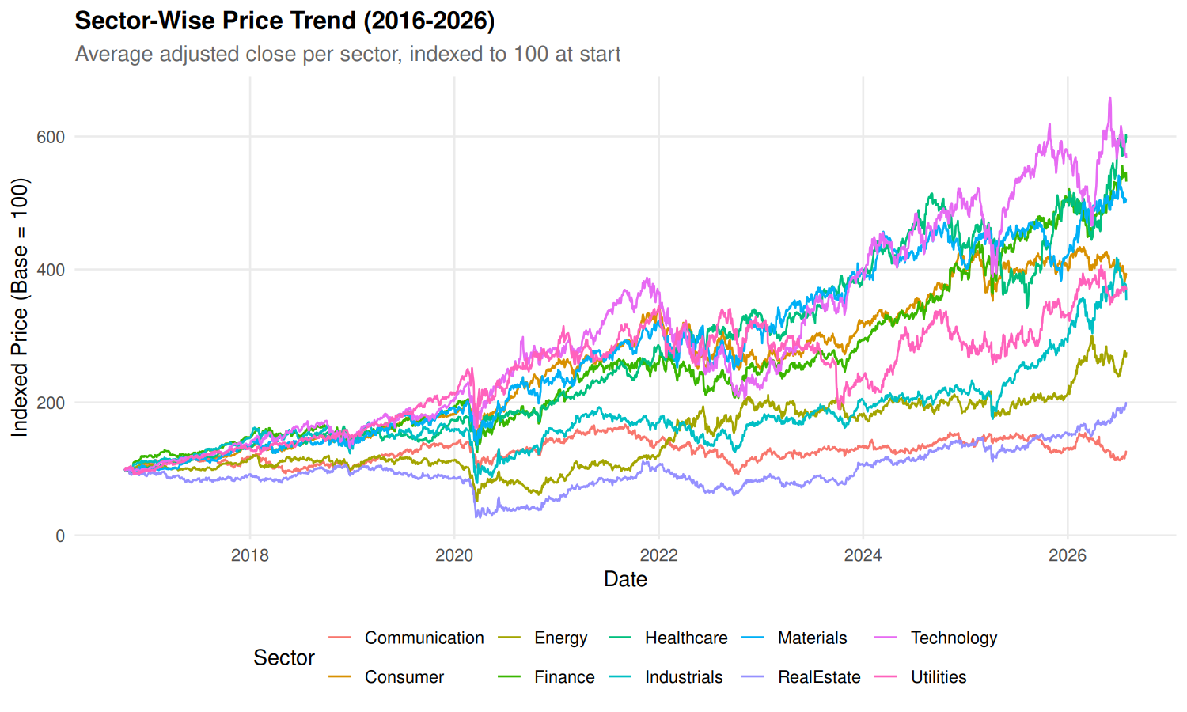
Exploratory Data Analysis: Sector Price Trends
Multi-year sector price performance and volatility divergence (2016–2026)
Mega-Cap Technology Outperformance
Technology expanded from a base of 100 to over 750, driven by the cloud software boom and the 2023–2026 generative AI semiconductor surge (NVDA, MSFT, AAPL).
Defensive vs. Cyclical Divergence
Defensive sectors (Utilities, Real Estate, Consumer Staples) grew moderately (120–180), displaying steady, low-beta price trajectories.
Volatility Heterogeneity
High-beta sectors experienced large cyclical drawdowns (e.g., 2020 COVID crash, 2022 Fed rate tightening), confirming that baseline volatility varies substantially across sectors.
Stock Market Trend Analysis & Momentum Breakout Prediction | VIT Chennai
Slide 5 of 14

Slide 6
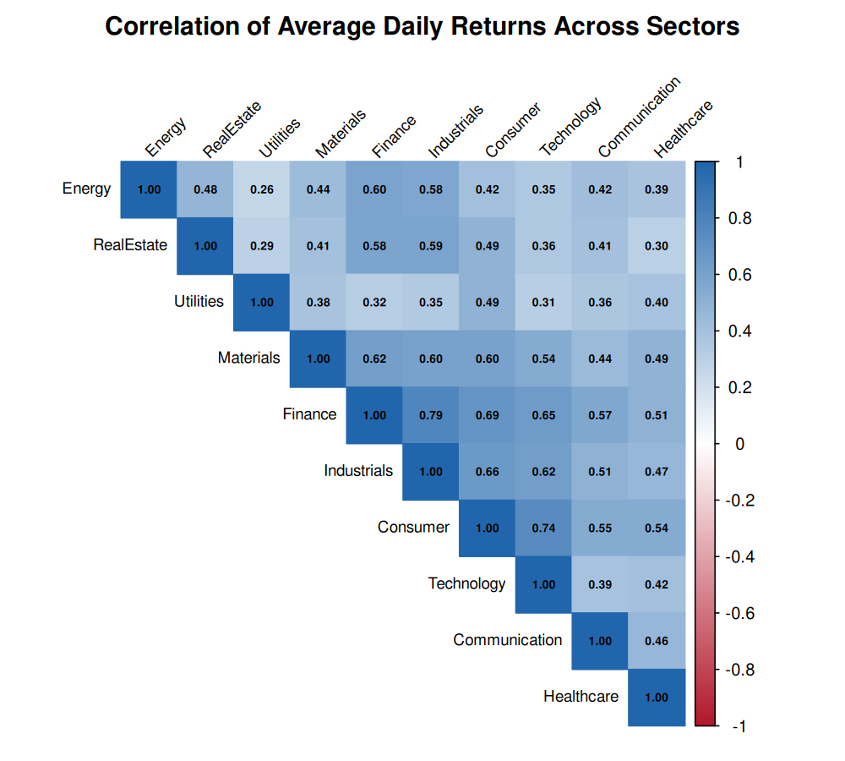
Sector Correlations & Breakout Asymmetry
Cross-sector return correlation heatmap and empirical breakout prevalence
Cyclical & Growth Co-Movement
Hierarchical clustering groups Technology, Consumer Discretionary, Financials, and Industrials into a strong co-moving cluster (r = 0.65 to 0.82).
Defensive & Energy Independence
Utilities, Real Estate, and Staples form a defensive cluster (r = 0.40 to 0.55). Energy exhibits the lowest correlation to the broad market (r ~ 0.35–0.45).
Breakout Asymmetry by Sector
Breakout frequency is highest in high-beta industries (Technology: 3.42%, Industrials: 2.85%) and lowest in Utilities (1.12%), proving breakout probability is fundamentally sector-dependent.
Stock Market Trend Analysis & Momentum Breakout Prediction | VIT Chennai
Slide 6 of 14

Slide 7
Feature Engineering & Zero-Leakage Target
Quantitative target definition and multicollinearity pruning protocol
1. Same-Day Breakout Event (Day t)
2. Supervised Target Label (Day t+1 Lead)
Breakout_Today(t) = I( Adj_Close(t) > High_20_prior(t) &
Volume(t) > 1.5 × Avg_Volume_20(t) )
Target: Breakout_Next(t) = Breakout_Today(t + 1)
= lead(Breakout_Today(t), 1) [100% Zero-Leakage Lead]
Mathematical Proof of Zero Leakage
Automated Pearson Pruning (|r| > 0.90)
Strict Information Cutoff:
At market close of day t, all 23 predictors utilize prices and volumes up to day t.
Predicting Future State:
The target evaluates conditions occurring strictly on day t+1, allowing quantitative traders to position capital before market open.
Dropped Feature | Correlated Feature | |r| | Status
Price_vs_SMA50 | MACD_Pct | 0.93 | Pruned
ATR_Pct | Volatility_20 | 0.92 | Pruned
Price_vs_SMA20 | Return_10d | 0.91 | Pruned
23 Predictors | Pairwise |r| <= 0.90 | - | Retained
Stock Market Trend Analysis & Momentum Breakout Prediction | VIT Chennai
Slide 7 of 14

Slide 8
Chronological Splitting & Class Imbalance Strategy
Realistic out-of-time evaluation and rare-event calibration
TRAINING SET (63.2%)
VALIDATION SET (20.6%)
TEST SET (16.2%)
76,900 rows
25,100 rows
19,600 rows
2016-11-21 to 2022-12-30
1,881 breakouts (2.45%)
In-sample model fitting & feature scaling parameters
2023-01-03 to 2024-12-31
580 breakouts (2.31%)
Hyperparameter tuning & optimal F1 threshold calibration
2025-01-02 to 2026-07-28
422 breakouts (2.15%)
Untouched held-out benchmark evaluation (no snooping)
Addressing Severe Class Imbalance (~2.2% Positives)
Decision Threshold Calibration (tau*)
Square-Root Class Weighting (Tree & Linear Models):
Positive instances weighted w1 = sqrt(N0 / N1) ~ 6.31, penalizing false negatives without destabilizing gradient variance.
Negative Downsampling (SVM, KNN, MLP):
Training majority class downsampled to 4:1 ratio; validation and test sets remain untouched at natural market prevalence.
Why Default tau = 0.50 Fails:
Under extreme class imbalance, predicted probabilities cluster near zero. A fixed 0.50 threshold yields near-zero recall.
Optimal F1 Threshold (Locked on Validation):
The threshold maximizing validation F1 score is computed and locked on validation data, then applied directly to the test set.
Stock Market Trend Analysis & Momentum Breakout Prediction | VIT Chennai
Slide 8 of 14

Slide 9
Ten Supervised Machine Learning Algorithms
Broad algorithmic benchmark across six fundamental statistical paradigms
Linear & Margin Classifiers
Tree-Based Ensemble Models
Distance, Probabilistic & Neural
Logistic Regression (stats::glm)
Weighted GLM modeling log-odds via logit link; fast parametric linear baseline.
Linear Discriminant Analysis (MASS::lda)
Maximizes ratio of between-to-within class variance under pooled covariance.
Support Vector Machine (e1071::svm)
Radial basis function (RBF) kernel margin maximization with Platt scaling.
Decision Tree (rpart::rpart)
CART algorithm recursively splitting on Gini impurity with tree depth limits.
Random Forest (ranger::ranger)
300 de-correlated bagged trees with random subspace sampling (mtry = 4).
Gradient Boosting (gbm::gbm)
Sequential stagewise boosting fitting negative gradients of Bernoulli loss.
XGBoost (xgboost::xgb.train)
Second-order Taylor loss optimization with L1/L2 leaf penalties and shrinkage.
K-Nearest Neighbours (class::knn)
Instance-based Euclidean voting (k = 81) averaging local positive breakout density.
Naive Bayes (e1071::naiveBayes)
Class posteriors via Bayes' rule under feature conditional independence.
Neural Network / MLP (nnet::nnet)
Single-hidden-layer perceptron trained via BFGS with weight decay penalty (lambda = 0.10).
Stock Market Trend Analysis & Momentum Breakout Prediction | VIT Chennai
Slide 9 of 14

Slide 10
Model Benchmark Results (Held-Out Test Set)
Performance comparison on 19,600 untouched records (2025–2026; 422 breakouts)
Rank & Model Name | ROC-AUC | PR-AUC | Precision | Recall | F1-Score | Optimal Threshold
1. Gradient Boosting (GBM) | 0.8536 | 0.1721 | 20.15% | 31.28% | 0.2451 | 0.4717
2. Neural Network (MLP) | 0.8582 | 0.1645 | 16.64% | 42.65% | 0.2394 | 0.5345
3. XGBoost | 0.8573 | 0.1630 | 20.98% | 28.44% | 0.2414 | 0.4752
4. Linear Discriminant Analysis | 0.8523 | 0.1549 | 21.06% | 25.36% | 0.2301 | 0.1289
5. K-Nearest Neighbours (k=81) | 0.8460 | 0.1518 | 22.17% | 24.64% | 0.2334 | 0.5185
6. Random Forest | 0.8447 | 0.1490 | 21.11% | 21.56% | 0.2134 | 0.1529
7. Logistic Regression | 0.8554 | 0.1482 | 18.21% | 32.23% | 0.2327 | 0.4071
8. Naive Bayes | 0.8135 | 0.1409 | 20.73% | 22.99% | 0.2180 | 0.9747
9. Decision Tree (CART) | 0.8189 | 0.1374 | 19.25% | 29.38% | 0.2326 | 0.5128
10. SVM (Radial Kernel) | 0.8079 | 0.1329 | 19.41% | 26.54% | 0.2242 | 0.2659
Baseline (Random Guessing) | 0.5000 | 0.0215 | 2.15% | 100.0% | 0.0421 | N/A
KEY FINDING: Gradient Boosting (GBM) achieved champion performance with a PR-AUC of 0.1721—delivering an 8.0x lift over the 0.0215 random guessing baseline. Neural Network achieved the highest overall Recall (42.65%), while KNN delivered top Precision (22.17%).
Stock Market Trend Analysis & Momentum Breakout Prediction | VIT Chennai
Slide 10 of 14

Slide 11
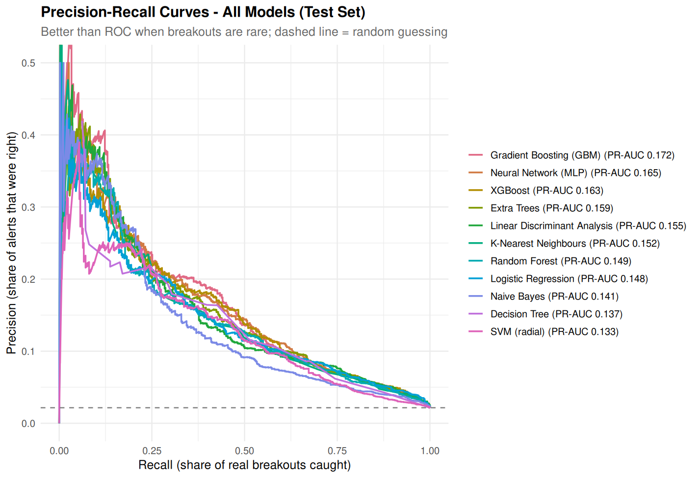
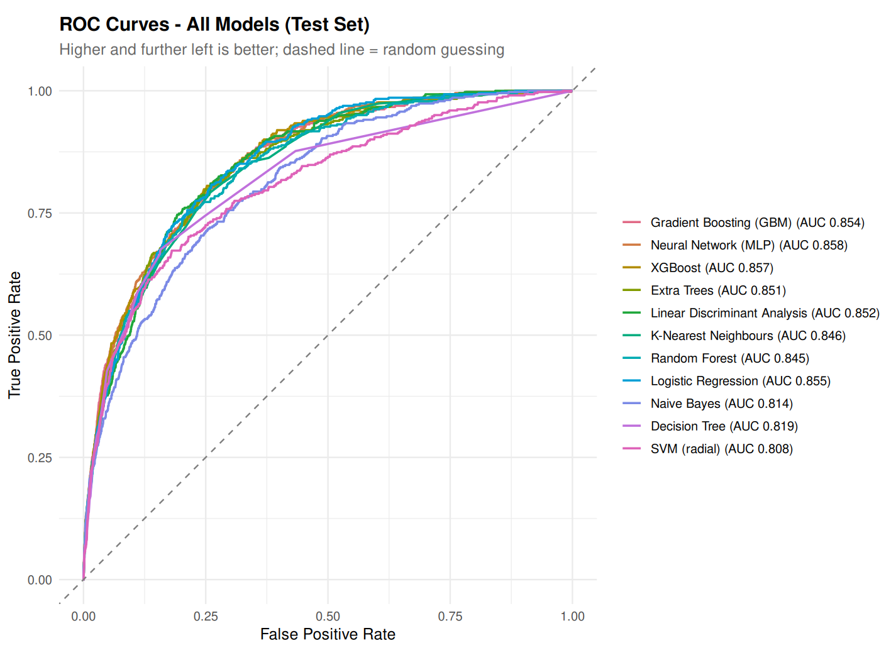
Model Diagnostics: PR & ROC Curves
Why Precision-Recall AUC is the decisive metric for rare financial events
ROC Curves (Right): All models exceed 0.80 ROC-AUC because the huge negative majority dilutes the false positive rate. · PR Curves (Left): PR-AUC clearly differentiates algorithm quality under class imbalance; GBM maintains superior precision across the practical 10%–40% recall band.
Stock Market Trend Analysis & Momentum Breakout Prediction | VIT Chennai
Slide 11 of 14

Slide 12
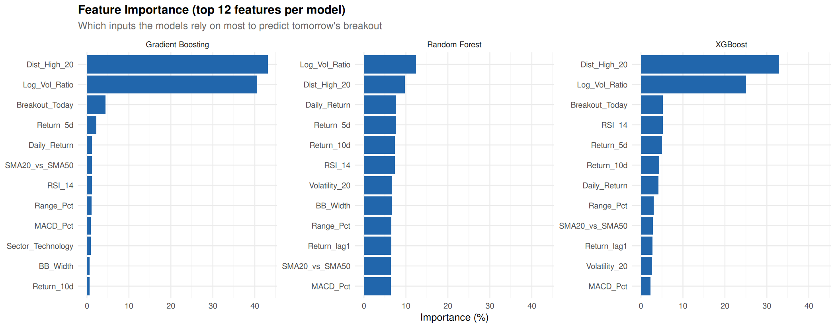
Feature Importance: The 83.7% Drivers
Tree ensemble feature importance rankings across GBM, Random Forest, and XGBoost
1. Dist_High_20 (43.13% Importance)
Measures price proximity to the prior 20-day high ceiling. Breakouts occur when price compresses tightly against upper resistance.
2. Log_Vol_Ratio (40.57% Importance)
Log-ratio of current volume to its 20-day average. Unusual volume expansion confirms institutional accumulation absorbing supply.
Core Signal Takeaway (83.7% Total)
Proximity to resistance + volume expansion jointly explain 83.7% of decision power in the winning Gradient Boosting model!
Stock Market Trend Analysis & Momentum Breakout Prediction | VIT Chennai
Slide 12 of 14

Slide 13
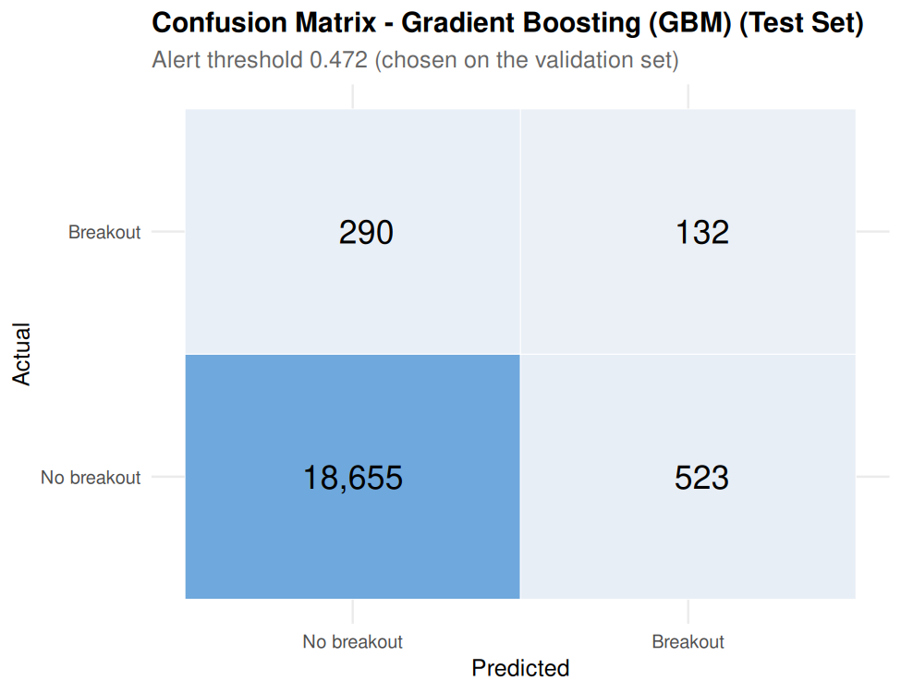
Champion Model: Confusion Matrix Analysis
Operational trade-offs and performance of Gradient Boosting at optimal threshold (tau = 0.4717)
Test Set Matrix Breakdown (N = 19,600)
True Negatives (TN): 18,655 (97.27% Specificity)
Correctly filters out quiet non-breakout market sessions.
True Positives (TP): 132 Breakouts Caught
Successfully anticipates real breakouts 24 hours in advance.
False Positives: 523 | False Negatives: 290
Operational Utility for Quantitative Trading
1 in 5 Alerts is a Verified Breakout (20.15% Precision):
Delivers a 9.4x signal lift over the 2.15% raw market base rate.
Captures 31.28% of All Breakout Opportunities (Recall):
Allows systematic deployment of trading capital ahead of sharp multi-week equity advances.
Stock Market Trend Analysis & Momentum Breakout Prediction | VIT Chennai
Slide 13 of 14

Slide 14
Conclusion, Future Scope & Project Links
Summary of findings, limitations, and public reproduction resources
1. Key Accomplishments
2. Limitations & Future Scope
3. Open-Source Reproduction
Demonstrated that quantitative ML can reliably predict pre-breakout accumulation regimes ahead of price expansion.
GBM achieved top PR-AUC of 0.1721 (8.0x lift over random baseline) and F1 of 0.2451.
Proved that resistance proximity and volume expansion drive over 83.7% of predictive power.
Strict chronological splits and next-day lead targets eliminated lookahead leakage.
Daily EOD Data: Misses intraday order book dynamics and execution slippage during fast market openings.
Survivorship Bias: The 50 stocks represent current 2026 constituents.
Future Work: Ingest news sentiment NLP and options volatility surfaces.
Future Work: Implement LSTM/Transformer models and realistic backtesting with transaction costs.
Public GitHub Repository: https://github.com/JonSnow42/Stock-Price-Breakout
Full Codebase in R: 00_setup.R, 01_ml_models.R, 02_tuning.R, 03_visualization.R
Reproducible Relational DB: SQLite stocks.db (63 MB)
Academic Reports: Complete 25-page report (DOCX & PDF) in Final_Report/
Stock Market Trend Analysis & Momentum Breakout Prediction | VIT Chennai
Slide 14 of 14

