Slide 1
Customed Performance test
Eric/Susan Wu/Chloe Guo
March 8, 2020

Slide 2
Outline
Project Description
Installation Specifics
Implementation Details
Future Work

Slide 3
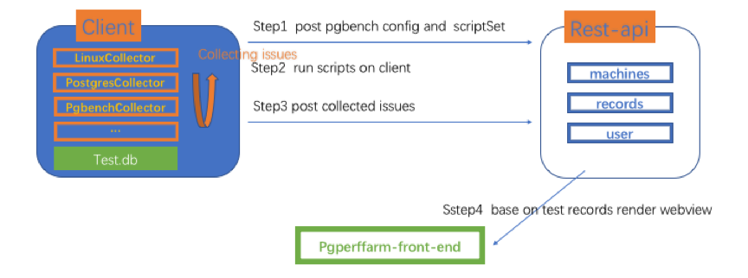
Project Description
To allow users to inject their own performance tests
select parameters
run custom scripts
Fig.1 Design Framework

Slide 4
Installation Specifics
Set the customized parameters(Eric)
Configure custom scripts(Susan)
Run customized performance(All)
upload results to the database(Chloe)

Slide 5
Installation Specifics
Set the customized performance tests parameters
1. Eric？??
configure custom scripts
1. set up custom scripts root folder
2. put some custom sql files under `SCRIPTS_DIR` folder，

Slide 6
Installation Specifics
Run customized performance(All)
1. start service `python3 manage.py runserver`
2. start client `python3 perffarm-client.py`
upload results to the database(Chloe)
the pgbench results and all the sql files under your `SCRIPTS_DIR` gonna automatly save to `pgperffarm-db`

Slide 7
Implementation Details
Client-Set the customized parameters(Eric)
Client-Configure custom scripts(Susan)
Server-upload results to the database(Chloe)
2020/3/7

Slide 8
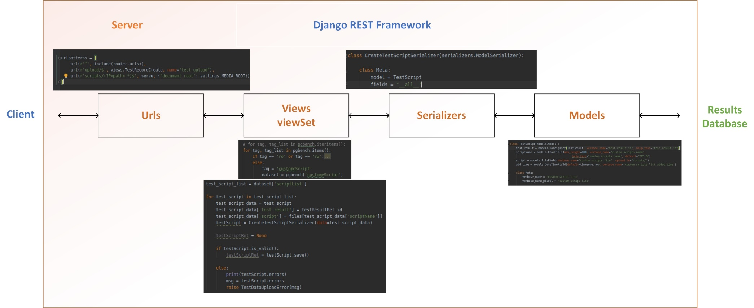
Implementation Details
Server-upload results to the database
add custome scripts and complete the related Django rest framework
2020/3/7

Slide 9
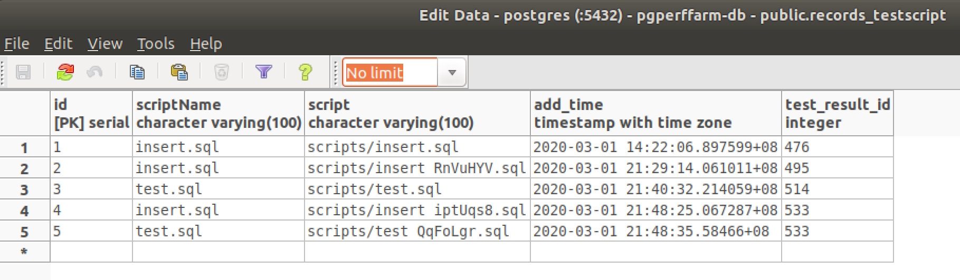
Implementation Details
Server-upload results to the database
Scripts(name, file, and add time) are saved in db.
2020/3/7

Slide 10
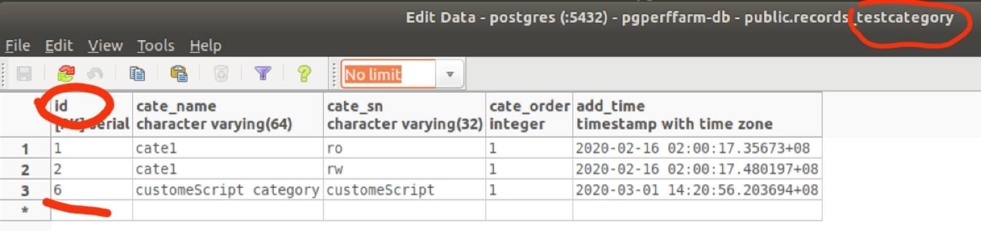
Implementation Details
Server-upload results to the database
add customeScript type in testcategory table in the database
2020/3/7

Slide 11
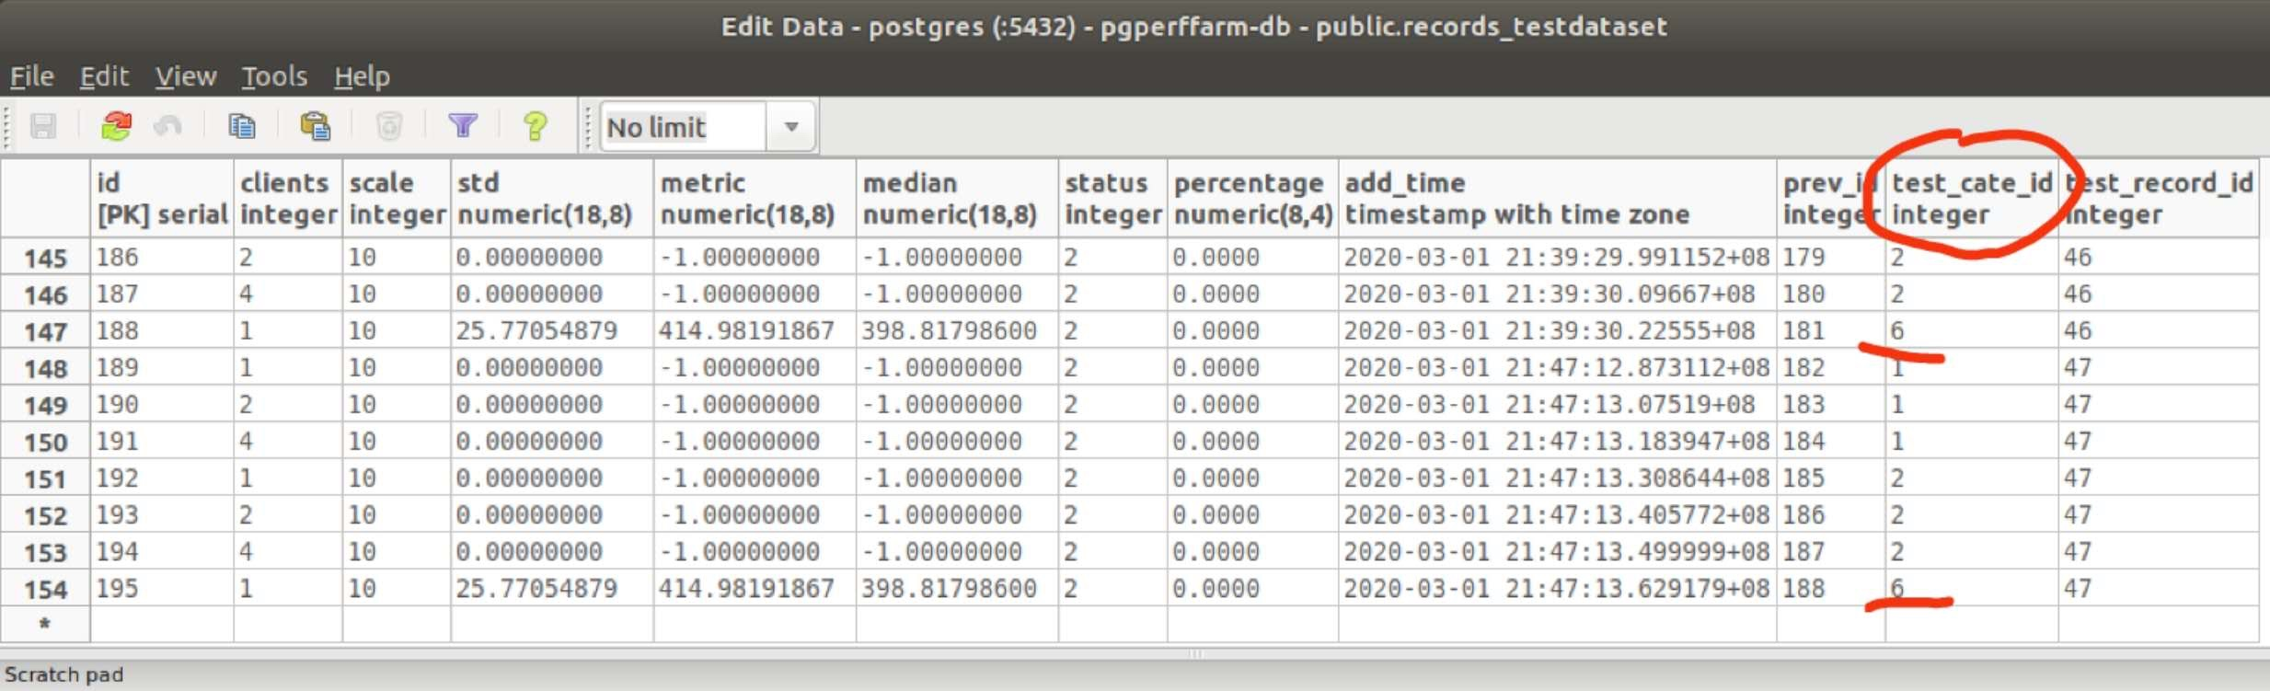
Implementation Details
Server-upload results to the database
upload result in db(6 indicate is a customeScript type)
2020/3/7

Slide 12
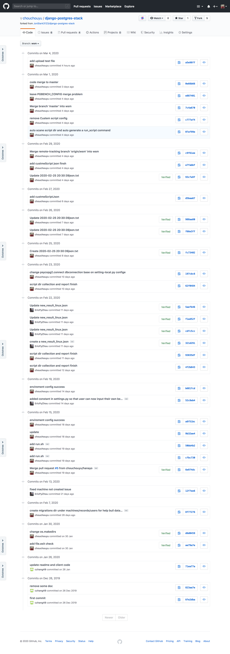
PR Summary

Slide 13
PR Summary

Slide 14
Future Work
add GUI for command line for environment setups

Slide 15
Thank you for your attention!
Any questions ?

