Slide 1
My own PostgreSQL Performance test
Eric/Susan Wu/Chloe Guo
March 8, 2020

Slide 2
Outline
Project Description
Installation Specifics
Implementation Details
PR Summary
Future Work

Slide 3
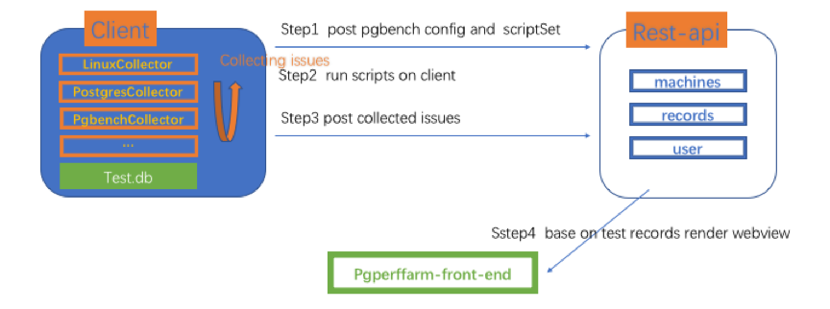
Project Description
To allow users to inject their own performance tests
select parameters
run custom scripts
Fig.1 Design Framework

Slide 4
Installation Specifics
Set the customized parameters(Eric)
Configure custom scripts(Susan)
Run customized performance(All)
upload results to the database(Chloe)

Slide 5
Implementation Details
Client-Set the customized parameters(Eric)
Client-Configure custom scripts(Susan)
Server-upload results to the database(Chloe)
2020/3/7

Slide 6
PR Summary

Slide 7
Future Work

Slide 8
Thank you for your attention!
Any questions ?

