Slide 1
MOCKING IN C++
Pittsburgh C++ Meetup 2020-01
Jonathan Povirk
https://github.com/JonTheBurger/mocking-in-cxx

Slide 2
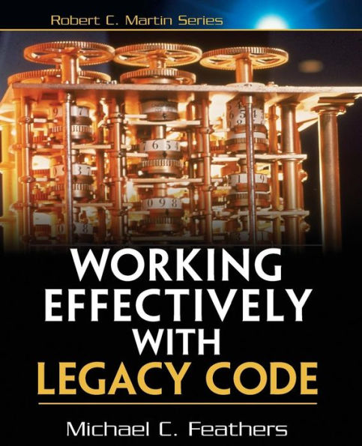
A REVIEW…
Seams – Point that allows you to modify behavior without modifying code
Types:
Object
Preprocessor
Linker
Template?
When?
Runtime
Preprocessor Time
Link Time
Compile Time

Slide 3
AN EXAMPLE…
class Uart {
public:
void read(uint8_t* out, uint32_t size);
};
class Sensor {
public:
Sensor(Uart* uart)
: uart_{ uart }
{
}
int16_t getReading();
private:
Uart* uart_;
};
int16_t Sensor::getReading()
{
int16_t reading;
uart_->read(
reinterpret_cast<uint8_t*>(&reading),
sizeof(reading)
);
return reading;
}

Slide 4
PRODUCTION CODE
int main() {
Uart uart;
Sensor sensor{ &uart };
std::cout << sensor.getReading() << std::endl;
return 0;
}

Slide 5
VIRTUAL DEPENDNECY
class Uart {
public:
virtual ~Uart() = default;
virtual void read(uint8_t *out, uint32_t size);
};
How did we do?
Overhead in production code
Modify existing code
No 3rd party code mocking
Wrappers?
#include "Uart.hpp"
class MockUart : public Uart {
public:
MockUart();
~MockUart() override;
MOCK_METHOD(void, read, (uint8_t * out, uint32_t size), (override));
};

Slide 6
UNIT TEST
TEST(TestSensor, Reading_is_parsed_as_little_endian)
{
using namespace ::testing;
NiceMock<MockUart> uart;
Sensor sensor{ &uart };
ON_CALL(uart, read(_, 2))
.WillByDefault(Invoke([](uint8_t* buf, uint32_t size) {
(void)size;
buf[0] = 0x34;
buf[1] = 0x12;
})
);
ASSERT_EQ(0x1234, sensor.getReading());
}

Slide 7
TEST VIRTUAL
#pragma once
#if TESTING
# define TEST_VIRTUAL virtual
#else
# define TEST_VIRTUAL
#endif
How did we do?
Compile definition
2 types of Uart
Modify existing code
A hack only a mother could love
No 3rd party code mocking
Wrappers…
#include "TestVirtual.hpp"
class Uart {
public:
TEST_VIRTUAL ~Uart() = default;
TEST_VIRTUAL void read(uint8_t* out, uint32_t size);
};

Slide 8
TEMPLATE
How did we do?
Compile times?
Error messages?
Modify existing code
Mock 3rd party code!
2 types of Sensor
template <typename TUart = Uart>
class Sensor {
public:
Sensor(TUart* uart)
: uart_{ uart }
{
}
int16_t getReading() {
int16_t reading;
uart_->read(reinterpret_cast<uint8_t*>(&reading), sizeof(reading));
return reading;
}
private:
TUart* uart_;
};

Slide 9
UNIT TEST WITH TEMPLATE
TEST(TestSensor, Reading_is_parsed_as_little_endian)
{
using namespace ::testing;
NiceMock<MockUart> uart;
Sensor<MockUart> sensor{ &uart };
ON_CALL(uart, read(_, 2))
.WillByDefault(Invoke([](uint8_t* buf, uint32_t size) {
(void)size;
buf[0] = 0x34;
buf[1] = 0x12;
})
);
ASSERT_EQ(0x1234, sensor.getReading());
}

Slide 10
EXTERN TEMPLATE
// .hpp
template <typename TUart = Uart>
class Sensor {
public:
Sensor(TUart* uart)
: uart_{ uart }
{
}
int16_t getReading();
private:
TUart* uart_;
};
// .tpp
#include "Sensor.hpp"
template <typename T>
int16_t Sensor<T>::getReading()
{
int16_t reading;
uart_->read(
reinterpret_cast<uint8_t*>(&reading),
sizeof(reading)
);
return reading;
}
// .cpp
#include "Sensor.hpp" #include "Sensor.tpp" template class Sensor<Uart>; // explicit instantiation

Slide 11
UNIT TEST WITH EXTERN TEMPLATE
#include "Sensor.tpp"
template class Sensor<MockUart>;
TEST(TestSensor, Reading_is_parsed_as_little_endian)
{
using namespace ::testing;
NiceMock<MockUart> uart;
Sensor<MockUart> sensor{ &uart };
ON_CALL(uart, read(_, 2))
.WillByDefault(Invoke([](uint8_t* buf, uint32_t size) {
// ...
})
);
ASSERT_EQ(0x1234, sensor.getReading());
}

Slide 12
EXTERN TEMPLATE REVIEW
How did we do?
Compile times solved!
Error messages?
.tpp files now?
Modify existing code
Mock 3rd party code!

Slide 13
OUR SEAMS
Sensor
Uart
Production Code
Test Code
Sensor
Uart Mock
Sensor
Uart Proxy
Uart Mock

Slide 14
template <typename T>
class ProxyMock {
public:
ProxyMock(const void* instance)
: instance_{ instance }
{
map_[instance] = static_cast<T*>(this);
}
static T& getMockFor(const void* instance) { return static_cast<T&>(*map_.at(instance)); }
~ProxyMock() {
auto it = map_.find(instance_);
if (it != map_.end()) { map_.erase(it); }
}
private:
const void* const instance_;
static std::map<const void*, T*> map_;
};
template <typename T>
std::map<const void*, T*> ProxyMock<T>::map_;
Uart Proxy
Uart Mock

Slide 15
LINKER SEAM IN ACTION
void Uart::read(uint8_t* out, uint32_t size)
{
return ProxyMock<MockUart>::getMockFor(this).read(out, size);
}
Uart Proxy
class MockUart : public ProxyMock<MockUart> {
public:
MockUart(Uart* impl)
: ProxyMock<MockUart>{ impl }
{
}
virtual ~MockUart();
MOCK_METHOD(void, read, (uint8_t* out, uint32_t size), ());
};
Uart Mock

Slide 16
UNIT TEST WITH PROXY MOCK
TEST(TestTemperatureSensor, Temperature_is_parsed_as_little_endian)
{
using namespace ::testing;
Uart uart;
NiceMock<MockUart> mock_uart{ &uart };
Sensor sensor{ &uart };
ON_CALL(mock_uart, read(_, 2))
.WillByDefault(Invoke([](uint8_t* buf, uint32_t size) {
(void)size;
buf[0] = 0x34;
buf[1] = 0x12;
})
);
ASSERT_EQ(0x1234, sensor.getReading());
}

Slide 17
HOW DID WE DO?
No touching existing code!
Mock 3rd party code!
Can work for any non-inlined function
Need to understand your build system
Need a generator… stay tuned!

Slide 18
Monkey Patching
Uart
Sensor
Uart Mock

Slide 19
HIPPOMOCKS
TEST(TestSensor, Reading_is_parsed_as_little_endian)
{
MockRepository mocks;
mocks.OnCallFunc(uart::read)
.Match([](uint8_t* out, uint32_t size) {
(void)out;
return size == 2;
})
.Do([](uint8_t* buf, uint32_t size) {
(void)size;
buf[0] = 0x34;
buf[1] = 0x12;
});
Sensor sensor;
ASSERT_EQ(0x1234, sensor.getReading());
}
namespace uart {
void read(uint8_t* out, uint32_t size);
}
How did we do?
No mock generation!
…for free, static, and virtual functions
No non-virtual member function support
Non-Inlined functions

Slide 20
Q & A
Thank You!

