Slide 1
ComBat Template Guide
Jonathan Zhang

Slide 2
Loading Datafiles
Peptide data will usually be given as a PSM file or a processed peptide expression table
PSM Files are more complicated to process
Each row is a peptide, with the intensities given by columns X126 – X131
The other relevant columns are Annotated.Sequence (Peptide sequence), Contaminant, Number.of.Protein.Groups, and Master.Protein.Accessions (Protein Accession ID).
We only want to look at look at peptides that aren’t contaminants, and are unique to one protein (i.e. must be 1 under Number.of.Protein.Groups column)
Also requires a Protein datafile (Protein info for each accession) and a list of the samples that were run
Processed peptide expression tables are the product of processData on a PSM file
Contains Accession, Sequence, and peptide intensities for each sample
Can also contain the Gene and Description, depending on who ran it

Slide 3
Pheno
Pheno (aka phenotype, which doesn’t really match) is used to keep track of information about each sample
I called it pheno because ComBat was originally designed for DNA/RNA microarray experiments, and their example code uses pheno for the same purpose
For ComBat, the most important column is the batch data, as this is required for correction
BatchDf can be used to create a base dataframe for each batch
Takes a dataframe and a batch number, and returns a list of the sample names and the input batch number
Pheno should also include information like tumour type for each sample, and can later be used to track clustering information

Slide 4
Processing the Data
Peptides that are missing from one or more batches will cause ComBat to raise an error, and must be removed
A peptide must have at least two readings in each batch to be considered present (so that variance can be calculated), but may require more depending on ComBat correction (see section on ComBat for unbalanced batches)
After peptides that are missing from 1+ batches are removed, we normalise sample intensity and probe intensity
Sample intensity is normalized because we work under the assumption that all samples should have the same total protein content; deviations are assumed to be either due to experimental variation or some issue with processing
Normalizing probe intensity will not effect differential expression analyses, but does present samples from being overly correlated with each other
Data is then converted to log-2 data to prevent negative absolute values during ComBat

Slide 5
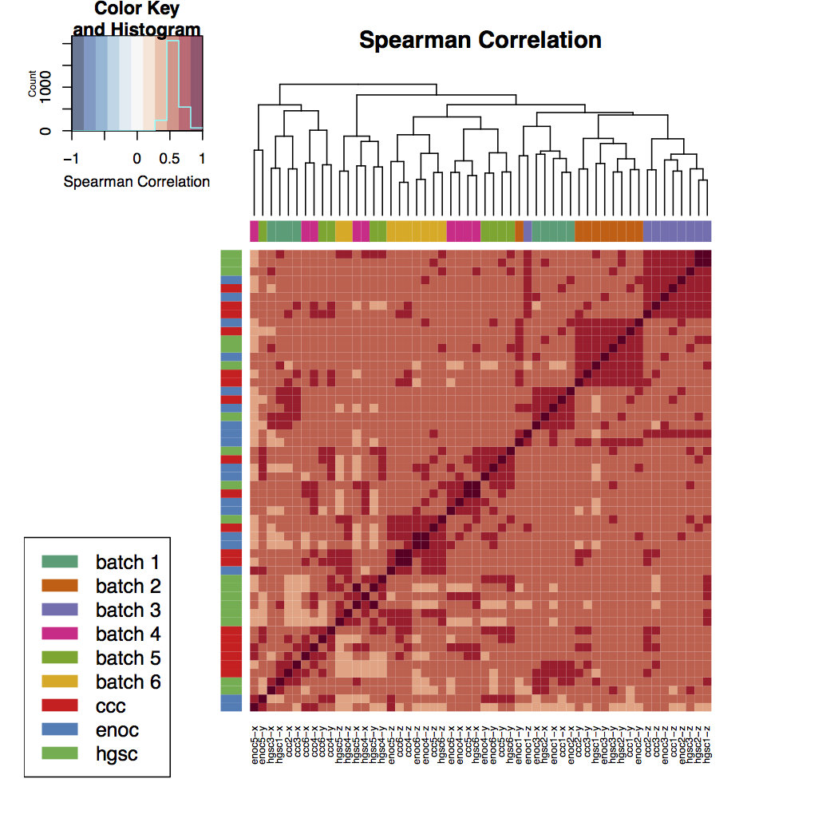
Example of Probe Normalization
No normalization
With normalization

Slide 6
ComBat
ComBat (Combating Batch effect) uses an empirical Bayes method to correct for batch effect
Requires:
dat: a matrix where the columns are samples and rows are peptides
Columns must be named with the same samples that are present in pheno$Sample
batch: if pheno was set up correctly, you can use pheno$batch here
batch requires the corresponding list of the batch each sample was from. The order of samples should match the order of columns in dat.
mod: the design model for the experiment
Each row should be a different sample, and each column should be a different design condition
Can be made with: modcombat = model.matrix(~1, data = pheno)

Slide 7
Unbalanced Batches
Occasionally batches will not have an equal amount of each tumour type
If Batch 1 has 9 samples of Type A and 1 sample of type B, and Batch 2 has 1 sample of Type A and 9 samples of Type B, then applying ComBat blindly will result in overcorrection
Most batch effect correction methods assume that the average intensity for each peptide should be the same for each batch, but this is no longer true if the batches have different numbers of each type!
To fix this, we adjust the model to include type:
modcombat = model.matrix(~as.factor(type), data = pheno)
Pros: allows us to process batches that are unbalanced
Cons: biases the data to exaggerate differences we expect to be there, and if there is an unknown type in the proteomic data that is unbalanced, we obviously can not correct for it

Slide 8
Effect of adding tumour types
Peptide heatmap of ComBat with a model of randomized tumour types (mix)
Samples do not cluster by randomized tumour type -> bias appears to be small if there is not a true difference in tumour type

Slide 9
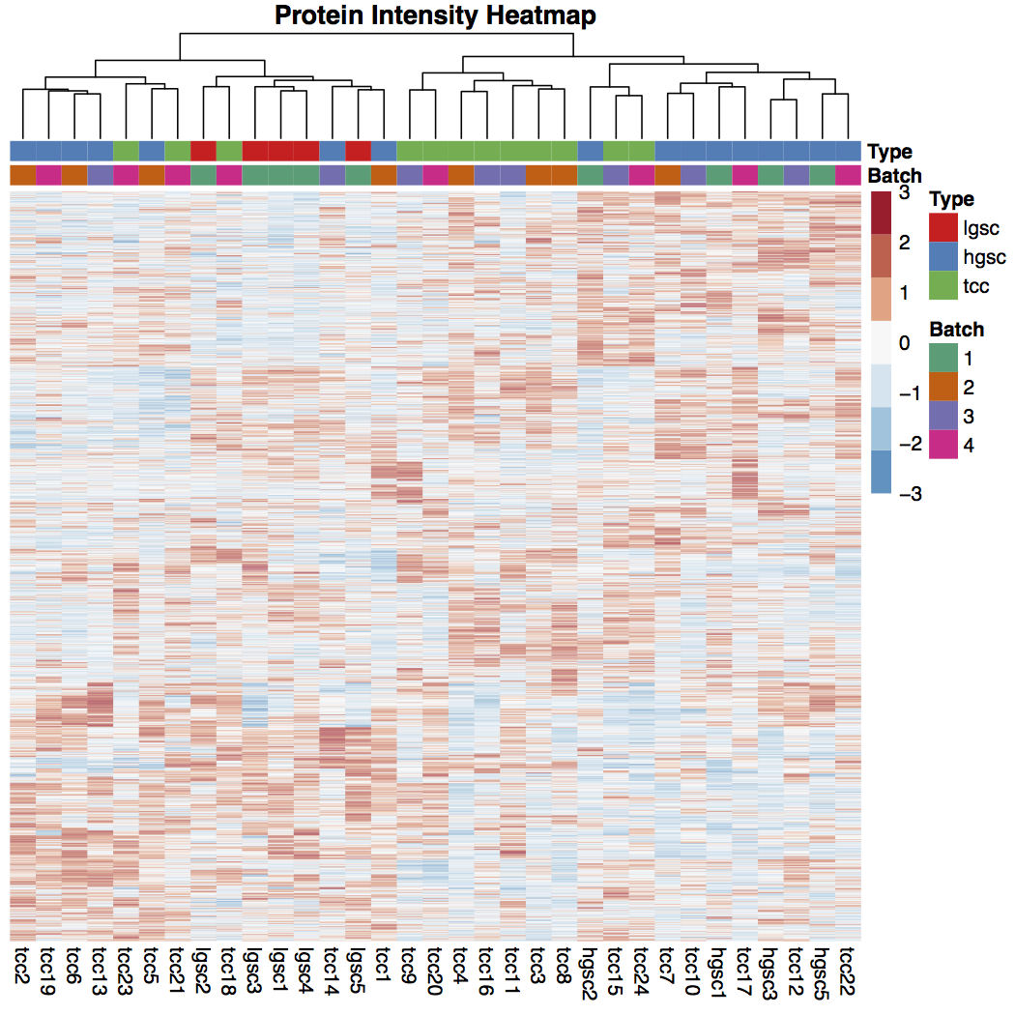
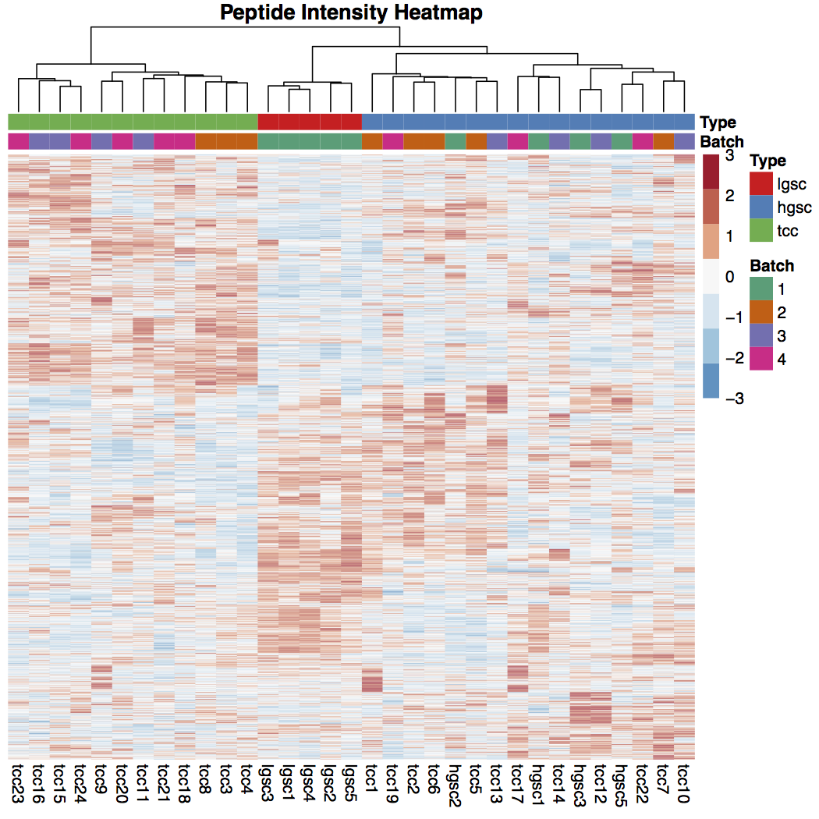
ComBat with Tumour Types
Model with no tumour types
Model with tumour types

Slide 10
Clustering
After ComBat, we can cluster the data using kmeans or hierarchical clustering into k clusters
 | K-means | Hierarchical Clustering
Info | Input a number of clusters k, iteratively selects for k clusters with closest Euclidean distance | Starting from each sample as a cluster, groups the two closest clusters at each step
Pros | Can pick number of clusters Closer to the ‘optimal’ clustering for a chosen k | Can see clustering at each step Can use a variety of distance metrics Can cluster over NA’s
Cons | Not always clear how many clusters to use No NA’s allowed | Clusters are lumped together at each step, so the clusters may not be optimal for each k

Slide 11
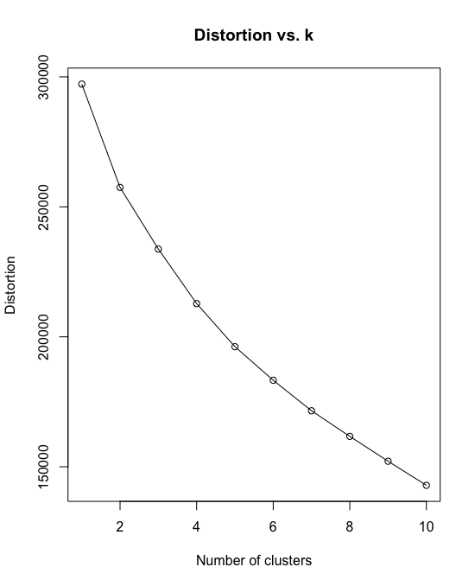
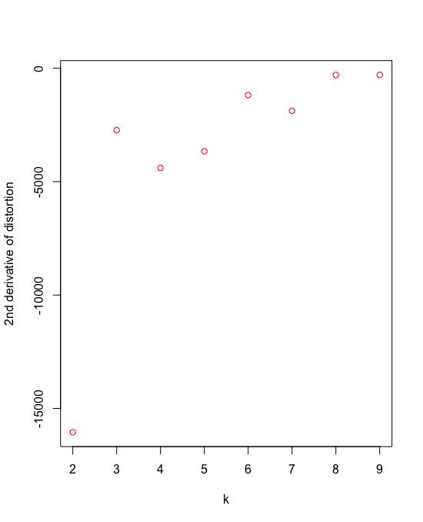
Picking the number of clusters
Distortion (Total variance within clusters) decreases with k
Have to balance between accounting for variance and having meaningful clustering
Pick a k such that the decrease in distortion drops off
2 would also be acceptable, but 4 is picked to get more meaningful clustering

Slide 12
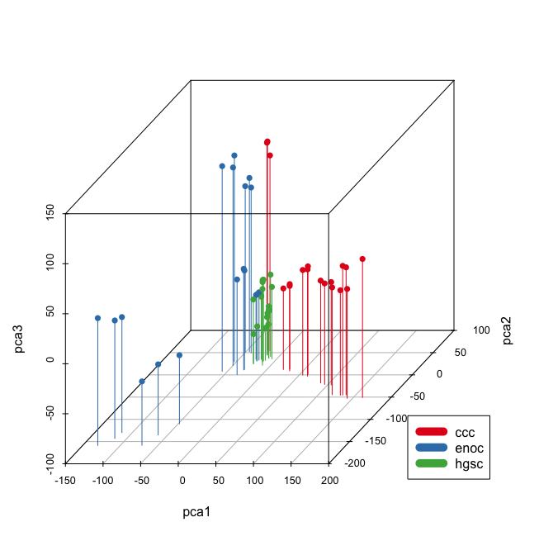
PCA
Principal Component Analysis aims to simplify data by reducing the number of probes (peptides)
Finds linear combinations of probes that can account for as much variance as possible; the first component has the most variance, the second one has the second most, etc.
Each component is orthogonal

Slide 13
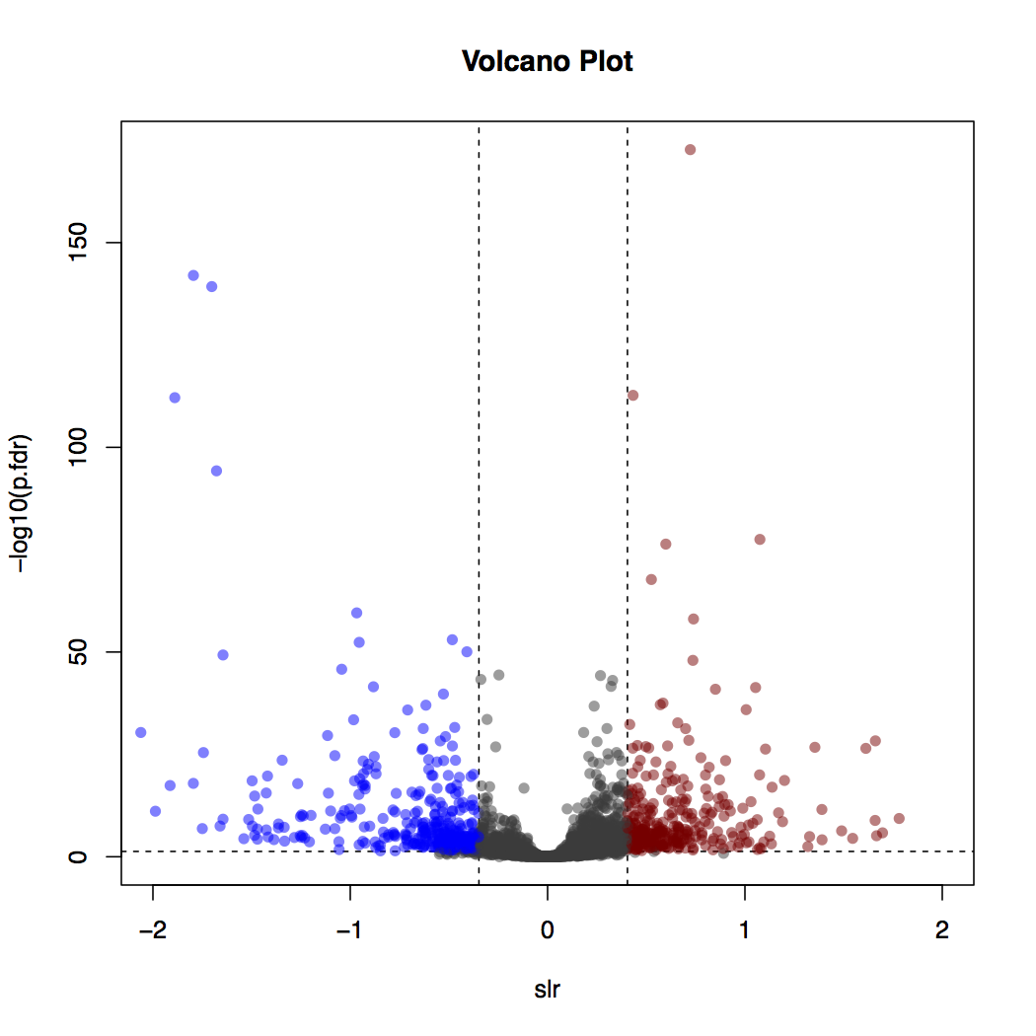
PECA
PECA (peptide-level expression-change averaging) calculates the differential expression of proteins between two groups by looking at peptide-level data
Calculates fold change (log2(group1 expression/group2 expression)) for each peptide in a protein, then uses median value as final result
Allows us to find proteins that can be used as biomarkers in immunohistochemical staining
CCC vs HGSC

Slide 14
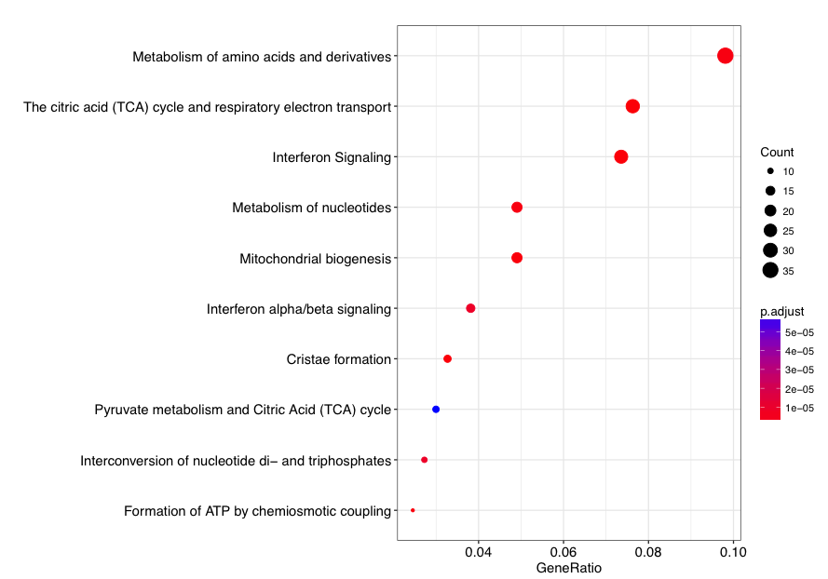
Pathway Analysis
Once differential expression is completed, we can use proteins that have been highly expressed to run pathway analysis
Proteins with a high differential expression correspond to genes that are highly expressed, which can then be used for pathway analysis
Allows us to match highly expressed proteins with functions in the tumour

