Slide 1
Split ComBat
Jonathan Zhang

Slide 2
Motivation
Ordinarily, ComBat requires all peptides to be present in all batches
As batches are added, the number of shared peptides decreases
We can compensate for this by splitting peptides into groups by which batches they are present in, and then running ComBat and downstream analyses on each group
Missing
 | Batch 1 | Batch 2 | Batch 3
P1
P2
P3
P4
P5
P6
P7
P8
P9
P10
P1
P6
P10
Present
P2
P4
P3
P5
P7
P8
P9

Slide 3
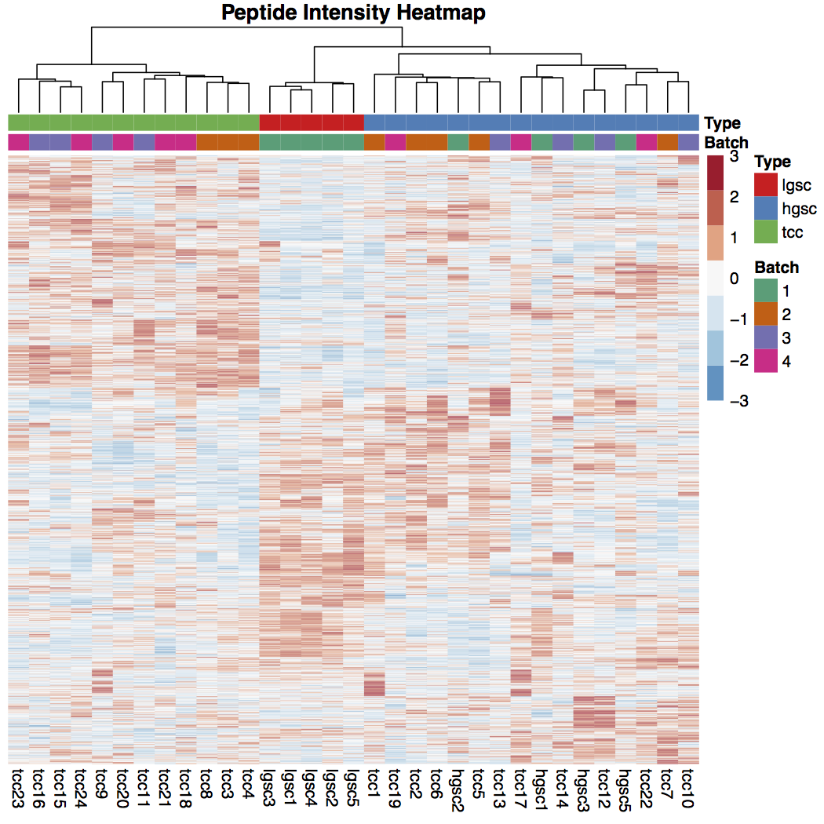
Motivation, cont’d
Only looking at peptides that are shared across all batches may bias data
Based on prior knowledge, hgsc and tcc should be more similar than lgsc and hgsc
The peptides shared across all batches show the opposite – how to resolve this?

Slide 4
Matching Peptides by Batch
Create a “hash code” based on what batches the peptide is present in
Use a binary code: a peptide present in batches 1, 3, and 4 will have code 2^1 + 2^3 + 2^4 = 26
Peptides are then grouped together by hash, and then processed with sample normalization, probe normalization , and ComBat if the peptides are present in more than 1 batch
Batch 1 | Batch 2 | Batch 3 | Batch 4 | Hash
 |  |  |  | 30
 |  |  |  | 28
 |  |  |  | 6
 |  |  |  | 2

Slide 5
Consensus Clustering
Can run clustering on each group of peptides, and find overall clustering
Each group can be clustered your choice of clustering, current template uses hierarchical clustering
Clustering first loops through different variance cut-offs to find the best one
Once the ideal variance cut-off is found, we cluster all peptide groups
The clustering of samples across each group is recorded and used to calculate how similar samples are
Distance metric should reflect how often samples are clustered together; current metric uses Jaccard index to reflect distance

Slide 6

Jaccard Index
Equation is given by , where S = number of clusters that were the same, and C is the number of comparable clusters (i.e. number of peptide groups where both samples were put into clusters)
Weighted method accounts for the fact that the peptide groups are not the same size
Group | A | B | Weight
1 | 1 | 1 | 5
2 | 1 | 0 | 10
3 | 0 | 0 | 5
4 | 0 | 1 | 9
5 | NA | 1 | 5
6 | 1 | 1 | 7
7 | 0 | NA | 3
Unweighted Distance
Weighted Distance

Slide 7
Finding the Best Variance Cutoff
Currently two options are implemented:
Variance cutoff that gives the cleanest clustering compared to a contrast (usually tumour type), defined as highest chi-squared value for a contingency table of clusters vs. contrast
Variance cutoff that gives the most stable clustering between studies, defined as the highest frobenius norm of (0.5 – dist), where dist is the distance matrix between samples based on their clusters, using the Jaccard index.
I don’t know how to formally prove that the most stable clustering will result in the highest frobenius norm of (0.5-dist)
Idea is that stable clustering will give a distance metric of mostly 0’s and 1’s, and unstable clustering will have distance metrics with values closer to 0.5
Therefore 0.5-dist should have a larger frobenius norm for more stable clustering

Slide 8
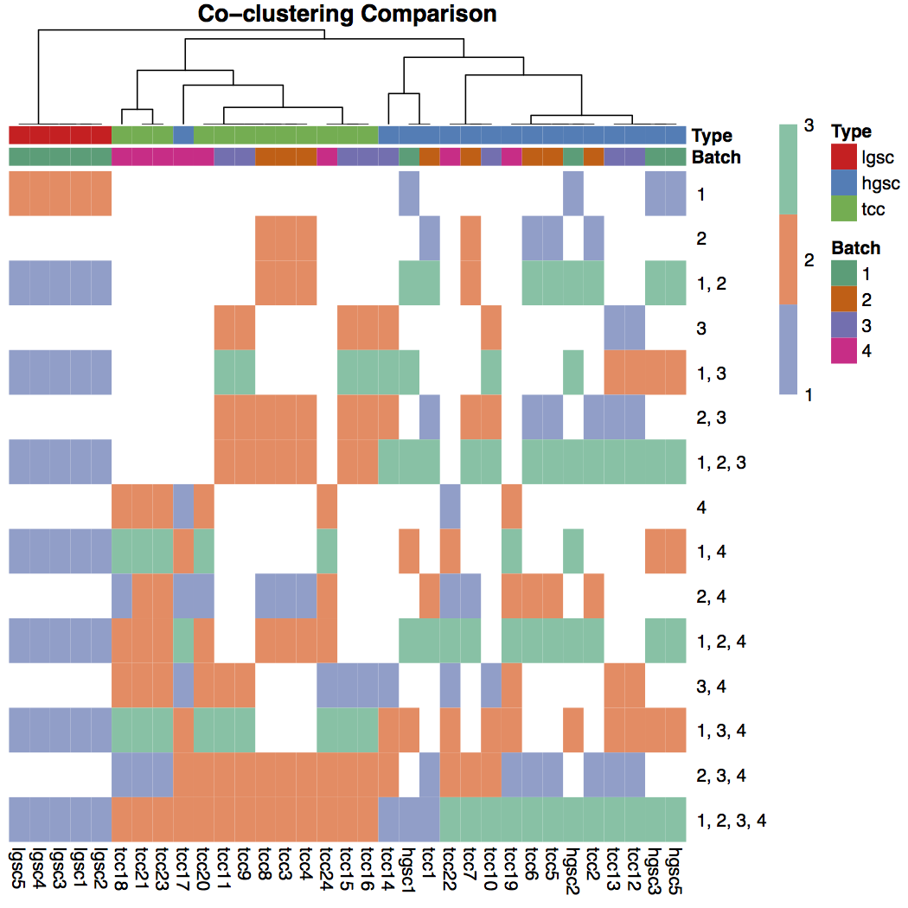
Consensus Clustering
For the TCC + HLGSC dataset, we now see that tcc and hgsc tend to cluster together more often then hgsc and lgsc, which matches prior knowledge
Columns are different samples, and rows are the results of clustering for each peptide group
Number of clusters for each group depends on number of tumour types in that group

Slide 9
PECA
Can run differential analysis on each group of peptides
For proteins that are shared between groups, we can combine the results with a weighted mean
P-values can be combined using fisher’s method or a weighted logit
Current template chooses to combine results if:
Protein has more than 1 peptide or the 1 peptide is present across more than 1 batch
p-value of result is less than chosen cutoff or number of peptides is greater than
In general, results that are significant in peptides shared across all batches will also be significant when looking at all peptides, and many more proteins with a significant fold change will be found

Slide 10
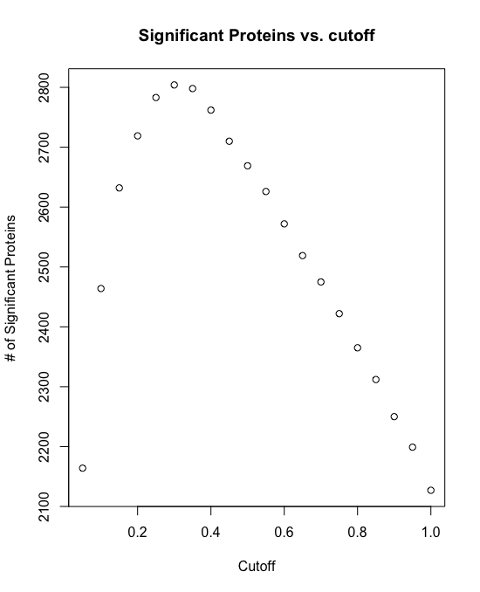
Cutoff for Combining Results
The current program loops through different q-value cutoffs to find the cutoff that gives the largest number of significant fold changes when combining PECA results
This maximises the number of proteins we can use in subsequent analyses

Slide 11
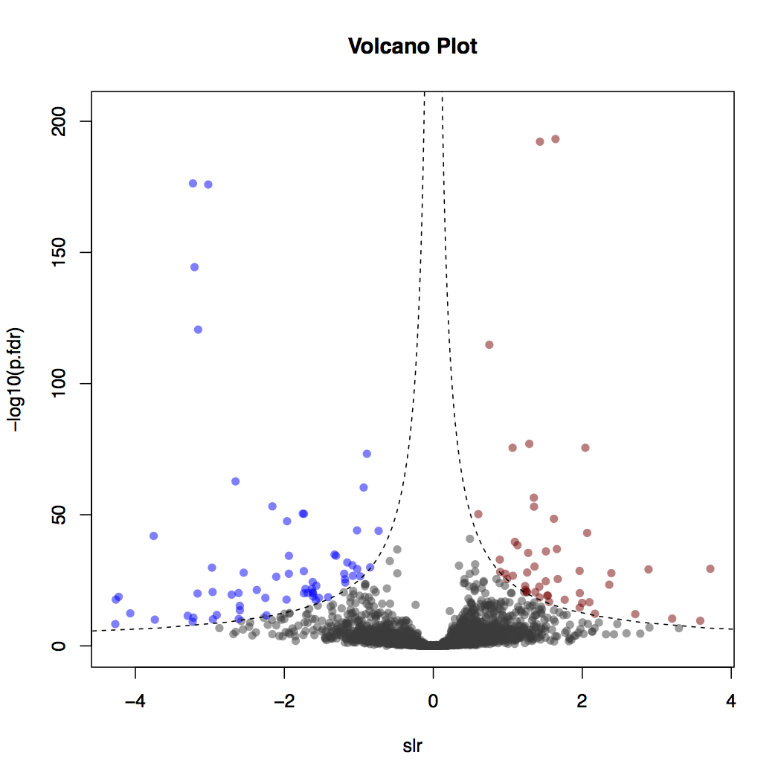
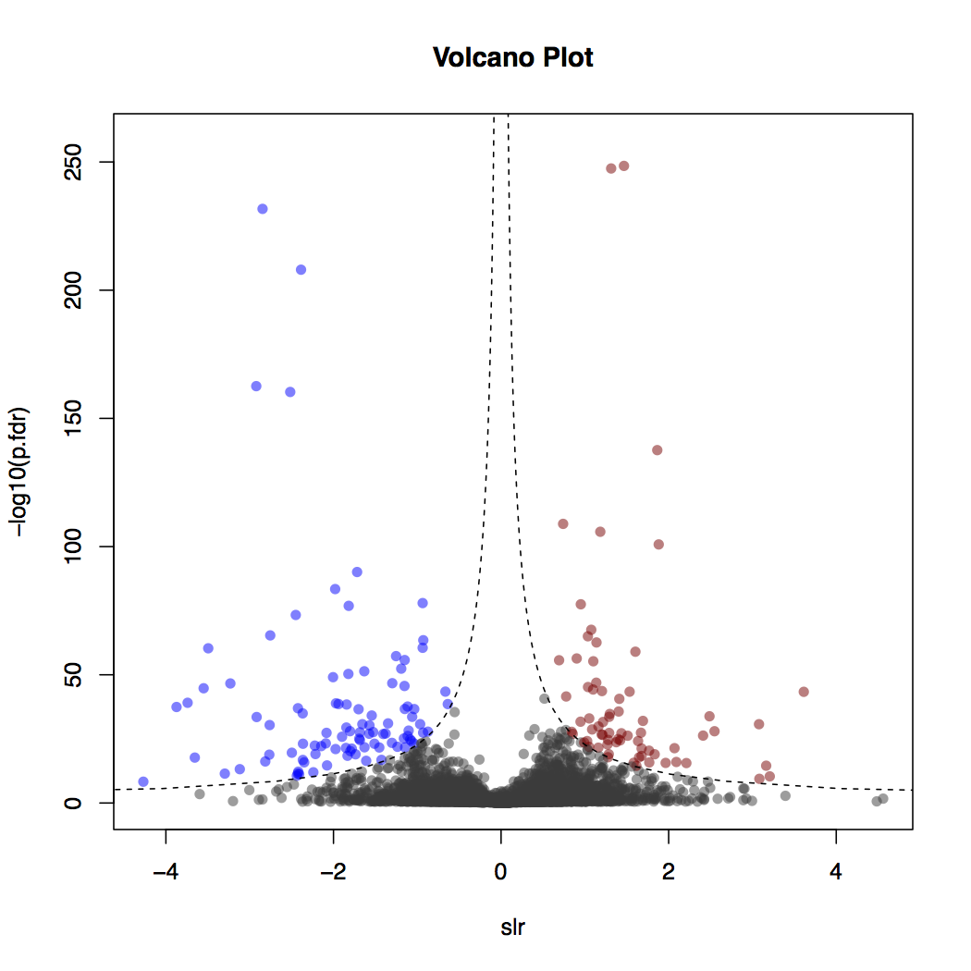
Volcano Plots from PECA
Peptides present in all batches
Combined results from Split ComBat
HGSC vs CCC PECA analysis

Slide 12
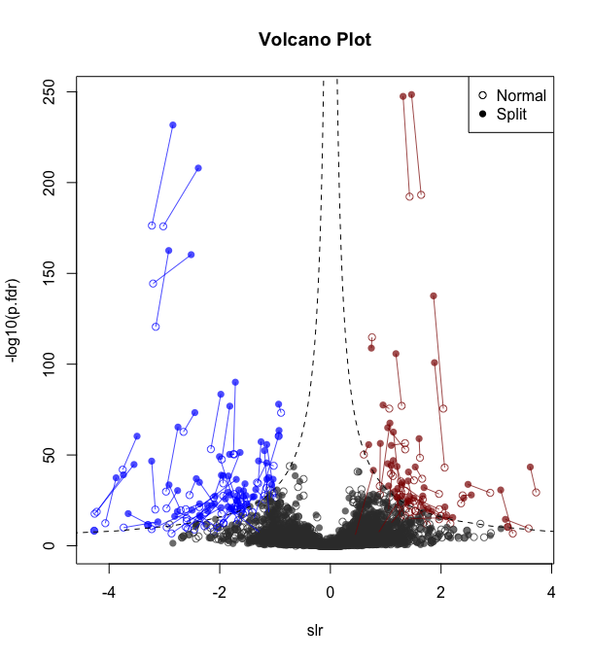
Comparing Normal vs Split ComBat
P-values tend to improve for proteins with significant p-values
Fold change shrinks a bit

Slide 13
To-do
Replace fisher’s method for combining p-values with the empirical Brown’s method
Difficulties: current EBM has no option for combining with weight
Defining a covariance matrix for different peptides combining into the same protein is unclear, given that different peptides will have NA values in different batches

