Slide 1
Finding TSS using RNAseq data
Eustaquio Lab
2022-08-25

Slide 2
Can transcription start sites (TSS) be inferred from RNAseq data?

Slide 3
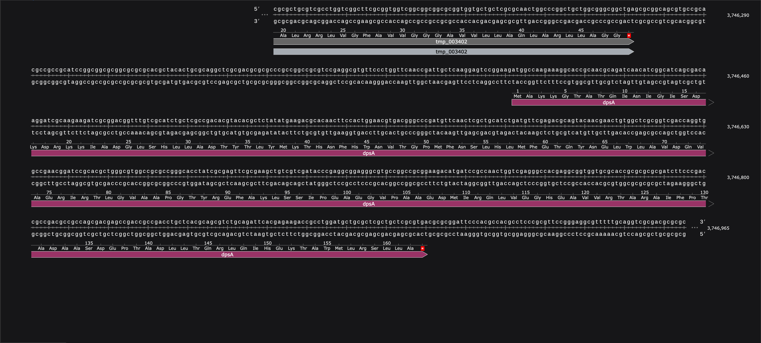
Can transcription start sites (TSS) be inferred from RNAseq data?

Slide 4
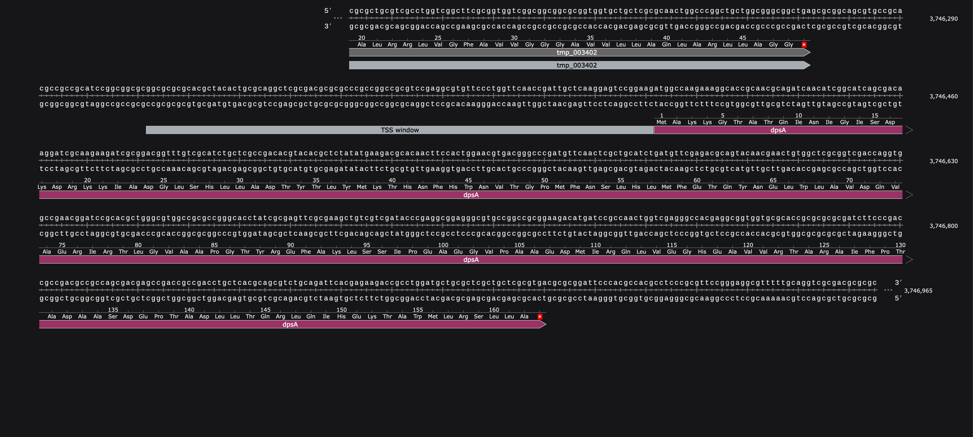
Look in likely TSS ‘window’

Slide 5
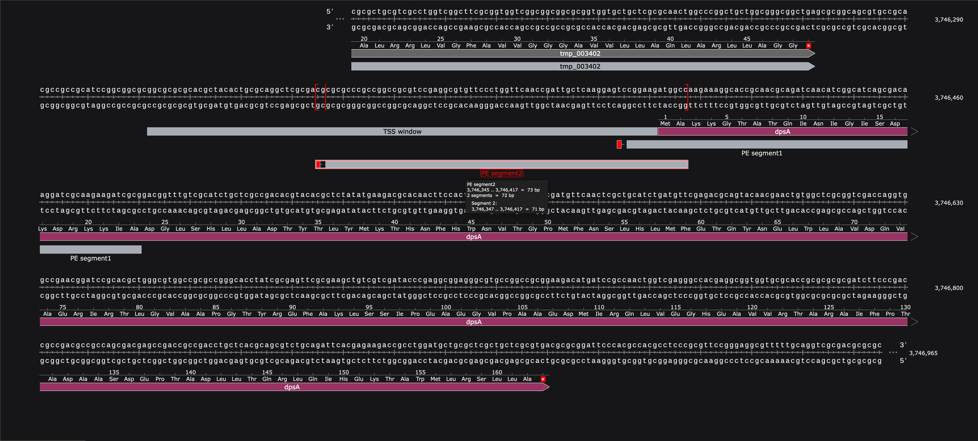

Slide 6
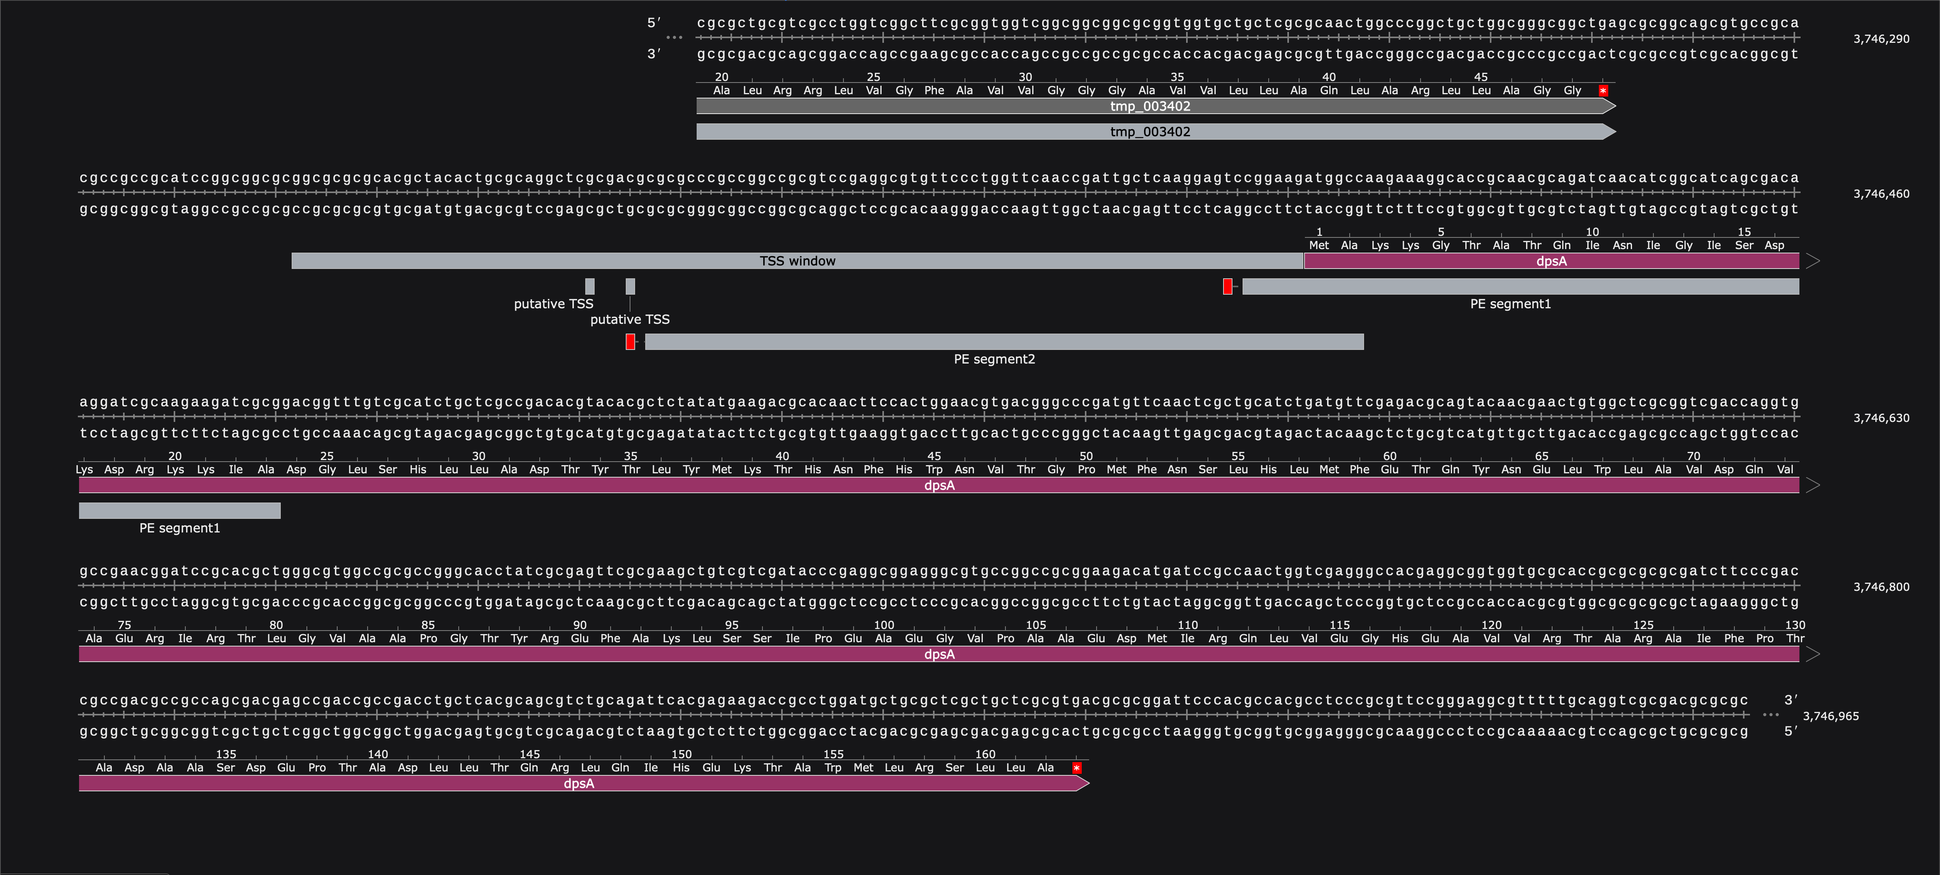

Slide 7
Can transcription start sites (TSS) be inferred from RNAseq data?

Slide 8
Look in likely TSS ‘window’

Slide 9
Map 5’ end of segment only

Slide 11
Raw data
5 chromosomes/plasmids: ('BF000000.1', 'BF000000.2', 'BF000000.3', 'BF000000.4', 'BF000000.5’)
12 paired end fastq files (6 R1 + 6 R2) ('../Illumina_RNA_Reads/fastq_files')
Filtering
Python scripts
Only 5’ position of PE segment kept
-5’ end of reads with Flags 147 or 163
Value counts at each genomic position for each experiment were summed to increase sequencing depth
Demultiplexing
None
Initial analyses
Python scripts
Function for getting reads within probable tss windows
Look 100 nt upstream of start codon for window
Throw out if:
other gene is within this tss window
Read density in window is below threshold
Trimming
None
Alignment
1) 5 chromosomes/plasmids combined into one fasta file and aligned
2) Bowtie2 alignment:
QC: multiQC report
The data used in the pipeline sits in AWS S3 buckets and the computations are done using AWS Batch. The pipeline is built with Nextflow using templates and prebuilt modules from the NF-Core team and adheres mostly to their guidelines, making it possible for those in the NF-Core community to easily read/understand the code and run it if needed.

