Slide 1
Disome ribo-seq
Mankin/Vázquez-Laslop Lab
2022-06-14

Slide 2
Random sample of sequences from
Mono1_Mono2_S1_R1_trimmed
Mono1_Mono2_S1_R2_trimmed (reverse complement)
@A00749:357:HNYM5DRXY:2:2101:13006:2378 1:N:0:TTATAACC+GATATCGT
TTTCGTACAACCCAGATGGCAACCCATTAACCATTGCTCGCCTAGA
TTTCGTACAACCCTGATGGCAACCCATTAACCATTGCTCGCCTAGC
@A00749:357:HNYM5DRXY:2:2101:10637:3662 1:N:0:TTATAACC+GATATCGT
ACTAAAGTACGTCAGTACCTGACTAAGGAACTGGCATACTAGA
ACTAAAGTACGTCAGTACCTGACTAAGGAACTGGCATAATATT
@A00749:357:HNYM5DRXY:2:2203:16188:20196 1:N:0:TTATAACC+GATATCGG
TCACCGTGCTGATGCCGTCTTACGTCAACATCGGCGCGGAGGCTAGA
TCACCGTGCTGATGCCGTCTTACGTCAACATCGGCGCGGAGGAGCGC
@A00749:357:HNYM5DRXY:2:2134:22887:31328 1:N:0:TTATAACC+GATATCGT
TTAGATCCACACCATTATCGGTGCGGGTGCAGCGTCTGCGGCTAGA
TTAGATCCACACCATTATCGGTGCGGGTGCAGCGTCTGCGGATATT
@A00749:357:HNYM5DRXY:2:2162:3341:5619 1:N:0:TTATAACC+GATATCGT
GCTATTGCTATCGTTCACGACAAACAGTACTCTAGA
GCTATTGCTATCGTTCACGACAAACAGTACTCGCTC
@A00749:357:HNYM5DRXY:2:2176:6126:4711 1:N:0:TTATAACC+GATATCGT
CCATCCGGTGGTTCTGAATGGAAGGGCCATCGCATGTTCTAGA
CCATCCGGTGGTTCTGAATGGAAGGGCCATCGCATGTTATCTG
@A00749:357:HNYM5DRXY:2:2177:30770:21746 1:N:0:TTATAACC+GATATCGT
TTACCTGCACGAATGGCGTAATGACGGCCTAGA
TTACCTGCACGAATGGCGTAATGACGGCAGCTC
@A00749:357:HNYM5DRXY:2:2116:7428:5650 1:N:0:TTATAACC+GATATCGT
ACAAAACCGATTATTTAATGCGTTTACGGGCTTCTAGA
ACAAAACCGATTATTTAATGCGTTTACGGGCTTCGCTG
UMI tag
BARCODE
Sequence maps to genome
Unknown?
R1
R2
v

Slide 3
Demultiplexing
using provided ‘CTAGA’ and ‘GATCA’ barcodes
Initial analyses
1. Correlation between termination scores
2. Normalized reads relative to start and stop
3. Runthrough scores
Trimming
with cutadapt remove UMI and demultiplexing barcode from ends
Filtering
Keep only paired-end aligned segments
Monosomes: size between 24-46 nts
Disomes: size between 47-69 nts
The data used in the pipeline sits in AWS S3 buckets and the computations are done using AWS Batch. The pipeline is built with Nextflow using templates and prebuilt modules from the NF-Core team and adheres mostly to their guidelines, making it possible for those in the NF-Core community to easily read/understand the code and run it if needed.
P-site offset
Genomic position of the 15th nt from
the 5’ end of the reverse read
(higher quality sequence).
This corresponds to 15 nt offset from 3’
end of ribosome protected RNA

Slide 4
Initial analyses
1. Correlation between termination scores
2. Normalized reads relative to start and stop
3. Runthrough scores

Slide 5
Current issue: Large amount of outliers that do not correlate between replicates
Initial analyses
1. Correlation between termination scores scores
2. Normalized reads relative to start and stop
3. Runthrough scores

Slide 6
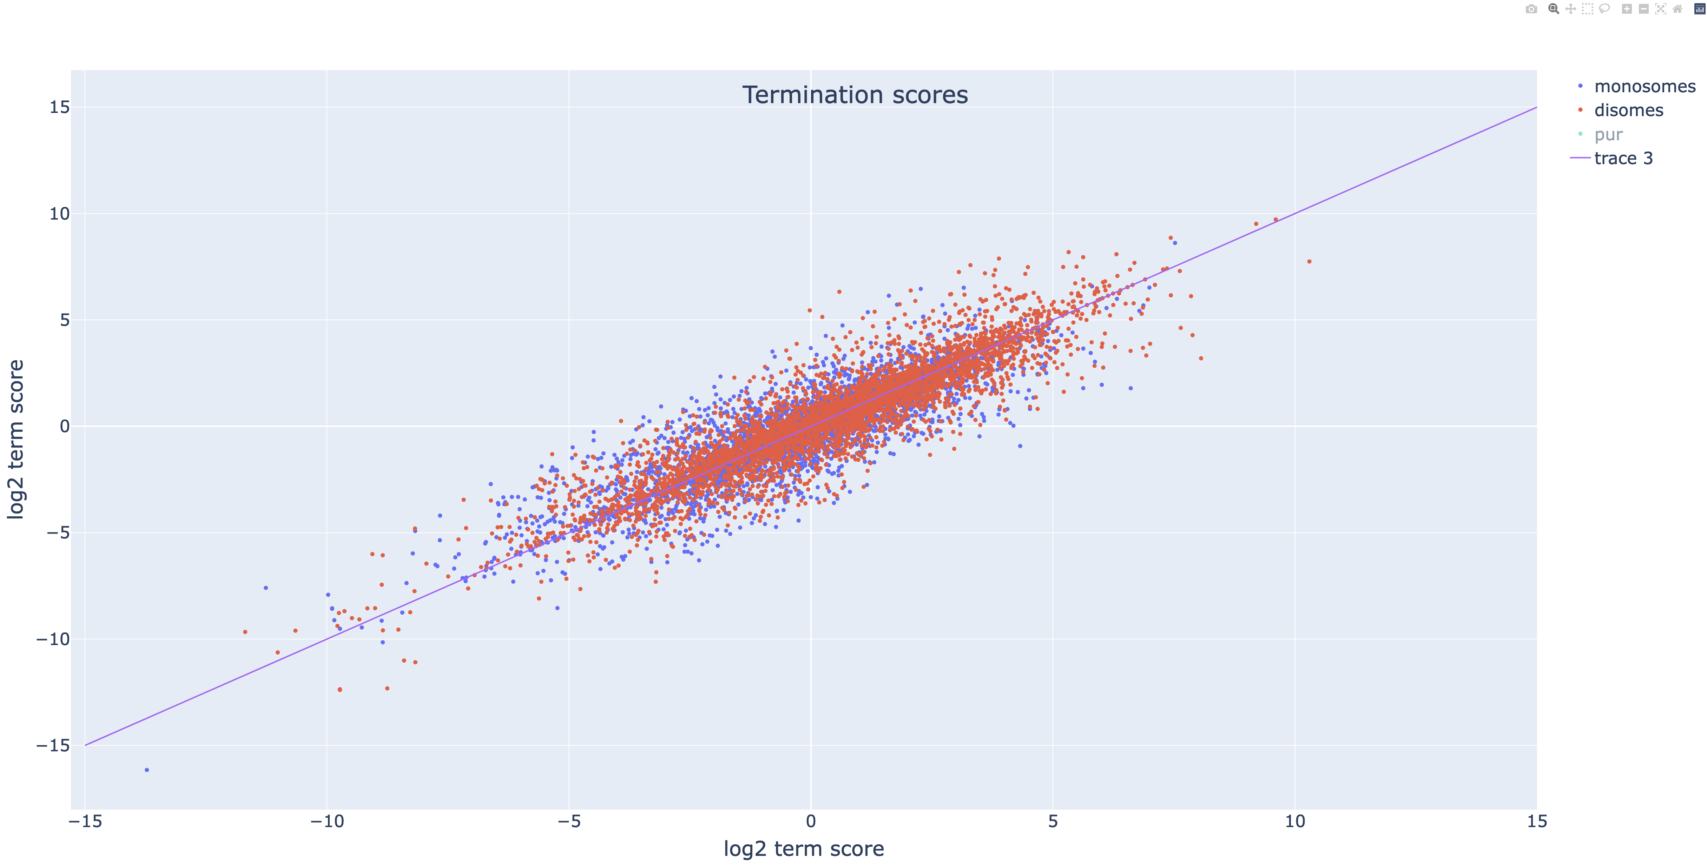
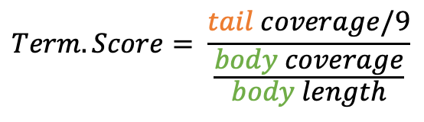
Initial analyses
1. Correlation between termination scores scores
2. Normalized reads relative to start and stop
3. Runthrough scores
Body = Body of ORF minus 30 nucleotides at 5’ and 3’ end
Tail = Last 9 nucleotides of ORF, corresponding to last two sense codons + STOP
$$Term. Score= \frac{tail coverage/9}{\frac{body coverage}{body length}}$$
Body
Tail
**outliers in galaxy analysis that do not correlate between replicates are likely a result of how that pipeline handled zero count values

Slide 7
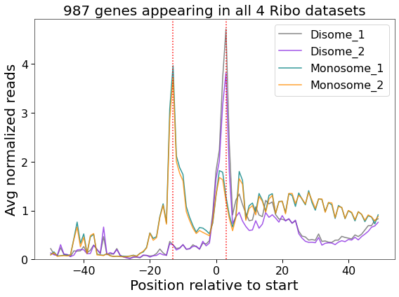
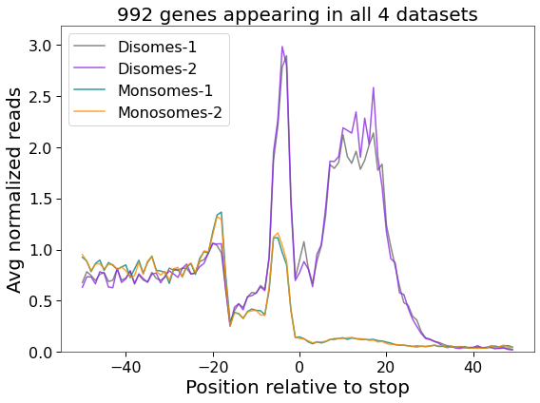
Initial analyses
1. Correlation between termination scores scores
2. Normalized reads relative to start and stop
3. Runthrough scores
Current issue: Disome, but not monosome, ribo-seq show strong signal downstream of STOP

Slide 8
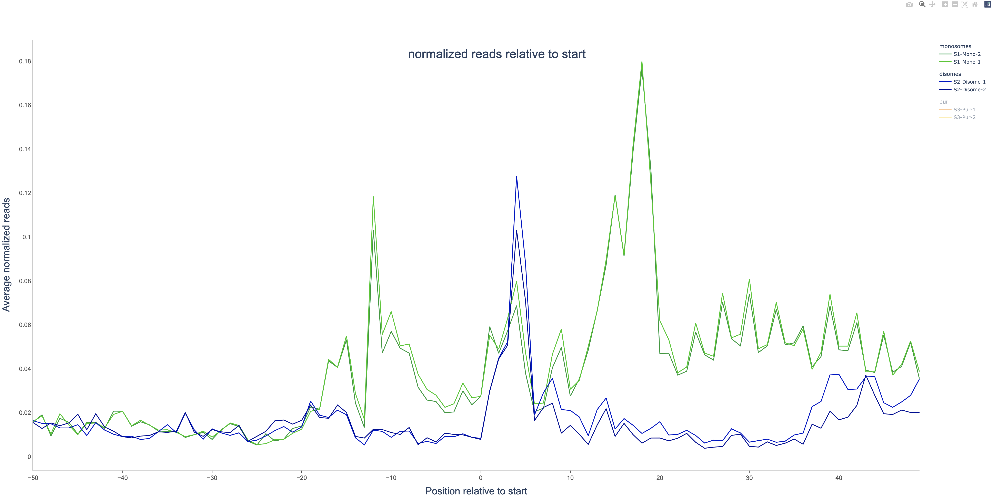
Disomes
Monosomes
Avg normalized reads
Position relative to start

Slide 9
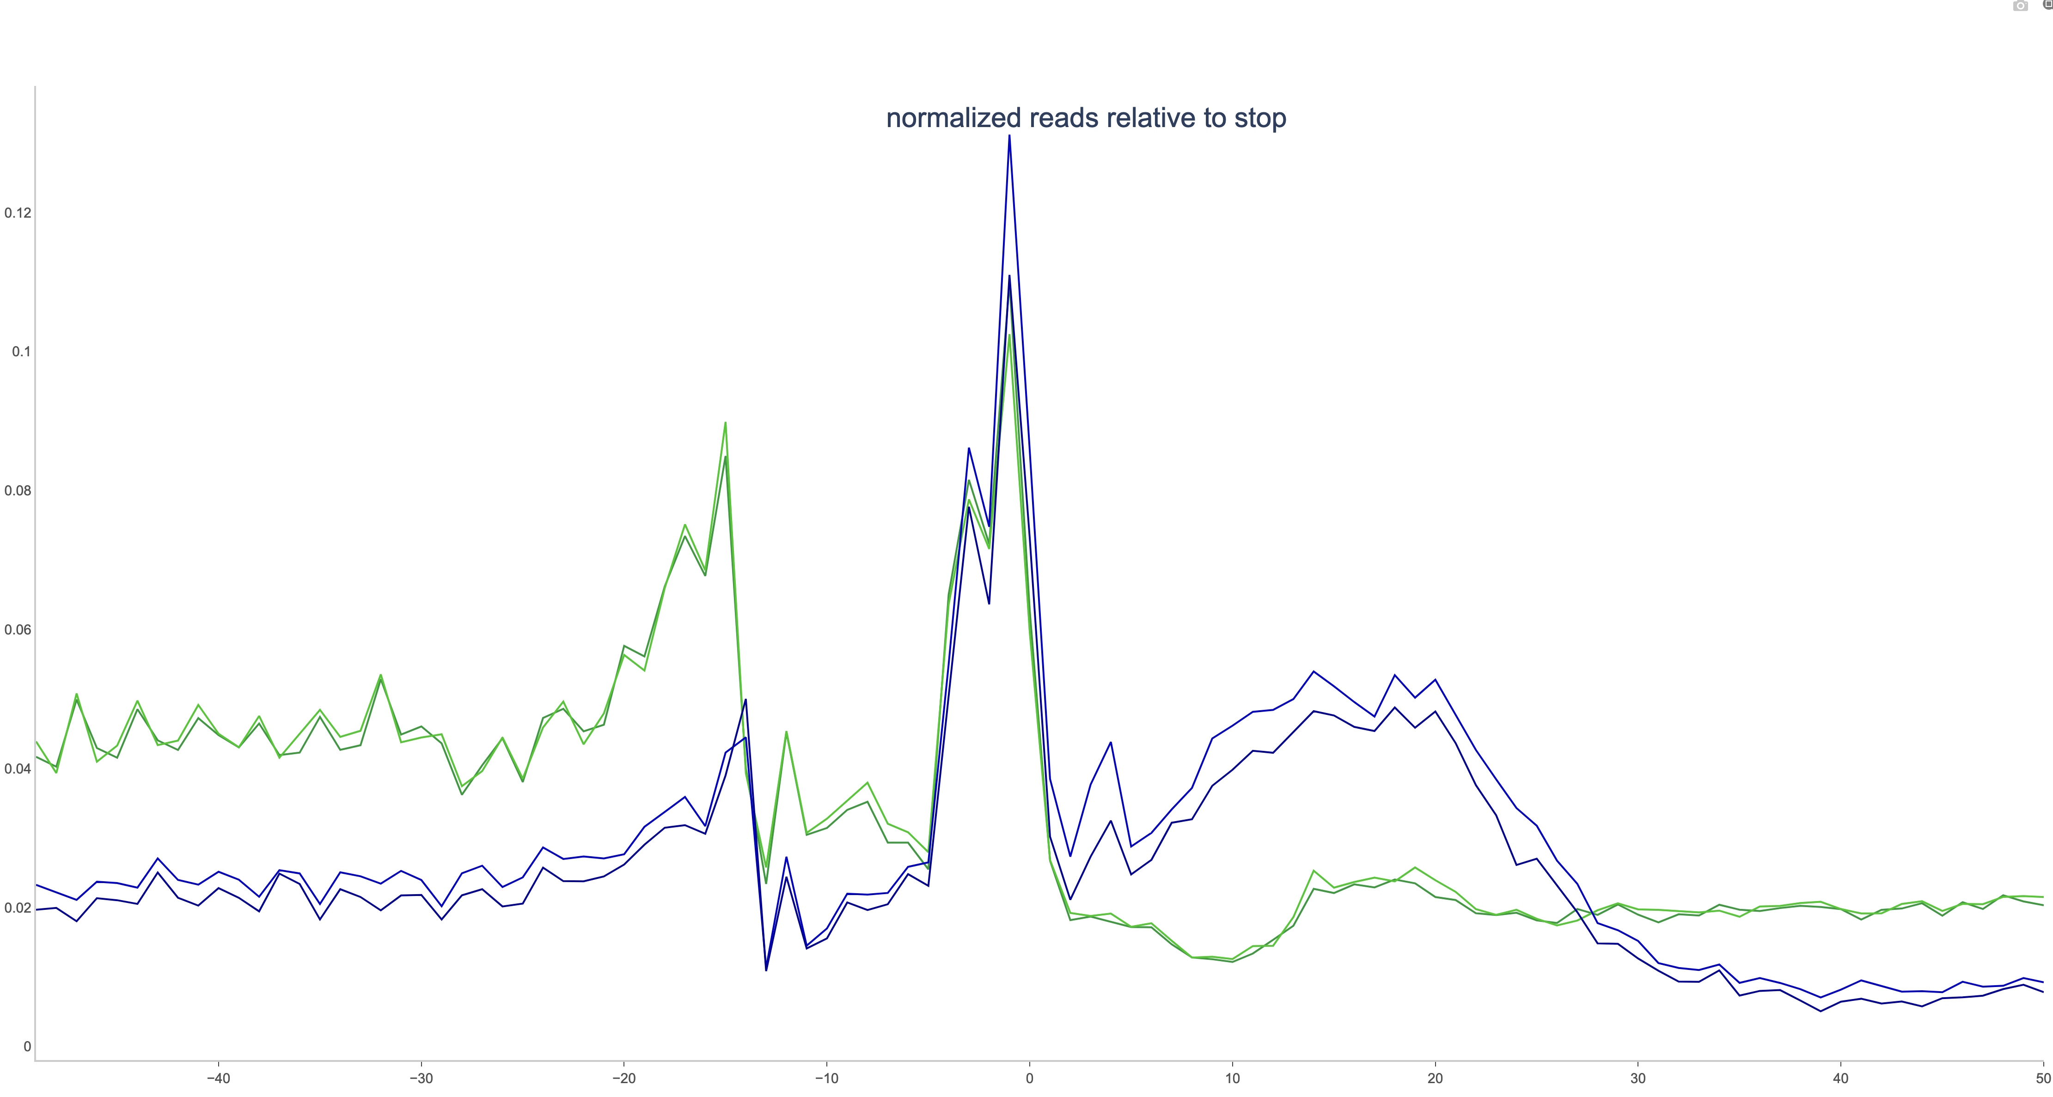
Disomes
Monosomes
Avg normalized reads
Position relative to start

Slide 10
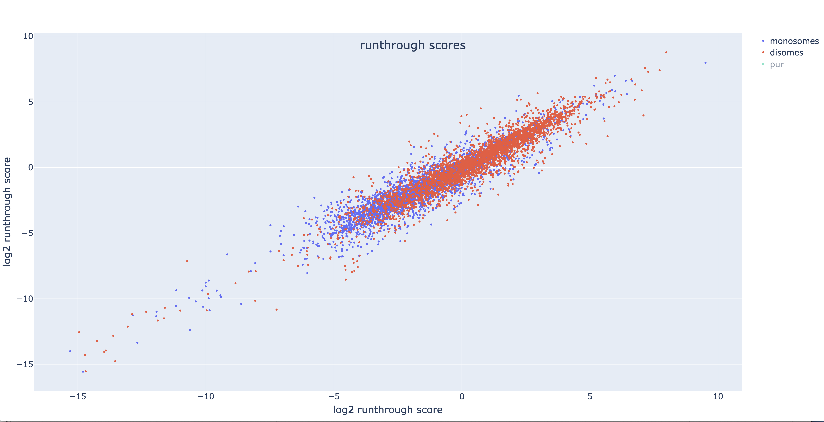
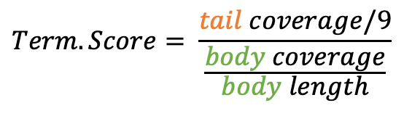
Initial analyses
1. Correlation between termination scores scores
2. Normalized reads relative to start and stop
3. Runthrough scores
Body = Body of ORF excluding 30 nts at start
Tail = Last 9 nucleotides of ORF, corresponding to last two sense codons + STOP
$$Term. Score= \frac{tail coverage/9}{\frac{body coverage}{body length}}$$
Body
Tail

Slide 11
Future analyses
1. Logos
2. Normalized reads relative to start and stop
3. Runthrough scores

