Slide 1
Category review: Chips
July 2024
Retail Analytics
Brand note: If client logo is not required, use alternate title page layout right click slide thumbnail > Layout > Title

Slide 2
Notes:
To view Privacy video explaining how important data privacy is to Quantium, please click here: https://www.youtube.com/watch?v=Zq1QDAkoRzU
or here Q:\Company Reference\Brand & Design\Brand videos\Q Privacy.mp4
At Quantium, we believe that data is the behavioural footprint of humanity and that it has to be treated with the utmost care and responsibility.
Histories, attitudes, indeed lives are stored within it in ways that aren’t always apparent – and that’s what makes its potential so powerful.
To work with it responsibly, sensitively, we set ourselves the highest data privacy protection and governance standards.
We have spent 17 years perfecting privacy-by-design and secure-by-design principles. Central to this is not holding any personally identifiable information about people –
we neither receive it, and put the necessary protections in place to be unable to decipher it.
Every aspect of handling data is safeguarded: from its de-identification, to its encryption – data security is paramount and of the highest grade.
We pride ourselves on gaining the trust of iconic organisations around the world through years of securely working with their data,
and in turn the trust that builds with their stakeholders.

Slide 3
Executive summary
Bulk Buying Preference: A significant majority of customers tend to purchase multiple packs of chips in a single transaction, indicating a strong preference for bulk buying.
Key Customer Segments: Sales are primarily driven by three customer segments: Budget Older-Families, Mainstream Young-Singles/Couples, and Retirees.
Preferred Chip Pack Size: The 175g chip pack size emerges as the most popular choice among consumers, accounting for 27% of total sales and over 120,000 units sold.
Market Dominance by Brand: Kettle dominates the market, being the preferred brand across most customer segments.
Seasonal Trends: Seasonal trends reveal an increase in transactions during December, likely linked to Christmas celebrations. Peak sales during this period reached $6410.9.
01
Customer Analytics

Slide 4
01
Customer Analytics.

Slide 5
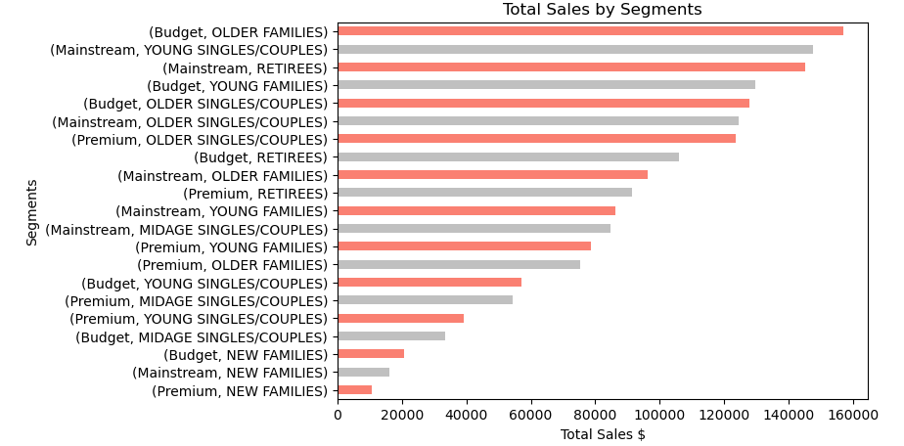
Sales are driven by three customer segments: Budget Older-Families, Mainstream Young-Singles/Couples, and Retirees.

Slide 6
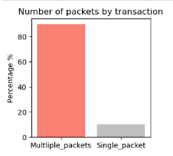
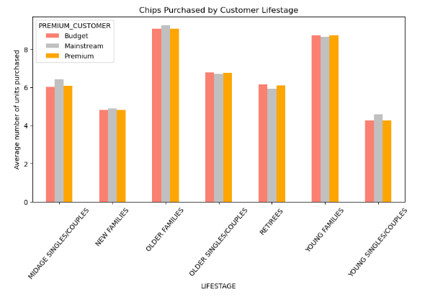
In 90% of transactions, customers purchased multiple packets, the Budget Older-Families and Young Families segments had an average purchase quantity exceeding 8 packets per transaction, setting them apart from the other segments.

Slide 7
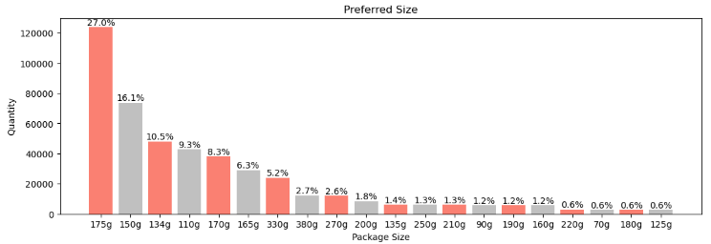
The 175g chip pack size emerges as the most popular choice among consumers, accounting for 27% of total sales.

Slide 8
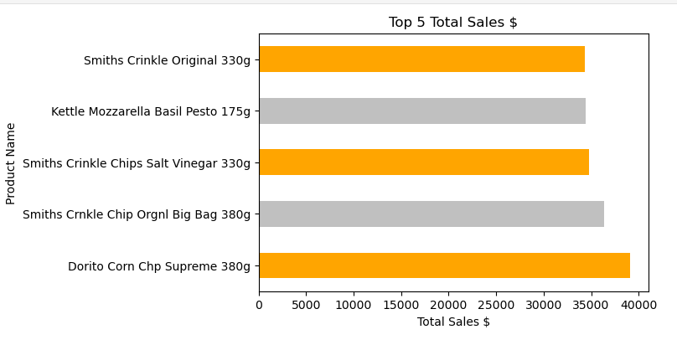
Kettle dominates the market, being the preferred brand across most customer segments. Exceptions exist for Budget-OLDER FAMILIES and Mainstream-RETIREES, which tend to buy products from the brand Smiths.
Kettle Mozzarella Basil Pesto 175g" leads product sales with 6381 units sold, closely followed by "Kettle’s Tortilla Chips Honey Jalapeño Chili 150g" at 6309 units sold.
Despite Kettle and Smiths being the preferred brands, Dorito Corn Chip Supreme 380g is the top-selling product, generating $39052, which is 13% higher than Kettle's best-selling product.

Slide 9
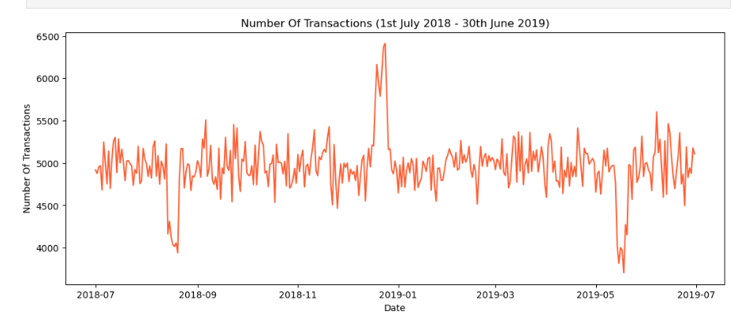
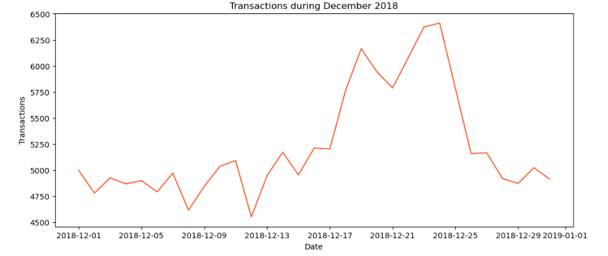
Seasonal trends show an increase in transactions during December, likely linked to Christmas celebrations, with peak sales reaching $6410.

