Slide 1
ALGORITHMS & DATA STRUCTURES
B
Disjoint-Set Union
& Percolation
A
C
E
From graph searches to almost-constant-time connectivity
- Jonah Sandow
- Daksh Panchal
- Harshpreet Singh
- Neetee Rawal
D
Problem 11 | Group 2 | 20-minute presentation
4 presenters • approximately 5 minutes each
Experiments - Github Repository

Slide 2
1. The problem: maintain connected groups
Union-Find answers connectivity questions as connections are added.
Union(u, v)
Find(x)
Connected(u, v)
Merge the groups containing u and v.
Example: Union(2, 5) joins their components.
Return the representative (root) of x's group.
Same root means same group.
Check whether Find(u) = Find(v).
Answer: True or False.
Simple real-world picture
Why not search the whole graph every time?
• People or computers are nodes.
• A connection joins two groups.
• We repeatedly ask: are these two in the same connected group?
For many repeated connectivity queries, BFS/DFS can revisit many nodes. Union-Find stores group structure so later queries become much faster.
Presenter 1 • ~3 min

Slide 3
2. The five-stage evolution (V1 → V5)
Each stage fixes a weakness in the previous approach.
Version | How it works | Main trade-off
V1 — Graph BFS/DFS | Store adjacency lists; search when asked | Simple, but each query scans graph
V2 — Quick-Find | Each item stores a component ID | Find O(1); Union scans array O(n)
V3 — Naive up-trees | Each item points to a parent | Can form a long chain; Find O(n)
V4 — Union by rank | Attach shorter tree below taller tree | Height O(log n)
V5 — Rank + compression | Flatten paths during Find | Amortized O(α(n)) per operation
Key idea
Rank in one sentence
Represent groups so repeated Find operations are cheap.
An upper-bound estimate of tree height; it guides which root becomes the parent.
Presenter 2 • ~2.5 min

Slide 4
3. Hand-worked examples: Q1, Q2 and Q3
The traces show what the algorithms actually do.
Q1 — 6-element chain
Q2 — 8-element rank tree
Q2 — after compression
Operations: U(0,1), U(1,2), …, U(4,5)
V2 overwrites: 1+2+3+4+5 = 15
V3 parent: [1,2,3,4,5,5] → height 5
V4 parent: [0,0,0,0,0,0] → height 1
Pair unions, then groups of 4, then all 8.
V4 parent: [0,0,0,2,0,4,4,6]
rank: [3,0,1,0,2,0,1,0]
Node 7 path: 7 → 6 → 4 → 0.
One Find(7) changes parent to:
[0,0,0,2,0,4,0,0]
Nodes 6 and 7 now point directly to 0.
Later finds are shorter.
Q3 — Kruskal's Minimum Spanning Tree
• Sort edges by increasing weight; accept only if endpoints are in different components.
• Accepted: AD(5), CE(5), DF(6), AB(7), BE(7), EG(9).
• Rejected edges would create cycles. 7 vertices need 6 MST edges; total weight = 39.
Presenter 2 • ~2.5 min

Slide 5
4. Percolation: can water cross the grid?
Q4 models open and blocked cells in an L × L grid.
Virtual nodes
Why add them?
OPEN
?
BLOCKED
vtop = L²
vbottom = L² + 1
For 3×3: vtop = 9, vbottom = 10.
Connect open top-row cells to vtop and open bottom-row cells to vbottom.
OPEN
OPEN
BLOCKED
?
OPEN
OPEN
Percolation test
Open path:
(0,0) → (1,0) → (1,1) → (2,1)
The grid percolates if Connected(vtop, vbottom) is True. One connectivity check replaces checking many top-to-bottom cell pairs.
Index formula: row × L + column • 3×3 cells are 0–8; the next two IDs are 9 and 10.
Presenter 3 • ~2.5 min

Slide 6
5. Backwash bug — and the dual-Union-Find fix
Why one virtual-bottom node can give a false fullness result.
The bug
The fix: two structures
After a real top-to-bottom path forms, vtop and vbottom are connected. Every open bottom-row cell is connected to vbottom. An isolated bottom cell can therefore appear connected to vtop, even with no physical water path.
uf_perc: has vtop + vbottom; answers percolates().
uf_full: has vtop only; answers is_full(r,c).
Bottom-row cells are not joined to vbottom in uf_full.
Percolates
Is full?
uf_perc.connected(vtop, vbottom)
cell is open AND uf_full.connected(vtop, cell)
Handout example note: (2,2) is adjacent to open (2,1), so that particular cell is reachable; the general backwash explanation still applies.
Presenter 3 • ~2.5 min

Slide 7
6. Q5 — complexity comparison
n = elements; e = graph edges; α(n) = inverse Ackermann function.
Version | Union | Find / Connected | Total: (n−1) unions + n queries | Space
V1 — BFS/DFS | O(1) | Θ(n + e) | Θ(n(n + e)) | Θ(n + e)
V2 — Quick-Find | Θ(n) | Θ(1) | Θ(n²) | Θ(n)
V3 — Naive tree | O(n) worst | O(n) worst | Θ(n²) worst | Θ(n)
V4 — Rank | O(log n) | O(log n) | O(n log n) | Θ(n)
V5 — Rank + compression | O(α(n)) amort. | O(α(n)) amort. | O(n α(n)) amort. | Θ(n)
Main trade-off
Best overall
V2 makes Find cheap but Union expensive; V3 can become a tall chain.
V5 combines rank + compression for almost-constant amortized operations.
Presenter 4 • ~2 min

Slide 8
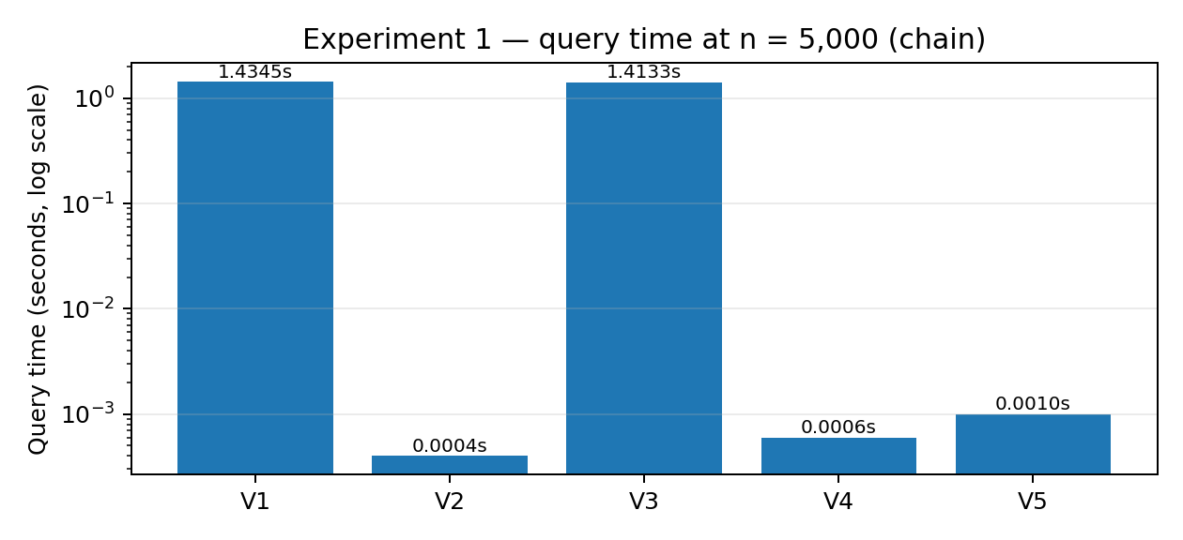
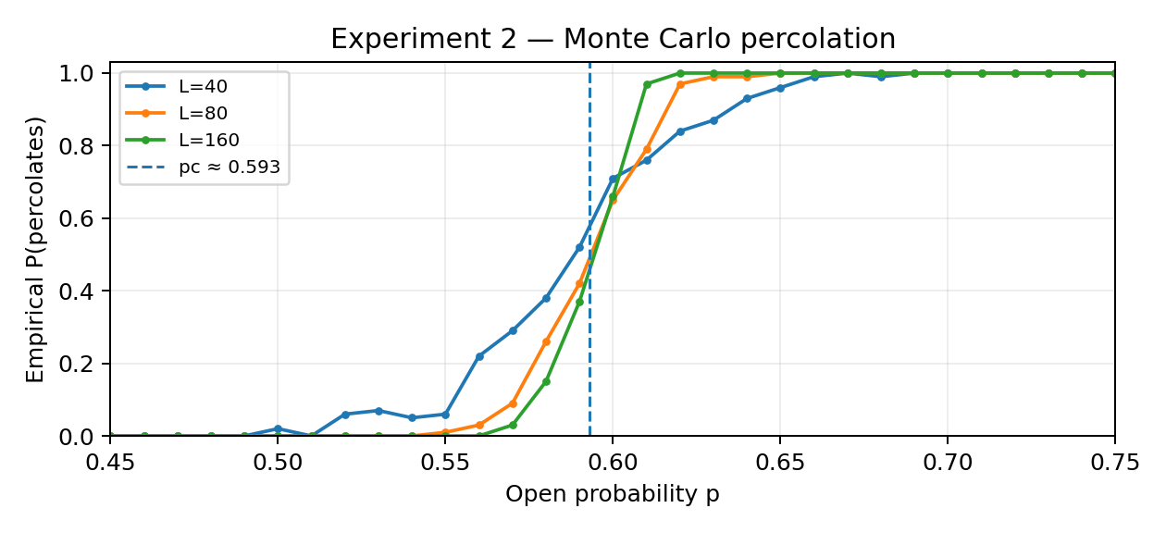
7. Implementation & experiments — what did we observe?
Two notebooks: connectivity benchmarking and Monte Carlo percolation.
EXPERIMENT 1
Chain sizes: 500, 1,000, 2,000, 5,000.
At n=5,000: V3 depth = 4,999; V4/V5 depth = 1.
V4/V5 average about 1 hop/query on this chain.
EXPERIMENT 2
L = 40, 80, 160; p = 0.45–0.75; 100 trials per p.
Percolation probability rises sharply near p ≈ 0.593.
Larger grids show a sharper transition.
Presenter 4 • ~2 min

Slide 9
8. Real-life applications & final takeaways
Union-Find is useful when groups merge and we repeatedly ask whether two items are connected.
Computer networks
Roads & maps
Images & science
Track whether devices belong to the same connected network as links are added.
Check connectivity as roads are built; Kruskal uses Union-Find to construct a minimum spanning tree.
Group neighbouring pixels/regions; percolation models fluid movement through porous materials.
What we learned
• The five versions progress from repeated searching to efficient connectivity.
• Union by rank keeps trees short; path compression makes future finds even faster.
• Virtual nodes simplify percolation; dual Union-Find prevents backwash.
Thank you — Questions?
Presenter 4 • ~1 min

