Slide 1
SEED LAB Systems Exploration, Engineering, and Design Laboratory
Team 7:
Jonah Bertolino, Hunter Burnham, Joseph Kirby, Caden Nubel, Joel Shorey

Slide 2
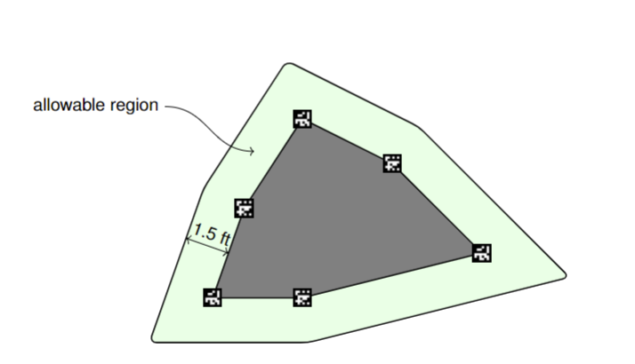
Final Project Overview
Simulate a search and rescue robot
Create a robot that explores an unknown area
The robot detects 6 markers and stays within 1.5 feet away from the markers
Notes:
Joseph

Slide 3
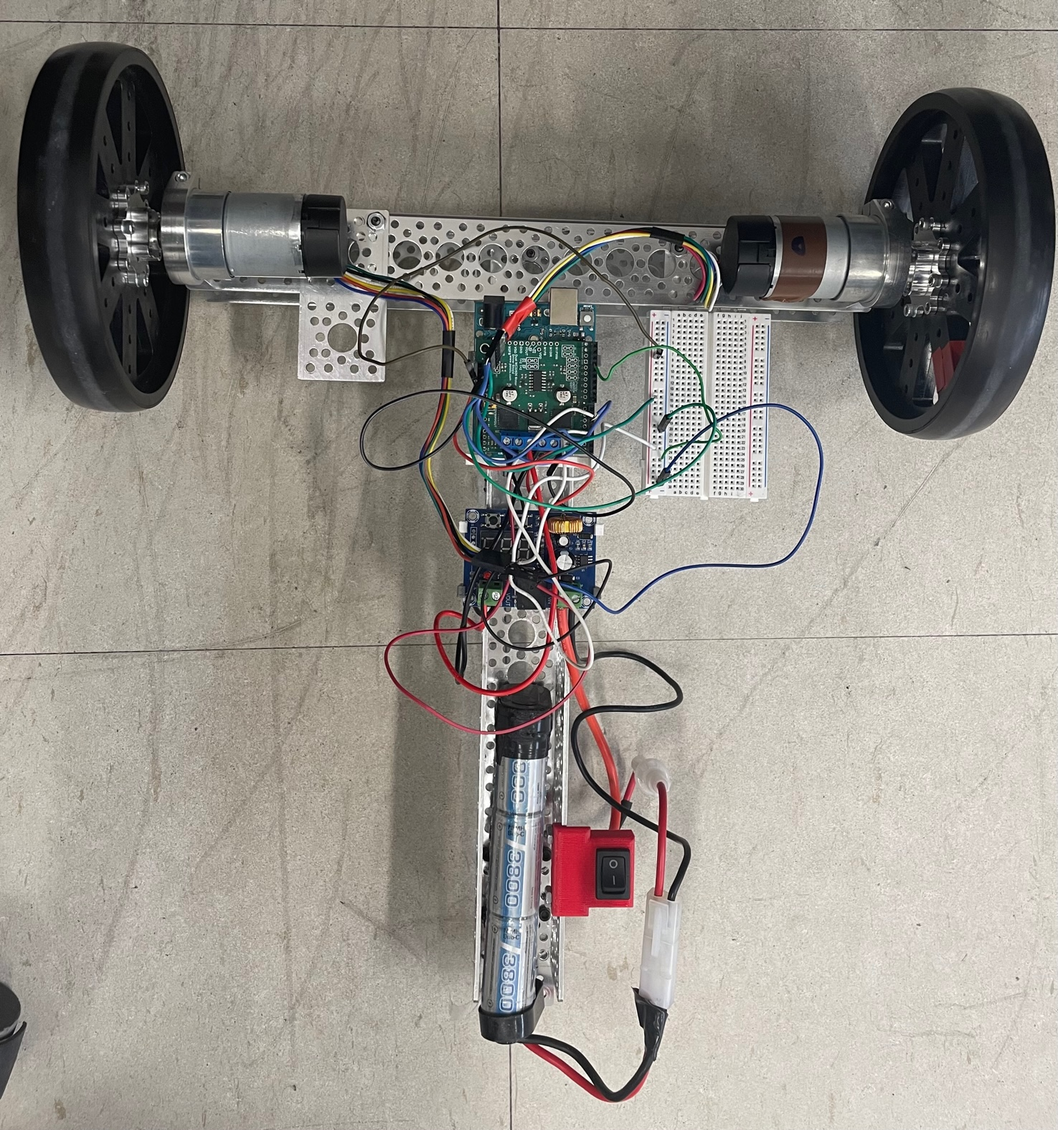
System Introduction
Components on robot: Motors, Wheels, Battery, Camera (not attached yet), Motor Driver, Voltage Regulator
Raspberry Pi – Used for computer vision/communication
Arduino Uno R3 – Used for localization/control

Slide 4
Controls Subsystem
Control Distance and Rotation
Set Desired Values
Compare Errors
Overall Goals:
Desired Distance (ft)
Desired Rotation (deg)
Notes:
In this subsystem the main aspects of control are controlling the distance and the rotation of the robot.
This is done using a feedback controller.
Using a feedback controller there is a desired value and a measured value and the error is the comparison of the two.
In this project our overall desired value is desired position in feet and desired rotation in degrees.

Slide 5
Control Subsystem – Getting Wheel Values
Calculate Velocities
Encoder Interrupts
Measure Robot
Precise Calculations
Notes:
We calculate the wheel velocities in a loop every 10ms.
Using Encoder Interrupts, we can judge how much each wheel has rotated in that 10ms period.
We compare the measured wheel velocities to the desired velocity of the robot in our controllers.
Using precise measurements of our physical robot (i.e. wheel diameter, wheelbase, etc.), we can also precisely calculate how much distance the robot has travelled in the 10ms period of rotation.

Slide 6
Controls Subsystem – Inner Loop Control
Two Inputs:
Forward Velocity
Angular Velocity
Two Outputs:
Voltages Applied to Each Motor
P Controller Between
Notes:
Our velocity subsystem has a two input two output system.
The two inputs are the desired forward velocity and the desired angular velocity.
The two outputs are the right and the left motor voltages.
We opted for a P controller on both velocity controllers and tuned them so that it goes mostly straight and minimizes error from the setpoint.

Slide 7
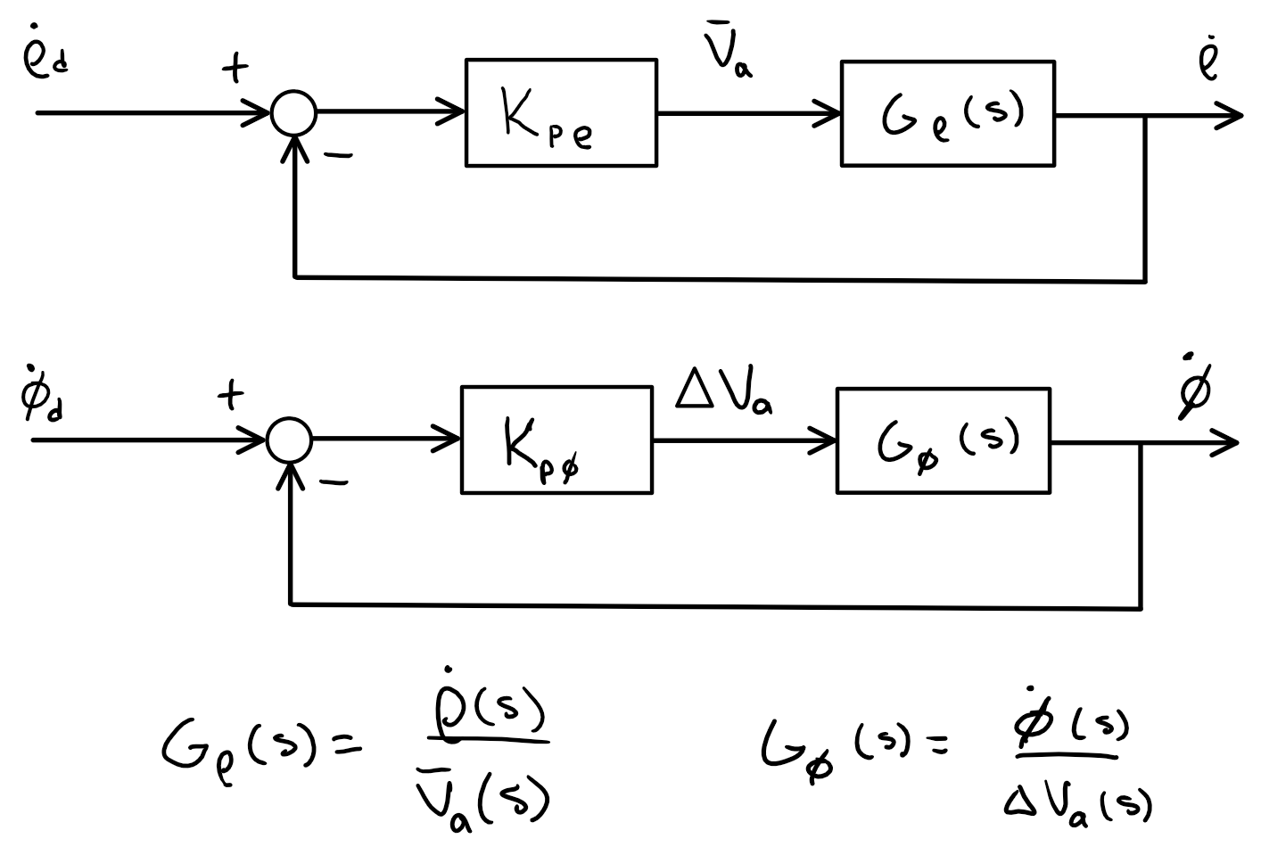
Block Diagram for Inner Loop P-Controller

Slide 8
Controls Subsystem – Outer Loop Control
PI Controller on Outer Loop
Zero Steady-State Error
Inner-Loop D-Controller
Notes:
To get from input velocity to output position, we utilize an integral controller.
We opted for a PI controller for our outer loop control because we wanted zero steady-state error for the position.
The inner loop controller acts as a D (derivative) term because it is a P-controller on the previously calculated derivative. This functions the same as a D-controller.

Slide 9
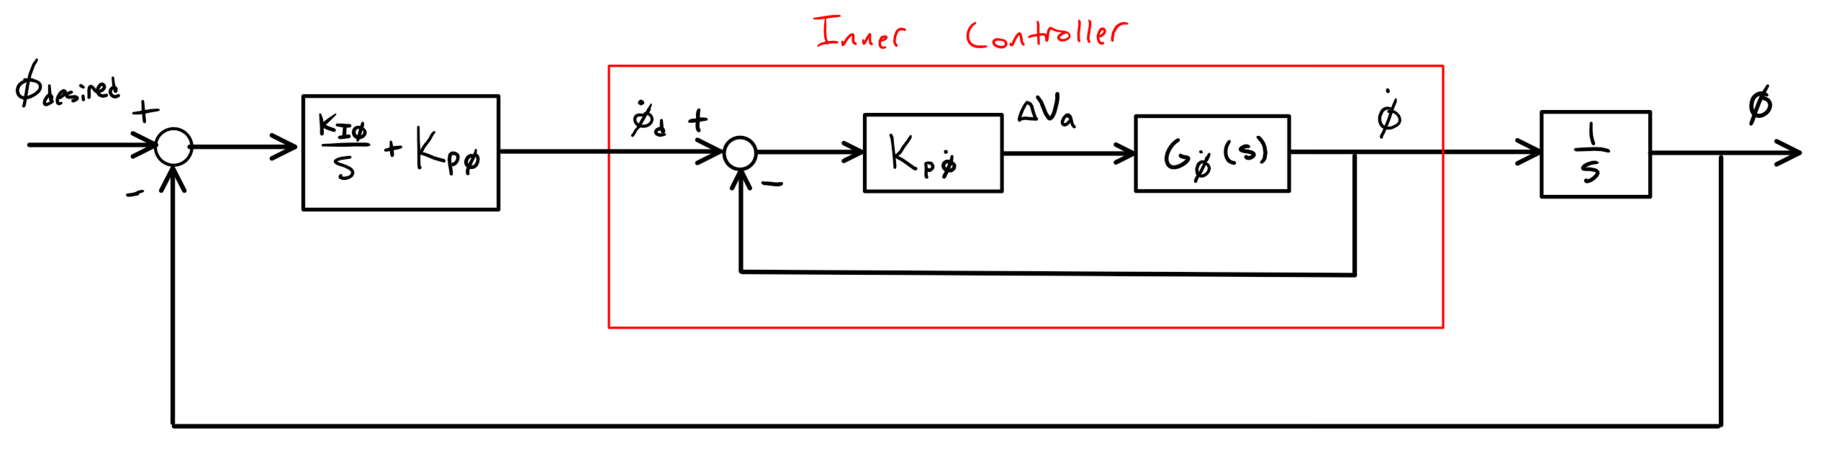
Block Diagram for Outer Loop PI-Controller

Slide 10
Control System Tuning Method (with Anti-Windup)
Started Too Fast
Anti-Windup
Better Precision
Notes:
When we first began tuning, we found that our robot went way too fast, which caused it to be out of control. It would drive in the wrong direction, and the controller would not be able to catch it. We solved this problem with anti-windup.
Anti-windup puts a bound on the maximum voltage that our controller is permitted to request from the battery.
Once we implemented anti-windup, our controller was much more accurate and precise, because the system could always provide enough voltage.

Slide 11
Control System Tuning
Minimized overshoot
Quick Response
No Steady-State Error
P-Gains Between 30-150
Low I-Gains
Notes:
We started by tuning our P gains to get a system that was not slow, which was responsive, because P gains are very responsible for the response of a system. While not too fast that it would overshoot.
We found that on the forward velocity gains above 150 made it less accurate and have overshoot from P while gains under 30 were very slow.
The I gains needed to be fairly low, because this is a slow system and should not need lots of I gain because it can cause overshoot.
The next is tuning the P gains on the velocity which needs to be done so that it doesn't overshoot but has a fast response.

Slide 12
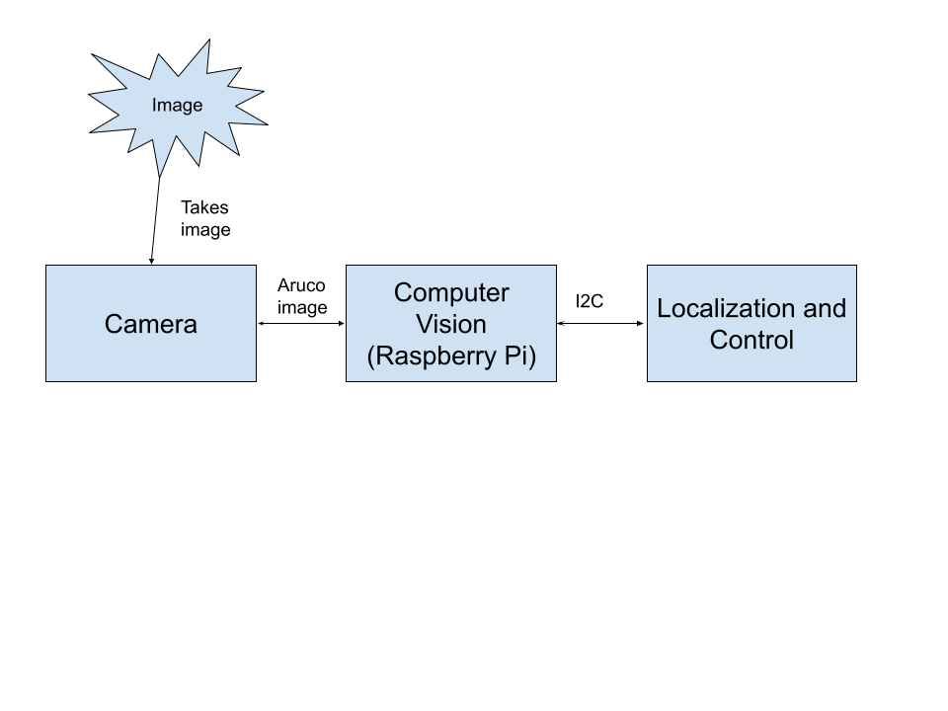
Computer Vision Subsystem
Goal: Detect ArUco markers and find necessary information

Slide 13
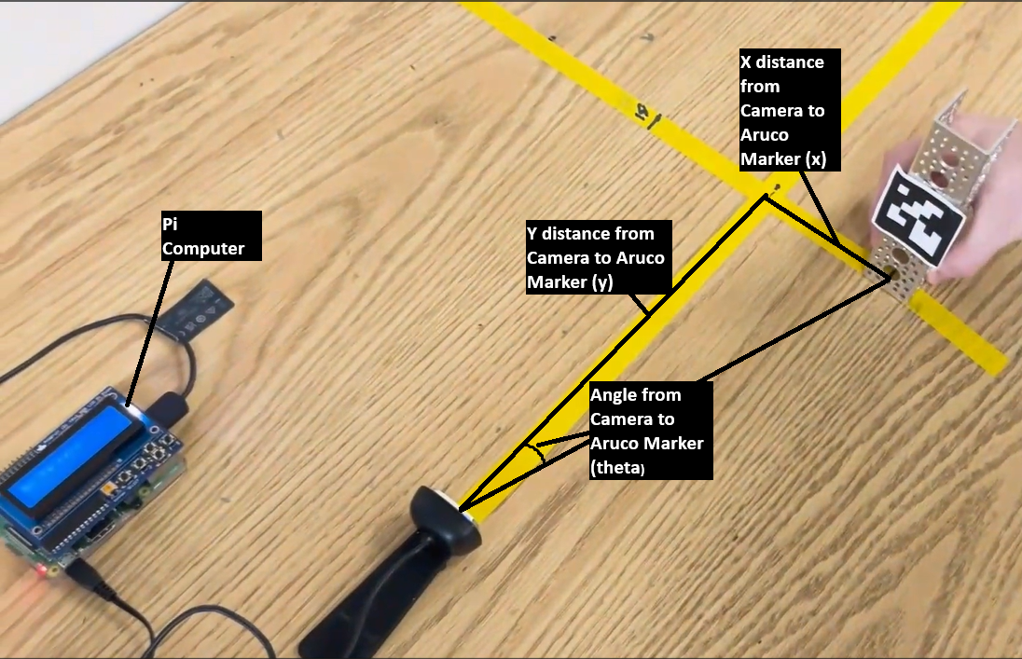
Demo 1 Approach
Goal: Calculate the angle of an ArUco marker from the camera axis
Notes:
Sate goal and its relation to scope of project
State two approaches

Slide 14
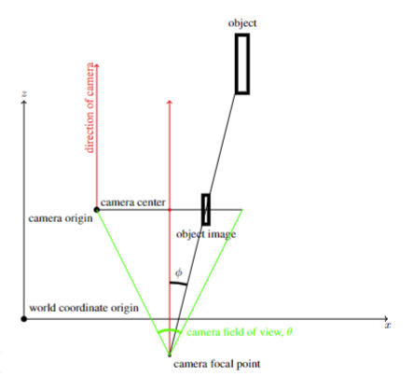
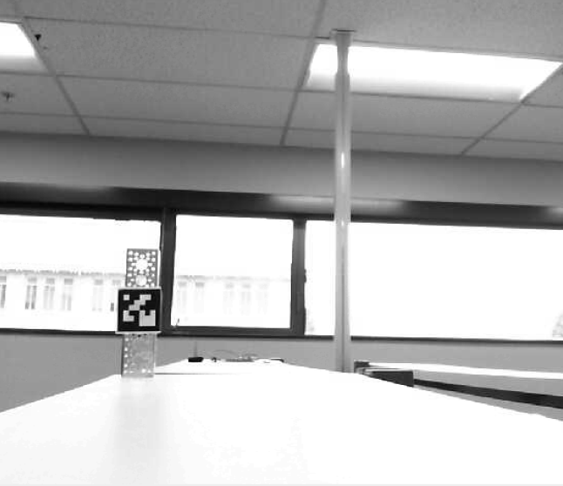
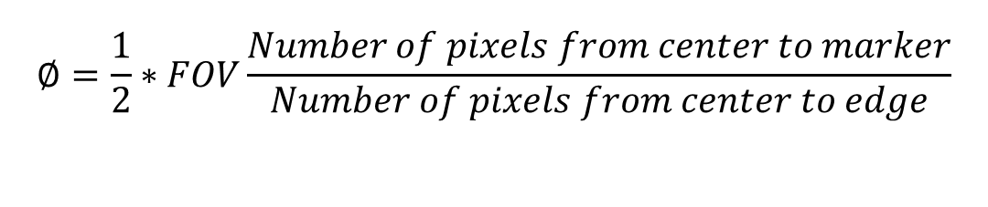
Aspect Ratio
$$∅=\frac{1}{2}∗FOV\frac{Number of pixels from center to marker}{Number of pixels from center to edge}$$
Notes:
Briefly explain process, mention pinhole camera model

Slide 15
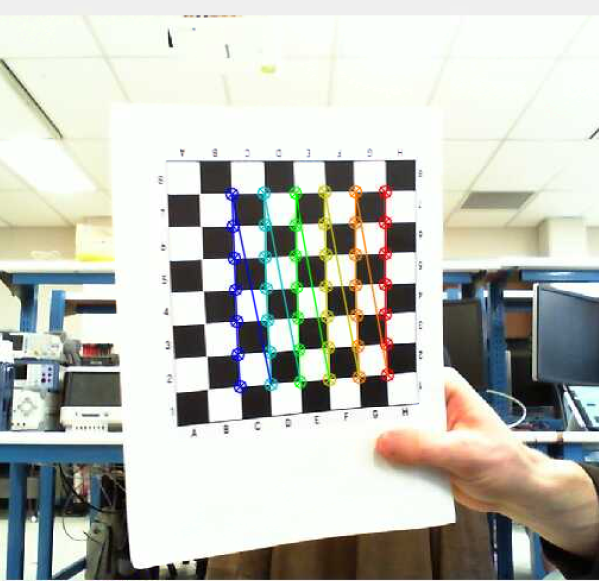
Camera Calibration and Pose Estimation
Use OpenCV Camera Calibration to obtain Camera Matrix and Distortion Coefficients
Use translation vectors from pose estimation function to calculate desired angle
Notes:
Briefly explain process

Slide 16
Experiment Setup

Slide 17
Demo 1 Results
Conducted Experiments by measuring the actual angle and then comparing it to the program’s result
Results are heavily affected by aligning the camera with 0 degrees
Aspect ratio proved to be more effective than pose estimation due to inconsistences with camera calibration
Results Using Aspect Ratio:
Average Error 0.5°
Actual Angle | Measure Angle | Error
18.5° | 18.9° | 0.4°
12.9° | 13.1° | 0.2°
-7.9° | -7.3° | 0.6°
-12.1° | -11.4° | 0.7°
-14° | -13.4° | 0.6°
Notes:
Explain experiments and results

Slide 18
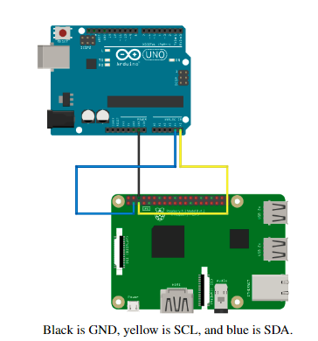
Communication and Integration
Goal: Communicate between Pi and Arduino using I2C Protocol and use LCD to display information.
Notes:
We use I2C protocol to communicate instructions between the Pi and Arduino. Additionally, we use threading to display necessary information on an LCD.

Slide 19

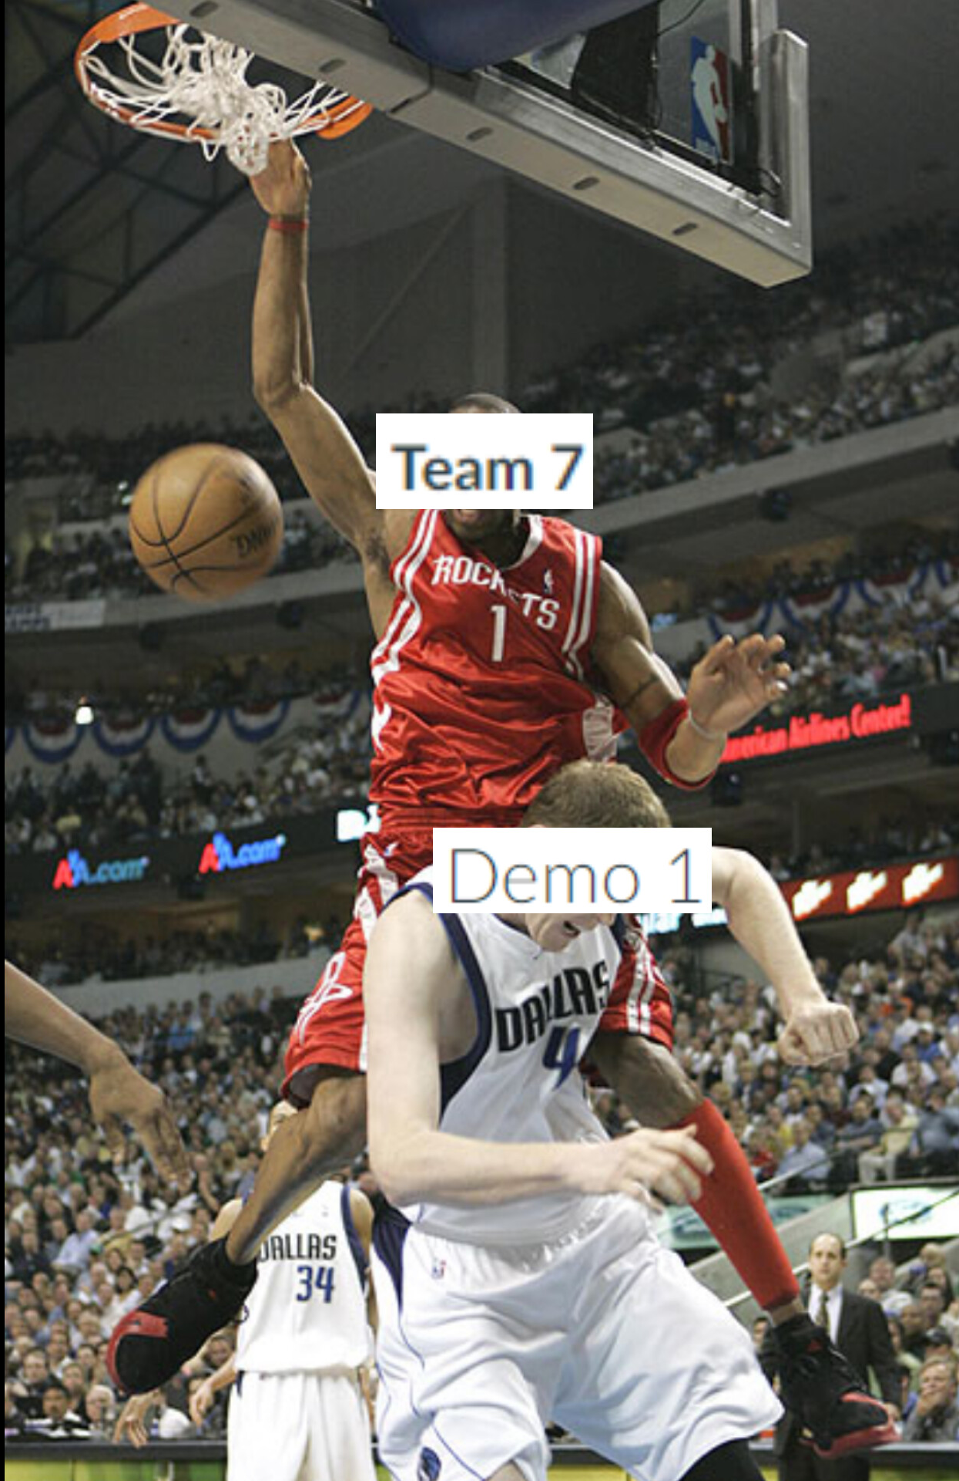
In Conclusion

