Slide 1

CORVUS
At 1:47 a.m.,
Maya says it out loud.
The move. The breakup.
The panic she hides at work.
The AI listens.
Then Maya closes the app.
01
Notes:
0:00-0:33
Here is the whole idea: Corvus turns an AI conversation into a path to the right therapist.
It is 1:47 in the morning, and Maya tells an AI the truth: she is not okay. She tells it about the move, the breakup, and the panic she hides at work - things she has never said out loud.
And the AI listens. For a minute, she feels less alone.
Then she closes the app.
[Sources]
- Internal script: docs/pitch/round-2/round-2-pitch-prep.md.
- Image is a fictional composite generated for this deck with the built-in image generator; it does not depict a real person or outcome.
[/Sources]

Slide 2
CORVUS
THE DROP-OFF
The AI knows her story.
Her therapist knows nothing.
Getting help still means starting over.
SEARCH / INSURANCE / INTAKE / RETELL
02
Notes:
0:33-1:00
No therapist knows. No appointment exists. Nothing in her real life has changed.
And getting help means starting over: searching profiles, checking insurance and availability, guessing who might understand her, filling out forms, and paying to retell the hardest parts of her life to a stranger.
She already did the hardest part. She said what was wrong.
[Sources]
- Internal script: docs/pitch/round-2/round-2-pitch-prep.md.
- This slide states the product problem and makes no prevalence or outcome claim.
[/Sources]

Slide 3
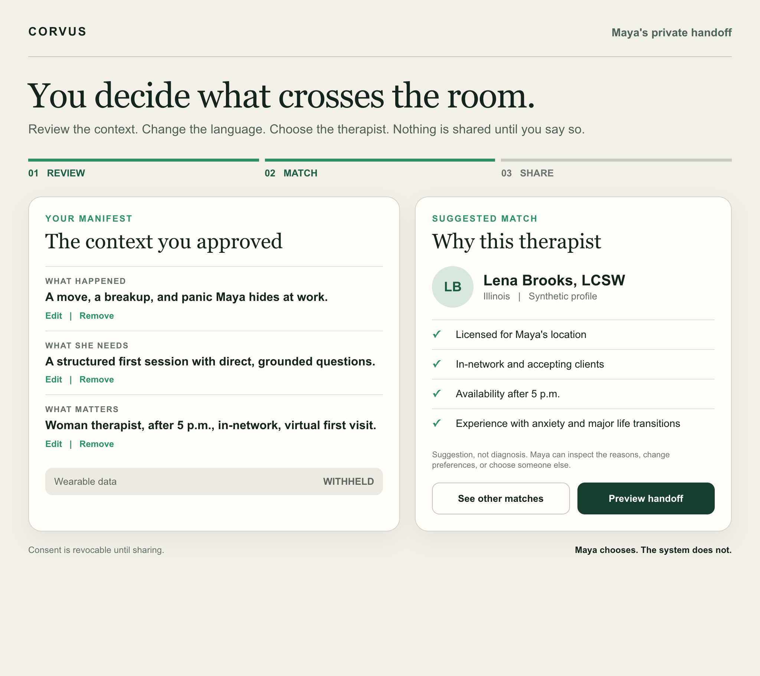
CORVUS
PRODUCT CONCEPT / SYNTHETIC SCENARIO
She controls
the handoff.
Review the manifest.
Edit, delete, or withhold.
Maya chooses.
The system does not.
03
Notes:
1:00-1:29
With permission, Corvus turns what Maya shared into a manifest she controls: what happened, what she needs, and what matters.
She can edit it, delete anything, or keep it private.
Then Corvus matches her with vetted therapists who are licensed, available, affordable, and fit her needs.
Maya chooses. The system does not.
[Sources]
- Internal script: docs/pitch/round-2/round-2-pitch-prep.md.
- Product boundary: docs/specs/wayfinder-production-alpha-prd-v0.1.md.
- The interface is a synthetic static concept created for this pitch. It is not evidence of implemented functionality or matching performance.
[/Sources]

Slide 4

CORVUS
THE HUMAN HANDOFF
The therapist starts
with context.
Maya still tells her story.
She just does not start from zero.
Maya starts
with a human.
04
Notes:
1:29-2:00
When Maya walks into her first session, the therapist already has the context she approved.
She still tells her story in her own voice. She just does not have to start from zero and hope they get it.
The therapist starts with context. Maya starts with a human.
People are already telling AI what is wrong. Corvus makes sure that conversation reaches someone who can actually help.
[Sources]
- Internal script: docs/pitch/round-2/round-2-pitch-prep.md.
- Image is a fictional composite generated for this deck using slide 1 as an identity reference; it does not depict a real person, therapist, session, or outcome.
[/Sources]

