Slide 1
OSANWE / WAYFINDER
ACU / ROUND 2
PARTICIPANT-OWNED PERSONALIZATION
Your behavior is already
being modeled.
The objective just is not your flourishing.
JONAH ELLIOTT / TWO-MINUTE PITCH
01
Notes:
Your behavior is already being modeled. The objective just is not your flourishing.
Technology companies learn which signals predict a click, purchase, or another minute on-screen. I want to turn that system around: a personal model that works for the person.
[Sources]
- Internal claim boundary: docs/research/adtech-to-flourishing-evidence-audit.md.
- Visual direction: https://vercel.com/ (official homepage, accessed 2026-08-26).
[/Sources]

Slide 2

OSANWE / WAYFINDER
ACU / ROUND 2
More plans are not the same
as more connection.
New city. More invitations.
Still unsure what will actually help.
The outcome is not another chat.
It is a better decision in real life.
02
Notes:
Start with someone who moved to a new city. They meet people and keep saying yes, but still feel disconnected. After a draining night, should they force another event, stay home, or follow up with the one person who felt promising?
Generic advice cannot know. And another chatbot conversation is not the outcome.
[Sources]
- Scenario is explicitly hypothetical and mirrors the synthetic prototype fixture.
- Illustration generated for this deck; it does not depict a real participant or outcome.
- Visual direction: https://vercel.com/ (official homepage, accessed 2026-08-26).
[/Sources]

Slide 3
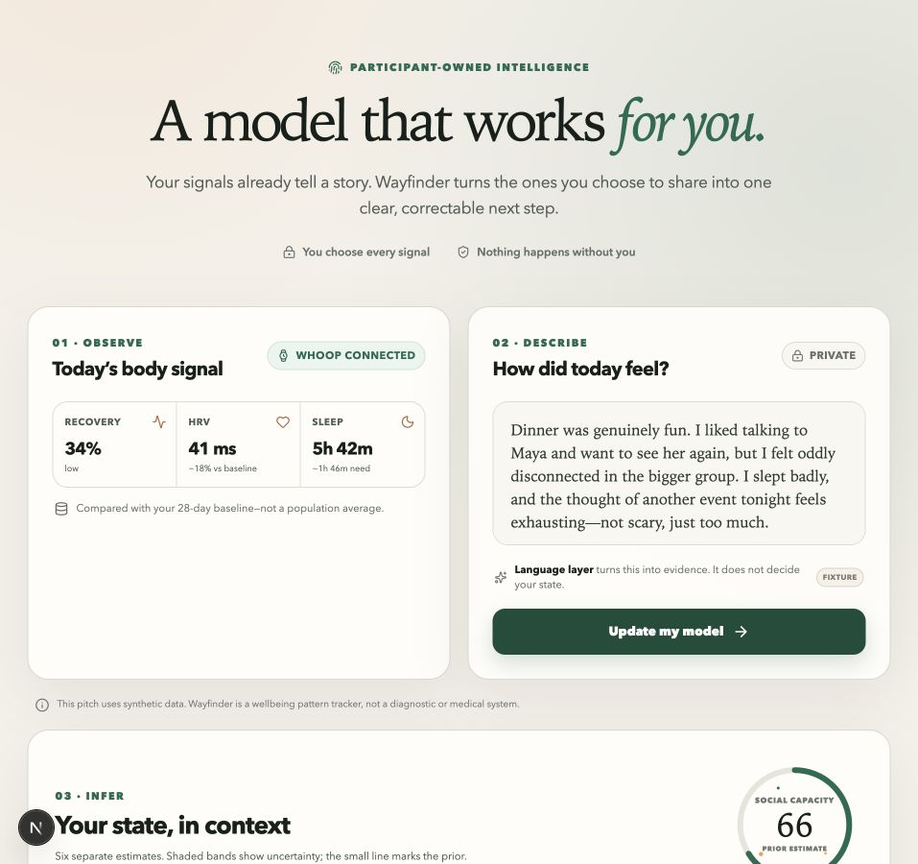
OSANWE / WAYFINDER
ACU / ROUND 2
WORKING PROTOTYPE / SYNTHETIC SCENARIO
Wayfinder starts with
signals you choose.
Reflection. Relationship events.
Optional recovery data.
The LLM proposes evidence.
The participant can inspect and correct it.
03
Notes:
Wayfinder begins with signals the participant chooses: a short reflection, a few relationship events, and optional recovery data.
The language model only turns words into inspectable evidence. A separate model updates an uncertain personal state. Every meaningful inference shows its source and can be corrected.
[Sources]
- Working prototype screenshot captured from origin/feat/two-minute-wayfinder-demo; synthetic data is visibly labeled.
- Product boundary: docs/specs/two-minute-demo-v0.1.md on the demo branch and docs/specs/wayfinder-production-alpha-prd-v0.1.md.
[/Sources]

Slide 4
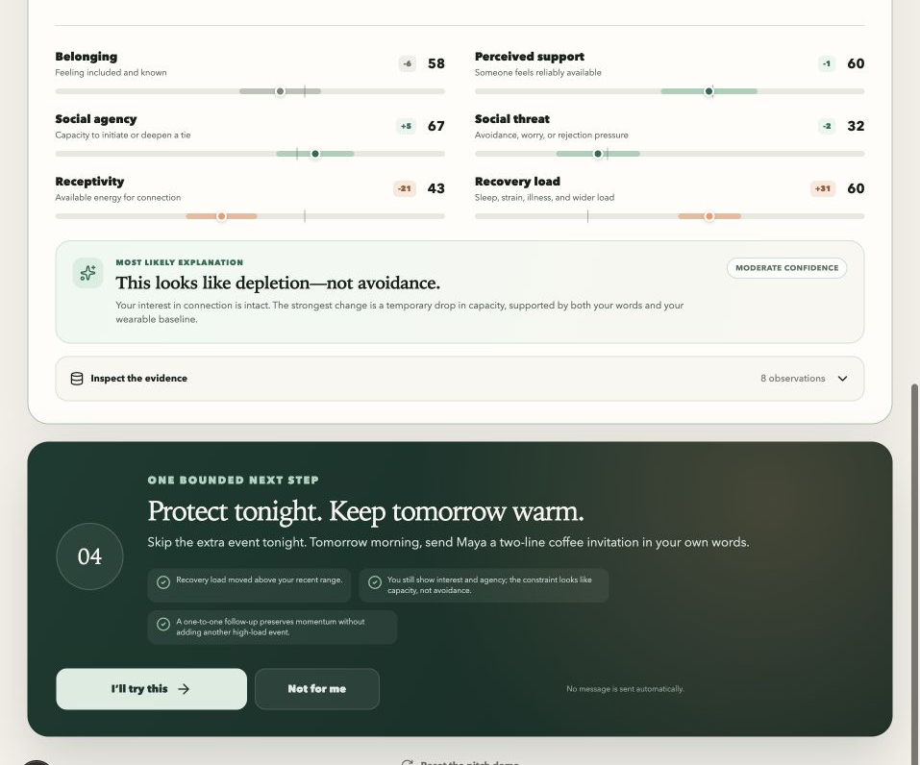
OSANWE / WAYFINDER
ACU / ROUND 2
ONE CORRECTABLE EXPLANATION
Capacity,
not avoidance.
Protect tonight.
Keep tomorrow warm.
One bounded next step.
Nothing is sent automatically.
04
Notes:
In this working prototype, the model notices that interest in connection is intact, but capacity is down. Instead of ‘socialize more,’ it offers one bounded next step: protect tonight, then send a low-pressure coffee invitation tomorrow—in your own words.
Nothing is sent automatically. What happened next becomes new evidence.
[Sources]
- Working prototype screenshot captured from origin/feat/two-minute-wayfinder-demo; the participant and data are synthetic.
- Recommendation boundary: docs/specs/two-minute-demo-v0.1.md and docs/specs/wayfinder-production-alpha-prd-v0.1.md.
[/Sources]

Slide 5
OSANWE / WAYFINDER
ACU / ROUND 2
NEXT / PRIVATE LONGITUDINAL ALPHA
More human connection.
Less AI dependence.
01 CONSENT
02 CORRECTION
03 REAL LIFE
Every source chosen and revocable.
Evidence and inferences remain inspectable.
Success happens outside the product.
05
Notes:
This is not a diagnosis, and the prototype uses synthetic data.
The next milestone is a private longitudinal alpha that remembers consent, corrections, and outcomes across days. The first market is people navigating social transitions and partners who already care about belonging.
The goal is not more time with AI. It is stronger human relationships—and less need for the system over time.
[Sources]
- Production-alpha milestone and guardrails: docs/specs/wayfinder-production-alpha-prd-v0.1.md.
- Market and channel language is explicitly a hypothesis; it has not been validated.
- Visual direction: https://vercel.com/ (official homepage, accessed 2026-08-26).
[/Sources]

