Slide 1
Megamarket Trends
Jonah Kim, Jihae In, Elliott Kim, Kaley Magdadaro

Slide 2
Implementation Flow Chart
Downloaded Megamarket dataset from Kaggle
Uploaded to HDFS as a parquet table
Created views focused on 2 variables using HiveQL
Analyzed bar, line, scatterplots
Analyzed using Microsoft BI, Excel

Slide 3
Clicks By Category

Slide 4
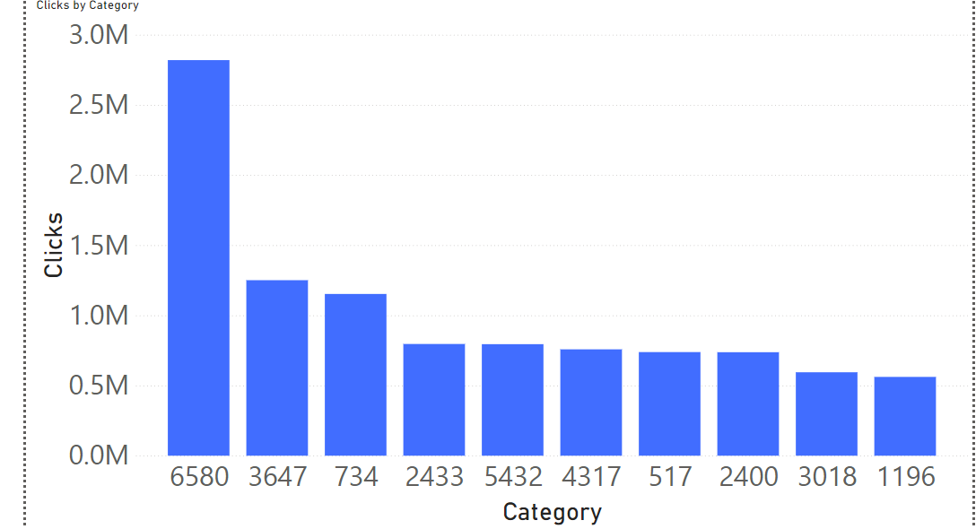
Category 6580 – most clicked category by ~1.5M, followed by 3647
Optimizing customer engagement:
Make items in 6580 accessible
Research why other categories are unpopular
Notes:
Clicks by Category Insights:
6580 is the most clicked category by ~1.5M compared to the next most popular category, 3647 - could be very nice-looking items that people like to “window shop” through,
like clothing
All other categories are within ~0.8M clicks of each other, making them relatively uniform

Slide 5
Clicks and Price

Slide 6
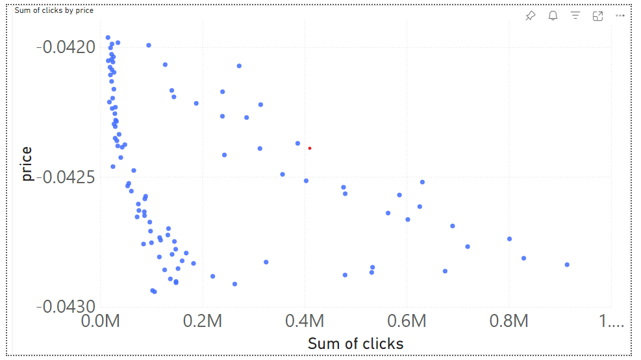
2 distinct negative trends:
1: price sharply decreases as clicks increases
2: Weaker, less sharp trend.
Further investigation into what items are associated with each trend is needed
Notes:
Insights:
Weak linear downward trend in general between clicks and price.
Interestingly, one range of prices dips sharply downward, indicating a more extreme version of this trend
For further analysis, if we knew what items were getting clicks, we could add this information and get more nuanced information.

Slide 7
Price Distribution

Slide 8
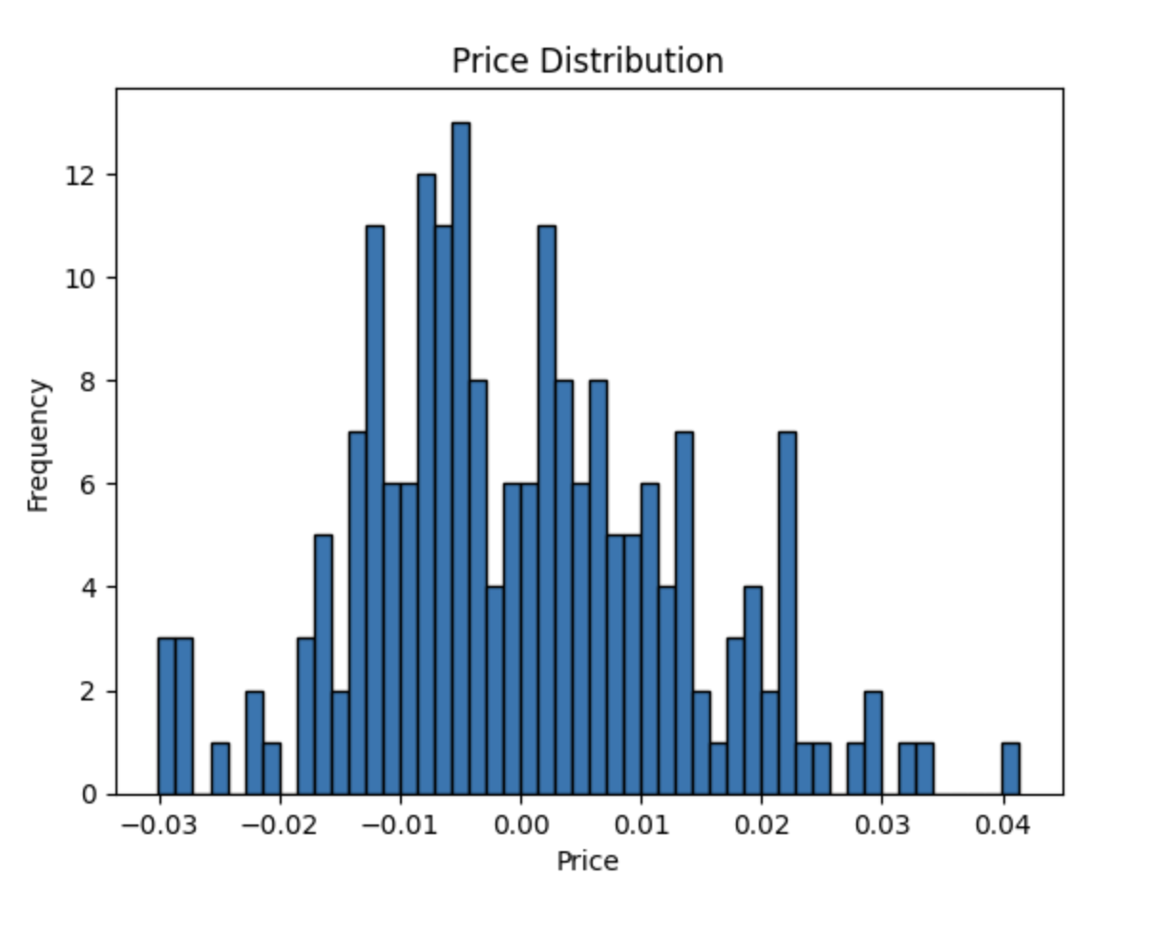
Prices are normally distributed
Megamarket should track what items / categories are more closely associated with specific prices – results in more accurate info regarding lucrative items
Notes:
Providing context for the price comparisons of items, as marketplace uses obscure pricing system
analyze in context of pricing system

Slide 9
Purchases Over Time

Slide 10
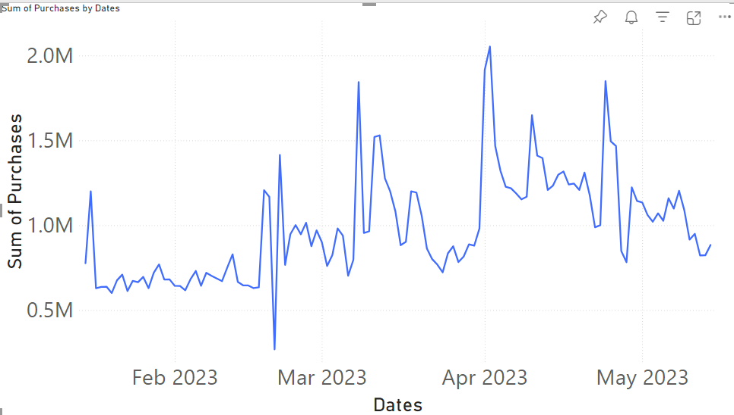
Purchases dip sharply in early March / peaks in mid April
Megamarket can track peaks and dips to see most popular times – see when to apply sales to boost engagement

Slide 11
Top 10 Prices

Slide 12
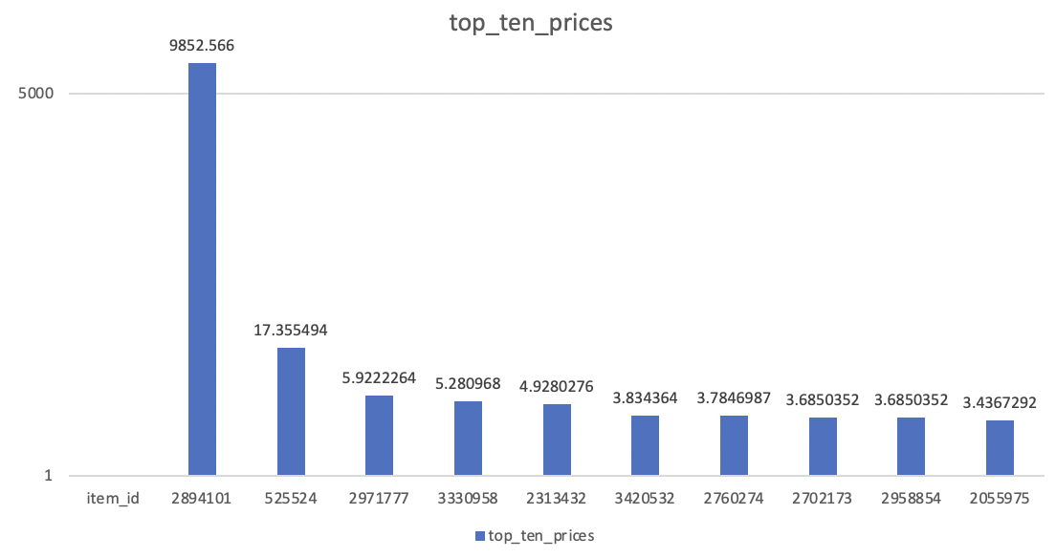
Item 2894101 is 567* pricier than 52524
Megamarket can track the categories of these items & see if the prices are consistent – see what types of items are priciest

Slide 13
Data Source URL
https://www.kaggle.com/datasets/alexxl/megamarket/data

