Slide 1
RepairShopr

Slide 2
Comprehensive Software for Service Businesses

Slide 3
Their Pain Points
Invoicing software is dumb
Email newsletters are spam
Staying modern is getting tougher every year
Good service means good communication – this is impossible for SMBs to scale

Slide 4
Our Job
A hosted app that has a deep understanding of their business
Business Builder will automate growth of their business
Make operations fun

Slide 5
Our Market
Some have called it the “fortune 5 million”
Repair
Field Service
All Services

Slide 6








Competition

Slide 7
Business Model
Packages
$49/mo
1 User
Low Limits
$99/mo
10 Users
Higher Limits
$299/mo
30 Users
Per user after that

Slide 8
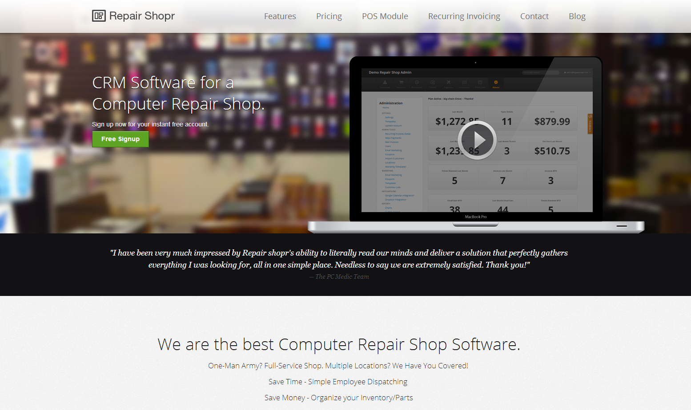
Us

Slide 9
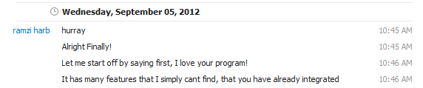
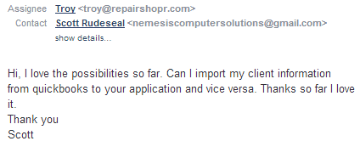
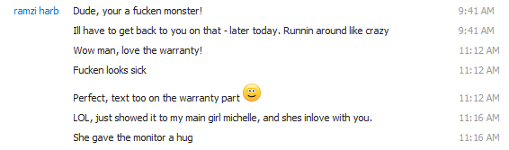
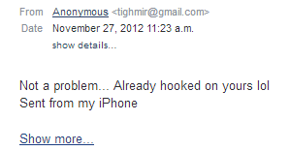
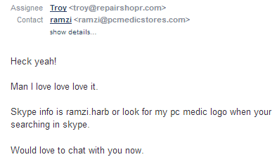
Resonating?

Slide 10
Traction

Slide 11
KPIs/Goals
Organically we are over 100 signups a month
Converting 2%
Conversion Goal: 5%
Current Cost of Acquisition: $100~
Estimated Lifetime Value: $5,000

Slide 12
Retention To Date

Slide 13
The Future (12 months)
Ramp up sales
Master SEM
Attack further verticals
All repair shops; watch, jewelry, electronics
Then field service verticals;
Repair-men, handy-men, plumbers, construction, HVAC

Slide 14
How to Help
We want to sprint.
$300k will get our dream team full time for a year

