Slide 1
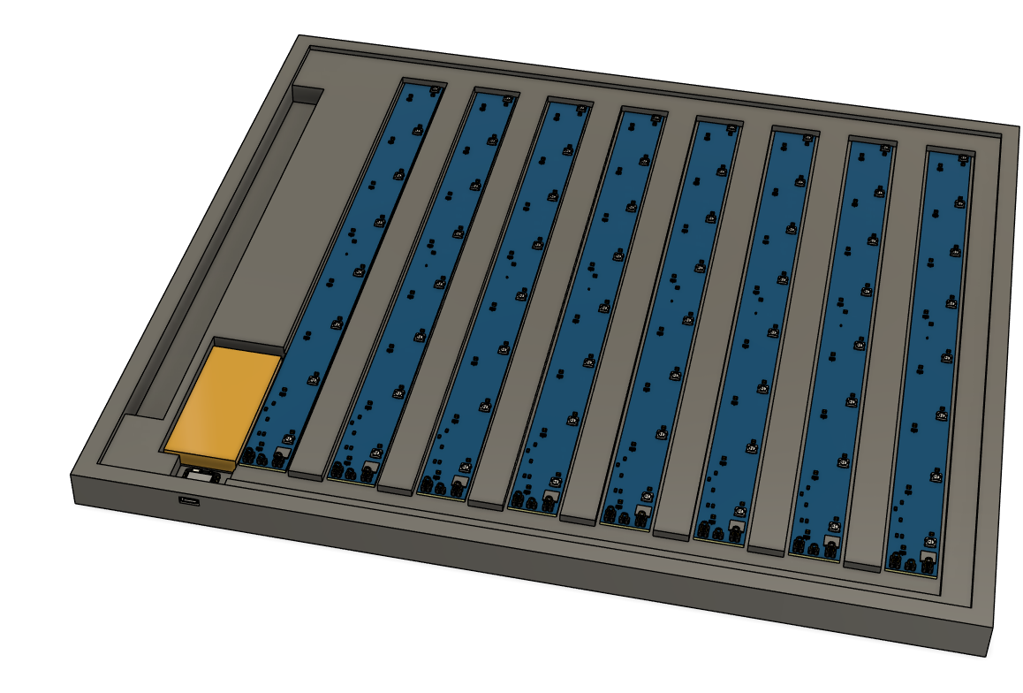
Neopixel 8
Neopixel 64
Hall Sensor
Battery
Neopixel 1
Xiao ESP32 C6
PCB I2C
address: 0x20
PCB I2C
address: 0x27

